Slide 1
Using Github

Slide 2
What Github Does
Online project hosting site.
"Remote" git repository with access control
Issue Tracking
Documentation and web pages (github.io)
Integrates with other services
  Continuous Integration, e.g. CircleCI

Slide 3
What to do
Create a Github Account
  Put your REAL NAME in your profile
  Add a PHOTO that clearly shows your face
  Write a short profile about yourself
Sign-up form: https://goo.gl/cwrBbW
Receive an e-mail invitation to join OOP2018
Click to join Github Organization.

Slide 4

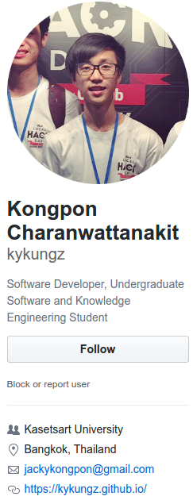
Github Profile
Students in last year's OOP course.
1. Real name
2. Photo
3. Email
4. Description of you

Slide 5
How to Use Github

Slide 6
2 Situations + 1 Special Case
Case 1: You already have project code on your local computer. You want to copy to Github.
Case 2: Project already exists on Github. You want to copy it to your computer.
Special Case:
Case 3: A new project (no files yet).

Slide 7
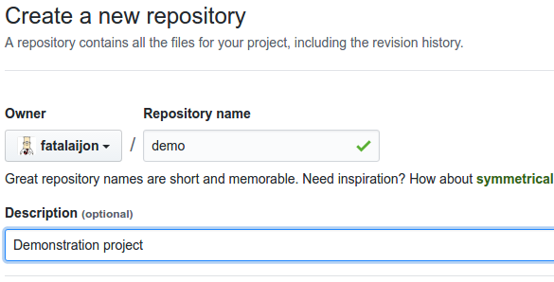
Case 1: Starting from Local Project
You already have a project on your computer
1. Create a local "git" repository.
cmd> git init
cmd> git add .gitignore src
cmd> git commit -m "initial code checkin"
2. Create an empty repo on Github.

Slide 8
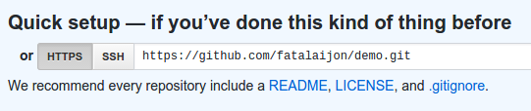

Case 1: adding Github as remote
3. Copy the URL of new Github repository (https or ssh).
4. In your local project directory, add Github as a remote repository named "origin":
cmd> git remote add origin
https://github.com/fatalaijon/demo.git
5. Copy the local repository to Github
cmd> git push -u origin master
You only need "-u origin master" the first time you push to Github. Next time, just type "git push".

Slide 9

Case 2: Starting from Github
A project already exists on Github.
You want to "clone" it your local computer & do work.
1. Get the Github project URL
https://github.com/fatalaijon/demo.git
or: go to project on Github and click on
then copy the URL.
2. In your workspace, type:
cmd> git clone https://github.com/...
NOTE: "git clone" creates a new directory (named demo) inside your current directory. If the directory already exists, clone won't work.

Slide 10
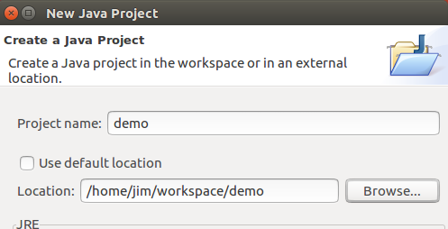
Case 2: Create an IDE project
3. Start your IDE and create a new project using the code in the directory you just cloned.
That's it!
Github is automatically the remote "origin".
Just "git push" your commited work to github.

Slide 11
You can use a different project name
The name of your local directory (cloned from Github) can be different from the Github repository name.
1) Rename the directory yourself.
= or =
2) Specify directory name when you "clone":
# Clone "demo" into local directory "mydemo"
cmd> git clone https://github.com/fatalai jon/demo.git mydemo

Slide 12
Comparison of 2 Cases

Slide 13
Git Workflow
After you have a repository + Github, what do you do?
Git workflow for an individual project:
1) Check status of your working copy:
cmd> git status
2) Commit changes or update your working copy.
"git commit ..."
3) Do some work:
Code, test. Code, test. ... Review.
Now what?

Slide 14
Git Workflow (cont'd)
4) Check status again:
cmd> git status
Changes not staged for commit:
modified: src/Problem2.java
Untracked files:
src/Problem3.java
5) Add and commit your work to the local repository
cmd> git add src/Problem2.java src/Problem3.java
cmd> git commit -m "Solved problems 2 and 3"
[master 29abae0] Solved problem 2 and 3
2 files changed, 44 insertions(+), 5 deletions

Slide 15
Git Workflow (with Github)
6) Push the changes to Github
cmd> git push
Compressing objects: 100% (12/12), done.
Writing objects: 100% (12/12), 3.60 KiB, done.
Total 12 (delta 9), reused 0 (delta 0)
remote: Resolving deltas: 100% (9/9), ...
To https://github.com/fatailaijon/demo.git
468abdf..29abae0 master -> master
That's it!
Repeat the cycle (1 - 6) as you work.

Slide 16
Git Workflow for Team Projects
On a team project, other people will be committing files to the same Github repository.
For team projects, you should update your local repository from Github before trying to "push" your work to Github.
If Github updates your local repository, then you should merge changes into your working copy and test again, before trying to push to Github.
(illustration in class)

Slide 17
Assignment
https://cpske.github.io/programming1/git/git-assignment

