Slide 1

Git: Version Control System

Slide 2
References:
PPT: https://github.com/shashwatx/git_101/blob/master/presentation.pptx
Babel Git: https://git.babel.es:4433/
SETUP: https://github.com/shashwatx/git_101/blob/master/SETUP_GIT_DOC.MD
WSL: https://winaero.com/blog/enable-wsl-windows-10-fall-creators-update/
MobaXTerm: https://mobaxterm.mobatek.net/download.html
git-create: https://github.com/shashwatx/git_101/blob/master/scripts/git-create.sh
Gitlab Access Token: https://docs.gitlab.com/ee/user/profile/personal_access_tokens.html

Slide 3
1.
The Problem
How do you maintain and share code ?

Slide 4
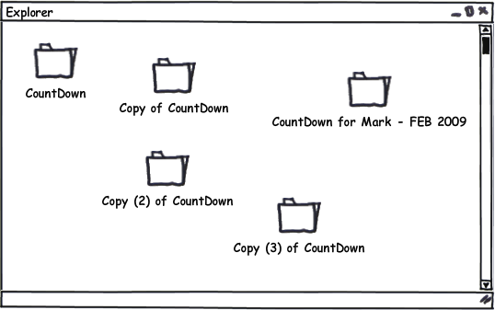
Copy? Email? Dropbox?
Latest version?
Roll back?
Almost impossible to maintain if the number of people working in the project is large

Slide 5
2.
Version Control System

Slide 6

Version Control: What is it?
A method for recalling versions of a codebase
Keeping a record of changes
Who did what and when in the system
Save yourself when things inevitably go wrong

Slide 7
Version Control: Why?
Single Developer Workflow
Back-ups of the project. Fearlessly modify code
Create a “checkpoint” in the project at any stage:
Tagging: Mark certain point in time
Branching: Release versions and continue development

Slide 8
Version Control: Why?
Team Workflow
Everything in “Individual”
Allow multiple developer to work on the same codebase
Merge changes across same files: handle conflicts
Check who made which change: blame/praise

Slide 9
Version Control: Types
Centralised VCS
Distributed VCS

Slide 10
Centralised VCS
A single authoritative data source (repository)
Check-outs and check-ins are done with reference to this central repository

Slide 11
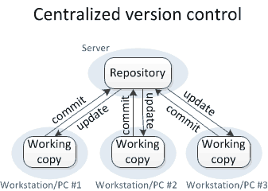
Centralised VCS

Slide 12
Centralised VCS
Examples:
Concurrent Version System (CVS)
Subversion (SVN)

Slide 13
No single repository is authoritative
Data can be checked in and out from any repository
Distributed VCS

Slide 14
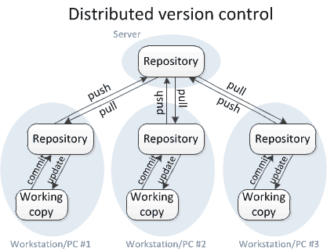
Distributed VCS

Slide 15
Examples
Git
Mercurial
Distributed VCS

Slide 16
3.
Git
--everything-is-local

Slide 17

Free, open source
Fully distributed
Handle small files very effectively
Tracks contents, not files
Data = Snapshot
Created by Linus Torvalds in less than 2 weeks

Slide 18
Git: Stages
Four stages:
Working directory
Staging/Index directory
Local repository
Remote repository

Slide 19
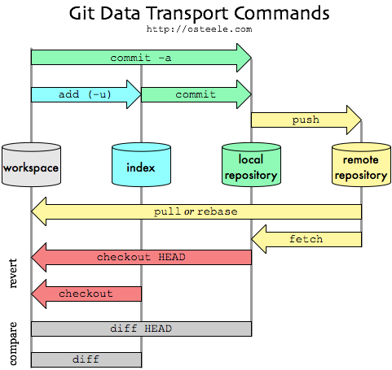
Git: Outline

Slide 20
Git: Development
Setup
git init
git clone <remote-url>
Save username and password.
git config –global credential.helper store
git config --global push.default current

Slide 21
Git: Development
Show commit logs
git log

Slide 22
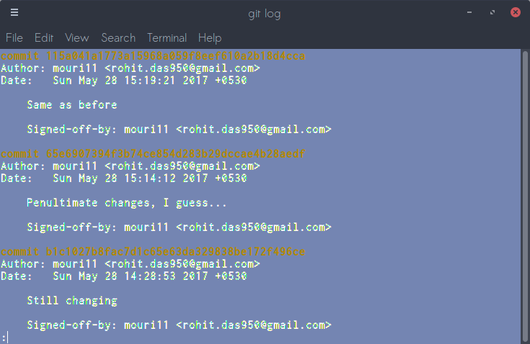
Git: Development
Commit logs

Slide 23
Git: Development
View changes
git diff

Slide 24
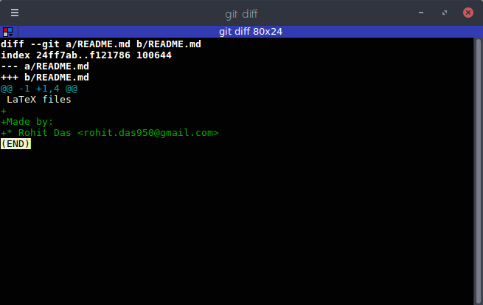
Git: Development
View changes

Slide 25
Git: Development
Add changed files to the index
git add -u

Slide 26
Git: Development
Create “snapshots” of your codebase
git commit
Push to remote
git push origin master

Slide 27
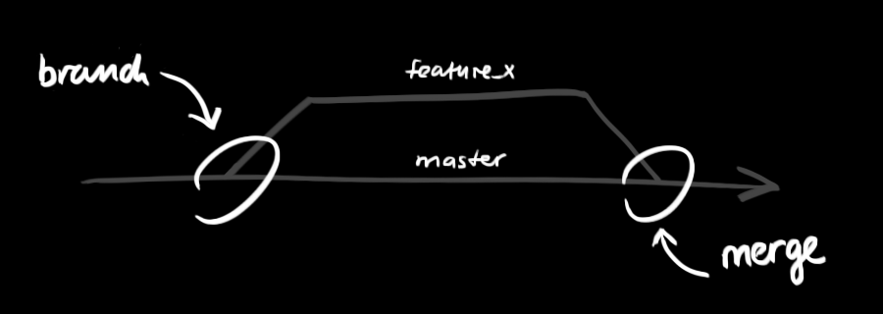
Git: Development
Branches
git checkout –b <branch-name>

Slide 28
Git: Development
Merge other branches
git merge

Slide 29
Result?
The development process of the Linux kernel is maintained using Git
The Linux kernel development process has:
Over 2000 individual contributors per year
Grows by nearly 300,000 lines per year

Slide 30
THANK YOU!
Roberto Olmedo
roberto.olmedo@babel.es
Shashwat Mishra
shashwat.mishra@babel.es

