Slide 1



US Healthcare Payment Integrity
Medicare Inpatient Billing Analysis
Shasti Alagan R | EXL Case Study

Slide 2

Data Overview
196,086 records · 3,182 hospitals · 51 states · 2017
$12.16B HOSPITALS BILLED
$2.34B MEDICARE PAID
$9.82B BILLING GAP
19.2% MEDICARE PAYS
T2-DRG DETAILS
(Treatment Complexity)
T1-Inpatient Payments (What was charged and Paid)
T3-Provider Info (Hospital Profiles)
CCN(Hospital ID)
DRG
Code
CCN stored as integer in T1, string in T3 so zero-padded before joining T1 contains 3,182 hospitals with active Medicare billing records. T3 contains 5,426 hospitals in the full CMS registry including hospitals that did not submit inpatient claims in 2017.

Slide 3



TASK 01
DATA UNDERSTANDING
T1
INPATIENT PAYMENTS
T2 DRG DETAILS
T3 PROVIDER INFO
Question: Describe what each table represents and how you link them
Hospital billing register.
What was charged vs what Medicare paid.
196,086 rows - 3,182 hospitals.
Complexity scorecard for treatments.
Each DRG has a relative weight (Higher = more serious).
543 DRGs - Heart transplant = 26x a routine knee treatment..
Hospital's government profile.
Ownership type, Hospital type, Patient Rating.
5,426 hospitals across 51 states.
JOIN LOGIC
T1 ↔ T2 on DRG code →to check if Medicare payment matches treatment complexity
T1 ↔ T3 on CCN → to check if hospital ownership drives billing behaviour

Slide 4
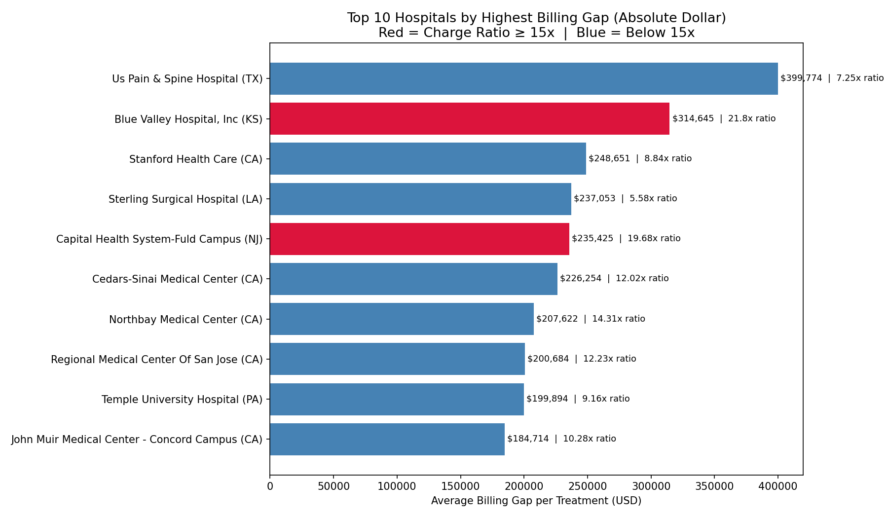
TASK 02A
BILLING GAP DEFINITION & TOP HOSPITALS
Question: Define billing gap. Which hospitals stand out and how did you define 'stands out'?
METRICS: Billing Gap = Avg Charged − Avg Medicare Payment
Charge Ratio = Avg Charged ÷ Avg Medicare Payment
HOW IT IS DEFINED “STANDS OUT” Hospitals above 10x charge ratio flagged as extreme outliers
These 200 hospitals (top 6.3%) sit well beyond the long tail of the distribution which is visible in the histogram on the next slide.
KEY FINDING: Blue Valley Hospital, KS is 21.8x. Medicare pays just $1 for every $21.8 billed.
Capital Health, NJ is 19.68x. Both are For-profit hospitals

Slide 5
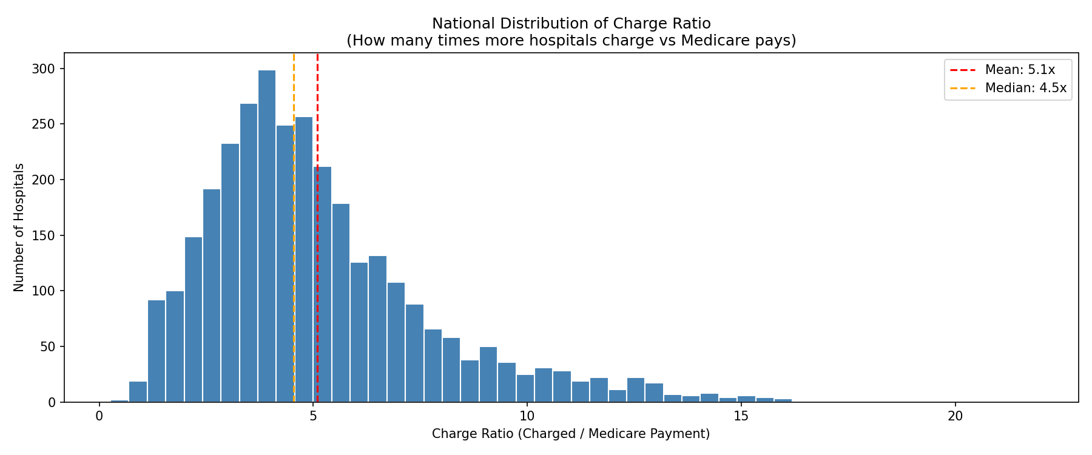
TASK 02B
NATIONAL DISTRIBUTION OF CHARGE RATIO
Question: Create a view of the national charge ratio distribution. Describe what you find.
OBSERVATION:
Right-Skewed - Most hospitals cluster at 3-6x. A small tail reaches beyond 20x.
Mean vs Median - Median 4.5x vs Mean 5.1x. Gap = Outliers pulling average up.
The tail is the target - 200 hospitals above 10x = 6.3% of providers = Highest audit risk.
“MEDICARE PAYS ONLY 19.2 CENTS FOR EVERY DOLLAR BILLED. AT EXTREME CASES AS LOW AS 1.4CENTS”

Slide 6
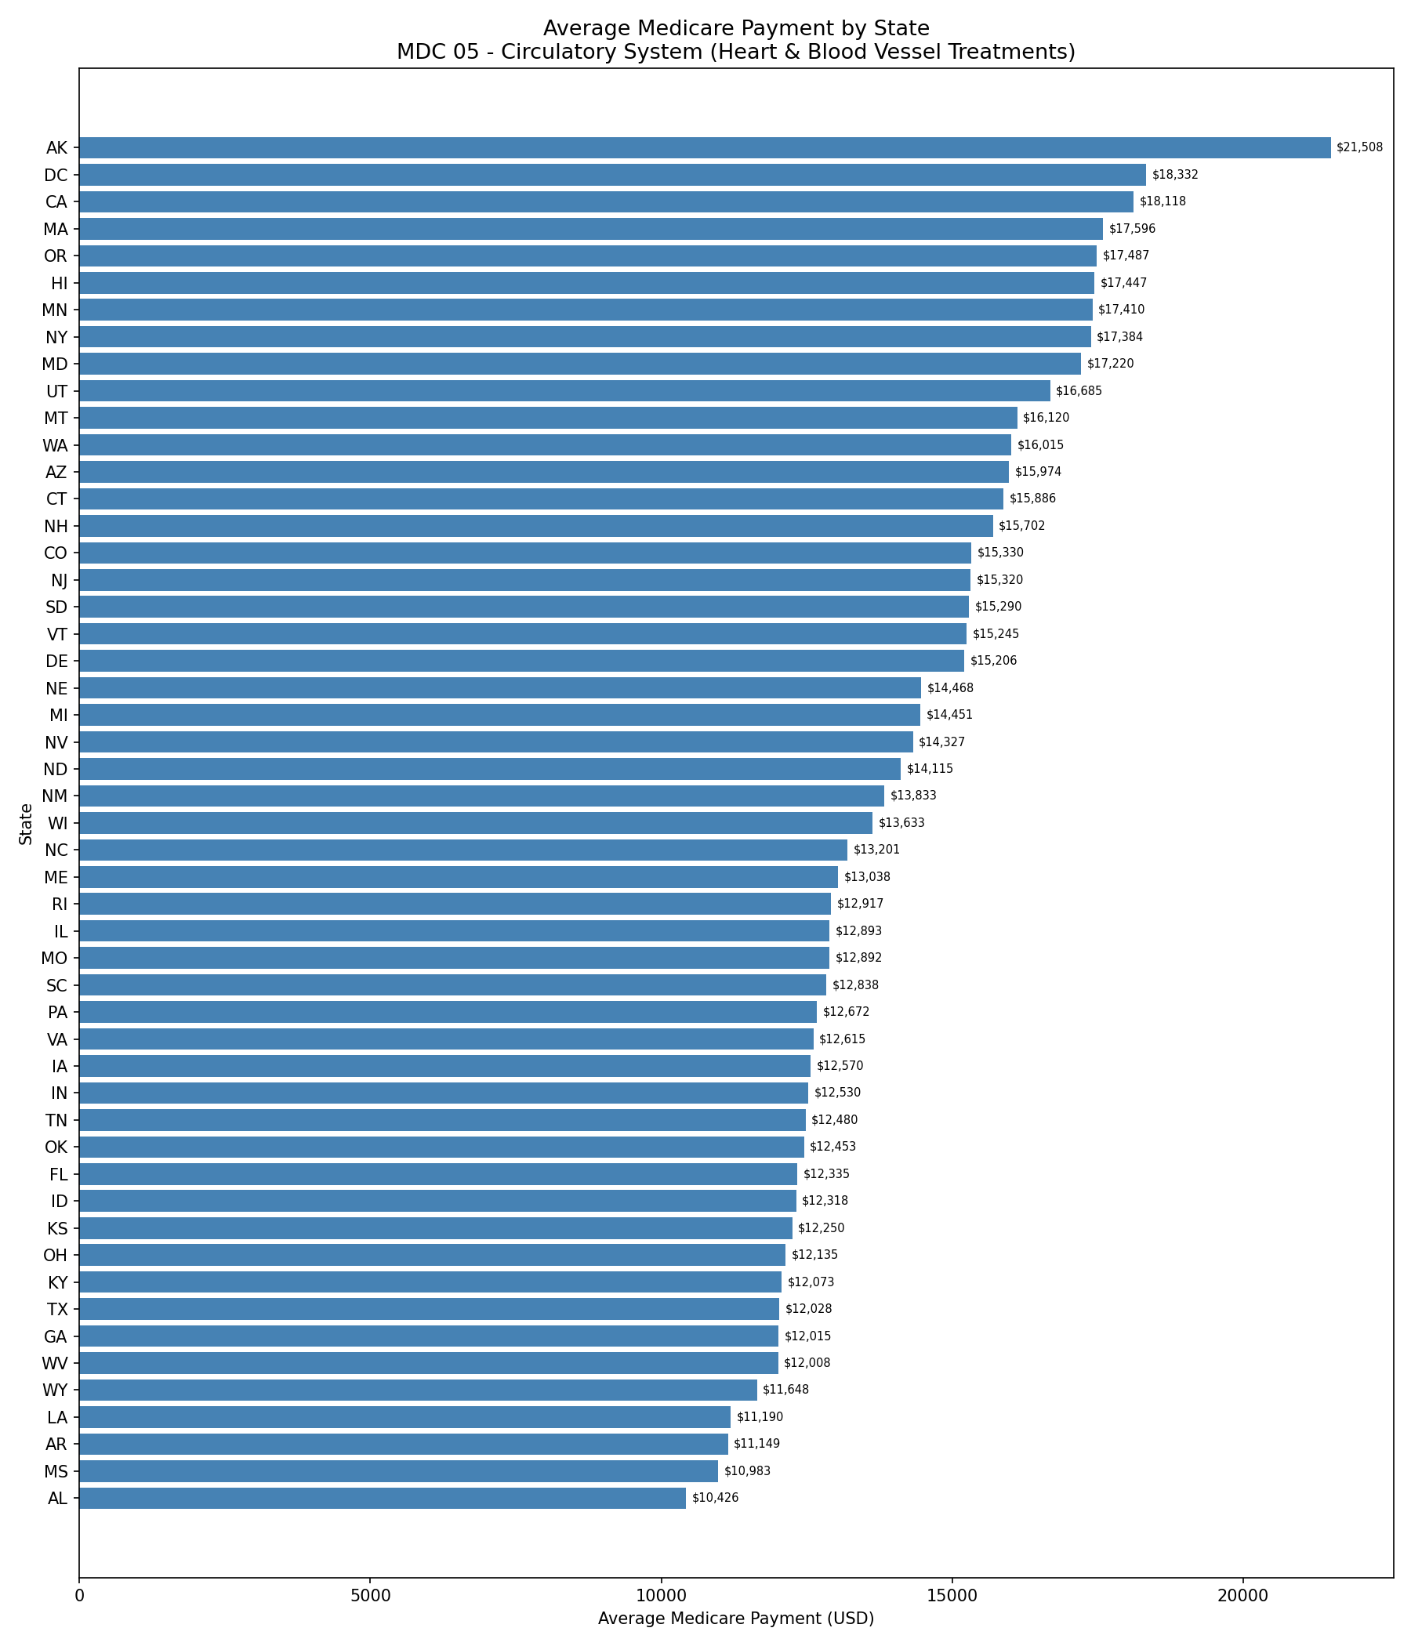
TASK 02C
GEOGRAPHIC PAYMENT VARIATION
Question: Pick a top MDC. How do payments vary geographically?
MDC 05 CHOSEN
MDC 05 Circulatory - 1.63M patients treated, highest volume MDC in dataset.Most reliable for geographic comparison.
KEY FINDINGS:
Alaska $21,508 vs Alabama $10,426 which is same treatment, 2x payment difference
Nevada ( $14,327) with 9.03x charge ratio is highest overbilling state for heart treatments.
Maryland ($17,220) with 1.22x is lowest overbilling in country. Only US state with government-regulated billing rates (All-Payer Model).
“MARYLAND(MD) ALL-PAYER MODEL PROVES REGULATION CONTROLS BILLING VARIATION”

Slide 7
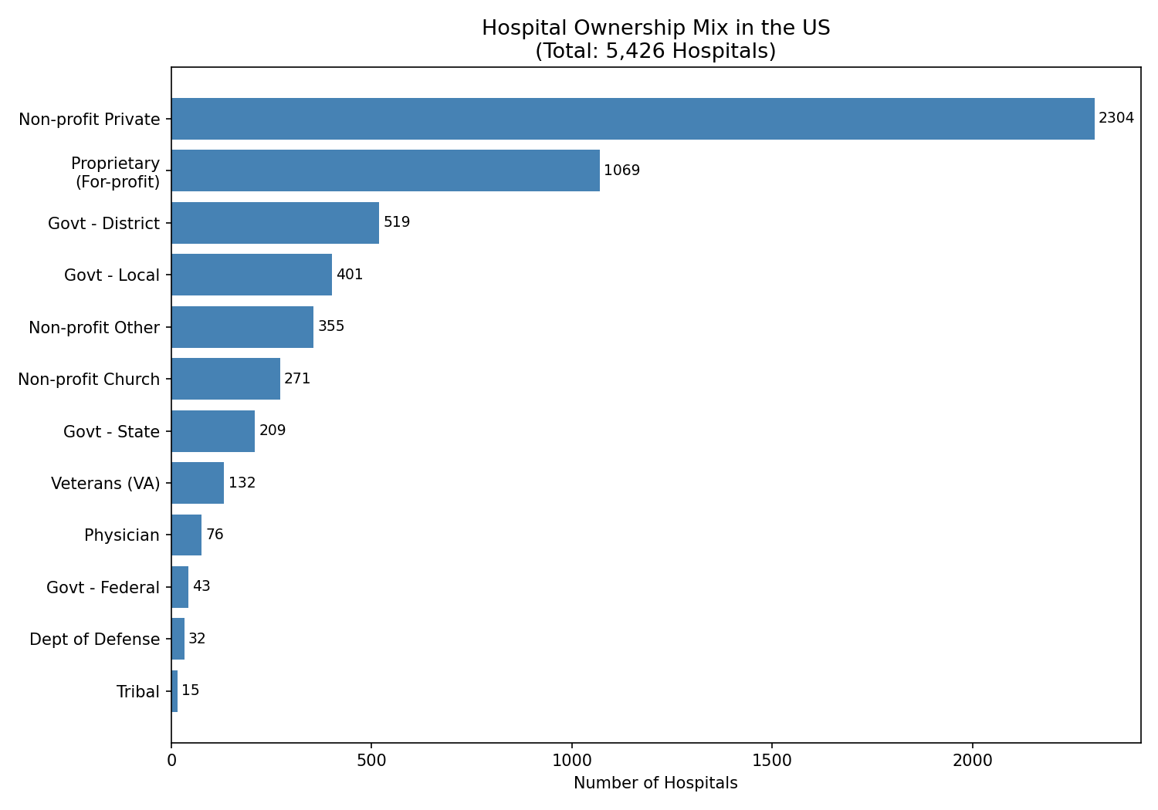
TASK 03A
Question: Summarise hospital ownership mix in the most informative way.
OWNERSHIP MIX
OWNERSHIP | HOSPITALS (Full Register) | CHARGE RATIO
For-Profit | 1,069 (20%) | 8.50x
Non-profit | 2,304 (42%) | 5.10x
Govt Local | 401 (7%) | 4.16x
Tribal | 15 (<1%) | 1.34x
INSIGHTS: For-profit hospitals are 20% of providers but charge 67% more than non-profits at 5.10x.
Ownership type shows the strongest observable pattern in billing behaviour across all hospital segments.

Slide 8
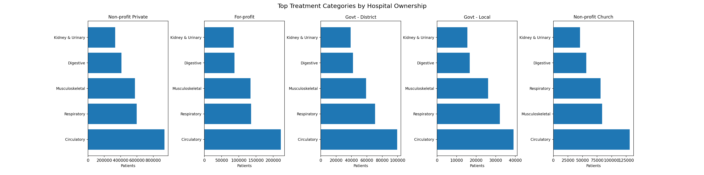
TASK 03B
MDC MIX BY OWNERSHIP
PATTERN | OWNERSHIP | KEY NUMBER
UNIVERSAL | All Ownership Types | Circulatory #1 everywhere
GOVERNMENT HOSPITALS | Govt Local · Govt District | Respiratory > Musculoskeletal (32,086 vs 26,110)
OUTLIER | Non-profit Church | Musculoskeletal > Respiratory (83,570 vs 81,048)
Question: Which MDCs dominate by hospital type? What patterns stand out?
Ownership used instead of Hospital Type
Hospital Type contains only ‘Acute Care hospitals, So Ownership gives 10 distinct groups with real variation.
“CIRCULATORY DOMINATES ALL OWNERSHIP TYPES. GOVERNMENT HOSPITAL(LOCAL & DISTRICT) SHOWS HIGHER EMERGENCY ADMMISSON”

Slide 9


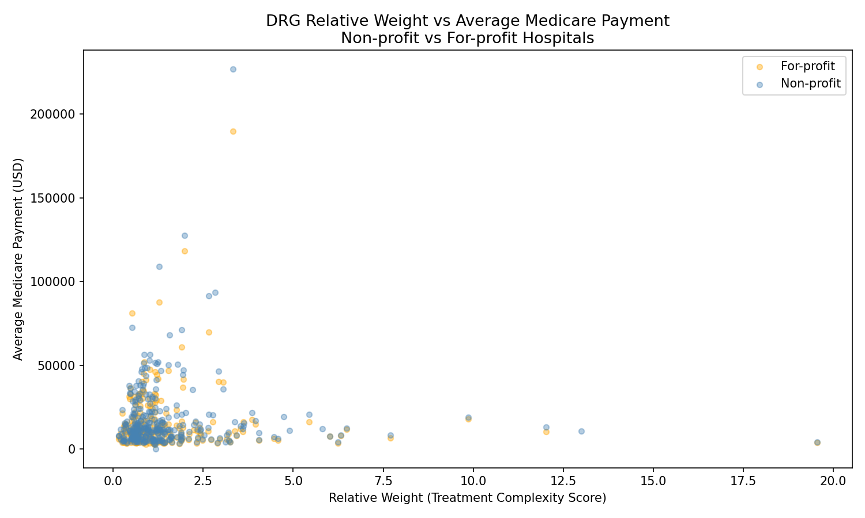
TASK 03C
DRG WEIGHT VS MEDICARE PAYMENT
Question: Do higher DRG weights always mean higher Medicare payments?
ZONES | DESCRIPTION
Low weight, High payment | Brain stent (weight 0.6) but Medicare paid $20,814 - overpayment risk
High weight, Low payment | Severe pneumonia (weight 3.4) but Medicare paid $6,475 - underpayment risk
ANSWER:
No. Higher weight does NOT guarantee higher payment.State, ownership, and volume all influence what Medicare pays
not just clinical complexity.

Slide 10
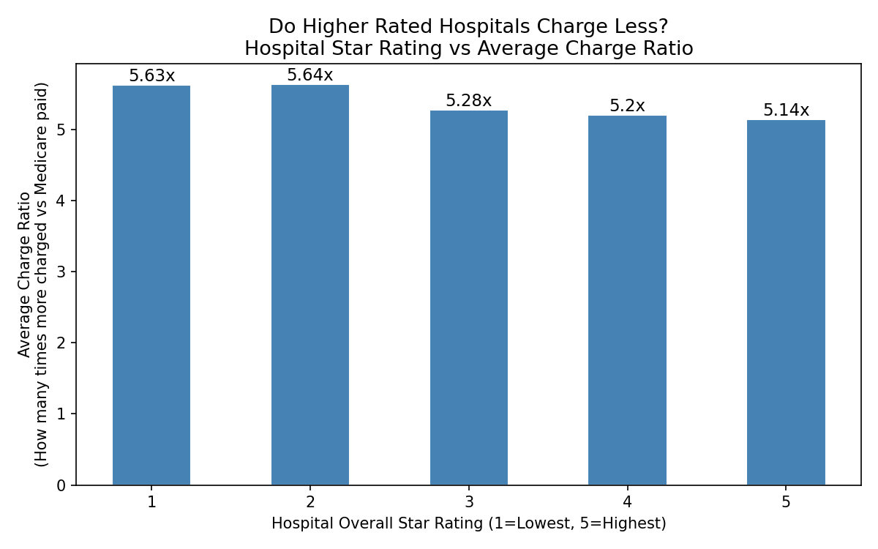
TASK 04A
SURPRISE FINDING
Question: What is the single most surprising thing you found that we did not ask about?
ANALYSIS
1-star hospitals with 516,676 patients charge 5.63x
5-star hospitals with 700,061 patients charge 5.14x
1 & 2-star hospitals treated 2.15 million elderly Medicare patients in 2017.
Every star rating improvement = lower billing aggression.
BUSINESS RECOMMENDATION
Prioritise 1–2 star For-profit hospitals for audit.
They are 6.3% of providers but carry the highest combined billing + quality risk.
“LOW RATED HOSPITALS ALSO SHOW HIGHER BILLING RATIOS IN THE DATASET”

Slide 11
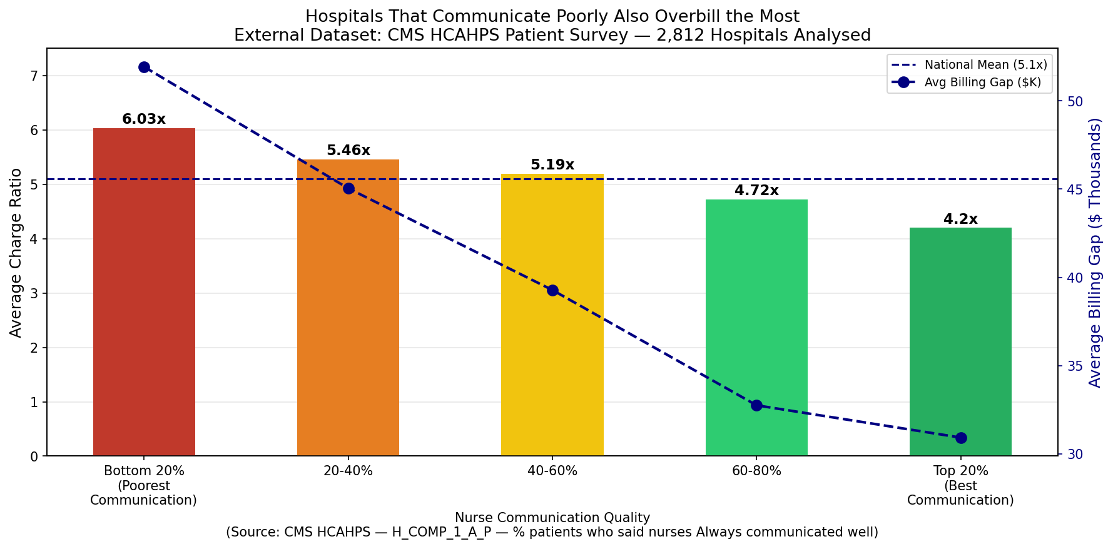
TASK 04B
BONUS FINDING
EXTERNAL DATASET 4-Dataset: CMS_HCAHPS PatientSurvey
Source: data.cms.gov Survey: 325,652 responses
Join: Facility ID = CCN
Measure: H_COMP_1_A_P
Matched: 2,812 hospitals
Question: Identify one dataset outside the 3 tables. Link it and find an interesting insight.
KEY NUMBERS Poorest 20%→6.03x -$51,926 gap
Best 20% → 4.20x · $30,922 gap
Hospitals that communicate poorly charge 44% more than hospitals that communicate well.
BUSINESS RECOMMENDATION Poor communication = billing integrity signal.
Incorporate HCAHPS scores as audit risk filter.
HOSPITALS THAT COMMUNICATE POORLY ALSO OVERBILL THE MOST

Slide 12
TOOLS & METHODOLOGY
PYTHON (JUPYTER) Load 3 CSVs Clean null Fix join key Add new columns
MYSQL Store 3 tables JOIN on CCN + DRG GROUP BY queries 196,086 rows
MATPLOTLIB 7 charts PNG exports
POWERPOINT This deck
Python → cleaned nulls · fixed CCN zero-padding · added billing_gap, charge_ratio, mdc · MySQL → GROUP BY, JOIN, ORDER BY · Matplotlib → all charts saved as PNG
FLOW
SELECT provider_name, state,
AVG(avg_charged - avg_medicare_payment)
AS billing_gap,
AVG(avg_charged / avg_medicare_payment)
AS charge_ratio
FROM inpatient_payments
GROUP BY provider_name, state
ORDER BY charge_ratio DESC
LIMIT 10
SELECT p.hospital_ownership,
COUNT(DISTINCT i.provider_id) AS hospitals,
ROUND(AVG(i.avg_charged /
i.avg_medicare_payment), 2)
AS avg_charge_ratio
FROM inpatient_payments i
JOIN provider_info p
ON i.provider_id = p.facility_id
GROUP BY p.hospital_ownership
ORDER BY avg_charge_ratio DESC
SELECT b.provider_name,
b.avg_charge_ratio,
h.nurse_always_pct
FROM inpatient_payments b
JOIN hcahps h
ON b.provider_id = h.facility_id
WHERE h.HCAHPS_Measure_ID
= 'H_COMP_1_A_P'
ORDER BY avg_charge_ratio DESC
Query 1: Metric Creation
Query 2: Aggregation
Query 3: External JOIN

Slide 13
SUMMARY: FROM DATA TO DECISION
Finding | Number | Action
Hospitals above 10x charge ratio | 200 hospitals (6.3%) | Immediate audit flag
For-profit charge ratio vs Govt | 8.50x vs 4.16x | Ownership-based risk scoring
Low-rated hospitals overbill most | 2.15M patients affected | Quality-linked audit priority
Heart Failure total exposure | $11.3B gap | Volume-weighted audit protocol
State billing gap | Maryland 1.22x vs Nevada 9.03x | Policy investigation
Five findings. One pattern. For-profit ownership, low quality ratings, and poor nurse communication consistently predict higher billing aggression — across 3,182 hospitals, 4 datasets, and $9.82 billion in billing gap. Audit the pattern, not just the outliers."

Slide 14
THANK YOU

