Slide 1



EduBuddy
An EdTech Initiative…..

Slide 2
What we aim?
To help students starting with programming who does not have the access to college.
Providing them the roadmap with various resources for each topic
Most importantly it's free

Slide 3

1. What makes it different
By the student community and for the students
Accessibility Access to all resources at one place
RoadMap First timers will find it useful to set their goals and remain on track
Repositories containing various topics
Different contributors can suggest the
links

Slide 4
Just one! Your own.
(With a little help from your smartphone)
At just one place you can have the resources to learn various things
You can contribute to it also

Slide 5
Its Open -Source
Everyone can contribute to the content and source code of the app

Slide 6
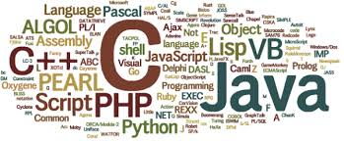
Users who do not have any idea about PROGRAMMING LANGUAGES can start learning at one place

Slide 7

2) In Present
Till now we have implemented this for
C Programming Covers major topics and their videos
Python Programming
Links of various websites Videos of topic in hindi and english

Slide 8

Getting suggestion for links on github
Quizzes for each topics
Multi-Lingual support

Slide 9

Cloud Service that can be used
SQL Database
Linking app with Azure
Sql Database
For storing quiz data
Azure Analytics Services
Analyzing the quiz performance
Identify weak topics and strong topics of students
We tried but but not able to implement in short time

Slide 10

What inspired us?
Giving back to community
Helping beginners to start

Slide 11

Team Members
Shaswat Kumar
Namit Bhandari
Shivam Kejriwal
Ramit Agarwal

Slide 12

Thanks to
LNM Hacks and MLH for organizing such a great event
And giving us food and space to work

Slide 13
Final Thanks
To audience and judges for listening us
Help Beginners
Don't forget to contribute

