Slide 1
Auction Performance Analysis
Shaswat Rajput
Bayesian Modeling in Python : Final Project
Fall 2020

Slide 2
Table of Contents
Introduction
Methods
Results
Conclusion

Slide 3
Introduction
There are mainly 3 type of type of Auction: English Auction, Dutch Auction and Sealed Bid.
English Auction :
Forward : It starts with a low starting price and then it proceeds with increments in price submitted by the people who are taking part in auction as buyer. In this auction whoever offer the highest bid wins the auction.
Reverse: It starts with a high price point and proceeds with decrement in price submitted by those who take part in auction. In this auction whoever offer the least bid wins. It usually go on for couple of hours as compared to forward auctions which can go on for days.

Slide 4
Introduction
Dutch Auction :
Forward : It starts with a high starting price and then proceeds with price decrement at particular intervals to a minimum price. Supplier is free to choose choose at any bid during decreasing intervals.
Reverse: It starts with a low starting price and then it proceeds with increment in price at particular intervals to a higher or maximum set price. Supplier is free to choose at any bid during increasing intervals.

Slide 5
Introduction
Sealed Bid:
A sealed bid is type of auction in which all bidders submit sealed bids to the auctioneer so that no other bidder knows what price they have have bid on.
Sealed Bid is a written in a sealed envelope and it is not opened until the stated date. The highest bidder is usually chosen as the inner of the auction.

Slide 6
Data Description
This dataset is collected from google open dataset archive. This dataset has following variables -
auction_id: unique identifier for a single multi-lot online auction event.
RoR: Return on Reserve over all lots sold in the auction event.
STR: proportion of lots (by reserve value) that were successfully sold in the auction event.
lots: number of lots offered in the auction.
avg_reserve: average reserve price over all lots in the multi-lot online auction.
avgstartbid: the average starting-bid (expressed as a fraction of the reserve bid).
BPL: average number of bidders per-lot.
auction_mech: the auction mechanism used for the auction event (English Forward, Sealed Bid or Fixed Price).
state: state where auction happened.

Slide 7
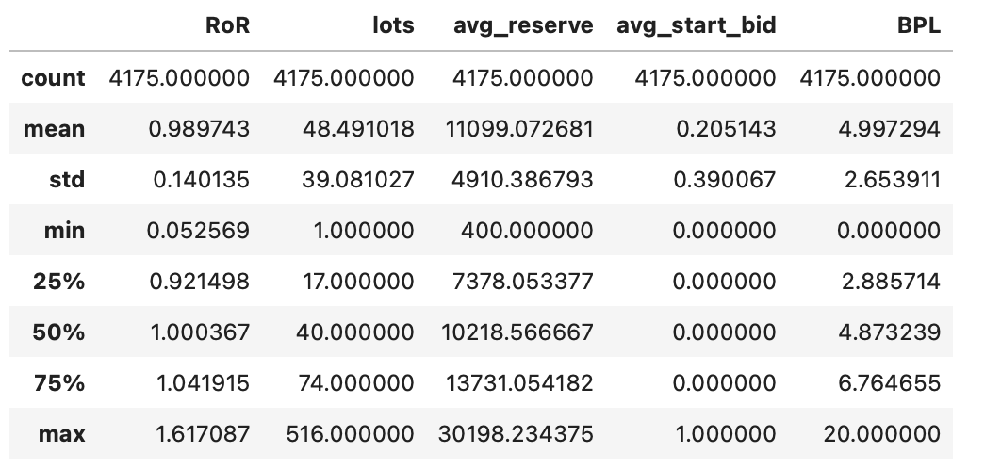
Data Cleaning
During initial analysis of data I have found some outliers in the data like average reserve price being in millions.
I filtered out Fixed Price auction event because technically they are not auctions and also their RoR is fixed at 1.
I have also filtered out auction event where nothing was sold as we can’t particularly say anything about it’s RoR.

Slide 8
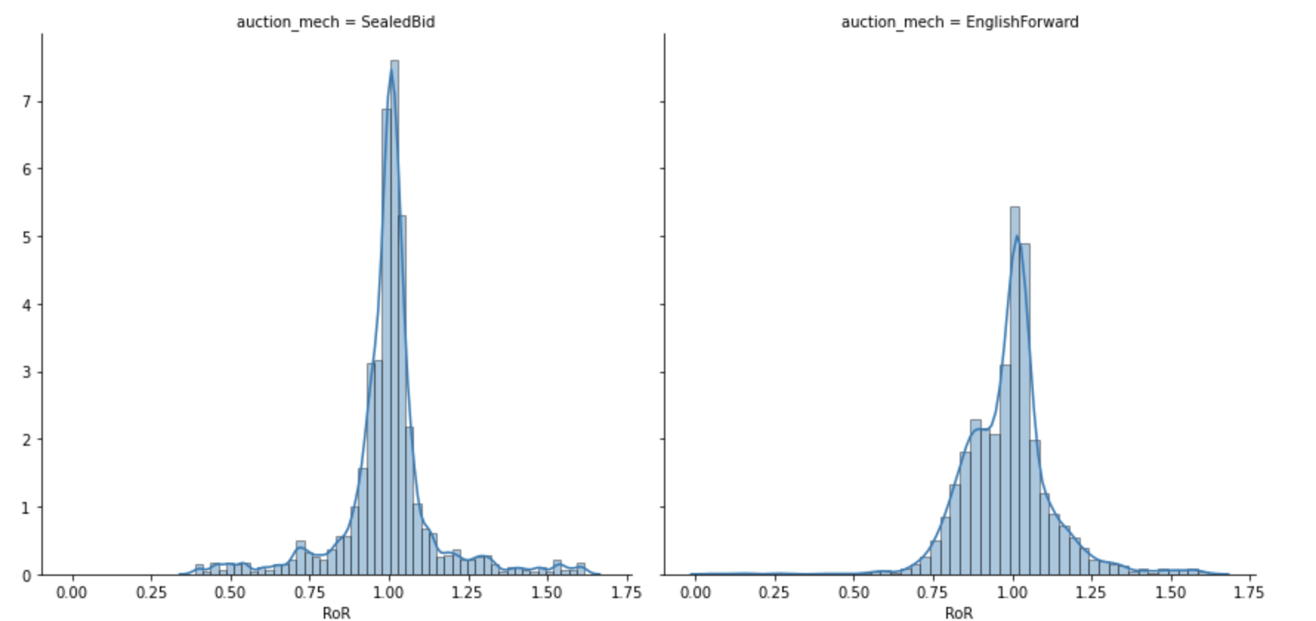
Data Analysis
Distribution of RoR based on Auction Mechanism

Slide 9
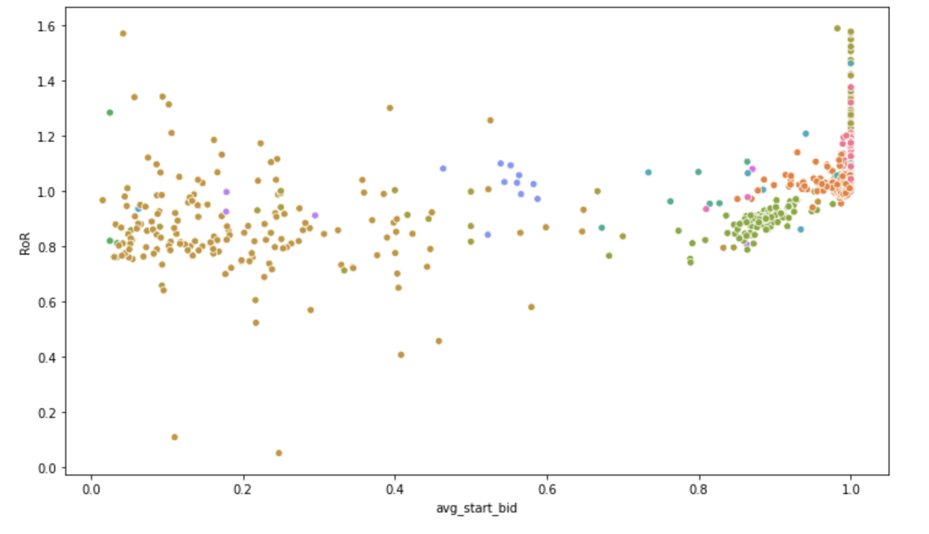
Data Analysis
As we can see in above plot that there are some states where RoR is greater than average start bid price which cannot be true so we will filter out these auction events from our data before modeling.

Slide 10
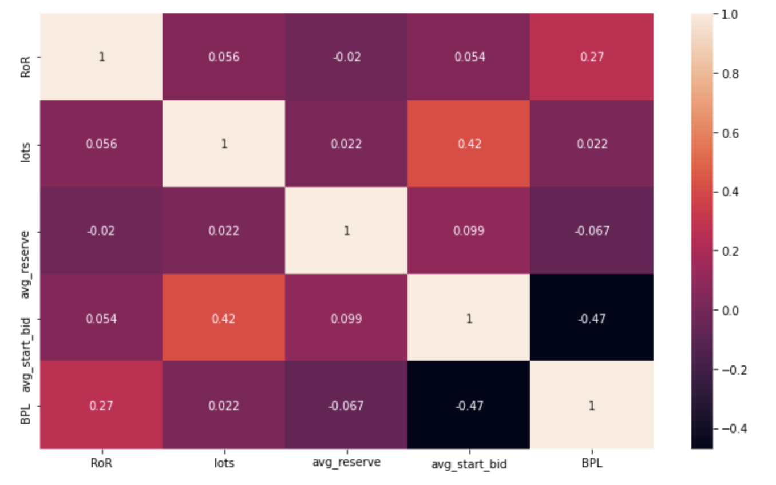
Data Analysis

Slide 11
Data Preparation
Select variable of Interest
Center and Scale the variables
Encoding Categorical variables
Log transformation on target variable

Slide 12
Model 1 (Weak Normalising priors with Normal Likelihood )
Simple pragmatic linear model
Used Normal Distribution for Priors and Likelihood
Used Mean 0 and Standard deviation 1 for priors
Used Half Cauchy distribution for sigma

Slide 13
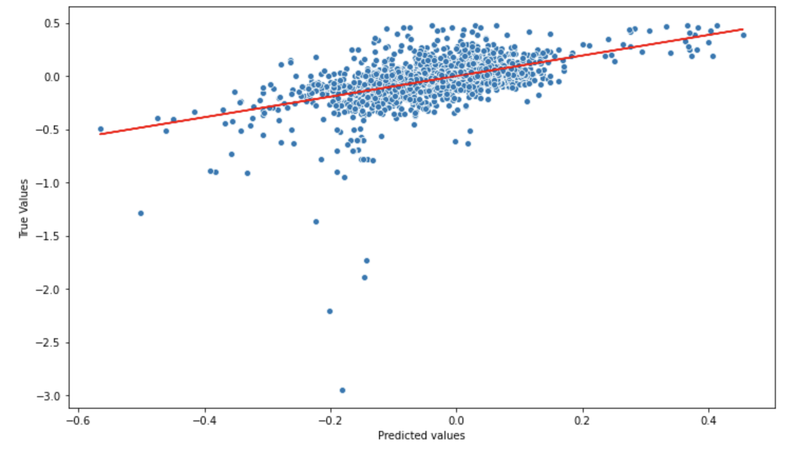
Model 1
Prediction Plot

Slide 14
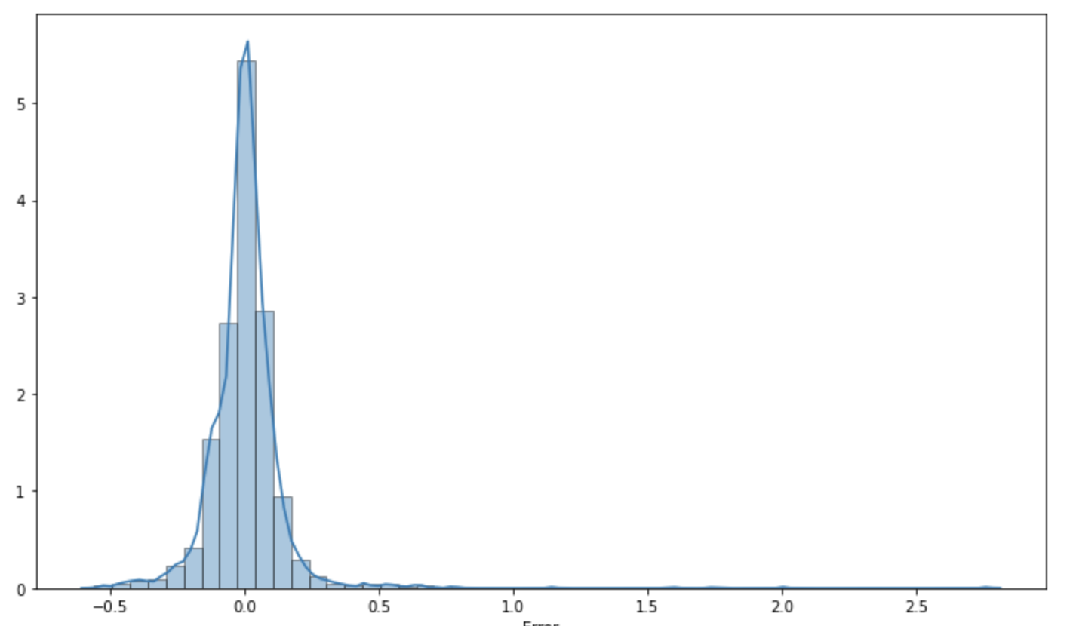
Model 1
Residual error plot

Slide 15
Model 2 (Weak Normalising priors with Normal Likelihood )
Simple pragmatic linear model
Used Normal Distribution for Priors and Likelihood
Used Mean 0 and Standard deviation 0.2 for priors
Used Half Cauchy distribution for sigma

Slide 16
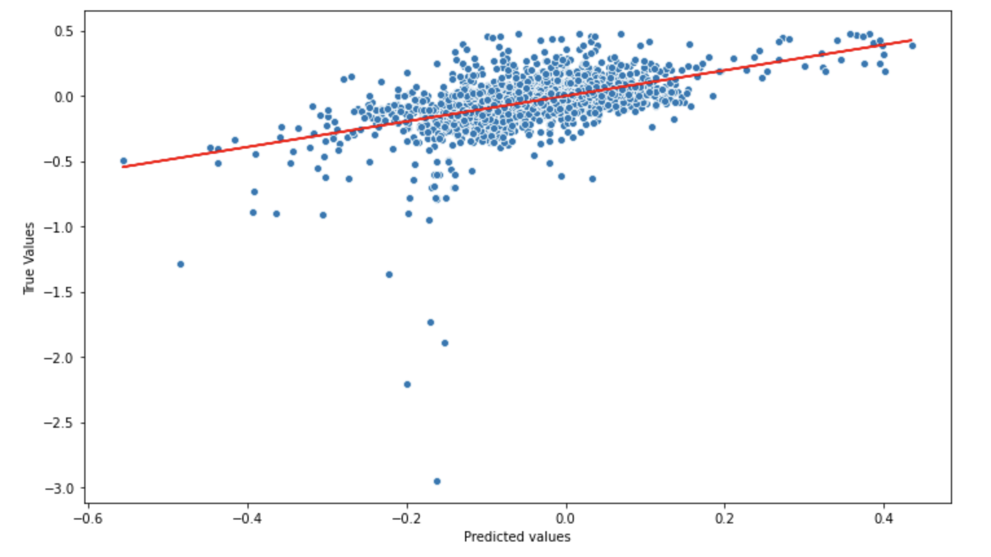
Model 2
Prediction Plot

Slide 17
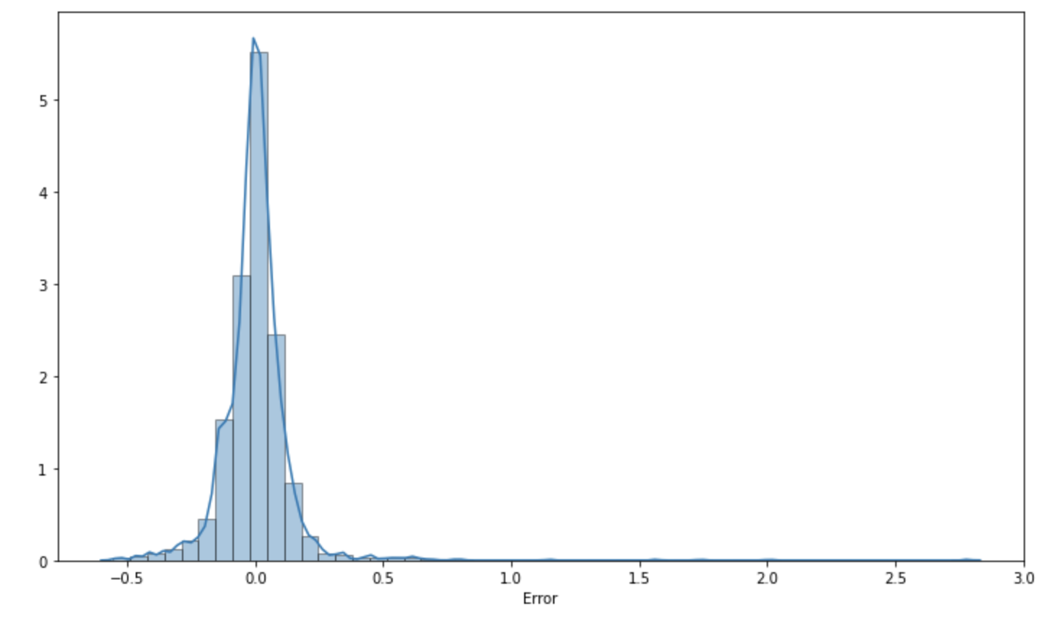
Model 2
Residual error plot

Slide 18
Model 3 (Weakly Normal Priors with student t-distribution)
Simple pragmatic linear model with Student t-distribution for likelihood
Used Normal Distribution for Priors
Used Mean 0 and Standard deviation 0.2 for priors
Used Half Cauchy distribution for sigma

Slide 19
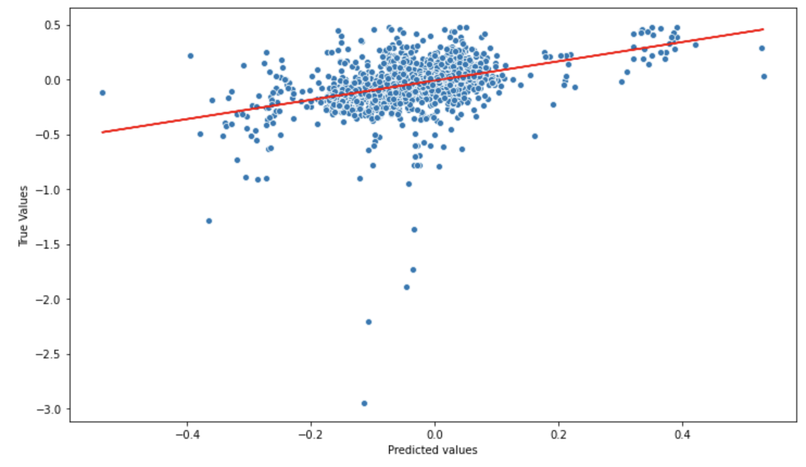
Model 3
Prediction Plot

Slide 20
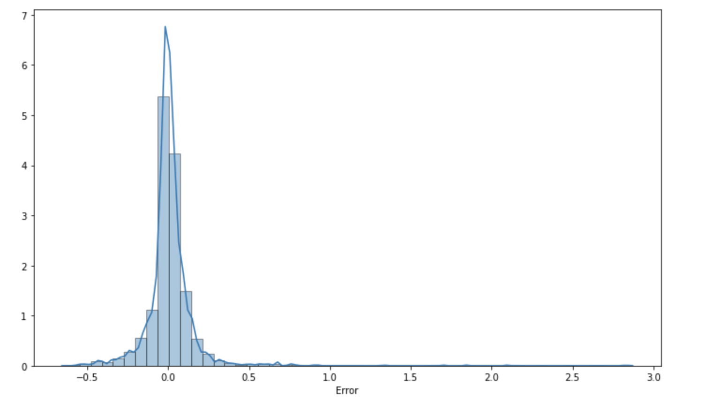
Model 3
Residual error plot

Slide 21
Model 4 (Hierarchical Model)
Hierarchical model with Normal distribution for likelihood
Used Normal Distribution for Priors
Used Mean 0 and Standard deviation 0.2 for hyper - priors
Used Half Cauchy distribution for sigma

Slide 22
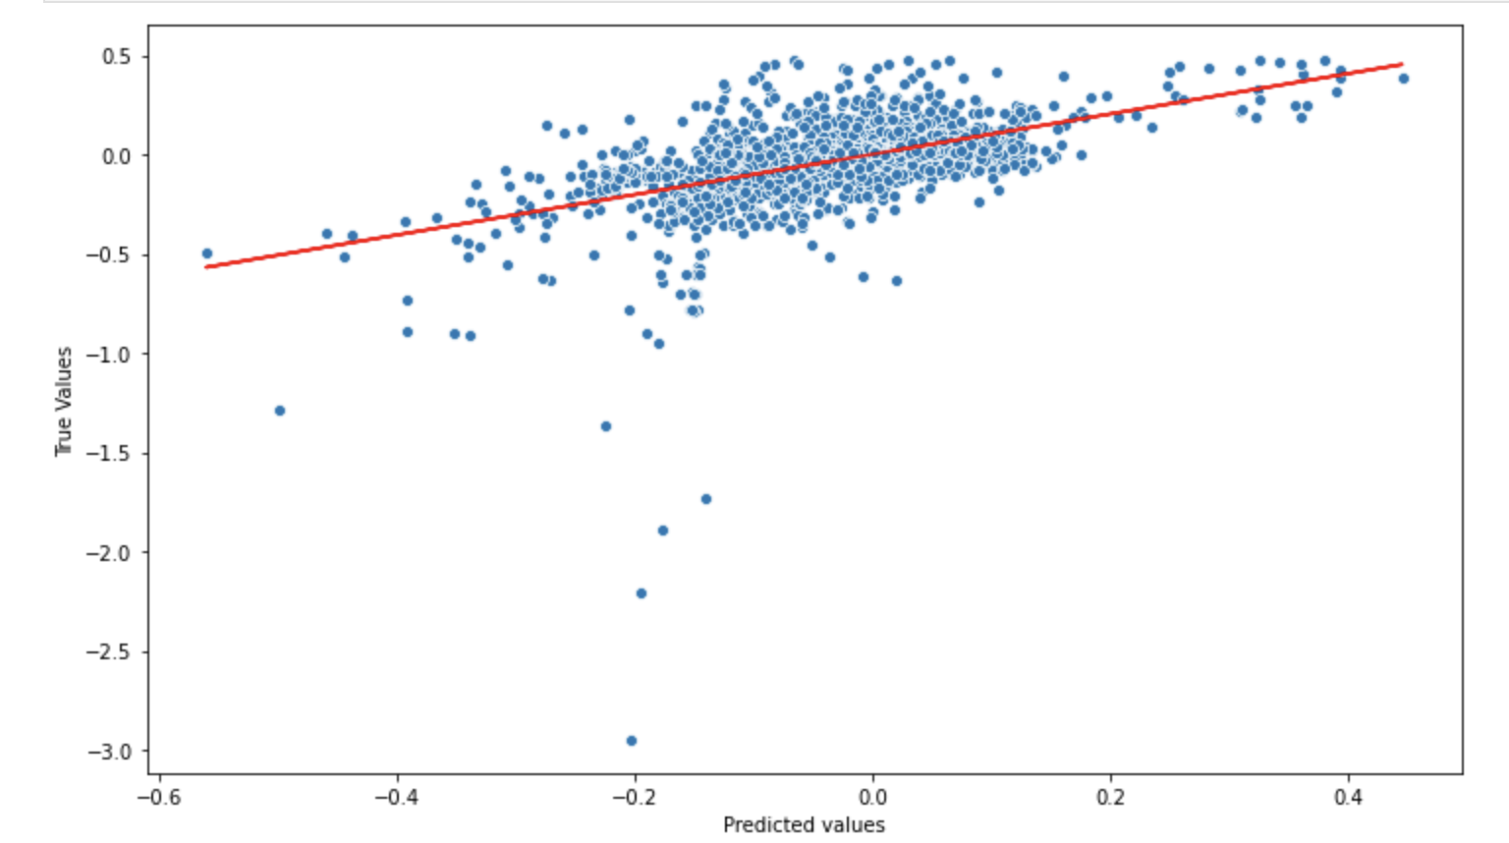
Model 4
Prediction Plot

Slide 23
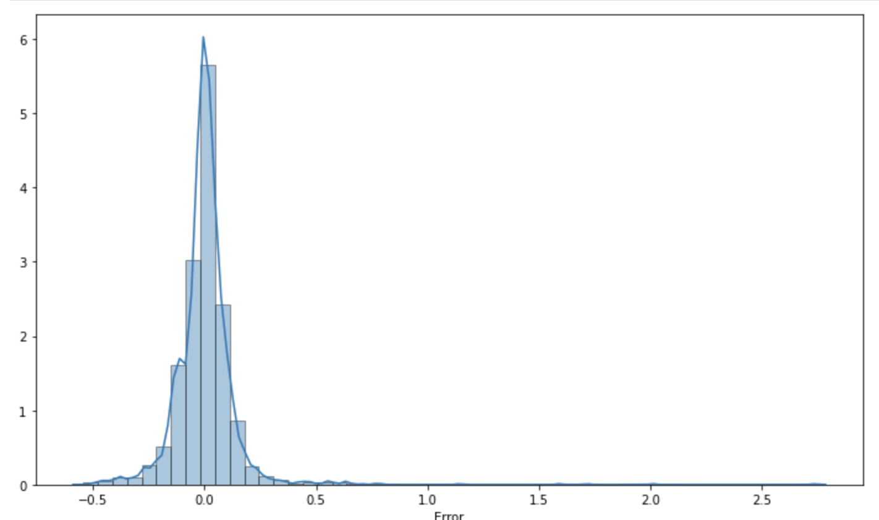
Model 4
Residual error plot

Slide 24
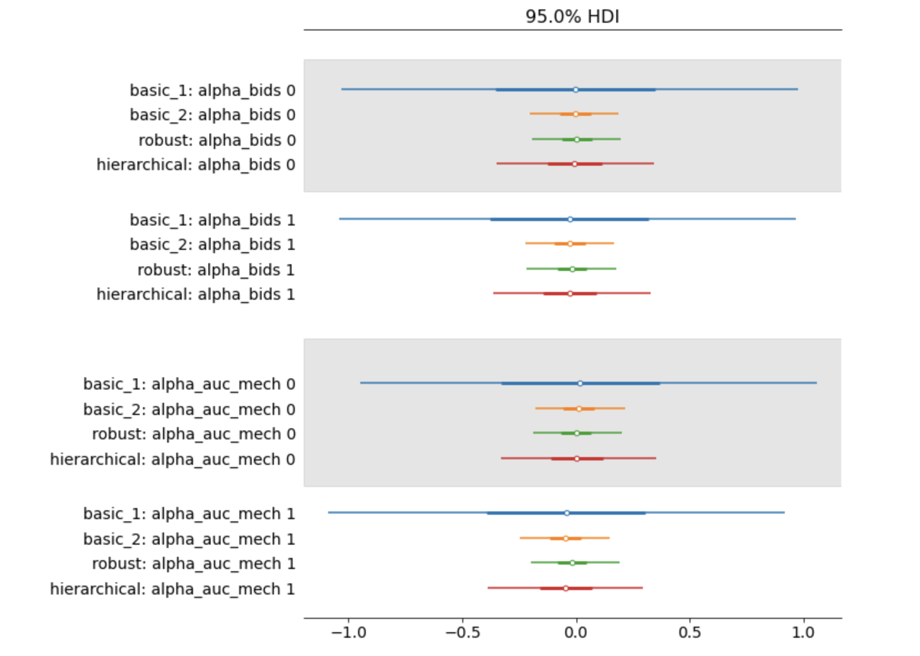
Model Comparison
(Categorical values)

Slide 25
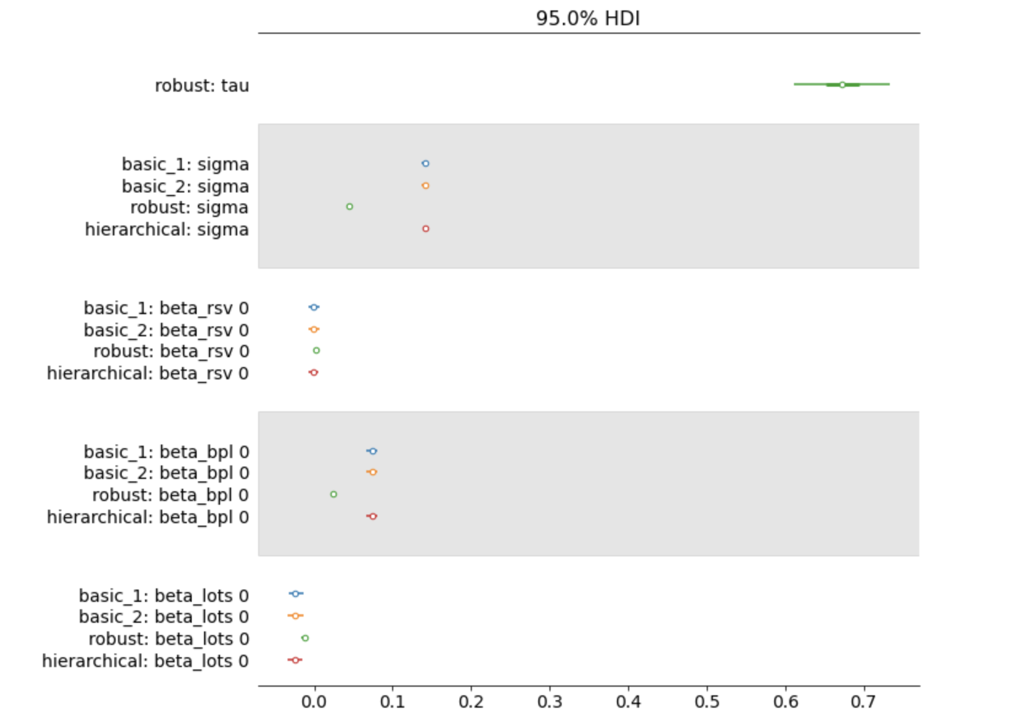
Model Comparison
(Non-Categorical values)

Slide 26
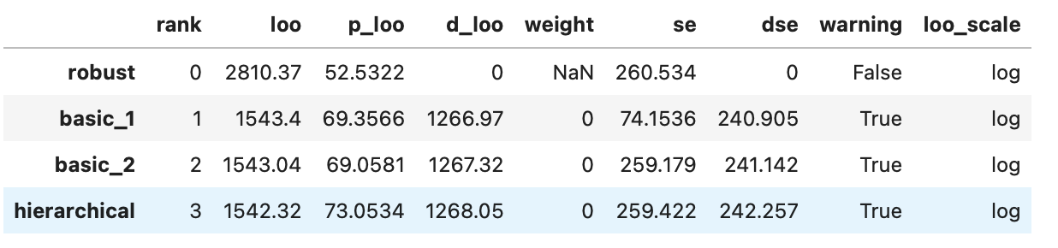
Model Comparison

Slide 27
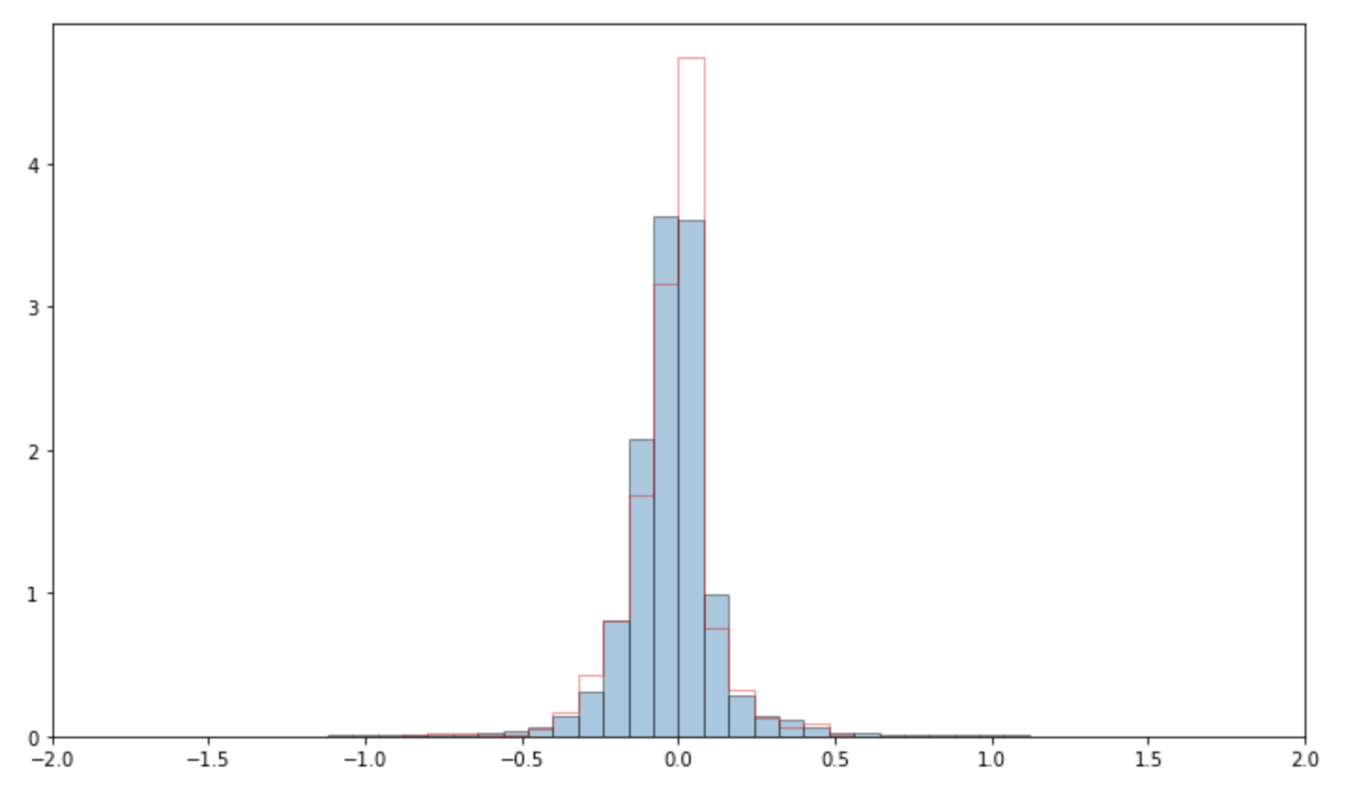
Features Analysis
Analysis 1: Posterior Predictive Check

Slide 28
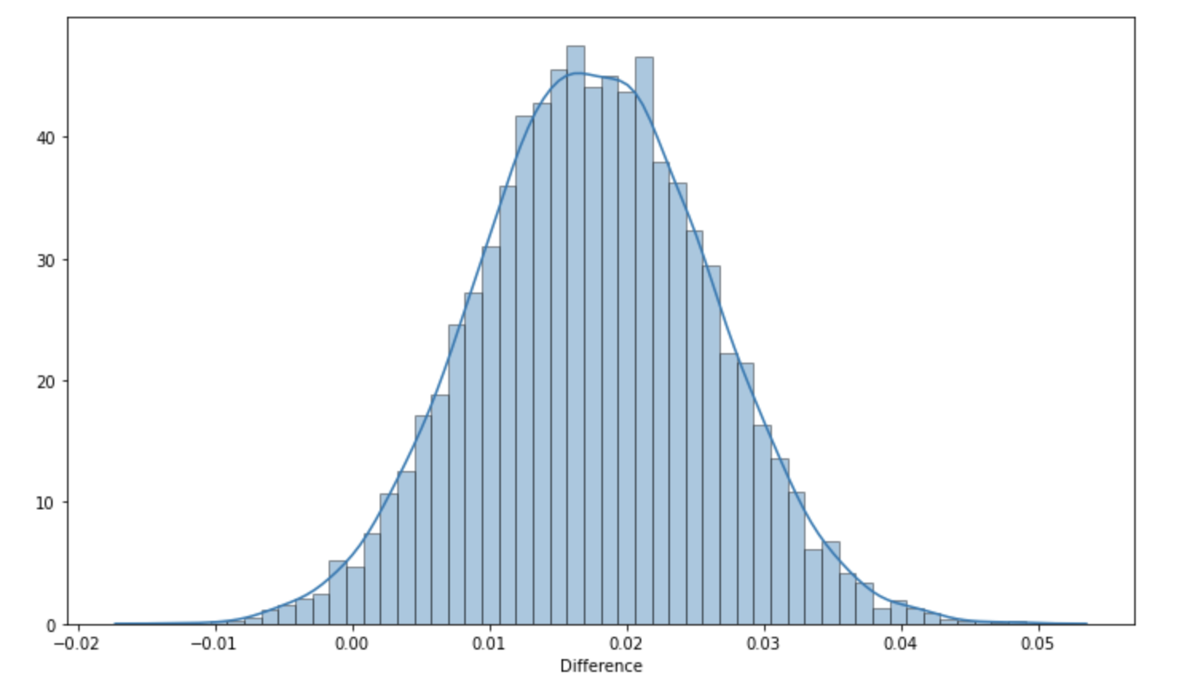
Features Analysis
Analysis 2: Forward vs Sealed bid Auctions
Mean Difference in RoR : 0.017

Slide 29
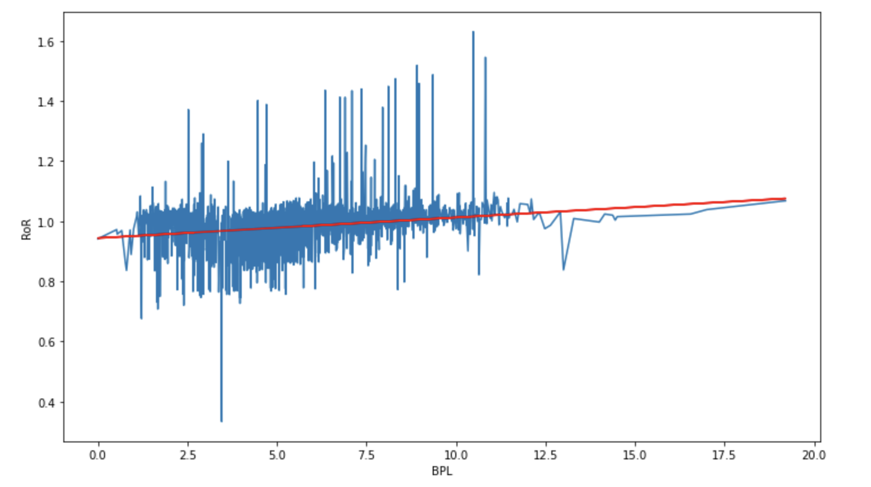
Features Analysis
Analysis 3: Impact of BPL on RoR
BPL has a positive effect on RoR

Slide 30
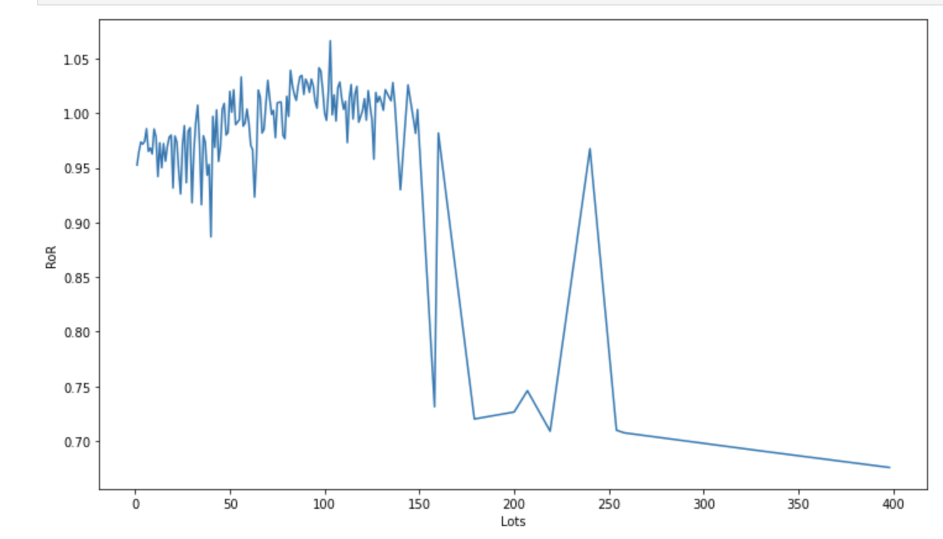
Features Analysis
Analysis 4: Impact of Lots offered on RoR
Number of lots has a slight negative effect on RoR

Slide 31
Conclusions
On an average Forward Auction are expected to outperform Sealed Bid auctions.
As bidders were increased then they tend to have a positive effect on RoR which is also expected that if there more bidders then RoR will be high in those cases.
If there are more lots offered in an auction then it will have negative effect on RoR. There seem to be little positive effect on RoR when lots were small but as they increased then lots had a negative effect on RoR.

