Slide 1

QUIZZY
A Web App for Creating , Attempting Exciting Quizzes
A
Project
Developed By :
Team : AgainLazyCoders
Members:
Shaswata Raha
Kathak Mistry
Vikas Patel
N

Slide 2
Overview:
This is a web app for quiz creation and attending .
Only quiz makers have to sign up with valid email and password
Each quiz will generate a link that can be shared. Interested participants can participate using the link and after finishing the quiz stats will be shown .
Quiz makers can make quiz and add questions as per their choice . Quiz details can be modified.
All stats related to the questions will be shown to maker
Technologies used :
Database : Mongodb
Backend : Node js , Express
Frontend : React ( for user interface components : Material ui )

Slide 3
Extra features :
Random ordering of questions for every quiz taker
List of all responses for a particular quiz and then exporting them to csv for later use
Variable weightage to different questions which can be set by the admin
A timer is set for every question within which the question needs to be answered.
Analytics for every question in a quiz like how may of them have given the correct answers and how percentage distribution for every option
The quiz taker will be able to view their scores after the quiz is over along with some other statistics ( i.e. no of question answered , bonus score etc. )
Admin can later update the quiz or the questions itself but will not be able to delete it

Slide 4
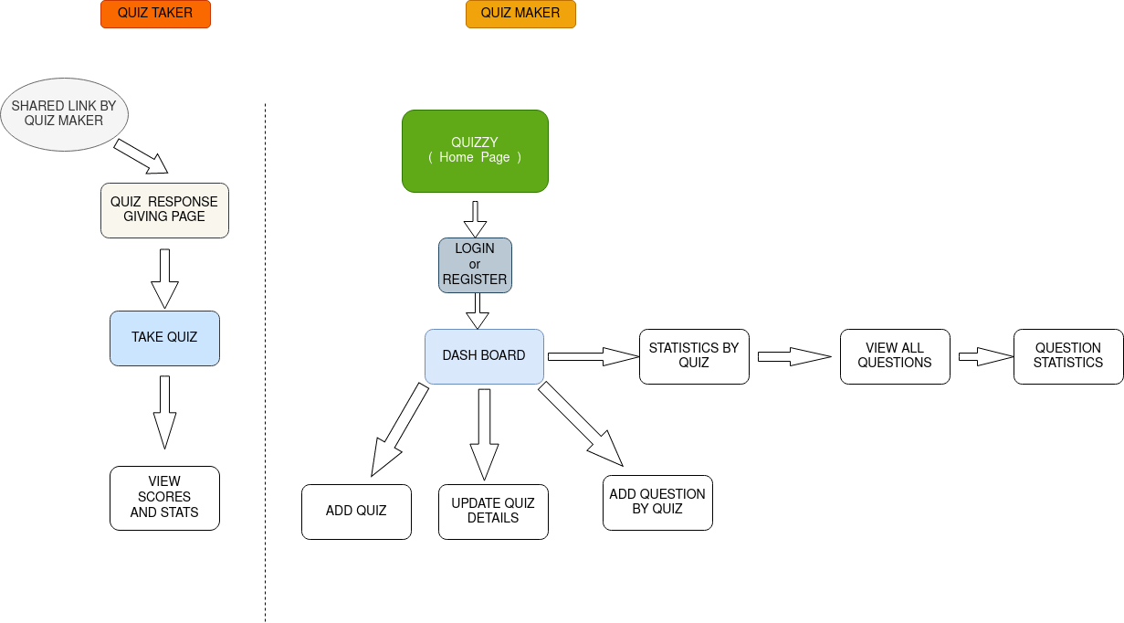
Work flow

Slide 5
THANK YOU

