Slide 1



TEXT FILE COMPRESSION
Project ID:26121
By
Shubhashree Muni
CSE201911430
Shatabdi Dash CSE201911481
Under the guidance of
Dr. Susmita Mahato
Notes:
B-TECH PROJECT MID-SEM PRESENTATION 2011
BY KHUSHBU KHAN & ISAN SAHOO

Slide 2

INTRODUCTION
Compression serves to save storage space and to save transmission time. The aim of compression algorithm is to produce a new file, as short as possible.
The term text should be understood in a wide sense. The interest in data compression techniques remains important even if mass storage systems improve regularly because the amount of data grows accordingly.
Compression ratio of the methods depend on the input data. However, most often, the size of compressed text vary from 30% to 50% of the size of the input.
Compression is the process of coding that will effectively reduce the total number of bits needed to represent certain information.
The first algorithm that takes into account is Static Huffman Coding.
201911430- Shubhashree Muni 201911481- Shatabdi Dash
Notes:
B-TECH PROJECT MID-SEM PRESENTATION 2011
BY KHUSHBU KHAN & ISAN SAHOO
2

Slide 3
PROBLEM STATEMENT
The focus is directed mainly to different file compression coding techniques and comparisons between them. Some memory efficient encoding schemes are analyzed and implemented in this work. They are:
STATIC HUFFMAN CODING
DYNAMIC HUFFMAN CODING
LZW CODING
ARITHMATIC CODING.
These analyses show how these coding techniques work, how much compression is possible for these coding techniques, comparison between these techniques to find out which technique is better in what conditions.
201911430- Shubhashree Muni 201911481- Shatabdi Dash
Notes:
B-TECH PROJECT MID-SEM PRESENTATION 2011
BY KHUSHBU KHAN & ISAN SAHOO
3

Slide 4
STATIC HUFFMAN CODING
The Huffman method is an optimal statistical coding.
It transform the original code used for characters of the text.
The Huffman algorithm uses the notion of prefix code.
In the model where characters of the text are given new code wards, the Huffman algorithm builds code that is optimal in the sense that comparison is the best possible.
It is an effective technique of lossless data compression which means no information is lost
The length of the encoded text is minimum.
201911430- Shubhashree Muni 201911481- Shatabdi Dash

Slide 5
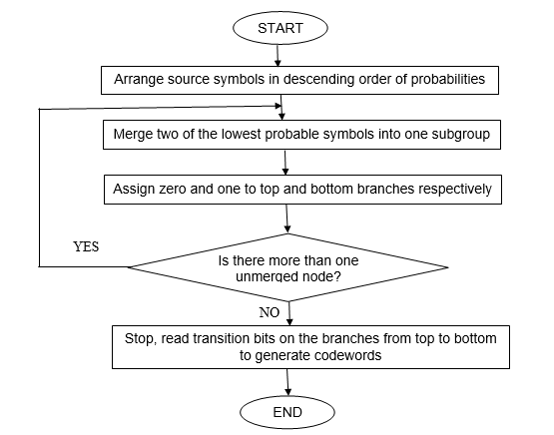
FLOW CHART
201911430- Shubhashree Muni 201911481- Shatabdi Dash

Slide 6

BEFORE COMPRESSION
201911430- Shubhashree Muni 201911481- Shatabdi Dash

Slide 7
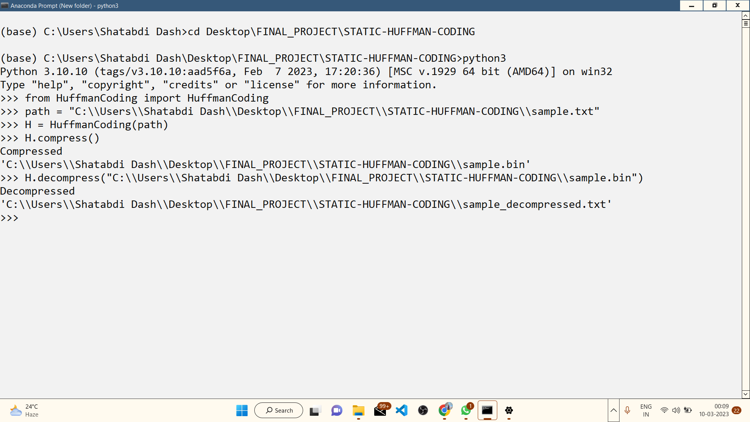

RUN PROCESS
201911430- Shubhashree Muni 201911481- Shatabdi Dash

Slide 8

AFTER COMPRESSION AND DECOMPRESSION
201911430- Shubhashree Muni 201911481- Shatabdi Dash

Slide 9
DYNAMIC HUFFMAN CODING
Dynamic Huffman Coding is also known as Adaptive Huffman Coding.
It permits building the code as the symbols are being transmitted, having no initial knowledge of source distribution, that allows one-pass encoding and adaptation to changing conditions in data.
In dynamic Huffman coding, the tree is initially empty, and symbols are added to the tree as they appear in the input stream. As symbols are added, the tree is dynamically modified to maintain the optimal code for each symbol.
The dynamic nature of the algorithm also means that it can be more computationally expensive than traditional Huffman coding, since the tree must be rebuilt as new symbols are added.
201911430- Shubhashree Muni 201911481- Shatabdi Dash

Slide 10
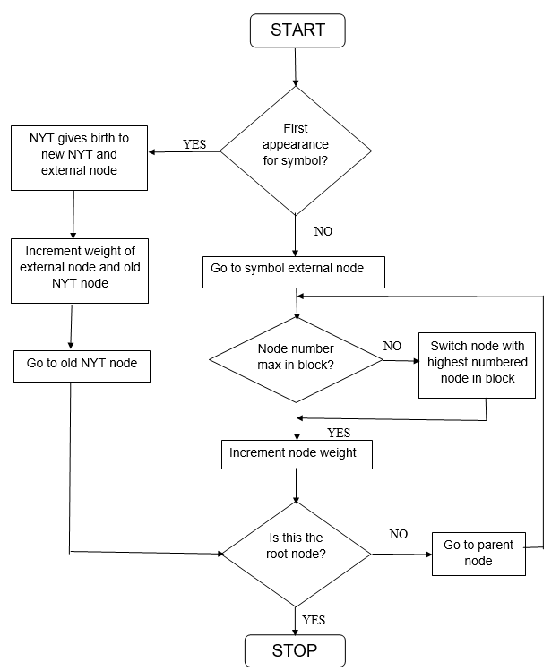
FLOW CHART
201911430- Shubhashree Muni 201911481- Shatabdi Dash

Slide 11

BEFORE COMPRESSION
201911430- Shubhashree Muni 201911481- Shatabdi Dash

Slide 12
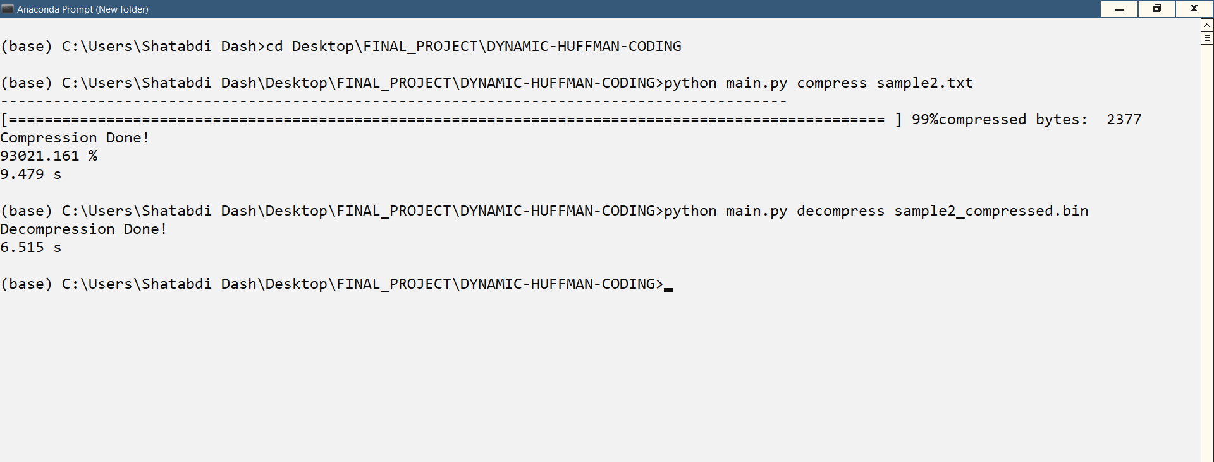
RUN PROCESS
201911430- Shubhashree Muni 201911481- Shatabdi Dash

Slide 13

AFTER COMPRESSION AND DECOMPRESSION
201911430- Shubhashree Muni 201911481- Shatabdi Dash

Slide 14
LZW CODING
Lempel-Ziv-Welch (LZW) coding is the foremost technique for general purpose data compression due to its simplicity and versatility.
It addresses spatial redundancies in an image.
It is an error free compression approach.
Prior knowledge of probability of occurrences of symbols to be encoded is not required.
As it's lossless, it produces files that are generally larger than other compressions.
LZW coding facilitates more compression ratio than Huffman algorithm.
201911430- Shubhashree Muni 201911481- Shatabdi Dash

Slide 15
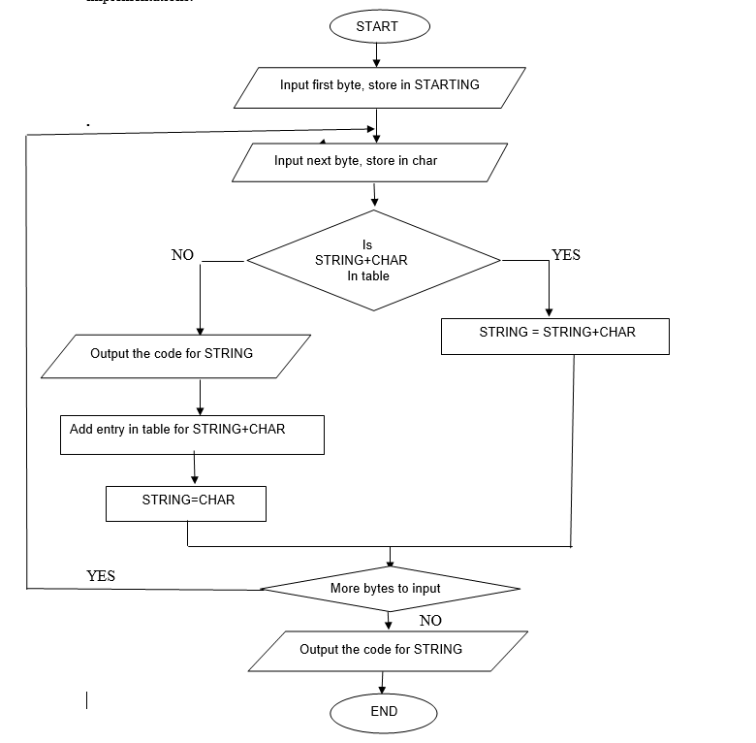
FLOW CHART
201911430- Shubhashree Muni 201911481- Shatabdi Dash

Slide 16

BEFORE COMPRESSION
201911430- Shubhashree Muni 201911481- Shatabdi Dash

Slide 17
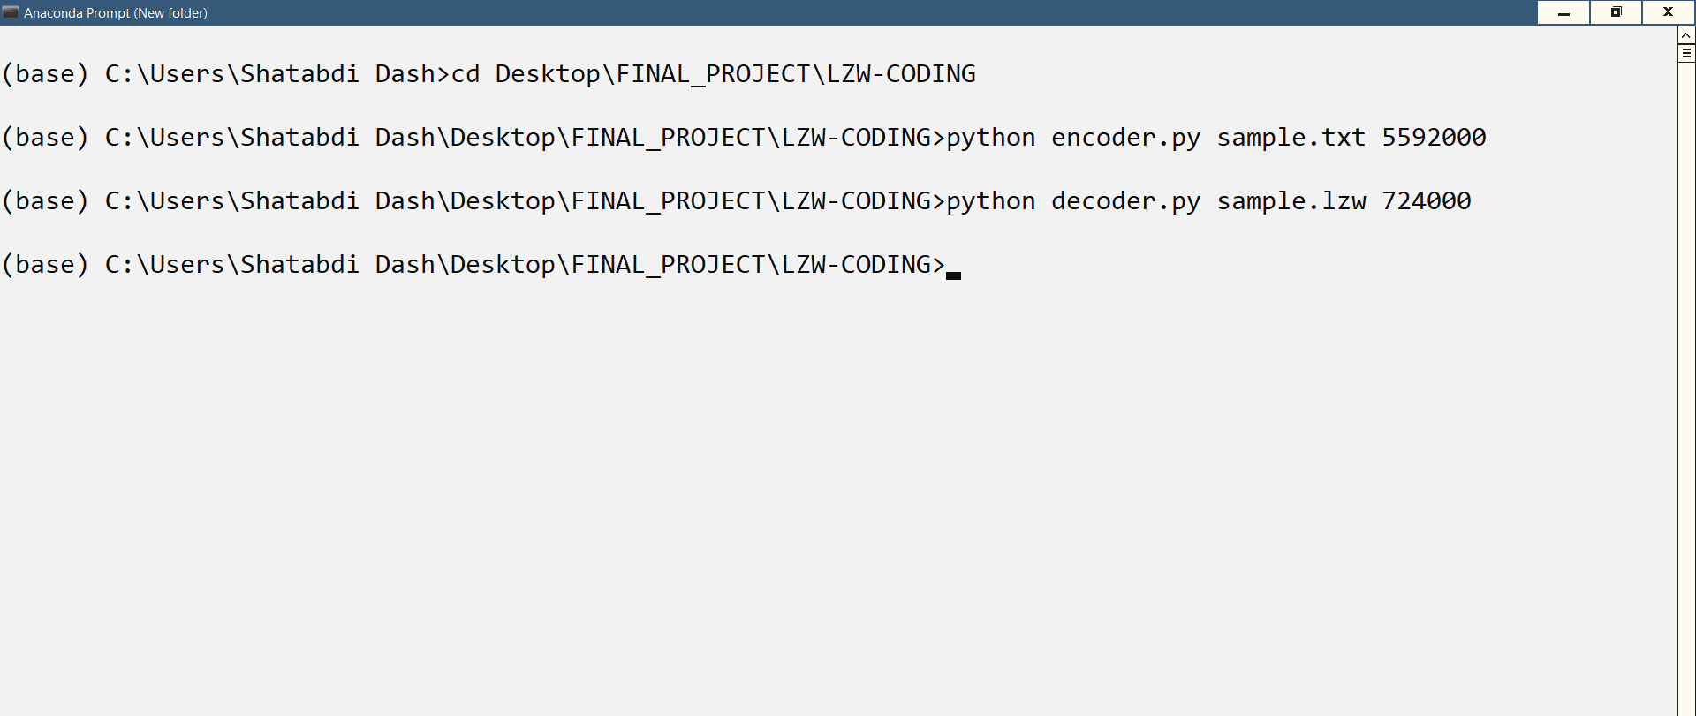
RUN PROCESS
201911430- Shubhashree Muni 201911481- Shatabdi Dash

Slide 18

AFTER COMPRESSION AND DECOMPRESSION
201911430- Shubhashree Muni 201911481- Shatabdi Dash

Slide 19
ARITHMETIC CODING
Arithmetic coding is superior in most respects to the better known Huffman method.
It represents information at least as compactly-sometimes considerably more so.
Its performance is optimal without the need for blocking of input data.
It encourages a clear separation between the model for representing data and the encoding of information with respect to the model.
It accommodates adaptive models easily and is computationally efficient.
Arithmetic coding surpasses the Huffman technique in its comparison ability.
In terms of complexity arithmetic coding is asymptotically better than Huffman coding.
201911430- Shubhashree Muni 201911481- Shatabdi Dash

Slide 20
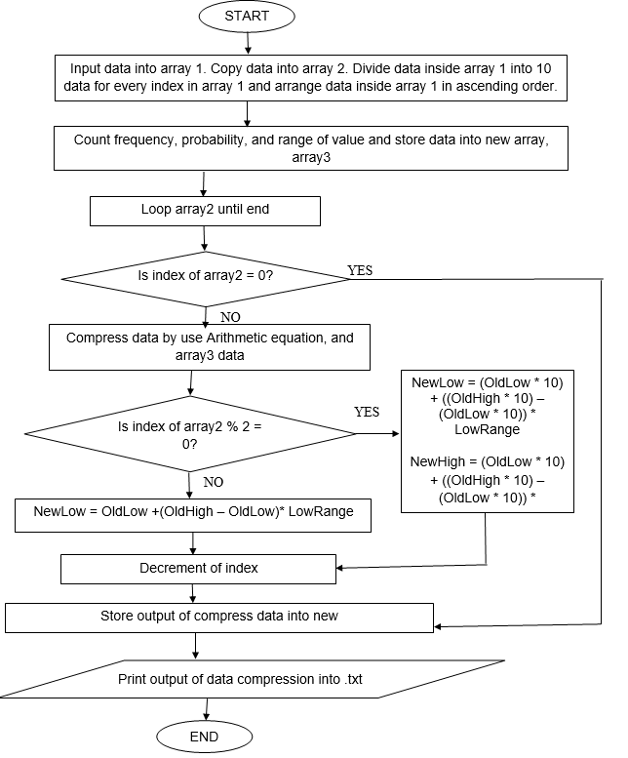
FLOW CHART
201911430- Shubhashree Muni 201911481- Shatabdi Dash

Slide 21

BEFORE COMPRESSION
201911430- Shubhashree Muni 201911481- Shatabdi Dash

Slide 22
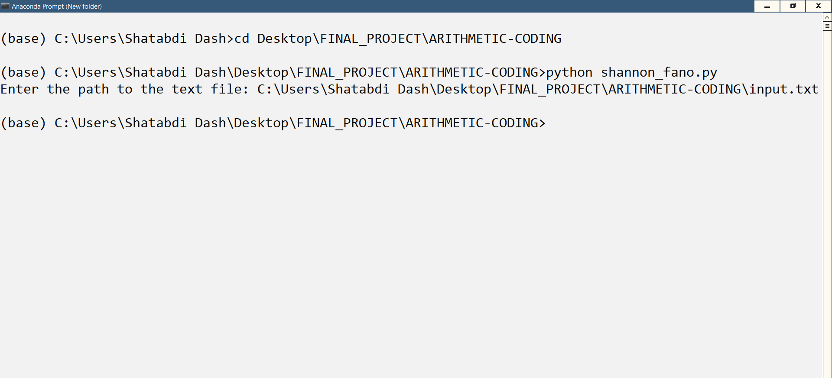
RUN PROCESS
201911430- Shubhashree Muni 201911481- Shatabdi Dash

Slide 23

AFTER COMPRESSION AND DECOMPRESSION
201911430- Shubhashree Muni 201911481- Shatabdi Dash

Slide 24
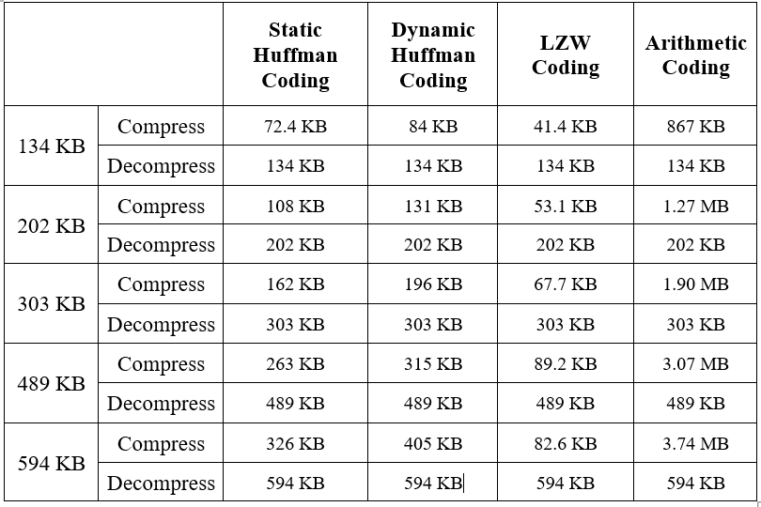
OUTPUT COMPARISON TABLE
201911430- Shubhashree Muni 201911481- Shatabdi Dash

Slide 25
CONCLUSION
The choice of compression algorithm depends on the specific requirements of the system and the characteristics of the input data.
The most commonly used algorithms for text file compression are Huffman coding and Lempel-Ziv-Welch (LZW) compression because of it’s lossless nature.
Huffman coding is particularly effective for text file compression.
LZW compression is especially good at compressing text files with repeating patterns of characters or words.
The most popular compression format, ZIP, uses both algorithms to achieve efficient text file compression.
201911430- Shubhashree Muni 201911481- Shatabdi Dash

Slide 26
REFERENCES
[1] M. R. Hasan, M. I. Ibrahimy, S. M. A. Motakabber, M. M. Ferdaus and M. N. H. Khan, “Comparative data compression techniques and multicompression results,” IOP Conference, 2013.
[2] C. Lamorahan, B. Pinontoan and N. Nainggolan, “ Data Compression Using Shannon-Fano Algorithm,” JdC, Vol. 2, No. 2, September, 2013, pp. 10-17.
[3] P. Yellamma and N. Challa, “Performance Analysis of Different Data Compression Techniques On Text File,” International Journal of Engineering Research & Technology (IJERT), Vol. 1 Issue 8, October – 2012.
[4] K. Sayood, “Introduction to Data Compression,” 4th ed., Elsevier, 2012.
201911430- Shubhashree Muni 201911481- Shatabdi Dash

Slide 27
Thank You
201911430- Shubhashree Muni 201911481- Shatabdi Dash

