Slide 1
Python Overview

Slide 2
Python is a high-level, interpreted, interactive and object-oriented scripting language. Python is designed to be highly readable. It uses English keywords frequently whereas other languages use punctuation, and it has fewer syntactical constructions than other languages.
Python is Interpreted − Python is processed at runtime by the interpreter. You do not need to compile your program before executing it. This is similar to PERL and PHP.
Python is Interactive − You can actually sit at a Python prompt and interact with the interpreter directly to write your programs.
Python is Object-Oriented − Python supports an Object-Oriented style or technique of programming that encapsulates code within objects.
Python is a Beginner's Language − Python is a great language for the beginner-level programmers and supports the development of a wide range of applications from simple text processing to WWW browsers to games.

Slide 3
History of Python
Python was developed by Guido van Rossum in the late eighties and early nineties at the National Research Institute for Mathematics and Computer Science in the Netherlands.
Python is derived from many other languages, including ABC, Modula-3, C, C++, Algol-68, Small Talk, and Unix shell, and other scripting languages.
Python is copyrighted. Like Perl, Python source code is now available under the GNU General Public License (GPL).
Python is now maintained by a core development team at the institute, although Guido van Rossum still holds a vital role in directing its progress.

Slide 4
Python Features
Python's features include −
Easy-to-learn − Python has few keywords, a simple structure, and a clearly defined syntax. This allows the student to pick up the language quickly.
Easy-to-read − Python code is more clearly defined and visible to the eyes.
Easy-to-maintain − Python's source code is fairly easy-to-maintain.
A broad standard library − Python's bulk of the library is very portable and cross-platform compatible on UNIX, Windows, and Macintosh.
Interactive Mode − Python supports an interactive mode that allows interactive testing and debugging of snippets of code.
.
Portable − Python can run on a wide variety of hardware platforms and has the same interface on all platforms

Slide 5
Extendable − You can add low-level modules to the Python interpreter. These modules enable programmers to add to or customize their tools to be more efficient.
Databases − Python provides interfaces to all major commercial databases.
GUI Programming − Python supports GUI applications that can be created and ported to many system calls, libraries, and windows systems, such as Windows MFC, Macintosh, and the X Window system of Unix.
Scalable − Python provides a better structure and support for large programs than shell scripting.

Slide 6
Apart from the above-mentioned features, Python has a big list of good features, few are listed below −
It supports functional and structured programming methods as well as OOP.
It can be used as a scripting language or can be compiled to byte-code for building large applications.
It provides very high-level dynamic data types and supports dynamic type checking.
It supports automatic garbage collection.
It can be easily integrated with C, C++, COM, ActiveX, CORBA, and Java.

Slide 7
In Python, code block refers to a collection of code that is in the same block or indent. This is most commonly found in classes, functions, and loops.
You can where code blocks are because they are
on the same indent and
are uninterrupted by other lines of code not on the same indent.

Slide 8
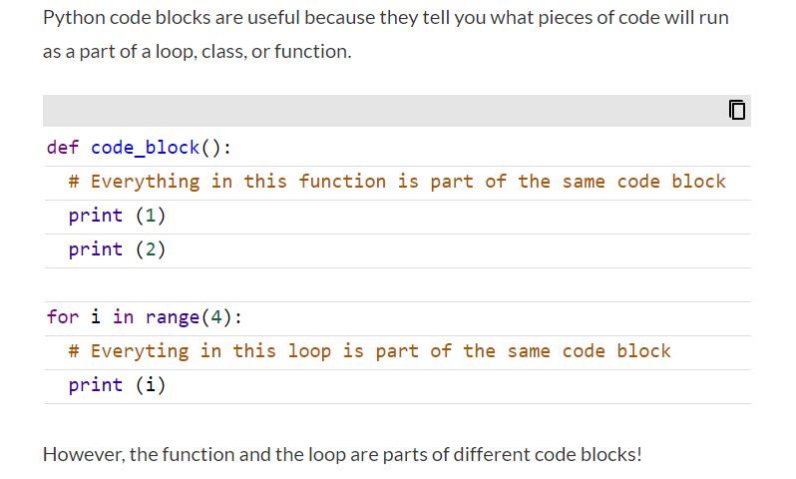

Slide 9
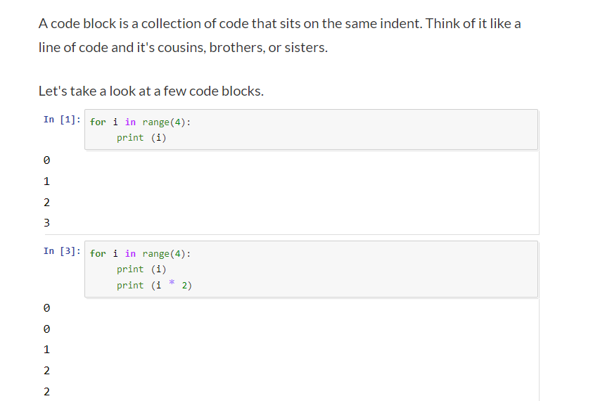

Slide 10
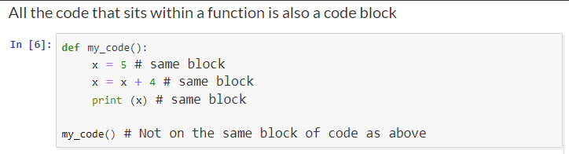

Slide 11
Libraries in Python

Slide 12
Normally, a library is a collection of books or is a room or place where many books are stored to be used later. Similarly, in the programming world, a library is a collection of precompiled codes that can be used later on in a program for some specific well-defined operations. Other than pre-compiled codes, a library may contain documentation, configuration data, message templates, classes, and values, etc.
A Python library is a collection of related modules. It contains bundles of code that can be used repeatedly in different programs. It makes Python Programming simpler and convenient for the programmer. As we don’t need to write the same code again and again for different programs. Python libraries play a very vital role in fields of Machine Learning, Data Science, Data Visualization, etc.

Slide 13
Working of Python Library
As is stated above, a Python library is simply a collection of codes or modules of codes that we can use in a program for specific operations. We use libraries so that we don’t need to write the code again in our program that is already available. But how it works. Actually, in the MS Windows environment, the library files have a DLL extension (Dynamic Load Libraries). When we link a library with our program and run that program, the linker automatically searches for that library. It extracts the functionalities of that library and interprets the program accordingly. That’s how we use the methods of a library in our program. We will see further, how we bring in the libraries in our Python programs.

Slide 14
Python standard library
The Python Standard Library contains the exact syntax, semantics, and tokens of Python. It contains built-in modules that provide access to basic system functionality like I/O and some other core modules. Most of the Python Libraries are written in the C programming language. The Python standard library consists of more than 200 core modules. All these work together to make Python a high-level programming language. Python Standard Library plays a very important role. Without it, the programmers can’t have access to the functionalities of Python. But other than this, there are several other libraries in Python that make a programmer’s life easier. Let’s have a look at some of the commonly used libraries:

Slide 15
Matplotlib
Pandas
NumPy
TensorFlow
SciPy
Scrapy
Etc….

