Slide 1
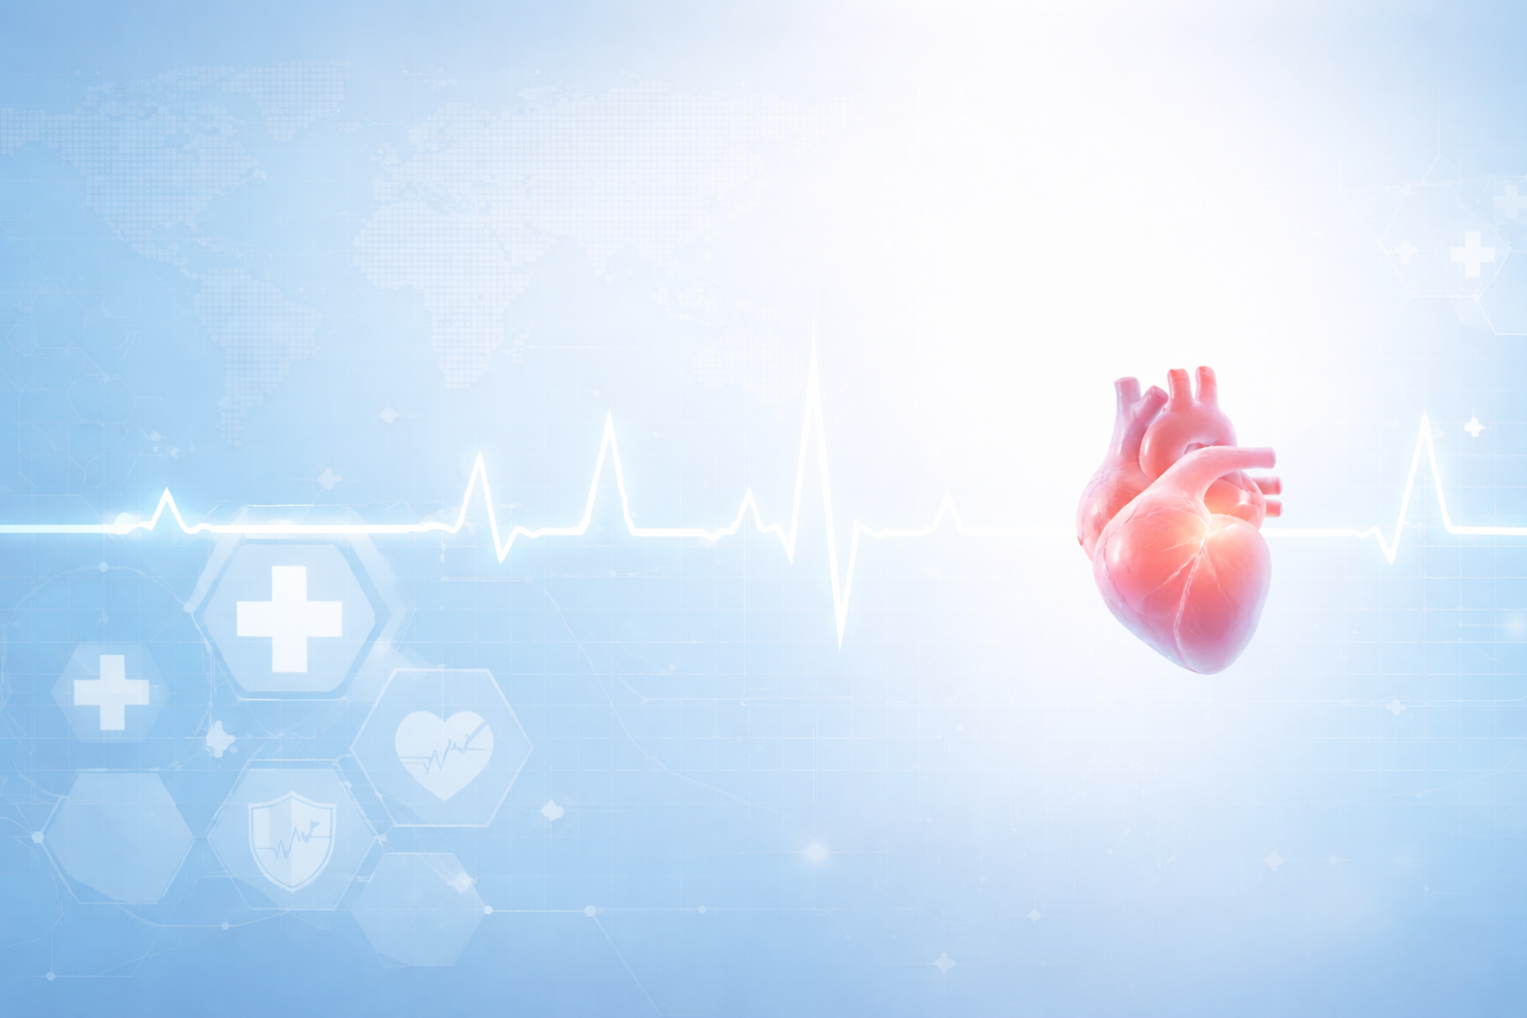
Heart Disease Prediction System using Machine Learning
Name: Shatadru Ghosh
Institute: NIT Durgapur
Department: Electrical Engineering
Year of Study: 1st year B.Tech UG

Slide 2

Introduction
Heart disease is a major cause of death worldwide.
Early diagnosis is very crucial for treatment and cure.
Diagnostic tests are often expensive and time consuming.
This ML based model helps in predicting if a person has heart disease or not based on some physical parameters of the person.
It can be very helpful for medical practitioners to detect heart disease in patients by just entering some values as input to this model.
This model makes detection of heart diseases very cost effective and fast.
Faster diagnosis ensures early beginning of treatment and faster recovery.

Slide 3
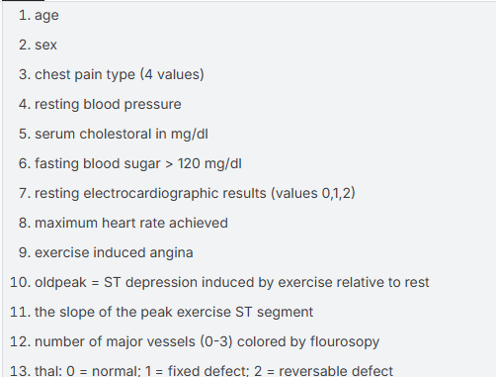
Dataset Description
Source: Kaggle https://www.kaggle.com/datasets/johnsmith88/heart-disease-dataset
Contains information of 1025 patients
Contains 14 attributes storing various parameters of patient’s health
“Target” attribute is integer valued [0=no disease; 1=disease]
The other 13 attributes are shown.

Slide 4
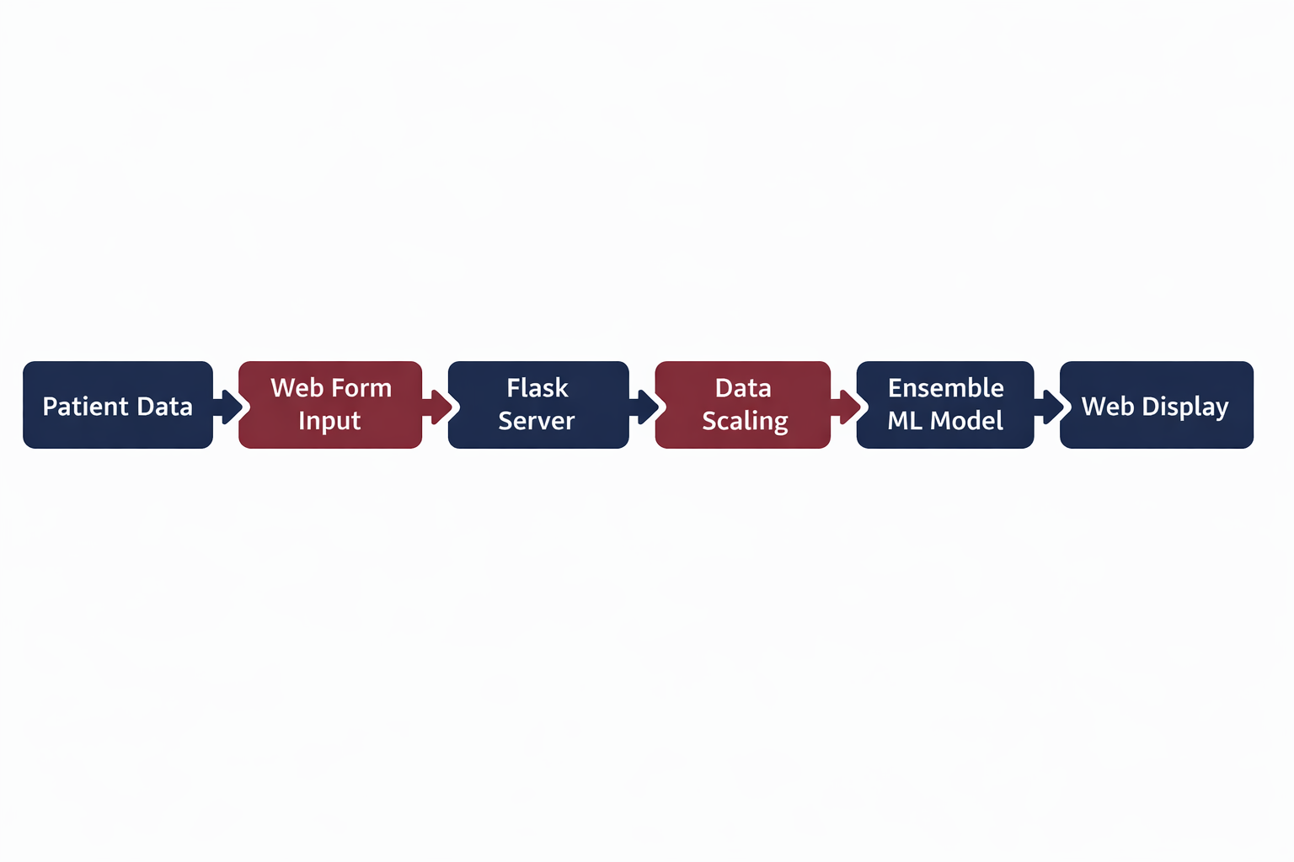
Flow of Data through the System

Slide 5
User Interface (Frontend)
Developed using HTML and CSS
Allows the doctor or user to input details of the patient like age, cholesterol, blood pressure, ECG result, maximum heart rate, etc.
Sends the input via POST request to Flask server
Also returns the final output of prediction

Slide 6
Flask Web Server
Acts as the middleware
Receives user input
Handles routing and response generation
Calls ML pipeline for prediction

Slide 7
Data Preprocessing Module
Uses StandardScaler from Scikit-Learn library of Python
It ensures
  Feature normalization
  Compatibility with trained ML models
Prevents bias due to scale differences

Slide 8
Machine Learning Ensemble method
Models used:
Technique:
From scikit-learn:
  Logistic Regression (linear model)
  Ensemble models:
    RandomForest Classifier
    XGBoost Classifier
XGBoost Classifier from XGboost
Soft voting ensemble
Combines probability outputs from all models
Improves:
  Accuracy
  Robustness
  Generalization

Slide 9
Prediction Module & Result Display
Final output:
  1 – Heart Disease Detected
  0 – No Heart Disease
Converts numerical output to human-readable medical result
Prediction rendered dynamically on web page
Clear visual feedback for users
Fast interface (<1 second)

Slide 10
Technologies Used
Layer | Technology
Frontend | HTML, CSS
Backend | Flask (Python)
ML Models | Scikit-Learn, XGBoost
Data Handling | Pandas, NumPy
Deployment | Localhost (Development Server)
Data transfer between ML model and Flask | Joblib
Generating accuracy score, classification report & confusion matrix | Scikit-Learn
Plotting confusion matrix | Matplotlib, Seaborn

Slide 11
Steps to run the project
Open the project directory in VS Code and check if it has the following
  A dataset named “heart.csv”
  A python file named “ml_model.py” (this code fetches data from the dataset, trains the ML model and dumps the data in 2 files named as “model.pkl” and “scaler.pkl”)
  A python file named “web_app.py” (this code fetches data from the 2 .pkl files and connects with Flask server
  A folder named “templates” containing a file named “index.html” (the html code creates the web page)
  A folder named “static” containing:
    a file named “style.css” (this code adds details to the web page)
    An image file named “heart_bg.jpeg”
Create a virtual environment with Python 3.14.2 as the interpreter and activate it.
Install required libraries in the virtual environment by running this command in the terminal of VS Code: “pip install numpy pandas matplotlib scikit-learn xgboost flask joblib seaborn”
Run the “ml_model.py” and “web_app.py” files one by one in the virtual environment using commands: “python –m ml_model” and “python –m web_app” respectively.
Open the web page by going to the displayed URL.
Enter all details in the form of the web page and click on “GET PREDICTION” button to view the prediction.

Slide 12
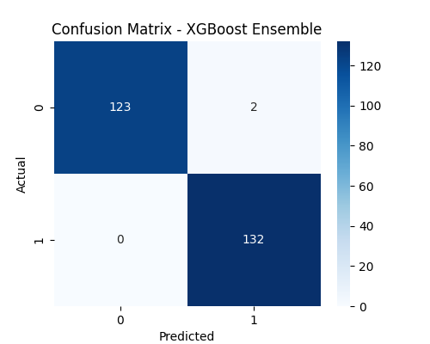
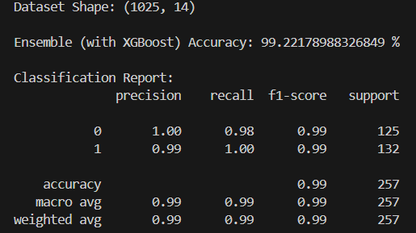
Some Statistics of the Project
Accuracy Score & Classification Report
Confusion Matrix

Slide 13
Thank You

