Slide 1


Slide 2

Executive Summary
- Objective: Build a predictive model to flag high-risk loan applicants before approval.
- Dataset analyzed: 5,960 records with 12 features.
- Defaulters: ~20% of applicants.
- Best Model: Random Forest (RandomizedSearchCV)
- Accuracy: 91.05%
- F1-score (Class 1): 0.77
- Recommendation: Deploy this model in production to reduce risk exposure.

Slide 3
Business Problem and Goals
- Problem: Loan defaulters increase financial risk.
- Goal: Use ML to predict default risk using applicant data.
- Benefits:
- Reduce NPAs
- Data-driven credit decisions
- Accelerate loan processing

Slide 4
Dataset Summary
- 5,960 loan applicants
- Target variable: BAD (1 = default)
- Numerical features: LOAN, MORTDUE, VALUE, DEBTINC
- Categorical: REASON, JOB
- Class imbalance handled using stratified sampling and class weights.

Slide 5
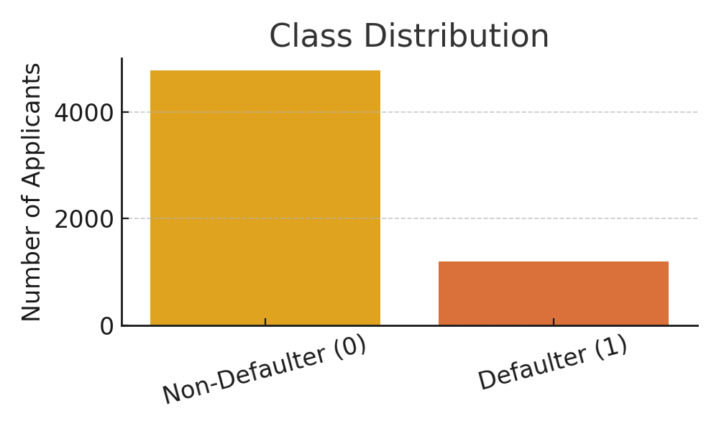
Class Distribution
- Around 20% of applicants are defaulters.
- Class imbalance addressed in training pipeline.

Slide 6
Key EDA Insights
- Defaulters tend to:
- Have smaller loans
- Have higher debt-to-income ratio
- Work fewer years in current job (YOJ)
- Debt Consolidation is most common reason for loan
- Home Improvement loans have higher default rate.

Slide 7
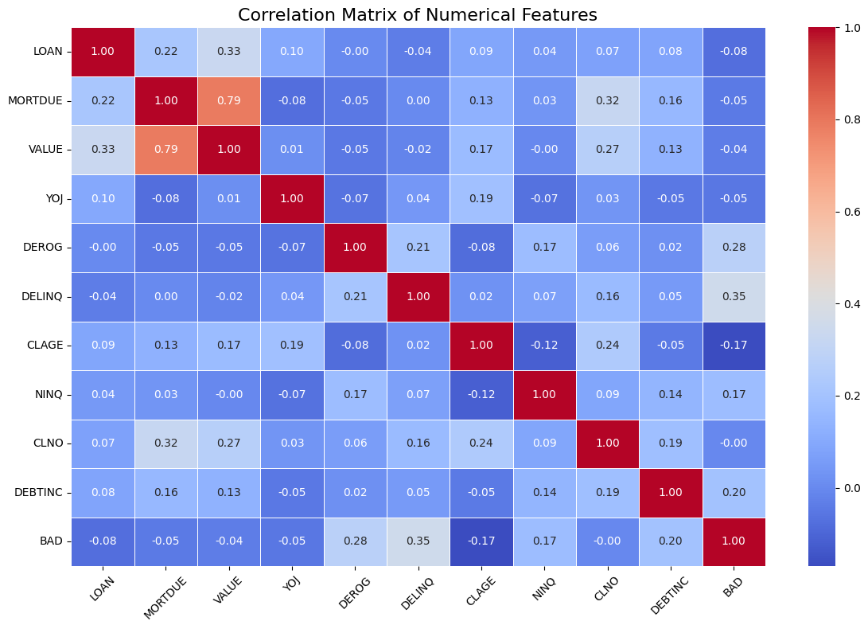
Correlation Heatmap
- BAD has weak correlation with most features.
- VALUE and MORTDUE show high correlation (0.79).

Slide 8
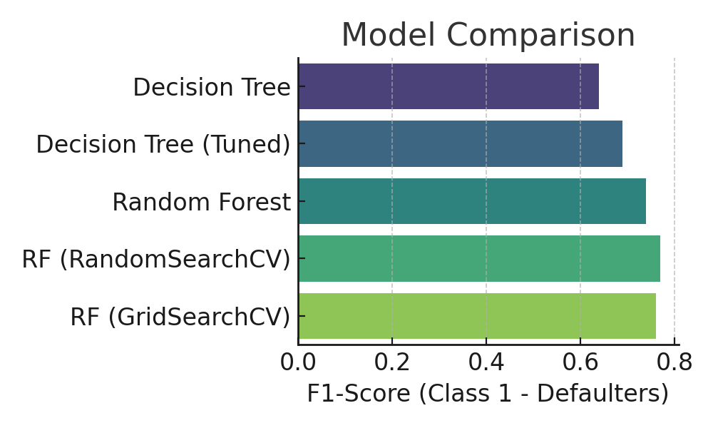
Model Comparison (F1 Score)
- Random Forest with RandomizedSearchCV had best F1 score (0.77).

Slide 9
Final Model Proposal
- Model: Random Forest with RandomizedSearchCV
- Parameters:
- n_estimators=100, criterion='entropy'
- max_depth=None, min_samples_leaf=2
- Chosen for:
- Best accuracy and F1-score
- Robustness and interpretability
- Handles imbalance and non-linearity well

Slide 10
Implementation Recommendations
- Deploy model via secure REST API
- Integrate with credit approval system
- Retrain every 6 months or 10,000+ records
- Monitor recall, precision, FPR

Slide 11
Risks, Benefits & Next Steps
- Benefits:
- Reduced losses, faster decisions, higher fairness
- Risks:
- False positives, data drift
- Next Steps:
- Pilot deployment (10% of loans)
- Include external credit data
- Try boosting models (XGBoost, LightGBM)

