Slide 1
Blockchain Analytics
Name
Department Course Number Section Time Location
DATE
With our persona of a BlockChain Analyst, my objective was to understand POPCAT trends to give trading advice for the meme coin
Which memecoin? POPCAT, a meme coin on the Solana blockchain, has captured significant attention in the cryptocurrency market. POPCAT has grown from a simple joke to a community-driven project with substantial market presence.
Why POPCAT? We've chosen to analyze POPCAT due to its unique characteristics: Rapid growth: POPCAT saw over 5,000% price growth in early 2024. Community ownership: The project is 100% community-owned and immutable. Solana-based: Leverages Solana's fast and low-cost transactions. Meme culture impact: Demonstrates the power of internet culture in cryptocurrency markets
93.1% of POPCAT tokens were allocated to the liquidity pool and subsequently burned, with the contract renounced, ensuring decentralization
Some Facts

Slide 2
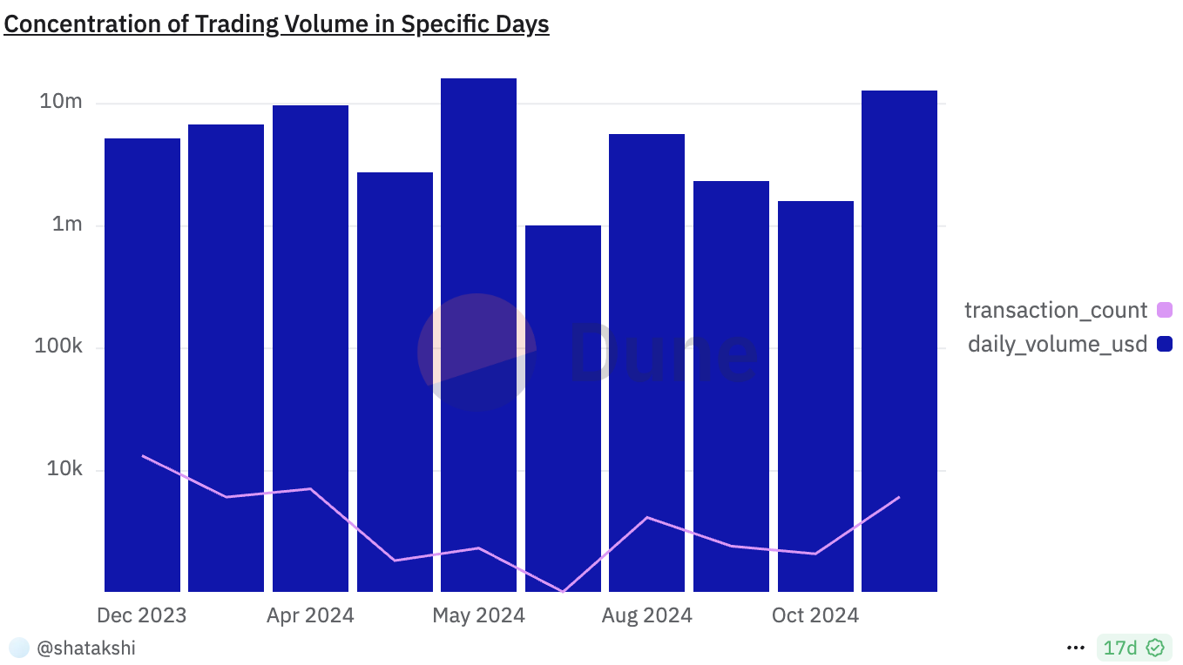
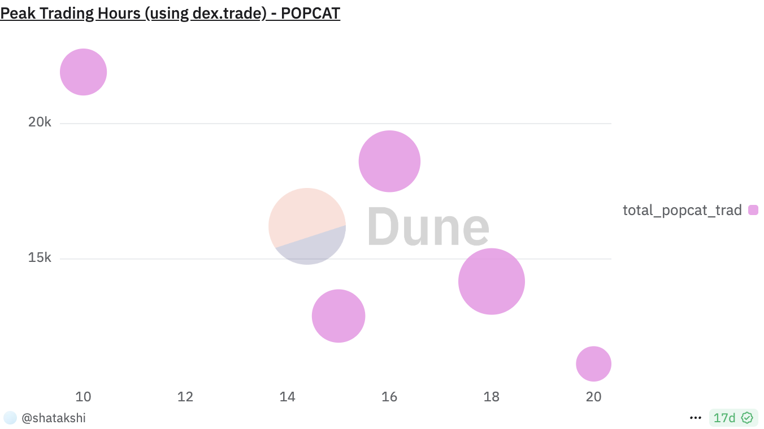
Project 2
Name
Department Course Number Section Time Location
DATE
Are the same people using POPCAT, or is it just occasional traders?
High trading volume on specific days suggests whale activity rather than consistent user engagement.
Trading behavior indicates potential pump-and-dump patterns on high-volume days
When do they trade?
Peak trading occurs at 10:00 UTC (highest trades) and 18:00 UTC (highest volume), aligning with global market overlaps.
Strategic timing during peak hours can maximize liquidity and minimize slippage.

Slide 3
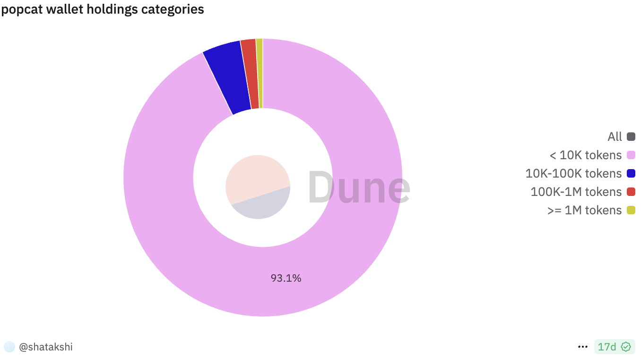
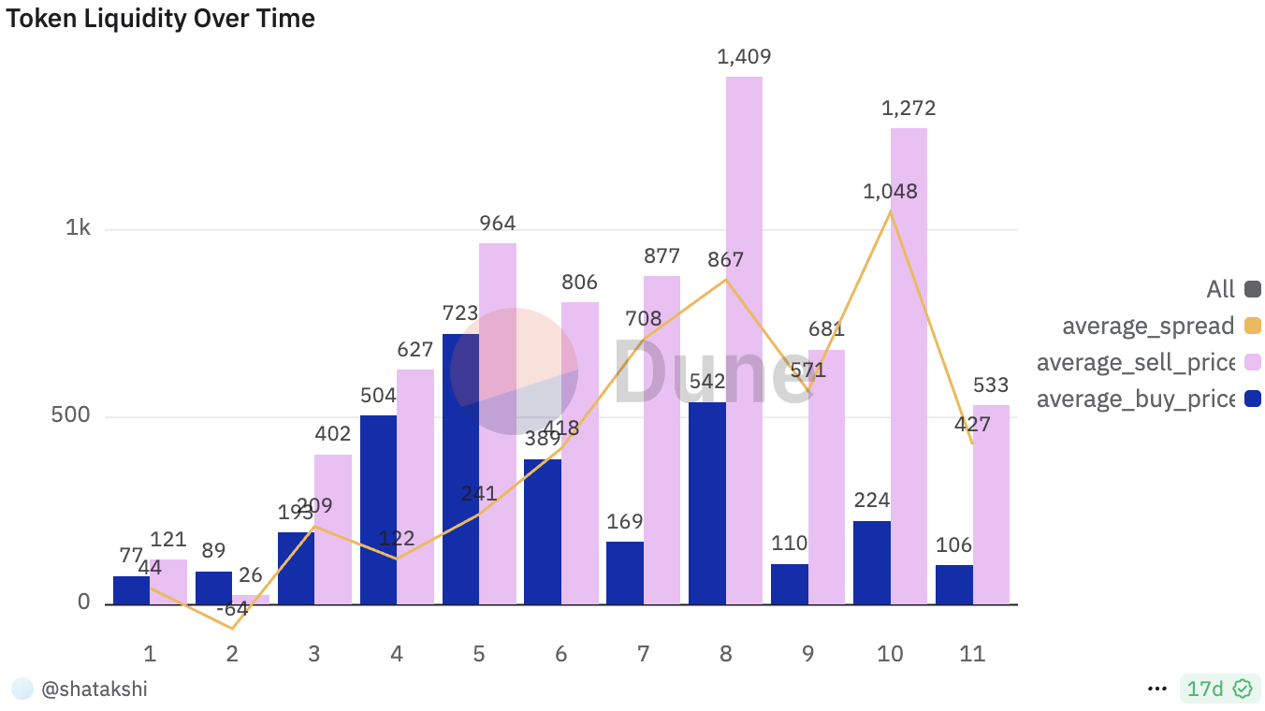
Project 2
Name
Department Course Number Section Time Location
DATE
Who holds the most of POPCAT tokens?
Most wallets (93.3%) hold fewer than 10K tokens, showing decentralization and community-driven ownership.
Only 1,673 wallets hold 1M+ tokens, reducing whale manipulation and ensuring price stability.
Is POPCAT good for long-term investment or short-term trading?
POPCAT’s mid-year peaks highlight its speculative nature, driven by short-term hype cycles. Long-term sustainability depends on consistent trading volume and strong community support

Slide 4
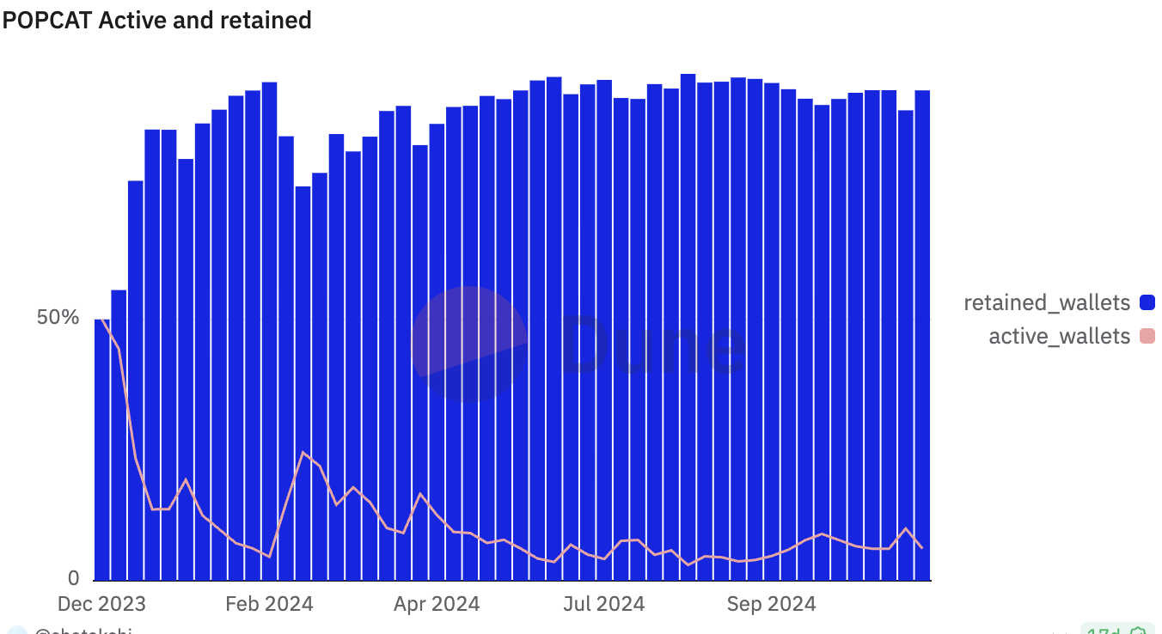
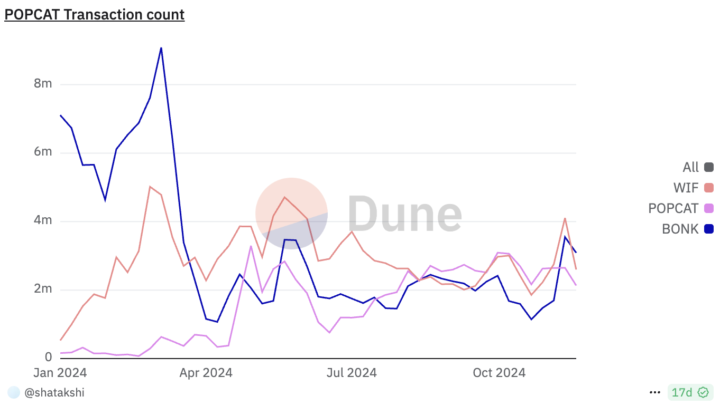
Project 2
Name
Department Course Number Section Time Location
DATE
Are people sticking with POPCAT after they start using it??
Retained wallets grew from 14,413 to 68,978 in January 2024, reflecting strong user retention.
Active wallets remained stable at 4-5%, surpassing industry standards and showing consistent engagement
How does POPCAT compare to other meme coins like BONK and WIF?
BONK outperforms POPCAT in transaction counts and volume, but POPCAT shows occasional spikes (e.g., 157T in June 2024), more community engagement can help better POPCAT’s performance

Slide 5
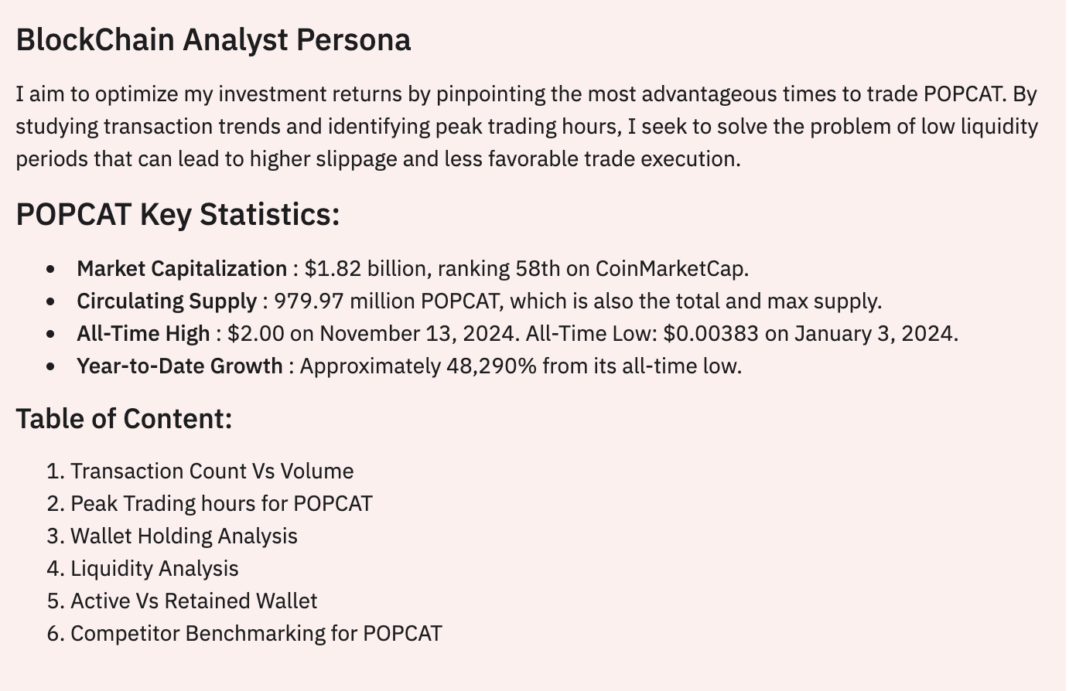
Learning Outcome
Name
Department Course Number Section Time Location
DATE
Outline
Key Skills Developed:
Writing and optimizing blockchain queries.
Analyzing metrics using Dune Analytics
Understanding token economics and user behavior on Solana.

Slide 6
Name
Department Course Number Section Time Location
DATE
Thank You

