Slide 1
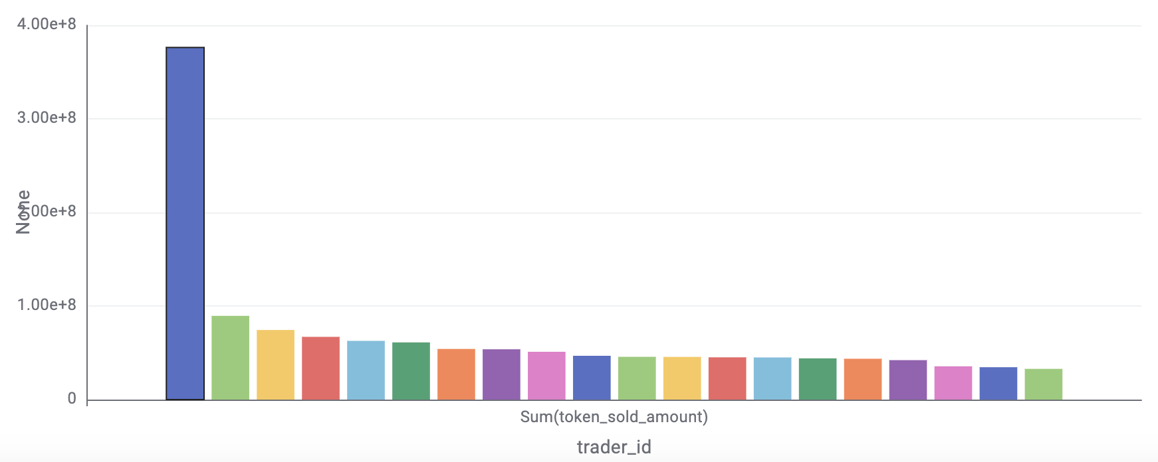
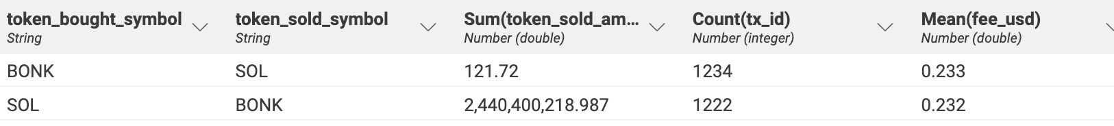
BONK Analytics
Name
Department Course Number Section Time Location
DATE
How can we analyze and optimize trading behavior in the BONK-SOL token ecosystem to enhance market liquidity, improve user engagement, and identify key trends for strategic decision-making
Who are the most significant players in the BONK?
It is decentralized but few top traders contributing significantly to transaction volumes. One trader dominated with a majority chunk of the total volume, indicating some influence in BONK
What is the balance of trade between BONK and SOL tokens for 28 nov
SOL purchases dominated over BONK, with over 2.4 billion SOL tokens traded compared to just 121.72 BONK tokens. This indicates stronger demand for SOL in transactions, possibly due to its broader utility or market stability compared to BONK

Slide 2
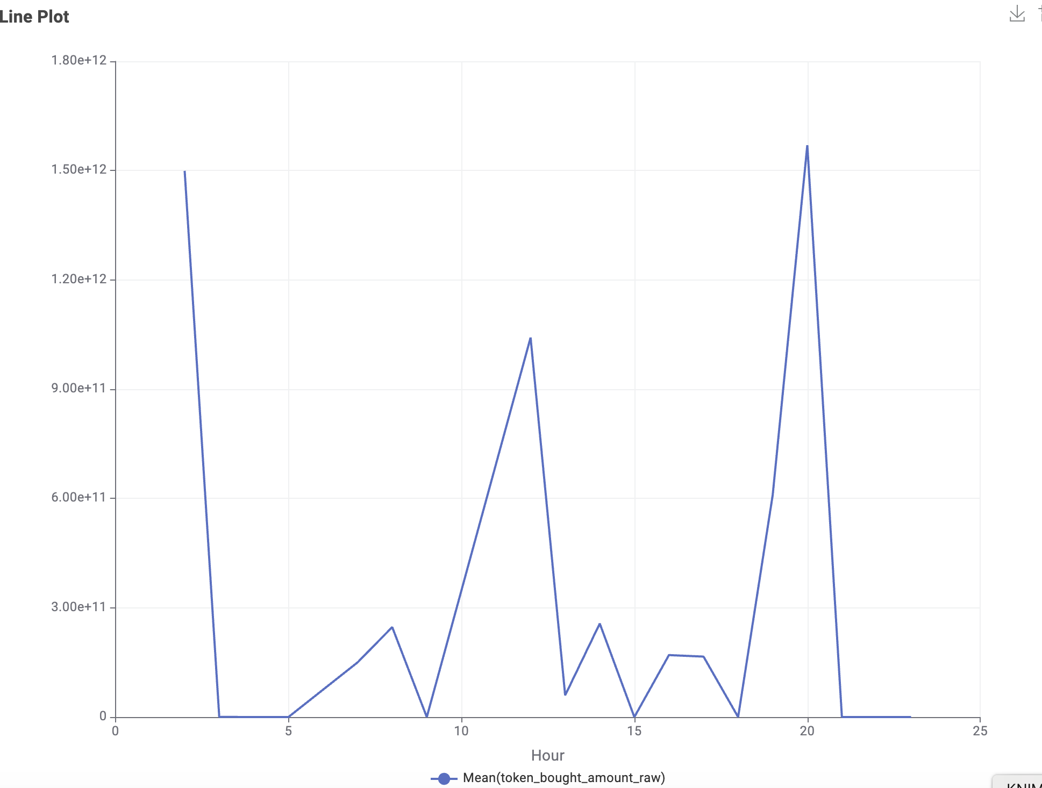
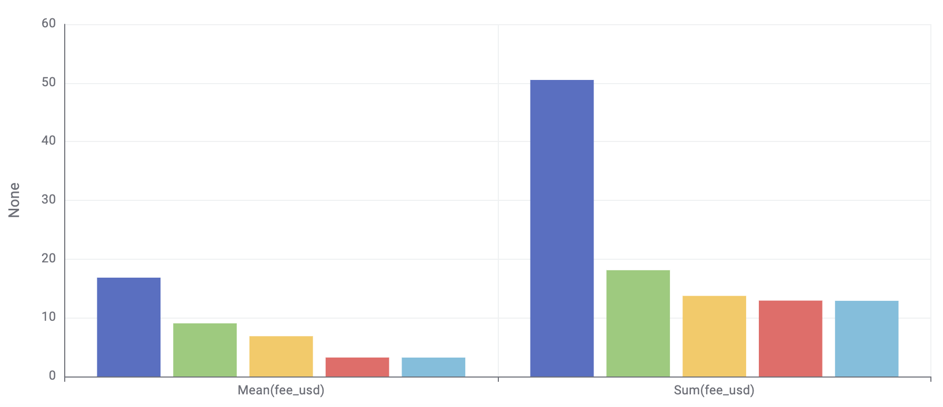
Project 3: BONK
Name
Department Course Number Section Time Location
DATE
When are users most active in trading tokens?
Two significant activity peaks—10:00 UTC (22,320 trades) and 18:00 UTC, coinciding with global market overlaps in Europe, Asia, and North America.
Timing token releases or promotions during these hours could maximize engagement and trading volume
What are the average fees traders for top traders?
We calculated that transaction fees for Top 5 Traders (basis of cumulative fees), the avg remains consistent at around $3.23 even when we sorted by descending order of total fees paid by a trader. Maximum a trader has paid in total is 15$
The low fees encourage frequent trading, contributing to higher transaction counts and user retention

Slide 3
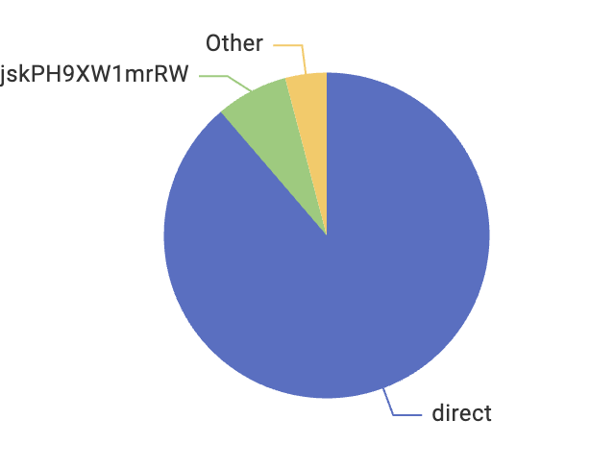
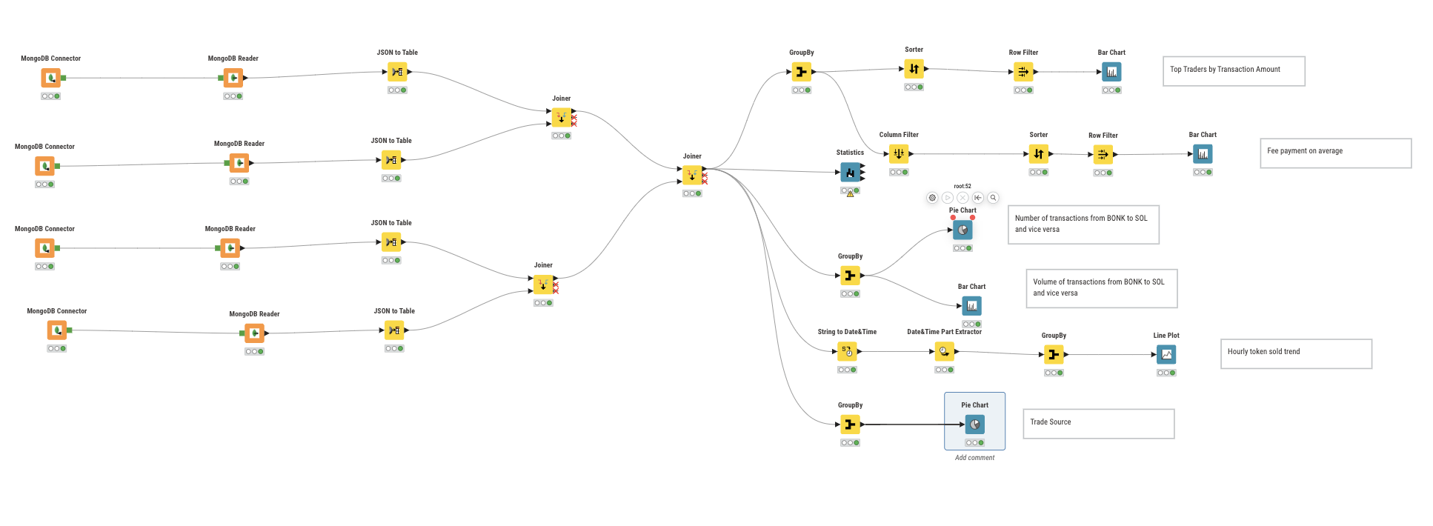
Project 3: BONK
Name
Department Course Number Section Time Location
DATE
What are the primary sources driving token trades?
Most trades were "direct," with minimal activity from other sources. This centralized trade behavior underscores the platform's reliance on direct transactions.
Enhancing partnerships or integrations with external trading platforms could diversify trade sources and increase activity.

Slide 4
Learning Outcome
Name
Department Course Number Section Time Location
DATE
Outline
Through this workflow, we uncovered critical patterns in the BONK-SOL transaction ecosystem.
From identifying key players and peak trading hours to understanding user retention and trade direction, each insight guides strategic decisions for market participation and token promotion
Key Skills Developed:
Connecting Knime with MongoDB (Extraction)
Workflow automation in Knime (Transformation)
Cleaning and preparing data for analysis.
Adding joined data to MongoDB (Loading)

Slide 5
Name
Department Course Number Section Time Location
DATE
Thank You

