Slide 1
Enterprise Database Management
Projects Reflection
Name
Department Course Number Section Time Location
DATE
To summarize our work, showcase learnings, and provide insights that align with real-world applications
Team 13:
Shatakshi Bhatnagar, Robin Luke
Edward Kang, Anish Saha

Slide 2
Name
Department Course Number Section Time Location
DATE
Project 1
Project 2
Project 3

Slide 3
Project 1
Name
Department Course Number Section Time Location
DATE
To determine the best restaurant category and location based on Yelp data.
Where to Open:
Location Hotspots: Analyzed check-ins to identify areas with the highest footfall in Philadelphia. Locations like 51 N 12th St showed high traffic, while streets like 3401 Walnut St had moderate footfall and lower competition
What to Open:
Evaluated restaurant categories to identify top choices like Pizza, Mexican, and Italian cuisine, with Pizza dominating customer preferences.
Mexican or Italian restaurants are less competitive alternatives with strong customer demand.
Insights

Slide 4
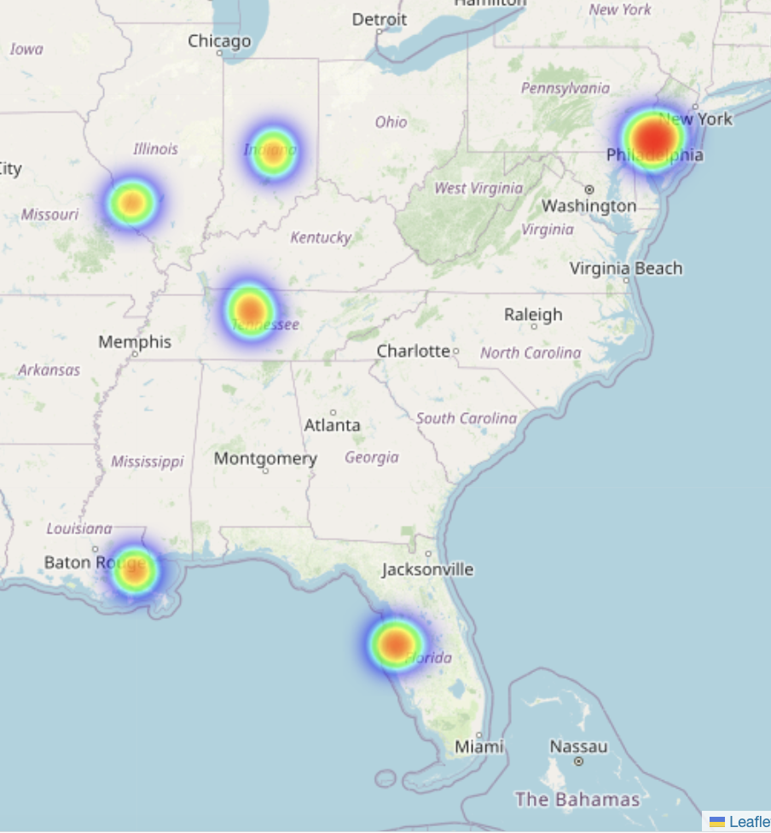
Project 1
Name
Department Course Number Section Time Location
DATE
When to Open:
Seasonality: Identified that fall season had the highest review volumes, aligning with peak customer activity. Helpful to understand for promotions.
What Price Range:
Found that restaurants in Price Range 3 $$$ (moderate premium) had higher average ratings and faced less competition compared to the most expensive options
What additional characteristics are customer looking for:
Observed that restaurants with outdoor seating consistently had higher average ratings

Slide 5
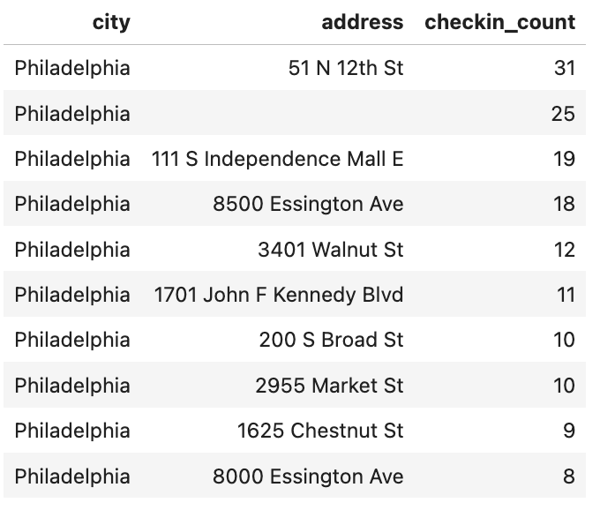
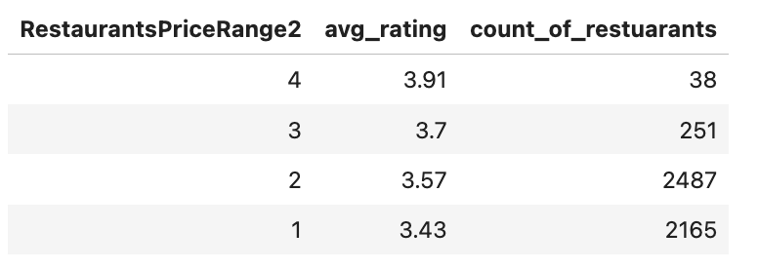
Learning Outcome
Name
Department Course Number Section Time Location
DATE
Outline
Key Skills Developed:
Writing efficient SQL queries to extract meaningful insights.
Using Azure for scalable cloud-based data processing.
Deriving actionable business insights from large datasets.

Slide 6
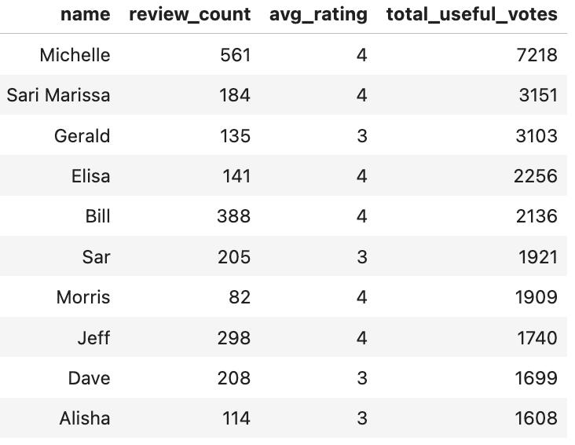
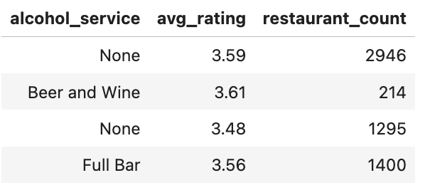
Additional Methods
Name
Department Course Number Section Time Location
DATE

