Slide 1

T5
Online Data Science Bootcamps
For SADAIA Academy
HOUSE PRICE
PREDICCTION
USING
LINEAR REGRESSION
By :
Shatha Alharbi

Slide 2

Motivation :

Slide 3
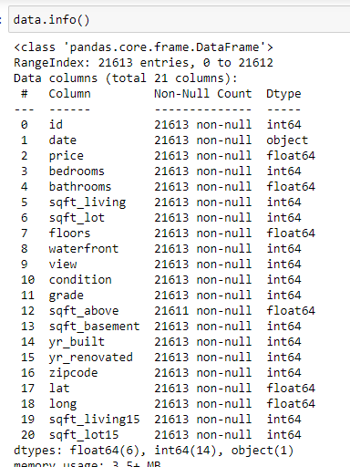
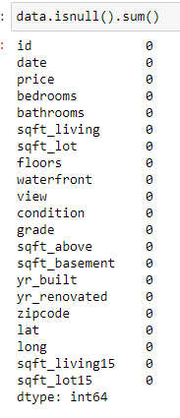


Data cleaning :
Kaggle does its best to provide users with clean data. However we must be careful.
So I used .info() and .isnall() to check null values .

Slide 4
Exploratory Data Analysis (EDA) :
This is where the data visualization often begins .
- The purpose of EDA in machine learning is to explore the quality of our data.
- For data visualization I used Seaborn and matplotilp libraries .

Slide 5
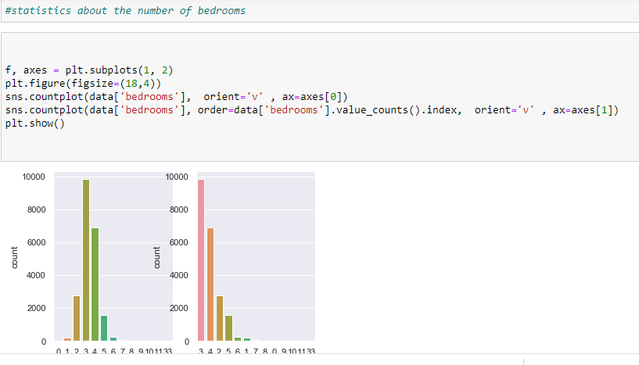

Slide 6
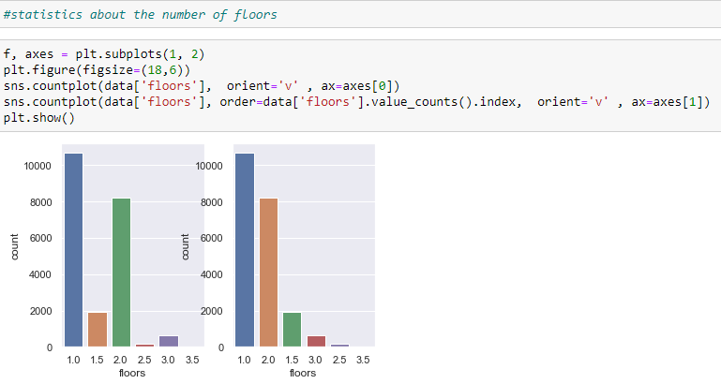

Slide 7
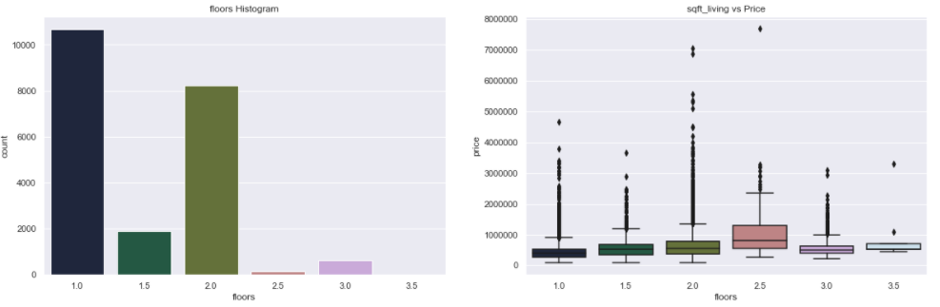
Using count plot and boxplot functions

Slide 8
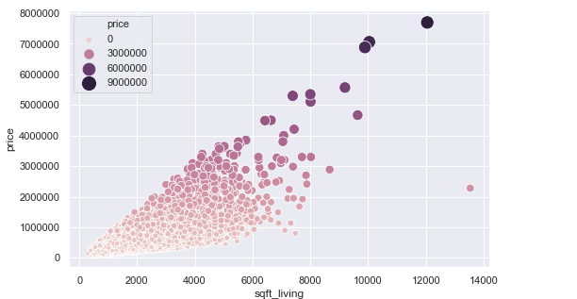
Using scatterplot function

Slide 9
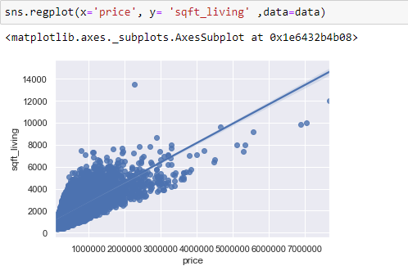
Using regplot function

Slide 10
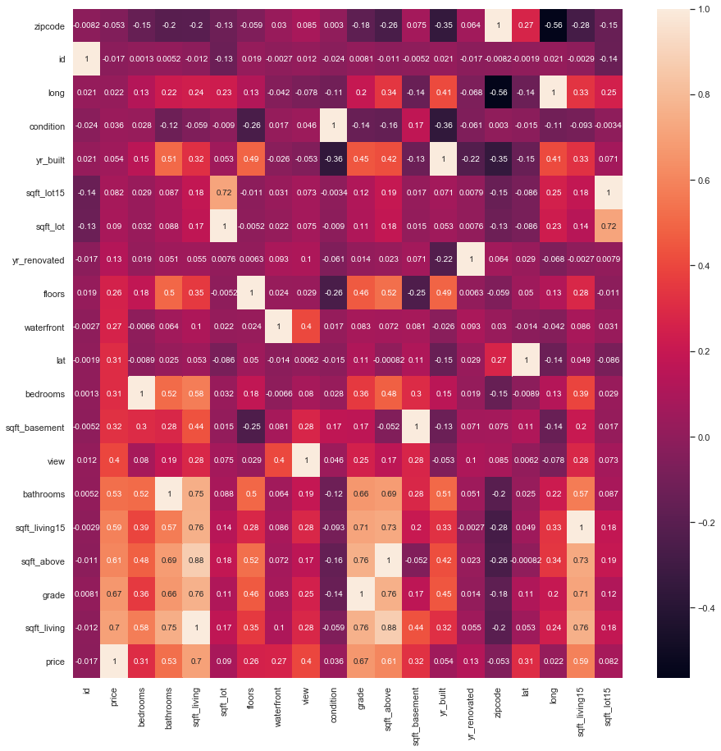

Slide 11

- After all data visualization steps , I choose the final features and the target .
-In features: (id) and (date) were dropped while the price is choose as the target .

Slide 12
Model Selection :
I approached this problem with supervised machine learning (Linear Regression ), We know it's a regression task because we are being asked to predict a numerical outcome (Price).
Train and Test Data :
- I split the data into train and test data , 33% of the data represent the test data while 67% represent the training data .

Slide 13
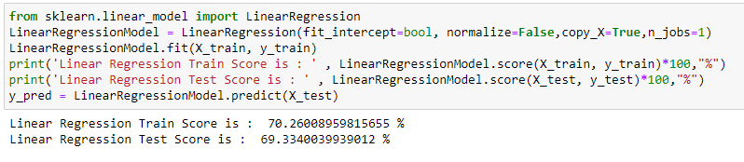
The Result after Applying Model :

Slide 14
Challenges :
No previous experience in Data Science .
Future work :
Try another regression model and compare the accuracy .
Keep going to learn more about Data Science and improve my skills in this field .

Slide 15
Thank you

