Slide 1
Capturing CO₂ Directly from Air:
Bimetal-Engineered MOFs with Moisture-Responsive Regeneration
FROM AMBIENT AIR TO CO₂ CAPTURE
Ambient Air
Low CO₂ concentration, with water vapor
CO₂
The target molecule
Raghad AlSawilam
Fahadh Mohammad
Porous MOF
Metal nodes joined by organic linkers
Supervisor: Dr. Lana Alghamdi
CO₂ Capture
Advanced Materials Technologies Institute
King Abdulaziz City for Science and Technology (KACST)
CO₂ held within the pores
Notes:
(~30 s) Good morning/afternoon. I am Raghad AlSawilam from the Advanced Materials Technologies Institute at KACST, supervised by Dr. Lana Alghamdi. Today I will present our study on bimetal-engineered metal–organic frameworks for capturing CO₂ directly from air, with moisture-responsive regeneration.

Slide 2
Bimetal-Engineered MOF for Direct Air CO₂ Capture
Research background, research gap and objective
1
What is a MOF?
2
Why is direct air capture hard?
3
Why does humidity matter?
metal node
MOF pore
organic linker
?
pore with CO₂
H₂O
CO₂
Porous crystalline solids of metal nodes joined by organic linkers; tunable pores and chemistry make them candidates for CO₂ capture.
CO₂ (dilute)
H₂O vapor
other gases
Water vapor may compete with CO₂ for adsorption sites or alter CO₂ binding.
Direction of effect is not assumed.
Atmospheric CO₂ is dilute (~420 ppm), so it must be captured at very low partial pressure, alongside ever-present water vapor.
RESEARCH GAP
CENTRAL RESEARCH QUESTION
The influence of humidity on CO₂ adsorption and regeneration in the developed bimetal-engineered MOF remains to be investigated.
How does humidity influence CO₂ adsorption and regeneration behavior in a bimetal-engineered MOF?
Objective: To characterize and compare the 12 synthesized samples, select the best-characterized candidate, and investigate how humidity may influence CO₂ adsorption and regeneration.
Notes:
SLIDE 1 (about 1.5-2 min). Research background, research gap and objective.
Introduce yourself and the team (KACST, Advanced Materials Technologies Institute). Metal-organic frameworks are porous crystalline solids built from metal nodes joined by organic linkers; their tunable pores and chemistry make them candidate materials for CO2 capture. Direct air capture is demanding because CO2 in ambient air is dilute (roughly 420 ppm), so a sorbent has to capture it at very low partial pressure, and ambient air always carries water vapor. Water vapor may compete with CO2 for adsorption sites or alter how CO2 binds - the direction of that effect is not assumed. Research gap: for the bimetal-engineered MOF developed here, the influence of humidity on CO2 adsorption and regeneration has not yet been investigated. State the question slowly: how does humidity influence CO2 adsorption and regeneration behavior in a bimetal-engineered MOF? Objective: to characterize and compare the 12 synthesized samples, select the best-characterized candidate, and then investigate how humidity may influence CO2 adsorption and regeneration. Transition: first, how the 12 samples were prepared.
(The three diagrams are schematic and not to scale. No CO2 capture performance is claimed for this material.)

Slide 3
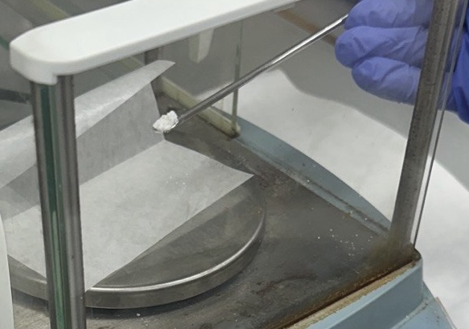
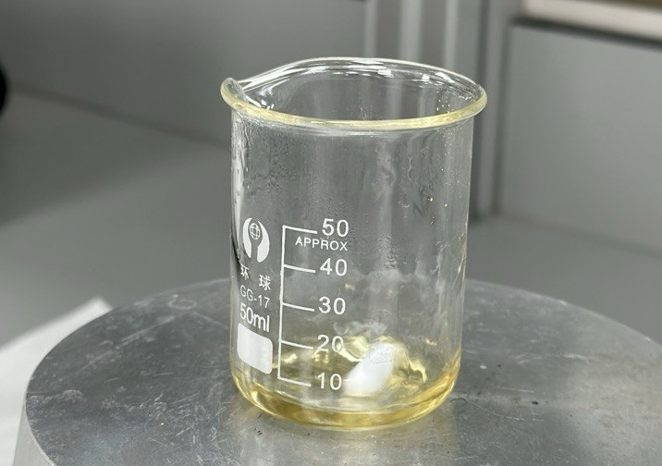
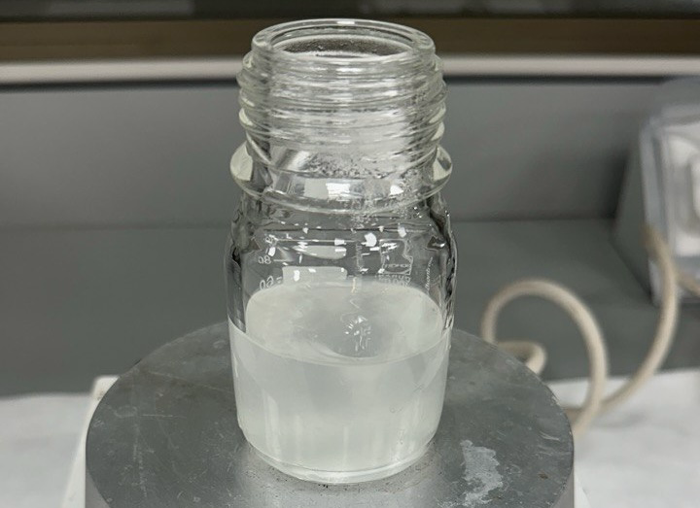
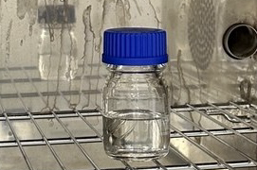
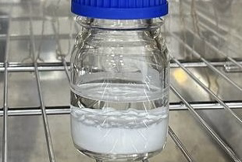
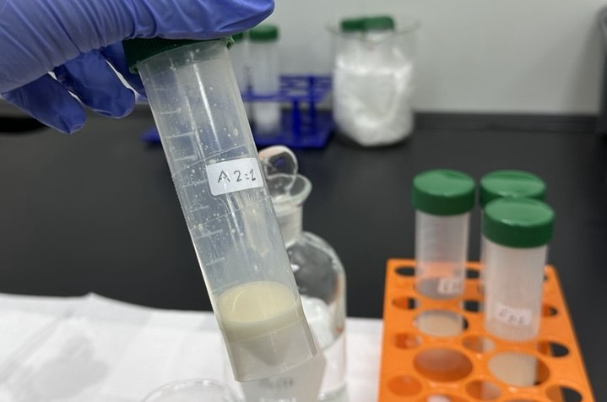
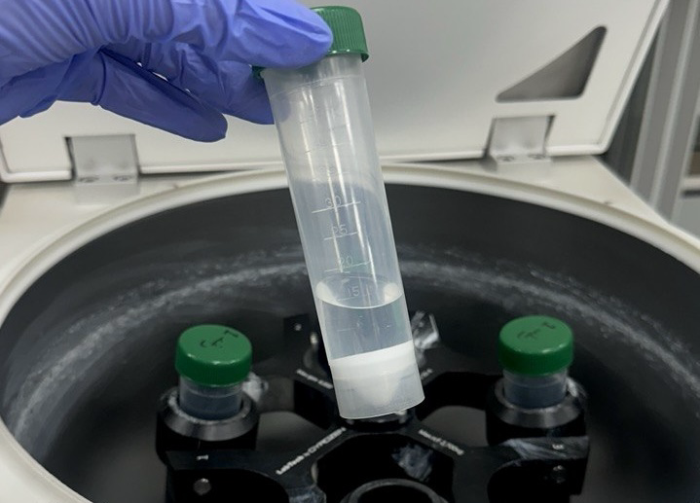
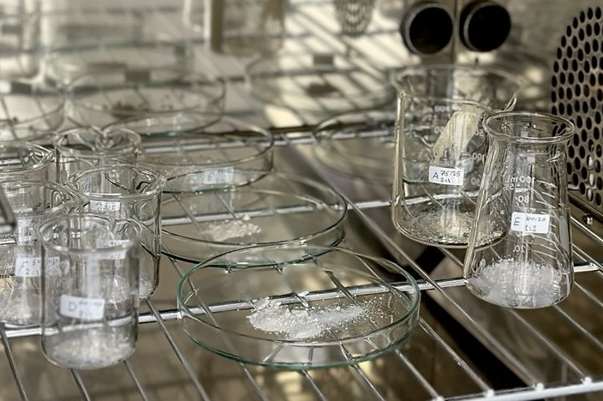
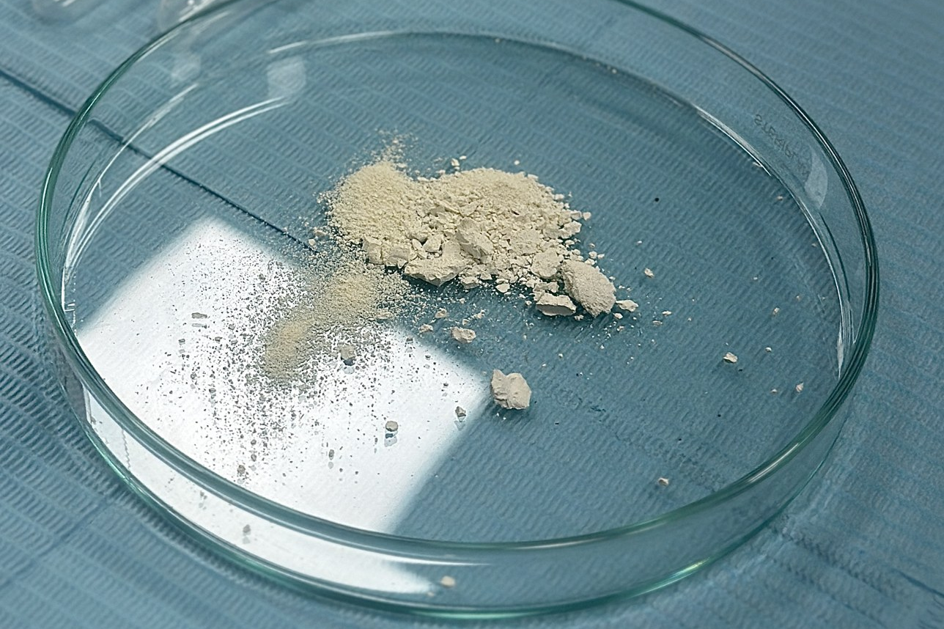
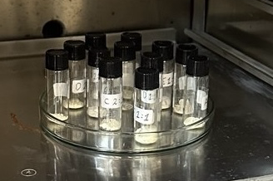
Material Synthesis and Experimental Progress
A · SAMPLE PREPARATION (SOLVOTHERMAL ROUTE)
B · ALL 12 SYNTHESIZED SAMPLES
All 12 samples synthesized
Solvothermal route · 6 metal compositions (A–F) × 2 metal-to-linker ratios
1 Weighing
2 Preparation
3 Mixing
4 Heating
5 After heating
Metal comp.
A
B
C
D
E
F
1:1 ratio
A1-1
B1-1
C1-1
D1-1
E1-1
F1-1
2:1 ratio
A2-1
B2-1
C2-1
D2-1
E2-1
F2-1
Result: white crystalline solids in all 12
→ all 12 compared by XRD and FTIR (slides 4–5)
6 Washing
7 Separation
8 Drying
9 After drying
10 After activation
C · CHARACTERIZATION AND RESEARCH PROGRESS
1 · Synthesis of 12 samples
2 · XRD and FTIR of all 12
3 · Evidence-based sample selection
4 · CO₂ adsorption evaluation
5 · Dry vs humid comparison
6 · Regeneration and cycling
Completed
Completed
Completed
Planned
Planned
Planned
Notes:
SLIDE 2 (about 1.5 min). Material synthesis of all 12 samples and experimental progress.
Section A: the ten laboratory photographs follow the synthesis in process order - weighing, preparation, mixing, heating, the reaction vessel after heating, washing, separation by centrifugation, drying, the dried powder, and the labelled vials after activation. Section B: all twelve mixed-metal MOF samples were synthesized by the solvothermal route - six metal compositions (A to F) at two metal-to-linker ratios (1:1 and 2:1). The code combines composition and ratio, so B2-1 is composition B at the 2:1 ratio. White crystalline solids were obtained in all twelve. Composition details are not disclosed. All twelve samples are compared on the next two slides - XRD first, then FTIR - and the best-characterized candidate is selected from that comparison on slide 6. Section C: synthesis, XRD/FTIR of all twelve samples and the evidence-based selection are completed; CO2 adsorption, dry-versus-humid comparison, regeneration and cycling are planned and have not yet been performed.

Slide 4
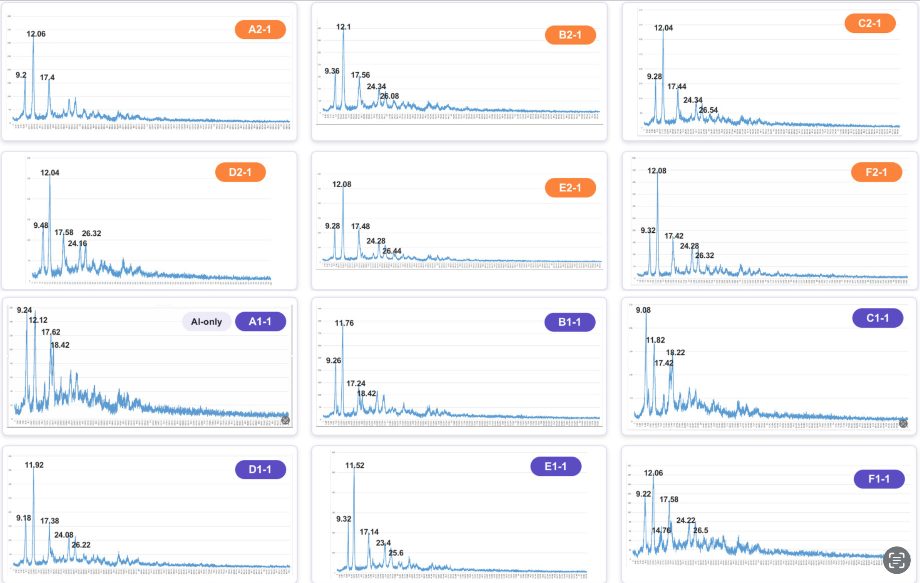
Comparative XRD Analysis of All 12 Samples
Sample | ~9.3° | ~12° | ~17.5° | ~24.3° | ~26.3° | Other / flag
A2-1 | 9.2 | 12.06 | 17.4 | — | — | 3 labelled
B2-1 | 9.36 | 12.1 | 17.56 | 24.34 | 26.08 | —
C2-1 | 9.28 | 12.04 | 17.44 | 24.34 | 26.54 | —
D2-1 | 9.48 | 12.04 | 17.58 | 24.16 | 26.32 | rough bkg
E2-1 | 9.28 | 12.08 | 17.48 | 24.28 | 26.44 | —
F2-1 | 9.32 | 12.08 | 17.42 | 24.28 | 26.32 | —
A1-1 | 9.24 | 12.12 | 17.62 | — | — | +18.42
B1-1 | 9.26 | 11.76 | 17.24 | — | — | +18.42
C1-1 | 9.08 | 11.82 | 17.42 | — | — | +18.22
D1-1 | 9.18 | 11.92 | 17.38 | 24.08 | 26.22 | —
E1-1 | 9.32 | 11.52 | 17.14 | 23.4 | 25.6 | shifted
F1-1 | 9.22 | 12.06 | 17.58 | 24.22 | 26.5 | +14.76
SIMILARITIES
All 12 patterns share sharp reflections near 9.1–9.5°, 11.5–12.1° and 17.1–17.6° 2θ: every sample is crystalline, and all appear to share a closely related structure.
DIFFERENCES & MEANING
Ratio: the ~12° peak lies at 12.04–12.10° in every 2:1 sample but spreads to 11.52–12.12° in the 1:1 series (lower 2θ = larger d-spacing).
Extra peaks (18.2–18.4° in A1-1, B1-1, C1-1; 14.76° in F1-1): possibly a secondary phase or residual precursor; unidentified without references.
E1-1: entire set at lower 2θ — a lattice change or different phase; cause not determined.
Raised, noisy background (A1-1, C1-1, F1-1; milder D2-1): possibly lower long-range order.
SHORTLIST CRITERIA
1 · Complete common set (≈9.3, 12.1, 17.5, 24.3, 26.3°)
2 · Sharp peaks on a low, flat background
3 · No extra or clearly shifted reflections
→ Shortlist: B2-1, C2-1, E2-1, F2-1, D1-1
Original figure, unmodified · rows 1–2: 2:1, rows 3–4: 1:1 · frames = XRD shortlist · panels scaled individually (heights compared within a pattern only).
Analysis: all 12 samples crystallized with closely related structures. The 2:1 ratio gave uniform patterns across compositions, whereas most 1:1 samples show extra, shifted or less-defined features. B2-1, C2-1, E2-1, F2-1 and D1-1 match the common pattern best; XRD quality alone does not predict CO₂ uptake.
Notes:
SLIDE 3 (about 2.5 min). Comparative XRD analysis of all 12 samples.
Left: my original, unmodified XRD figure - rows 1-2 are the 2:1 series, rows 3-4 the 1:1 series. Middle: the peak positions exactly as labelled in the figure. Similarities: every pattern has sharp reflections near 9.1-9.5, 11.5-12.1 and 17.1-17.6 degrees 2-theta, so all twelve samples are crystalline and appear to share a closely related structure. Differences and what they may mean: first, the metal-to-linker ratio matters - in all six 2:1 samples the ~12 degree reflection sits at 12.04-12.10 degrees, while in the 1:1 series it spreads from 11.52 to 12.12 degrees; a lower angle means a slightly larger lattice spacing. Second, A1-1, B1-1 and C1-1 show an extra reflection at 18.2-18.4 degrees and F1-1 one at 14.76 degrees; these may come from a secondary crystalline phase or residual precursor, which cannot be identified without reference patterns. Third, E1-1 has its whole set shifted to lower angle - a lattice change or a different phase; the cause is not determined. Fourth, A1-1, C1-1 and F1-1 (and to a lesser extent D2-1) have raised, noisy backgrounds, which may indicate lower long-range order. Shortlist criteria: complete common set, sharp peaks on a low flat background, and no extra or shifted reflections - met by B2-1, C2-1, E2-1, F2-1 and D1-1. Limitations: panels are scaled individually, so intensities are not compared between samples; no phase, crystallinity score or crystallite size is assigned; XRD quality alone does not predict CO2 uptake.

Slide 5
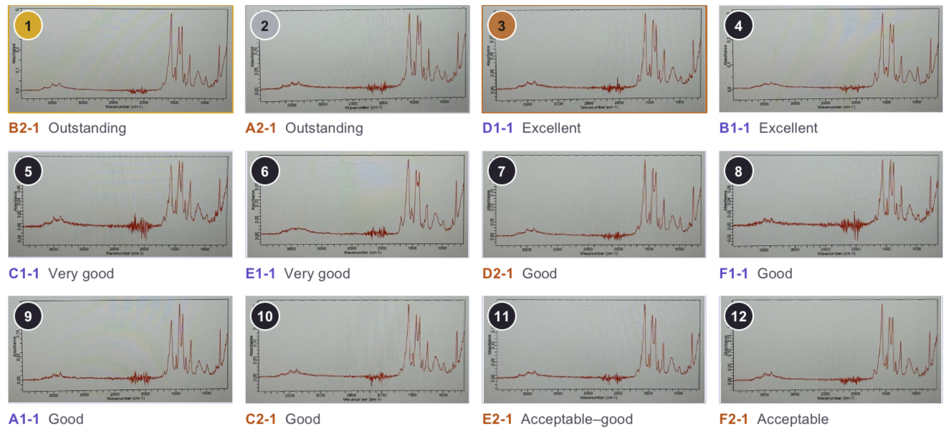
Comparative FTIR Analysis of All 12 Samples
Sample | COO⁻ bands ~1600 / ~1400 | Stronger band in cluster | Extra band >1650 cm⁻¹ | Noise 2200–1950 cm⁻¹ | Original rating
A2-1 | Both present | ~1600 ≈ ~1400 | — | minor | Outstanding
B2-1 | Both present | ~1600 | — | minor | Outstanding
C2-1 | Both present | ~1600 | — | minor | Good
D2-1 | Both present | ~1600 | — | minor | Good
E2-1 | Both present | ~1600 | — | minor | Acceptable–good
F2-1 | Both present | ~1600 | — | minor | Acceptable
A1-1 | Both present | ~1400 | — | moderate | Good
B1-1 | Both present | ~1600 | weak band | minor | Excellent
C1-1 | Both present | ~1600 ≈ ~1400 | — | pronounced | Very good
D1-1 | Both present | ~1600 | — | minor | Excellent
E1-1 | Both present | ~1600 | weak band | moderate | Very good
F1-1 | Both present | ~1600 ≈ ~1400 | — | pronounced | Good
Original figure, unmodified. Orange frames = spectra matching the majority pattern.
DIFFERENCES BETWEEN SAMPLES
AGREEMENT WITH XRD
SIGNIFICANCE OF THE COO⁻ BANDS
~1400 band ≈ ~1600 (A2-1, C1-1, F1-1) or stronger (A1-1): possibly a different coordination environment.
Weak band >1650 cm⁻¹ (B1-1, E1-1): possibly residual uncoordinated –COOH.
Noise at 2200–1950 cm⁻¹ (C1-1, F1-1): measurement-related.
Every FTIR-deviating sample (A2-1, A1-1, B1-1, C1-1, E1-1, F1-1) also has extra, shifted or less-defined XRD features. Only D2-1 is flagged by XRD alone.
~1600 cm⁻¹ (ν_{as}) and ~1400 cm⁻¹ (ν_{s}) are the stretching modes of deprotonated carboxylate (COO⁻). Present in all 12: consistent with linker carboxylates bound to metal centers. The binding mode needs the free-linker spectrum (acid C=O ~1700 cm⁻¹) and precise Δν.
FTIR conclusion: the data support carboxylate–metal coordination in all 12 samples, and six spectra (B2-1, C2-1, D2-1, E2-1, F2-1, D1-1) match the majority pattern. FTIR alone cannot confirm the full structure, the coordination mode or CO₂ adsorption performance.
Notes:
SLIDE 4 (about 2.5 min). Comparative FTIR analysis of all 12 samples.
Left: my original, unmodified FTIR figure with all twelve spectra and the labels printed in it. Significance: the strong bands near 1600 and 1400 cm-1 are the asymmetric and symmetric stretching modes of deprotonated carboxylate groups. They appear in all twelve samples, which is consistent with linker carboxylates bound to metal centers, as expected for a MOF. To confirm the binding mode we still need the free-linker spectrum - for example, whether the acid C=O band near 1700 cm-1 disappears - and precise band positions to evaluate the separation between the two bands. Differences: in eight samples the ~1600 cm-1 band is the strongest in the cluster; in A2-1, C1-1 and F1-1 the ~1400 cm-1 band is about as strong, and in A1-1 it is stronger, which may point to a different coordination environment. B1-1 and E1-1 show a weak extra band above about 1650 cm-1, possibly residual uncoordinated carboxylic acid. The noisy region near 2200-1950 cm-1, strongest in C1-1 and F1-1, is measurement-related and is not interpreted. Agreement with XRD: every sample that deviates in FTIR also has extra, shifted or less-defined XRD features; only D2-1 is flagged by XRD but consistent by FTIR. Conclusion: FTIR supports carboxylate-metal coordination in all twelve samples and identifies six spectra that match the majority pattern; it cannot by itself confirm the full structure, the coordination mode or CO2 adsorption performance. The printed ratings are qualitative labels from the source figure, and small band shifts cannot be resolved because the spectra are photographs.

Slide 6
Evidence-Based Sample Selection and Planned Experiments
HOW THE 12 SAMPLES WERE NARROWED DOWN — COMPLETED
1
12 samples
2
XRD screen → 5
3
FTIR check → 5
4
Lead + shortlist
All synthesized; XRD and FTIR recorded for every sample
Complete common set · sharp peaks, low background · no extra/shifted peaks
Both COO⁻ bands · majority band pattern · no extra band
Agreement of both techniques
A1-1
B1-1
C1-1
D1-1
E1-1
F1-1
A1-1
B1-1
C1-1
D1-1
E1-1
F1-1
B2-1
C2-1
E2-1
F2-1
D1-1
B2-1
C2-1
E2-1
F2-1
D1-1
A2-1
B2-1
C2-1
D2-1
E2-1
F2-1
A2-1
B2-1
C2-1
D2-1
E2-1
F2-1
Start: all 12 compared (slides 4–5)
7 excluded (reasons: slide 4)
All 5 pass · agrees with XRD
Lead B2-1; four alternates, not ranked
Why B2-1 leads: it meets every criterion in both techniques — the complete set of sharp reflections on a low background (XRD) and both COO⁻ bands in the majority pattern with no extra band (FTIR) — and it has the top qualitative rating in the original FTIR figure. C2-1, E2-1, F2-1 and D1-1 also pass; the data do not support ranking them.
Best-characterized ≠ highest CO₂ capacity
B2-1's CO₂ adsorption has not been measured; no sample has been tested yet.
PLANNED NEXT STEPS — NOT YET PERFORMED
No capacities, humidity levels, temperatures or efficiencies are reported.
1
CO₂ adsorption evaluation
2
Dry vs humid comparison
3
Regeneration and CO₂ release
4
Repeated-cycle testing
Uptake of B2-1, then the shortlist, under defined conditions
Same procedure with and without water vapor
Release of captured CO₂; recovery of the sorbent
Is performance maintained over cycles? (potential reuse)
Planned
Planned
Planned
Planned
Notes:
SLIDE 5 (about 2 min). Evidence-based sample selection and planned experiments.
Top row - completed: how the twelve samples were narrowed down. Step 1: all twelve were synthesized and measured by XRD and FTIR. Step 2, XRD screen: keep samples with the complete common reflection set, sharp peaks on a low background and no extra or shifted reflections - B2-1, C2-1, E2-1, F2-1 and D1-1. Excluded: A1-1, B1-1, C1-1 and F1-1 for extra reflections, E1-1 for a shifted set, D2-1 for a rougher background, A2-1 because only three peaks are labelled. Step 3, FTIR check: all five show both carboxylate bands in the majority pattern and no extra band; independently, every sample FTIR flags was also flagged by XRD. Step 4: B2-1 is the lead because it meets every criterion in both techniques and carries the top qualitative rating in the original FTIR figure; C2-1, E2-1, F2-1 and D1-1 also pass and are kept as alternates, but the data do not support ranking them. Important: best-characterized does not mean highest CO2 capacity - no sample's CO2 adsorption has been measured yet. Bottom row - planned, not yet performed: CO2 adsorption evaluation starting with B2-1 and then the shortlist; a dry-versus-humid comparison with the same procedure; regeneration and CO2 release with recovery of the sorbent; and repeated-cycle testing to assess potential reuse. Close with the broader goal - advancing MOF-based approaches for CO2 capture under environmentally relevant conditions - thank the audience and invite questions.

Slide 7

Capturing CO₂ Directly from Air: Bimetal-Engineered MOFs with Moisture-Responsive Regeneration

Slide 8


Slide 9
Thank You
Notes:
(~30 s) To close: our study combines bimetal engineering with the evaluation of humidity and regeneration, as one route to advancing MOF-based direct air capture of CO₂. Thank you — I welcome your questions.

