Slide 1
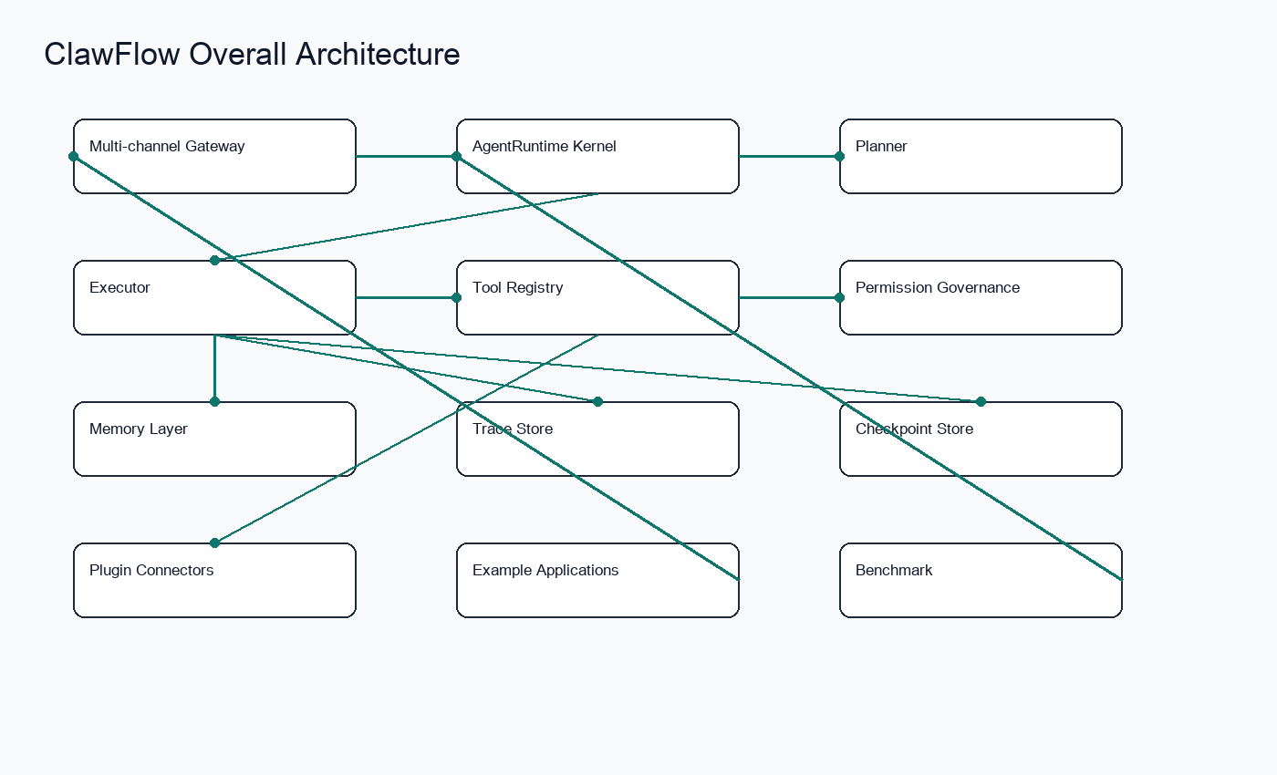
ClawFlow
面向下一代个人智能体的轻量级 Agent Runtime
Agent Runtime · AgentOS Kernel · Workflow Orchestration · Permission Governance · Trace Replay

Slide 2
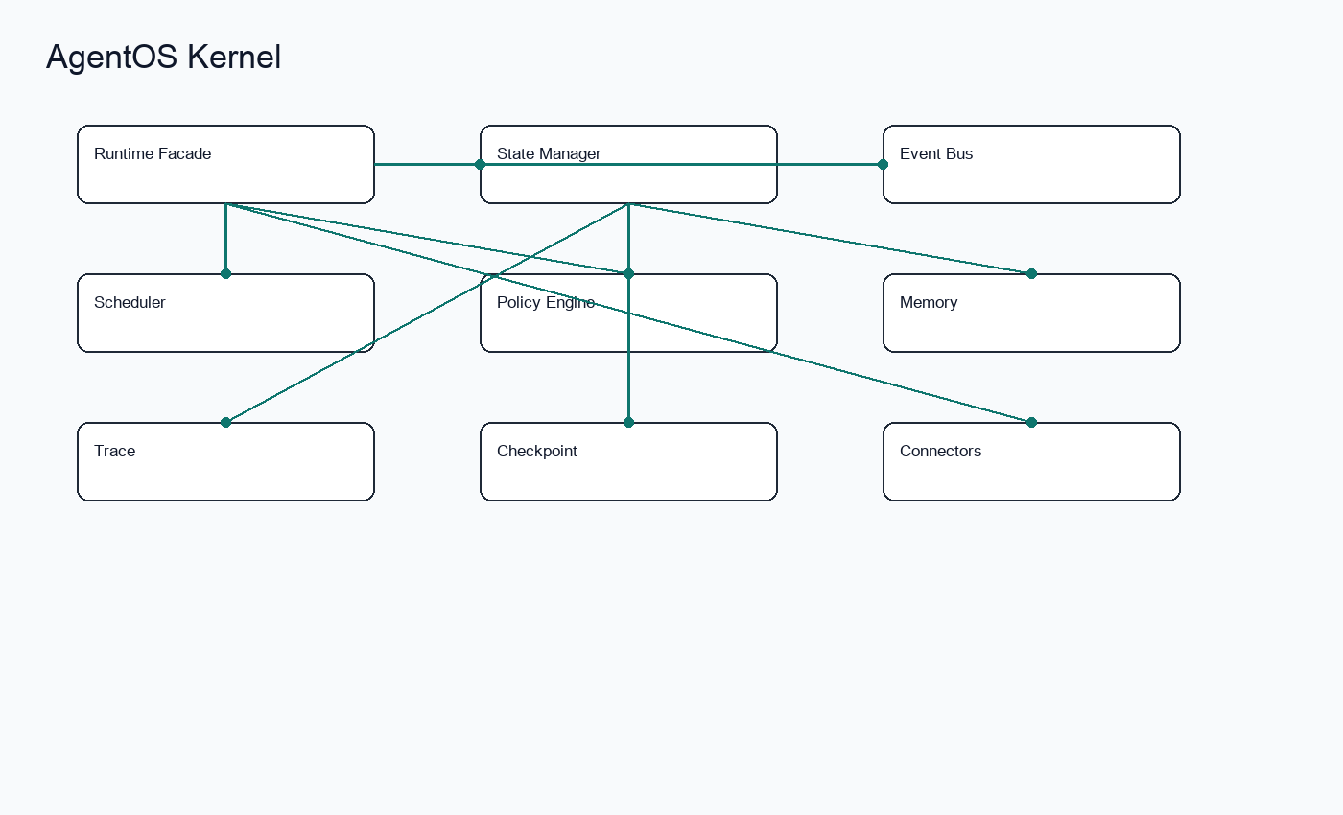
从 Chatbot 到 AgentOS
Agent 需要可执行、可记忆、可恢复、可治理的基础设施。
Agent Runtime · AgentOS Kernel · Workflow Orchestration · Permission Governance · Trace Replay

Slide 3
现有问题
Demo 化严重、缺少状态恢复、权限不可控、执行不可观测、插件和记忆难管理。
ClawFlow
Unified Runtime
Real State
Replayable Trace
Agent Runtime · AgentOS Kernel · Workflow Orchestration · Permission Governance · Trace Replay

Slide 4
项目目标
能执行、能记忆、能恢复、能治理、能扩展、能支撑真实应用构建。
ClawFlow
Unified Runtime
Real State
Replayable Trace
Agent Runtime · AgentOS Kernel · Workflow Orchestration · Permission Governance · Trace Replay

Slide 5
总体架构
Gateway + AgentOS Kernel + Tool
Sandbox + Memory + Trace + Plugin +
Applications。
Agent Runtime · AgentOS Kernel · Workflow Orchestration · Permission Governance · Trace Replay

Slide 6
AgentOS Kernel
Runtime Kernel、State Manager、Event
Bus、Scheduler、Policy Engine。
Agent Runtime · AgentOS Kernel · Workflow Orchestration · Permission Governance · Trace Replay

Slide 7
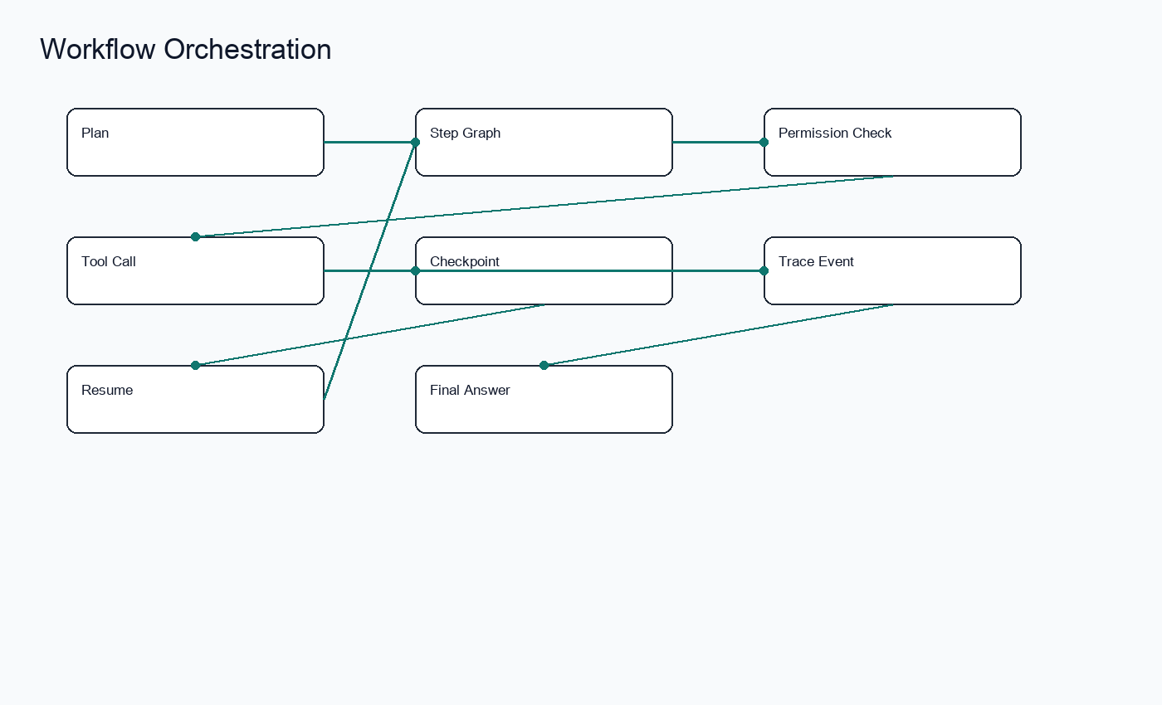
Agent Runtime
Planner 生成 Plan，Executor 执行 Step，Tool
Registry 提供能力边界。
Agent Runtime · AgentOS Kernel · Workflow Orchestration · Permission Governance · Trace Replay

Slide 8
Workflow + Checkpoint
Step Graph、Retry
边界、Resume、Replay、Workflow Export。
Agent Runtime · AgentOS Kernel · Workflow Orchestration · Permission Governance · Trace Replay

Slide 9
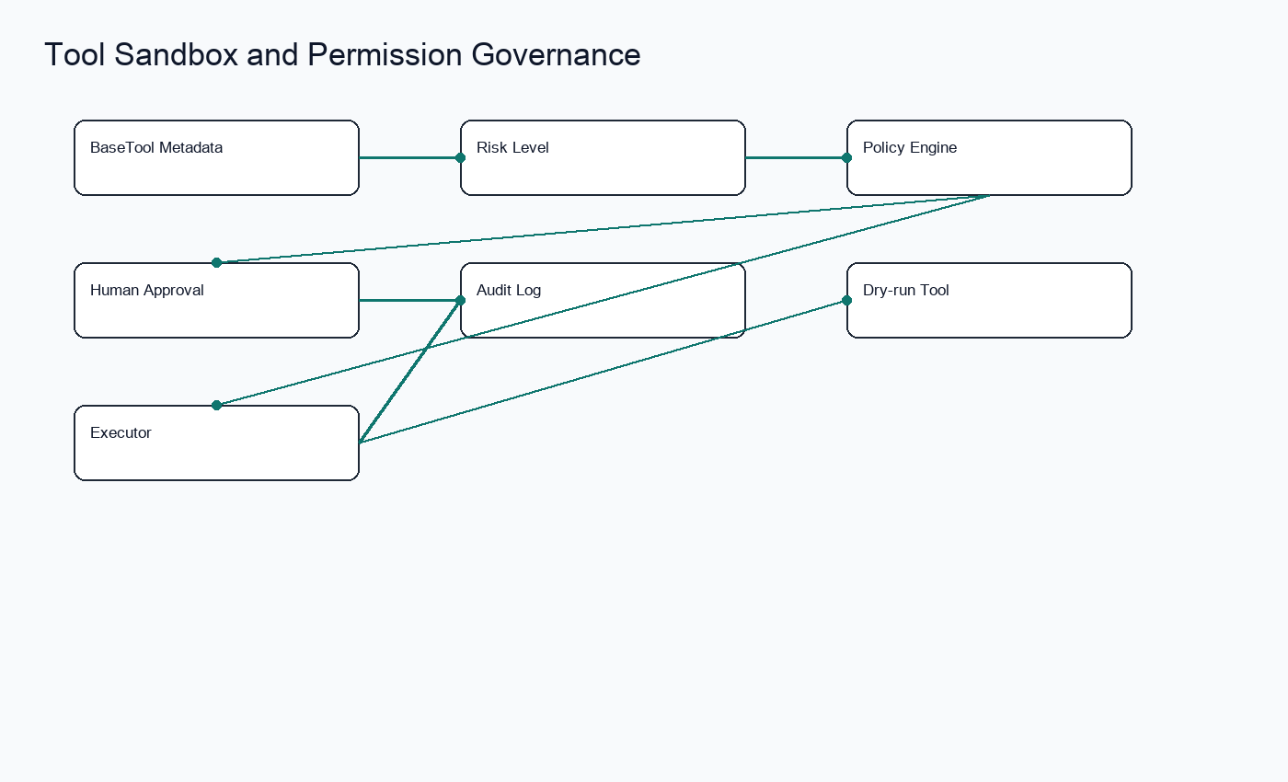
Tool Sandbox
BaseTool 元数据、risk_level、schema、shell
白名单。
Agent Runtime · AgentOS Kernel · Workflow Orchestration · Permission Governance · Trace Replay

Slide 10
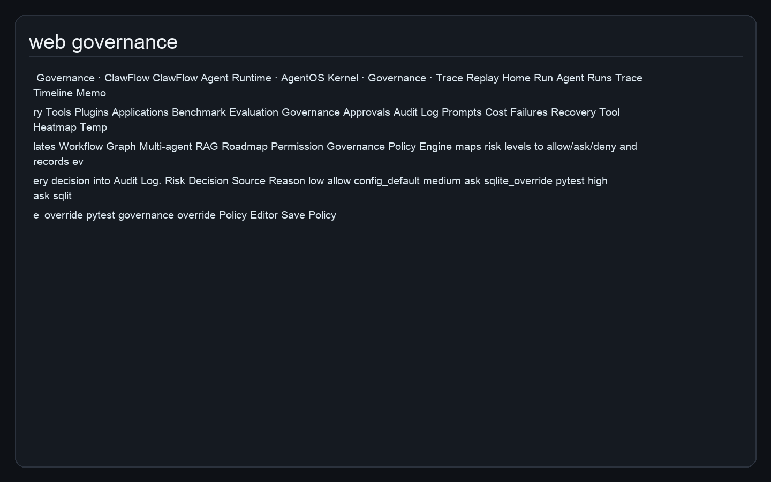
Permission Governance
allow / ask / deny、Human-in-the-
loop、Audit Log。
Agent Runtime · AgentOS Kernel · Workflow Orchestration · Permission Governance · Trace Replay

Slide 11
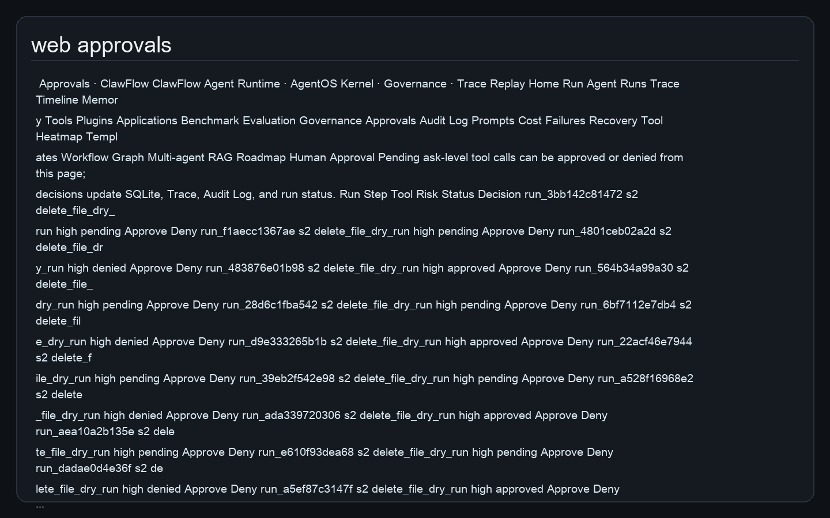
Human Approval Queue
Web/API/CLI approve or deny pending
high-risk tool calls with trace and
audit updates.
Agent Runtime · AgentOS Kernel · Workflow Orchestration · Permission Governance · Trace Replay

Slide 12
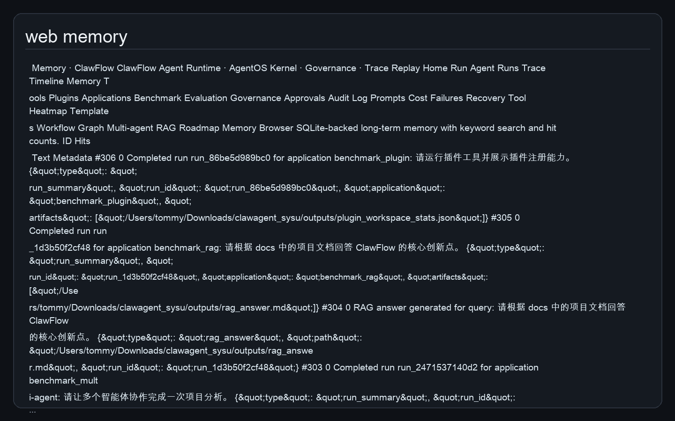
Memory Layer
SQLite 长期记忆、keyword search、hit
count、vector interface。
Agent Runtime · AgentOS Kernel · Workflow Orchestration · Permission Governance · Trace Replay

Slide 13
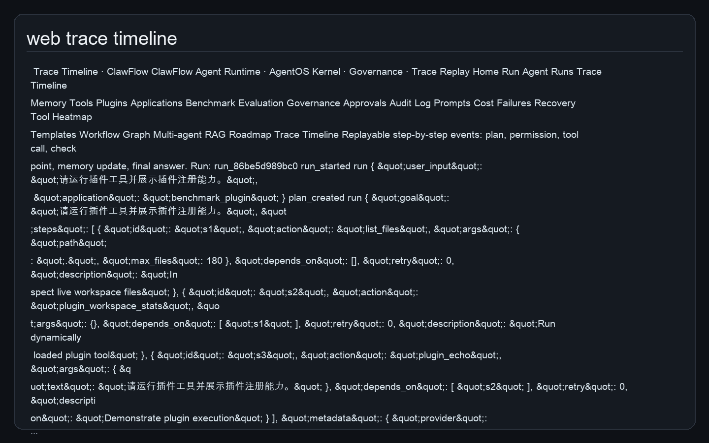
Observability
Trace Timeline、Metrics、Error、Cost
estimation、Replay。
Agent Runtime · AgentOS Kernel · Workflow Orchestration · Permission Governance · Trace Replay

Slide 14
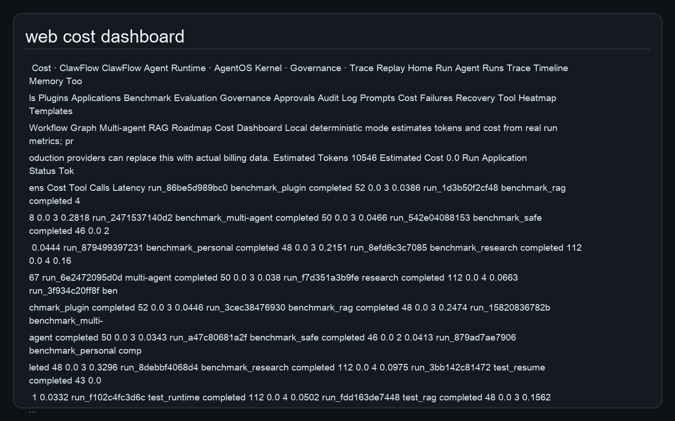
Prompt Registry + Cost Dashboard
Prompt templates, usage count,
estimated tokens, cost and failure
analysis.
Agent Runtime · AgentOS Kernel · Workflow Orchestration · Permission Governance · Trace Replay

Slide 15
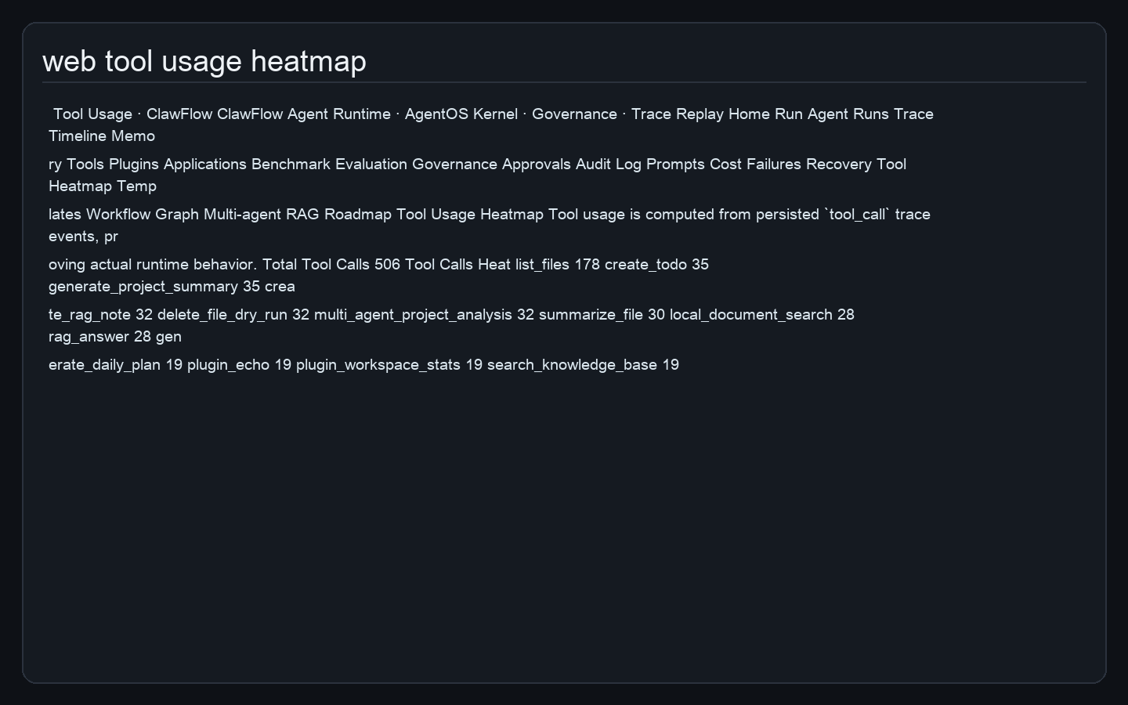
Tool Usage Heatmap
Aggregate real tool_call trace events
to show runtime behavior and
infrastructure observability.
Agent Runtime · AgentOS Kernel · Workflow Orchestration · Permission Governance · Trace Replay

Slide 16
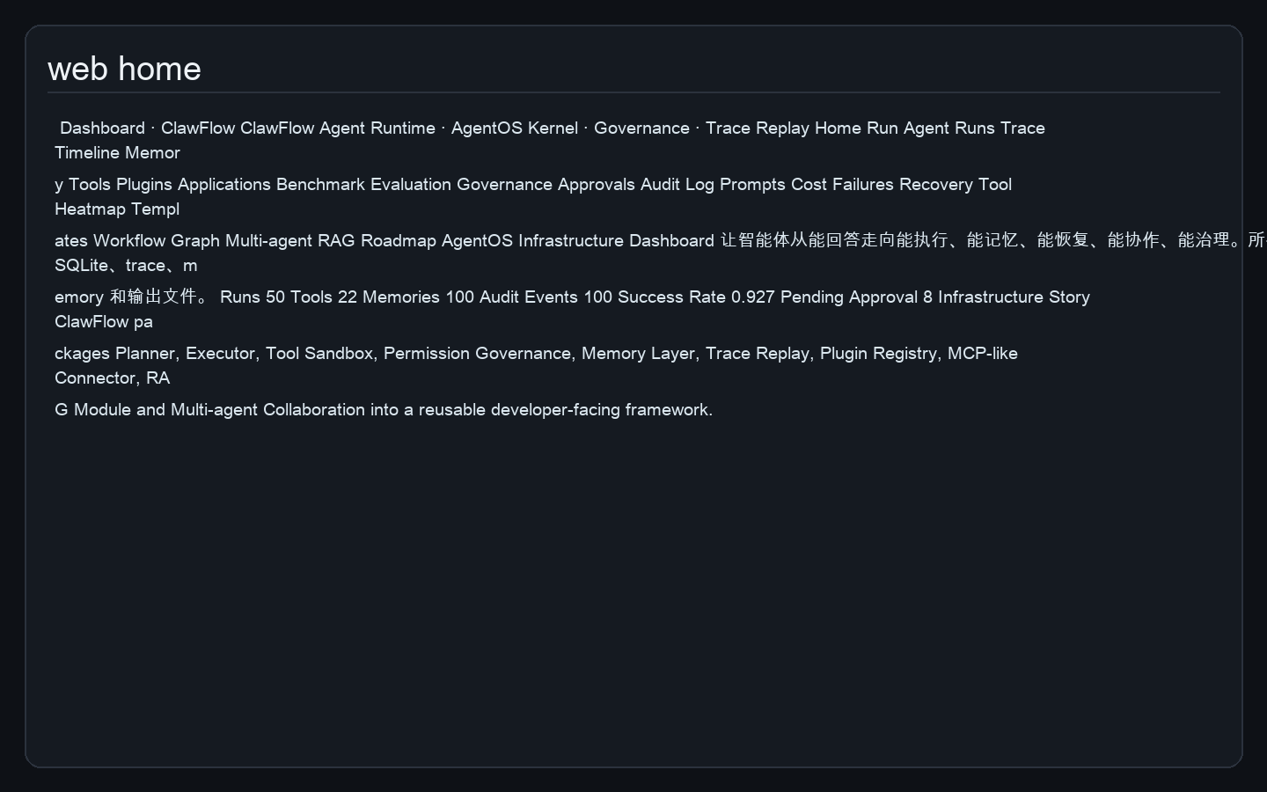
Multi-channel Gateway
CLI、FastAPI、Web UI 共享同一个 Runtime。
Agent Runtime · AgentOS Kernel · Workflow Orchestration · Permission Governance · Trace Replay

Slide 17
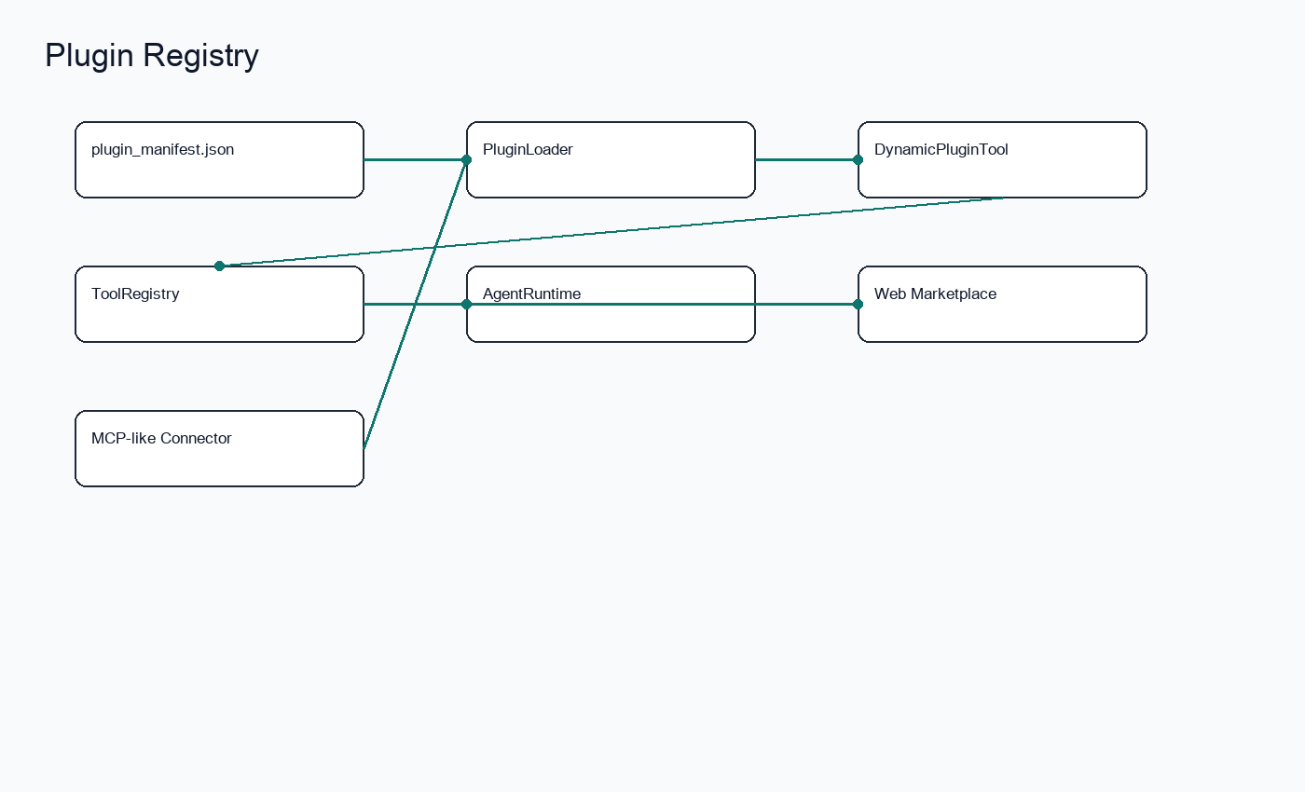
Plugin System
Manifest-driven Plugin Registry and
MCP-like connector expansion.
Agent Runtime · AgentOS Kernel · Workflow Orchestration · Permission Governance · Trace Replay

Slide 18
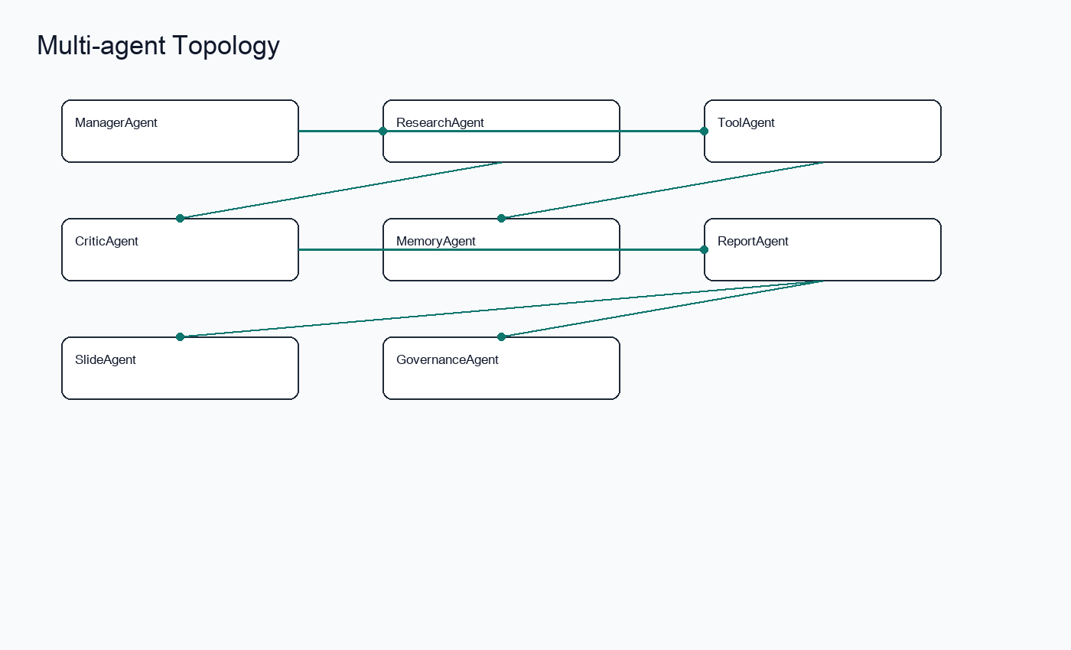
Multi-agent Collaboration
ManagerAgent、ResearchAgent、ToolAgent、C
riticAgent、ReportAgent。
Agent Runtime · AgentOS Kernel · Workflow Orchestration · Permission Governance · Trace Replay

Slide 19
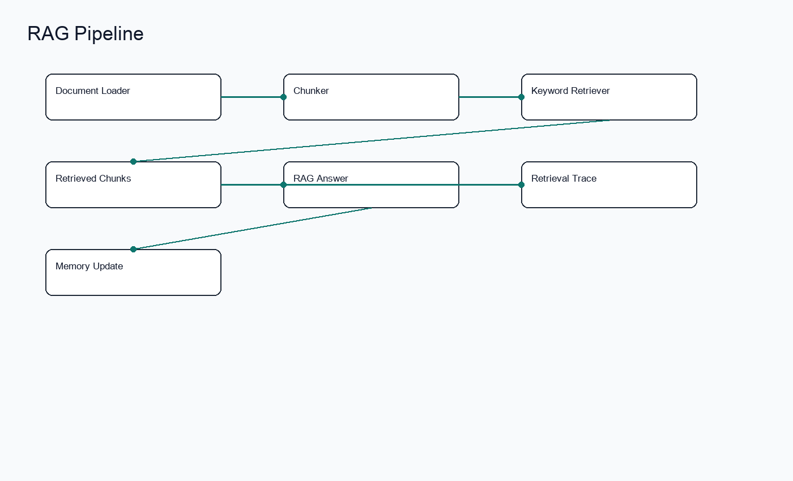
RAG Module
Document ingestion、chunk、retrieval
trace、grounded answer。
Agent Runtime · AgentOS Kernel · Workflow Orchestration · Permission Governance · Trace Replay

Slide 20
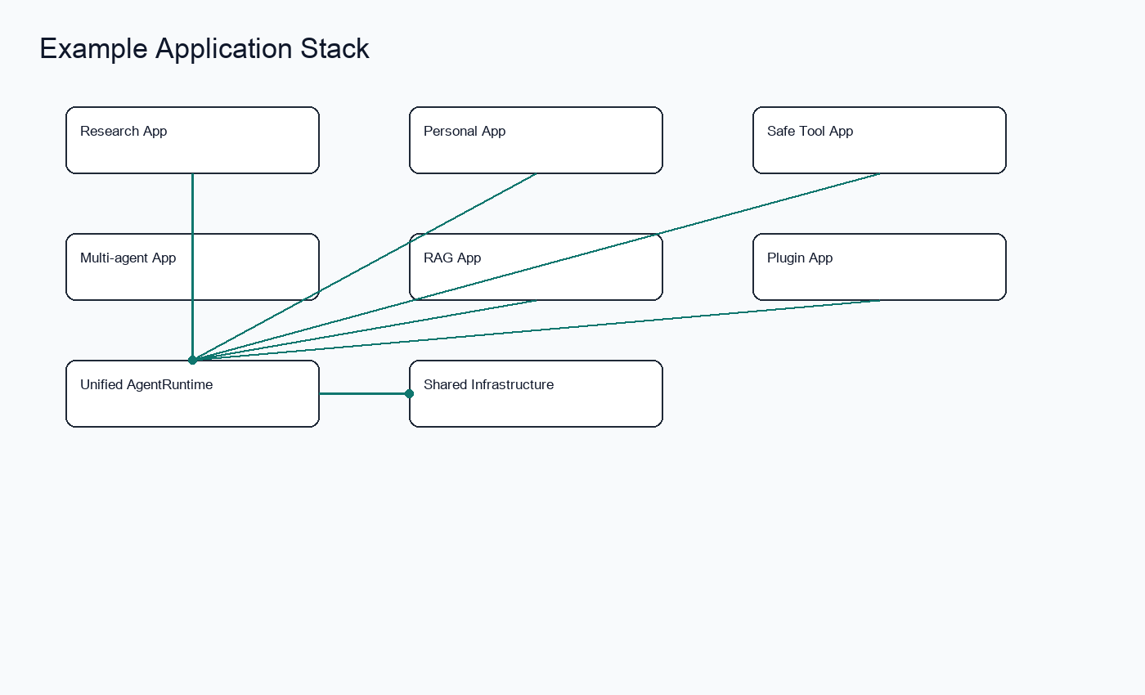
From Demo to Example Application
Example Applications 不是孤立脚本，而是 Runtime
验证工作负载。
Agent Runtime · AgentOS Kernel · Workflow Orchestration · Permission Governance · Trace Replay

Slide 21
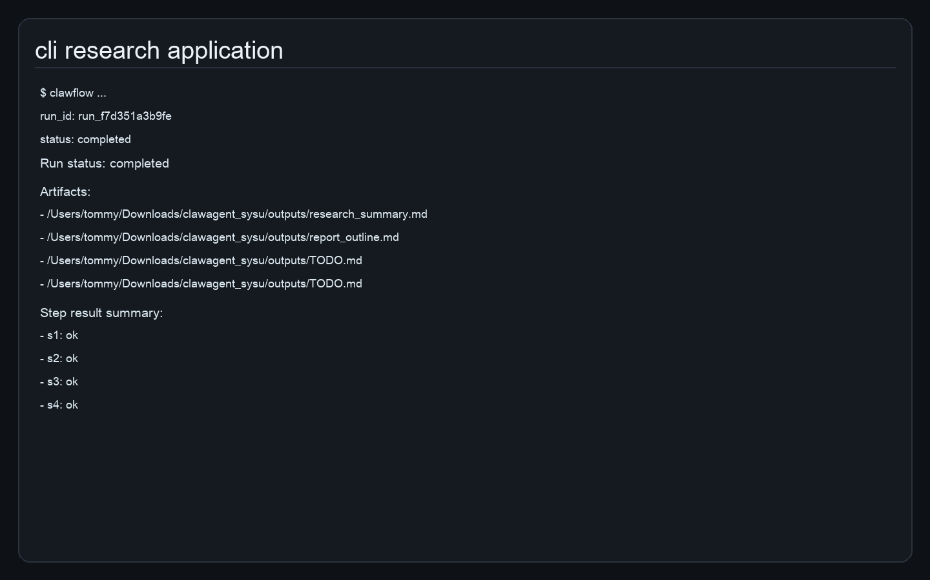
Application 1: Research Assistant
生成项目摘要、报告大纲、TODO，并写入
trace/memory/checkpoint。
Agent Runtime · AgentOS Kernel · Workflow Orchestration · Permission Governance · Trace Replay

Slide 22
Application 2: Personal Assistant
生成 daily_plan.md 并写入长期记忆。
Agent Runtime · AgentOS Kernel · Workflow Orchestration · Permission Governance · Trace Replay

Slide 23
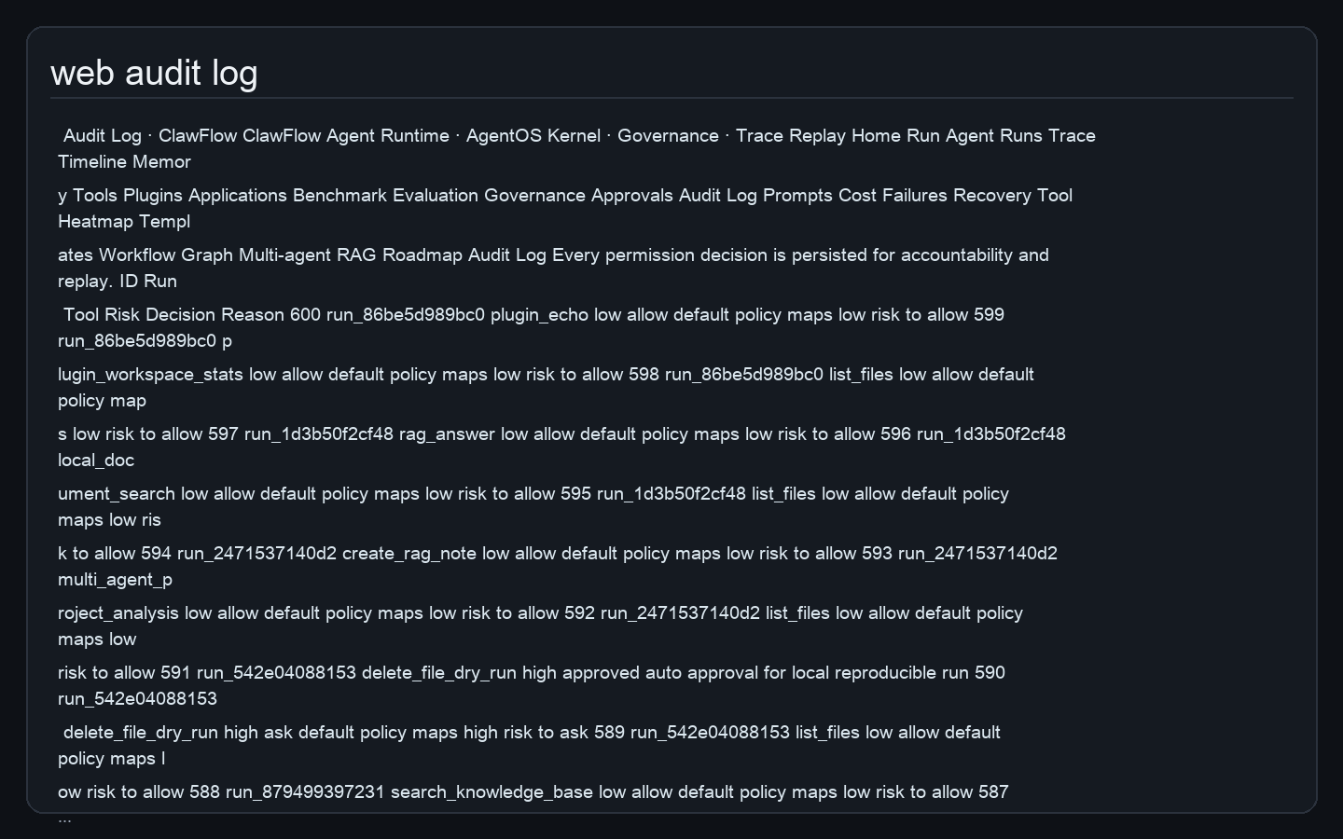
Application 3: Safe Tool Call
高风险删除请求转为 dry-run，记录 audit。
Agent Runtime · AgentOS Kernel · Workflow Orchestration · Permission Governance · Trace Replay

Slide 24
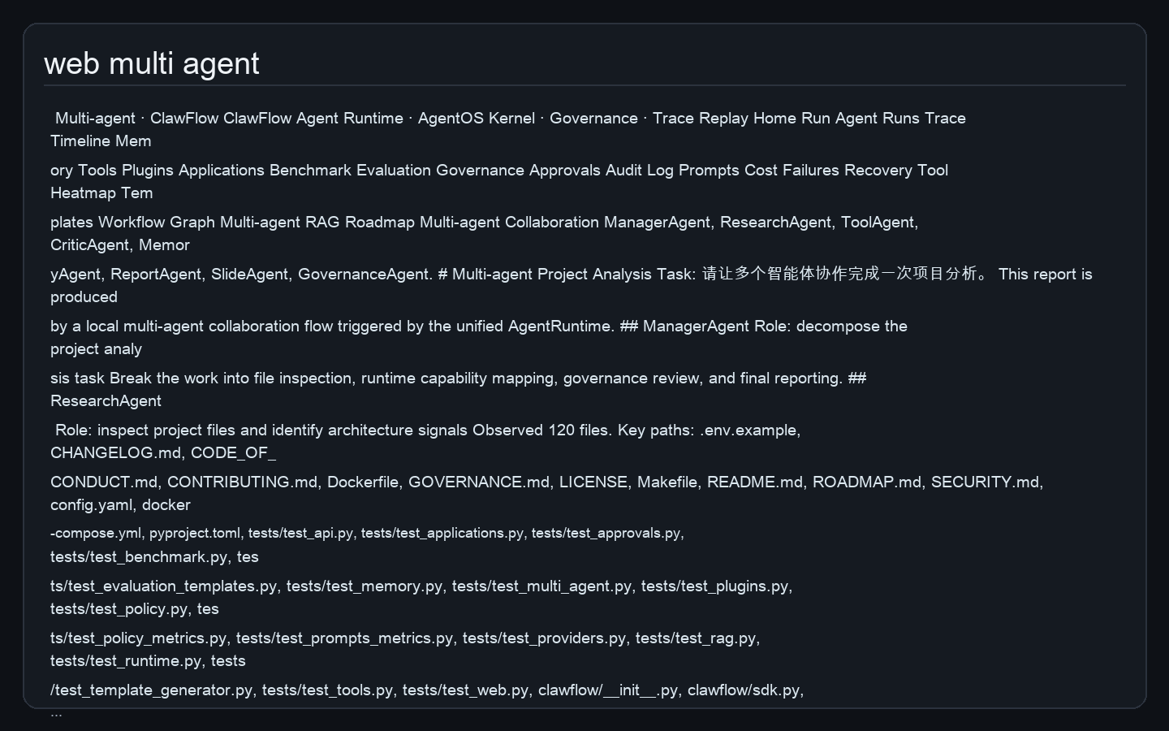
Application 4: Multi-agent / RAG
多角色协作与文档检索回答均通过统一 Runtime。
Agent Runtime · AgentOS Kernel · Workflow Orchestration · Permission Governance · Trace Replay

Slide 25
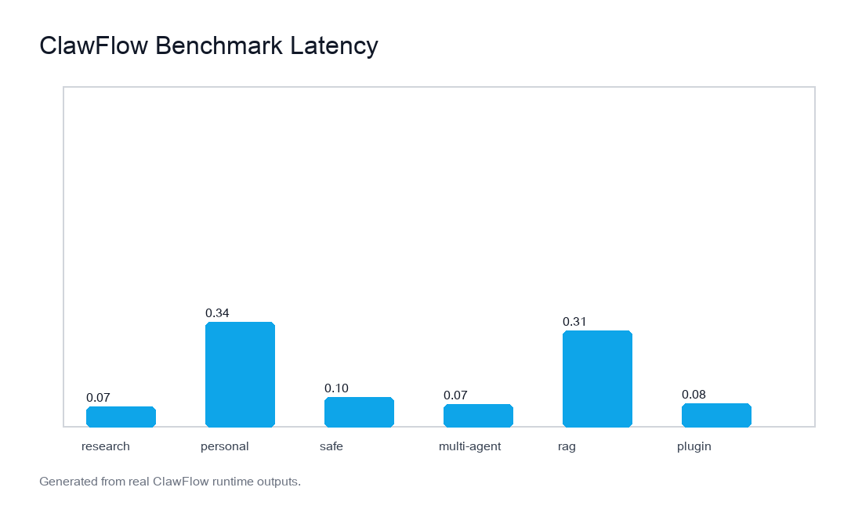
Benchmark
真实 Runtime 任务生成 latency、success
rate、tool calls、trace events。
Agent Runtime · AgentOS Kernel · Workflow Orchestration · Permission Governance · Trace Replay

Slide 26
开源协议与社区规范
Apache-
2.0、CONTRIBUTING、SECURITY、GOVERNANCE、R
OADMAP。
ClawFlow
Unified Runtime
Real State
Replayable Trace
Agent Runtime · AgentOS Kernel · Workflow Orchestration · Permission Governance · Trace Replay

Slide 27
对比与差异化
从 demo.py 到可复用开发框架；从黑盒执行到可观测 Runtime。
ClawFlow
Unified Runtime
Real State
Replayable Trace
Agent Runtime · AgentOS Kernel · Workflow Orchestration · Permission Governance · Trace Replay

Slide 28
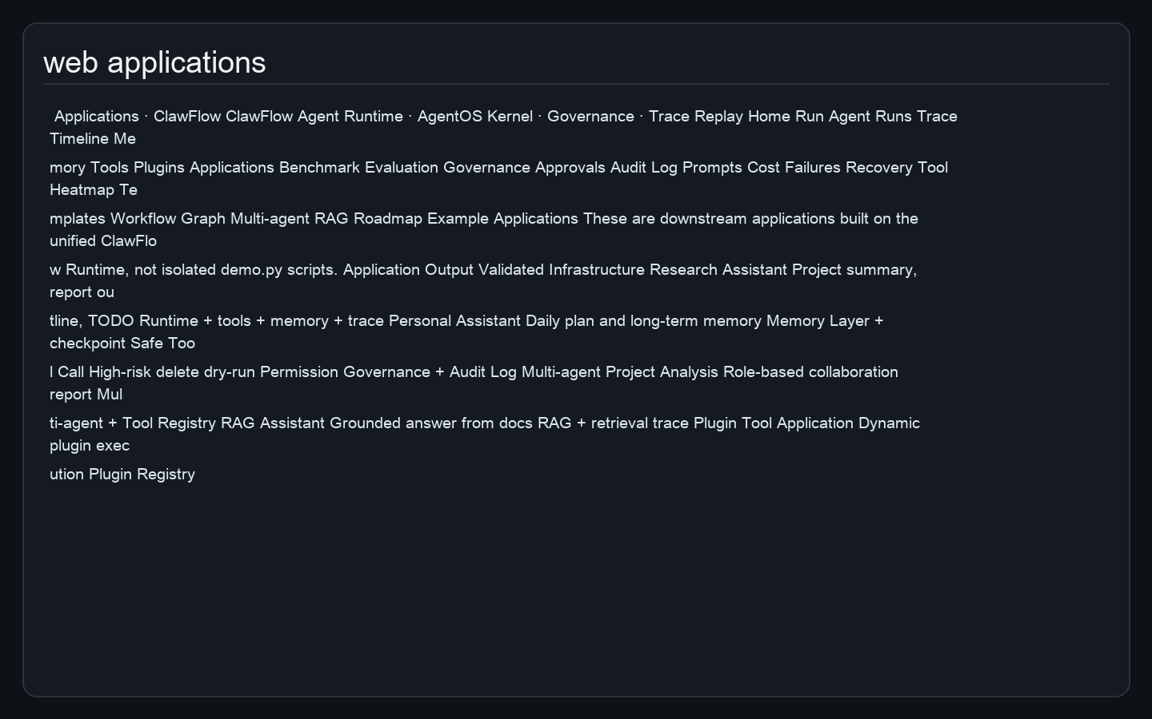
开发者框架
SDK wrapper、Application Template
Generator、Tool Template
Generator，支持二次开发。
Agent Runtime · AgentOS Kernel · Workflow Orchestration · Permission Governance · Trace Replay

Slide 29
未来展望
MCP、云端部署、移动端入口、企业知识库、多模型路由、插件市场。
Agent Runtime · AgentOS Kernel · Workflow Orchestration · Permission Governance · Trace Replay

Slide 30
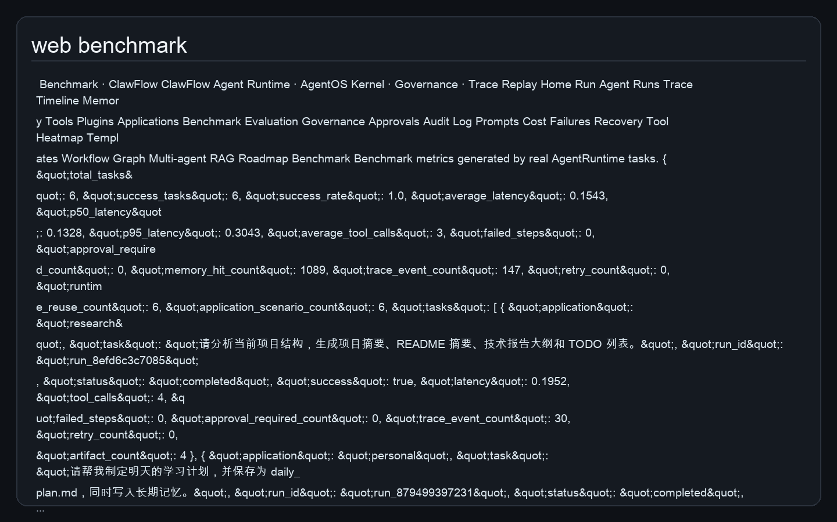
总结
从 Prompt Demo 到 Agent Runtime；从孤立样例到统一
Runtime 驱动的基础设施。
Agent Runtime · AgentOS Kernel · Workflow Orchestration · Permission Governance · Trace Replay

