Slide 1


Food ordering website
Group by:
Abida Akter Nadia (200103020022)
Shatorupa Debi Puja (190203020004)

Slide 2

introduction
This project is a food ordering website designed to make the process of ordering food online simple and efficient. Users can browse the menu, add items to their cart, and place orders with ease. Restaurants can manage their menus and customer orders through an admin panel. This project combines essential web development technologies to deliver a practical solution for online food ordering.

Slide 3
motivation
This project is created to make ordering food online simple and convenient for everyone. It allows users to explore menus, select their favorite dishes, and place orders easily from their homes.
For restaurants, the website offers a system to manage menus and handle customer orders more effectively. It can help them save time, reduce errors, and improve customer satisfaction.
The goal is to provide a user-friendly platform that benefits both customers and restaurants, while also gaining hands-on experience in creating functional web applications.

Slide 4
Used Technologies
PHP
HTML
CSS
MySQL

Slide 5
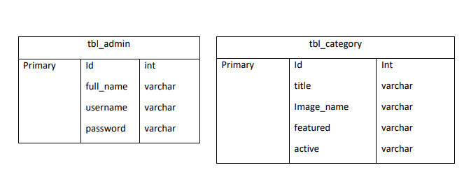
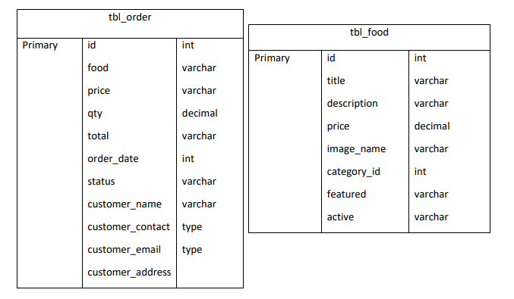
Database Design

Slide 6
features
User Registration and Login System
Browse Food Menu by Categories
Add/Remove Items to/from Cart
Order Checkout with Summary
Admin Panel to Add/Edit Menu Items and Manage Orders

Slide 7
Thank you

