Slide 1

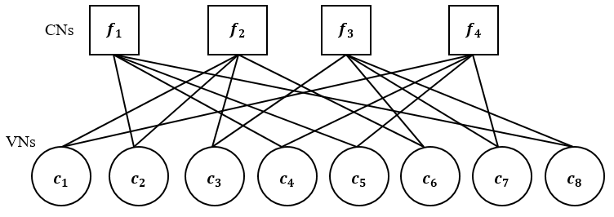
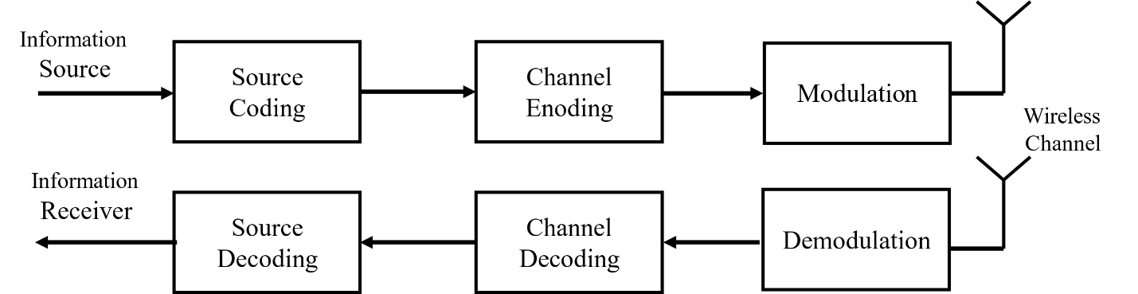
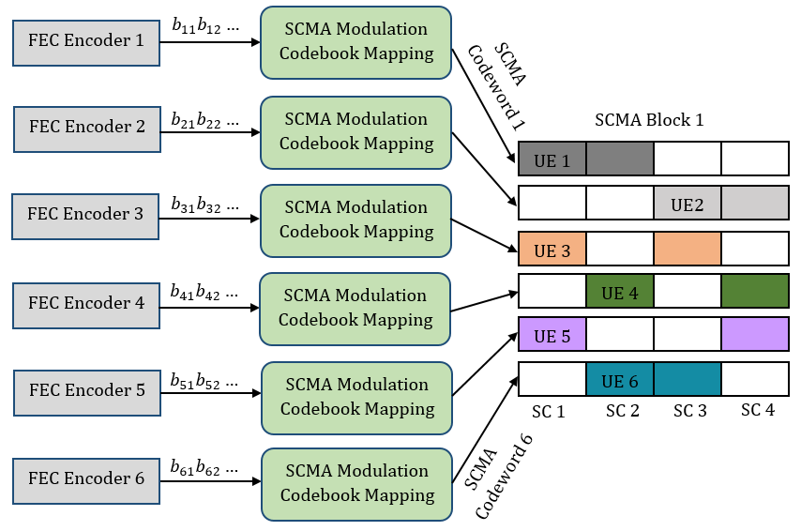
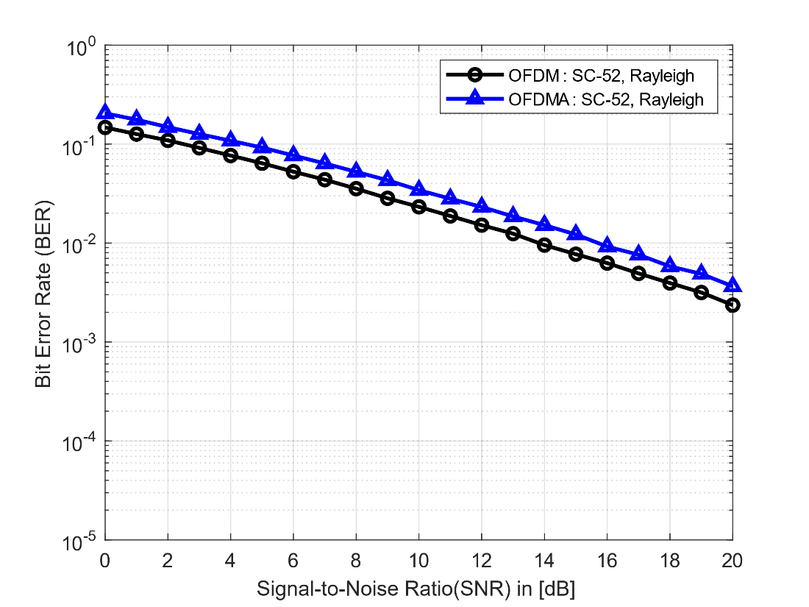
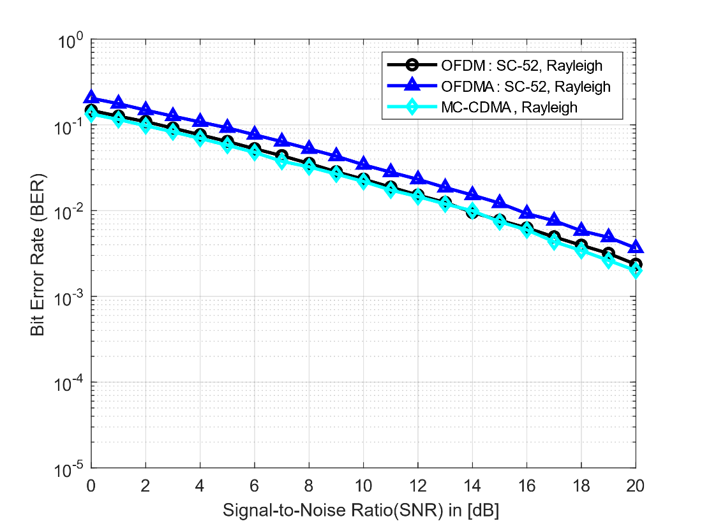
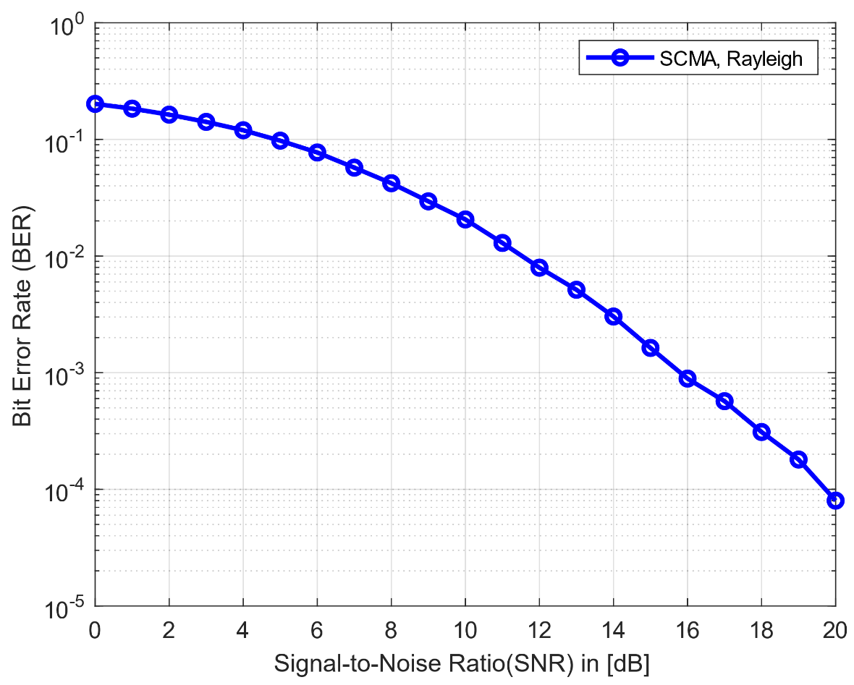
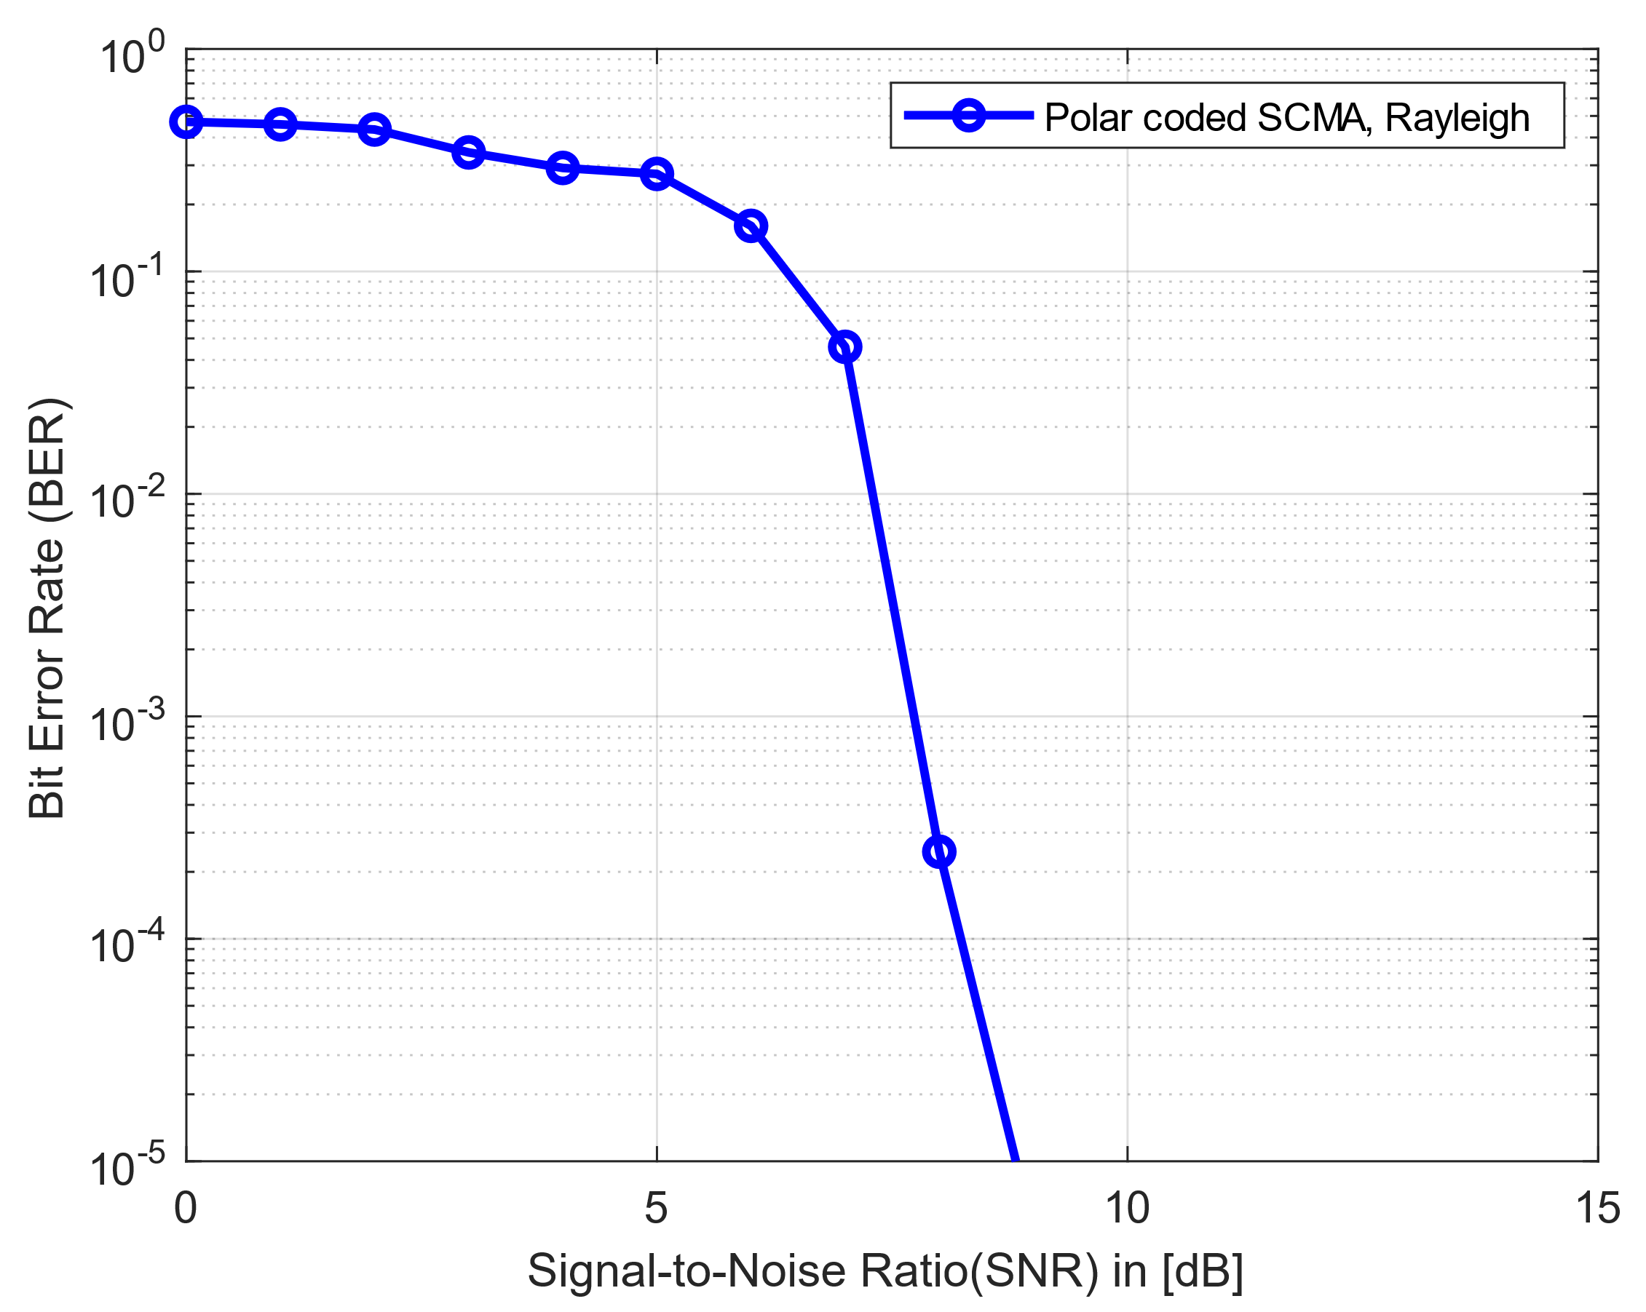
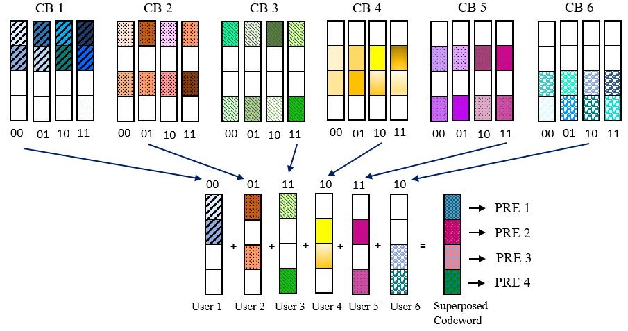
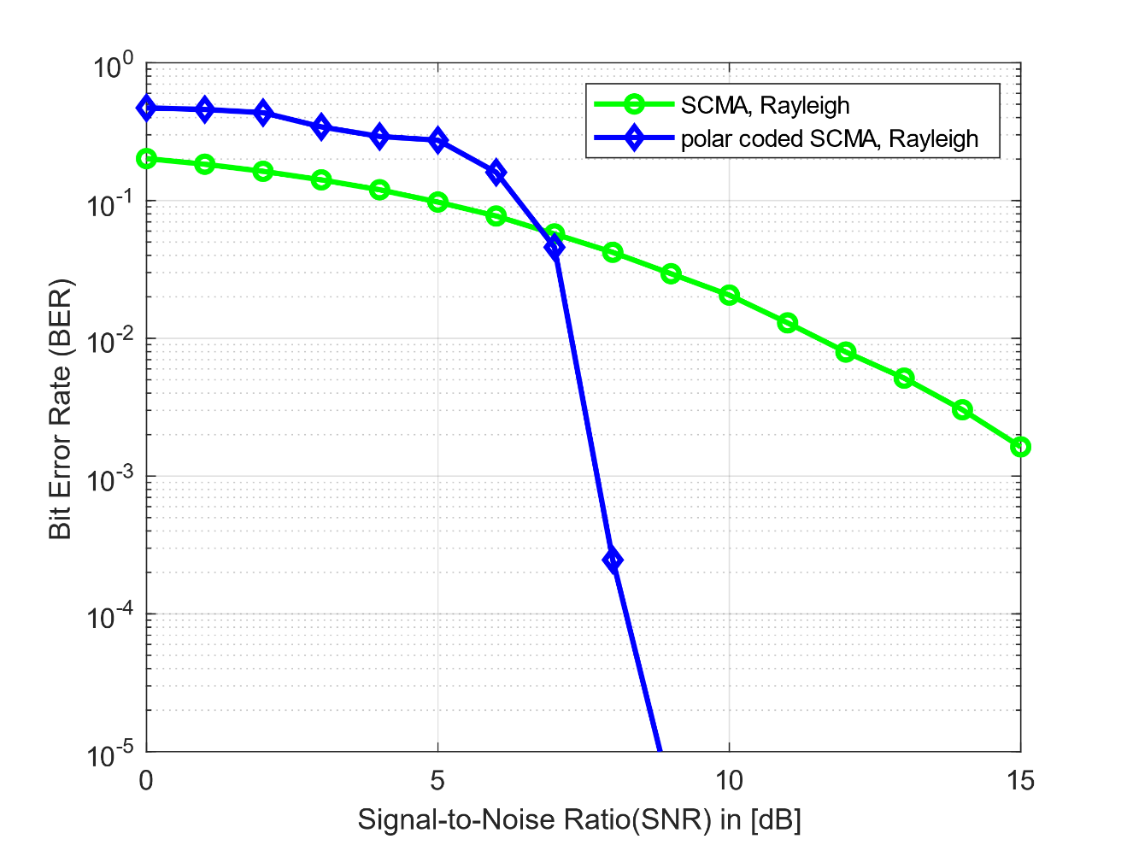
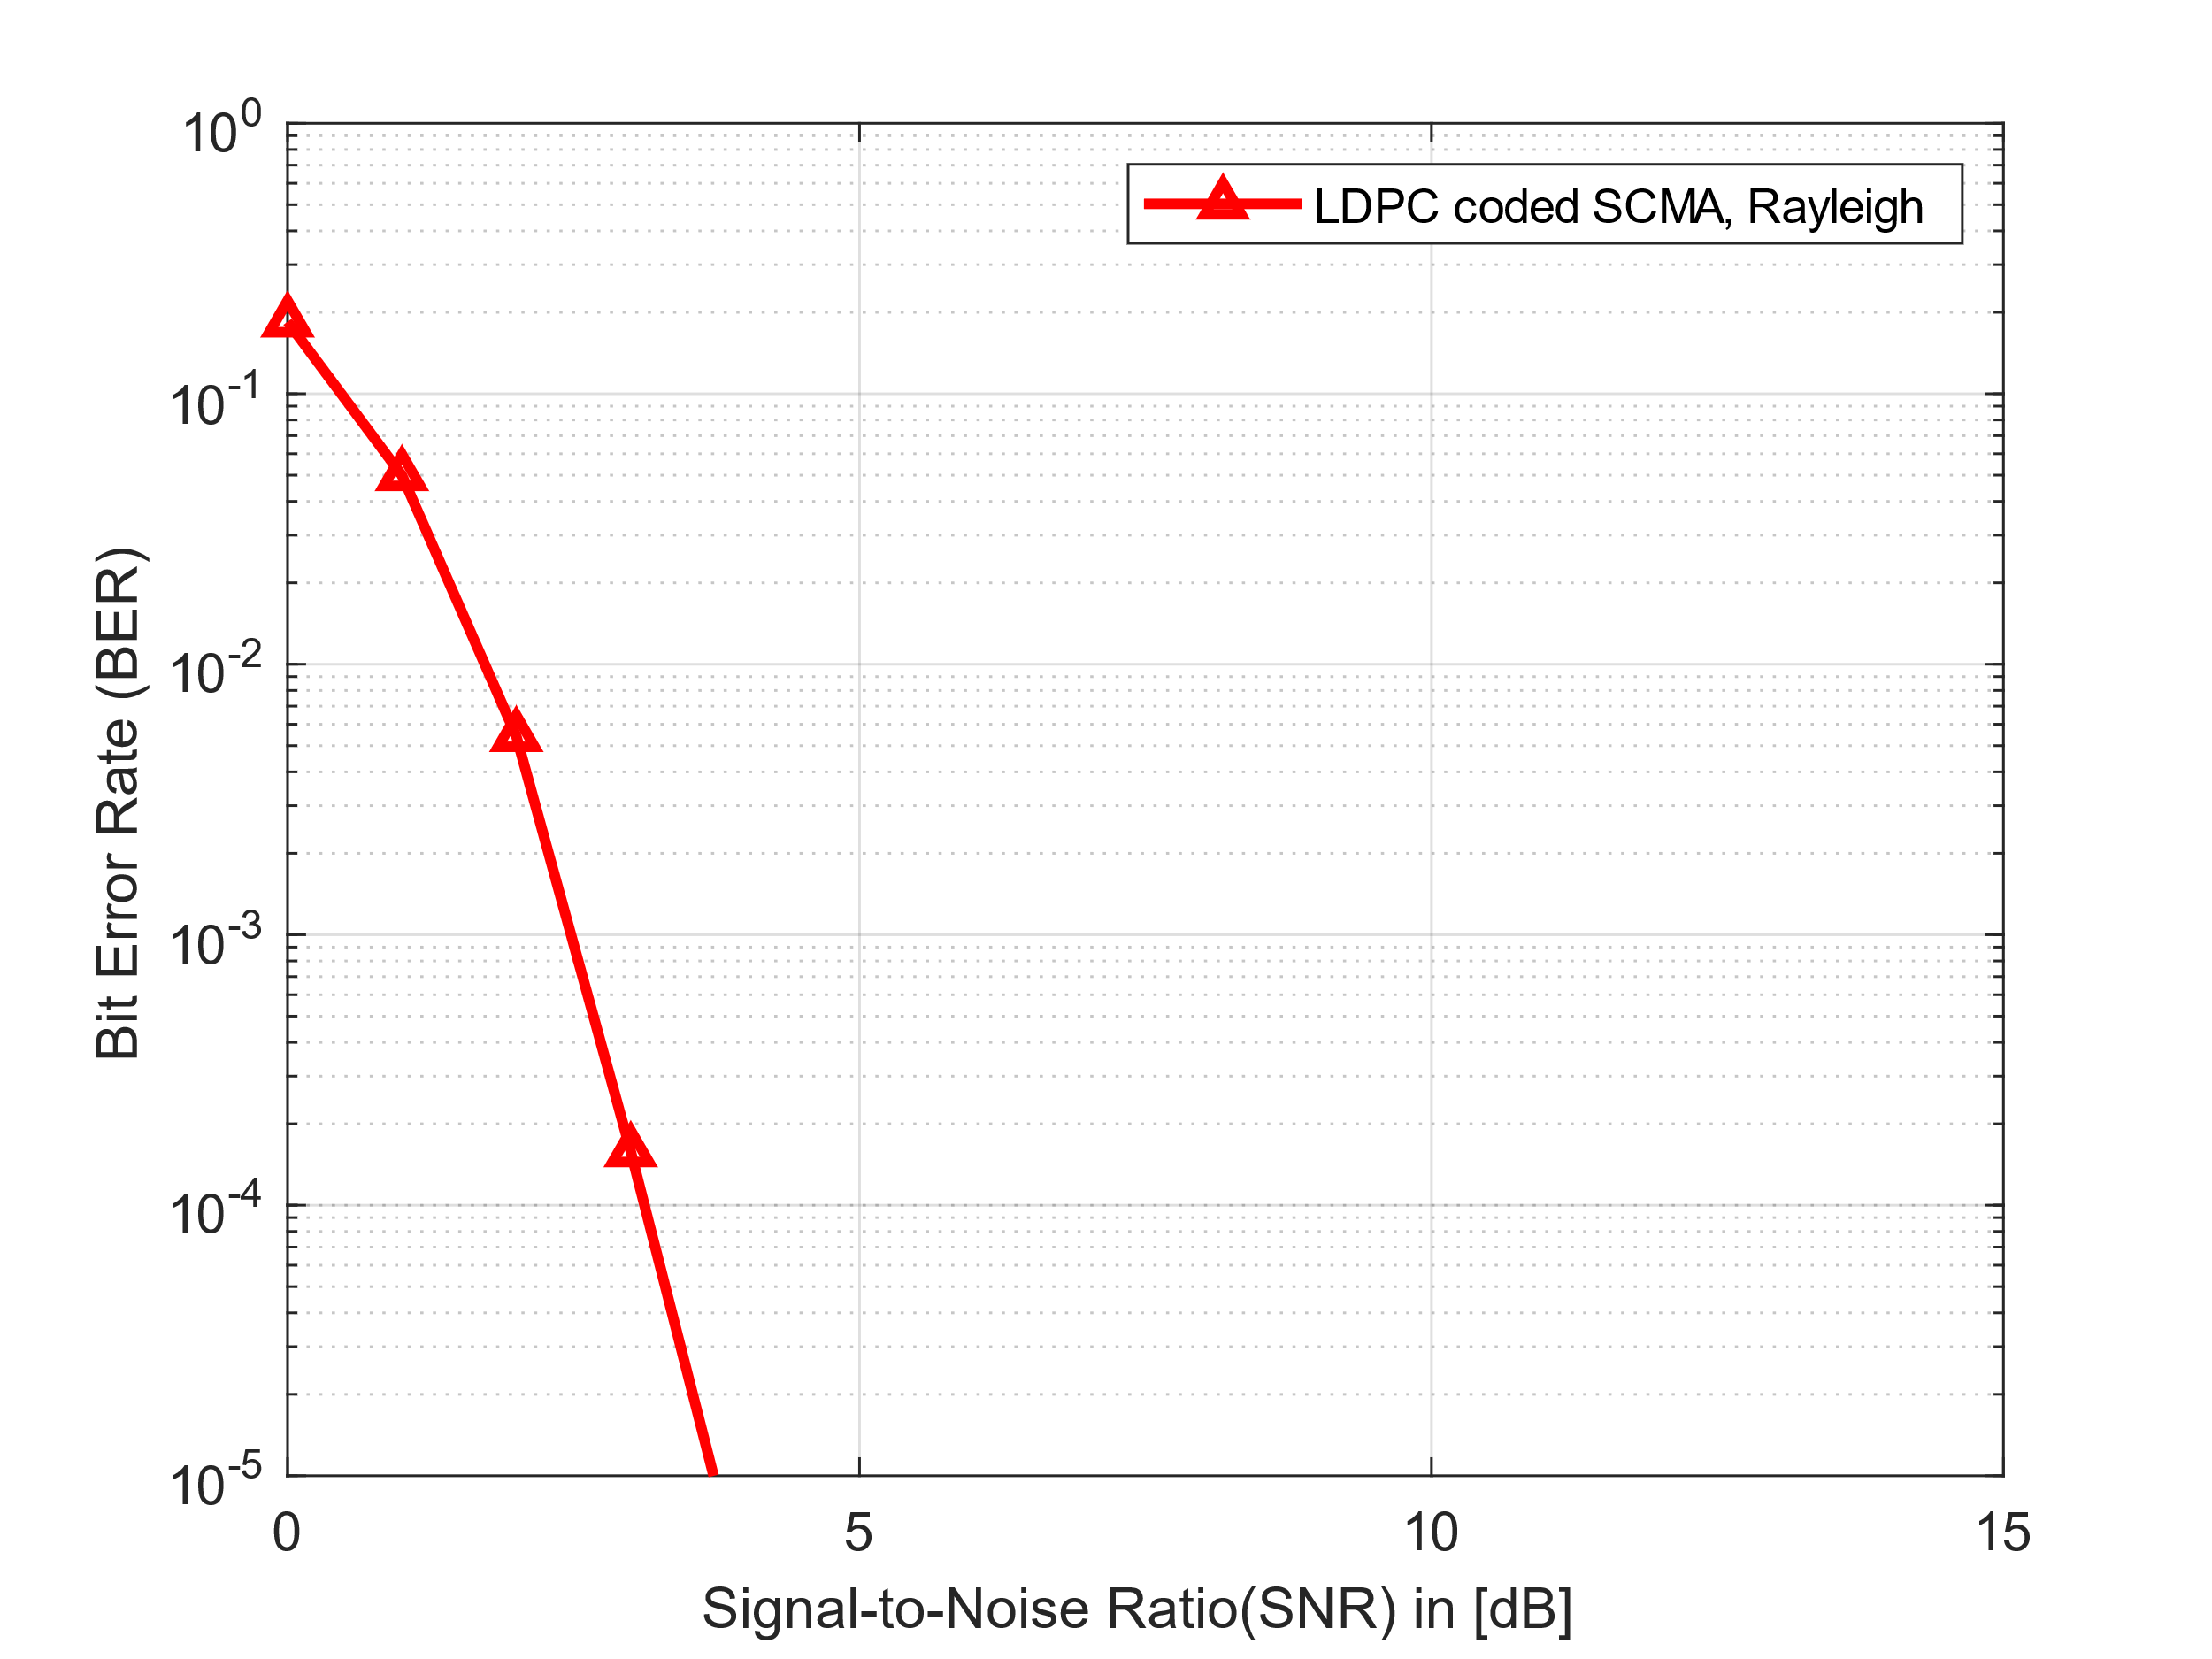
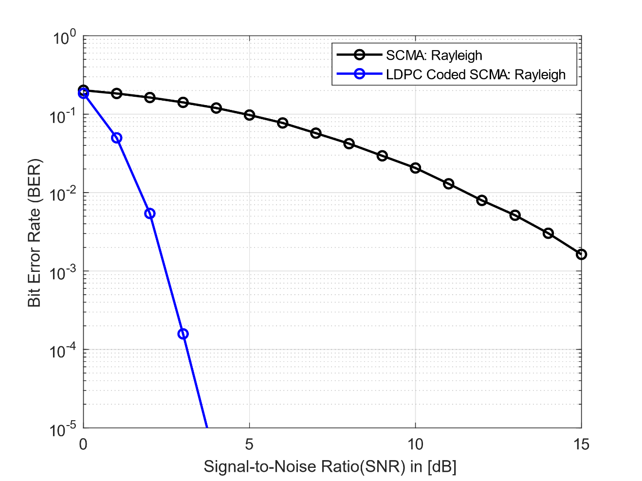
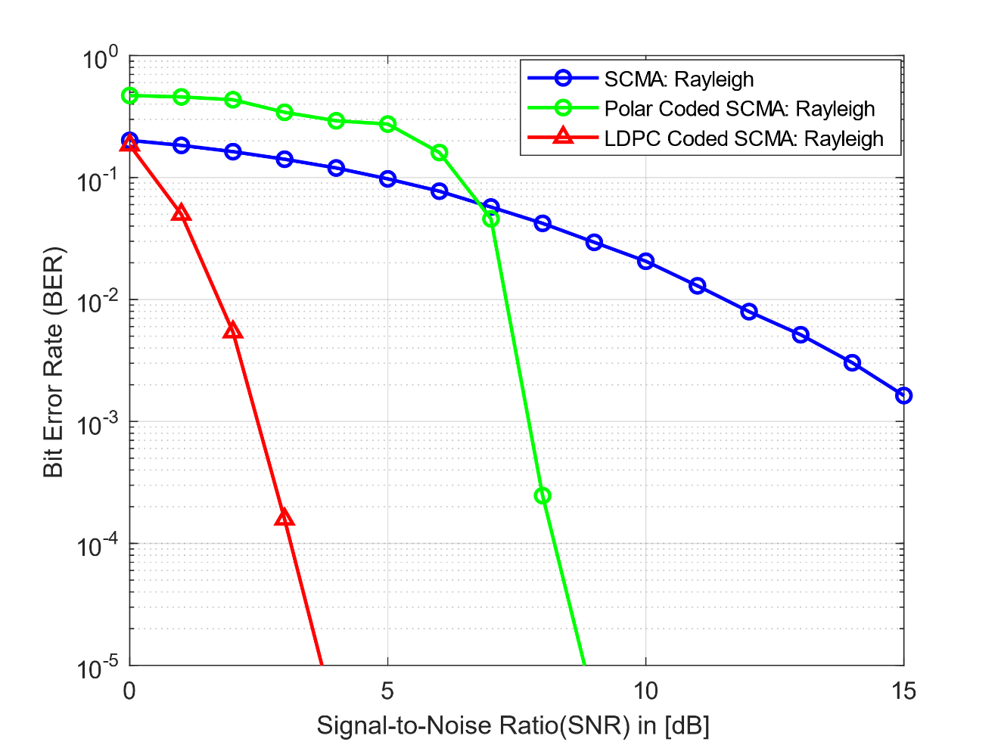
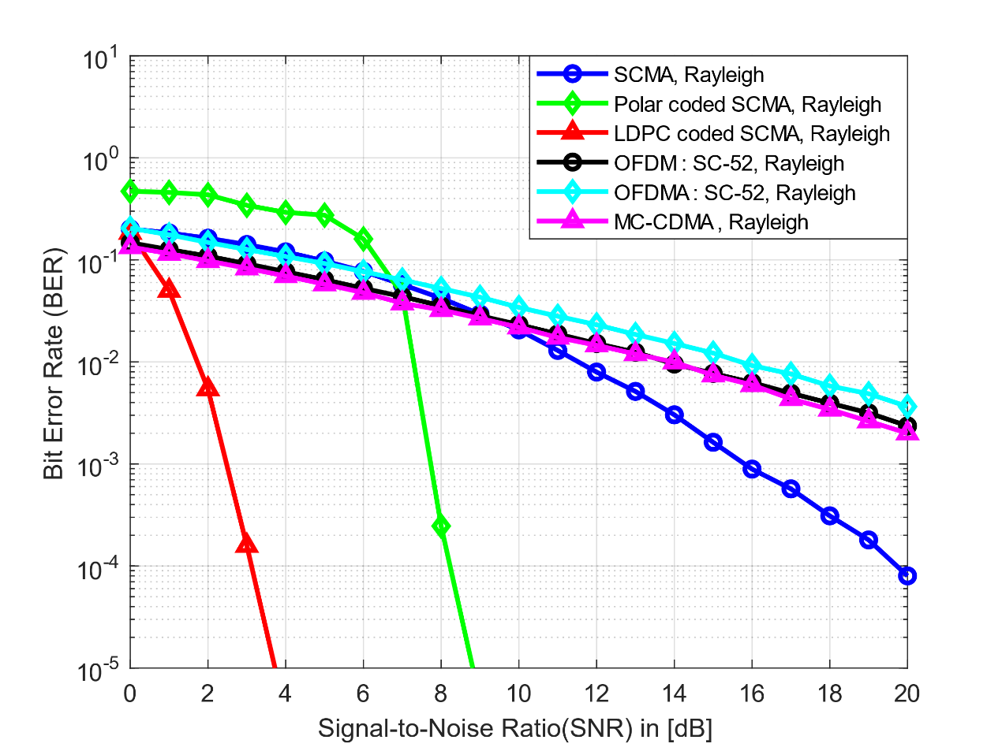
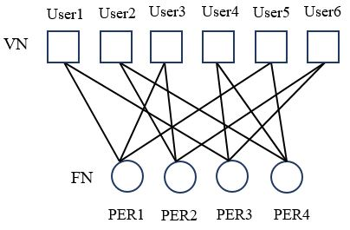
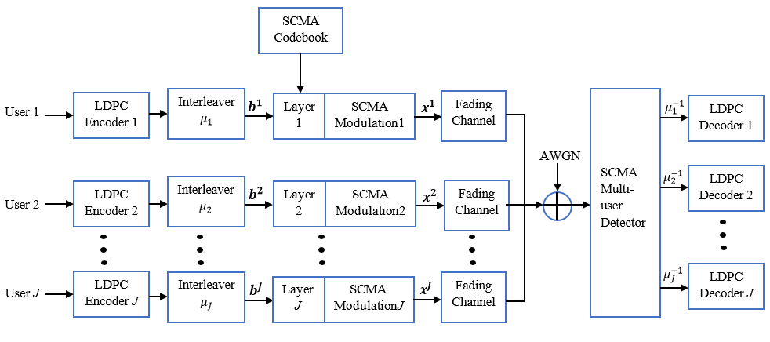

A Comparative Performance Analysis of LDPC coded SCMA with Different types of Multiple Access Schemes
Jinnaton Nessa Laboni, Shatu Karmokar and Prof. Dr. Ismat Kadir
Electronics And Communication Engineering Discipline, Khulna University
Introduction
Introduction
Literature Review
Tanner Graph
The primary goal of wireless communication is to send data, including audio, video, text, and other types of data, without any interference or lag time. Other requirements for wireless communication systems include enhanced synchronization, reduced battery consumption, and security protection.
In telecommunications networks, multiple access refers to methods that let several users effectively share constrained network resources.
We don't require various wireless communication access mechanisms if there is only one user. However, if more than one user needs to share a wireless communication system, we must have a method that enables several users to access the same base station, as the term implies.
An excellent substitute for next-generation wireless communications is the LDPC-coded SCMA receiver.
Lisu et al. have analyzed of SCMA systems with codebooks based on star-QAM signalling constellations. Due to the sparsity of the codewords in SCMA systems, inter-user interference is removed at the receiver using the message passing algorithm (MPA). Numerical analysis and computer simulations had revealed that the analytical and simulation results were well matched, particularly in the high SNR region [1].
Shusen Jing et al. have showed a joint detection and Decoding of Polar Coded SCMA systems. Unlike traditional orthogonal multiple access schemes like CDMA, this novel scheme can support a much higher number of simultaneous connections and has been proposed as a competitive option for 5G air interface technique. In this work the possible joint detection and decoding (JDD) of SCMA and polar code system was analyzed [2].
Kaining Han et al. have proposed a high performance joint detection and decoding scheme of LDPC coded SCMA system [3].
Fig 7: Graphical Representation of Sparse Parity Matrix
Wireless Communication System
Simulation Result
System Model
Performance Analysis of OFDM and OFDMA
BER Performance of OFDM, OFDMA and MC-CDMA
Fig 2: System Model of Sparse code multiple Access
Motivation
SCMA Multiplexing
The goal of the 5G air interface is to provide improved access speeds, higher transmission rates, the ability to support higher density of users, and a superior user experience. Multiple access, a key physical layer technology utilized in wireless communications, enables base stations to serve a diverse group of terminal users simultaneously. The aim of using Sparse Code Multiple Access (SCMA) is to enhance the utilization of spectrum in wireless radio access, thereby improving its efficiency. SCMA utilizes unique codebooks to allow multiple users to share the same resource blocks, minimizing the risk of user collision and providing immunity to interference. Unlike orthogonal multiple access techniques, SCMA can accommodate the large capacity and low latency demands of next-generation communications networks, such as 5G, by proportionally allocating resources according to the number of users.
Fig 3: A Demonstration of SCMA Multiplexing
Contributions
Factor Graph
We have designed LDPC coded SCMA scheme on the rayliegh fading channel. As SCMA is the key enabling NOMA techniques in fifth generation communication, provides an enhanced bit error rate performance due to its sparsity of codebook. Low density parity check codes are capable of performing channels with performance close to Shannon's limit, high throughput, low latency, low decoding complexity, and low rate complexity. Hence, we have synthesized the LDPC encoding and decoding process as a channel coding with SCMA system
For a wireless communication system, polar-coded SCMA has been used in the performance study of the proposed scheme.
We have evaluated the proposed scheme against other multiple access techniques, including Orthogonal Frequency Division Multiplexing (OFDM), Orthogonal Frequency Division Multiple Access (OFDMA), and Multi-Carrier Code Division Multiple Access (MC-CDMA), for a comprehensive comparison and future advancements.
A factor graph can efficiently characterize the low density structure of SCMA code-words, which is similar to that for low density parity check (LDPC) codes.
BER performance of Different Multiple Access schemes
Future Work
Fig 5: Factor Graph Representation of an SCMA System
LDPC coded SCMA system’s performance evaluation can be done by using constellation diagram analysis.
Convergence analysis can be done by using an extrinsic information transfer (EXIT) chart for the better performance analysis.
LDPC Coded SCMA System
Outcome
The key outcome of this thesis is to effectively improve transmission technique performance for 5G and future wireless networks and efficiently fulfil the demands of services required. Previously, numerous access techniques were employed by 5G communication systems. In this instance, Low-Density Parity Check Code (LDPC) based transmission using an rayliegh fading channel has been proposed to enhance the performance of 5G and next-generation wireless networks. When compared to conventional alternative multiple access techniques, LDPC-coded SCMA performs better because the bit error rate (BER) is much lower, channel capacity is greater, less complexity in decoding process. Thus LDPC coded SCMA scheme can provides higher rate data transmission with lower error rate for fifth generation and future wireless communication systems.
Conclusion
we presented the LDPC coded SCMA system for increasing the performance of the wireless system. The LDPC coded SCMA system has advantages when channels are complicated by significant distortion and interference, and also reduce the bit error rate. The simulation results demonstrate the efficiency and improved performance of the proposed system. For high data rate, better channel performance, low bit error rate, low interference among multiple users, the proposed system is effective for the present wireless communication techniques.
Fig 6: LDPC Coded SCMA System
References:
Contact:
Jinnaton Nessa Laboni and Shatu Karmokar
Electronics and Communication Engineering Discipline
Khulna University, Khulna-9208
Email: labonihasan456@gmail.com and shatunatore98@gmail.com
Phone: +8801312546768 and +8801521120767
[1] L. Yu, P. Fan, X. Lei, and P. T. Mathiopoulos, "BER analysis of SCMA systems with codebooks based on star-QAM signaling constellations," IEEE Communications Letters, vol. 21, no. 9, pp. 1925-1928, 2017.
[2] S. Jing, C. Yang, J. Yang, X. You, and C. Zhang, "Joint detection and decoding of polar-coded SCMA systems," in 2017 9th International Conference on Wireless Communications and Signal Processing (WCSP), 2017: IEEE, pp. 1-6.
[3]Han, K., Zhang, Z., Hu, J. and Chen, J., 2016, December. A high performance joint detection and decoding scheme for LDPC coded SCMA system. In 2016 IEEE Globecom Workshops (GC Wkshps) (pp. 1-6). IEEE.
Powered By:

