Slide 1
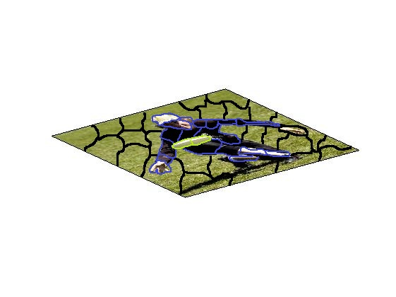
Y
Latent Vars
Measurements

