Slide 1
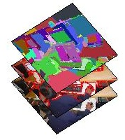
Action node
Fully-connected layer of superpixel labels
Measurements

