Slide 1

Oral, Pharynx & Larynx: Clinical Basics

Slide 2
Learning Objectives
Describe the basic anatomy and function of oral cavity, pharynx and larynx.
Take a focused history and exam for sore throat, hoarseness and oral lesions.
Recognize must-know conditions: peritonsillar abscess, pharyngitis, mono, laryngitis, benign lesions, and early laryngeal cancer.
Know when to refer to ENT (without going into emergency management).

Slide 3





Three Main Complaints
Sore Throat
Hoarseness
"Mouth Problem"
Infection, inflammation, or abscess affecting the pharynx and tonsils.
Any change in voice quality, often pointing to laryngeal (vocal cord) issues.
Ulcers, white patches, or masses found in the oral cavity.

Slide 4

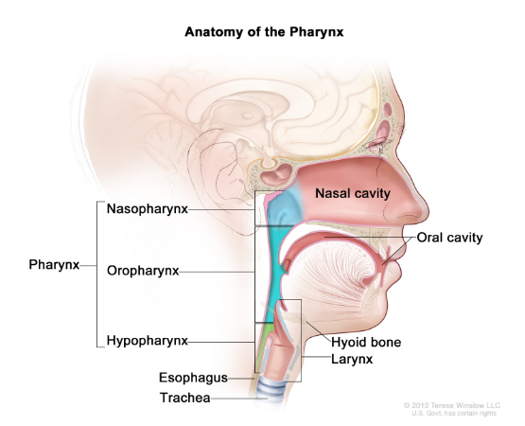
Anatomy Overview
We will move from front to back, then apply this anatomy to our clinical scenarios.
•
Oral Cavity: The entrance.
•
Nasopharynx: Behind the nose.
•
Oropharynx: Behind the mouth.
•
Hypopharynx: Behind the larynx.
•
Larynx: The voice box and airway guardian.

Slide 5
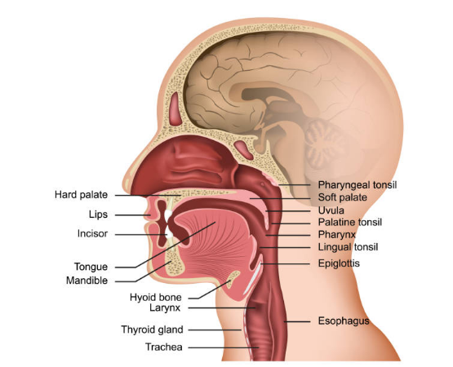
Oral Cavity: Compartments
Boundaries & Spaces
•
Vestibule: Space between lips/cheeks and teeth.
•
Oral Cavity Proper: Inside the alveolar bone/teeth.
•
Roof: Hard & Soft Palate.
•
Floor: Floor of mouth & Tongue.

Slide 6



Oral Cavity: Key Functions
Mastication & Taste
Articulation
Airway
Mechanical and chemical breakdown of food begins here. The tongue is critical for both.
The tongue, lips, and palate work together to form clear speech.
The oral cavity is a crucial part of the upper respiratory tract.

Slide 7
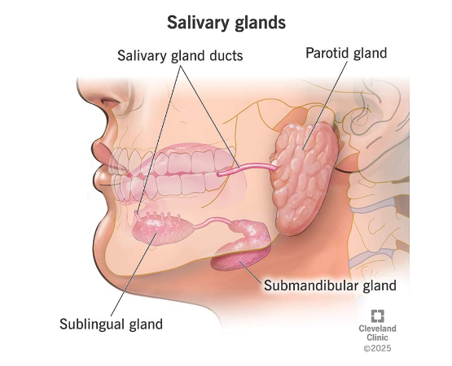
Salivary Glands
Major Glands
•
Parotid
•
Submandibular
•
Sublingual
Key Functions
Lubrication, early digestion (amylase), protection (antimicrobial), and buffering.

Slide 8
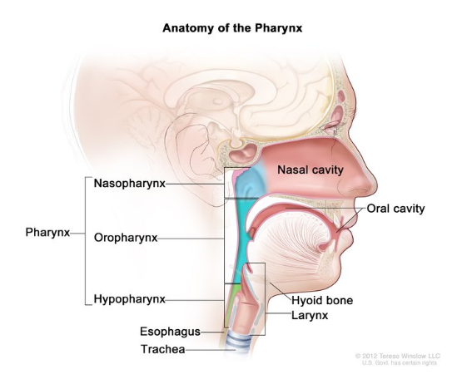
Pharynx: Three Regions
•
Nasopharynx: Respiratory epithelium. Contains adenoids & Eustachian tube opening.
•
Oropharynx: Squamous epithelium. Contains palatine tonsils & base of tongue.
•
Hypopharynx: Behind the larynx. Guides food bolus to the esophagus.

Slide 9
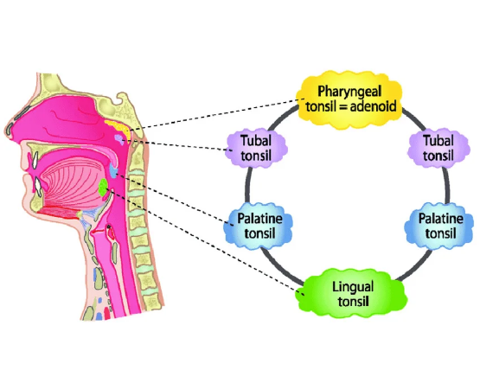
Waldeyer’s Ring
Immune Role
The first immunological barrier for air and food entering the body.
Components
•
Palatine Tonsils (Tonsils)
•
Adenoids (Pharyngeal Tonsil)
•
Lingual Tonsil
•
Tubal Tonsils

Slide 10



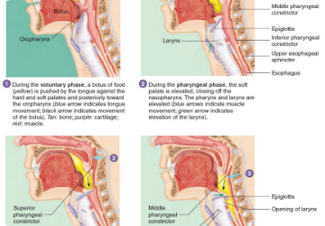
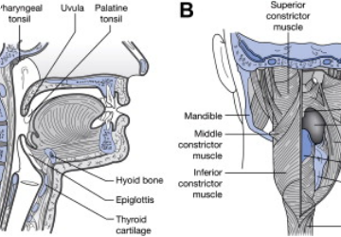

Swallowing Protection
1. Soft palate elevates to close the nasopharynx.
2. Larynx elevates & epiglottis tilts to close the airway.
3. Pharyngeal constrictors contract, pushing bolus to esophagus.

Slide 11
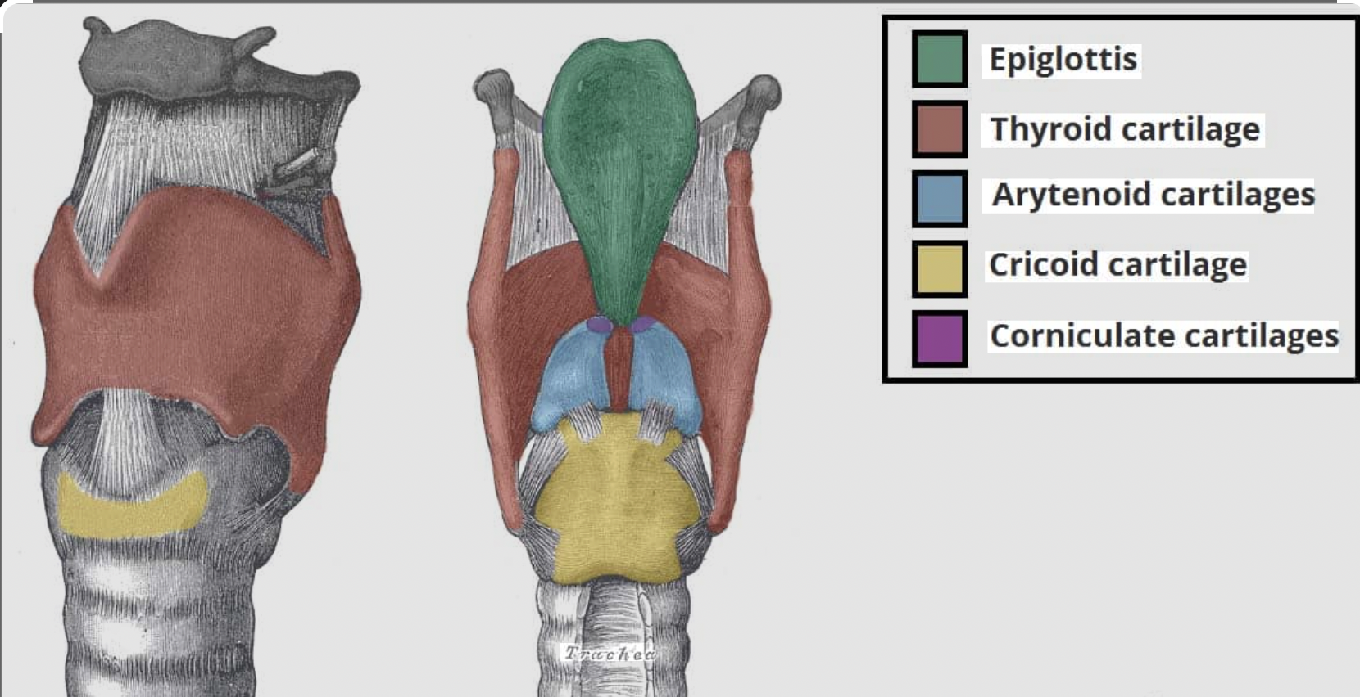

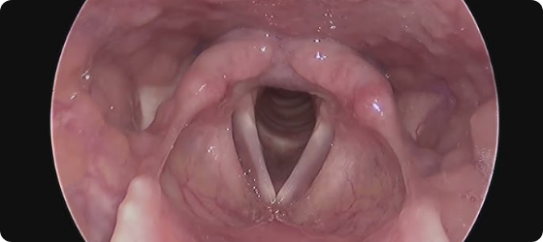
Larynx: Framework
External Framework: Thyroid, Cricoid, Arytenoids, Epiglottis.
Compartments (Endoscopic View): Supraglottis, Glottis (vocal cords), Subglottis.

Slide 12
Sore Throat: History
Duration: Acute vs. Recurrent.
Systemic Features: Fever, malaise, rash.
Associated Symptoms: Cough, rhinorrhea, conjunctivitis (suggests viral).
Severity: Odynophagia (painful) vs. Dysphagia (difficult).
Antibiotics only if bacterial features are present.

Slide 13



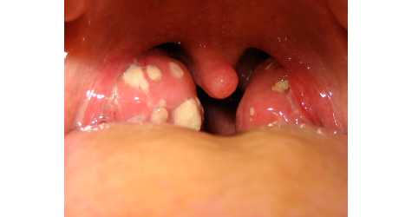
Viral vs. Bacterial Pharyngitis
Viral (Most Common)
Group A Strep
•
Cough
•
High Fever
•
Rhinorrhea (runny nose)
•
Tonsillar Exudate
•
Conjunctivitis
•
Tender Anterior Cervical Nodes
•
Oral ulcers
•
Absence of cough
•
Exanthem (rash)

Slide 14

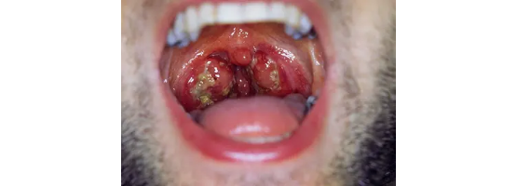
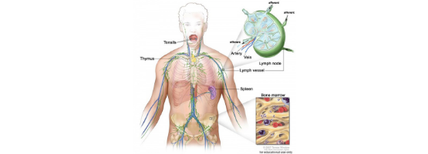
Infectious Mononucleosis (EBV)
Typical Scenario
•
Teen/Young Adult
•
Prolonged fatigue + sore throat
•
Large "Kissing Tonsils"
•
Generalized lymphadenopathy
•
Splenomegaly (risk of rupture)
•
Rash after Amoxicillin

Slide 15
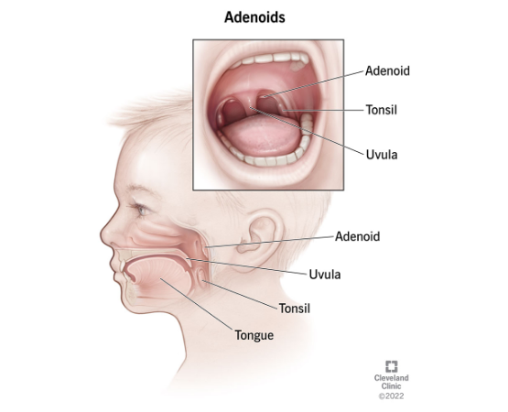
Recurrent Tonsillitis & Adenoids
Recurrent Tonsillitis
Multiple episodes per year. Tonsillectomy indications are specific (e.g., >7 in 1 year, >5/yr for 2 yrs, >3/yr for 3 yrs ).
Adenoid Hypertrophy
Common in children. Leads to:
•
Mouth breathing
•
Snoring
•
Recurrent otitis media

Slide 16
Peritonsillar Abscess: Importance
Clinical Picture:
Severe UNILATERAL sore throat & odynophagia.
Fever, malaise.
Difficulty swallowing, drooling.
limited mouth opening

Slide 17

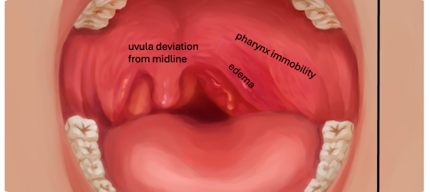
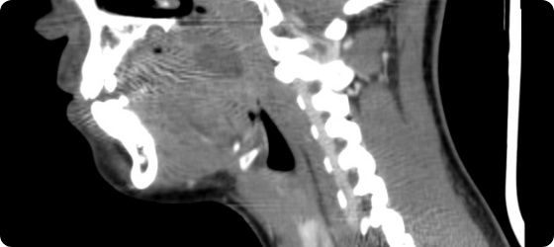
Peritonsillar Abscess: Exam
Clinical Exam: Unilateral swelling, bulging soft palate, uvula deviated to opposite side.
CT Scan: Rim-enhancing collection (abscess) pushing tonsil medially.
Also look for: Trismus (limited mouth opening) and "Hot-potato" muffled voice.

Slide 18






Sore Throat: Your Role
1. Take History
2. Perform Exam
3. Recognize Patterns
Use a structured sore throat history (duration, fever, cough, etc.).
Use light & tongue depressor. Inspect tonsils, pillars, palate elevation. Check for asymmetry & trismus.
Viral vs. Strep vs. Mono. Know when the picture fits peritonsillar abscess and requires ENT review.

Slide 19
Hoarseness: Definition
Hoarseness = symptom; Dysphonia = clinical finding.
Common and often benign, but can be an early sign of serious disease.
“
e.g., A singer with acute laryngitis vs. A smoker with chronic hoarseness.

Slide 20
Hoarseness: History
Duration: Acute (<2 wks), Subacute, Chronic (>4 wks).
Voice Use: Teacher, singer, call center, etc.
Risk Factors: Smoking & Alcohol.
Associated: Reflux, URTI, cough, dyspnea, dysphagia, otalgia, weight loss, neck mass, recent surgery/intubation.

Slide 21
Hoarseness: Red Flags
Hoarseness > 4 weeks → Laryngoscopy recommended.
Immediate/Urgent ENT If:
Neck mass
Significant dysphagia/odynophagia
Respiratory distress / Stridor
Recent head/neck/chest surgery or intubation
Heavy smoker with persistent hoarseness

Slide 22

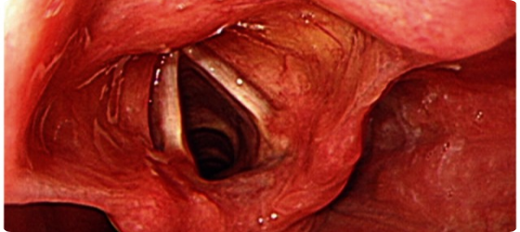
Acute Laryngitis
Normal Larynx: Clean, white, mobile vocal folds.
Acute Laryngitis: Red, swollen vocal folds after URTI or vocal overuse.
Management: Voice rest (no shouting/whispering), hydration. Avoid unnecessary antibiotics.

Slide 23
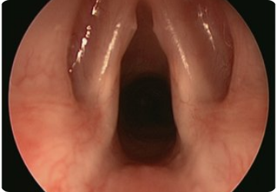
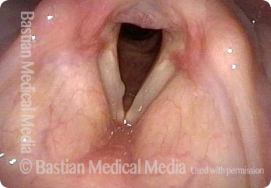
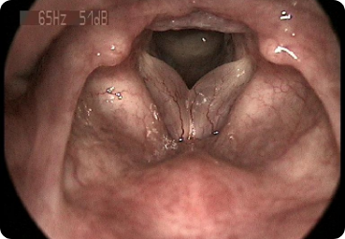
Benign Vocal Fold Lesions
Nodules: Bilateral, symmetric. From overuse (teachers, singers). Voice therapy is first-line.
Polyp: Unilateral lesion. Often from smoking or acute phonotrauma.
Reinke’s Edema: Swollen, "water-bag" cords. Classic deep "smoker's voice".

Slide 24
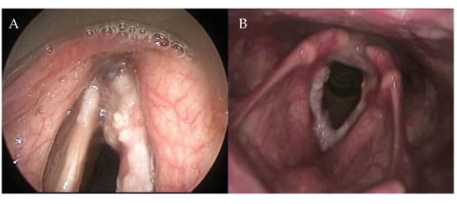
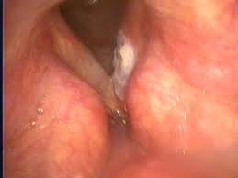
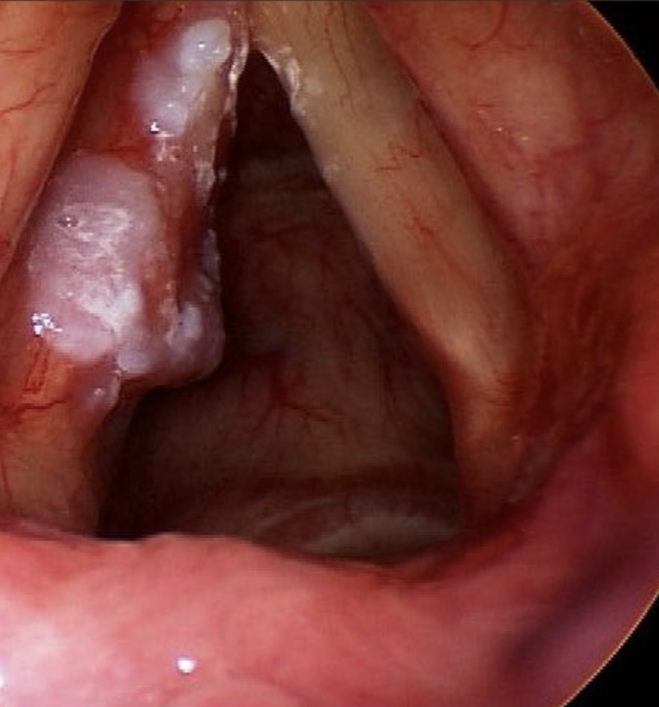
Early Laryngeal Cancer
Endoscopic View: A lesion (often leukoplakia or ulcer) on one vocal cord.
Classic Presentation: Isolated hoarseness > 4 weeks in a smoker.
Any persistent hoarseness with risk factors → needs laryngeal visualization.

Slide 25
Hoarseness: Algorithm
< 2 Weeks (Acute)
2-4 Weeks (Subacute)
>4 Weeks or Red Flags
After URTI/overuse, no red flags.
Action: Conservative (voice rest, hydration).
Risk factors present (e.g., smoking).
Action: Arrange for laryngoscopy.
Any red flag (neck mass, stridor) OR persistent hoarseness.
Action: ENT Evaluation (visualize larynx).

Slide 26
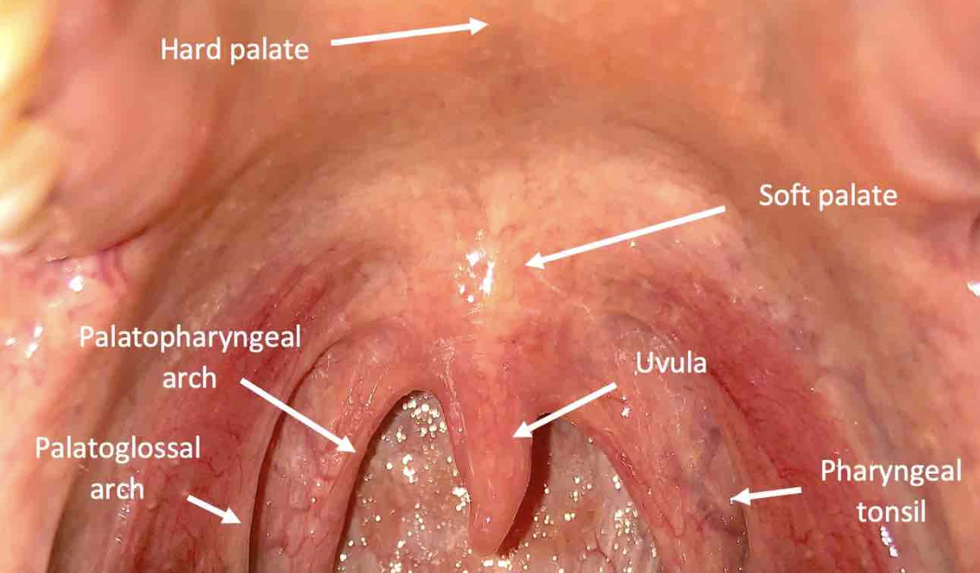
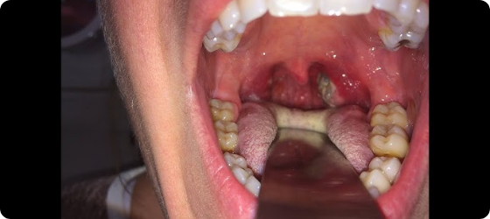
Oral Cavity Exam
Systematic Exam: Use good light, gloves, tongue depressor. Inspect Lips → Buccal Mucosa → Teeth/Gingiva → Floor of Mouth
...Tongue (esp. lateral borders) → Hard/Soft Palate → Tonsils/Pillars. Ask patient to say "eee" to check palate symmetry.

Slide 27
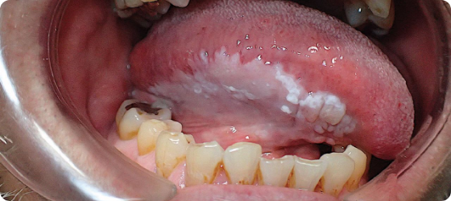
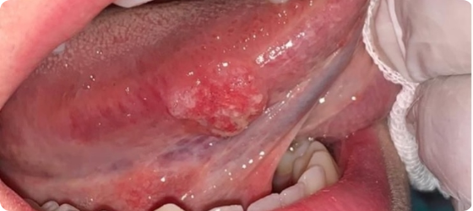
Oral Lesions: Red Flags
Leukoplakia/Erythroplakia: White or red patch that doesn't rub off. High-risk on lateral tongue/floor of mouth.
Suspicious Ulcer: Ulcer > 2-3 weeks, indurated (hard) edges, bleeding, fixed mass.

Slide 28
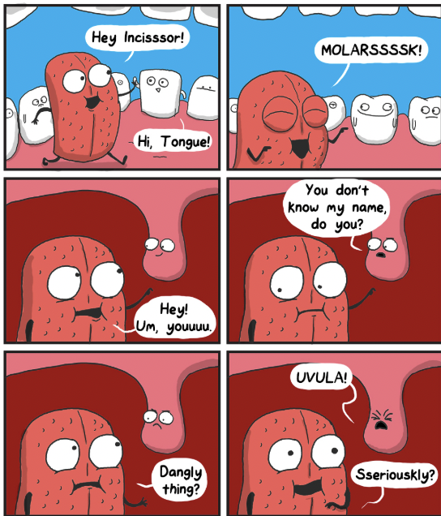
Thank you

