Slide 1

An Introduction to ENT Emergencies For Medical Students
Ory Madgar
Sheba Medical Center

Slide 2

Airway Obstruction
Symptoms:
Signs:
  Dyspnea
  Dysphagia
  Change in voice
Tachypnea
Use of accessory muscles
Stridor – inspiratory/biphasic/expiratory
Drooling
Hoarseness
Agitation
Cyanosis

Slide 3
Airway Obstruction
Pediatric causes
Etiology | Common causes
Congenital | Laryngomalacia, tracheomalacia, subglottic stenosis, vocal cord paralysis, hemangioma
Infectious | Croup, epiglottitis, deep neck abscess
Allergic | Angioedema, anaphylaxis
Trauma | Blunt neck trauma, inhalation injury,
Foreign body | Inhaled foreign body
Masses | Lymphoma, Lymphovascular malformation

Slide 4
Airway Obstruction
Adult causes
Etiology | Common causes
Infectious | Supraglottitis, deep neck abscess
Allergic | Angioedema, anaphylaxis
Trauma | Blunt neck trauma, laryngeal fracture, inhalation injury,
Foreign body | Inhaled foreign body (high risk in elderly or intoxicated)
Neurologic | Bilateral vocal cord paralysis
Masses | Laryngeal carcinoma, oropharyngeal carcinoma, neck mass compressing the airway

Slide 5
Airway Obstruction
Management:
  Investigations are secondary to immediate management.
  Investigation that agitates patients may risk decompensation.
  Flexible endoscopy and imaging in a stable patient can help identify the cause.

Slide 6
Airway Obstruction
Initial management (ABC first):
  Oxygen, or Heliox if available
  Nebulized adrenaline
  High-dose steroids – IV and nebulized
  If the patient fails to improve, consider intubation
    Video laryngoscope
    Awake fiberoptic intubation
    - If intubation is not possible/successful surgical airway may be necessary.

Slide 7
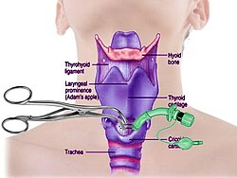
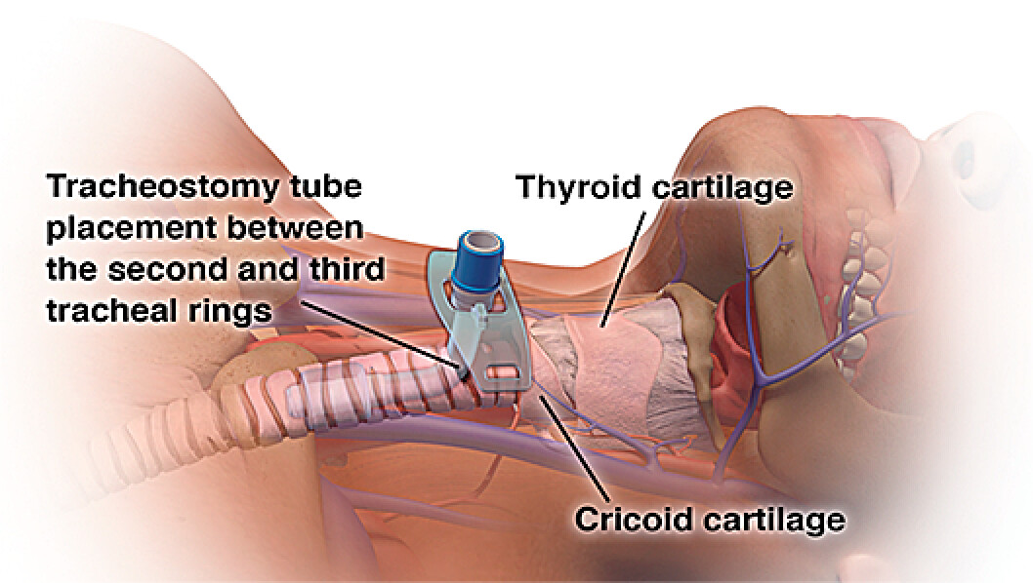
Airway Obstruction
Tracheostomy
Coniotomy

Slide 8
Sudden Sensorineural Hearing Loss - SSHL
A rapid-onset subjective sensation of hearing impairment in one or both ears, which is:
  Sensorineural in nature
  Occurs ≤72-hour
  ≥30dB loss across at least 3 consecutive frequencies

Slide 9
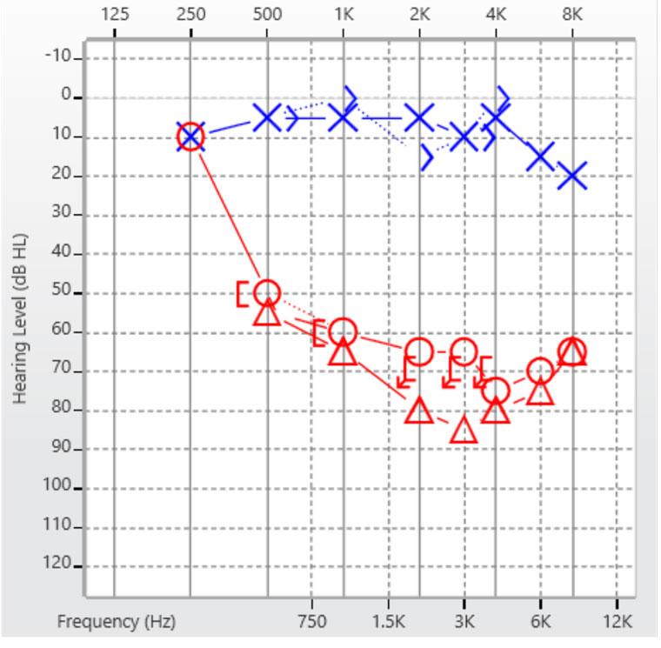
SSHL – Diagnosis
Physical exam:
  Normal otoscopy
  Weber lateralizes to the contralateral ear.
  Audiometry

Slide 10
SSHL – Diagnosis
Etiology:
Idiopathic
Infectious:
    Meningitis
    Viral infection
    Lyme
    Syphilis
  Neoplasm
    Vestibular schwannoma
    Inflammatory
      Autoimmune inner ear disease
Neurologic
  Vascular
  Multiple sclerosis
  Meniere disease
  Trauma
  Temporal bone fracture

Slide 11
SSHL – management
Time is of the essence!
First line (up to 2 weeks)
  High-dose steroid therapy
  Can be combined with hyperbaric oxygen therapy
  Salvage therapy (up to 6 weeks)
    Intratympanic steroid injection
    Hyperbaric oxygen therapy
  MRI – to rule CPA/IAC tumor.
  Follow-up audiometry

Slide 12
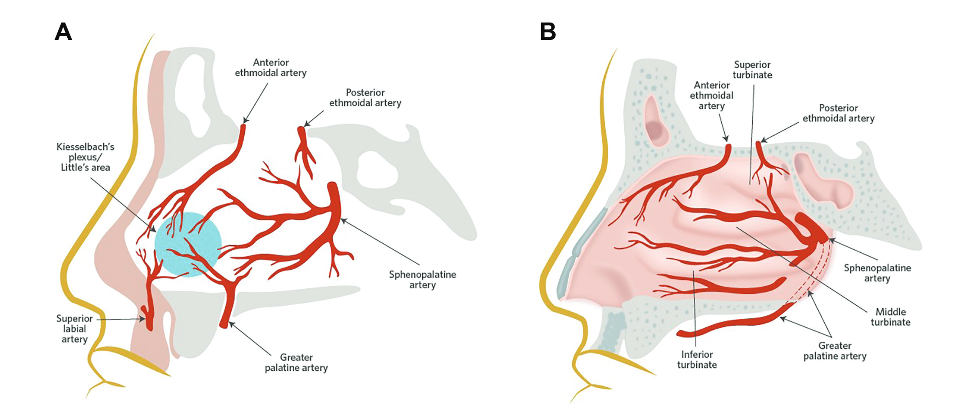
Epistaxis
Rich blood supply from ICA &ECA
90% - anterior bleeding

Slide 13
Epistaxis
Local factors:
Systemic
Idiopathic
Trauma
Iatrogenic (post-op)
Neoplasm
Coagulopathies
Antiplatelet/anticoagulant medications
HHT

Slide 14
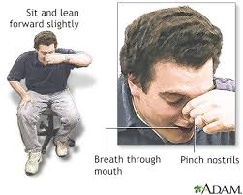
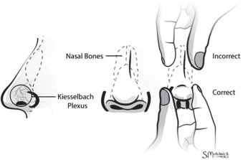
Epistaxis
First aid:
  Continuous alar pressure
  Lean forward
  Head flexion
  Breath through the mouth
If severe (ABC):
  A: sitting forward, suction
  B: through the mouth
  C:
    IV access
    CBC, PT, PTT, INR, blood type
    Estimate blood loss
    IV fluids, packed cells if need

Slide 15
Epistaxis - Management
Establish source:
  Remove clots
  Decongest and anaesthetize
  Anterior rhinoscopy and nasoendoscopy
  Treatment options:
    Cautery – chemical/electric
    Packing
      Dissolvable/non-dissolvable
      Anterior/posterior
  Surgery:
    Sphenopalatine artery ligation
    Anterior/posterior ethmoidal artery ligation
  Selective Embolization

Slide 16
Epistaxis - Management
Establish source:
  Remove clots
  Decongest and anaesthetize
  Anterior rhinoscopy and nasoendoscopy

Slide 17
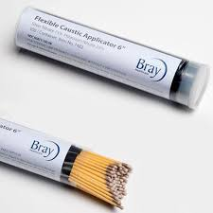
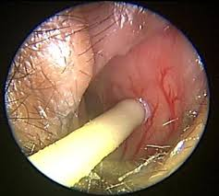
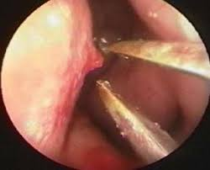
Epistaxis - Management
Nasal cautery
Chemical
Electrocautery

Slide 18
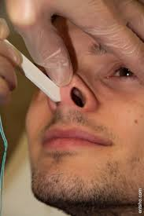
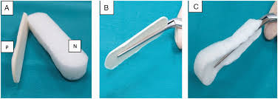
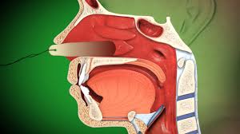
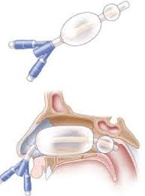
Epistaxis - Management
Anterior packing
Posterior packing

Slide 19
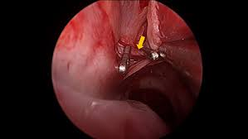
Epistaxis - Management
  Surgery:
    Sphenopalatine artery ligation
    Anterior/posterior ethmoidal artery ligation
  Selective Embolization

Slide 20
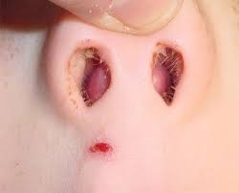
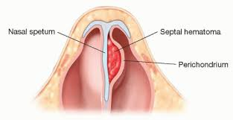
Septal Hematoma
Collection of blood between the septal cartilage and perichondrium
Most commonly caused by trauma or septal surgery
If untreated, may lead to:
  Septal necrosis
  Septal perforation
  Septal abscess
  Nasal deformity
Any nasal trauma → always examine the septum for hematoma

Slide 21
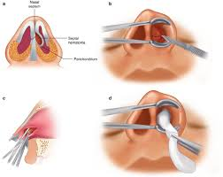
Septal Hematoma
Management
  Incision and drainage
  Nasal tamponade
  Prompt treatment will prevent complications

Slide 22
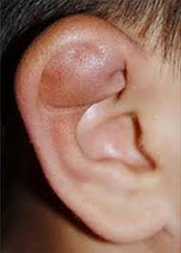
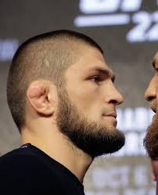
Auricular Hematoma
Collection of blood between the perichondrium and the cartilage of the ear
Typically, the result of blunt trauma
Complications:
  Abscess formation
  Cauliflower ear

Slide 23
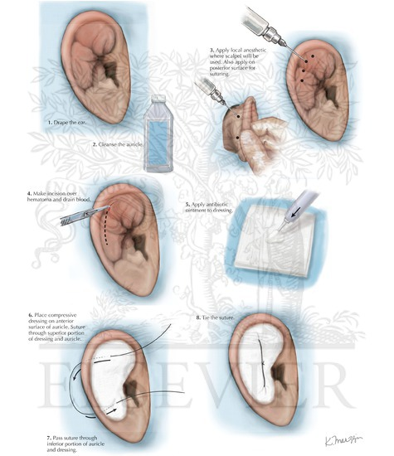
Auricular Hematoma

Slide 24
Clinical Case 1 – Stridor
A 4-year-old arrives with inspiratory stridor, fever, and barking cough.
Most likely diagnosis?
Initial management steps?

Slide 25
Clinical Case 2 – Sudden Hearing Loss
A 55-year-old wakes up unable to hear in the right ear.
Tuning fork: Weber lateralizes left.
Next steps?

Slide 26
Clinical Case 3 – Epistaxis
72-year-old on anticoagulation presents with heavy nose bleeding.
First aid?
When to pack?

