Slide 1
Thyroid and Parathyroid Surgical diseases
Otolaryngology Head and Neck Surgery Rotation –
TAU Medical Students
Prepared by Dr. Liyona Kampel, 2025

Slide 2
Learning Objectives
Review thyroid and parathyroid embryology and anatomy
Discuss evaluation and management of thyroid nodules, thyroid cancer and hyperparathyroidism
Recognize surgical indications, surgical challenges and complications

Slide 3
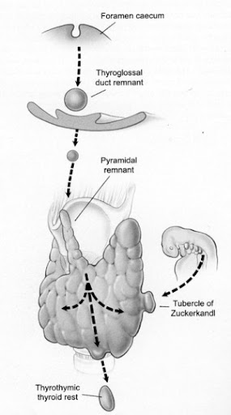
Thyroid gland
Embryology
Endodermal outpouching, between 1st- 2nd pharyngeal pouches
Mature shape - 2 lobes connected by an isthmus
  up to 40% pyramidal lobe
Parafollicular C cells - 4th pharyngeal pouch (ultimobranchial body)
Notes:
Proliferation of endodermal cells in pharyngeal floor. Descends from foramen cecum, connects tongue via thyroglossal duct

Slide 4
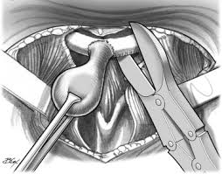
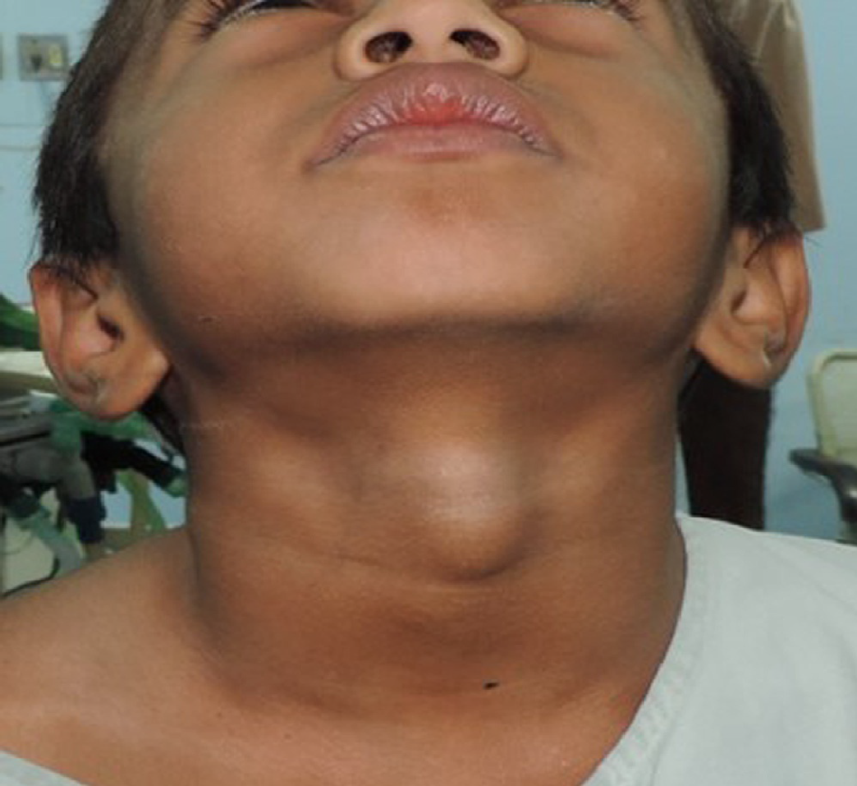
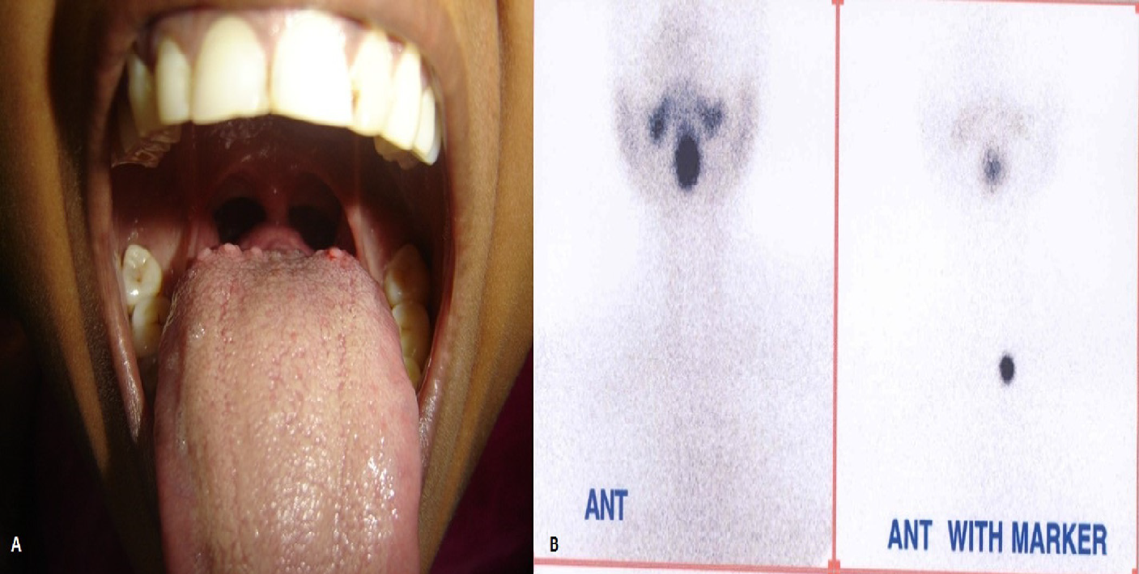
Anatomic variations
Thyroglossal duct cyst
  Midline mass
  Pre-op US to detect thyroid tissue
Ectopic thyroid (most common lingual thyroid)
Sistrunk procedure

Slide 5
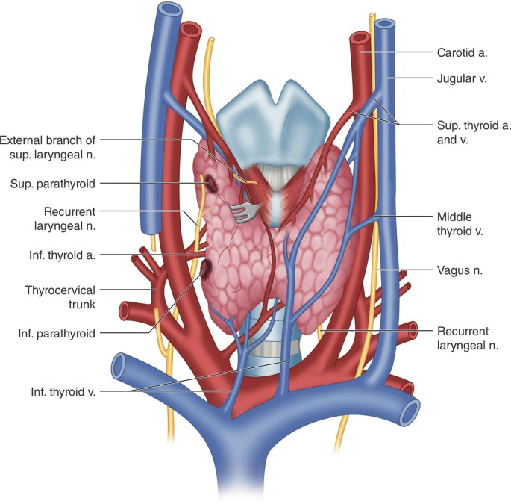
Surgical Anatomy of the Thyroid
Relations:
Trachea and esophagus medially
Carotid sheath laterally
PT glands, RLN
Prevertebral fascia posteriorly
Blood supply:
  Arteries: Superior thyroid, Inferior thyroid, IMA
  Venous drainage: Superior, Middle and Inferior thyroid veins

Slide 6
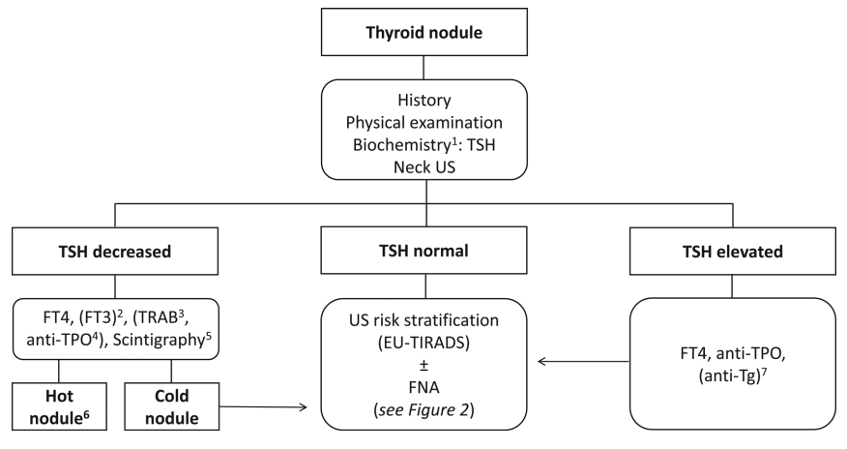
Thyroid nodules
Prevalence: ~5% of adults have palpable nodule
5-15% malignant depending on risk factors
ATA algorithm:
History, physical exam, TSH
Ultrasound: size, echogenicity, margins, calcifications
FNA if >1 cm or high-risk features
If indeterminate → molecular testing or diagnostic surgery
ATA = Americal Thyroid Association

Slide 7
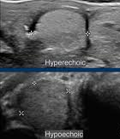
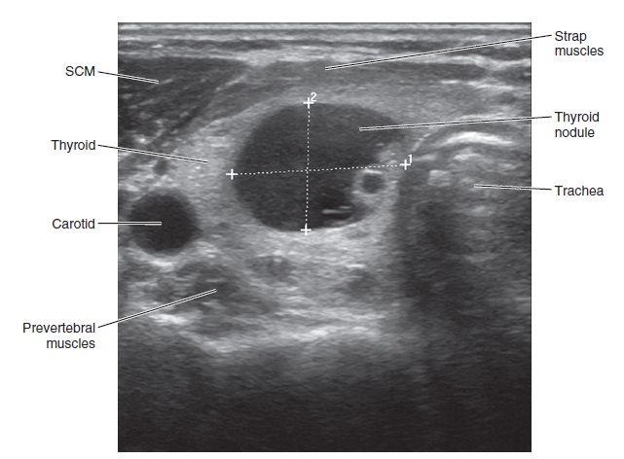
Thyroid nodules
Sonographic Criteria for FNA
High suspicion: microcalcifications, irregular margins, hypoechoic, taller-than-wide, extrathyroidal extension
Intermediate suspicion: hypoechoic, smooth margins, solid
Low suspicion: isoechoic or partially cystic
Very low suspicion: spongiform or purely cystic

Slide 8
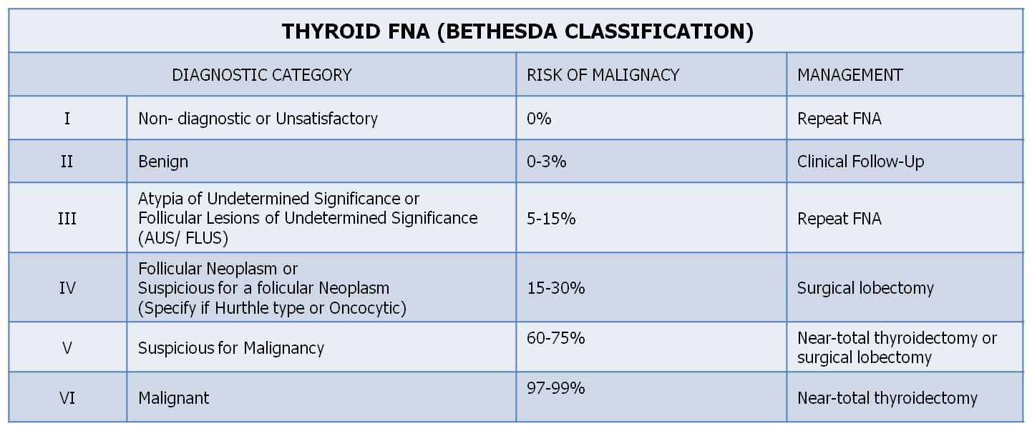
Thyroid nodules
Cytology – risk for malignancy

Slide 9
Thyroid Cancer
Follicular cells:
  Papillary (80%) – lymphatic spread, excellent prognosis
  Follicular (15%) – hematogenous spread (lung, bone)
Parafollicular cells:
  Medullary (5%) –C cells producing calcitonin
Anaplastic (<2%)- highly aggressive, poor prognosis
Others (1%): Lymphoma, Metastasis

Slide 10
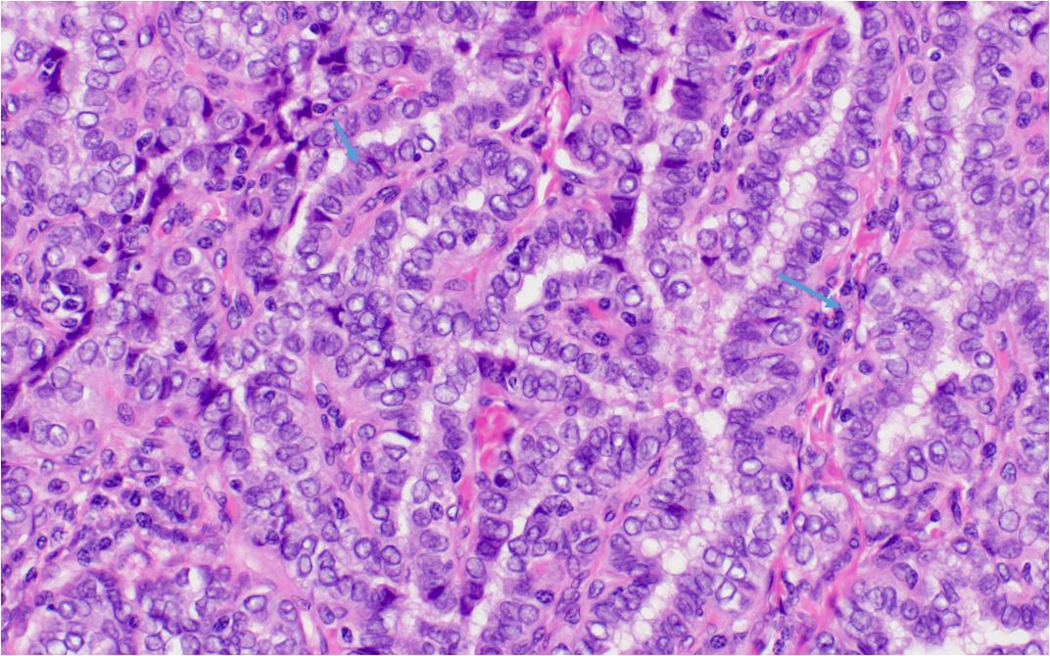
Thyroid Cancer
Papillary thyroid carcinoma (PTC)
Females (X3 than males), median age: 51
Risk factors:
  Radiation exposure
  Familial papillary CA
  Cowden syndrome, Familial adenomatous polyposis coli
25-50% of patients have involved lymph nodes at presentation
Treatment: Surgery ± neck dissection ± RAI

Slide 11
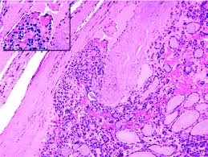
Thyroid cancer
Thyroid Cancer
Follicular thyroid carcinoma (FTC)
Female: Male - 3:1 , more in iodine deficient regions (endemic goiter)
Lymph node metastasis is unusual, but locally advanced / hematogenous spread (metastasis to lung, bone, brain)
Capsular or lympho-vascular invasion
Treatment: Surgery ± neck dissection ± RAI

Slide 12
Thyroid cancer
Thyroid Cancer
Medullary thyroid carcinoma (MTC)
Parafollicular C cells : secreting calcitonin (CEA )
M = F
Sporadic (70%) / Familial / Syndromic (MEN 2a/2b) - RET mutation
More aggressive: 80% LN mets, 50% distal metastases
Treatment: Surgery ± neck dissection

Slide 13
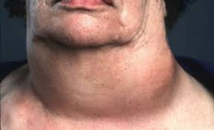
Thyroid Cancer
Anaplastic thyroid carcinoma (ATC)
Female > Male, older age
Very aggressive, poor prognosis
80% coexisting PTC/FTC (transformation)
> 60% regional metastases, >50% distal metastases at presentation
Treatment: Targeted therapies (dabrafenib if BRAF mutation), External beam radiation, Chemotherapy, Immunotherapy, Palliative care

Slide 14
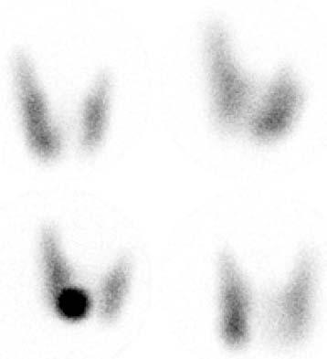
Benign Thyroid Diseases
Thyroid Adenoma:
Benign, encapsulated follicular neoplasm
May present as solitary nodule
Usually nonfunctional; some are toxic (autonomous hyperfunction(

Slide 15
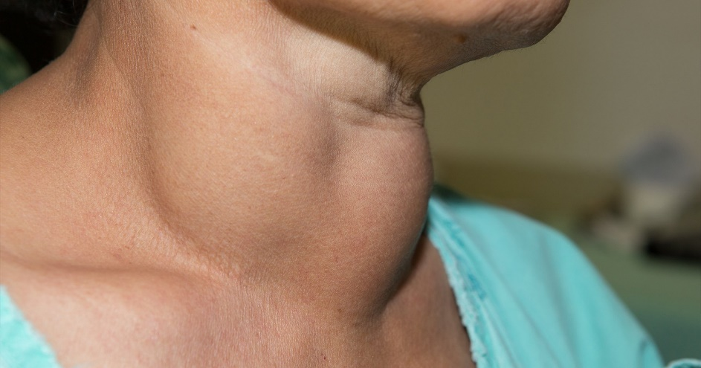
Benign Thyroid Diseases
Goiter:
Chronic stimulation by TSH (iodine deficiency or dyshormonogenesis(
Affecting up to 10% of adults in iodine deficient regions
May cause compression symptoms (dysphagia, dyspnea)
Surgical indications: compressive symptoms, substernal extension, suspicion of malignancy, aesthetic

Slide 16
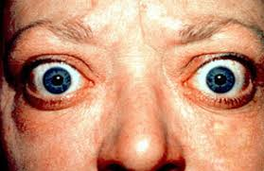
Benign Thyroid Diseases
Graves’ disease:
Autoimmune hyperthyroidism (TSI stimulates TSH receptor) 🡪 diffuse hyperplasia and thyrotoxicosis
Features: diffuse goiter, ophthalmopathy, pretibial myxedema
Management: antithyroid drugs, RAI, or thyroidectomy if medically uncontrolled symptoms, drugs AE or large goiters

Slide 17
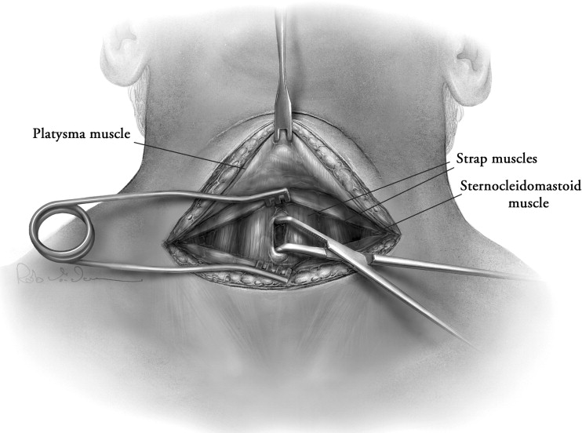
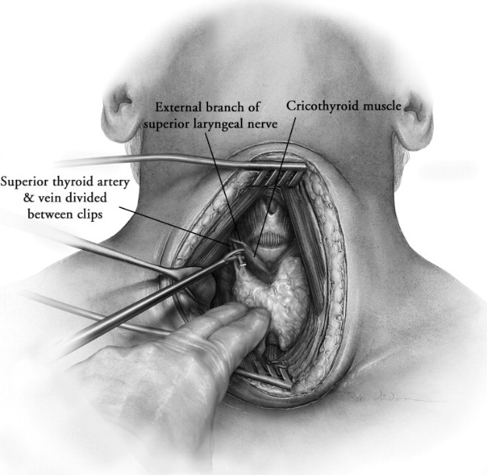
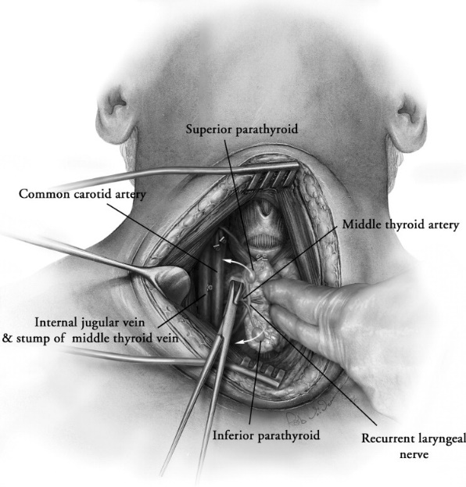
Thyroidectomy
Indicated for:
Cancer
Diagnostic uncertainty (indeterminate cytology)
Compressive symptoms or cosmetic concerns
Refractory hyperthyroidism (Graves’ or toxic adenoma)

Slide 18
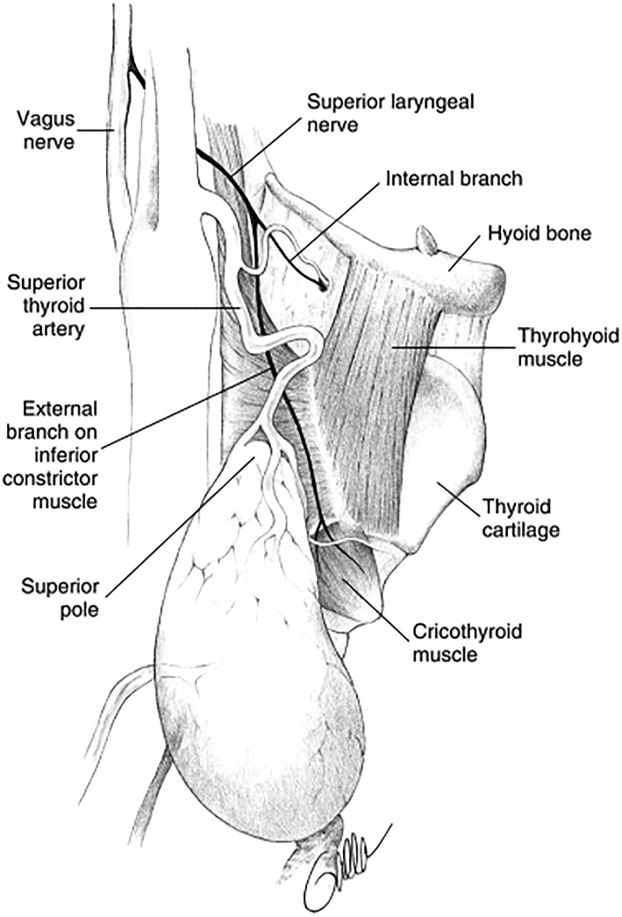
Thyroidectomy - complications:
Hypocalcemia (transient or permanent)
Recurrent laryngeal nerve injury (hoarseness)
Superior laryngeal nerve injury (voice fatigue)
Hematoma or wound infection

Slide 19
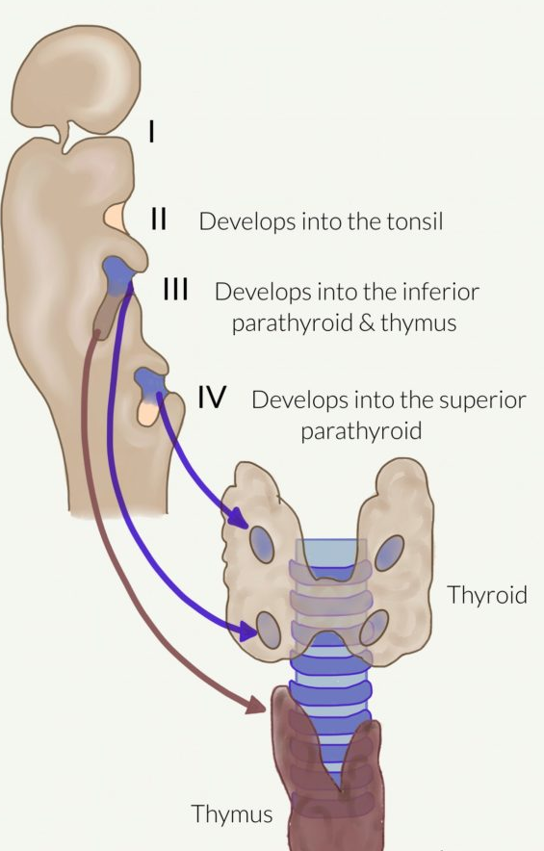
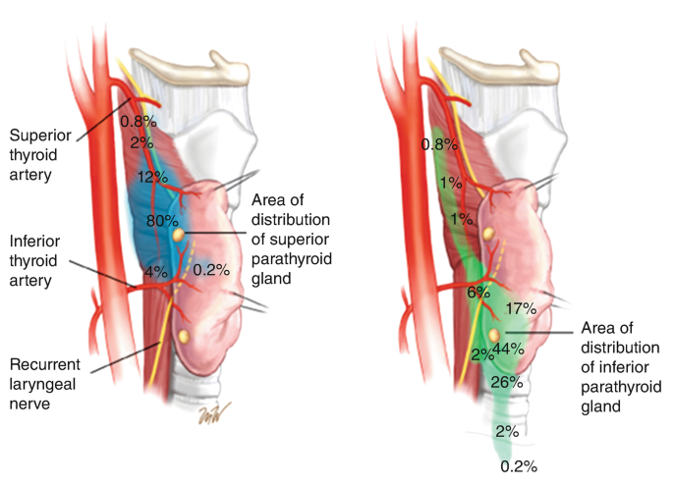
Parathyroid
Embryology
Superior Glands derived from 4th pharyngeal pouch
Inferior Glands derived from 3rd pharyngeal pouch

Slide 20
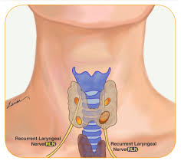
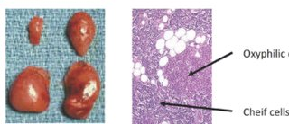
Parathyroid
Anatomy and physiology:
Superior PT glands are dorsal to RLN, and inferior glands are ventral
Normal gland: 5 mm in size, weighs about 30–50 mg
80% supplied by inferior thyroid artery
Chief cells produce PTH → increases serum calcium
normal PT gland
Parathyroid adenoma

Slide 21
Hyperparathyroidism
Primary: autonomous overproduction (85% single adenoma, 15% hyperplasia, <1% Carcinoma)
Secondary: chronic hypocalcemia (renal failure, vit D deficiency)
Tertiary: autonomous secretion post renal transplant
Syndromic:
MEN1 – parathyroid hyperplasia + pancreatic and pituitary tumors
MEN2A – medullary thyroid carcinoma, pheochromocytoma, parathyroid hyperplasia

Slide 22
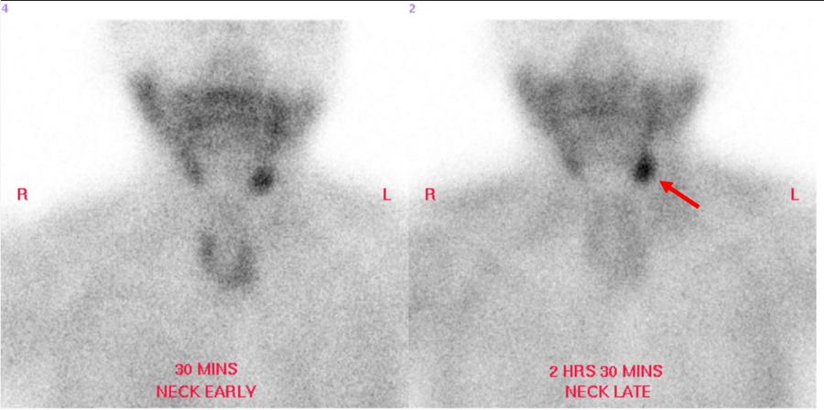
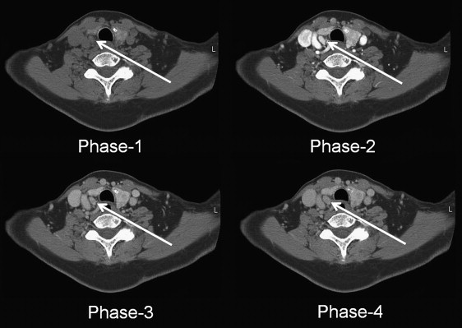
Hyperparathyroidism
Diagnostic Approach to Hypercalcemia
Confirm calcium (total or ionized)
Measure PTH
  High → primary hyperparathyroidism
  Low → malignancy, vitamin D excess, etc.
Localization imaging (US, sestamibi, 4D CT)

Slide 23
Hyperparathyroidism
Indications for Parathyroid Surgery (NIH Criteria)
Symptomatic hypercalcemia (“Stones, bones, groans, psychic overtones”)
Serum calcium >1 mg/dL above normal
Age <50 years
Reduced bone density or renal function
Hypercalciuria
Patient preference or poor surveillance candidates

Slide 24
Parathyroidectomy
Intraoperative Monitoring in Parathyroid Surgery
Intraoperative PTH Monitoring: >50% drop at 10 min post-excision
Frozen Section: histologic confirmation of hypercellular parathyroid
Fluorescence Imaging: autofluorescence or indocyanine green to identify viable glands

Slide 25
Questions?

