Slide 1
Visualizing Geographically Referenced Data with Linked Micromaps
Michael McManus¹ , Marc Weber², Quinn Payton³, Anthony Olsen², and Thomas Kincaid²
¹Office of Research and Development
National Center for Environmental Assessment, Cincinnati, OH
²Office of Research and Development
National Health and Environmental Effects Research Lab, Corvallis, OR
³Department of Statistics, Oregon State University
44 Kidder Hall Corvallis, OR Corvallis, OR
The views expressed in this presentation are those of the authors and do not necessarily reflect the
views and polices of the U.S. Environmental Protection Agency. Mention of trade names or commercial
products does not constitute endorsement or recommendation for use.
Notes:
Linked micromaps provide a means to simultaneously summarize and display both statistical and geographic distributions by linking statistical summaries to a series of small maps. This work has been a team effort between 3 statisticians, a geographer, and an ecologist. Quinn is developer of the R package. Marc is a geographer, & he solved some of the geographical issues. I am an aquatic ecologist, and my role was to be the naïve, but insightful, beta tester. Tom Kincaid is a statistician that knows how to assemble R packages. Tony Olsen is our team historian.
The objective for this first session of the webinar is to provide an overview to what linked micromaps are and how they differ from other spatial summaries. The second session is for scientists and analysts that will be creating linked micromaps, such as for Integrated Water Quality Monitoring and Assessment Reports.
A great deal of effort is spent collecting and analyzing monitoring data that are often expressed over some areal unit. For example, cancer mortality rates per state, or bushels of corn produced per county, or median total phosphorus concentration of lakes per ecoregion. For your Integrated Water Quality Monitoring and Assessment reports, you want to summarize that data both statistically and spatially, and linked micromaps can help you do that.

Slide 2
Outline
Maps and Statistical Summaries
Four Steps to Producing a Linked Micromap
Examples of Linked Micromaps
Data Structure & Micromap Plot Syntax
Outreach and Conclusions
Notes:
Outline for workshop: Begin with an overview of maps & statistical summaries by looking at the same data summarized three different ways. Next, I will go over the four steps to making a linked micromap. Third, I will show examples of different types of micromaps. In the fourth section, I will explain the data structure needed to produce a micromap. I will end with our outreach efforts to have micromaps used and some conclusions.

Slide 3
I.A Three Options: National Lake Assessment pH
Point Map
Choropleth Map
Linked Micromap
Notes:
Use pH data from the National Lakes Assessment and summarize it three ways: 1st as a pin map, then a choropleth map, and finally as a linked micromap. The NLA was a spatially balanced probabilistic survey of over a thousand lakes that was done to report on the condition of lakes.

Slide 4
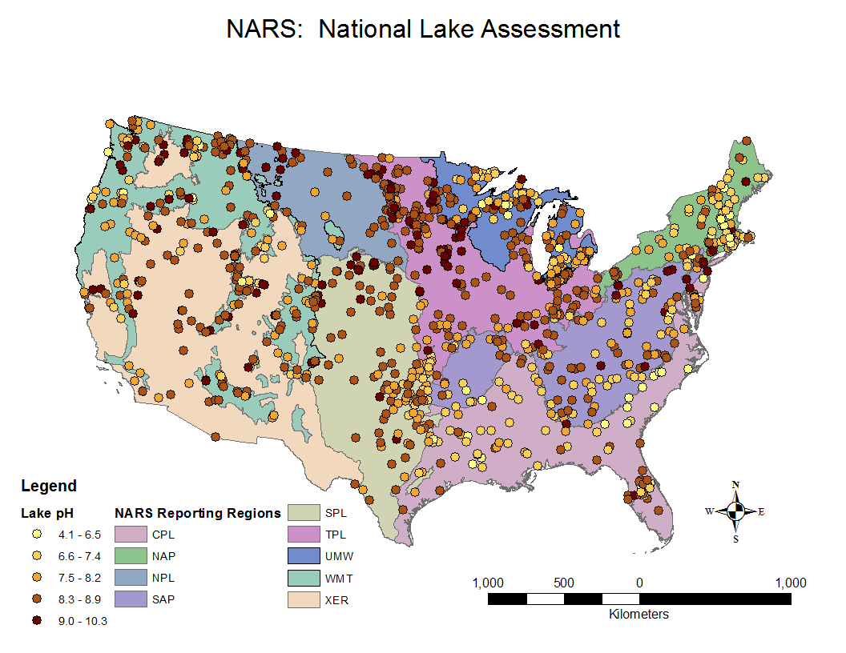
Point Map
Notes:
This map displays the pH of the lakes that met the target population criteria and were sampled. It shows the polygons or areal units used for the NARS reporting regions. Points are coded from yellow to dark brown to indicate low to high pH. CPL is for the coastal plains. A pin map shows well the spatial distribution of the data. However, summarizing the statistical distribution of the data is challenging. We kind of see more yellows and oranges in NAP, and perhaps more browns in NPL. It’s tough.

Slide 5
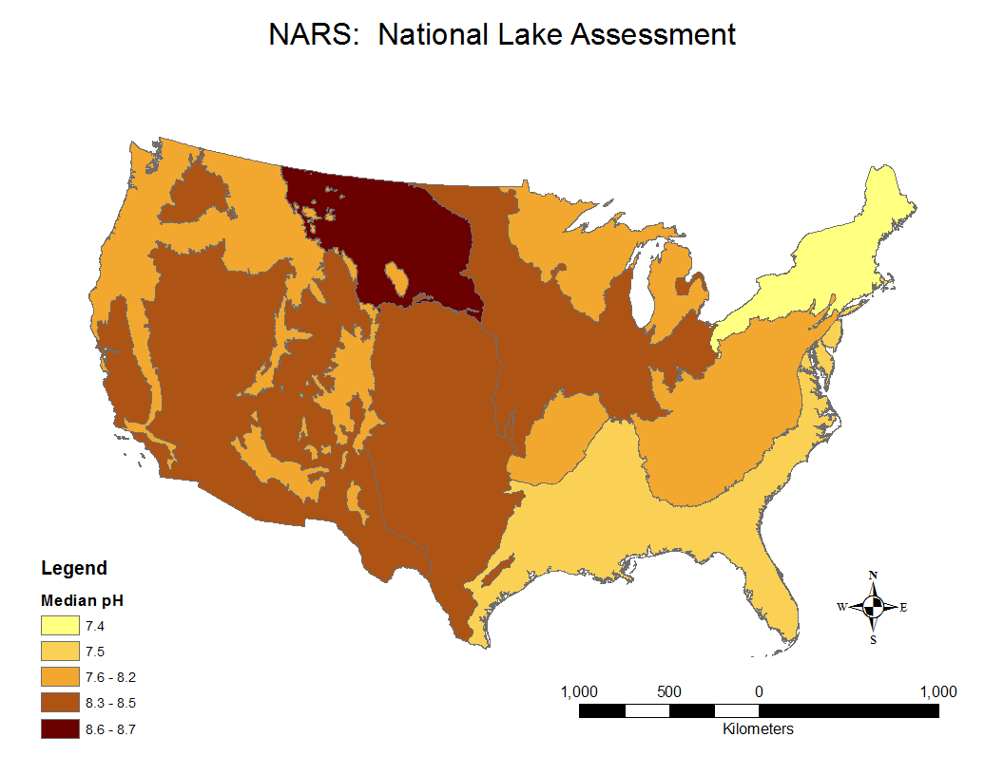
Choropleth Map
Notes:
Choropleth map gives a summary of the statistical distribution of the data based on sampled median pH for the reporting regions using that same color scheme. But using just one summary statistic, in this case the median, we get no sense of variation in the data.

Slide 6
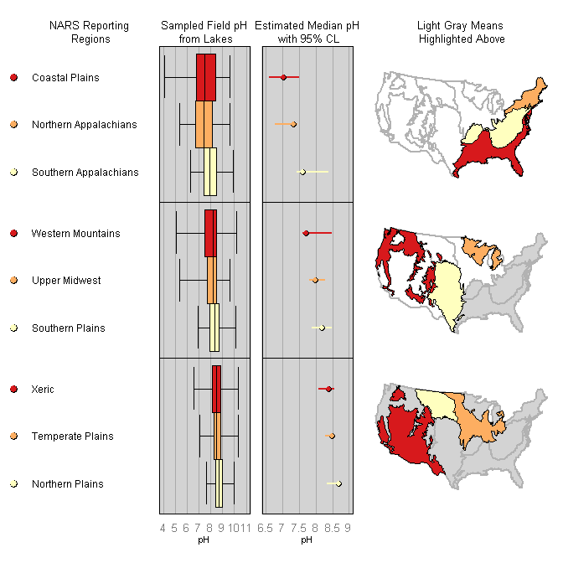
Linked Micromap
Notes:
Here is a linked micromap of the NLA data. Key features to recognize here are that the statistical and spatial data are presented in separate panels or columns. We have a panel of a color legend, labels, two panels of statistical summaries, and fifth panel of maps. The labels, summaries, and maps are linked across by rows based on color. I think this type of micromap plot is very suitable for an Integrated Water Quality Assessment and Monitoring Report. Because the data are from a survey, we have estimates of pH. The data have been sorted from lowest to highest estimate of median pH. Because these are estimates we can display the confidence limits. The medians and CLs were estimated using the spsurvey R package. Now this other statistical summary panel consists of the five number summary or box plot of the measured pH values. Several patterns, some of which we didn’t detect with our earlier maps, can be seen. Lowest median pH values are in the NAP and CPL, and as median pH increases we see less variation, as noted by the smaller boxes.

Slide 7
I.B. Linked Micromaps
1998 Linked Micromap Plots Named & Described, Carr, D. et al.
2010 Visualizing Data with Micromaps, Carr, D. & Pickle L.
Structure: Row-oriented graph consisting of different panels
Summarize two distributions: Statistical and geographic
Linked micromaps have had limited use - difficulty producing
2009 NCI GIS Linked micromap tool - Java graphing program
R library micromap developed by Quinn Payton et al.
micromap: Linked Micromap Plots December 2012
micromapST: Linked Micromap Plots for U.S. States June 2013
Notes:
Linked micromaps in a nutshell are collections of small maps linked to corresponding plots of statistical summary data. Build on idea of small multiples introduced by Edward Tufte. Basic idea is linking statistical summaries over a geographic region with location in series of small maps and data panels – see patterns in geographic context. Background on linked micromaps. A way they have been produced is use statistical software to make a graph, use GIS software to make the maps, take the two images and merge them in a third software.

Slide 8
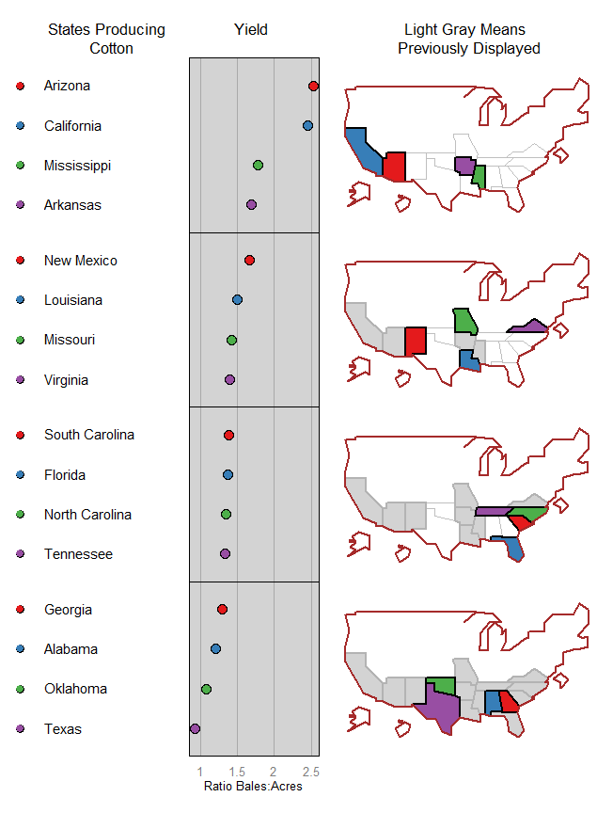
I.C. Elements of a Linked Micromap
Perceptual
Groups
Panels
Notes:
Here is an example of a micromap using agricultural data with the areal unit, or polygon, being states. I am showing this to reiterate the elements of a linked micromap: legend, labels, statistical summary panel, map panel. The rows break up the data into manageable chunks, or perceptual groups, to make it easier for the eye and brain to comprehend the data. Also have plotted a dashed vertical line for the overall U.S. average.

Slide 9
I.D. Benefits & Challenges of Linked Micromaps
Apply to shapefile of areal units (watersheds, ecoregions, etc.)
Display measures of variation (IQR, CL)
Facilitate exploratory spatial data analysis (local, global outliers)
Compare statistical summaries to a reference value
Compare whole areal unit, or polygon, to its components
Evaluate multiple variables simultaneously
Displaying summaries of many areal units
Add other types of graphs for statistical summaries
Make interactive for web applications
Notes:
Some of the benefits and challenges to using linked micromaps. The first set of bullets will be highlighted in the examples I show. The second set of bullets lists some of the challenges.

Slide 10
II. Four Steps to Make a Linked Micromap
Geoprocessing of Spatial Data, or Polygons, in GIS or R
Structuring the Spatial and Statistical Data
Making the Basic Linked Micromap Plot
Refining the Linked Micromap Plot
Notes:
Four steps to producing linked micromaps. Those four steps were applied to all the examples I will show you. Quiz 1

Slide 11
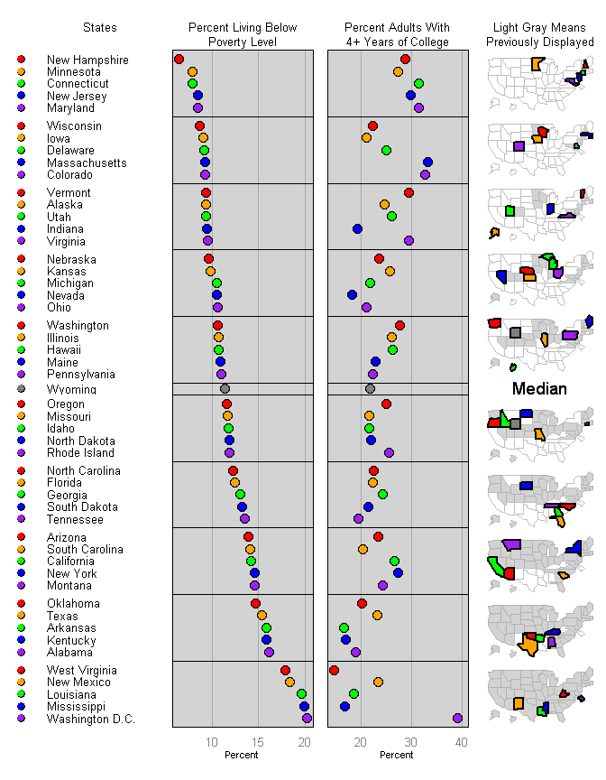
II. Socio-Economic Data
Notes:
Micromap of socioeconomic data for 50 states and District of Columbia. Note we have five panels: dot legend, labels, 2 statistical summaries, and map. As one reads down the perceptual groups, note how the states are filled in after they have been displayed. Also, the state having the median poverty level is highlighted. Dan Carr described these small maps, or micromaps, as caricatures.

Slide 12
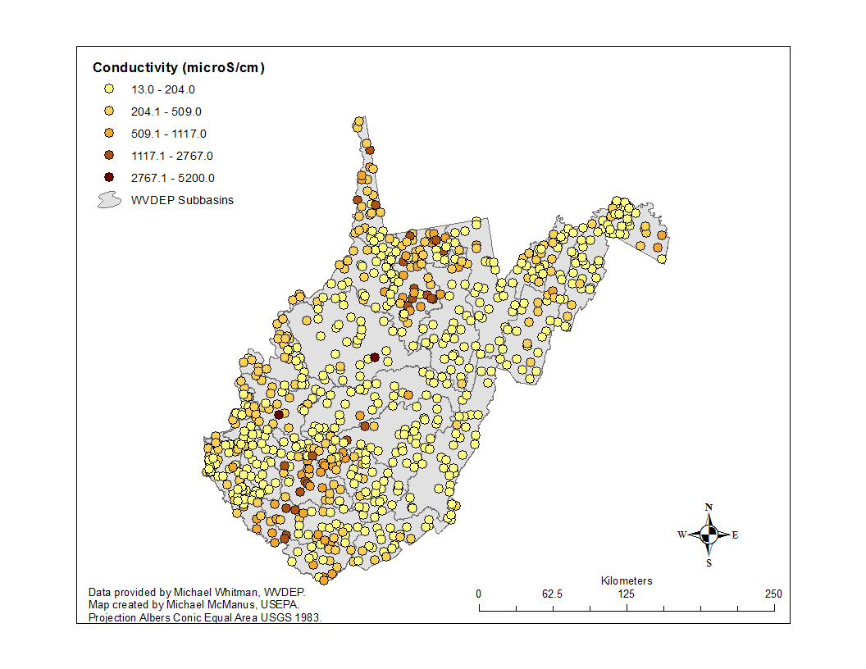
WVDEP Stream Survey
Notes:
Let’s use another example with data from a spatially balanced probabilistic stream survey. These data are provided by Michael Whitman from WVDEP. The target population was 1st-4th order streams from 25 WVDEP subbasins sampled from 2002-2006. Here is a point map of stream conductivity at the sampled sites. Benthic macrorinvertebrates collected at each were site were used to calculate a stream condition index.

Slide 13
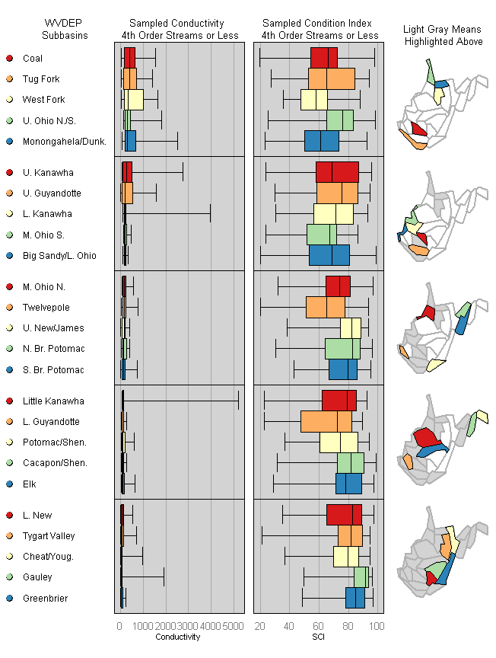
III. Box Plots & ESDA & IQR
Notes:
Boxplot linked micromap of stream conductivity and condition index. For the SCI, higher values mean the sampled sites more resemble reference sites based on the collected invertebrates. Looking at descriptive statistical summary of conductivity and stream condition index. Specifically, the five number summary of minimum, first quartile, median, third quartile, and maximum. The data have been sorted from highest median conductivity to lowest. This boxplot summary shows both global and local spatial outliers. The Little Kanawha site is a global outlier. Can also see the geographic pattern of high median conductivities occurring in two “pockets”, southern & northern, and that lower median conductivities occur in some of the eastern watersheds. Looking at the IQR as a robust measure of variation see some subbasins have a small spread in their SCI and high values in the eastern subbasins.

Slide 14
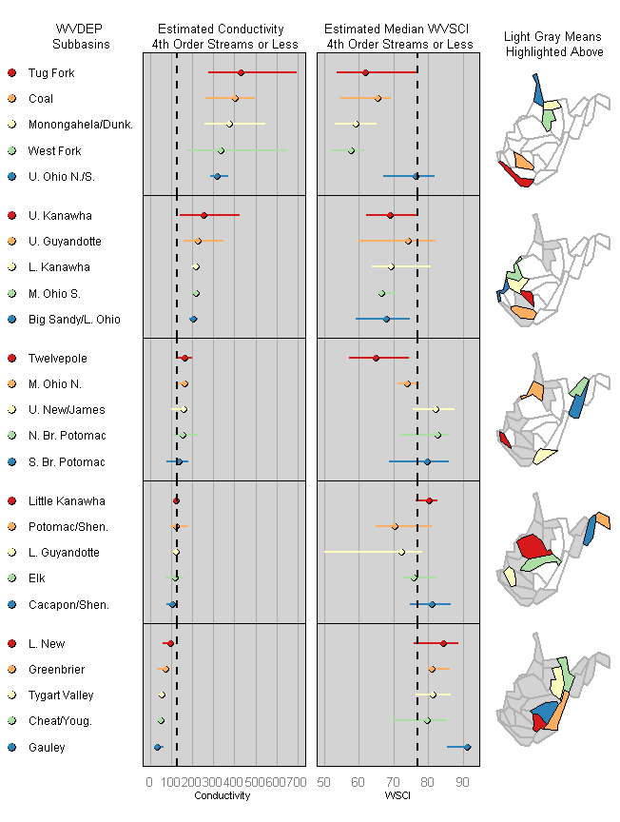
III. Example of Reference Line
Notes:
Spatially balanced probabilistic surveys are done to provide estimates and confidence limits around those estimates. Here are the median estimates, and 95% confidence limits, for conductivity and stream condition. The data are sorted from highest to lowest median conductivity. The black dashed vertical lines are the statewide medians for conductivity and SCI. Note that we have a one-to-one relationship with one polygon being associated with one statistical summary as a single row in a perceptual group.

Slide 15
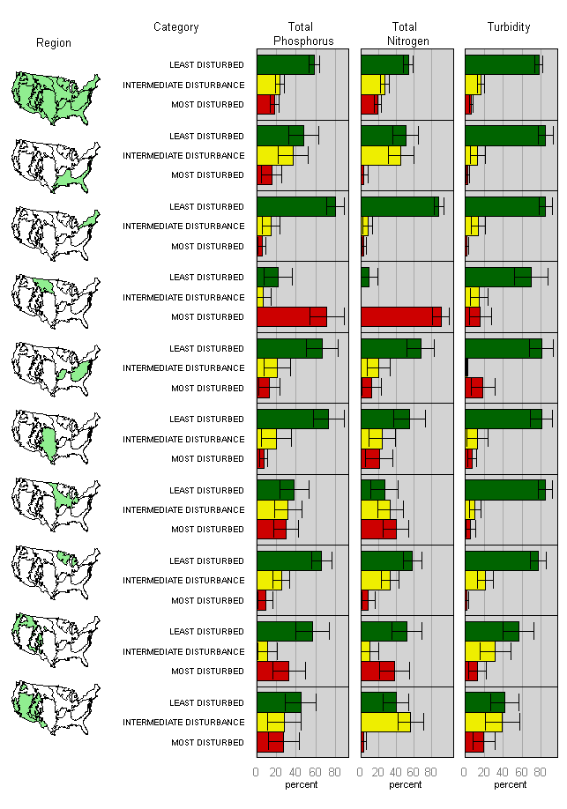
III. Example of Group-Categorized Plot
Notes:
Group Categorized Micromap from NLA, which has 1 polygon linked to several rows of data, in this case 3. This is a way to compare a whole nationwide response to its regional parts. We compare whole area to parts and look at 1 polygon being associated with many statistical summaries in a perceptual group, in this case one polygon to three categorical estimates of least, intermediate, and most disturbed. This is the structure of many figures in EPA National Aquatic Resource Survey reports and here we replicate one of these figures in EPA National Lake Assessment Report. A group-categorized micromap is an alternative to stacked bar charts or pie charts.

Slide 16
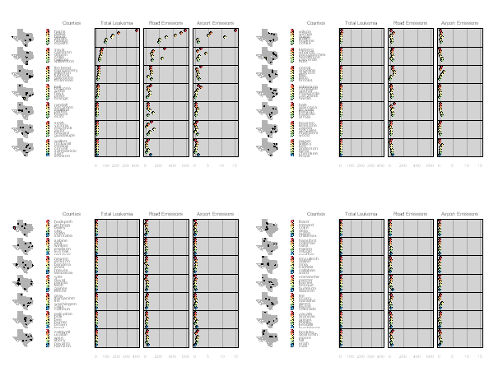
III. Example: Many Areal Units
Notes:
This final example is a challenge that Dan Carr recognized of having statistics for many areal units. Public health data used by an EPA scientist for all 254 counties in Texas looking at leukemia cancers and emissions measured at roads and airports. This example is included in a manuscript for the JSS. Displaying lots of data for many areal units remains a challenge.

Slide 17
IV. Four Steps to Make a Linked Micromap
Geoprocessing of Spatial Data, or Polygons, in GIS or R
Structuring the Spatial and Statistical Data
Making the Basic Linked Micromap Plot
Refining the Linked Micromap Plot
Notes:
Recall these four steps I mentioned when I put up the socio-economic micromap of US states and DC. I am very briefly going to go over those 4 steps so you understand how the spatial data and statistical data need to be put together.

Slide 18
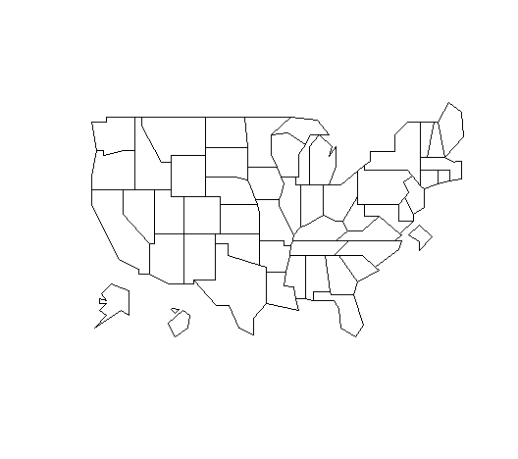
IV.A. Map Simplification
Notes:
This was the map used for the poverty and education micromap. Polygons for the map can be simplified as they only need to be detailed enough to convey shape and relative position of the areas & provide spatial framework to identify neighboring polygons. Note here layout, or position, and size of Alaska, Hawaii, and Washington DC. Simplifying, or generalizing or smoothing, of polygons can be in in R or in GIS. We describe that in the user guide.

Slide 19
IV. B. Structuring the Spatial & Statistical Data
head(USstates@data)
ST | ST_NAME | AREA_KM | PERIM_KM
AK | Alaska | 1506038 | 60260
AL | Alabama | 133761 | 2354
AR | Arkansas | 137733 | 2172
AZ | Arizona | 295267 | 2395
CA | California | 409603 | 5682
CO | Colorado | 269599 | 2100
Notes:
Here are the first six rows of that spatial data, and recall we need to link these data to our statistical data.

Slide 20
IV. B. Structuring the Spatial & Statistical Data
head(edPov)
state | ed | pov | region | StateAB
Alaska | 24.7 | 9.4 | W | AK
Alabama | 19.0 | 16.1 | S | AL
Arkansas | 16.7 | 15.8 | S | AR
Arizona | 23.5 | 13.9 | W | AZ
California | 26.6 | 14.2 | W | CA
Colorado | 32.7 | 9.3 | W | CO
Notes:
Here are the first six rows of the statistical data. What column would be a good linking variable from the statistical data to the spatial data? Note your data do not need to be sorted, but the link variable needs to be the same case.

Slide 21
IV.B. Structuring the Spatial & Statistical Data
Use the create_map_table function in R package micromap to format spatial data and specify linking variable, “ST”
Link the spatial and statistical data frames with map.link
Notes:
Two functions are used to structure the data. In our example, the linking variable “ST” from the spatial data gets the column name “ID” assigned to it.

Slide 22
IV. C. Draft Micromap Plot Syntax
mmplot(stat.data=edPov,
map.data=statePolys,
map.link=c('StateAb','ID'),
panel.types=c('dot_legend' ,'labels', 'dot', 'dot', 'map'),
panel.data=list(NA, 'state', 'pov', 'ed', NA),
ord.by='pov',
grouping=5, median.row=T)
Notes:
mmplot function is used to make the draft micromap plot. The parentheses contain the arguments that go with that function. This basic syntax allows the user to check if the two data frames are structured correctly and to see if refining the plot is worthwhile. N.B. the sequential and parallel structure of panel.types and list for panel.data.

Slide 23
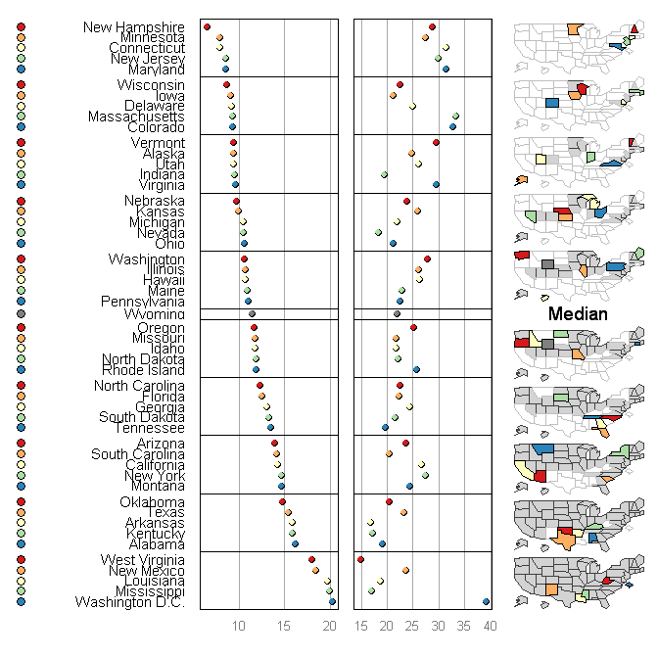
Draft Micromap Plot with Five Panels
Notes:
Those few lines of code make a draft linked micromap plot. The idea here is to quickly make a linked micromap plot so you can decide if refining that plot is worthwhile.

Slide 24
IV.D. Refine the Micromap Plot
Notes:
By using more options to refine the five panels, a publication quality linked micromap plot can be made.

Slide 25
IV.E. Session 2 of Webinar Covers
Read in Spatial Data & Create a Map Table
Read in Statistical Data
Basic Syntax
Syntax for Refining the Plot
Exercises Making Linked Micromap Plots
Notes:
For those taking session 2 of the webinar. Quiz 2 and 3.

Slide 26
V. Outreach & Conclusions
Journal of Statistical Software article special issue on spatial statistics
Sala Senkayi, EPA Region 6, applying to public health data
Webinars to agency scientists & in-person workshop at 9th National Monitoring Conference in Cincinnati so micromaps can be used in Integrated Water Quality Monitoring and Assessment reports
Jüergen Symanzik using in Applied Spatial Statistics course at Utah State University
Notes:
In the JSS article, we tie linked micromaps to information visualization, how to explore, analyze, and present large amounts of data. That is a challenge for many environmental monitoring and assessment programs, such as NARS and your survey programs. I think an informative linked micromap for Integrated Water Quality Monitoring and Assessment reports is the format I used for the NLA pH of one statistical panel with sampled observations from stations, and the other statistical panel with the estimates and CL. In second session, one of the exercises is to make such a linked micromap. Linked micromaps offer a versatile way to summarize data over a range of areal units.

Slide 27
V. Outreach & Conclusions
Peterson, G. (February 28, 2011). Micromap Software. Blog by Gretchen Peterson.
Robbins, N. (May 23, 2012). Linked Micromaps for Geographically
Referenced Data. Blog by Naomi Robbins.
Zhang, C. (2012). Interfaces and Visual Analytics for Visualizing Spatio-Temporal Data with Micromaps
Symanzik, J. and Carr, D.B. (2013) Linked Micromap Plots in R. Proceedings of Joint Meeting of the IASC Satellite Conference and the 8th Conference of the Asian Regional Section of the IASC. Theme: Big Data and Statistical Computing. http://hbutton.com/IASC/
Notes:
Interest and development of micromap continues, along with more applications of linked micromaps.

Slide 28
Contact Information
For questions and suggestions about the library please email us:
Mike McManus – mcmanus.michael@epa.gov
Marc Weber – weber.marc@epa.gov
Quinn Payton – paytonq@science.oregonstate.edu
Notes:
Contact information

