Slide 1


Data-Driven Storytelling Presentation
Impactful Sales Insights: Driving Growth at JPMorgan Chase & Co.
A Comprehensive Analysis of Account Sales Performance (2017-2021)
Presentation By : Shaunak Sharma

Slide 2

Elevating Performance: A Five-Year Journey of Growth
Briefly introduce the consistent growth in sales over the past five years, focusing on the 51.77% AVG 5yr CAGR.

Slide 3
Questions & Problems
Problem Statement
✓ J.P. Morgan Chase & Co. is a prominent global financial services firm providing a wide range of services and operating internationally.
✓ The company seeks to evaluate the account performance metrics over the past five years (2017-2021) and identify the factors contributing to the compound annual growth rate (CAGR) in unit sales. This involves pinpointing opportunities for further enhancement.
Business Questions
Reviewing the overall unit sales for each year. o Assessing the year-over-year growth in sales. o Determining which account types are outperforming others in terms of unit sales. o Calculating the average 5-year compound annual growth rate (CAGR) for various account types. o Identifying the top-performing and bottom-performing accounts.

Slide 4
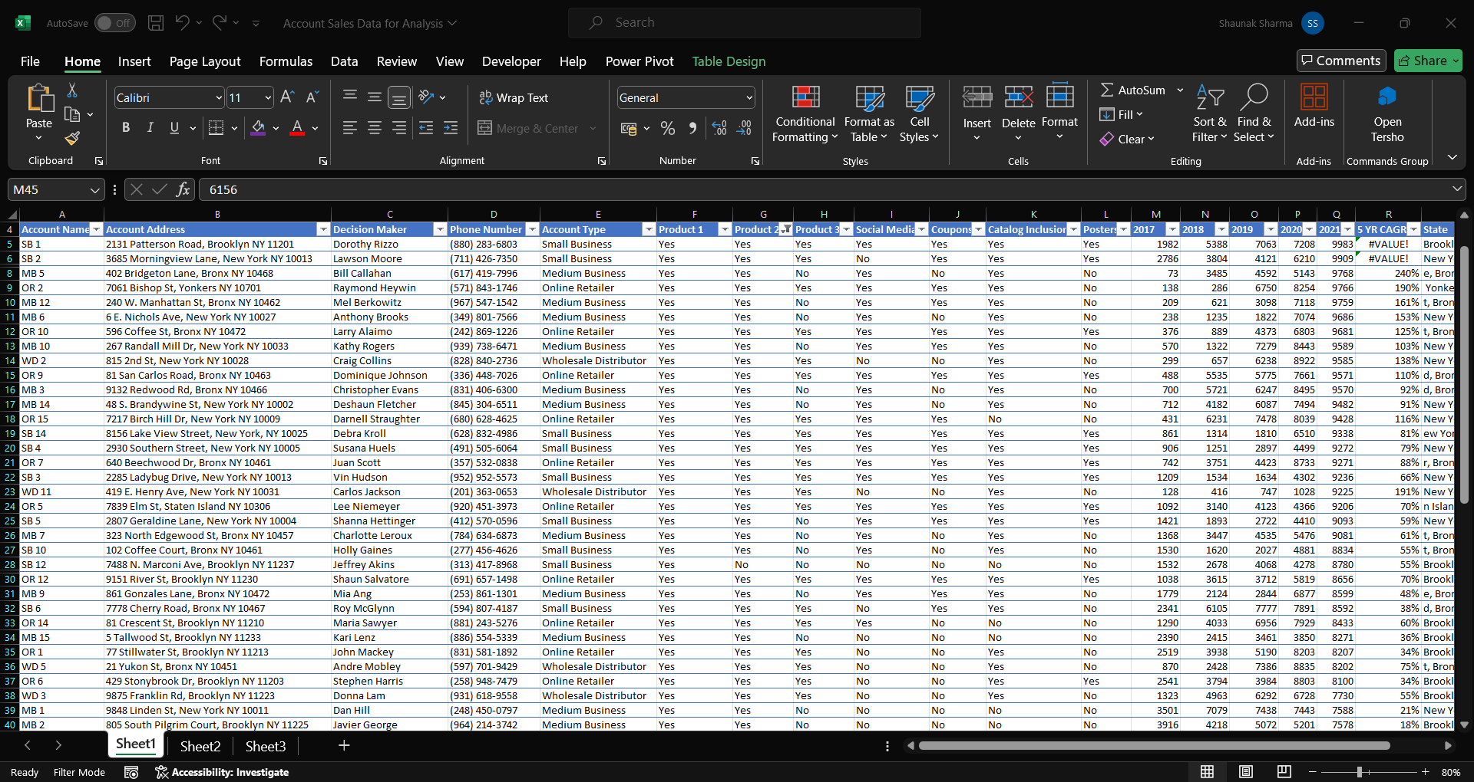
Data Transformation
✓ Using the Power Query tool in Excel, we will extract relevant columns for account information, product sales volumes, and marketing programs and create a structured table with useful columns for efficient analysis.

Slide 5
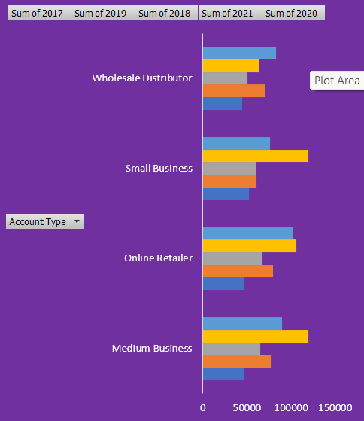
Sales Distribution by Account Type & Year
We observe Our sales distribution across various account types illustrates a balanced market penetration, with each segment contributing significantly to our overall sales:
❑ Medium Business: Leading with 26%, highlighting strong relationships in this segment.
❑ Online Retailer: Close behind at 28%, reflecting our robust presence in the e-commerce space.
❑ Small Business and Wholesale Distributor: Each holds 23%, demonstrating our broad appeal across different business sizes and models.

Slide 6
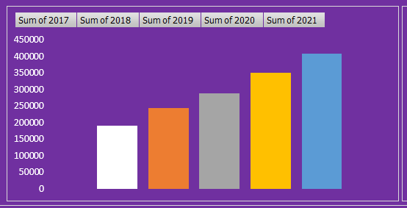
Year-over-Year Growth Trends
This graph illustrates the Year-over-Year (YoY) sales growth from 2017 to 2021, highlighting our company’s ability to sustain growth over a five-year period.
❑ 2017-2018: We see a steady increase in sales, setting a strong foundation for growth.
❑ 2019: A significant spike in growth, indicating successful market expansions or product launches.
❑ 2020: A slight dip possibly due to market challenges, yet our overall trajectory remains positive.
❑ 2021: A robust recovery with sales soaring to nearly 5 million units, showcasing our resilience and strategic adaptability.

Slide 7
Summary & Recommendations
Summary: Over the past five years, our sales analysis reveals a robust growth trajectory, with significant contributions from diverse account types and top-performing accounts. Despite minor fluctuations, our Year-over-Year growth showcases a pattern of resilience and strategic adaptability, positioning us strongly in the market.
Recommendations:
❑ Enhance Focus on High-Performing Accounts:
Strengthen relationships and customize offerings for the top 5 accounts to maximize sales and loyalty.
❑ Expand Market Share in Underutilized Sectors:
Increase penetration in the wholesale distributor and small business sectors, leveraging tailored marketing strategies to meet their unique needs.
❑ Invest in Data Analytics:
Continue to refine our sales strategies through advanced analytics, ensuring we adapt dynamically to market trends and customer preferences.
❑ Resilience and Adaptability:
Enhance operational flexibility to maintain growth momentum and manage market disruptions effectively, as evidenced by our recovery in 2021.

