Slide 1

Predictive Modeling for Direct Marketing Optimization in Financial Services
By Shaun Levenson
ECON 562: Analytics 2
John Garcia
Spring 2025
Master of Science in Quantitative Economics
Notes:
Hello Professor, this is my submission for the final project on the optimization of marketing strategies based on predictive and causal modelling for our client, a large financial institution.

Slide 2

Overview
What is the Purpose?
Notes:
Getting right into it, it is important to first discuss what the purpose of this project is. Why are we bothering to run these models?

Slide 3
Overview
Goals
Objective:
Build predictive models that help a major financial institution better understand and anticipate customer behavior in response to marketing efforts
Purpose:
Identify the models that offer the best predictability while maintaining information regarding the most impactful factors
Dataset:
Uses the bank dataset, which includes 24 variables and 1.06m observations from account holders at a large financial services firm
Value:
Gaining insights from large datasets and generating real actionable strategies for marketing and revenue generation
Notes:
The goal for this project is to build predictive models that help a major financial instutition better understand and anticipate customer behavior in response to marketing efforts. It is intended to identify the models that offer the best predictability while maintaining gathering information about the most impactful factors on predicting customer activity. The initial dataset includes 24 variables and over 1 million observations. And this project is valuable because it leverages large data to generate real actionable strategies for marketing and revenue generation.

Slide 4
Background
Original Data
Notes:
A bit of background on the original dataset

Slide 5
Background
Initial Dataset
Dataset Source: Provided by the client.
Dataset Composition: Contains 1,060,038 observations and 24 quantitative and classification variables related to customer activities
Response Variables: measures Customer interaction (b_tgt), magnitude of customer interaction (int_tgt), and a count of new products purchased (cnt_tgt)
Predictors: includes 2 categorical account and customer activity variables, 12 interval inputs , and 7 demographic inputs
Notes:
The dataset provided by the client contains 1 million 60 thousand and 38 observations with 24 quantitative and classification variables related to customer activities. The response variables, our main focuses, measure customer interaction with new products (b)_tgt), the magnitude of those interactions (int_tgt), and the quantity of those interactions (count_target). The predictors include 2 categorical account and customer activity variables, 12 interval inputs, and 7 demographic inputs

Slide 6
EDA
Variable Descriptions
Notes:
Next we have our variable descriptions.

Slide 7
EDA
Descriptions
Variable | Type | Description
Target Variables
B_TGT | Binary | Tried a New Product (Yes/No)
INT_TGT | Numeric | Total New Sales
CNT_TGT | Count | Count of New Products Purchased
Categorical Predictors
CAT_INPUT1 | Categorical | Account Activity
CAT_INPUT2 | Categorical | Customer Value Level
RFM Interval Inputs
RFM1 | Numeric | Average Sales Past 3 Years
RFM2 | Numeric | Average Sales Lifetime
RFM3 | Numeric | Avg Sales Past 3 Years - Direct Promo Response
RFM4 | Numeric | Last Product Purchase Amount
RFM5 | Numeric | Count Purchased Past 3 Years
RFM6 | Numeric | Count Purchased Lifetime
RFM7 | Numeric | Count Purchased Past 3 Years - Direct Promo Response
RFM8 | Numeric | Count Purchased Lifetime - Direct Promo Response
RFM9 | Numeric | Months Since Last Purchase
RFM10 | Numeric | Count Total Promos Past Year
RFM11 | Numeric | Count Direct Promos Past Year
RFM12 | Numeric | Customer Tenure
Demographic Inputs
DEMOG_AGE | Numeric | Customer Age
DEMOG_GENF | Binary | Female (Yes/No)
DEMOG_GENM | Binary | Male (Yes/No)
DEMOG_HO | Binary | Homeowner (Yes/No)
DEMOG_HOMEVAL | Numeric | Home Value
DEMOG_INC | Numeric | Income
DEMOG_PR | Numeric | Geographical Retirement Percentage
Notes:
Here we have the descriptions of the available variables from the original dataset. Our targets are a binary model for trying a new product (Measured by a high AUC), a numeric model for dollar amount of new sales (measured by a low RMSE), and a count model for count of new products purchased (also measured by a low RMSE). Our categorical inputs are account activity and customer value level. Our interval inputs are various different metrics of average sales, counts purchased, counts purchased from promotionals, and customer tenure. And then our demographic inputs include age, gender, homeownership, home value, income level, and geographical retirement percentage.

Slide 8
EDA
Variable Statistics
Notes:
Next we have our variable descriptions.

Slide 9
EDA
Numeric Statistics
Variable | Stage | Mean | Std Dev | Median | Min | Max | Skewness
int_tgt | Before | 11235.87 | 8491.80 | 10000.00 | 0.00 | 500000.00 | 13.30
– | After | 2583.73 | 5931.40 | 0.00 | 0.00 | 200000.00 | 4.77
cnt_tgt | Before | 0.31 | 0.70 | 0.00 | 0.00 | 6.00 | 2.40
– | After | 0.37 | 0.76 | 0.00 | 0.00 | 5.00 | 2.09
rfm1 | Before | 16.09 | 19.30 | 15.00 | 0.00 | 3713.31 | 103.31
– | After | 15.44 | 15.09 | 13.98 | 1.15 | 2507.50 | 84.12
rfm2 | Before | 13.35 | 9.47 | 11.67 | 1.58 | 650.00 | 11.12
– | After | 12.80 | 8.93 | 11.10 | 1.58 | 436.00 | 9.92
rfm3 | Before | 15.31 | 18.97 | 14.00 | 0.00 | 3713.31 | 114.92
– | After | 15.22 | 11.10 | 14.00 | 0.00 | 600.00 | 9.85
rfm4 | Before | 17.47 | 37.55 | 15.00 | 0.00 | 10000.00 | 207.18
– | After | 16.70 | 44.24 | 15.00 | 0.00 | 10000.00 | 205.74
rfm5 | Before | 2.91 | 2.03 | 2.00 | 0.00 | 18.00 | 1.23
– | After | 3.29 | 2.05 | 3.00 | 0.00 | 18.00 | 1.10
rfm6 | Before | 9.54 | 8.47 | 7.00 | 0.00 | 127.00 | 1.91
– | After | 10.34 | 8.78 | 8.00 | 0.00 | 127.00 | 1.77
rfm7 | Before | 1.67 | 1.53 | 1.00 | 0.00 | 11.00 | 1.22
Notes:
For our numerical statistics, I have a before and after removing observations with missing variables and limiting the age range to greater than 15 to illustrate the changes in range and skew. Some notable changes are int_tgt, dropping the max from 500 thousand to 200 thousand, and significantly improving the skew. Then rfm3 where the skew dropped from 114 to 9.85

Slide 10
EDA
Numeric Statistics
Variable | Stage | Mean | Std Dev | Median | Min | Max | Skewness
rfm8 | Before | 5.03 | 4.51 | 4.00 | 0.00 | 46.00 | 1.42
– | After | 5.67 | 4.61 | 4.00 | 0.00 | 36.00 | 1.31
rfm9 | Before | 18.35 | 4.02 | 18.00 | 2.00 | 29.00 | -0.60
– | After | 18.18 | 3.87 | 18.00 | 2.00 | 28.00 | -0.73
rfm10 | Before | 12.89 | 4.61 | 12.00 | 0.00 | 77.00 | 2.86
– | After | 13.07 | 4.51 | 13.00 | 0.00 | 60.00 | 2.91
rfm11 | Before | 5.36 | 1.36 | 6.00 | 0.00 | 22.00 | 0.32
– | After | 5.50 | 1.29 | 6.00 | 0.00 | 17.00 | 0.47
rfm12 | Before | 68.13 | 37.35 | 64.00 | 0.00 | 571.00 | 0.30
– | After | 69.32 | 37.36 | 65.00 | 13.00 | 571.00 | 0.30
demog_age | Before | 58.72 | 16.85 | 60.00 | -1.00 | 89.00 | -0.36
– | After | 59.11 | 16.43 | 60.00 | 16.00 | 89.00 | -0.24
Demog_homeval | Before | 106103.55 | 93289.97 | 73880.00 | 0.00 | 600067.00 | 2.46
– | After | 106619.64 | 92456.21 | 74908.00 | 0.00 | 600067.00 | 2.50
demog_inc | Before | 40368.69 | 28029.02 | 43174.00 | 0.00 | 200007.00 | 0.23
– | After | 46562.05 | 25211.91 | 46450.00 | 0.00 | 200007.00 | 0.24
demog_pr | Before | 30.57 | 11.53 | 31.00 | 0.00 | 101.00 | -0.15
– | After | 31.16 | 11.24 | 31.00 | 0.00 | 100.00 | -0.09
Notes:
Some more stats to look at.

Slide 11
EDA
Categorical Statistics
Variable | Level | Count (Before) | % (Before) | Count (After) | % (After) | Variable | Level
b_tgt | 0 | 848529 | 80.05% | 471669 | 76.61% | b_tgt | 0
- | 1 | 211509 | 19.95% | 144045 | 23.39% | - | 1
cat_input1 | X | 831371 | 78.43% | 498539 | 80.97% | cat_input1 | X
- | Y | 77847 | 7.34% | 37624 | 6.11% | - | Y
- | Z | 150820 | 14.23% | 79551 | 12.92% | - | Z
cat_input2 | A | 188398 | 17.77% | 110689 | 17.98% | cat_input2 | A
- | B | 192382 | 18.15% | 118279 | 19.21% | - | B
- | C | 169550 | 15.99% | 101607 | 16.50% | - | C
- | D | 122282 | 11.54% | 71510 | 11.61% | - | D
- | E | 387426 | 36.55% | 213629 | 34.70% | - | E
demog_ho | 0 | 476741 | 44.97% | 206092 | 33.47% | demog_ho | 0
- | 1 | 583297 | 55.03% | 409622 | 66.53% | - | 1
demog_genf | 0 | 464288 | 43.80% | 272906 | 44.32% | demog_genf | 0
- | 1 | 595750 | 56.20% | 342808 | 55.68% | - | 1
Notes:
For our categorical statistics, we have a relatively unchanged distribution of observations across categories except for demog_ho, in which the negative class dropped by 11%

Slide 12
EDA
Correlation
Notes:
Looking at correlation prior to modelling helps with understanding what variables to be focusing on, or which variables to be wary of in terms of multicollinearity issues.

Slide 13
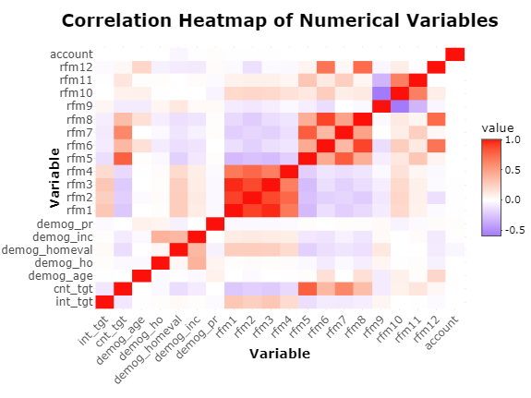
EDA
Correlation
Notable Correlations
Variable1 | Variable2 | Correlation
rfm3 | rfm1 | 0.96
rfm2 | rfm1 | 0.91
rfm8 | rfm6 | 0.89
rfm3 | rfm2 | 0.88
rfm7 | rfm5 | 0.80
rfm5 | cnt_tgt | 0.79
rfm4 | rfm2 | 0.76
rfm12 | rfm8 | 0.74
rfm12 | rfm6 | 0.71
rfm4 | rfm1 | 0.69
rfm4 | rfm3 | 0.66
rfm11 | rfm10 | 0.66
rfm7 | cnt_tgt | 0.62
Notes:
As part of my EDA, I did some correlation testing using a heatmap and filtered notable correlations by correlation of greater than .6 for further analysis, where the most notable were between rfm1 , 2, and 3, all of which had very high correlation with each other.

Slide 14
Modelling
Int_tgt Modelling
Notes:
Now onto modelling, you will notice that I have the best model as being a highly predictive model, but I still have regression coefficients for each. This is because I leveraged the coefficient signs to inform the variable importance charts shown later. Additionally, I included 3 interaction terms, those being income and homevalue, age and home value, and age and income. Across all 3 generalized linear models, those coefficients were reduced to 0 but the predictive models found them to be valuable. As for modelling strategy, I used the power of h2o’s automatic machine learning function to run several models and optimize them on its own, which is extremely effective for time saving and generating powerful models.

Slide 15
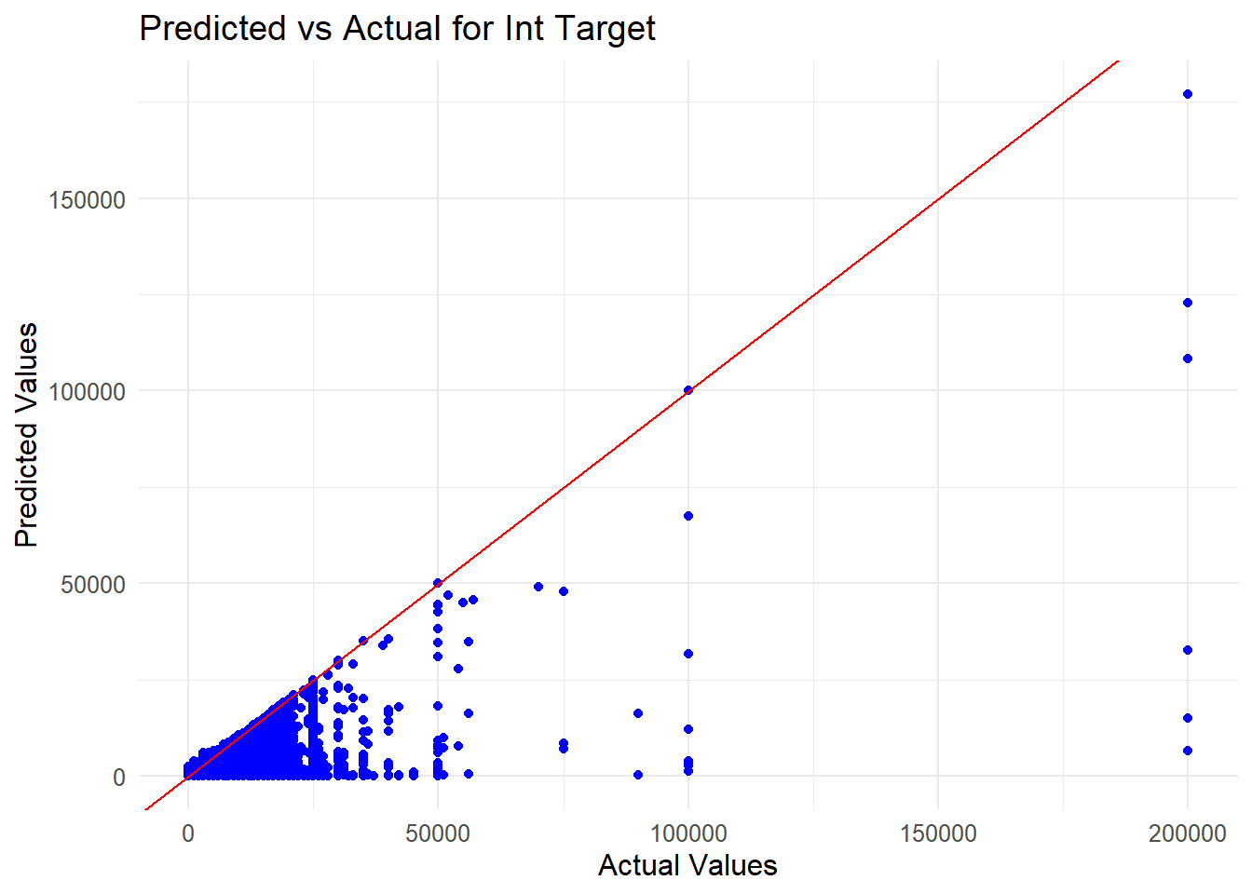
Modelling
Int_tgt
Validation Set
Model Rank | Type | RMSE | MSE | Unlogged_RMSE | r2
Model 1 | drf | 1.4412 | 2.0770 | 2.64 | 0.8599
Model 2 | gbm | 1.7095 | 2.9224 | 4.19 | 0.8029
Model 3 | deeplearning | 3.1637 | 10.0093 | 149.10 | 0.3251
Model 4 | glm | 3.3184 | 11.0119 | 246.15 | 0.2575
Test Set
Model Rank | Type | RMSE | MSE | Unlogged_RMSE | r2
Final Model (Model 1) | drf | 1.4457 | 2.0902 | 2.66 | 0.8585
Notes:
For int_tgt, the best model that was found ended up being a distributed random forest, where running it on the test set performed very similarly to the validation set, proving its capability as a highly generalized model. I thought the predicted versus actual plot was vital to include here, as it shows that it is fairly conservative with it’s predicted values, but not so much so as to be unreasonable.

Slide 16
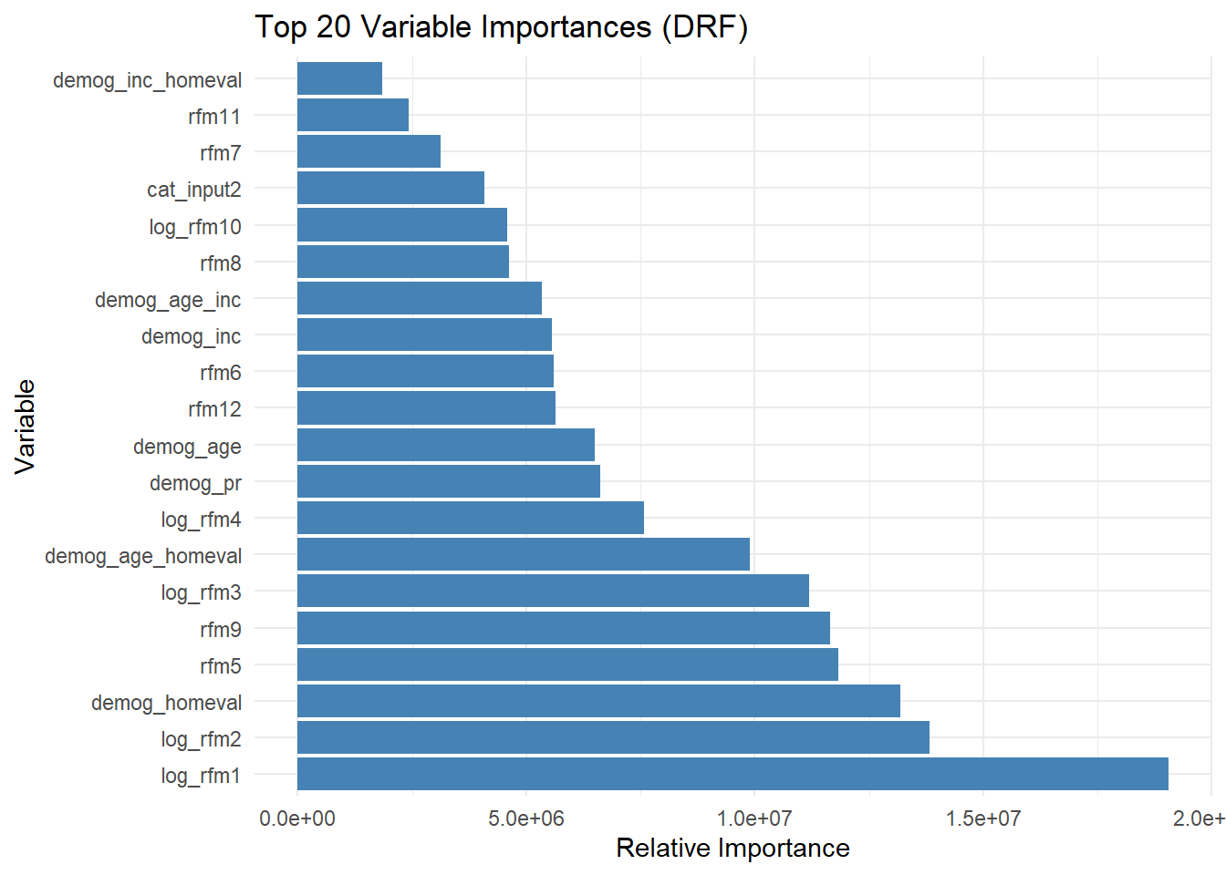
Modelling
Predictor | Coefficient | Odds Ratio (%)
Intercept | 9.1656809 | 956223.08
cat_input2.A | 0.1102875 | 11.66
cat_input2.B | 0.0886604 | 9.27
cat_input2.C | -0.0050504 | -0.50
cat_input2.D | -0.0575689 | -5.59
cat_input2.E | -0.1377800 | -12.87
cat_input1.X | 0.0404378 | 4.13
cat_input1.Y | -0.0142278 | -1.41
cat_input1.Z | -0.0243132 | -2.40
demog_genf.0 | -0.0134046 | -1.33
demog_genf.1 | 0.0153435 | 1.55
demog_age | -0.0042269 | -0.42
demog_ho | -0.0318255 | -3.13
demog_homeval | 0.0000085 | 0.00
demog_inc | 0.0000022 | 0.00
demog_pr | -0.0011127 | -0.11
rfm5 | 0.4166238 | 51.68
rfm6 | -0.0062728 | -0.63
rfm7 | -0.1152239 | -10.88
rfm8 | 0.0249737 | 2.53
rfm9 | -0.1990148 | -18.05
rfm11 | 0.0126836 | 1.28
rfm12 | 0.0026433 | 0.26
log_rfm1 | -0.9859614 | -62.69
log_rfm2 | -1.1087890 | -67.00
log_rfm3 | 0.1029872 | 10.85
log_rfm4 | -0.0548908 | -5.34
log_rfm10 | -0.1889794 | -17.22
demog_inc_homeval | 0.0000000 | 0.00
demog_age_homeval | 0.0000000 | 0.00
demog_age_inc | 0.0000000 | 0.00
Int_tgt
Notes:
What is important here are the bars for the Variable Importance chart and the magnitude and sign of the odds ratio in the table. The larger the bar for variable importance indicates a more important variable for the model and the larger the odds ratio in absolute value means it is more important, with the sign indicating response causality. Across all 3 target variables, you will notice a pattern of variable importance, with log_rfm1 being highly important for prediction with a large negative coefficient and odds ratio. Also notice demog_homeval, rfm5, and rfm9. More on that later.

Slide 17
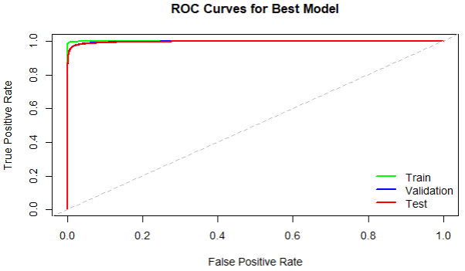
Modelling
B_tgt
Validation Set
Model Rank | Type | AUC
Model 1 | gbm | 0.9970
Model 2 | drf | 0.9961
Model 3 | deeplearning | 0.8657
Model 4 | glm | 0.8521
Test Set
Model Rank | Type | AUC
Best Model (Model 1) | gbm | 0.9965
Notes:
For b_tgt, we get a gradient boosted model as our best performing model in validation. This model in particular runs incredibly well, an AUC of .9970 in validation and .9965 in testing is very impressive. Even considering the GLM, which is usually not too impressive at predicting when compared to other models, runs very well with an AUC of .852 which when considering it is a range from .5 at worst and 1.0 at best, .8521 is very respectable.

Slide 18
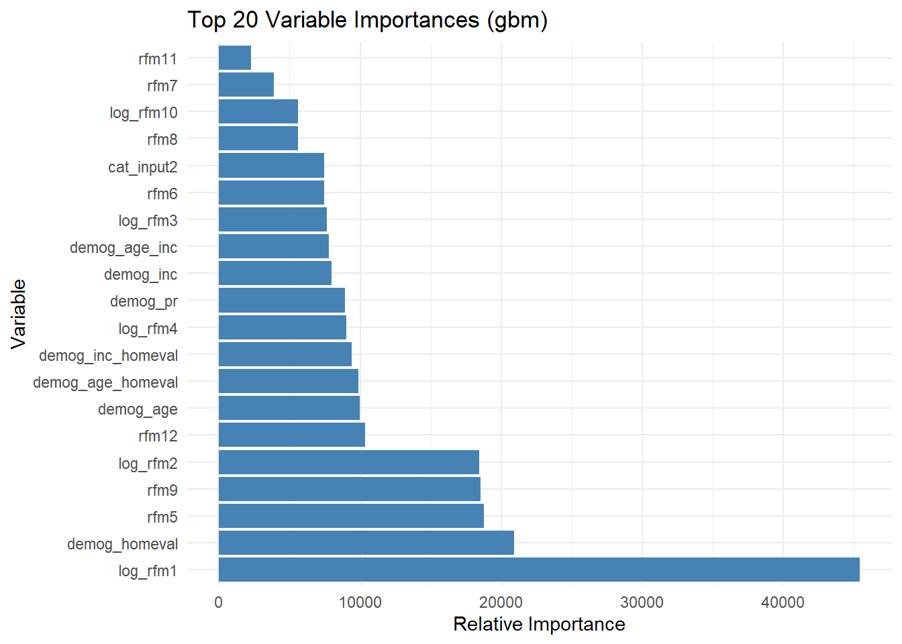
Modelling
Predictor | Coefficient | Odds Ratio (%)
Intercept | 5.0998005 | 16298.92
cat_input2.A | 0.1119309 | 11.84
cat_input2.B | 0.0942768 | 9.89
cat_input2.C | -0.0037163 | -0.37
cat_input2.D | -0.0437802 | -4.28
cat_input2.E | -0.1597183 | -14.76
cat_input1.X | 0.1709740 | 18.65
cat_input1.Y | 0.1377629 | 14.77
cat_input1.Z | -0.3239737 | -27.67
demog_genf.0 | -0.0148939 | -1.48
demog_genf.1 | 0.0032531 | 0.33
demog_age | -0.0015614 | -0.16
demog_ho | -0.0298982 | -2.95
demog_homeval | 0.0000078 | 0.00
demog_inc | 0.0000041 | 0.00
demog_pr | 0.0006671 | 0.07
rfm5 | 0.2830672 | 32.72
rfm6 | -0.0106399 | -1.06
rfm7 | -0.0864276 | -8.28
rfm8 | 0.0154354 | 1.56
rfm9 | -0.1787102 | -16.37
rfm11 | 0.0672027 | 6.95
rfm12 | 0.0027677 | 0.28
log_rfm1 | -0.7637720 | -53.41
log_rfm2 | -1.3508529 | -74.10
log_rfm3 | 0.0610994 | 6.30
log_rfm4 | 0.0424615 | 4.34
log_rfm10 | -0.2590137 | -22.82
demog_inc_homeval | 0.0000000 | 0.00
demog_age_homeval | 0.0000000 | 0.00
demog_age_inc | 0.0000000 | 0.00
B_tgt
Notes:
Here again we see high importance for rfm1, but we also see demog_homeval, rfm5, and rfm9 again, showing high relative variable importance (with rfm1 taking the cake clearly).

Slide 19
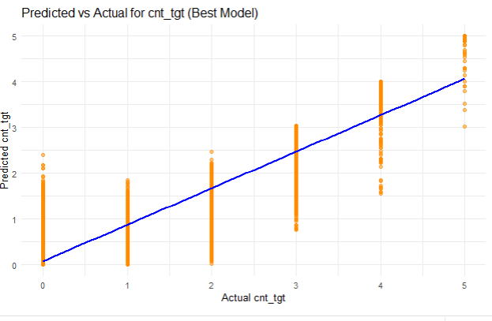
Modelling
Cnt_tgt
Validation Set
Model | Type | RMSE
Model 1 | drf | 0.2574
Model 2 | gbm | 0.2754
Model 3 | deeplearning | 0.5745
Model 4 | glm | 0.6165
Test Set
Model | Type | RMSE
Best Model (Test Set) | drf | 0.2562
Notes:
For count target, we end up with a best model being another distributed random forest, with an rmse of 0.2574 in validation and it even improves in test, at 0.2562., which again is very impressive. The chart shows that it does a good job at ensuring that no observations are too highly overpredicted or too lowly underpredicted. Something we could take from this in regard to marketing is identifying who the model predicted to purchase 1 or 2 products, but actually bought nothing, and marketing some promotions towards them.

Slide 20
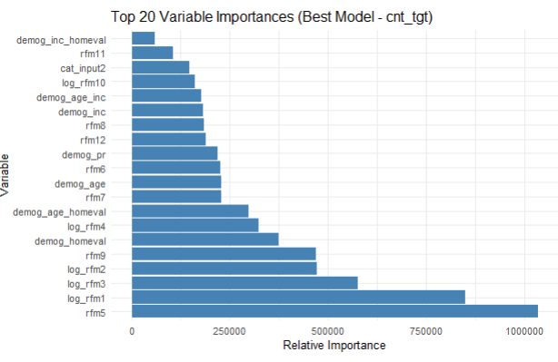
Modelling
Predictor | Coefficient | Odds Ratio (%)
Intercept | 1.5087728 | 352.12
cat_input2.A | 0.0181896 | 1.84
cat_input2.B | 0.0232440 | 2.35
cat_input2.C | -0.0044892 | -0.45
cat_input2.D | -0.0100478 | -1.00
cat_input2.E | -0.0272705 | -2.69
cat_input1.X | -0.0171031 | -1.70
cat_input1.Y | -0.0281818 | -2.78
cat_input1.Z | 0.0487102 | 4.99
demog_genf.0 | 0.0003223 | 0.03
demog_genf.1 | 0.0023244 | 0.23
demog_age | -0.0009596 | -0.10
demog_ho | -0.0055315 | -0.55
demog_homeval | 0.0000013 | 0.00
demog_inc | 0.0000004 | 0.00
demog_pr | -0.0003986 | -0.04
rfm5 | 0.1519339 | 16.41
rfm6 | 0.0021239 | 0.21
rfm7 | -0.0164522 | -1.63
rfm8 | 0.0029292 | 0.29
rfm9 | -0.0364782 | -3.58
rfm11 | -0.0255904 | -2.53
rfm12 | -0.0001056 | -0.01
log_rfm1 | -0.1606913 | -14.84
log_rfm2 | -0.1890883 | -17.23
log_rfm3 | 0.0418248 | 4.27
log_rfm4 | -0.0147741 | -1.47
log_rfm10 | -0.0331659 | -3.26
demog_inc_homeval | 0.0000000 | 0.00
demog_age_homeval | 0.0000000 | 0.00
demog_age_inc | 0.0000000 | 0.00
Cnt_tgt
Notes:
Once again here we see rfm5, 1, and 9 being in the top with homeval not being too far behind.

Slide 21
Marketing
Marketing Insights
Notes:
What can we actually glean from these models?

Slide 22
Marketing
Insights
High-impact variables:rfm1 (avg sales past 3 years), rfm2 (lifetime avg sales), and demog_homeval (home value) consistently have the most impact in models.
These make logical sense: prior spending and wealth are predictive of future financial behavior.
Negative impact of rfm1 across models:
As prior average sales increase, new product adoption and sales decrease — likely due to market saturation.
Suggests targeting individuals who haven't spent much yet may yield higher returns.
Positive impact of rfm5 (count of past purchases):
Indicates loyal, repeat buyers — great targets for promotions and retention marketing.
Negative impact of rfm9 (months since last purchase):
Strong signal that the longer it’s been since last purchase, the lower the future sales probability.
These customers are poor targets for marketing efforts.
Notes:
So, when we examine the variable importance across all three predictive models, we consistently see that rfm1, rfm2, and demog_homeval come out as the most impactful features. That’s absolutely expected.
rfm1 and rfm2 capture past sales behavior — average over the past three years and lifetime, respectively — and demog_homeval, which is a proxy for customer wealth. It's reasonable to assume that individuals with higher wealth are more likely to invest more in financial products.
But here’s something interesting — the coefficient for rfm1 is negative across all response variables. That means that as a customer’s past average sales increase, their likelihood of buying new products or spending more now actually decreases. This is probably due to market saturation — they’ve already purchased quite a bit, so they’re less likely to buy more.
This insight is useful for marketing strategy. Rather than targeting customers who have already spent heavily, it may be more effective to target those who haven’t yet, but could be open to trying products if they’re aware of them.
On the flip side, rfm5, which is the count of purchases in the past 3 years, shows a positive impact across models. These customers are likely repeat buyers, showing loyalty. That makes them ideal for retention campaigns, such as loyalty rewards or personalized deals.
Finally, we need to think about who not to target. rfm9, which measures the months since last purchase, has a consistently strong negative coefficient. The longer it's been since their last purchase, the less likely they are to buy again. So we probably shouldn’t waste marketing spend on these customers — they’ve likely disengaged.

Slide 23
The End!
Notes:
That is all! It has been a pleasure being in your classes, I hope to see you soon.

