Slide 1
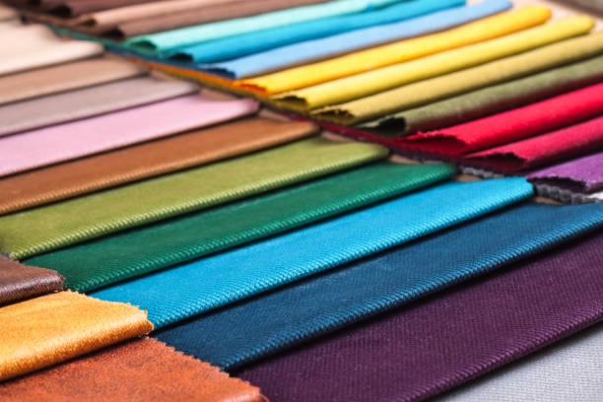
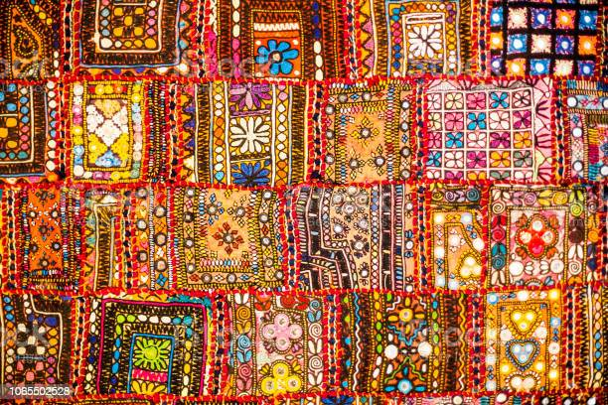
Technothon
Project : Textile Process Management System
Group : Textile Group 3
vishwajeetA Gholap
KUNAL RAJPUT
TEJASWINI TEKALE
VAISHNAVI JADHAV
SUBODH JOSHI
SHAUNAK MAHAJAN
KOUSHKI GUPTA
NAINSI PATEL

Slide 2

Problem Statement
The production of clothing involves various stages, including storage, warping, looming, checking, repairing, and dispatch, all of which are currently managed manually using paper or Excel. This process is prone to inefficiencies and errors due to the lack of digitalization and process synchronization. To ensure accuracy and optimize profits, a monitoring mechanism and a tool for complex calculations and data analysis should be implemented.

Slide 3
Objective
Objective is to create a system that will trigger faster communication and response among the different process coordinators. We endeavor to ease their calculations stuff by dynamic calculation and replace paperwork whole and solely with a website. Also, we seek to provide easy retrieval of data, advanced visualizations for better understanding and continuous process tracking to improve their work pace.

Slide 4
Technology Stack
Backend: Python , Django
Frontend: Html, CSS, Bootstrap
Database: SQLite

Slide 5
Architectural Diagram

Slide 6
Admin
System
Yarn worker
Yarn storage
Winding worker
Winding storage
Warping worker
Warping storage
Looming worker
Looming storage
Checking worker
Checking storage
Repair worker
Repair storage
Dispatch worker
Dispatch storage

Slide 7
DEMO

Slide 8
Future Scope
The project can be used in any other textile industry, where a similar type of implementation is followed. More advanced technologies like Machine Learning can be added for predicting profit and loss, analyzing the historical data to reduce future dissipation.

Slide 9
THANK YOU

