Slide 1
Design and Analysis of Algorithms
Sid Nath
Sep 19, 2022

Slide 2
Agenda
Welcome!!!
Introduction
Administrative
Lecture

Slide 3
About Me
First time Adjunct Faculty at SCU!
Ph.D. in CSE from UC San Diego
13+ years of industry experience
Combinatorial optimization, algorithms and Machine Learning
  https://www.linkedin.com/in/siddhartha-nath-6454b01/
  Google Scholar: https://tinyurl.com/yc87zw7p
Grader: Bharat Chadalawada

Slide 4
Key Announcements
Confirm that you can receive course credits ( 4 units )
Textbook is “Intro to Algo” 4th edition

Slide 5
Course Overview
Goal: Learn principles/techniques in algorithm design & analysis.
  design: different techniques: recursion, divide and conquer, greedy method, dynamic programming, linear programming
  analysis: correctness, lower bound and complexity
Foundations Ch. 2-4, 8.
  loop invariant, divide and conquer
  growth of functions
  recurrences
  lower bounds of sorting algorithms
Greedy algorithms, Ch. 15, 21, 22
Dynamic programming, Ch. 14, 23
Linear programming, Ch. 29, 24
NP-complete, Ch. 34
Prerequisites: discrete math, data structure, and linear algebra (preferred)

Slide 6
Evaluations
Homeworks (~4): 15%
Two programming assignments: 10%
Midterm exam: 30%
Presentation or a survey paper: 5%
Final exam: 40%
Extra credits

Slide 7
Expectations
Focus on learning technique of algorithm design and analysis
  Develop your own algorithms, show correctness and analyze efficiency
Foundation for pretty much any career path you take
  Competitive advantage
  High growth
Questions via email or Camino Discussions

Slide 8
Two kinds of applications/problems
Non optimization problem vs Optimization problem with an objective
Non optimization problem
    Sorting
    Matrix multiplication
    Interested in designing a fastest algorithm to find a solution
Optimization problem with an objective
    UPS delivery: minimizing the delivery time
    Build a house with fixed budget: maximizing area inside
    Interested in
      Finding a solution with the optimal objective value
      Fastest algorithm
Problem size: number of inputs

Slide 9
Ch. 1: Role of Algorithm in Computing
Definition of algorithm: a procedure that maps a set of input of a given application to output.
Application:
  Optimal binary search tree
Algorithm
input
Sequence of computational steps
output
Shortest path
Yes/No decision
Complexity of an algorithm = f(input size)
e.g., Running time, space

Slide 10
Applications
Search engine
Greedy – shortest path, assignment
Dynamic programming – optimization of buffers on a net, similarity in DNA sequences in Human Genome Project
Linear programming – optimization

Slide 11
Chapter 2 Getting Started--Overview
Examine two algorithms for sorting: insertion sort and merge sort.
See how to describe algorithms in pseudocode.
Begin using asymptotic notation to express running-time.
Learn the technique of “divide and conquer” in the context of merge sort.
Express algorithms in “pseudocode”
  Expressive, concise method to describe an algorithm in English
  Uses C/C++/Java-like syntax without programming overheads

Slide 12
Design of Algorithms
Correctness
Efficiency: running time, space
  E.g., 2n^2 vs. 50nlog n; n → input size
  Check for n = 10^7
Instance of a problem – input, constraints needed to compute a solution
An algorithm is computationally correct if it
  Halts for every problem instance, and
  Outputs the correct solution

Slide 13
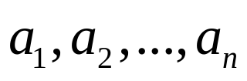
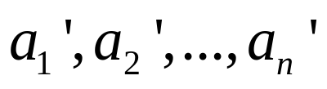
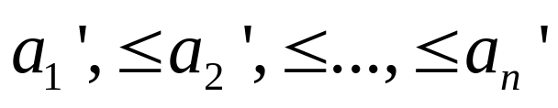
The sorting problem
Input: A sequence of n numbers
Output: A permutation (reordering) of the input sequence such that
  increasing order
  each element: key
Example:

Slide 14
Questions we may ask for this application
How to do sorting?
How many ways to do sorting?
Is my algorithm correct?
Is my algorithm the best?

Slide 15
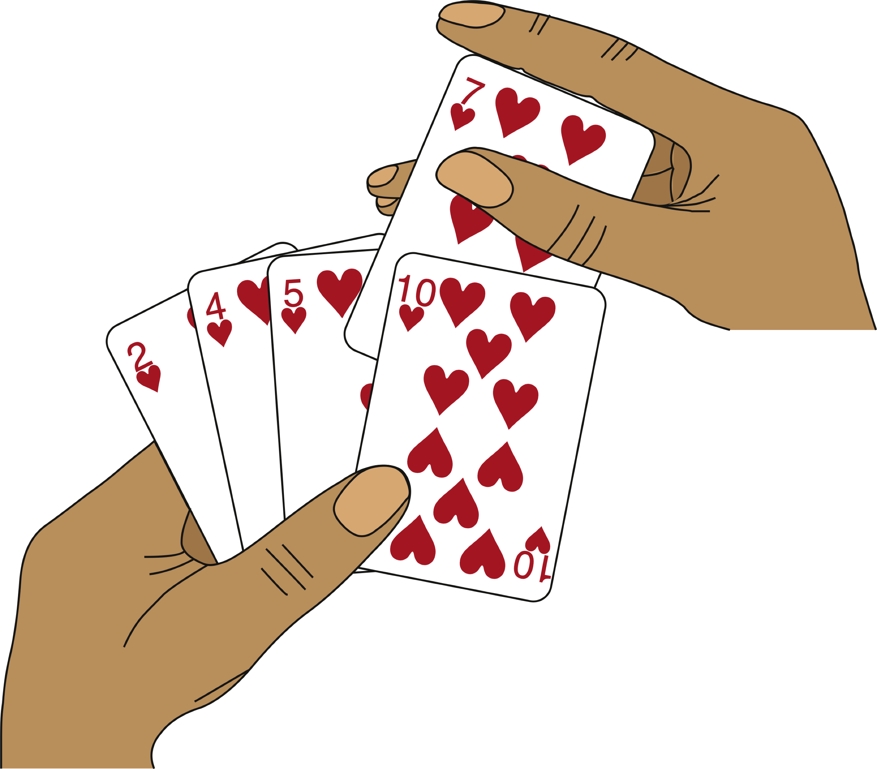
Insertion Sorting– one of the ways
Basic idea:
  n keys are in array A[1:n]
  assume A[1:j-1] are sorted
  for A[j]: compared against A[1:j-1] & inserted in right place

Slide 16
Express insertion sorting in pseudo code
INSERTION-SORT (A)
1 for j = 2 to A.length
2 key = A[ j ]
3 // Insert A[ j ] into the sorted sequence A[1 ..j -1]
4 i = j -1
5 while i >0 and A[i ] >key
6 A[i +1] = A[i ]
7 i = i -1
8 A[i +1] = key
Is the above algorithm correct? How to prove?

Slide 17
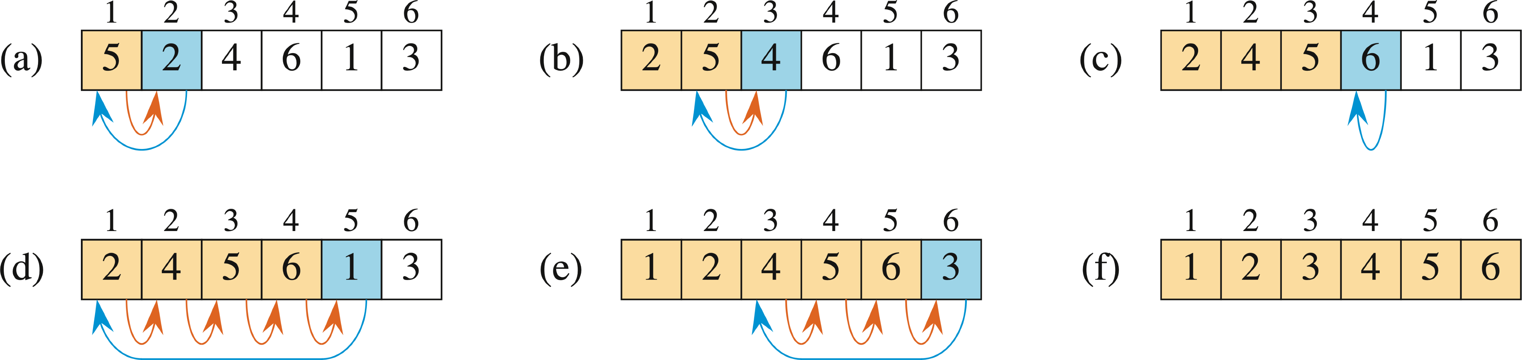
Example
A = {5, 2, 4, 6, 1, 3 }
|A| = n = 6

Slide 18
Algorithm analysis: correctness
Loop invariant method: Similar to mathematics induction with 3 steps: base, assumption, induction
Basic idea: show four steps
  Identity the loop invariant
  Initialization: It is true prior to the first iteration of the loop (assumption)
  Maintenance: If it is true before an iteration of the loop, it remains true before the next iteration (induction)
  Termination: When the loop terminates, the invariant gives us a useful property that shows the algorithm is correct.
  ‘it’ means the loop invariant of the algorithm
The loop invariant of the insertion sorting: At the start of each iteration of the for loop indexed by j , sub-array A[1 ...j -1] consists of the elements originally in A[1 ..j -1] but in sorted order.

Slide 19
Proof of correctness: insertion sort
The loop invariant: sub-array A[1 ...j -1] consists of the elements originally in A[1 ..j -1] but in sorted order
Initialization: Before iteration 1, j =2, A[1 ...j -1]=A[1],
  the element originally in A[1]
  sorted.
Maintenance--need to prove a loop invariant
  inner while loop works by moving A[ j -1], A[ j -2], A[ j -3] ..., by one position to right until the proper position for key (= A[ j ]) is found, key is placed into this position.
Termination: Outer for loop ends when j =n+1.
  current sub-array A[1 ..n] consists of the elements originally in A[1 ..n] but in sorted order.
  => the entire array is sorted!

Slide 20
Algorithm analysis: running time (time complexity)
Running time (time complexity) is measured by the number of an operation that take constant time such as
  multiplication, division, comparison, ...
Problem (input) size: = n in sorting problem
  parameter that describes the size of input data.
For the comparison-based sorting algorithms, the time complexity is measured by the number of elements in the input

Slide 21
What are missing from the model?
Memory hierarchy
  different algorithms show different data locality => different cache miss penalty.

Slide 22
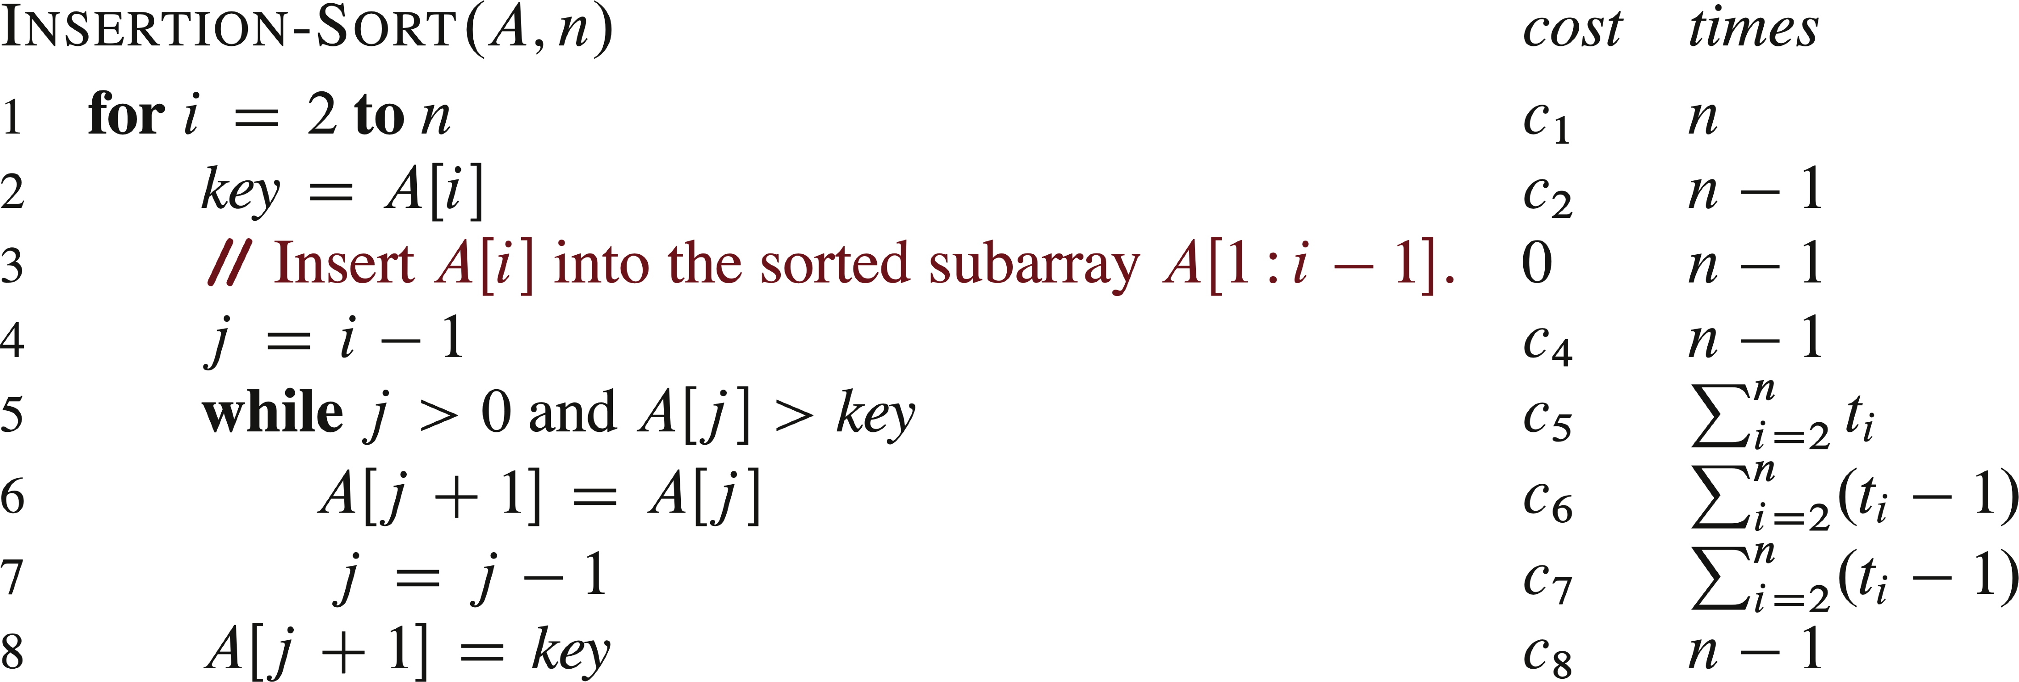
Complexity (running time) analysis of insertion sort

Slide 23

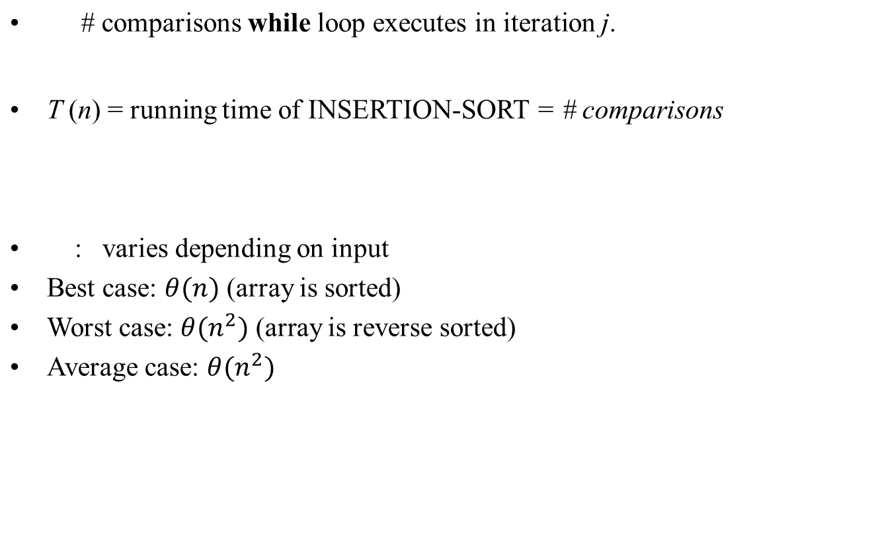
Complexity analysis-- insertion sort

Slide 24

Order of growth
Another abstraction to ease analysis and focus on the important features.
Look only at the leading term of the formula for running time.
  drop lower-order terms.
  ignore the constant coefficient in the leading term.
Example: For insertion sort, the worst-case running time is
Drop lower-order terms
Ignore constant coefficient
The worst-case running time
  Meaning: It grows like it does not equal

Slide 25
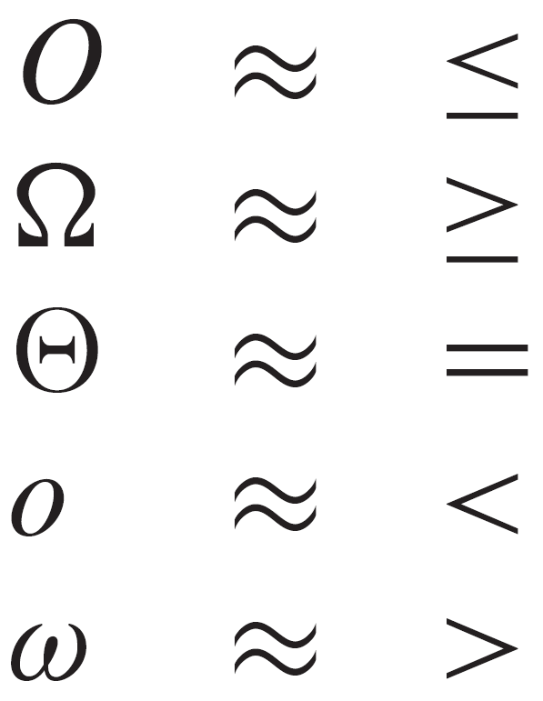
How do we compare growth of functions?
Formal definitions

Slide 26
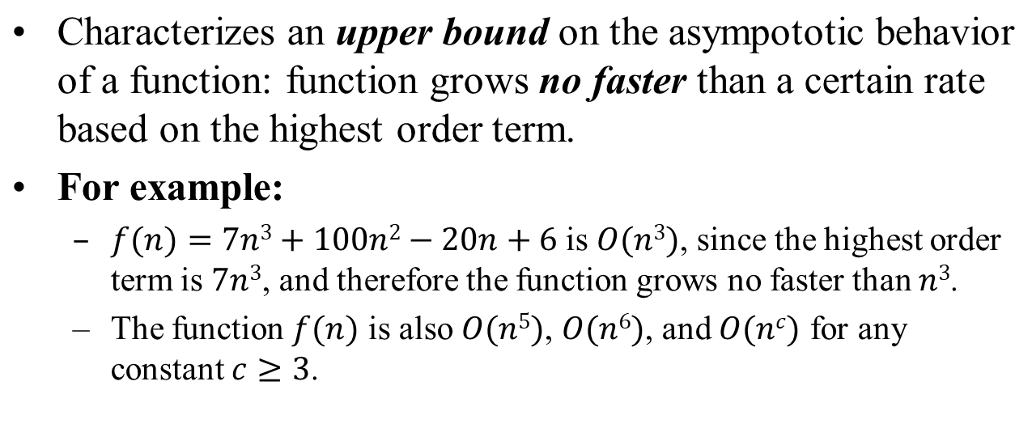
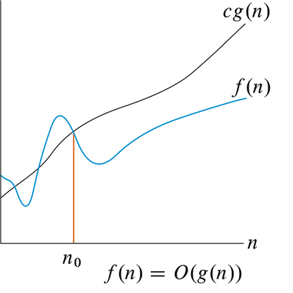
O-notations

Slide 27

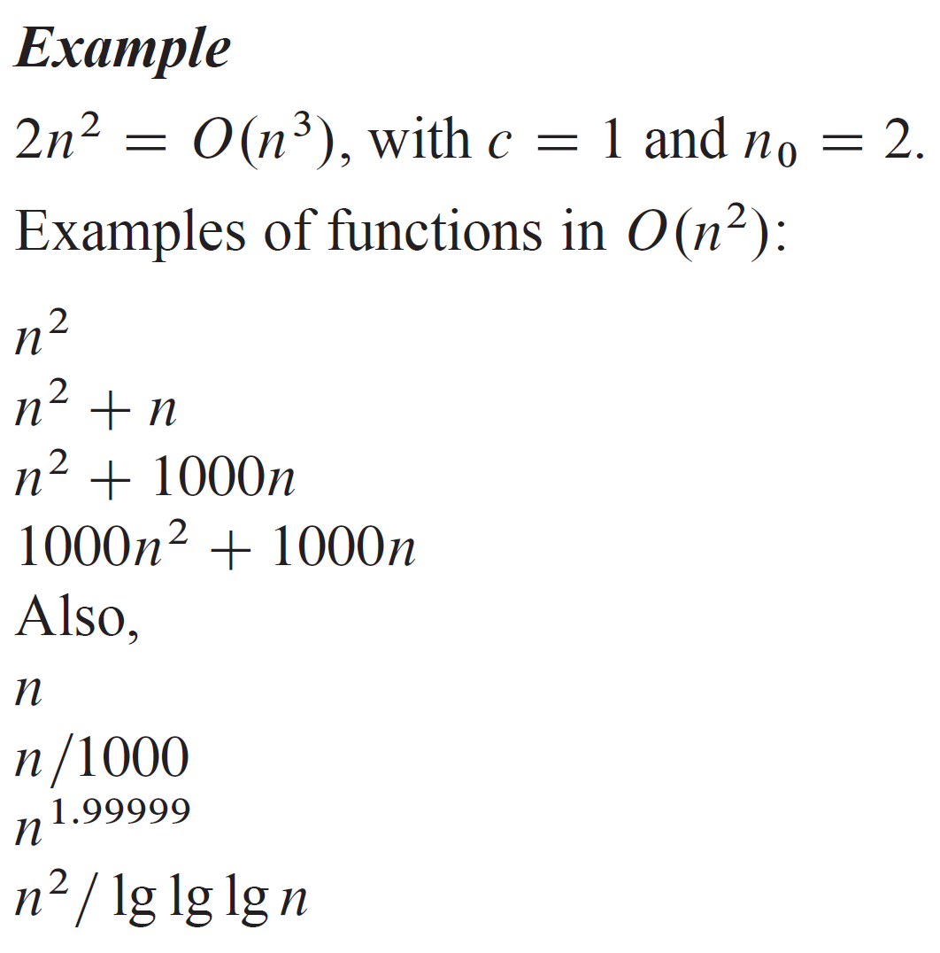
Example

Slide 28
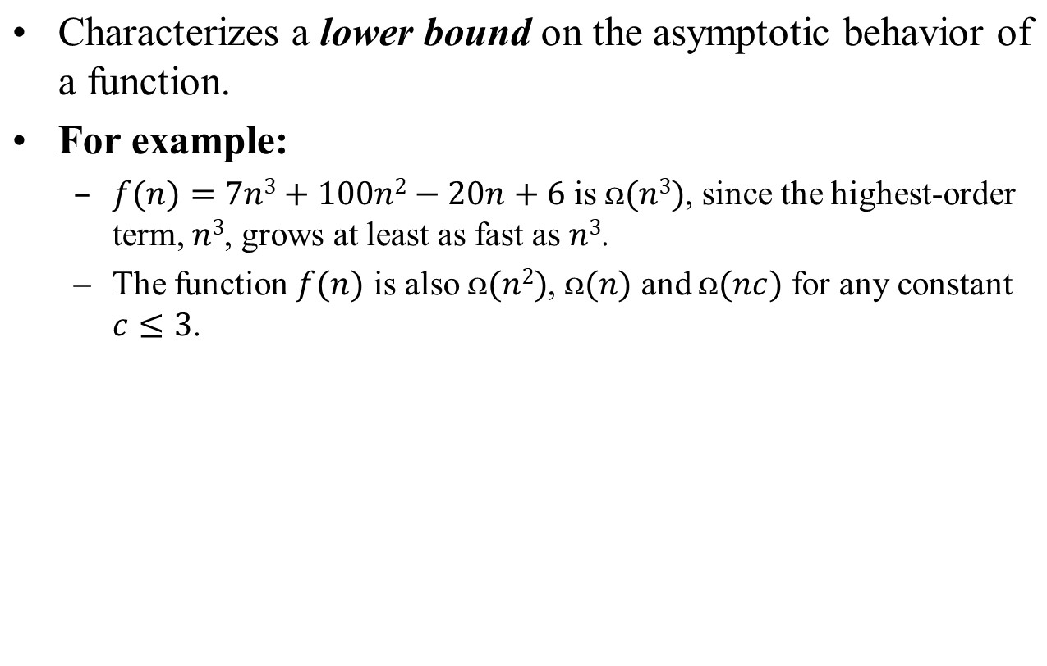
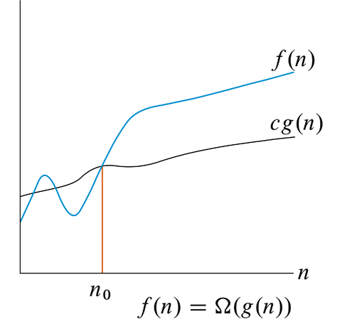

Slide 29
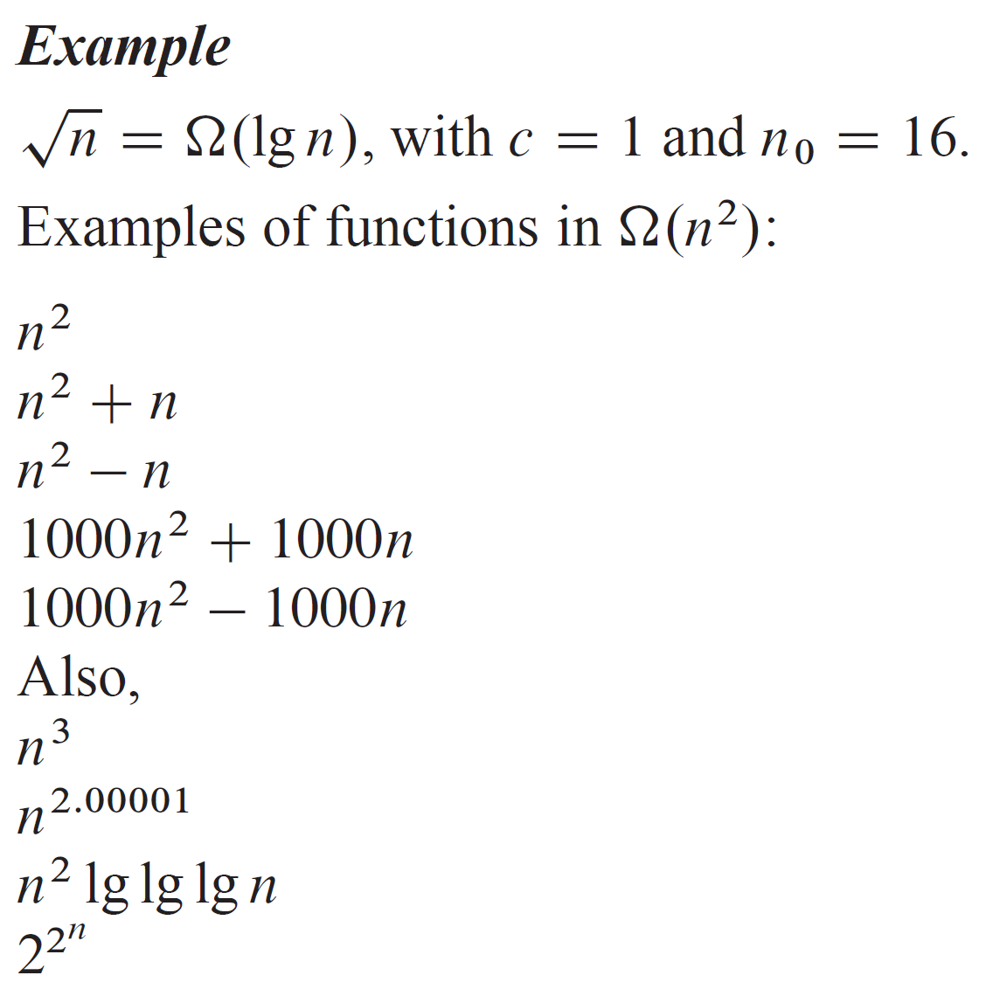
Example

Slide 30
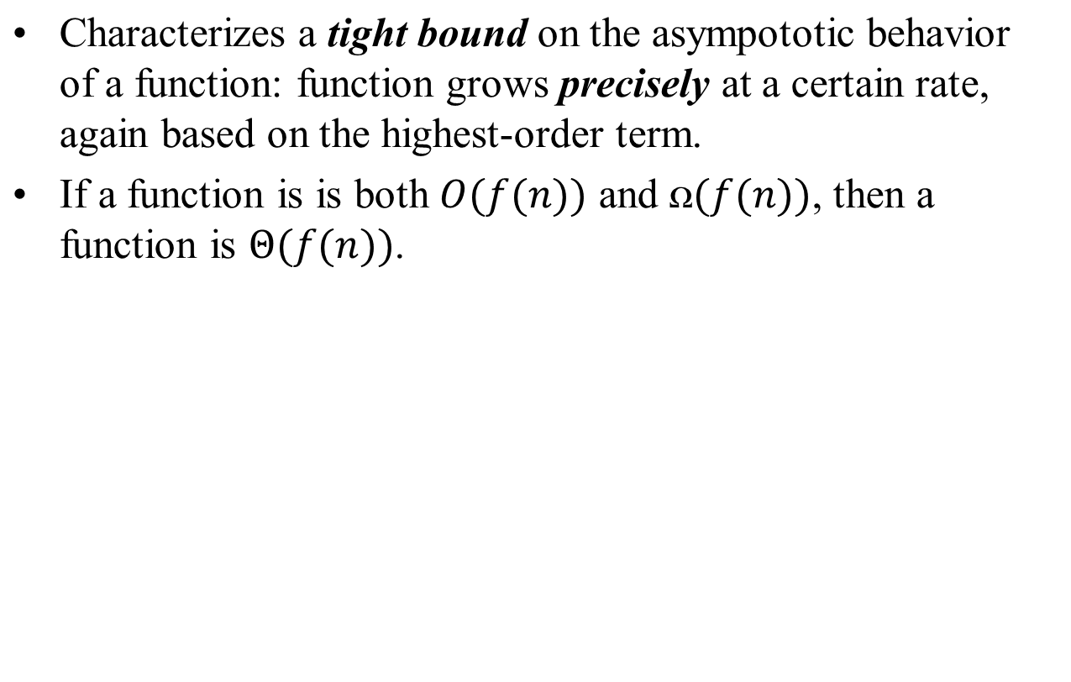
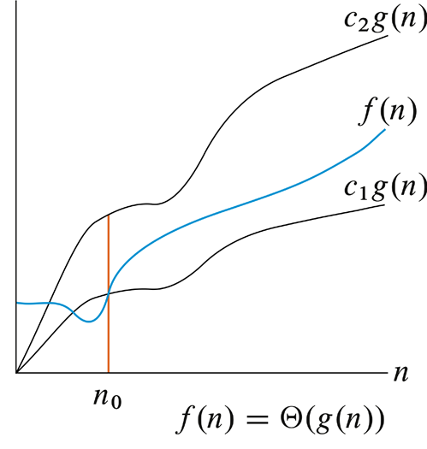

Slide 31
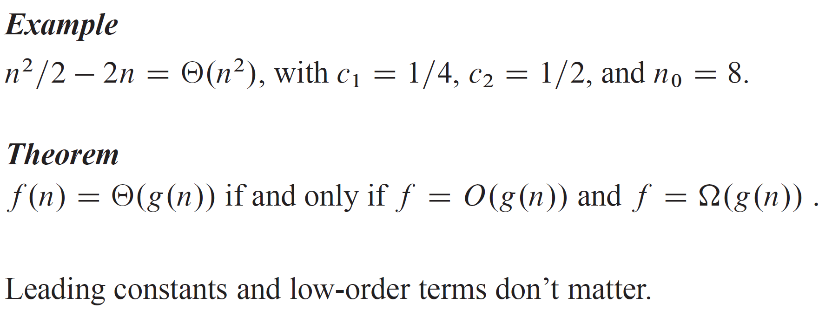
Example

Slide 32
Algorithm design techniques
Insertion sort: incremental
Merge sort: divide & conquer--basic idea
  divide the problem into 2 sub problems
  conquer the sub problems recursively
  combine sub problems
  example:

Slide 33
Lecture 1 summary
What is an algorithm?
Examples of algorithms and applications
Insertion sort--incremental
Concept of loop invariant
Analysis of asymptotic running times
Comparison of running times

