Slide 1
Design and Analysis of Algorithms
Sid Nath (snath@scu.edu)
Lecture 3
Sep 26, 2022

Slide 2
Agenda
Administrative
Lower-bound of comparison-based sorting
Graph algorithms

Slide 3
Administrative
Homeworks will be done individually and submitted online
  No handwritten photos / scans
  Must be typed either using Word or LaTeX or any other software
  LaTeX guide uploaded
Look for HW1 announcement and due date
  OK to consult colleagues but each question MUST be answered and written out by you based on your understanding
  No copying / see academic honesty policy of SCU
Syllabus being modified, Midterm pulled in by a week
  Topics covered up to end of Week 4 (i.e., greedy)

Slide 4
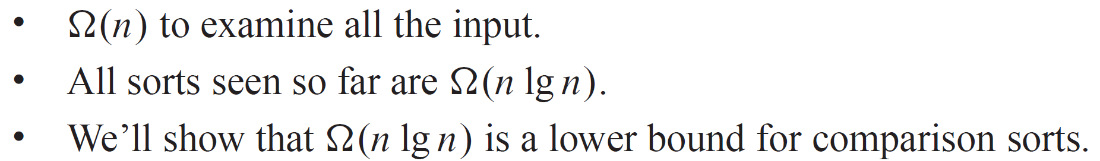
Sorting so far…
Comparison sorting
  The only operation to decide the order of keys is comparison of pairs of keys.
  Following are comparison sorts: insertion sort, selection sort, merge sort, quick sort, heap sort.
How fast can we sort?
  Is there a lower bound?
  Can we do it in linear time?

Slide 5
Decision tree
Abstraction of any comparison sort
  A node: corresponds a comparison
  Two branches: correspond to yes and no cases
  A leaf: corresponds to a permutation of inputs
Represents comparisons made by
  a specific sorting algorithm on inputs of a given size.
Abstracts away everything else: control and data movement.
We’re counting only comparisons.

Slide 6

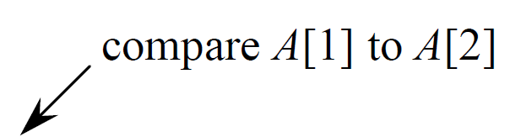
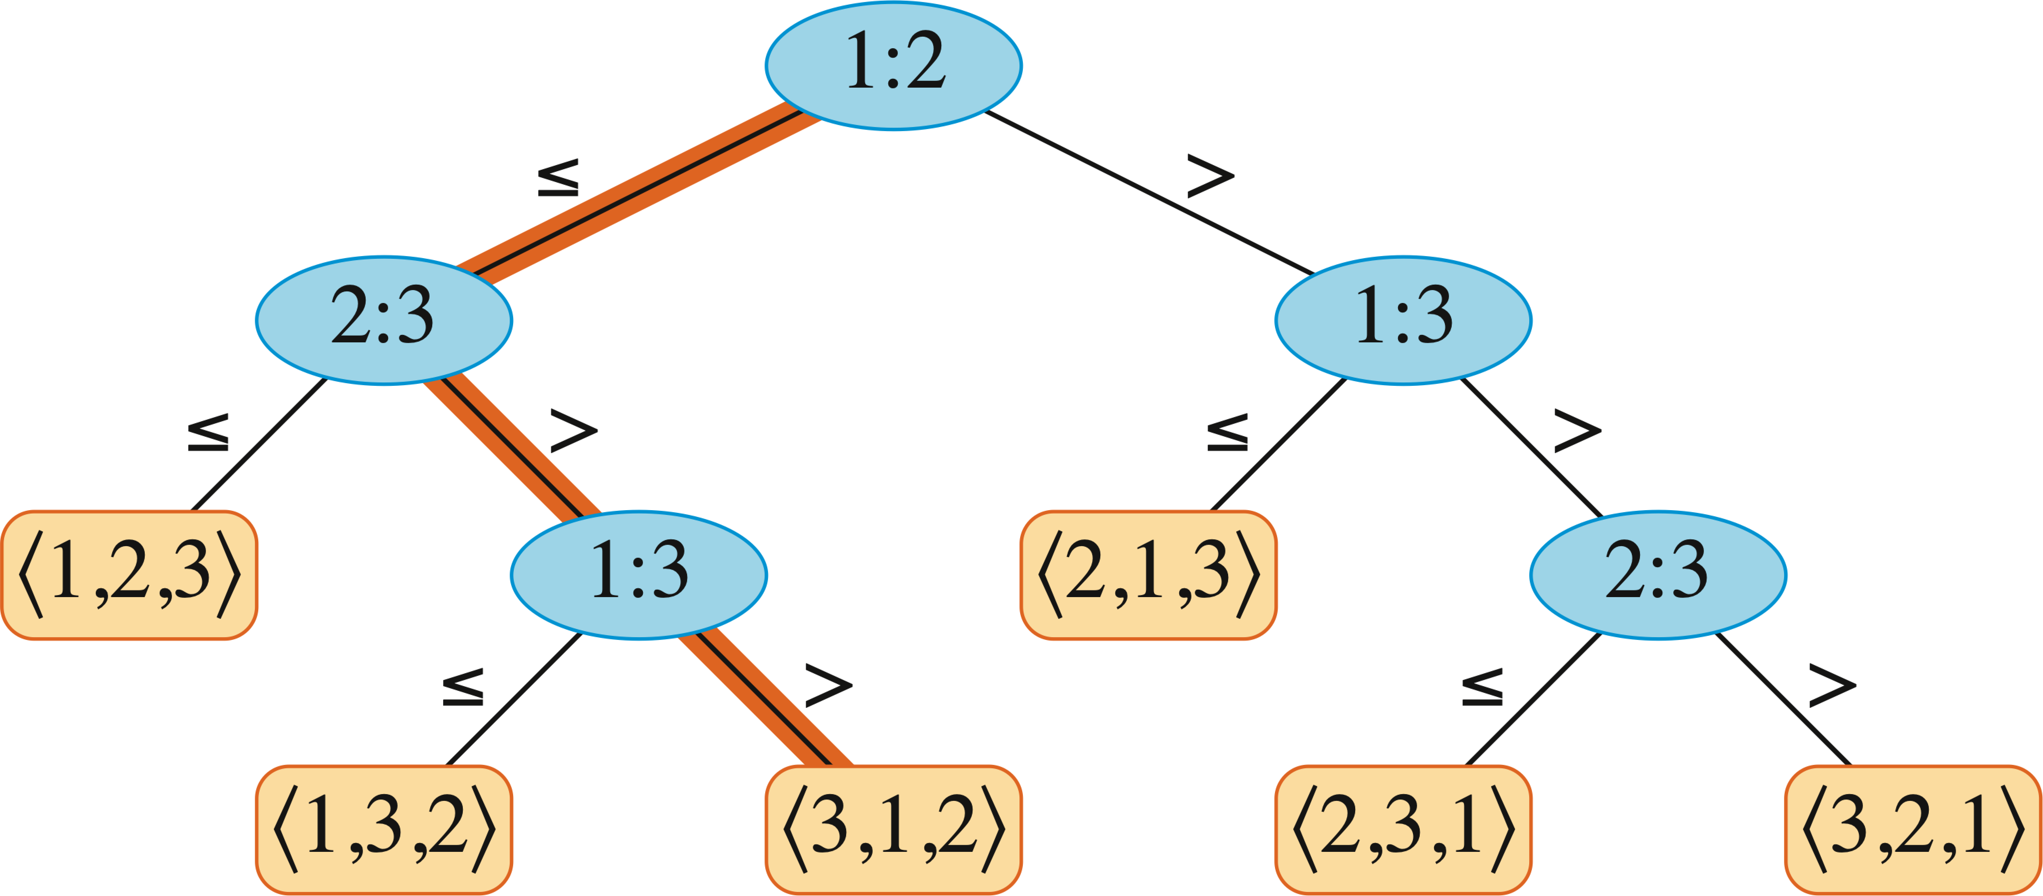


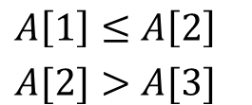
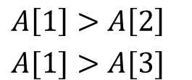

Decision Tree Examples

Slide 7
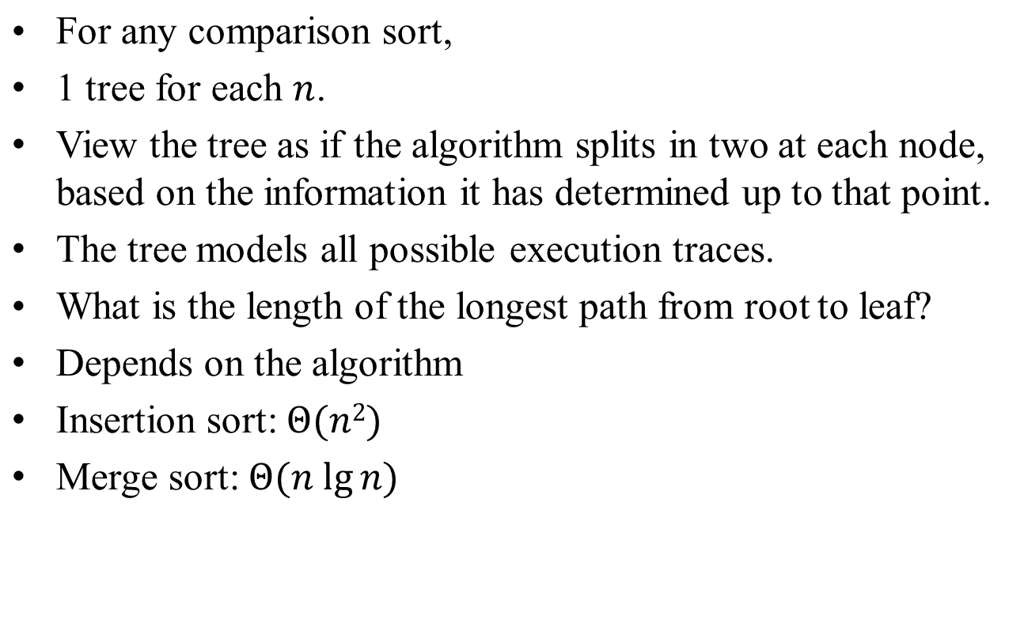
Lower Bounds for Sorting

Slide 8
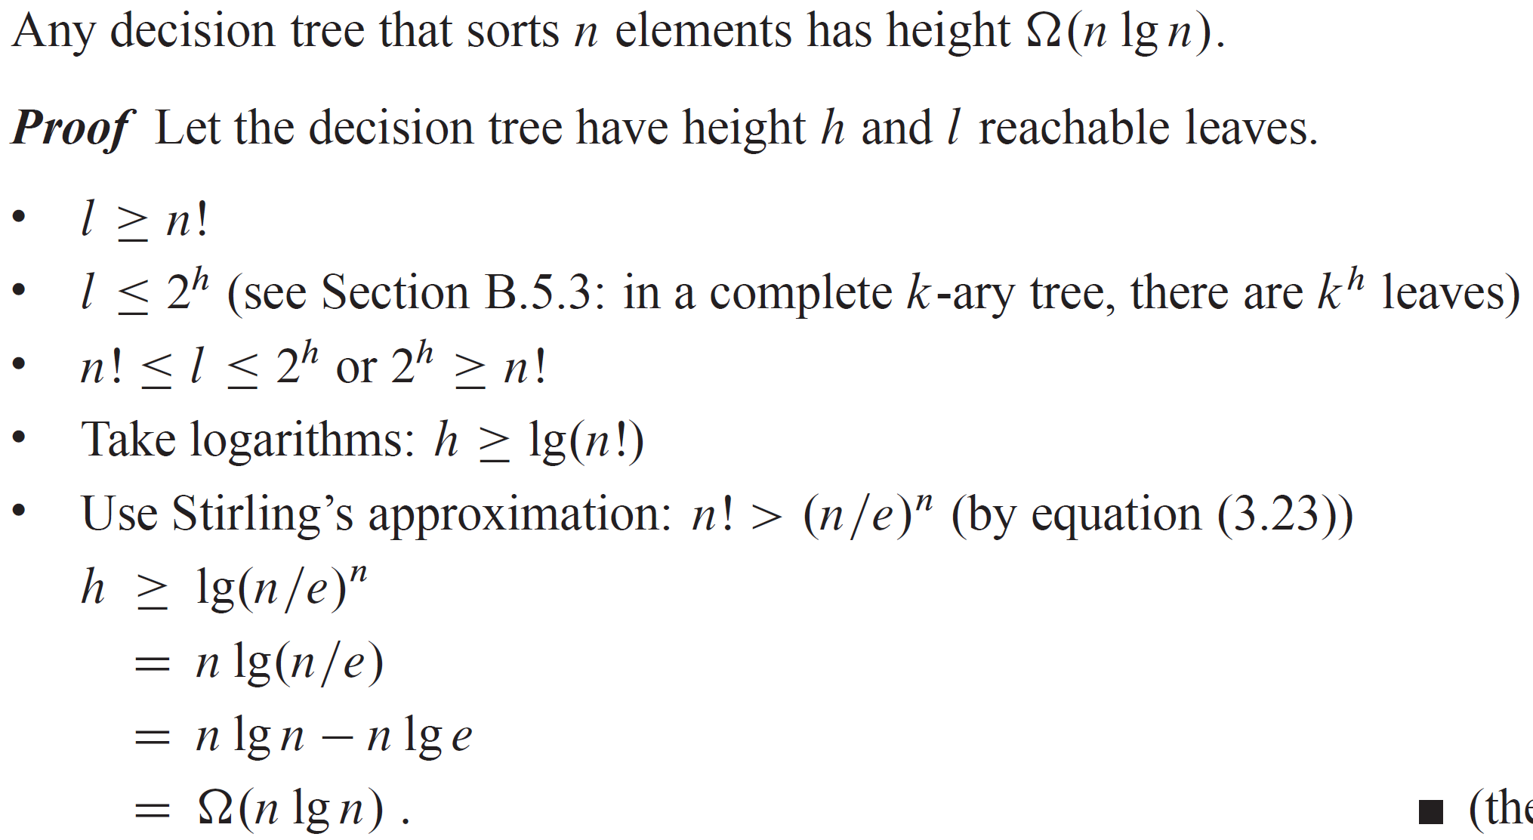
Theorem
Corollary -- merge sort is asymptotically optimal comparison sort.

Slide 9
Linear Time Sorting
Counting sort – Ch. 8.2
Radix sort – Ch. 8.3
Bucket sort – Ch. 8.4

Slide 10
Graphs and Connectivity
Graph basics and representation
Depth First Search
Connected components
Pre- and Post- orderings
DAGs / Topological Sort
General directed graphs & strongly connected components
BFS

Slide 11
Graph Definition
A graph G = (V,E) consists of two things:
  A collection V of vertices, or objects to be connected.
  A collection E of edges, each of which connects a pair of vertices.
Examples
  The internet V = {websites}, E = {links}or V = {computers}, E = {physical connections}
  Highway system, V = {intersections}, E = {roads}
  SCU, V = {students}, E = {classes}
A
B
E
V = {A,B,C,D,E}
E = {AB, AC, AD, BD, CE, DE}
D
C

Slide 12
Basic Algorithm
Keep track of all areas discovered
While there is an unexplored path, follow path

Slide 13
Systematize
Need to keep track of:
Which vertices discovered
Which edges have yet to be explored
Explore Algorithm will:
Use a field v.visited to let us know which vertices we have seen.
Store edges to be explored implicitly in the program stack.

Slide 14
Explore
explore(v)
v.visited ← true
For each edge (v,w)
If not w.visited
explore(w)
w.prev ← v

Slide 15
Example
Note: edges used leave behind “DFS tree”.
C
explore(A)
explore(B)
explore(A)
explore(C)
explore(A)
explore(B)
explore(C)
explore(D)
explore(A)
explore(H)
explore(D)
explore(F)
explore(E)
explore(A)
explore(F)
explore(G)
explore(F)
explore(H)
explore(E)
B
A
D
G
H
E
F

Slide 16
Result
Theorem: If all vertices start unvisited, explore(v) marks as visited exactly the vertices reachable from v.
Proof:
Only visits vertices reachable from v.
If u is visited, eventually visit every adjacent w.
  If there is a chain of vertices
  v → u₁ → u₂ → … → w
  eventually visit all of them

Slide 17
Question: explore
Which vertices does explore(v) mark as visited?
A
E
B
v
D
C

Slide 18
Depth First Search
explore only finds the part of the graph reachable from a single vertex. If you want to discover the entire graph, you may need to run it multiple times.
DepthFirstSearh(G)
Mark all v ∈ G as unvisited
For v ∈ G
If not v.visited, explore(v)

Slide 19
Example
E
explore(A)
explore(D)
A
B
D
C
DFS(G) eventually discovers all vertices in G.

Slide 20
Runtime of DFS
explore(v)
v.visited ← true
For each edge (v,w)
If not w.visited
explore(w)
DFS(G)
Mark all v ∈ G as unvisited
For v ∈ G
If not v.visited, explore(v)
Run once per vertex
O(|V|) total
Run once per neighboring vertex
O(|E|) total
O(|V|)
Final runtime: O(|V|+|E|)

Slide 21
Note on Graph Algorithm Runtimes
Graph algorithm runtimes depend on both |V| and |E|. (Note O(|V|+|E|) is linear time)
What algorithm is better may depend on relative sizes of these parameters.
Sparse Graphs:
|E| small ( ≈ V )
Examples:
Internet
Road maps
Dense Graphs:
|E| large ( ≈ V² )
Examples:
Flight maps
Wireless networks

Slide 22
Graph Representations
How do you store a graph in a computer?
Adjacency matrix: Store list of vertices and an array A[i,j] = 1 if edge between v_{i} and v_{j}.
  Small space for dense graphs.
  Slow for most operations.
Edge list: List of all vertices, list of all edges
  Hard to determine edges out of single vertex.
Adjacency list: For each vertex store list of neighbors.
  Needed for DFS to be efficient
  We will usually assume this representation

Slide 23
Connected Components
Want to understand which vertices are reachable from which others in graph G.
explore(v) finds which vertices are reachable from a given vertex.
Theorem: The vertices of a graph G can be partitioned into connected components so that v is reachable from w if and only if they are in the same connected component.

Slide 24
Example
D
A
C
E
B
G
F
H
I

Slide 25
Problem: Computing Connected Components
Given a graph G, compute its connected components.
Easy: For each v, run explore(v) to find vertices reachable from it. Group together into components.
Runtime: O(|V|(|V|+|E|)).
Better: Run explore(v) to find the component of v. Repeat on unclassified vertices.

Slide 26
DFS lets us do this!
ConnectedComponents(G)
CCNum ← 0
For v ∈ G
v.visited ← false
For v ∈ G
If not v.visited
CCNum++
explore(v)
explore(v)
v.visited ← true
v.CC ← CCNum
For each edge (v,w)
If not w.visited
explore(w)
Runtime O(|V|+|E|).

Slide 27
Example
CCNum:
1
2
3
4
2
D
1
A
C
2
1
E
1
B
G
F
2
2
3
H
4
I

Slide 28
Discussion about DFS
What does DFS actually do?
No output.
Marks all vertices as visited.
Easier ways to do this.
However, DFS also is a useful way to explore the graph. By augmenting the algorithm a bit (like we did with the connected components algorithm), we can learn useful things.

Slide 29
Pre- and Post- Orders
Augment how?
Keep track of what algorithm does & in what order.
Have a “clock” and note time whenever:
  Algorithm visits a new vertex for the first time.
  Algorithm finishes processing a vertex.
Record values as v.pre and v.post.

Slide 30
Computing Pre- & Post- Orders
DFS(G)
clock ← 1
For v ∈ G
v.visited ← false
For v ∈ G
If not v.visited
explore(v)
explore(v)
v.visited ← true
v.pre ← clock
clock++
For each edge (v,w)
If not w.visited
explore(w)
v.post ← clock
clock++
Runtime O(|V|+|E|).

Slide 31
Example
2
7
8
5
1
10
3
6
4
9

Slide 32
What do these orders tell us?
Prop: For vertices v, w consider intervals
[v.pre, v.post] and [w.pre, w.post].
These intervals:
Contain each other if v is an ancestor/descendant of w in the DFS tree.
Are disjoint if v and w are cousins in the DFS tree.
Never interleave
(v.pre < w.pre < v.post < w.post)

Slide 33
Proof
Assume algorithm finds v before w
(v.pre < w.pre)
If algorithm discovers w after fully processing v:
  v.post < w.pre
  Intervals disjoint
  v and w are cousins
If algorithm discovers w before fully processing v:
  Algorithm finishes processing w before it finishes v
  v.pre < w.pre < w.post < v.post
  Nested intervals
  v is ancestor of w

Slide 34
Directed Graphs
Often an edge makes sense both ways, but sometimes streets are one directional.
Definition: A directed graph is a graph where each edge has a direction. Goes from v to w.
Draw edges with arrows to denote direction.

Slide 35
DFS on Directed Graphs
Same code
Only follow directed edges from v to w.
Runtime still O(|V|+|E|)
explore(v) discovers all vertices reachable from v following only directed edges.

Slide 36
Example

Slide 37
Dependency Graphs
Go to work
Breakfast
7:10
Wake up
Breakfast
Go to work
Wake up
7:50
Shower
Dress
Shower
Dress
7:00
7:25
7:40

Slide 38
Dependency Graphs
A directed graph can be thought of as a graph of dependencies. Where an edge v→w means that v should come before w.
Definition: A topological ordering of a directed graph is an ordering of the vertices so that for each edge (v,w), v comes before w in the ordering.

Slide 39
Cycles
Definition: A cycle in a directed graph is a sequence of vertices v₁, v₂, v₃,…,v_{n} so that there are edges
(v₁,v₂), (v₂,v₃),…,(v_{n-1},v_{n}),(v_{n},v₁)

Slide 40
Obstacle
Proposition: If G is a directed graph with a cycle, then G has no topological ordering.
Proof:
Have cycle v₁, v₂,…, v_{n}.
By running DFS, we have an ordering.
Find earliest v_{i} in the ordering.
Note that v_{i} comes before v_{i-1}, in contradiction to the order property.

Slide 41
Lecture 3 summary
Lower-bound of comparison sorting
  Theorem
  Linear time sorting
Graph algorithms
  Introduction
  DFS
  Pre-/post-order traversals
  Directed graphs and detecting cycles

Slide 42
Extra Credit Qs (2 points)
Email solutions to snath@scu.edu before 7pm of next class to receive credit
Question: Suppose that you have two graph algorithms for the same problem
Alg1 has runtime O(|V|^{3/2})
Alg2 has runtime O(|E|)
Which of the following is likely true?
( a ) Alg1 is faster on most graphs
( b ) Alg2 is faster on most graphs
( c ) Alg1 is faster on sparse graphs, slower on dense graphs
( d ) Alg2 is faster on sparse graphs, slower on dense graphs

