Slide 1
Design and Analysis of Algorithms
Sid Nath (snath@scu.edu)
Lecture 5
Oct 3, 2022

Slide 2
Agenda
Administrative
Extra credit Qs review
Paths in a graph
Greedy

Slide 3
Administrative
HW1, EC3 due now!
HW2, PA1 announced and available
Midterm on Oct 17 (M) vs. Oct 19 (W)
7:10p in Kenna 104
Closed book; cheat sheet OK
Calculators OK, but no other device (phones, smart watches, laptops, etc.)

Slide 4

EC1: 9/21
Coppersmith-Wingrad: $θ\left(n^{2.376}\right)$
Andrew-Stothers: $θ\left(n^{2.374}\right)$
Virginia-Vassilevska-Williams: $θ\left(n^{2.3727}\right)$

Slide 5
EC2: 9/26
Question: Suppose that you have two graph algorithms for the same problem
Alg1 has runtime O(|V|^{3/2})
Alg2 has runtime O(|E|)
Which of the following is likely true?
( a ) Alg1 is faster on most graphs
( b ) Alg2 is faster on most graphs
( c ) Alg1 is faster on sparse graphs, slower on dense graphs
( d ) Alg2 is faster on sparse graphs, slower on dense graphs

Slide 6
EC3: 9/28
How many strongly connected components does the graph below have?
1
2
3
4
5
A
B
C
H
E
D
G
F

Slide 7
Priority Queue
A Priority Queue is a datastructure that stores elements sorted by a key value.
Operations:
Insert – adds a new element to the PQ.
DecreaseKey – Changes the key of an element of the PQ to a specified smaller value.
DeleteMin – Finds the element with the smallest key and removes it from the PQ.

Slide 8
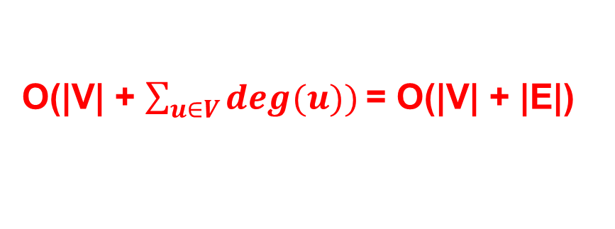
Runtime
BFS(G,s)
For v ∈ V, dist(v) ← ∞
Initialize Queue Q
Q.enqueue(s)
dist(s) ← 0
While(Q nonempty)
u ← Q.dequeue()
For (u,v) ∈ E
If dist(v) = ∞
dist(v) ← dist(u)+1
Q.enqueue(v)
v.prev ← u

Slide 9
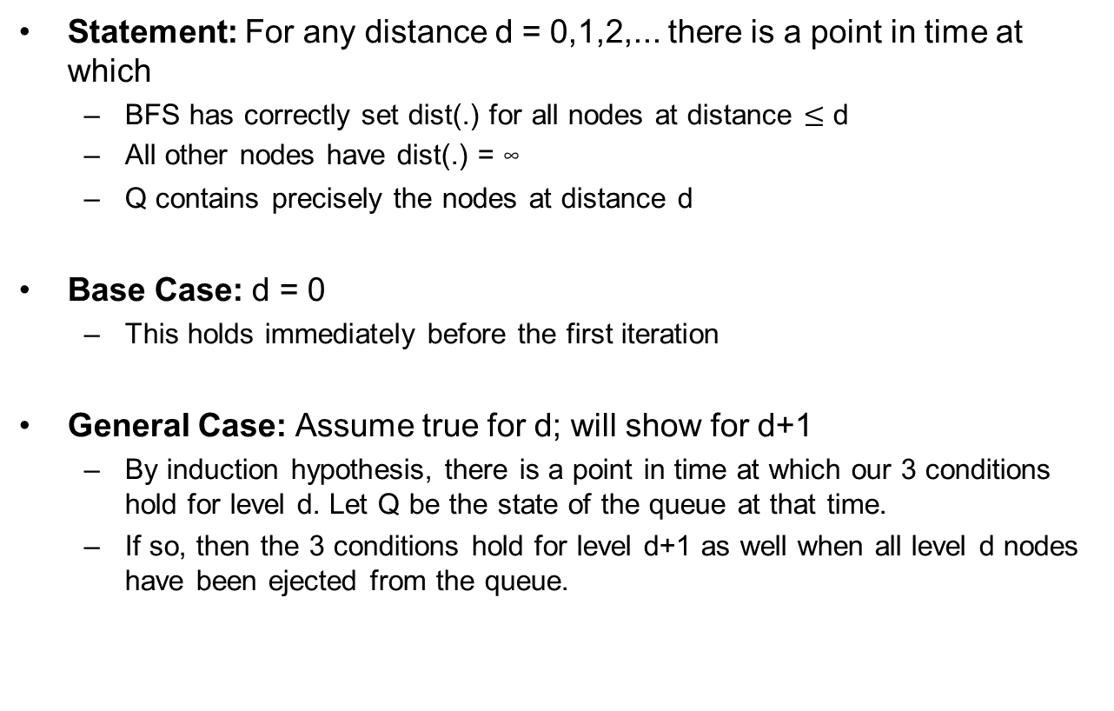
BFS Correctness

Slide 10
Edge Lengths: Towards Dijkstra’s Algorithm
The number of edges in a path is not always the right measure of distance. Sometimes, taking several shorter steps is preferable to taking a few longer ones
BFS treats all edges as having the same length
We assign each edge (u,v) a non-negative length ℓ(u,v). The length of a path is the sum of the lengths of its edges
Sometimes, edge lengths / weights ℓ(u,v) can be negative

Slide 11
Problem: Shortest Paths
Problem: Given a Graph G with vertices s and t and a length function ℓ, find the shortest path from s to t.

Slide 12
Extending BFS
Suppose graph G has positive, integral edge lengths
Simple trick: add dummy nodes to make G’ with unit-length edges
For ‘real nodes’, distance in G = distances in G’
We know how to run BFS on G’
But BFS on G’ could waste a lot of time
Can we adapt BFS to ‘work’ only when there is something
interesting to do?

Slide 13
“Alarm Clocks”
Idea
Snooze through visits to dummy nodes
‘Alarm’ should wake us up whenever something interesting is happening, i.e., when BFS encounters a real node
Alarm for each real node = estimated time of arrival based on edges currently being traversed
T = 0: set alarms for A (100), B (200); snooze
T = 100: wake up, BFS is at A; set alarm for B (150); snooze
T = 150: wake up; done.

Slide 14
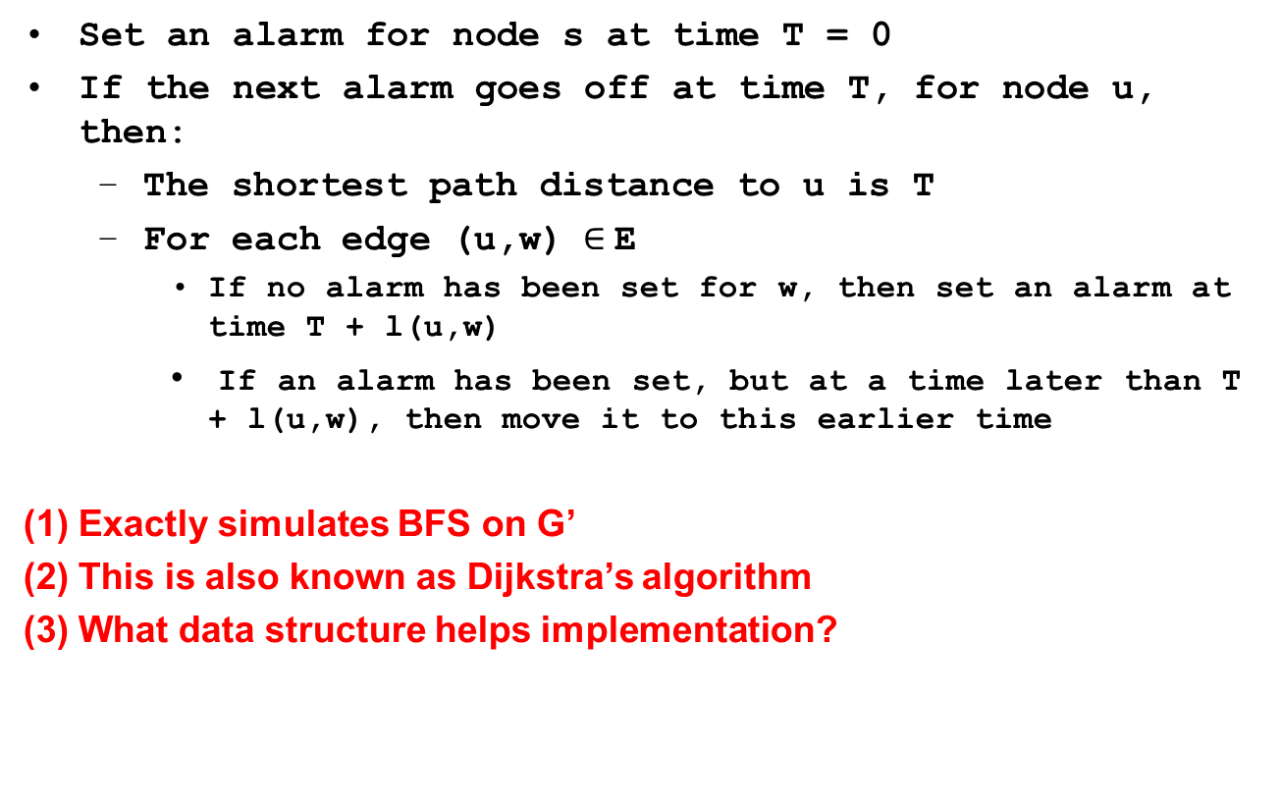
“Alarm Clock” Algorithm

Slide 15
Dijkstra’s Algorithm
Dijkstra(G,s,ℓ)
Initialize Priority Queue Q
For v ∈ V
dist(v) ← ∞
Q.Insert(v)
dist(s) ← 0
While(Q not empty)
v ← Q.DeleteMin()
For (v,w) ∈ E
If dist(v)+ℓ(v,w) < dist(w)
dist(w) ← dist(v)+ℓ(v,w)
Q.DecreaseKey(w)
Runtime:
O(|V|) Inserts + O(|V|) DeleteMins + O(|E|) DecreaseKeys
O(|V|) times
O(|V|) times
O(|E|) times

Slide 16
Example
5
5
5
2
2
2
4
0
s
t
7
5
3
2
1
4
3
4
1
0+1=1
1+2=3
1+3=4
2+3=5
5+2=7
0+5=5

Slide 17
Why does this work?
Claim: Whenever the algorithm assigns a distance to a vertex v that is the length of the shortest path from s to v.
Proof by Induction:
dist(s) = 0 [the empty path has length 0]
When assigning distance to w, assume that all previously assigned distances are correct.

Slide 18
Inductive Step
ℓ(v,w)
w
dist(v)
v
This is the shortest path from s to any vertex outside the bubble.
s
Correctly Assigned Distances

Slide 19
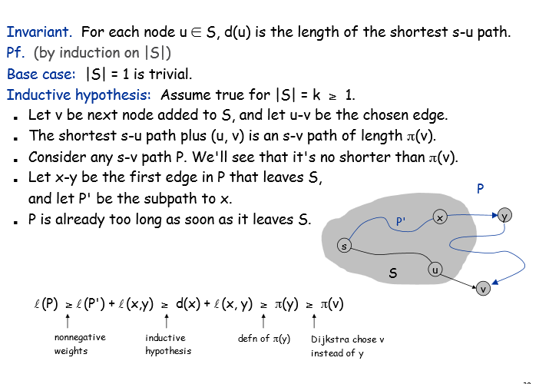
Proof of Dijsktra

Slide 20
Algorithm Design Key Ideas (Shortest Paths)
For SOME problems, the following property enables an efficient solution:
“Principle of Optimality”: Any subsolution of an optimal solution is itself an optimal solution
For such problems, solution strategies can include:
“Tabulate (cache) Subproblem Solutions”:
Avoid recomputation by creating a table of subproblem solutions
“Relaxation / Successive Approximation”:
Make multiple passes, each time solving a less restricted version of the original problem
Eventually, solve completely unrestricted = original problem instance

Slide 21
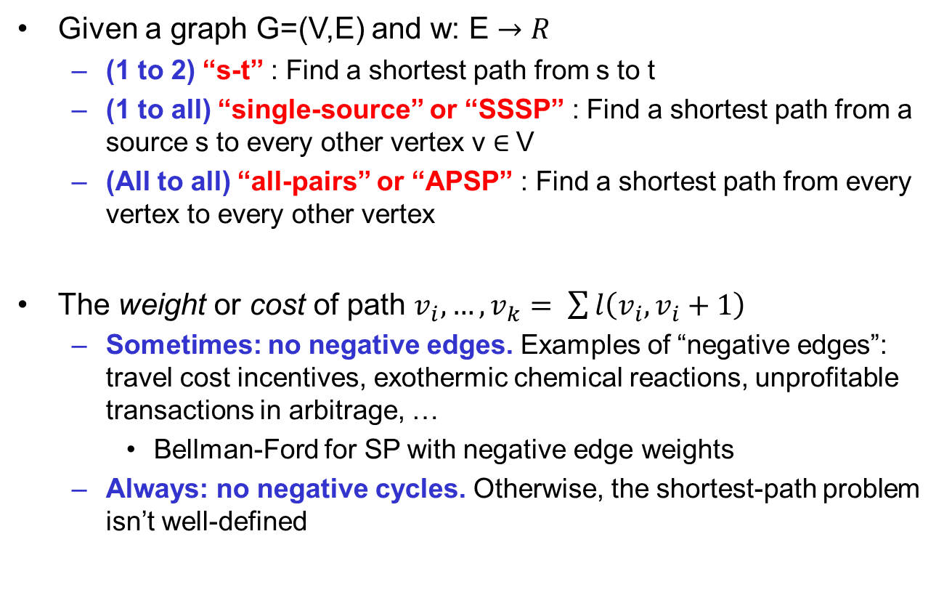
Shortest Path Problem Types

Slide 22
Greedy Algorithms
A greedy algorithm always makes the choice that looks best at the moment
Put another way: Greed makes a locally optimal choice in the hope that this choice will lead to a globally optimal solution
Greedy algorithms do not always yield optimal solutions, but for some problems they do
We’ll study some problems where they do

Slide 23
Greedy Algorithms
When do we use greedy algorithms?
When we need a heuristic for a hard problem
When the problem itself is “greedy”
Examples of “Greedy” problems:
Minimum Spanning Tree
Prim’s and Kruskal’s algorithms follow from “cut property” and “cycle property”, which we’ll see next time
Minimum Weight Prefix Codes (Huffman coding)
Activity selection
Interval scheduling

Slide 24
Properties of Greedy Problems
Greedy-choice property: A globally optimal solution can be arrived at by making a locally optimal (greedy) choice
Difficulty is in proving this…
Optimal substructure property: An optimal solution to the problem contains within it optimal solutions to subproblems
Key ingredient of both DP and Greed

Slide 25
Examples of Greedy Approaches
Traveling Salesperson Problem
What is a greedy approach? Start somewhere, always go to the nearest unvisited city
Knapsack Problem
What is a greedy approach? Use as much as possible of the highest value/weight ratio item (optimal for fractional knapsack problem)
Coin Changing Problem
What is a greedy approach? Use as much as possible of the largest denominations first (optimal for US currency)
Graph Coloring, Vertex Cover, K-Center
Min #colors needed so that no edge has same-color endpoints. Use lowest unused color
Min #vertices to have at least one endpoint of each edge. Add highest-degree vertex
Pick k “centers” out of n points to minimize max point-to-center distance. Add new center that is farthest from all existing centers

Slide 26
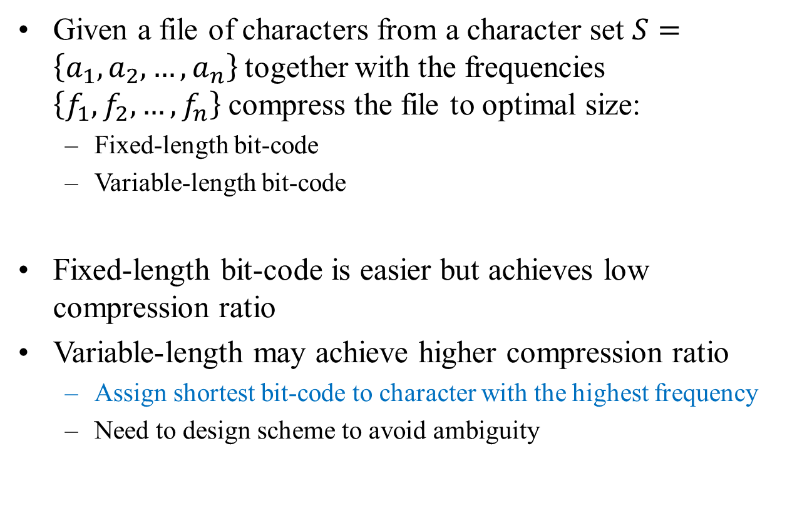
Huffman Codes

Slide 27
Huffman Codes
How to transmit English text using binary code?
26 letters + space = alphabet has 27 characters
5 bits per character suffices
Observation #1: Not all characters occur with same frequency
Sherlock Holmes, “The Adventure of the Dancing Men” : ETAOIN SHRDLU
Suggests variable-length encoding
Observation #2: Variable-length code should have prefix property
One code word per input symbol
No code word is a prefix of any other code word
Simplifies decoding process

Slide 28
Huffman Codes
Prefix codes
An optimal code using full tree:
Assign bit 0 to left branch
Assign bit 1 to right branch
No ambiguity
Simplify encoding / decoding

Slide 29
Huffman Coding: Greedy Algorithm
Huffman coding is based on probability with which symbols appear in a message
Goal is to minimize the expected code message length
How it works
Create a tree root node for each nonzero symbol frequency, with the frequency as the value of the node
REPEAT
Find two root nodes with smallest value
Create a new root node with these two nodes as children, and value equal to the sum of the values of the two children
(Until there is only one root node remaining)

Slide 30
Example of Huffman Coding
Example:
Symbol: A E G I M N O R S T U V Y Blank
Frequency: 1 3 2 2 1 2 2 2 2 1 1 1 1 3
(Generic Implementation)
• Place the elements into a min heap (by frequency)
• Remove the first two elements from the heap
• Combine these two elements into one
• Insert the new element back into the heap

Slide 31
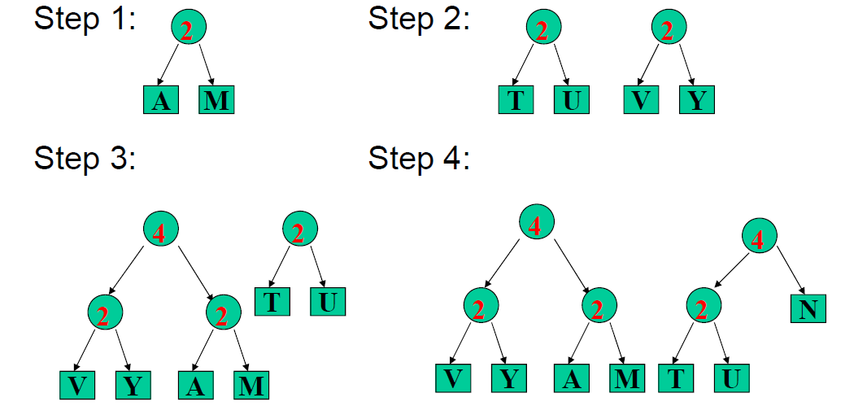
Example of Huffman Coding

Slide 32
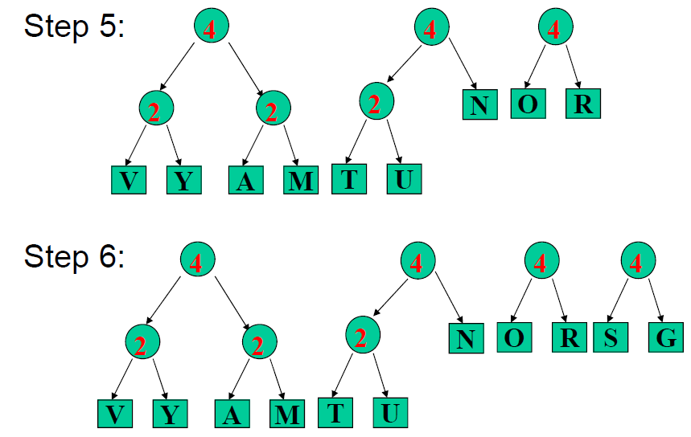
Example of Huffman Coding

Slide 33
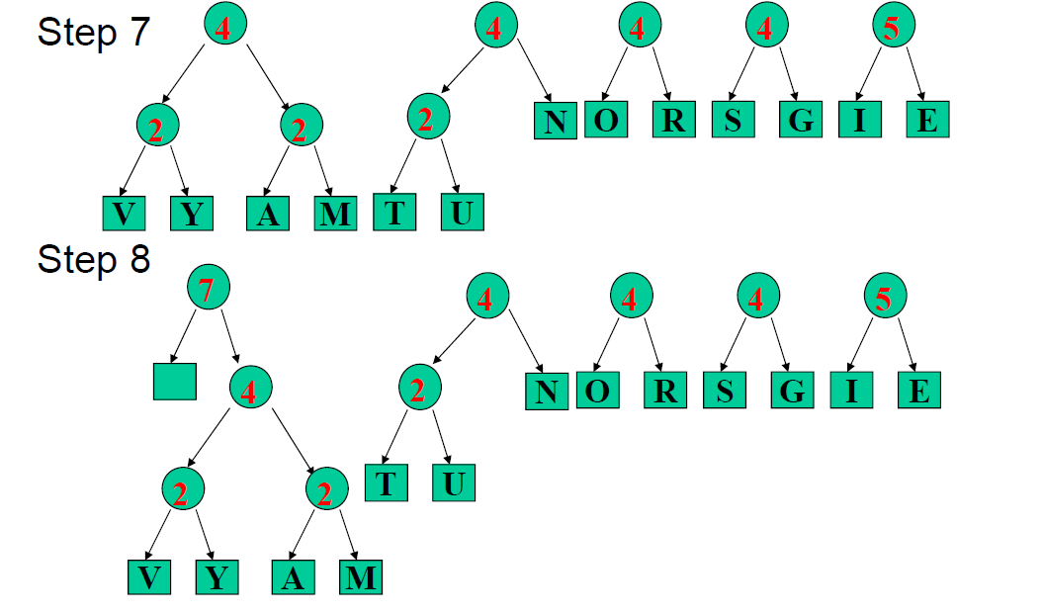
Example of Huffman Coding

Slide 34
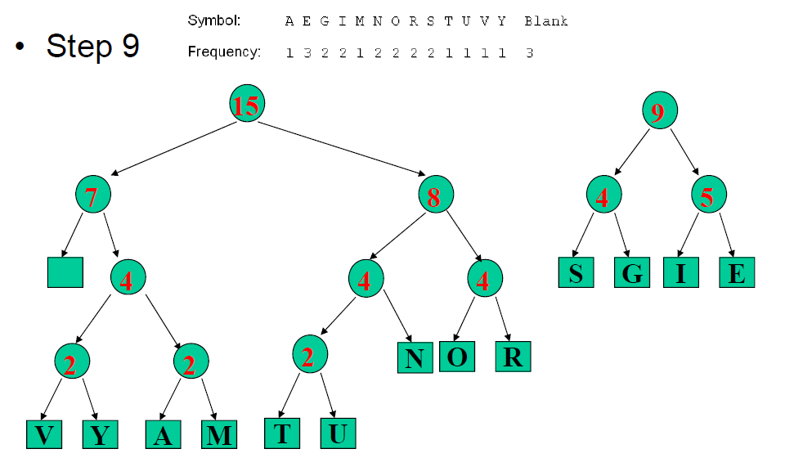
Example of Huffman Coding

Slide 35
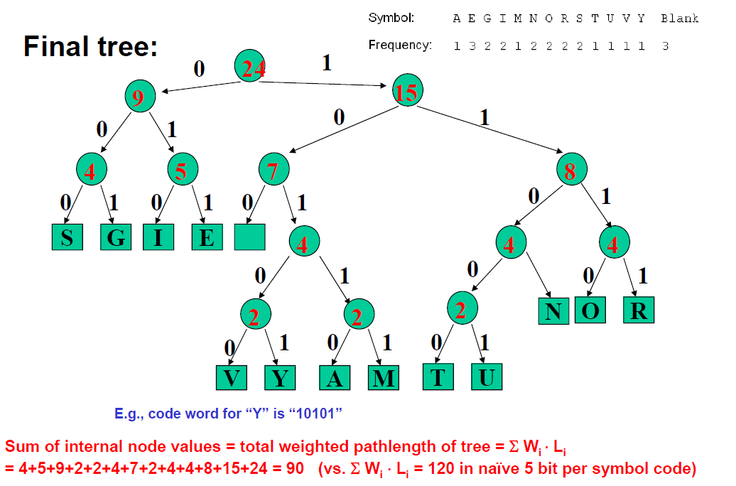
Example of Huffman Coding

Slide 36
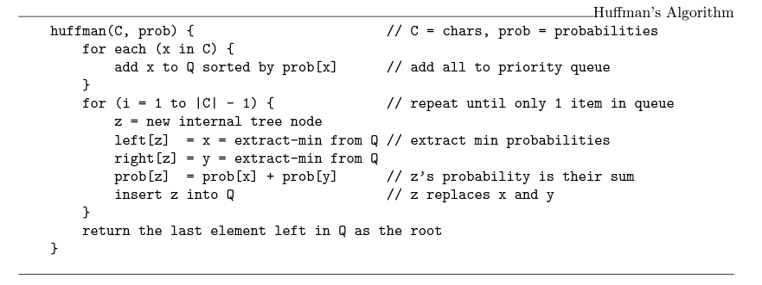
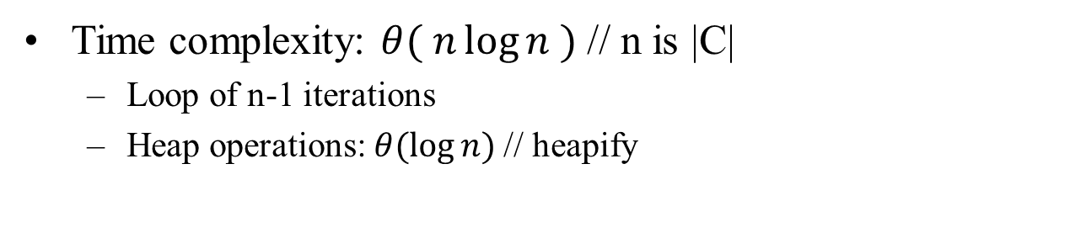
PseudoCode

Slide 37
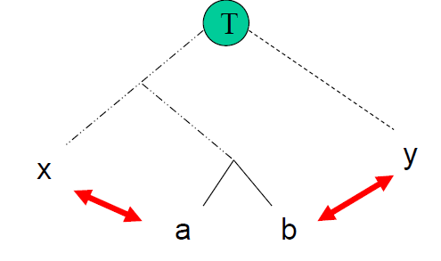
Why Huffman is Optimal
Greedy choice: Merging of 2 trees with minimum frequencies
Suppose we have an optimal tree T, where a, b are siblings at the deepest level, while x, y are the two nodes merged by Huffman’s algorithm
Swap x with a, y with b
Neither swap can increase cost
x and y have minimum weight
locations of a and b are at the deepest level

Slide 38
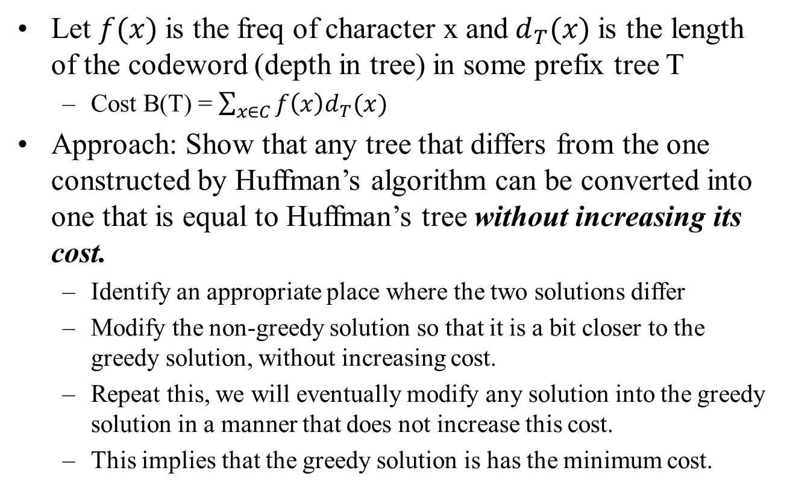
Proof of Correctness

Slide 39
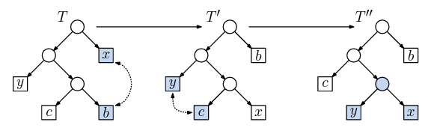
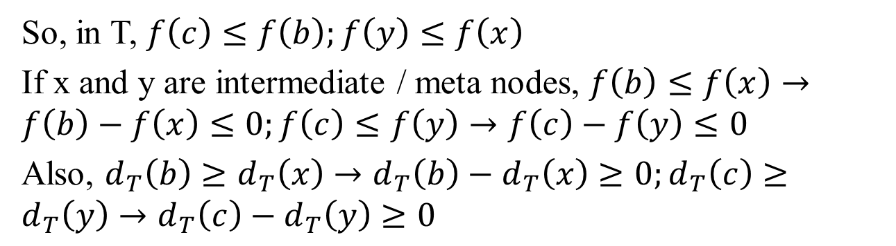
Proof of Correctness
Claim 1: Consider 2 characters b and c with the smallest freq, then it is an optimal prefix tree in which these 2 characters are siblings at the max depth in the tree
So, in T, $f\left(c\right)≤f\left(b\right);f\left(y\right)≤f\left(x\right)$
If x and y are intermediate / meta nodes, $f\left(b\right)≤f\left(x\right)→f\left(b\right)−f\left(x\right)≤0;f\left(c\right)≤f\left(y\right)→f\left(c\right)−f\left(y\right)≤0$
Also, $d_{T}\left(b\right)≥d_{T}\left(x\right)→d_{T}\left(b\right)−d_{T}\left(x\right)≥0;d_{T}\left(c\right)≥d_{T}\left(y\right)→d_{T}\left(c\right)−d_{T}\left(y\right)≥0$

Slide 40
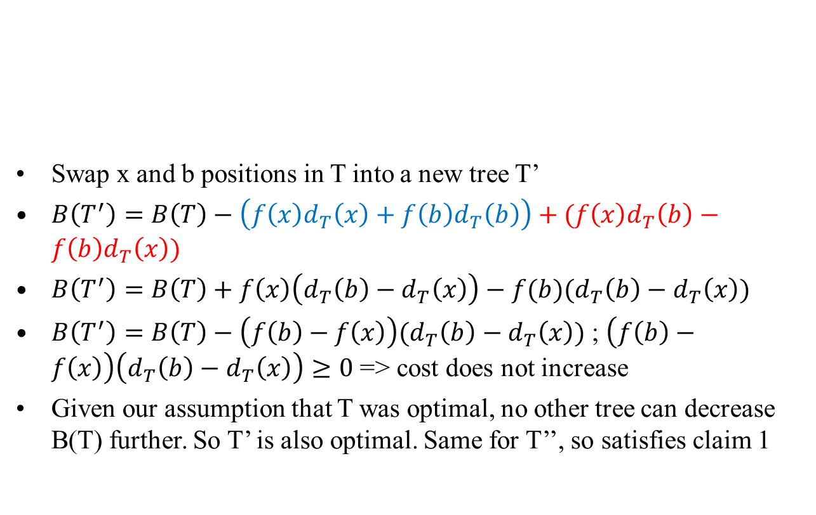
Proof of Correctness

Slide 41
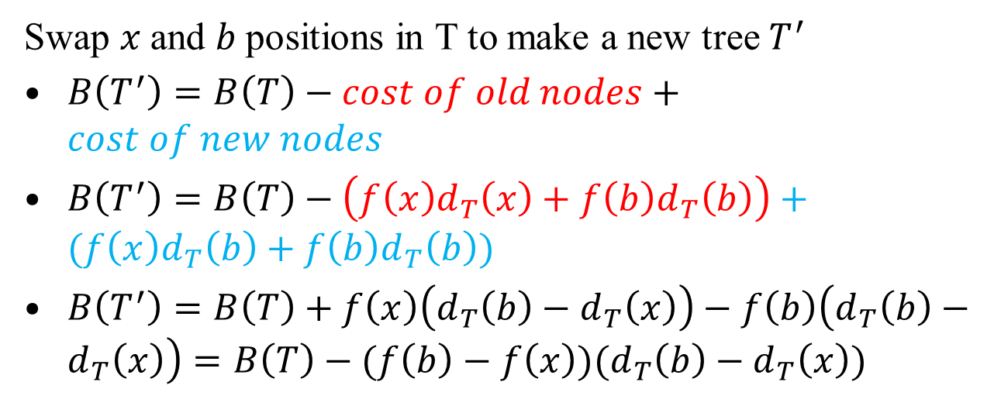
Proof of Correctness
Swap $x$and $b$positions in T to make a new tree $T^{′}$
$B\left(T^{′}\right)=B\left(T\right)−cost of old nodes+cost of new nodes$
$B\left(T^{′}\right)=B\left(T\right)−\left(f\left(x\right)d_{T}\left(x\right)+f\left(b\right)d_{T}\left(b\right)\right)+(f\left(x\right)d_{T}\left(b\right)+f\left(b\right)d_{T}\left(b\right))$
$B\left(T^{′}\right)=B\left(T\right)+f\left(x\right)\left(d_{T}\left(b\right)−d_{T}\left(x\right)\right)−f\left(b\right)\left(d_{T}\left(b\right)−d_{T}\left(x\right)\right)=B\left(T\right)−(f\left(b\right)−f\left(x\right))(d_{T}\left(b\right)−d_{T}\left(x\right))$

Slide 42
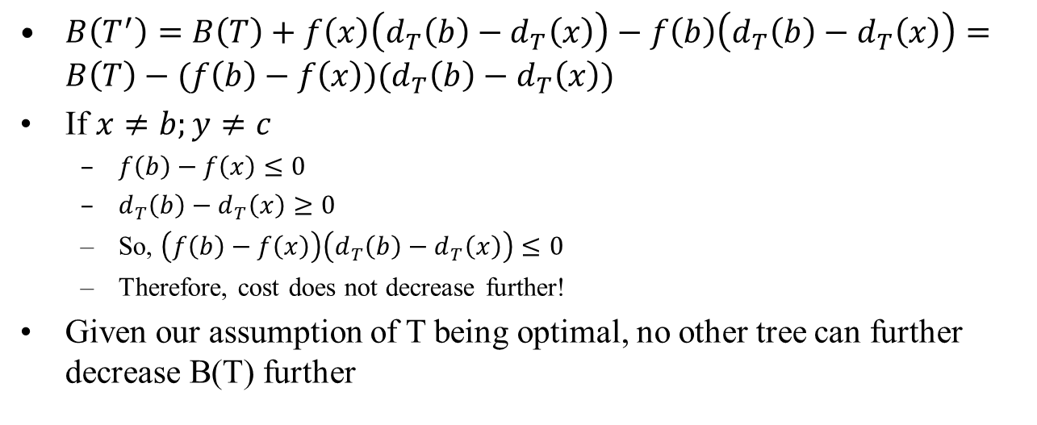
Proof of Correctness
$B\left(T^{′}\right)=B\left(T\right)+f\left(x\right)\left(d_{T}\left(b\right)−d_{T}\left(x\right)\right)−f\left(b\right)\left(d_{T}\left(b\right)−d_{T}\left(x\right)\right)=B\left(T\right)−(f\left(b\right)−f\left(x\right))(d_{T}\left(b\right)−d_{T}\left(x\right))$
If $x≠b;y≠c$
$f\left(b\right)−f\left(x\right)≤0$
$d_{T}\left(b\right)−d_{T}\left(x\right)≥0$
So, $\left(f\left(b\right)−f\left(x\right)\right)\left(d_{T}\left(b\right)−d_{T}\left(x\right)\right)≤0$
Therefore, cost does not decrease further!
Given our assumption of T being optimal, no other tree can further decrease B(T) further

Slide 43
Lecture 5 summary
Graph algorithms
PQ and BFS
Shortest path and Dijkstra
Greedy algorithms
Huffman coding

Slide 44
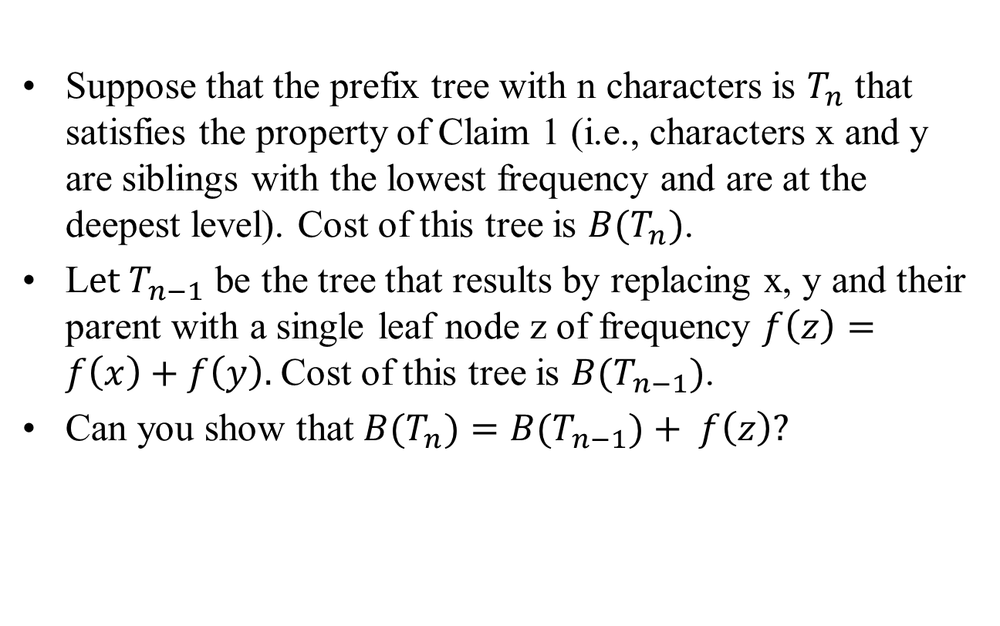
Extra Credit Qs (3 points)
Email solutions to snath@scu.edu by Oct 5, 2022 7:09pm

