Slide 1
Design and Analysis of Algorithms
Sid Nath (snath@scu.edu)
Lecture 6
Oct 5, 2022

Slide 2
Agenda
Administrative
Greedy
Activity selection
Interval partitioning

Slide 3
Administrative
EC4 due now!
Midterm on Oct 17 (M)
7:10p in Kenna 104
Closed book; cheat sheet OK
Calculators OK, but no other device (phones, smart watches, laptops, etc.)

Slide 4
Shortest Path Algorithms Summary
Unit Weights: Breadth First Search O(|V|+|E|)
Non-negative Weights: Dijkstra O(|V|log|V|+|E|)
Arbitrary Weights: Bellman-Ford O(|V||E|)
Arbitrary Weights, graph is a DAG: Shortest-Paths-In-DAGs
O(|V|+|E|)

Slide 5
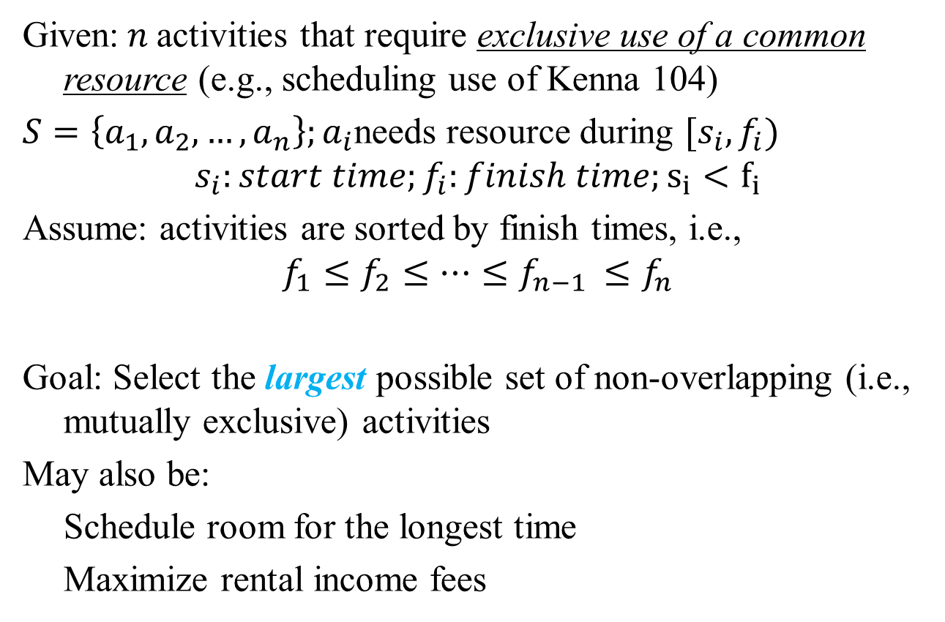
Problem 1: Activity Selection
Given:$n$activities that require exclusive use of a common resource (e.g., scheduling use of Kenna 104)
$S=\left\{a_{1},a_{2}, …, a_{n}\right\};a_{i}$needs resource during $[s_{i}, f_{i})$
$$s_{i}:start time;f_{i}:finish time;s_{i}<f_{i}$$
Assume: activities are sorted by finish times, i.e.,
$$f_{1}≤f_{2}≤…≤f_{n−1 }≤f_{n}$$
Goal: Select the largest possible set of non-overlapping (i.e., mutually exclusive) activities
May also be:
Schedule room for the longest time
Maximize rental income fees

Slide 6
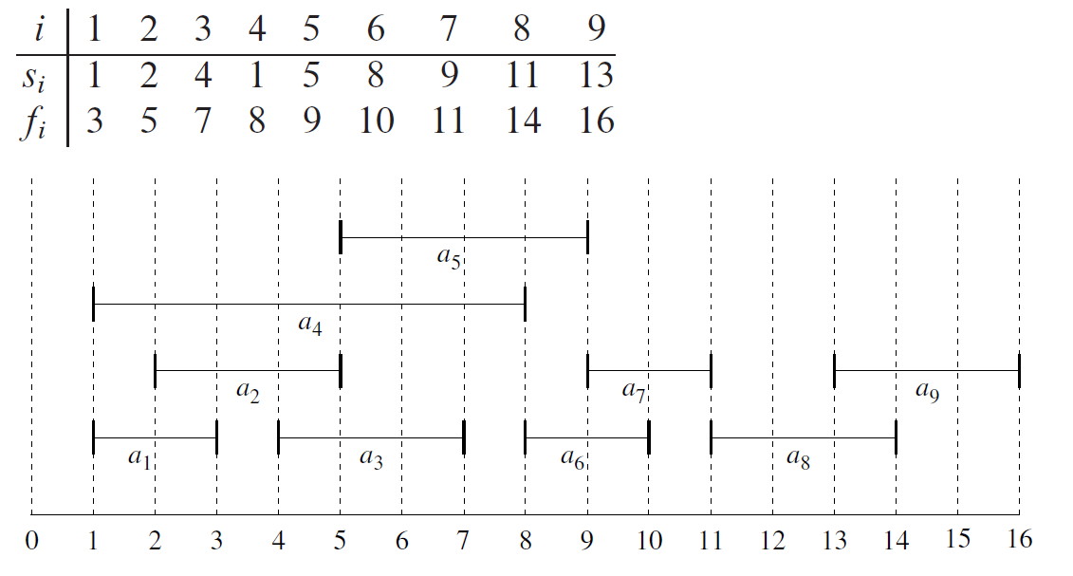
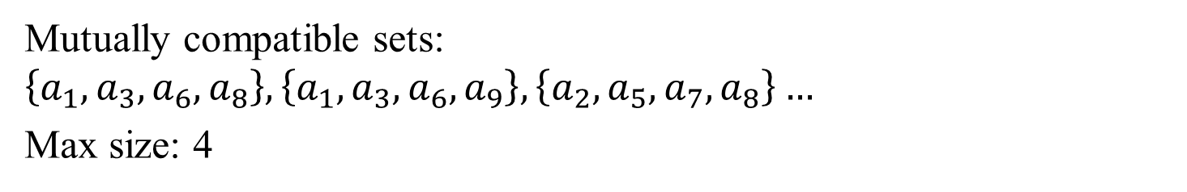
Example
Mutually compatible sets: $\left\{a_{1},a_{3},a_{6},a_{8}\right\}, \left\{a_{1},a_{3},a_{6},a_{9}\right\}, \left\{a_{2},a_{5},a_{7},a_{8}\right\}…$
Max size: 4

Slide 7
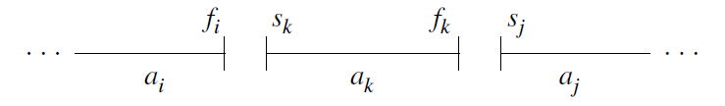
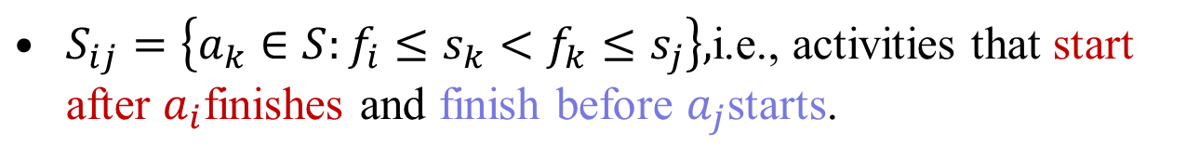
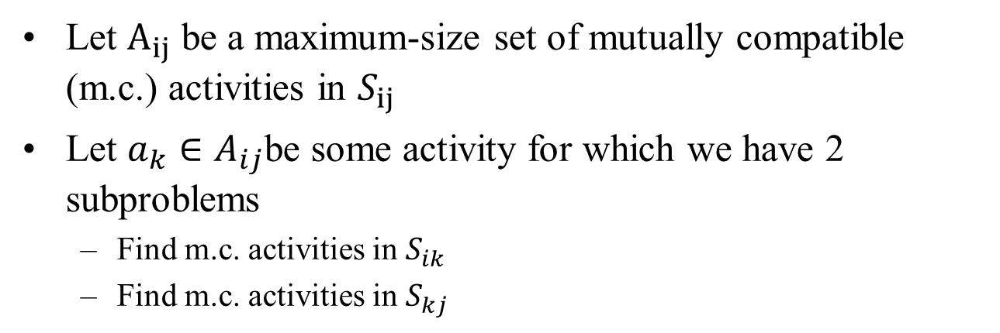
What is an Optimal Substructure?
$S_{ij}=\left\{a_{k}∈S:f_{i}≤s_{k}<f_{k}≤s_{j}\right\},$i.e., activities that start after $a_{i}$finishes and finish before $a_{j}$starts.
Let $A_{ij}$ be a maximum-size set of mutually compatible (m.c.) activities in $S_{ij}$
Let $a_{k}∈A_{ij}$be some activity for which we have 2 subproblems
Find m.c. activities in $S_{ik}$
Find m.c. activities in $S_{kj}$

Slide 8
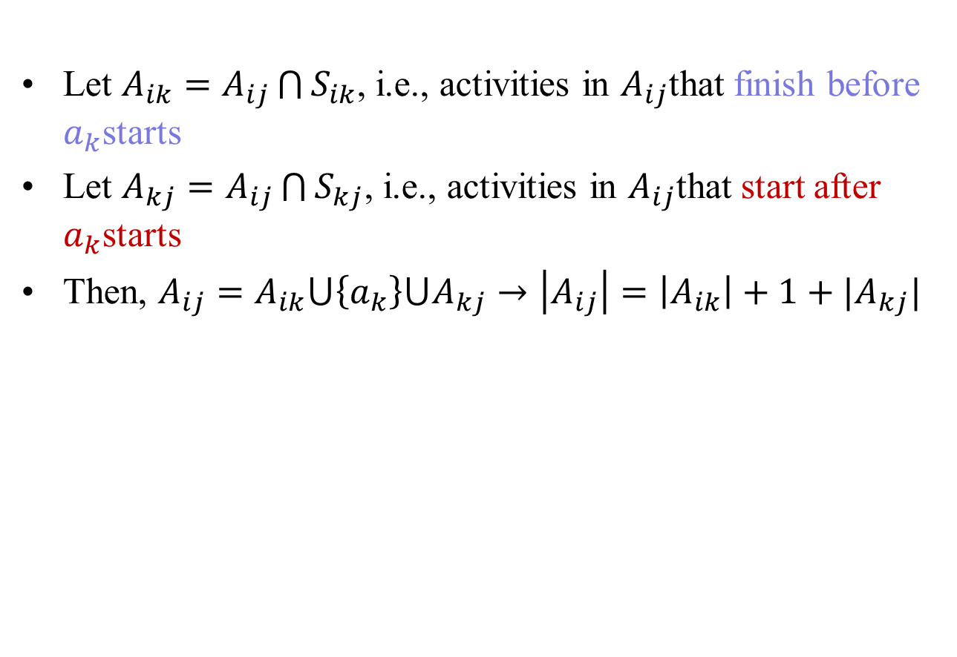
Optimal Substructure
Let $A_{ik}=A_{ij}\bigcap{S_{ik}}$, i.e., activities in $A_{ij}$that finish before $a_{k}$starts
Let $A_{kj}=A_{ij}\bigcap{S_{kj}}$, i.e., activities in $A_{ij}$that start after $a_{k}$starts
Then, $A_{ij}=A_{ik}⋃\left\{a_{k}\right\}⋃A_{kj}→\left|A_{ij}\right|=\left|A_{ik}\right|+1+|A_{kj}|$

Slide 9
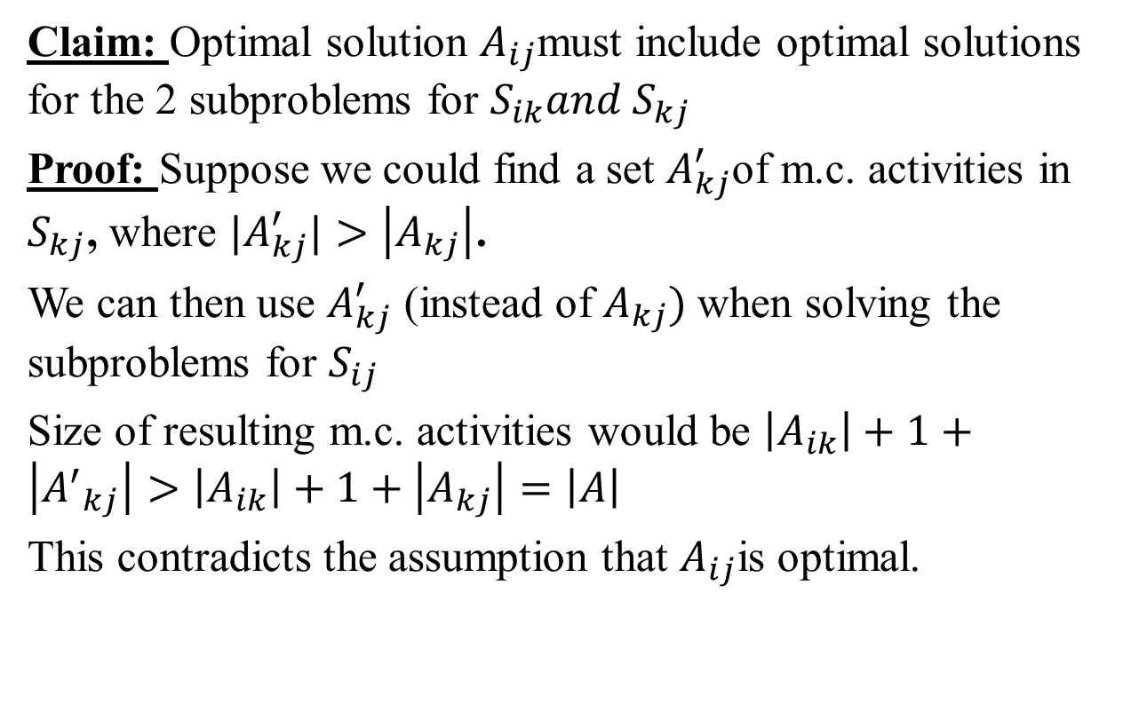
Proof
Claim: Optimal solution $A_{ij}$must include optimal solutions for the 2 subproblems for $S_{ik}{and S}_{kj}$
Proof: Suppose we could find a set $A_{kj}^{′}$of m.c. activities in $S_{kj}$, where ${|A}_{kj}^{′}|>\left|A_{kj}\right|$.
We can then use $A_{kj}^{′}$ (instead of $A_{kj})$when solving the subproblems for $S_{ij}$
Size of resulting m.c. activities would be $\left|A_{ik}\right|+1+\left|{A^{′}}_{kj}\right|>\left|A_{ik}\right|+1+\left|A_{kj}\right|=\left|A\right|$
This contradicts the assumption that $A_{ij}$is optimal.

Slide 10
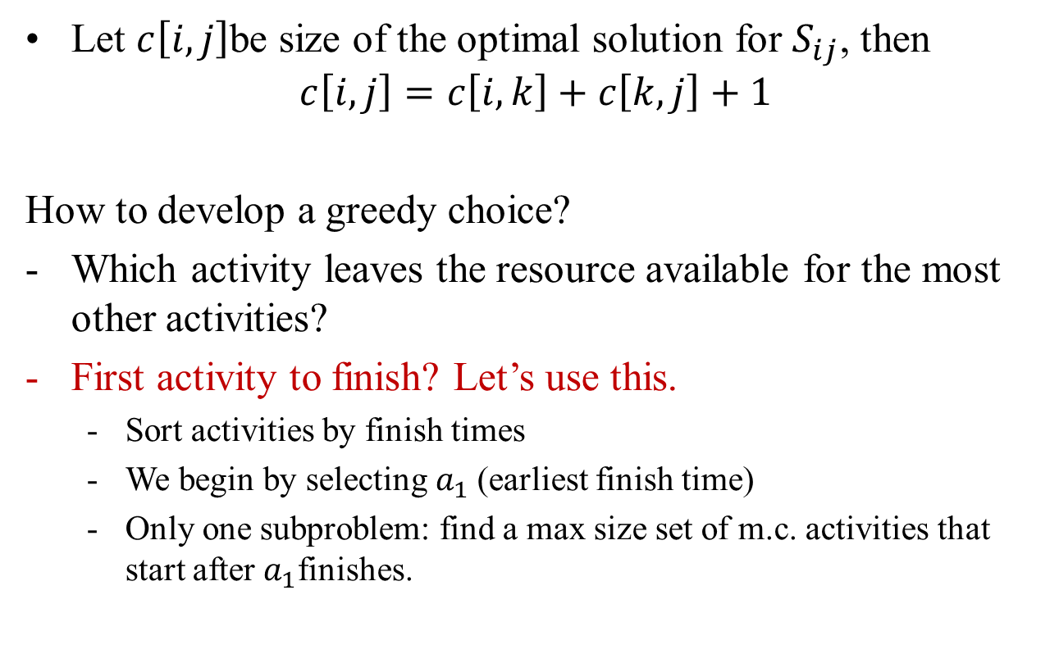
Recursive Solution Construction
Let $c\left[i,j\right]$be size of the optimal solution for $S_{ij}$, then
$$c\left[i,j\right]=c\left[i,k\right]+c\left[k,j\right]+1$$
How to develop a greedy choice?
Which activity leaves the resource available for the most other activities?
First activity to finish? Let’s use this.
Sort activities by finish times
We begin by selecting $a_{1}$(earliest finish time)
Only one subproblem: find a max size set of m.c. activities that start after $a_{1}$finishes.

Slide 11
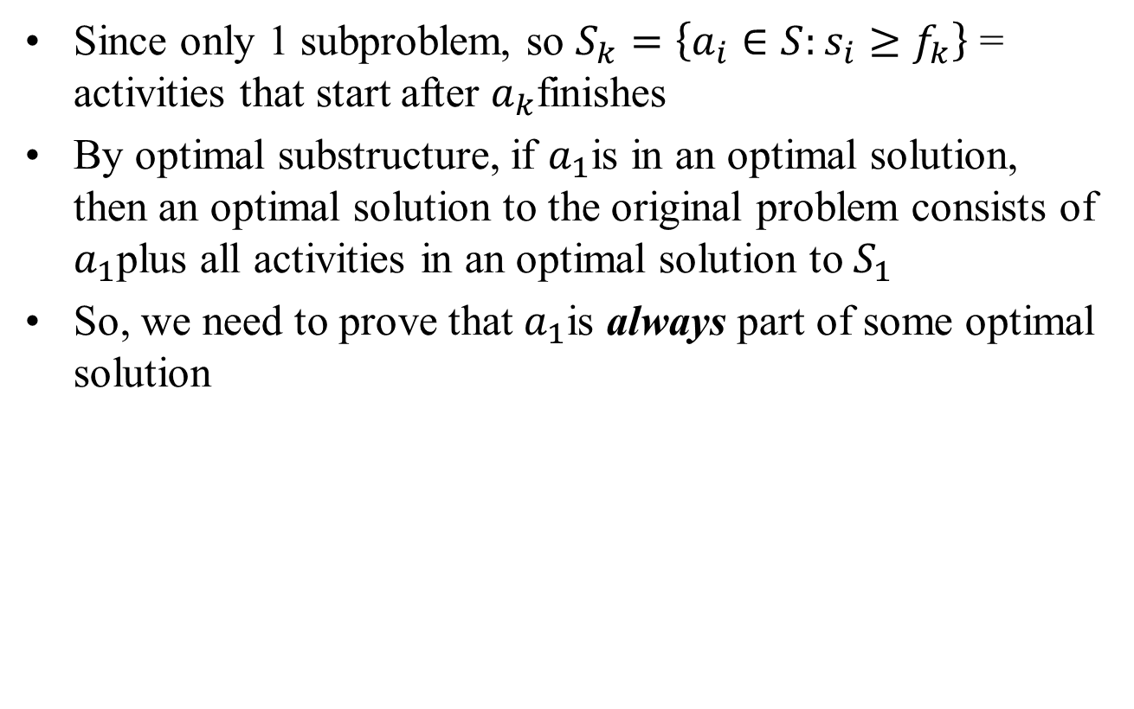
Recursive Solution
Since only 1 subproblem, so $S_{k}=\left\{a_{i}∈S:s_{i}≥f_{k}\right\}$ = activities that start after $a_{k}$finishes
By optimal substructure, if $a_{1}$is in an optimal solution, then an optimal solution to the original problem consists of $a_{1}$plus all activities in an optimal solution to $S_{1}$
So, we need to prove that $a_{1}$is always part of some optimal solution

Slide 12
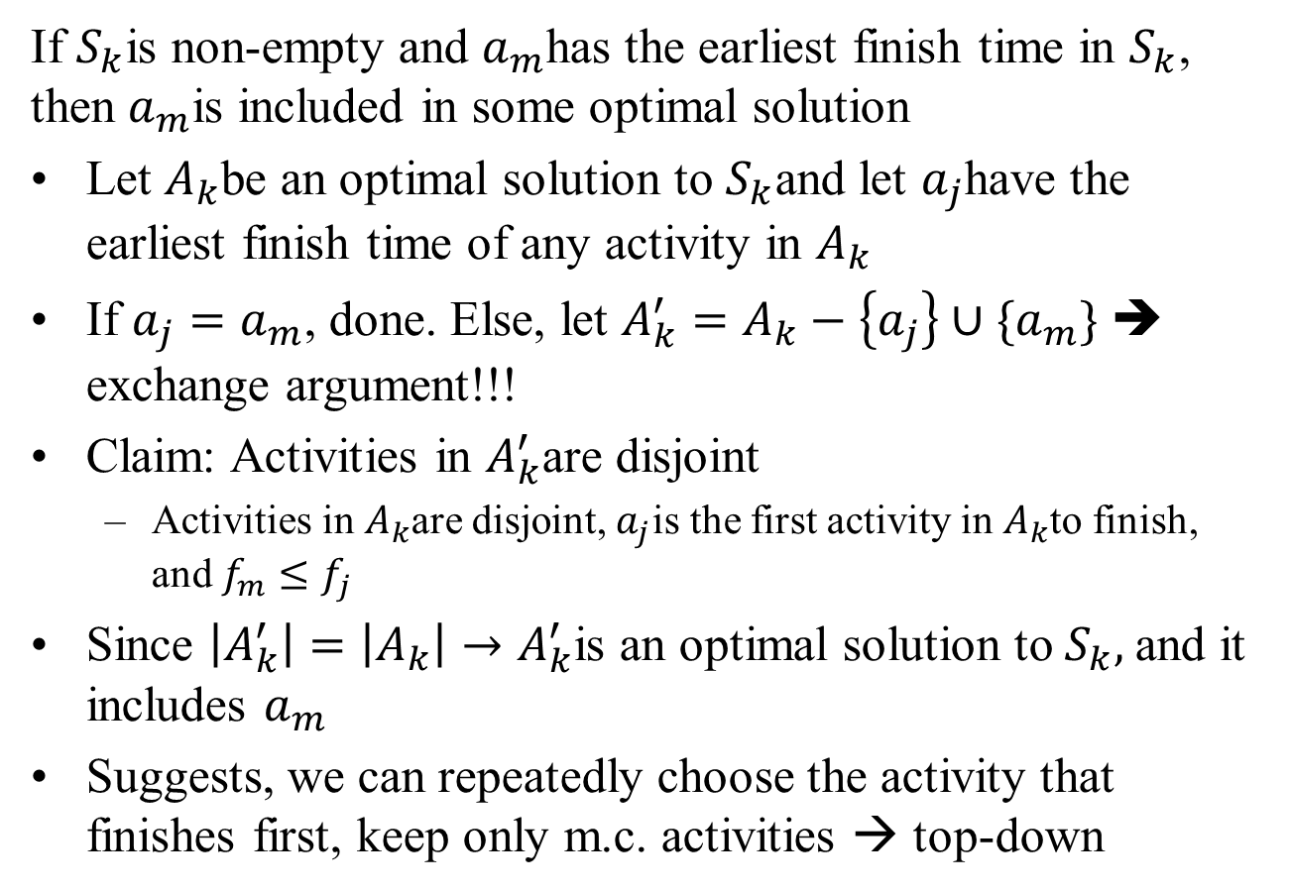
Proof
If $S_{k}$is non-empty and $a_{m}$has the earliest finish time in $S_{k}$, then $a_{m}$is included in some optimal solution
Let $A_{k}$be an optimal solution to $S_{k}$and let $a_{j}$have the earliest finish time of any activity in $A_{k}$
If $a_{j}=a_{m}$, done. Else, let $A_{k}^{′}=A_{k}−\left\{a_{j}\right\}∪\{a_{m}\}$ ➔ exchange argument!!!
Claim: Activities in $A_{k}^{′}$are disjoint
Activities in $A_{k}$are disjoint, $a_{j}$is the first activity in $A_{k}$to finish, and $f_{m}≤f_{j}$
Since $\left|A_{k}^{′}\right|=\left|A_{k}\right|→A_{k}^{′}$is an optimal solution to $S_{k},$and it includes $a_{m}$
Suggests, we can repeatedly choose the activity that finishes first, keep only m.c. activities → top-down

Slide 13
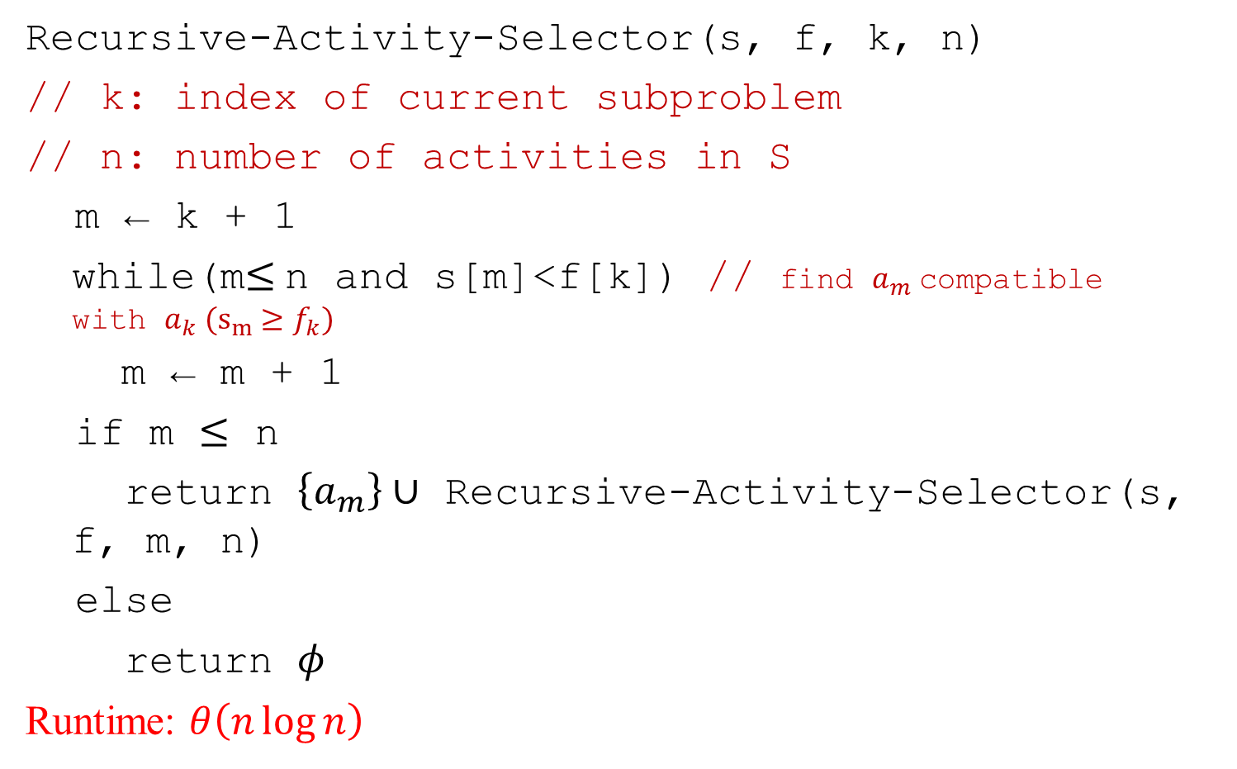
Pseudocode
Recursive-Activity-Selector(s, f, k, n)
// k: index of current subproblem
// n: number of activities in S
m ← k + 1
while(m$≤$n and s[m]<f[k]) // find $a_{m}$compatible with $a_{k} (s_{m}≥f_{k})$
m ← m + 1
if m $≤$ n
return $\left\{a_{m}\right\}∪$ Recursive-Activity-Selector(s, f, m, n)
else
return $φ$
Runtime: $θ\left(n\log{n}\right)$

Slide 14

Also Called
Interval scheduling
Activities $≡$ jobs

Slide 15

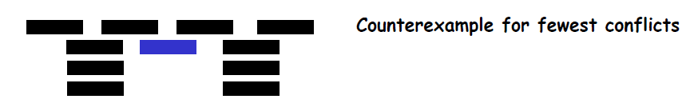
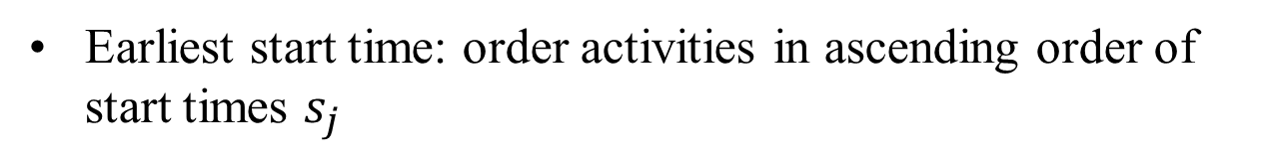
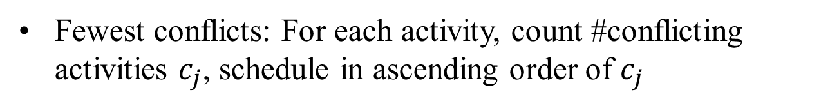
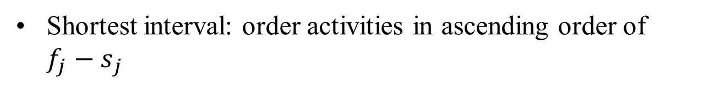
Other Strategies
Earliest start time: order activities in ascending order of start times $s_{j}$
Shortest interval: order activities in ascending order of ${f_{j}−s}_{j}$
Fewest conflicts: For each activity, count #conflicting activities $c_{j}$, schedule in ascending order of $c_{j}$

Slide 16
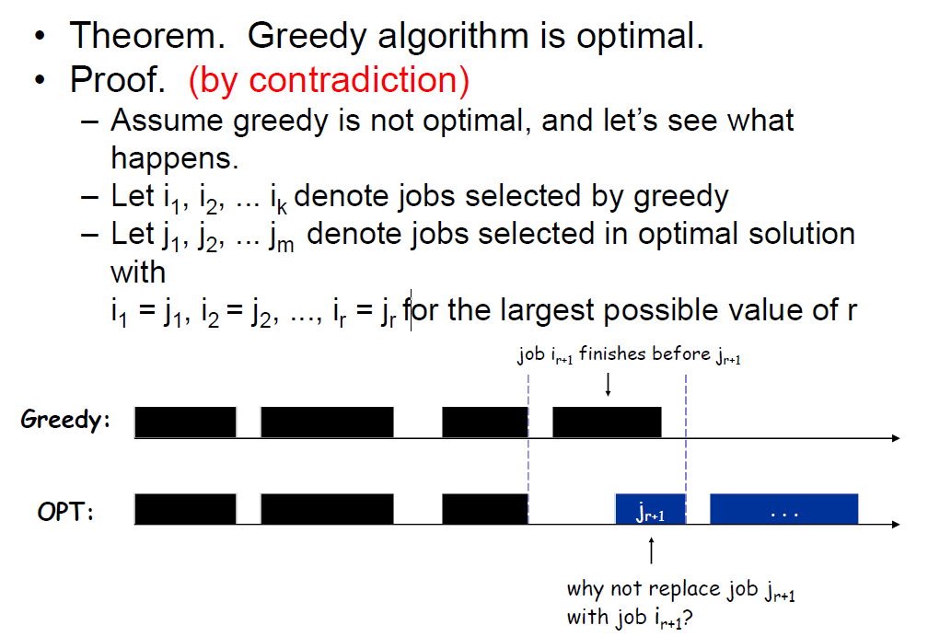
Another Way to Prove
Feasible, but contradicts maximality of r

Slide 17
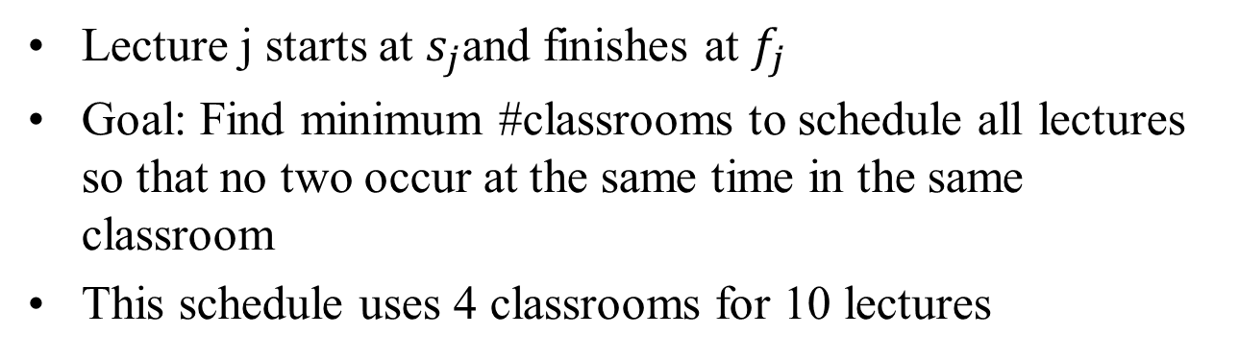
Problem 2: Interval Partitioning
Lecture j starts at $s_{j}$and finishes at $f_{j}$
Goal: Find minimum #classrooms to schedule all lectures so that no two occur at the same time in the same classroom
This schedule uses 4 classrooms for 10 lectures

Slide 18
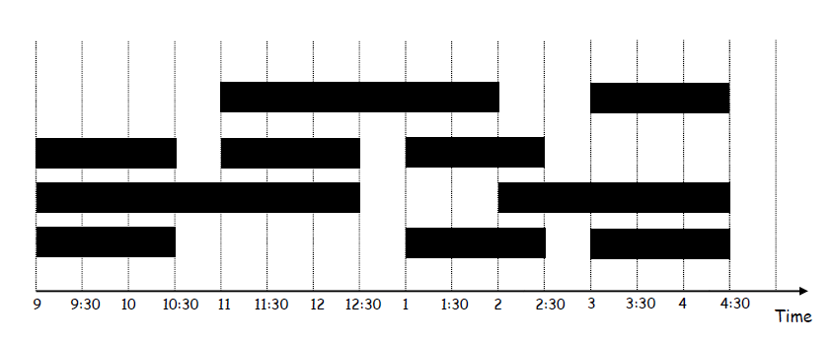
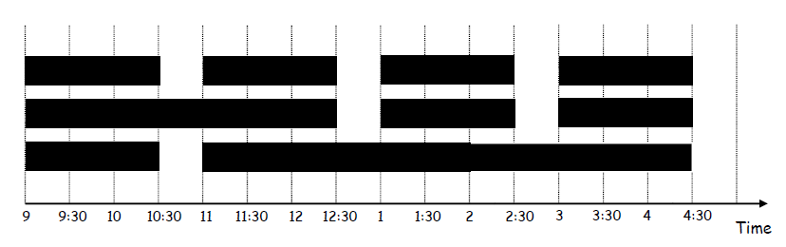
Examples of 10 lectures
4 classrooms
3 classrooms

Slide 19

Lower Bound on Optimal Solution
Defn: The depth of a set of open intervals is the max num that contain any given time
Key observation: #classrooms needed $≥$ depth
Example: Depth of intervals = 3 ➔ schedule is optimal

Slide 20
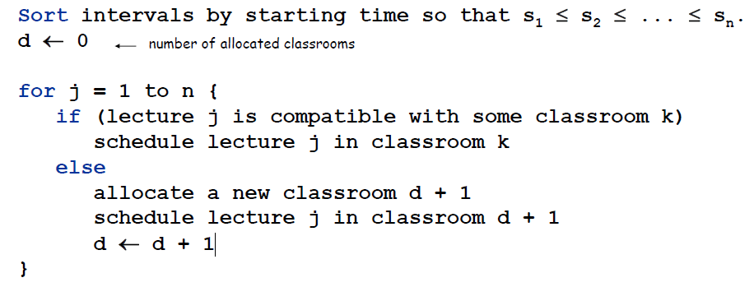
Greedy Algorithm for Interval Partitioning
Greedy choice: Consider lectures in increasing order of start time: assign lecture to any compatible classroom

Slide 21
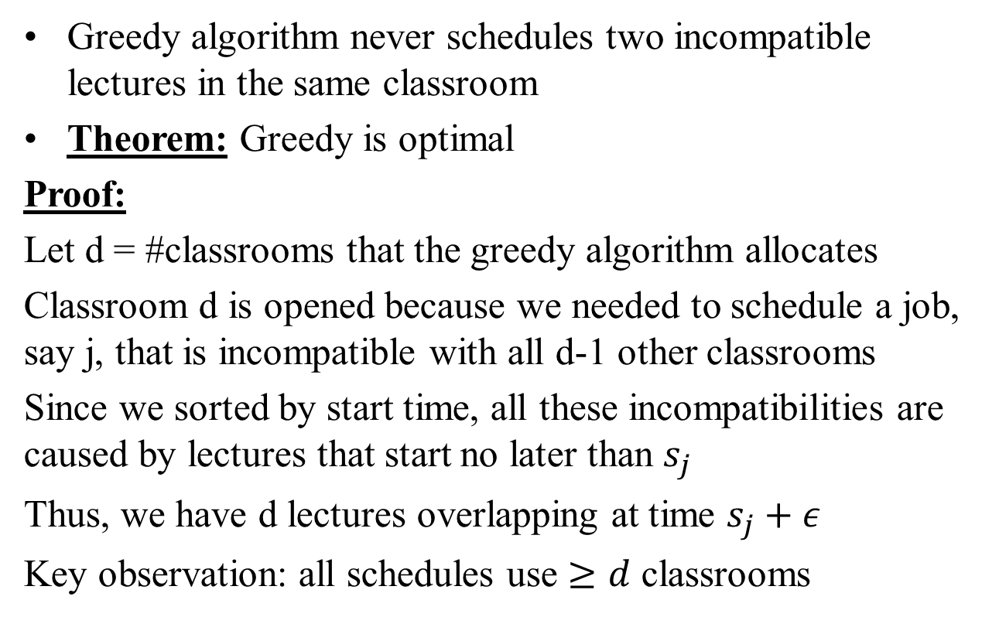
Analysis
Greedy algorithm never schedules two incompatible lectures in the same classroom
Theorem: Greedy is optimal
Proof:
Let d = #classrooms that the greedy algorithm allocates
Classroom d is opened because we needed to schedule a job, say j, that is incompatible with all d-1 other classrooms
Since we sorted by start time, all these incompatibilities are caused by lectures that start no later than $s_{j}$
Thus, we have d lectures overlapping at time $s_{j}+ε$
Key observation: all schedules use $≥d$ classrooms

Slide 22
Lecture 6 summary
Greedy algorithms
Activity selection / interval scheduling
Interval partitioning
No extra credit today, enjoy!

