Slide 1
Design and Analysis of Algorithms
Sid Nath (snath@scu.edu)
Lecture 7
Oct 10, 2022

Slide 2
Agenda
Administrative
Greedy
Cache eviction
Minimum Spanning Trees

Slide 3
Administrative
HW2 due now!
Midterm on Oct 17 (M)
7:10p in Kenna 104
Closed book; cheat sheet OK
Calculators OK, but no other device (phones, smart watches, laptops, etc.)

Slide 4
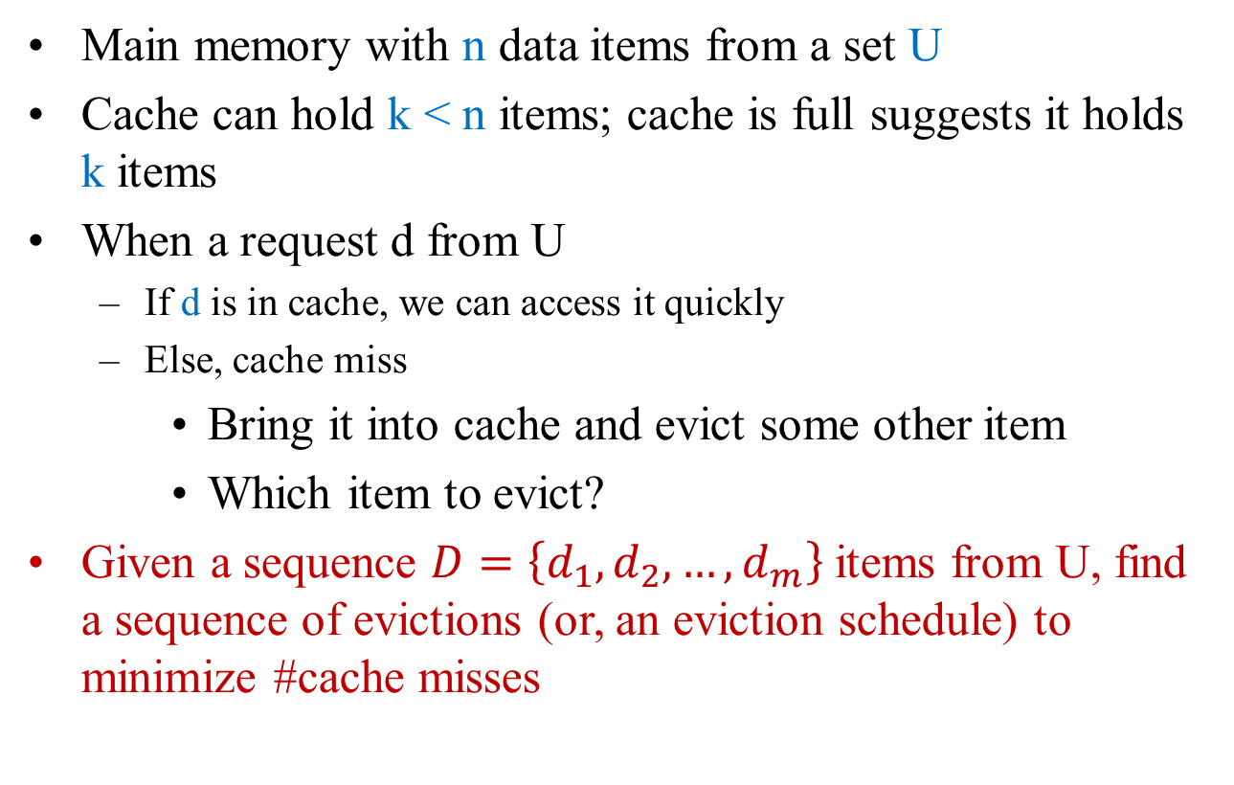
Problem 3: Optimal Caching
Main memory with n data items from a set U
Cache can hold k < n items; cache is full suggests it holds k items
When a request d from U
If d is in cache, we can access it quickly
Else, cache miss
Bring it into cache and evict some other item
Which item to evict?
Given a sequence $D=\left\{d_{1},d_{2},…, d_{m}\right\}$ items from U, find a sequence of evictions (or, an eviction schedule) to minimize #cache misses

Slide 5
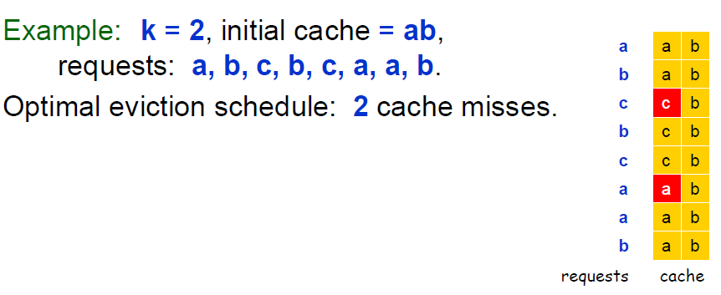
Example

Slide 6
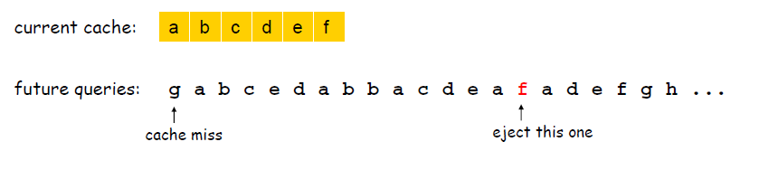
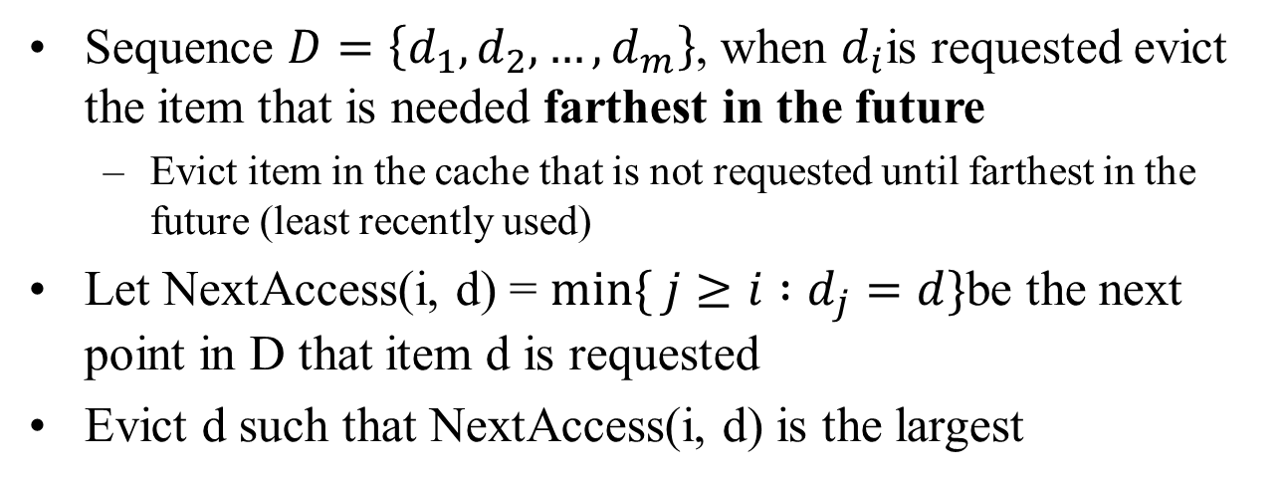
Greedy Strategy
Sequence $D=\left\{d_{1},d_{2},…, d_{m}\right\}$, when $d_{i}$is requested evict the item that is needed farthest in the future
Evict item in the cache that is not requested until farthest in the future (least recently used)
Let NextAccess(i, d) = $min⁡\{ j≥i :d_{j}=d\}$be the next point in D that item d is requested
Evict d such that NextAccess(i, d) is the largest

Slide 7
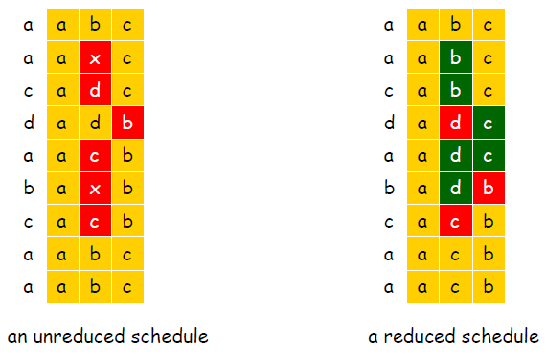
Reduced Eviction Schedules
Defn: A reduced schedule only inserts an item into the cache in a step in which that item is requested
Can transform an unreduced schedule to a reduced schedule with no more cache misses

Slide 8
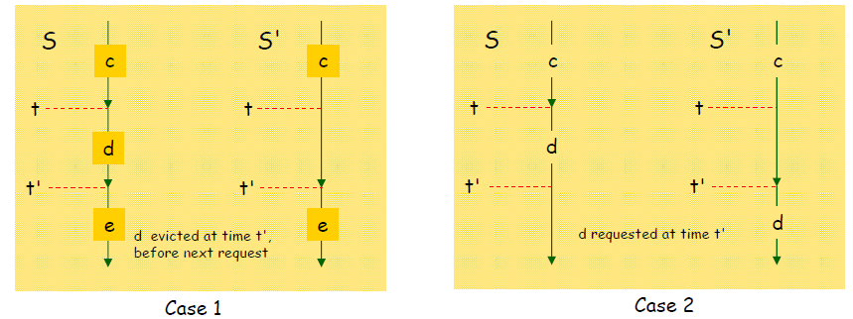
Reduced Eviction Schedules
Claim: Given any unreduced schedule S, can transform it into a reduced schedule S’ with no more cache misses
Proof: (by induction on # of unreduced items)
Suppose S brings d into cache at time t, without a request
Let c be the item S evicts when it brings d into cache
Case 1: d evicted at time t’, before next request for d
Case 2: d requested at time t’, before d is evicted

Slide 9
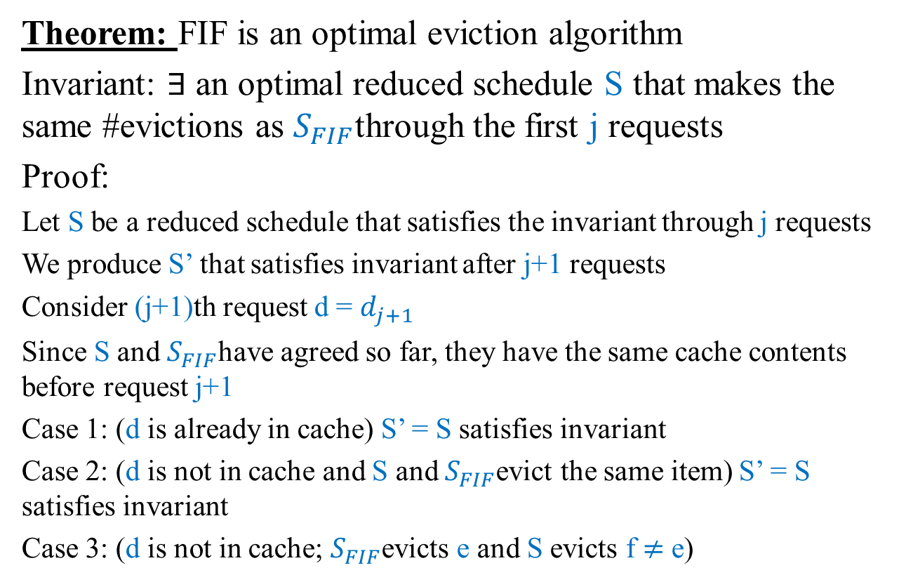
Farthest-in-Future (FIF) Analysis
Theorem: FIF is an optimal eviction algorithm
Invariant: $∃$ an optimal reduced schedule S that makes the same #evictions as $S_{FIF}$through the first j requests
Proof:
Let S be a reduced schedule that satisfies the invariant through j requests
We produce S’ that satisfies invariant after j+1 requests
Consider (j+1)th request d = $d_{j+1}$
Since S and $S_{FIF}$have agreed so far, they have the same cache contents before request j+1
Case 1: (d is already in cache) S’ = S satisfies invariant
Case 2: (d is not in cache and S and $S_{FIF}$evict the same item) S’ = S satisfies invariant
Case 3: (d is not in cache; $S_{FIF}$evicts e and S evicts f $≠$ e)

Slide 10
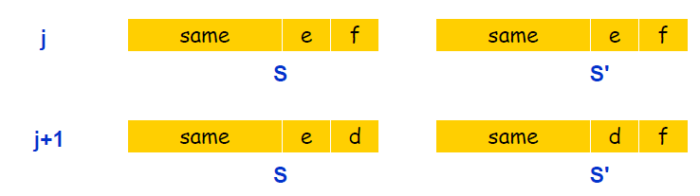
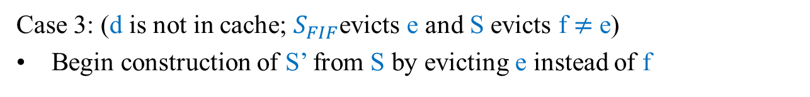
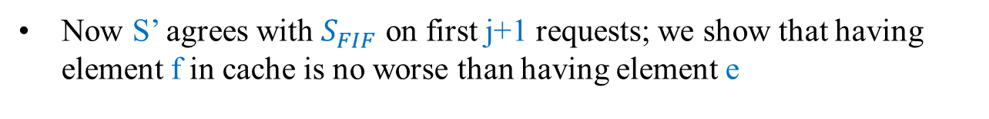
Farthest-in-Future (FIF) Analysis
Case 3: (d is not in cache; $S_{FIF}$evicts e and S evicts f $≠$ e)
Begin construction of S’ from S by evicting e instead of f
Now S’ agrees with $S_{FIF}$ on first j+1 requests; we show that having element f in cache is no worse than having element e

Slide 11

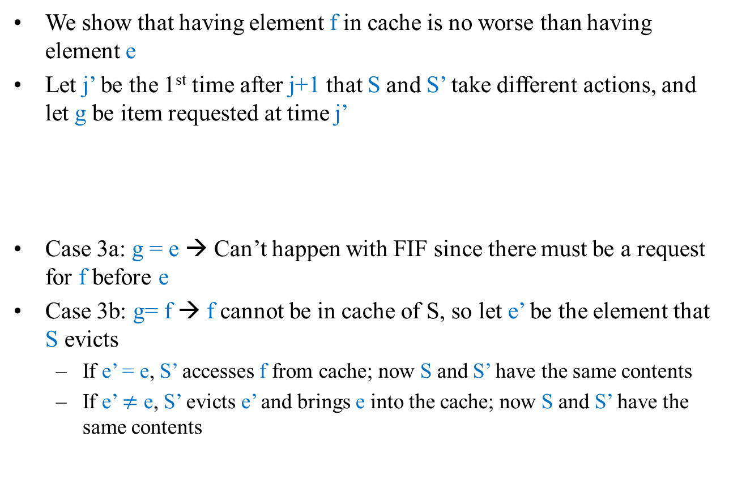
Farthest-in-Future (FIF) Analysis
We show that having element f in cache is no worse than having element e
Let j’ be the 1st time after j+1 that S and S’ take different actions, and let g be item requested at time j’
Case 3a: g = e → Can’t happen with FIF since there must be a request for f before e
Case 3b: g= f → f cannot be in cache of S, so let e’ be the element that S evicts
If e’ = e, S’ accesses f from cache; now S and S’ have the same contents
If e’ $≠$ e, S’ evicts e’ and brings e into the cache; now S and S’ have the same contents

Slide 12
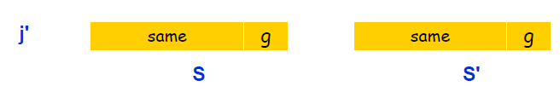
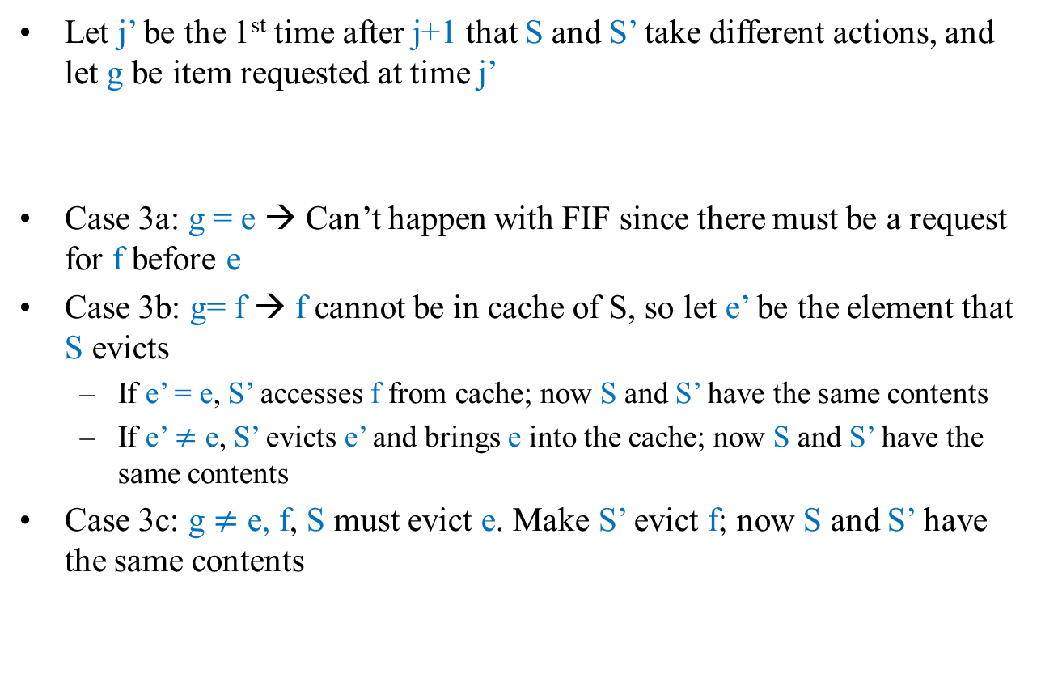
Farthest-in-Future (FIF) Analysis
Let j’ be the 1st time after j+1 that S and S’ take different actions, and let g be item requested at time j’
Case 3a: g = e → Can’t happen with FIF since there must be a request for f before e
Case 3b: g= f → f cannot be in cache of S, so let e’ be the element that S evicts
If e’ = e, S’ accesses f from cache; now S and S’ have the same contents
If e’ $≠$ e, S’ evicts e’ and brings e into the cache; now S and S’ have the same contents
Case 3c: g $≠$ e, f, S must evict e. Make S’ evict f; now S and S’ have the same contents

Slide 13
Trees
A tree is connected and acyclic
A tree has n nodes and (n-1) edges
Any connected, undirected graph with |V|-1 edges is a tree
An undirected graph is a tree if and only if (iff) there is a unique path between any pair of nodes
Fact about trees: any two of the following properties imply the third:
Connected
Acyclic
|V|-1 edges

Slide 14
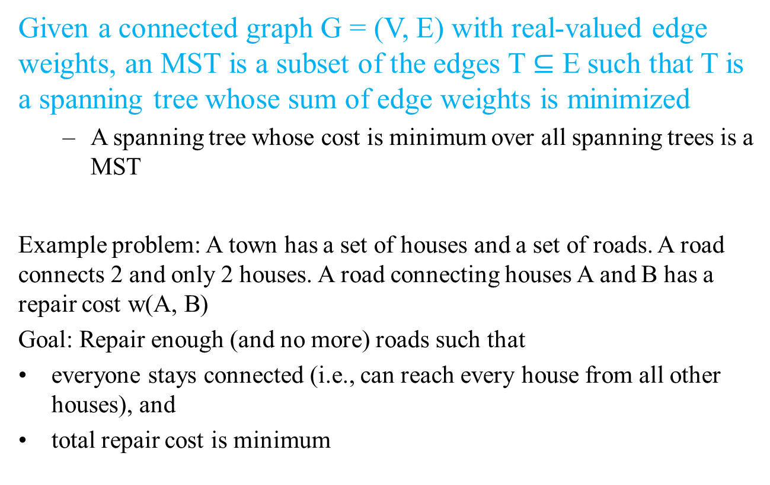
Problem 4: Minimum Spanning Trees
Given a connected graph G = (V, E) with real-valued edge weights, an MST is a subset of the edges T $⊆$ E such that T is a spanning tree whose sum of edge weights is minimized
A spanning tree whose cost is minimum over all spanning trees is a MST
Example problem: A town has a set of houses and a set of roads. A road connects 2 and only 2 houses. A road connecting houses A and B has a repair cost w(A, B)
Goal: Repair enough (and no more) roads such that
everyone stays connected (i.e., can reach every house from all other houses), and
total repair cost is minimum

Slide 15
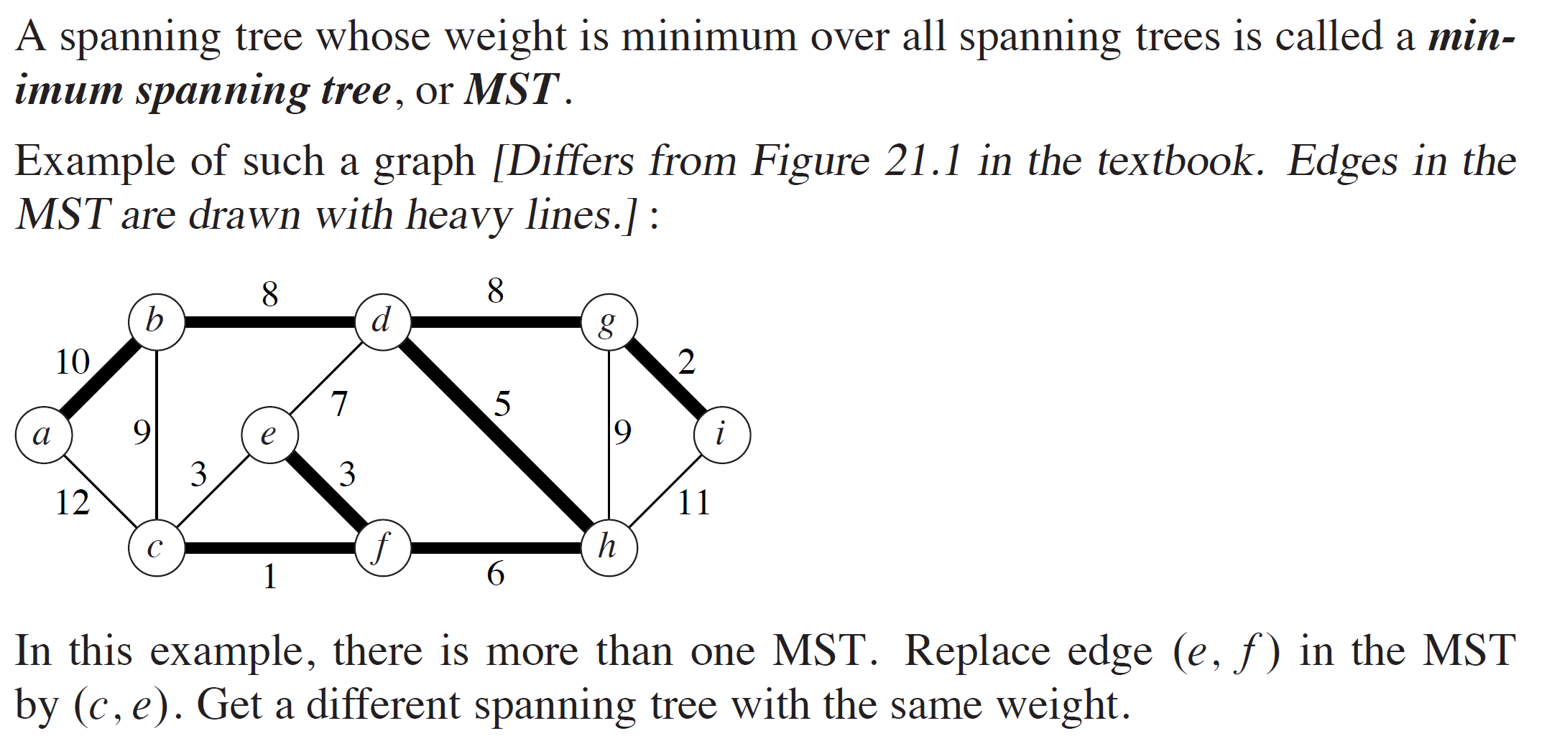
Example

Slide 16
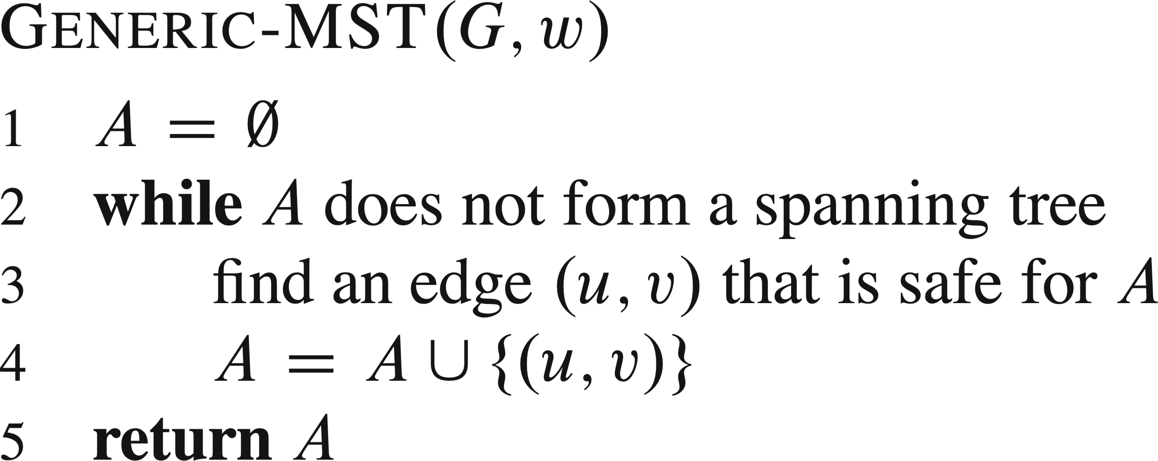
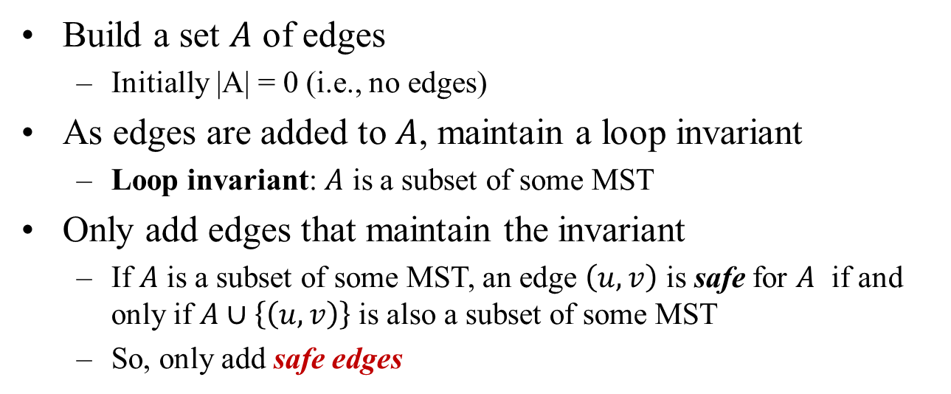
Towards a Solution
Build a set $A$ of edges
Initially |A| = 0 (i.e., no edges)
As edges are added to $A$, maintain a loop invariant
Loop invariant: $A$ is a subset of some MST
Only add edges that maintain the invariant
If $A$ is a subset of some MST, an edge $\left(u, v\right)$ is safe for $A$ if and only if $A∪\left\{\left(u, v\right)\right\}$ is also a subset of some MST
So, only add safe edges

Slide 17
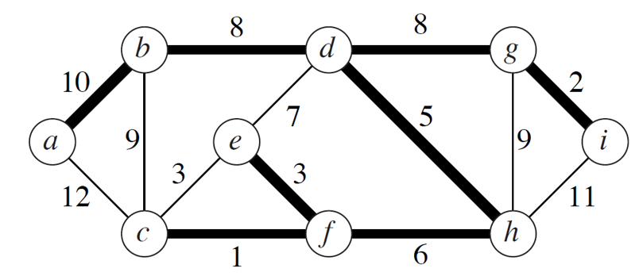
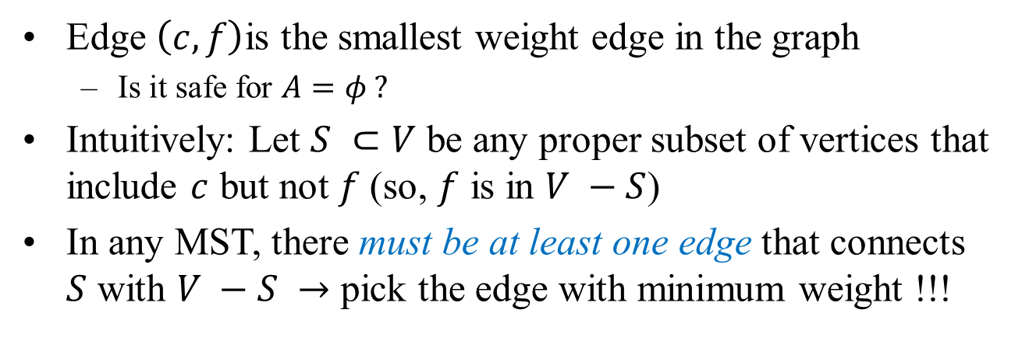
How to Find a Safe Edge?
Edge $\left(c, f\right)$is the smallest weight edge in the graph
Is it safe for $A=φ ?$
Intuitively: Let $S ⊂V$ be any proper subset of vertices that include $c$ but not $f$(so, $f$ is in $V −S$)
In any MST, there must be at least one edge that connects $S$ with $V −S →$ pick the edge with minimum weight !!!

Slide 18
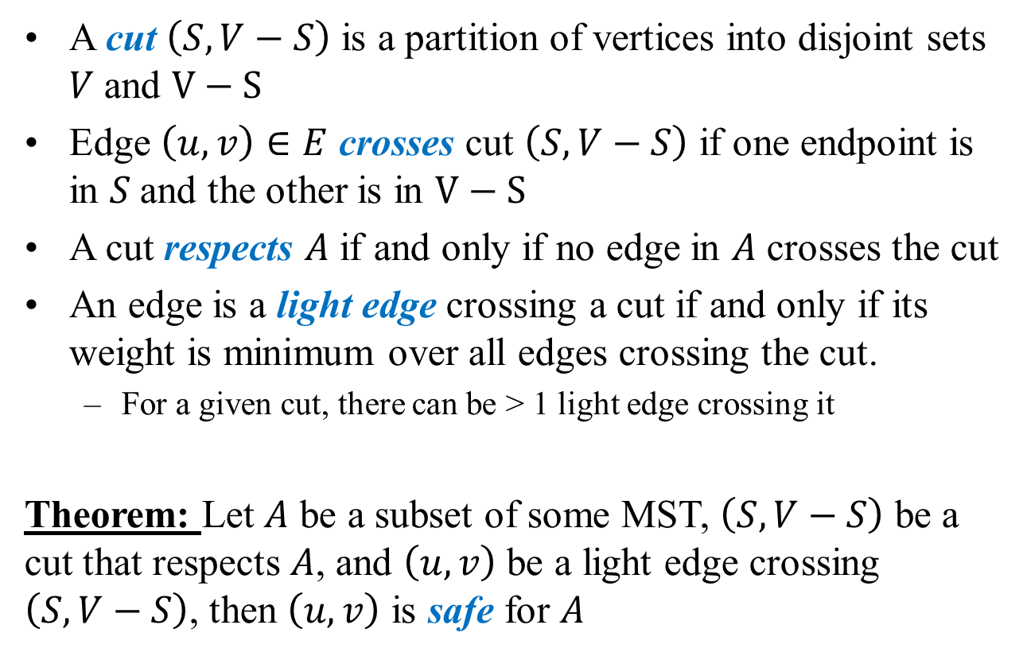
Definitions
A cut $\left(S, V−S\right)$ is a partition of vertices into disjoint sets $V$and $V−S$
Edge $\left(u, v\right)∈E$ crosses cut $\left(S, V−S\right)$ if one endpoint is in $S$and the other is in $V−S$
A cut respects $A$ if and only if no edge in $A$ crosses the cut
An edge is a light edge crossing a cut if and only if its weight is minimum over all edges crossing the cut.
For a given cut, there can be > 1 light edge crossing it
Theorem: Let $A$ be a subset of some MST, $\left(S, V−S\right)$ be a cut that respects $A$, and $\left(u, v\right)$ be a light edge crossing $\left(S, V−S\right)$, then $\left(u, v\right)$ is safe for $A$

Slide 19
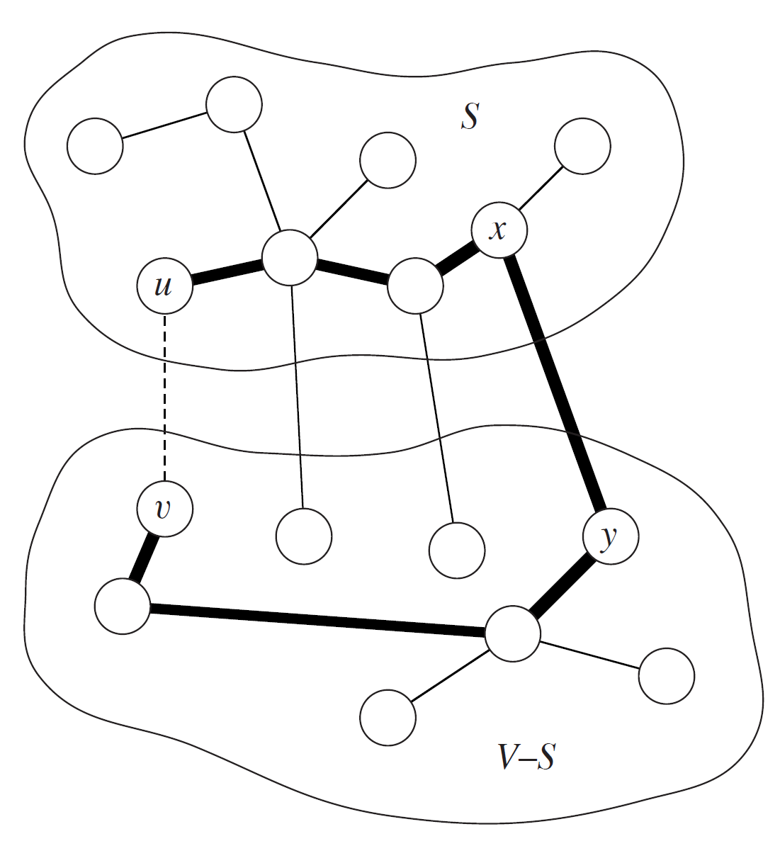
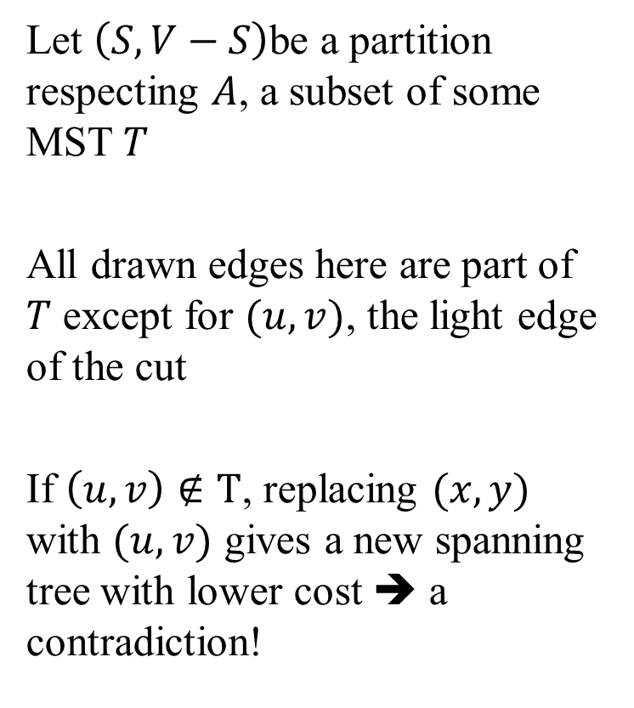
Proof
Let $\left(S, V−S\right)$be a partition respecting $A$, a subset of some MST $T$
All drawn edges here are part of $T$ except for $(u,v)$, the light edge of the cut
If $\left(u,v\right)∉T$, replacing $(x,y)$ with $(u,v)$ gives a new spanning tree with lower cost ➔ a contradiction!

Slide 20
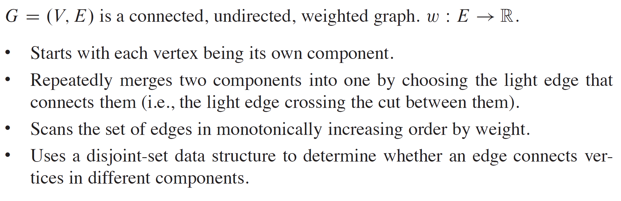
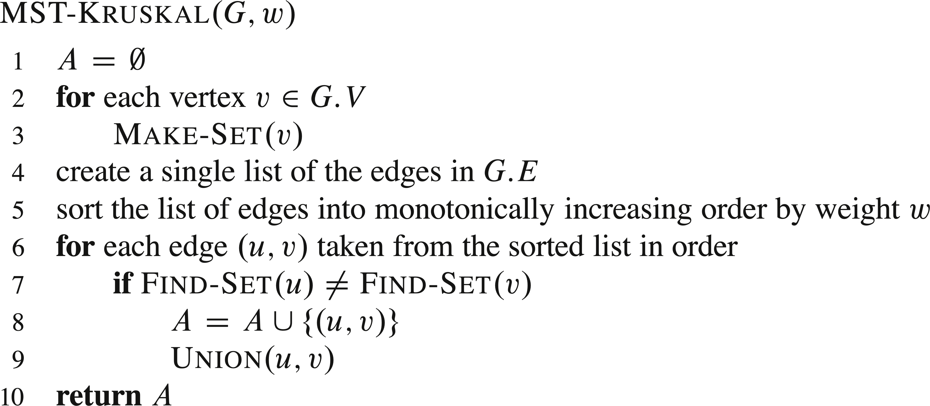
Kruskal’s Algorithm
O(|E| log |E|)
O(|E|)
Running time: O(|E| log |E|) by using union-find and path compression

Slide 21
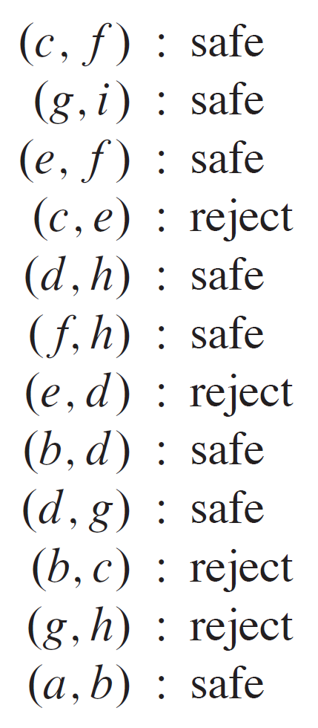
Example of Kruskal

Slide 22
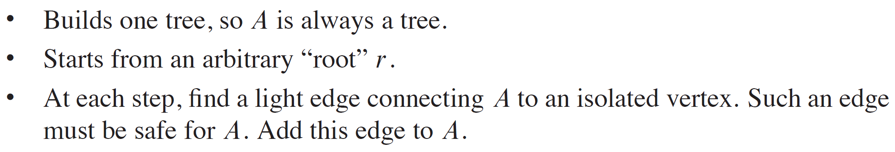
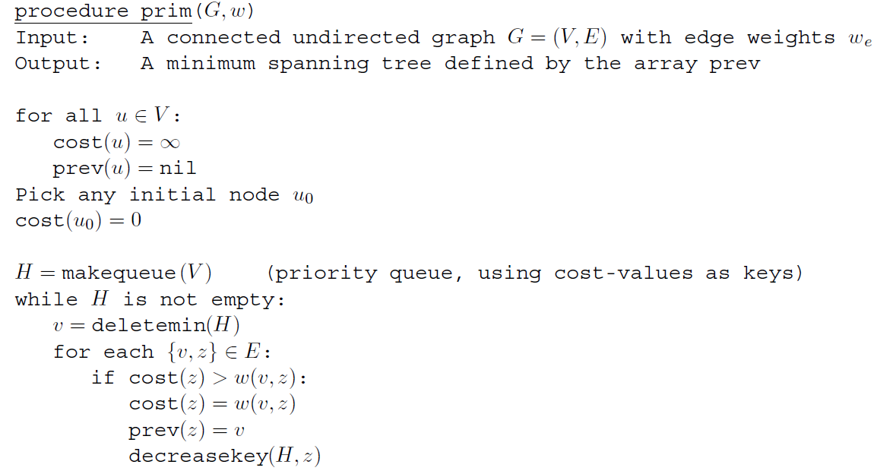

Prim’s Algorithm
Running time: O(|V|log|V|+|E|)

Slide 23
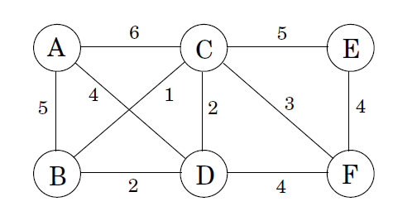
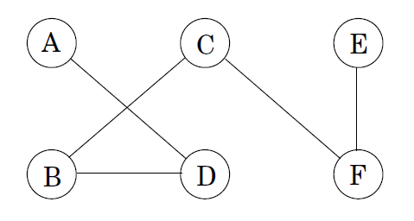
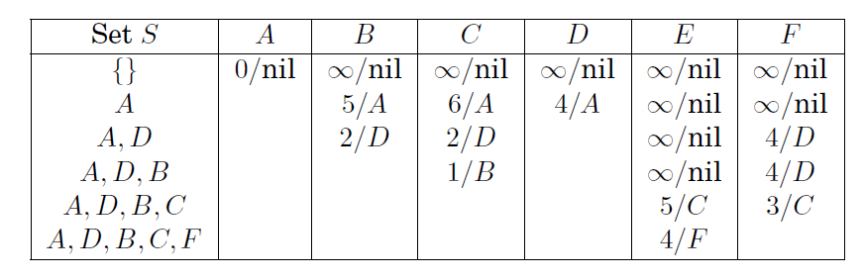
Example of Prim’s
Cost = 14

Slide 24
Lecture 7 summary
Greedy algorithms
Offline cache eviction
Minimum spanning trees
Kruskal’s
Prim’s
Next class: midterm review

Slide 25
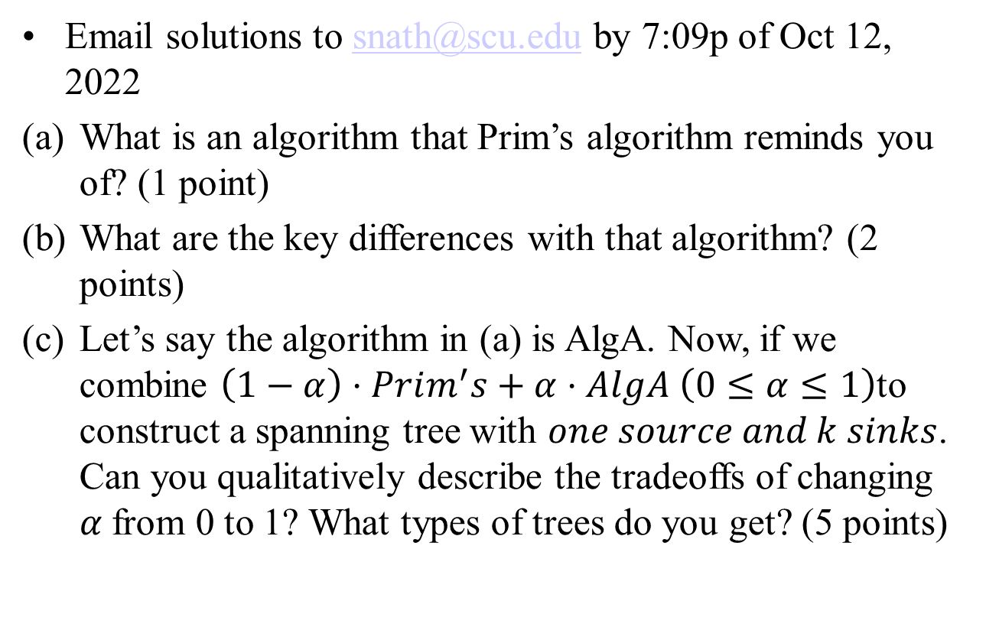
Extra Credit Qs 5 (8 points)
Email solutions to snath@scu.edu by 7:09p of Oct 12, 2022
What is an algorithm that Prim’s algorithm reminds you of? (1 point)
What are the key differences with that algorithm? (2 points)
Let’s say the algorithm in (a) is AlgA. Now, if we combine $\left(1−α\right)⋅Prim^{′}s+α⋅AlgA \left(0≤α≤1\right)$to construct a spanning tree with $one source and k sinks$. Can you qualitatively describe the tradeoffs of changing $α$from 0 to 1? What types of trees do you get? (5 points)

