Slide 1
Design and Analysis of Algorithms
Sid Nath (snath@scu.edu)
Lecture 8
Oct 19, 2022

Slide 2
Agenda
Administrative
Dynamic Programming

Slide 3
Administrative
Midterm feedback (20)
Difficulty
Easy: 0
Moderate: 3
Hard: 17
Time
Too short: 0
Just right: 0
Too lengthy: 20
How much extra time:
Did cheat sheet help?

Slide 4
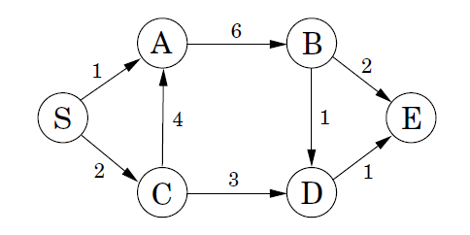
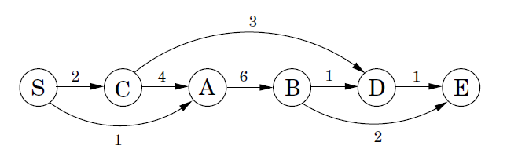
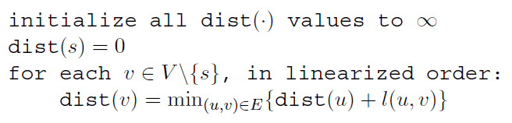
Shortest Paths in DAGs
Linearize
Given DAG G = (V; E), what is the shortest path from S to any node?
E.g., D
$$dist\left(D\right)=min⁡\{dist\left(B\right)+1, dist\left(C\right)+3\}$$

Slide 5
String Reconstruction
Given corrupted document with no punctuation, can you reconstruct it as a sequence of valid words (with aid of a dictionary)?
“tomatomiced” = tom | atom | iced
“catchaserat” = cat | chase | rat
“afarfarbetterthing” = ?
Input
Corrupted document x[1:n] (array of characters)
Dictionary function dict(w) (returns true if w is a valid word)
How would you solve this?

Slide 6
String Reconstruction
Given corrupted document with no punctuation, can you reconstruct it as a sequence of valid words (with aid of a dictionary)?
“tomatomiced” = tom | atom | iced
“catchaserat” = cat | chase | rat
“afarfarbetterthing” = ?
Input
Corrupted document x[1:n] (array of characters)
Dictionary function dict(w) (returns true if w is a valid word)
Dynamic Programming: Basic Approach
Formulate problem recursively using subproblems
Solve subproblems in an efficient order (not recursively)

Slide 7
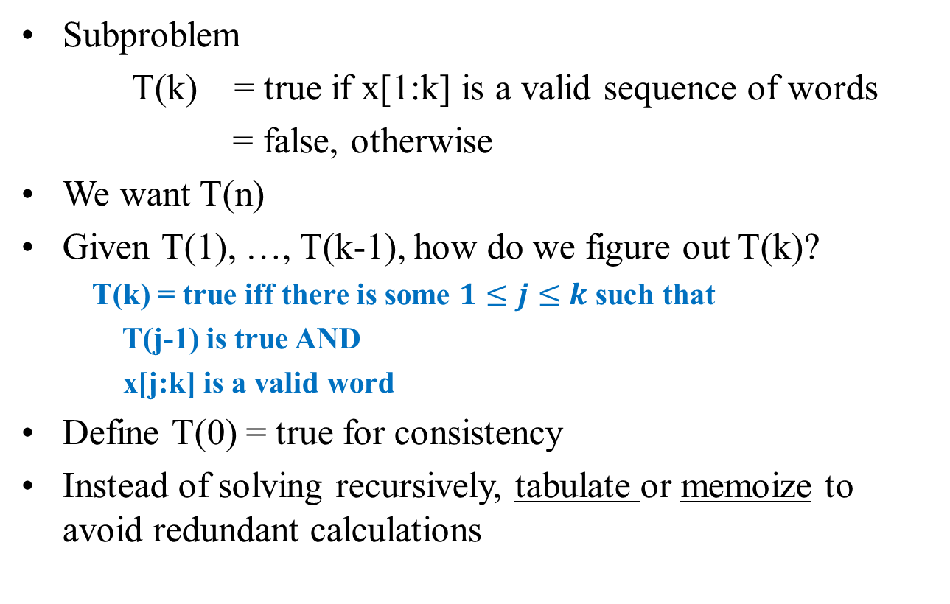
Formulate and Express Recursively Using Subproblems
Subproblem
T(k) = true if x[1:k] is a valid sequence of words
= false, otherwise
We want T(n)
Given T(1), …, T(k-1), how do we figure out T(k)?
T(k) = true iff there is some $1≤j≤k$ such that
T(j-1) is true AND
x[j:k] is a valid word
Define T(0) = true for consistency
Instead of solving recursively, tabulate or memoize to avoid redundant calculations

Slide 8
Solve Subproblems in an Efficient Order
In what order should we compute T(j)’s?
T(0), T(1), T(2), …
Algorithm
T(0) = true
for k = 1 to n:
T(k) = false
for j = 1 to k:
if T(j-1) AND dict(x[j:k])
T(k) = true
D(k) = j
Running time: O(n²)
To reconstruct the document, use additional array D[1:n]
If T(k) = true then D(k) = starting position of the word that ends at x[k] → reconstruct by following backpointers

Slide 9
DP is a Promising Approach if…
Optimal substructure: A problem exhibits optimal substructure if an optimal solution to the problem contains within it optimal solutions to subproblems
True for DP and greedy
Overlapping subproblems: A recursive algorithm for the problem would end up solving the same subproblems over and over, rather than always generating new subproblems

Slide 10
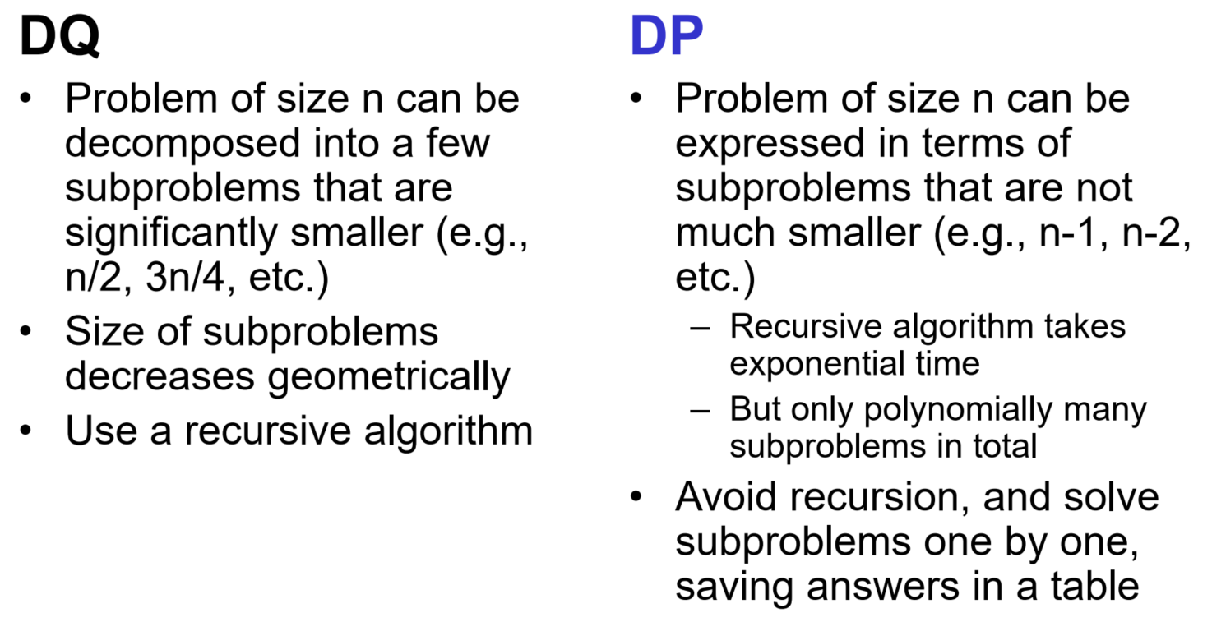
DQ vs. DP
In both cases, we start by formulating the problem recursively, in terms of subproblems

Slide 11
DP Problem Examples
Rod cutting to maximize revenue
Longest increasing subsequence
Minimum edit distance
Knapsack
Matrix chain product
All pairs shortest path (Floyd-Warshall)
Independent set in trees
Longest common subsequence
Optimum polygon triangulation
Transitive closure
Change making
….

Slide 12
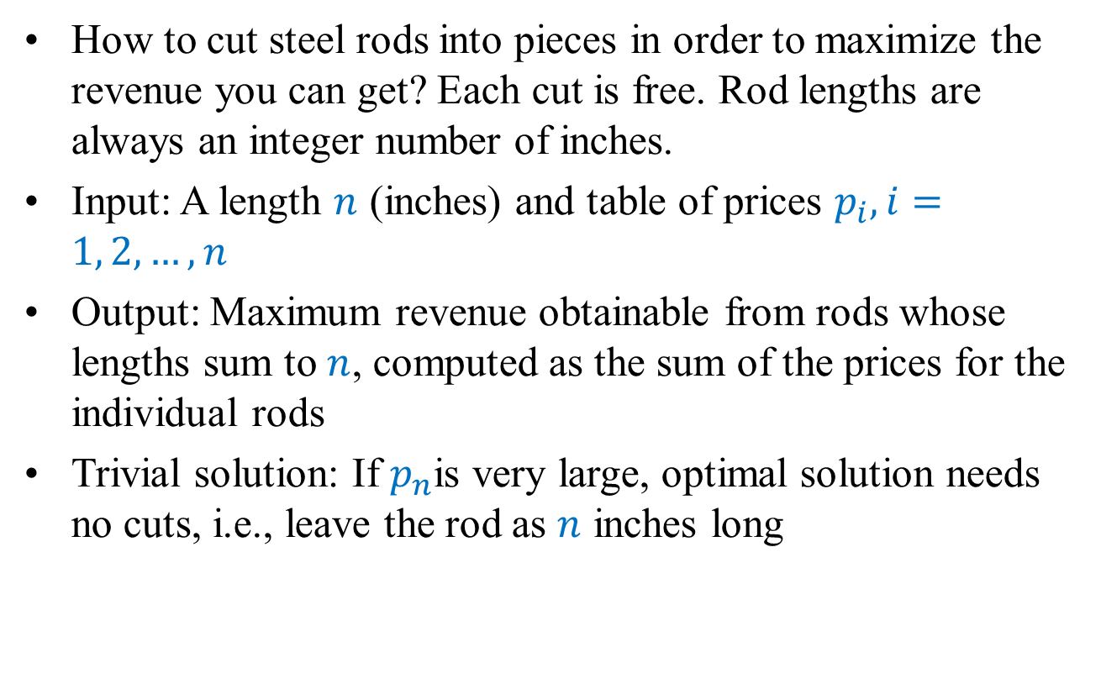
Problem 1: Rod Cutting
How to cut steel rods into pieces in order to maximize the revenue you can get? Each cut is free. Rod lengths are always an integer number of inches.
Input: A length $n$ (inches) and table of prices $p_{i}, i=1, 2, …, n$
Output: Maximum revenue obtainable from rods whose lengths sum to $n$, computed as the sum of the prices for the individual rods
Trivial solution: If $p_{n}$is very large, optimal solution needs no cuts, i.e., leave the rod as $n$ inches long

Slide 13

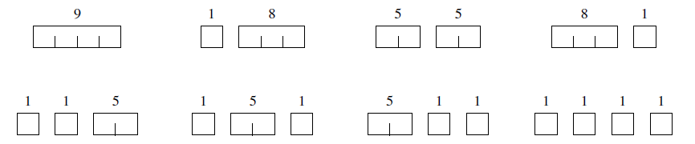
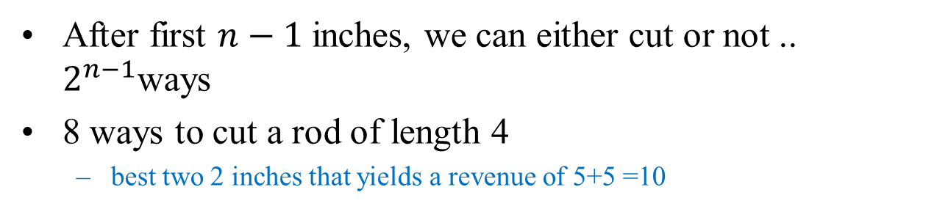
Example
After first $n−1$inches, we can either cut or not .. $2^{n−1}$ways
8 ways to cut a rod of length 4
best two 2 inches that yields a revenue of 5+5 =10

Slide 14
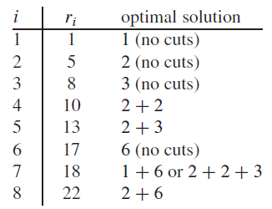
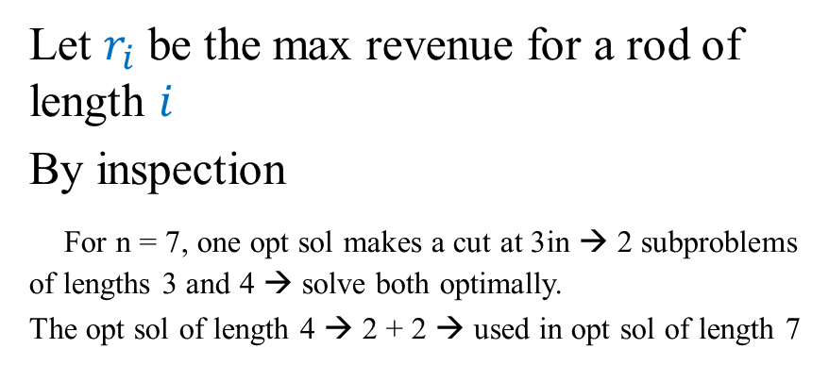
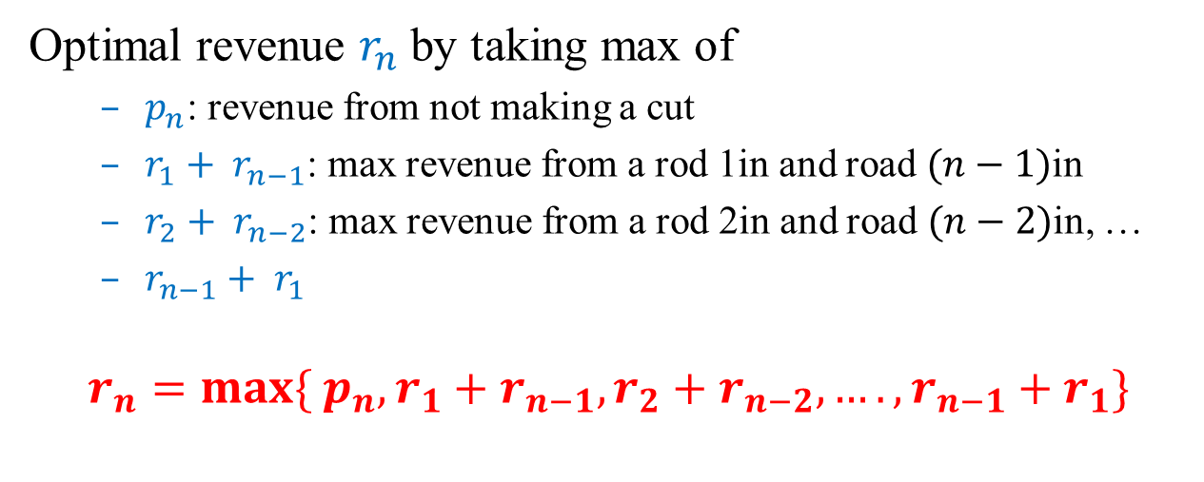
Formulation
Let $r_{i}$ be the max revenue for a rod of length $i$
By inspection
For n = 7, one opt sol makes a cut at 3in → 2 subproblems of lengths 3 and 4 → solve both optimally.
The opt sol of length 4 → 2 + 2 → used in opt sol of length 7
Optimal revenue $r_{n}$ by taking max of
$p_{n}$: revenue from not making a cut
$r_{1}+ r_{n−1}$: max revenue from a rod 1in and road $(n−1)$in
$r_{2}+ r_{n−2}$: max revenue from a rod 2in and road $(n−2)$in, …
$r_{n−1}+ r_{1}$
$$r_{n}=max⁡\{ p_{n}, r_{1}+r_{n−1}, r_{2}+r_{n−2}, …., r_{n−1}+r_{1}\}$$

Slide 15
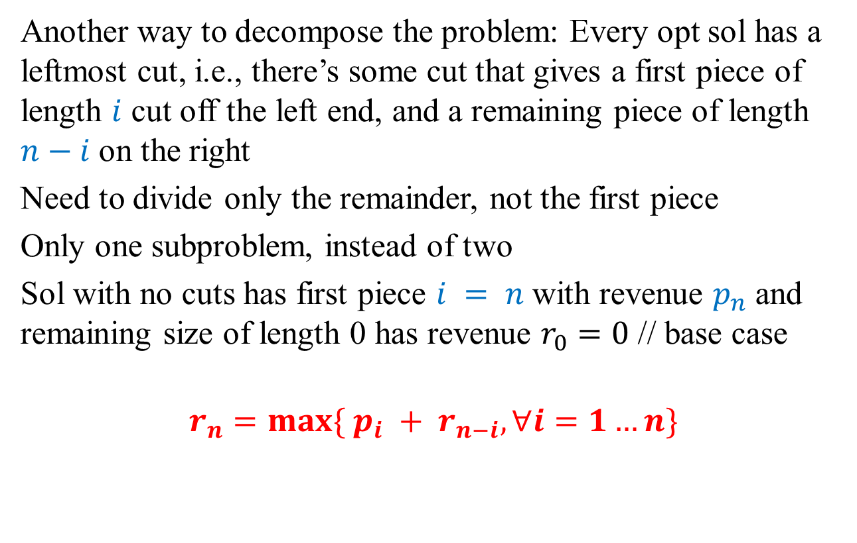
Formulation
Another way to decompose the problem: Every opt sol has a leftmost cut, i.e., there’s some cut that gives a first piece of length $i$ cut off the left end, and a remaining piece of length $n−i$ on the right
Need to divide only the remainder, not the first piece
Only one subproblem, instead of two
Sol with no cuts has first piece $i = n$with revenue $p_{n}$ and remaining size of length 0 has revenue $r_{0}=0$ // base case
$$r_{n}=max⁡\{ p_{i} + r_{n−i},∀i=1…n\}$$

Slide 16
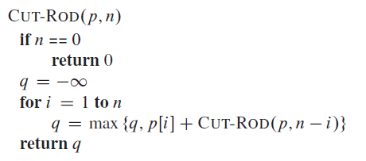
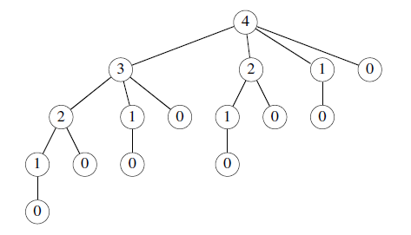
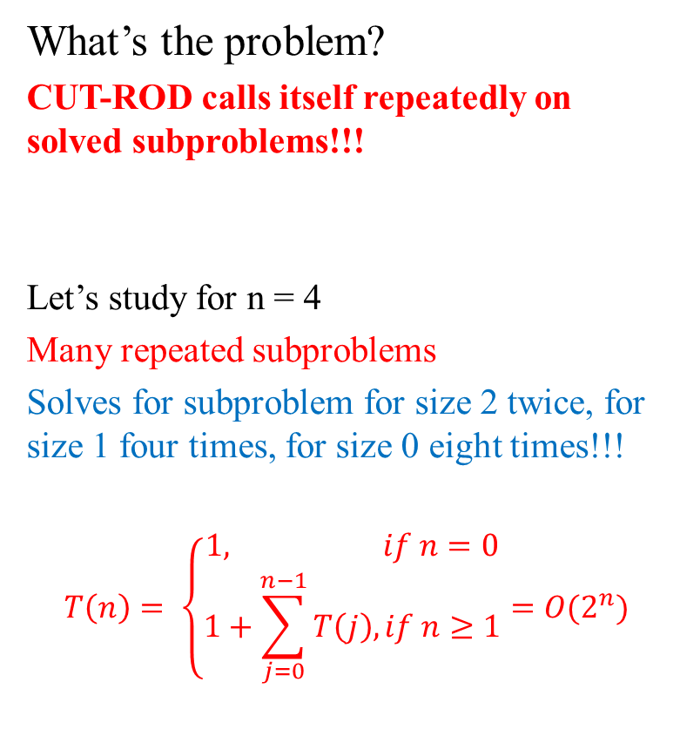
Naïve Recursive Top-Down Solution
What’s the problem?
CUT-ROD calls itself repeatedly on solved subproblems!!!
Let’s study for n = 4
Many repeated subproblems
Solves for subproblem for size 2 twice, for size 1 four times, for size 0 eight times!!!
$$T\left(n\right)= \left\{\begin{aligned}1, if n=0 \\ 1+\sum_{j=0}^{n−1}{T\left(j\right), if n≥1}\end{aligned}={O(2}^{n})\right.$$

Slide 17
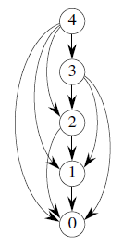
Subproblem Graphs
How to understand the dependency of subproblems? Directed graph
One vertex for each distinct subproblem
Directed edge (x, y) if computing an opt sol to subproblem x directly requires knowing an opt sol to subproblem y
Running time: Sum of times needed to solve each subproblem
Time to compute a subproblem is typically linear in the out-degree of its vertex

Slide 18
DP Solution
Arrange to solve each subproblem just once by saving solution in a table
Pick solution from table when revisiting solved subproblems
Turns exponential-time solution to a polynomial-time solution
Two basic approaches:
Top-down with memoization
Bottom-up

Slide 19
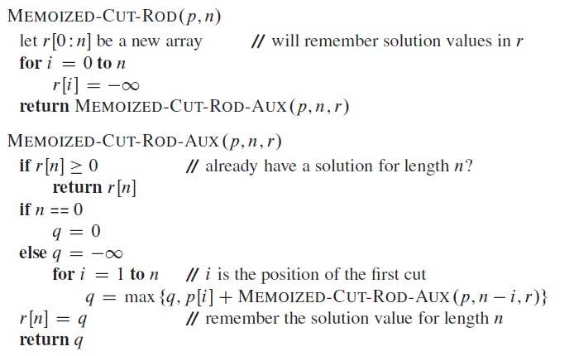
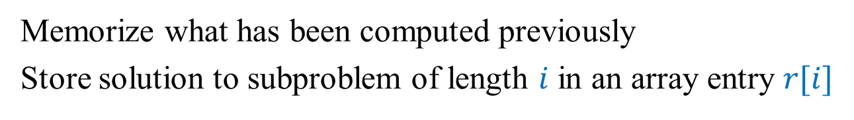
Top-Down with Memoization
Memorize what has been computed previously
Store solution to subproblem of length $i$ in an array entry $r[i]$

Slide 20
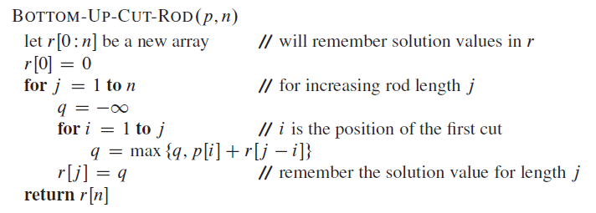
Bottom-Up
Sort the subproblems by size and solve the smaller ones first

Slide 21
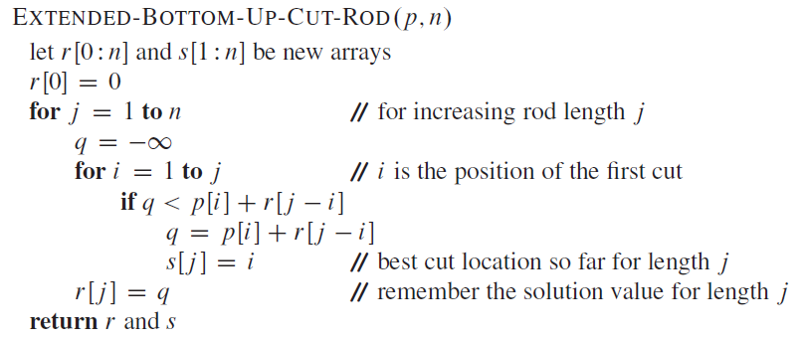
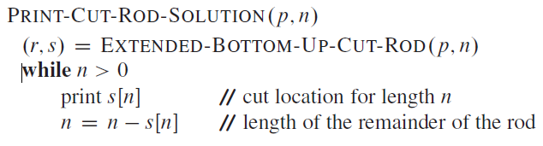
How to Reconstruct a Solution?
Extend bottom-up approach to output opt values AND opt choices
Save opt choices in a separate table and print it

Slide 22
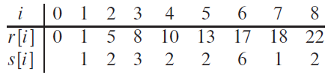
Example of Output
Example: PRINT-CUT-ROD-SOLUTION(p , 8)

Slide 23
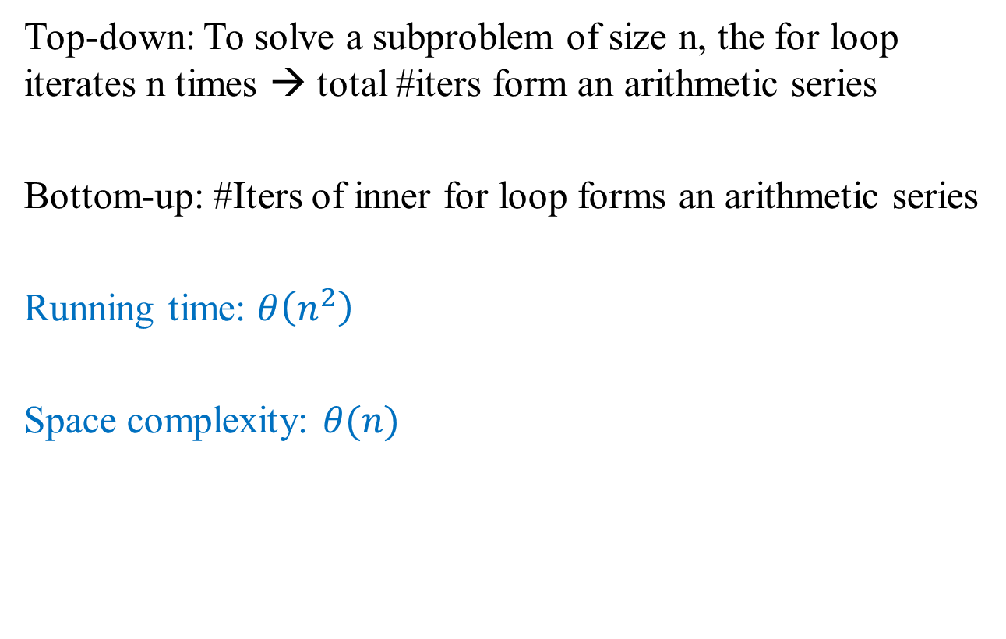
Runtime and Space Complexity
Top-down: To solve a subproblem of size n, the for loop iterates n times → total #iters form an arithmetic series
Bottom-up: #Iters of inner for loop forms an arithmetic series
Running time: $θ\left(n^{2}\right)$
Space complexity: $θ(n)$

Slide 24
DP in BioInformatics
DNA is a string of bases: { ‘A’, ‘C’, ‘G’, ‘T’ }
Given two DNA strands (== string), how “similar” are they? Are organisms closely related?
Similarity
One strand is a substring of the other
If #changes needed to turn one strand into another is small
Find a third strand in which the bases appear in the same order as in the given strands (not necessarily consecutive). So, longer the third strand, the more similar are the input strands

Slide 25
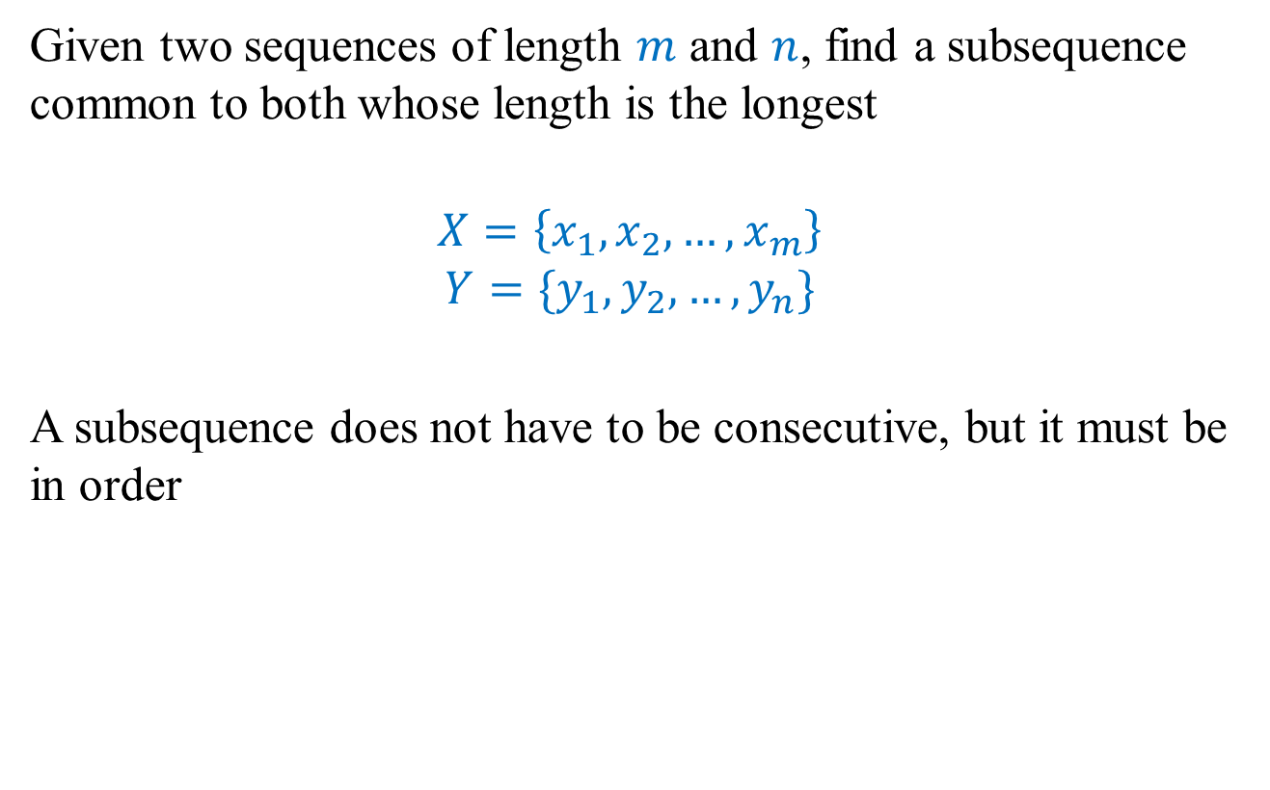
Problem 2: Longest Common Subsequence (LCS)
Given two sequences of length $m$ and $n$, find a subsequence common to both whose length is the longest
$$X=\left\{x_{1},x_{2},…, x_{m}\right\}$$
$$Y=\{y_{1},y_{2},…, y_{n}\}$$
A subsequence does not have to be consecutive, but it must be in order

Slide 26
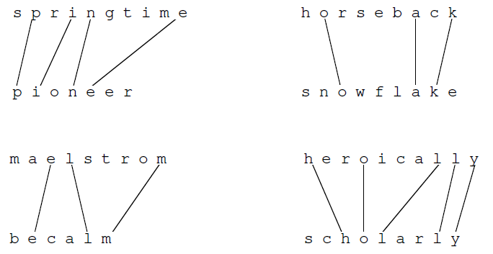
Examples

Slide 27
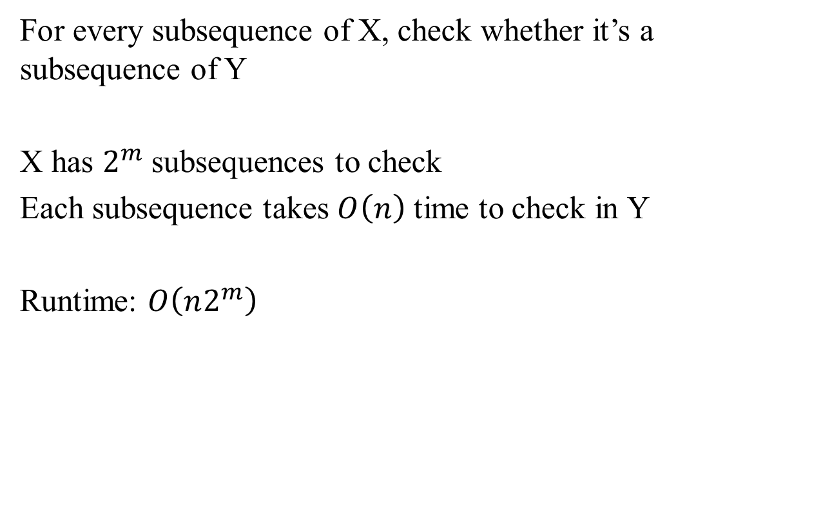
Naïve / Brute-Force Algorithm
For every subsequence of X, check whether it’s a subsequence of Y
X has $2^{m}$ subsequences to check
Each subsequence takes $O\left(n\right)$ time to check in Y
Runtime: $O\left(n2^{m}\right)$

Slide 28
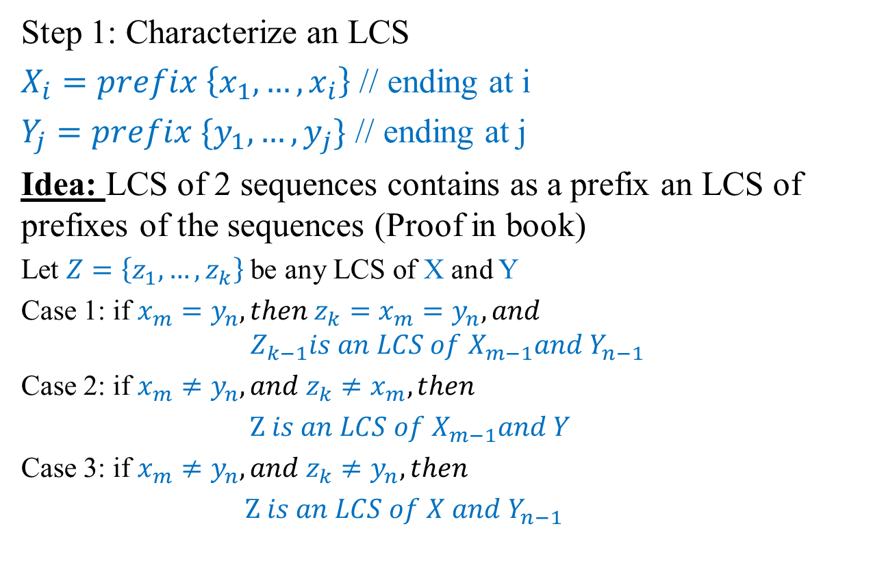
Towards a DP Formulations
Step 1: Characterize an LCS
$X_{i}=prefix \left\{x_{1},…, x_{i}\right\}$ // ending at i
$Y_{j}=prefix \{y_{1},…, y_{j}\}$ // ending at j
Idea: LCS of 2 sequences contains as a prefix an LCS of prefixes of the sequences (Proof in book)
Let $Z=\left\{z_{1},…, z_{k}\right\}$ be any LCS of X and Y
Case 1: if $x_{m}=y_{n}, then z_{k}=x_{m}=y_{n},and$
$$Z_{k−1}is an LCS of X_{m−1}and Y_{n−1}$$
Case 2: if $x_{m}≠y_{n}, and z_{k}≠x_{m},then$
$Z is an LCS of X_{m−1}and Y$
Case 3: if $x_{m}≠y_{n}, and z_{k}≠y_{n},then$
$Z is an LCS of X and Y_{n−1}$

Slide 29
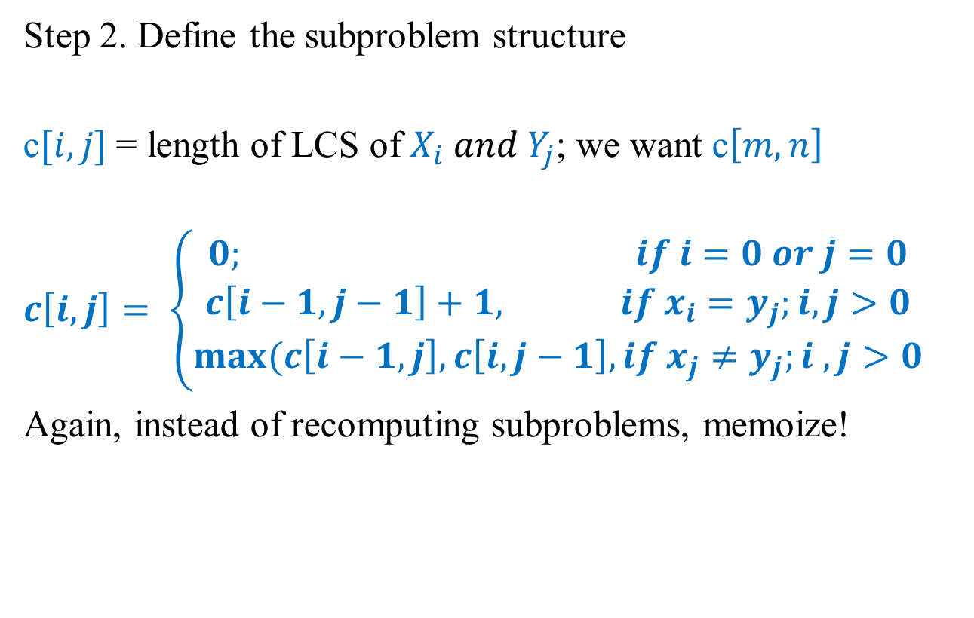
Recursive Definition of an Optimal Solution
Step 2. Define the subproblem structure
c$[i, j]$= length of LCS of $X_{i} and Y_{j}$; we want c$\left[m, n\right]$
$$c\left[i,j\right]= \left\{\begin{aligned}0; if i=0 or j=0 \\ c\left[i−1, j−1\right]+1, if x_{i}=y_{j};i, j>0 \\ max⁡(c\left[i−1,j\right], c\left[i,j−1\right], if x_{j}≠y_{j};i , j>0\end{aligned}\right.$$
Again, instead of recomputing subproblems, memoize!

Slide 30
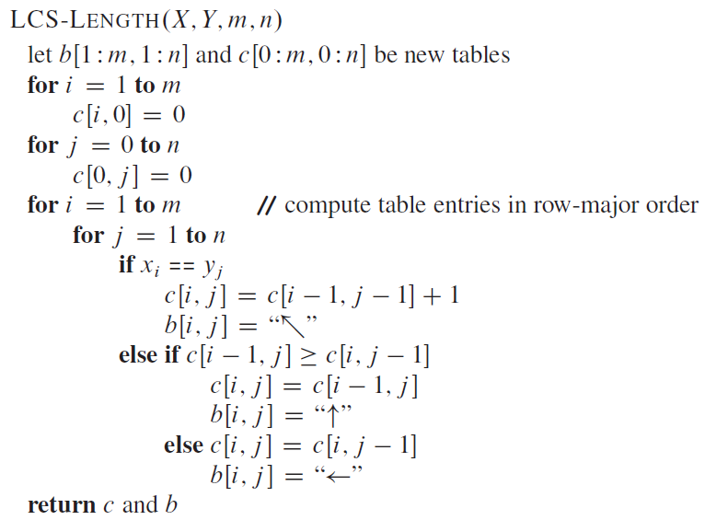
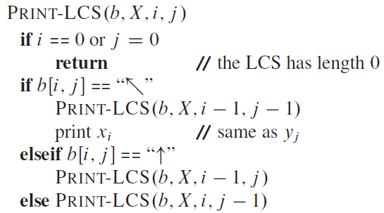
Pseudocode

Slide 31
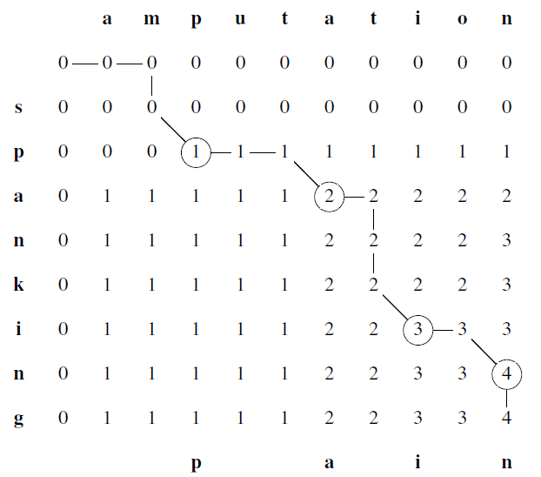
Example
X = {s,p,a,n,k,i,n,g} Y = {a,m,p,u,t,a,t,i,o,n}

Slide 32

Running Time and Space Complexity
$$Θ(mn)$$

Slide 33
Lecture 8 Summary
Dynamic programming
Strategy
P1: Rod cutting
Top-down and bottom-up
Reconstructing solution from opt choices
P2: Longest common subsequence
Top-down
Reconstructing solution from opt choices

Slide 34
Extra Credit Question #6 [2 points]
Please email your responses to snath@scu.edu by 7:09pm of Oct 24, 2022.
Question: What is “programming” in DP, given that it has little to do with writing code? Who coined this term and why?

