Slide 1
Design and Analysis of Algorithms
Sid Nath (snath@scu.edu)
Lecture 10
Oct 26, 2022

Slide 2
Agenda
Administrative
Dynamic Programming continued
Knapsack
Problems

Slide 3
Administrative
PA2 announced
Team mate info due by Oct 30, 2022 11:59pm
PR announced
Team mate info due by Nov 1, 2022 11:59pm
Thanksgiving week plans? Nov 21, 23
Graded midterms on Mon
Today DP problem solving hour
Need class participation
Only solution sketches will be posted

Slide 4
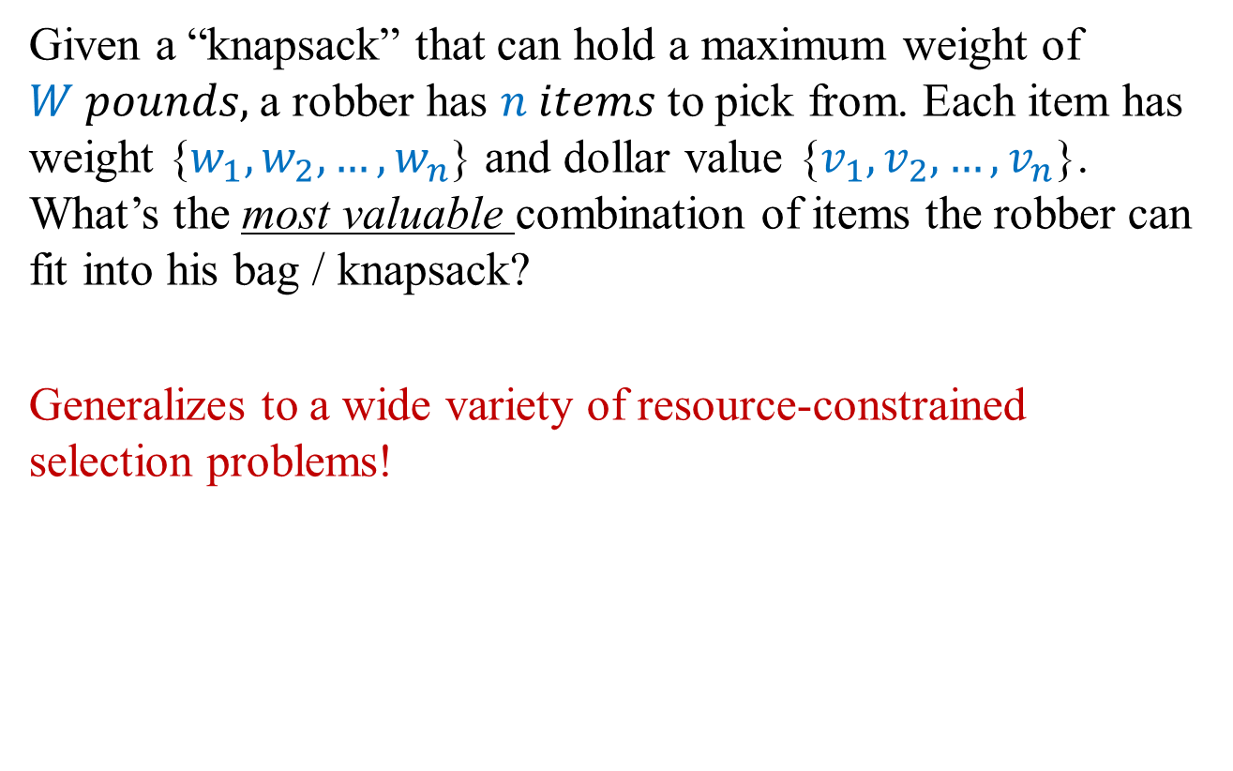
Problem 6: Knapsack (w/ Repetition)
Given a “knapsack” that can hold a maximum weight of $W pounds,$a robber has $n items$to pick from. Each item has weight {$w_{1}, w_{2},…, w_{n}$} and dollar value {$v_{1}, v_{2},…, v_{n}$}. What’s the most valuable combination of items the robber can fit into his bag / knapsack?
Generalizes to a wide variety of resource-constrained selection problems!

Slide 5
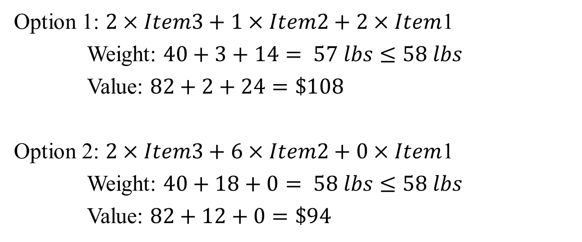
Example
Item | Weight (lbs) | Value ($)
1 | 7 | 12
2 | 3 | 2
3 | 20 | 41
W = 58 lbs
Option 1: $2×Item3+1×Item2+2×Item$1
Weight: $40+3+14= 57 lbs≤58 lbs$
Value: $82+2+24=\$108$
Option 2: $2×Item3+6×Item2+0×Item$1
Weight: $40+18+0= 58 lbs≤58 lbs$
Value: $82+12+0=\$94$

Slide 6
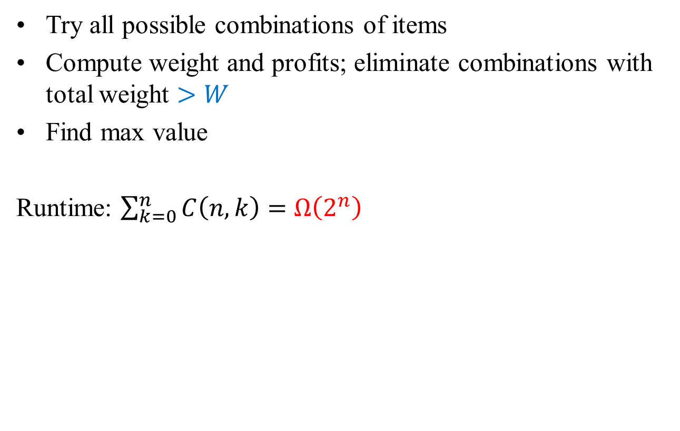
A Brute-Force Approach
Try all possible combinations of items
Compute weight and profits; eliminate combinations with total weight $>W$
Find max value
Runtime: $\sum_{k=0}^{n}{C\left(n,k\right)=}$ $Ω\left(2^{n}\right)$

Slide 7
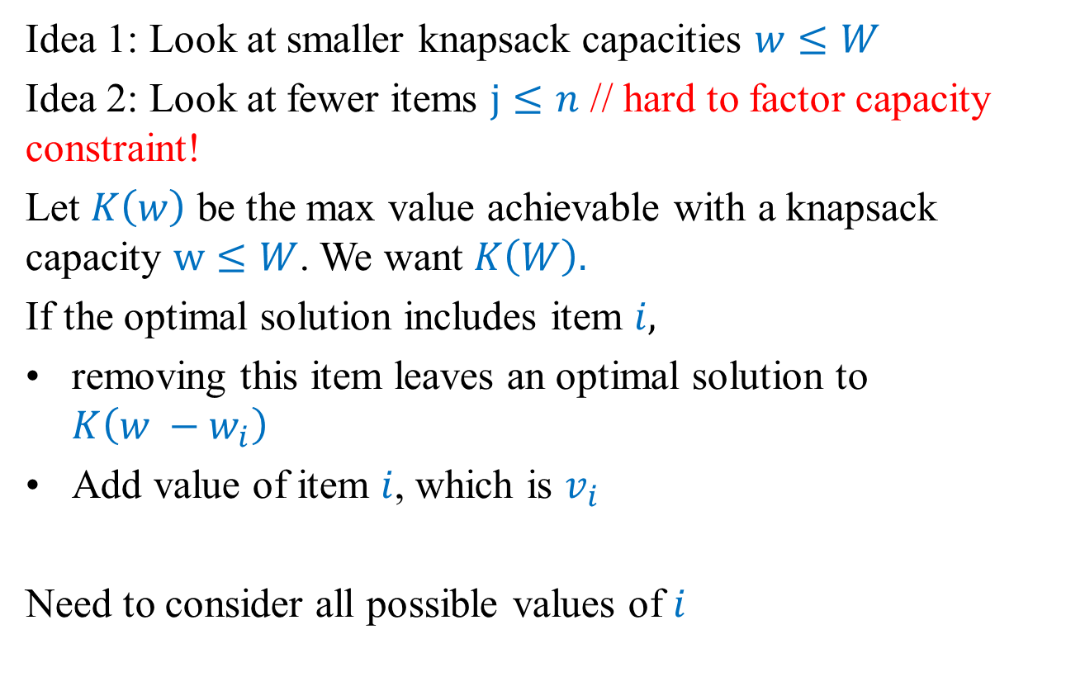
DP: Structure of an optimal solution
Idea 1: Look at smaller knapsack capacities $w≤W$
Idea 2: Look at fewer items $j≤n$ // hard to factor capacity constraint!
Let $K\left(w\right)$ be the max value achievable with a knapsack capacity $w≤W$. We want $K\left(W\right).$
If the optimal solution includes item $i,$
removing this item leaves an optimal solution to $K\left(w −w_{i}\right)$
Add value of item $i$, which is $v_{i}$
Need to consider all possible values of $i$

Slide 8

DP: A Recursive Solution
$$K\left(w\right)=\max\left\{K\left(w−w_{i}\right)+v_{i}\right\}∀{i: w}_{i }≤w$$
Base case: $K\left(0\right)=0$

Slide 9
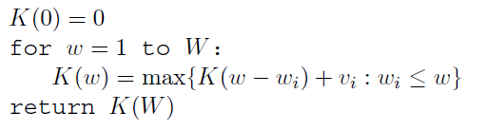
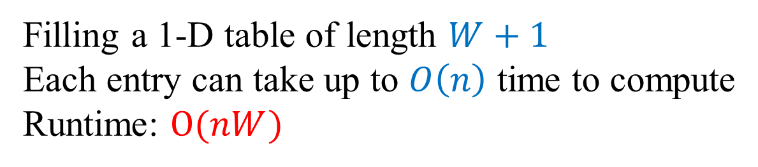
DP: Pseudocode (Tabular, bottom-up)
Filling a 1-D table of length $W+1$
Each entry can take up to $O\left(n\right)$ time to compute
Runtime: $O(nW)$

Slide 10
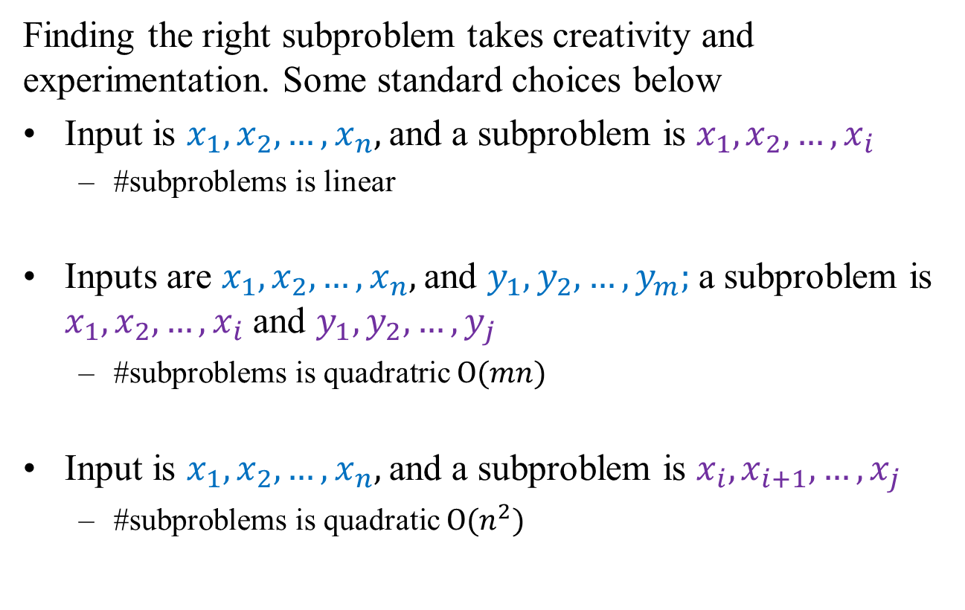
DP: Common Subproblems
Finding the right subproblem takes creativity and experimentation. Some standard choices below
Input is $x_{1},x_{2},…, x_{n},$and a subproblem is $x_{1},x_{2},…, x_{i}$
#subproblems is linear
Inputs are $x_{1},x_{2},…, x_{n},$and $y_{1},y_{2},…, y_{m};$a subproblem is $x_{1},x_{2},…, x_{i}$ and $y_{1},y_{2},…, y_{j}$
#subproblems is quadratric $O(mn)$
Input is $x_{1},x_{2},…, x_{n},$and a subproblem is $x_{i},x_{i+1},…, x_{j}$
#subproblems is quadratic $O(n^{2})$

Slide 11
DP Problem Solving: Interactive

Slide 12

DP1: Knapsack w/o Repetition
If repetitions are not allowed to our knapsack problem. How can we solve it using DP?
$K\left(w,j\right)=$max value achievable using knapsack of capacity $w$ and items $1, …, j$
We need $K\left(W,n\right)$
$$K\left(w,j\right)=\max{\{K\left(w−w_{j}, j−1\right)+v_{j}, K\left(w, j−1\right)\}}$$

Slide 13
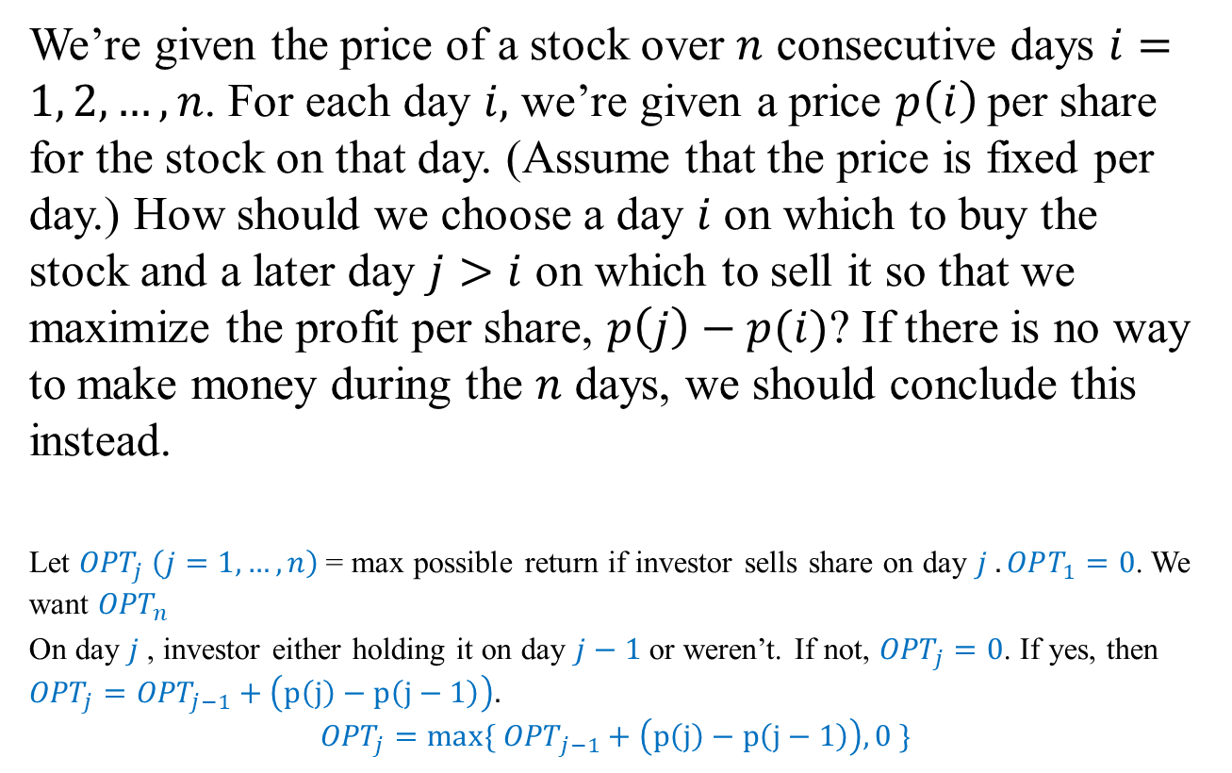
DP2: Investing
We’re given the price of a stock over $n$ consecutive days $i=1, 2, …,n$. For each day $i,$ we’re given a price $p\left(i\right)$per share for the stock on that day. (Assume that the price is fixed per day.) How should we choose a day $i$ on which to buy the stock and a later day $j>i$ on which to sell it so that we maximize the profit per share, $p\left(j\right)−p(i)$? If there is no way to make money during the $n$ days, we should conclude this instead.
Let ${OPT}_{j} \left(j=1, …, n\right)$ = max possible return if investor sells share on day $j . OPT_{1}=0$. We want ${OPT}_{n}$
On day $j$, investor either holding it on day $j−1$ or weren’t. If not, ${OPT}_{j}=0$. If yes, then ${OPT}_{j}={OPT}_{j−1}+\left(p\left(j\right)−p\left(j−1\right)\right).$
$${OPT}_{j}={max⁡\{ OPT}_{j−1}+\left(p\left(j\right)−p\left(j−1\right)\right), 0 \}$$

Slide 14
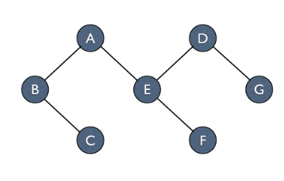
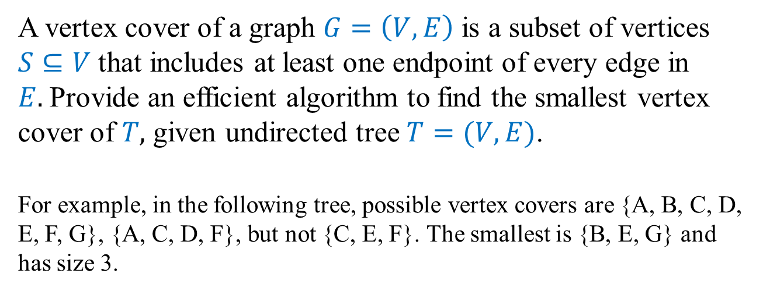
DP3: Vertex Cover
A vertex cover of a graph $G=\left(V,E\right)$ is a subset of vertices $S⊆V$ that includes at least one endpoint of every edge in $E.$Provide an efficient algorithm to find the smallest vertex cover of $T,$ given undirected tree $T=(V,E)$.
For example, in the following tree, possible vertex covers are {A, B, C, D, E, F, G}, {A, C, D, F}, but not {C, E, F}. The smallest is {B, E, G} and has size 3.

Slide 15
Lecture 10 Summary
Dynamic programming
P6: Knapsack
DP interactive problem solving
Knapsack w/o repetitions
Investing
Vertex cover

