Slide 1
Design and Analysis of Algorithms
Sid Nath (snath@scu.edu)
Lecture 11
Oct 31, 2022

Slide 2
Agenda
Administrative
Dynamic Programming continued
Problem: Vertex cover
Network flows
Max flow, min cut
Ford Fulkerson algorithm

Slide 3
Administrative
PA2 announced
PR announced
Team mate info due by Nov 1, 2022 11:59pm; else some single and rest random
Thanksgiving week plans… Nov 23 no class
Graded midterms today
Finals details announced
Part 1 (take-home, 6hrs, 4-5 algo design questions)
Part 2 (in-class)

Slide 4
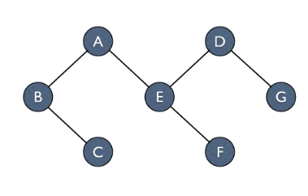
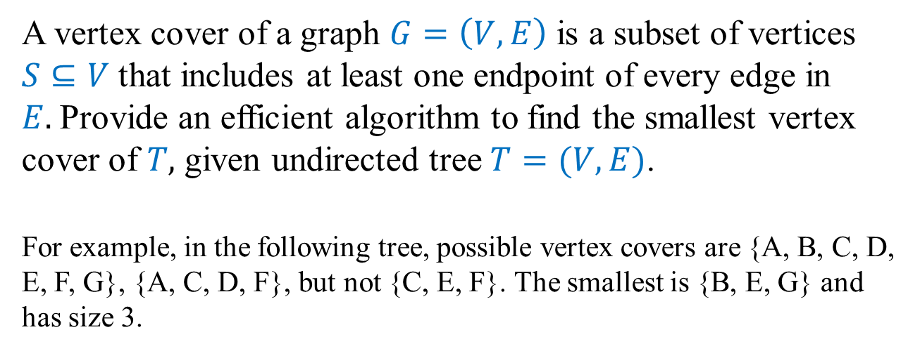
DP3: Vertex Cover
A vertex cover of a graph $G=\left(V,E\right)$ is a subset of vertices $S⊆V$ that includes at least one endpoint of every edge in $E.$Provide an efficient algorithm to find the smallest vertex cover of $T,$ given undirected tree $T=(V,E)$.
For example, in the following tree, possible vertex covers are {A, B, C, D, E, F, G}, {A, C, D, F}, but not {C, E, F}. The smallest is {B, E, G} and has size 3.

Slide 5
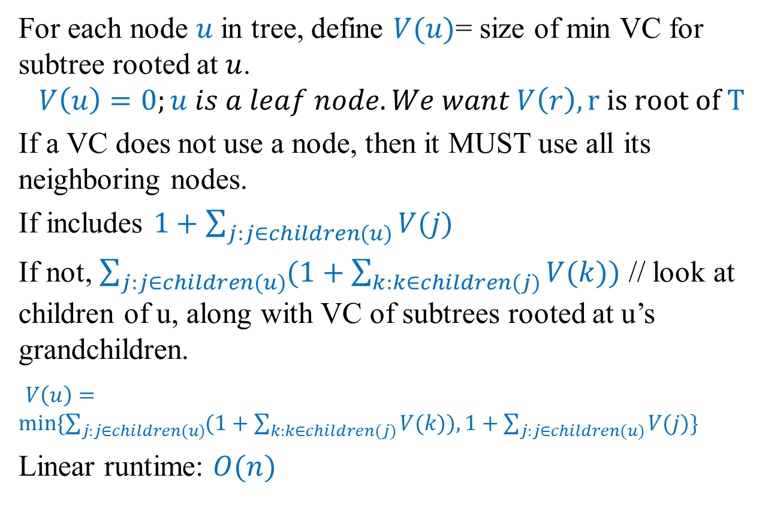
Solution Sketch
For each node $u$in tree, define $V(u)$= size of min VC for subtree rooted at $u$.
$$V\left(u\right)=0;u is a leaf node. We want V\left(r\right), r is root of T$$
If a VC does not use a node, then it MUST use all its neighboring nodes.
If includes $1+\sum_{j:j∈children(u)}{V(j)}$
If not, $\sum_{j:j∈children(u)}{(1+\sum_{k:k∈children(j)}{V(k))}}$ // look at children of u, along with VC of subtrees rooted at u’s grandchildren.
$V\left(u\right)=min⁡\{\sum_{j:j∈children(u)}{(1+\sum_{k:k∈children(j)}{V(k)), 1+\sum_{j:j∈children(u)}{V(j)\}}}}$
Linear runtime: $O(n)$

Slide 6
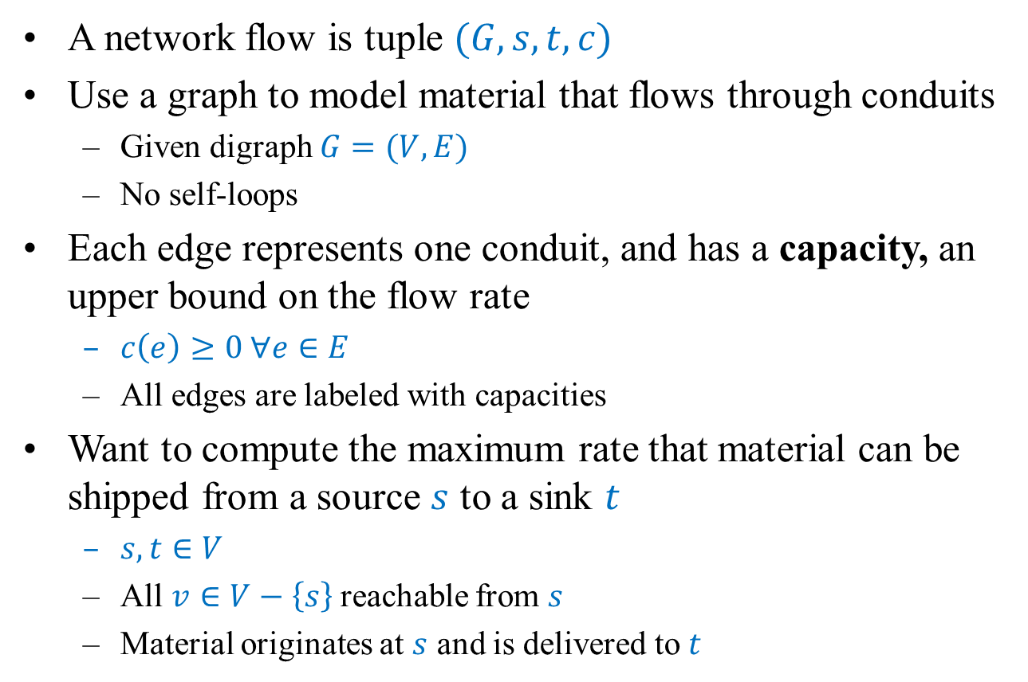
Network flow
A network flow is tuple $(G, s, t, c)$
Use a graph to model material that flows through conduits
Given digraph $G=(V,E)$
No self-loops
Each edge represents one conduit, and has a capacity, an upper bound on the flow rate
$c\left(e\right)≥0 ∀e∈E$
All edges are labeled with capacities
Want to compute the maximum rate that material can be shipped from a source $s$ to a sink $t$
$s, t∈V$
All $v∈V−\left\{s\right\}$reachable from $s$
Material originates at $s$ and is delivered to $t$

Slide 7
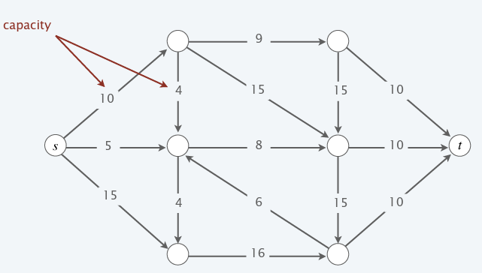
Example

Slide 8
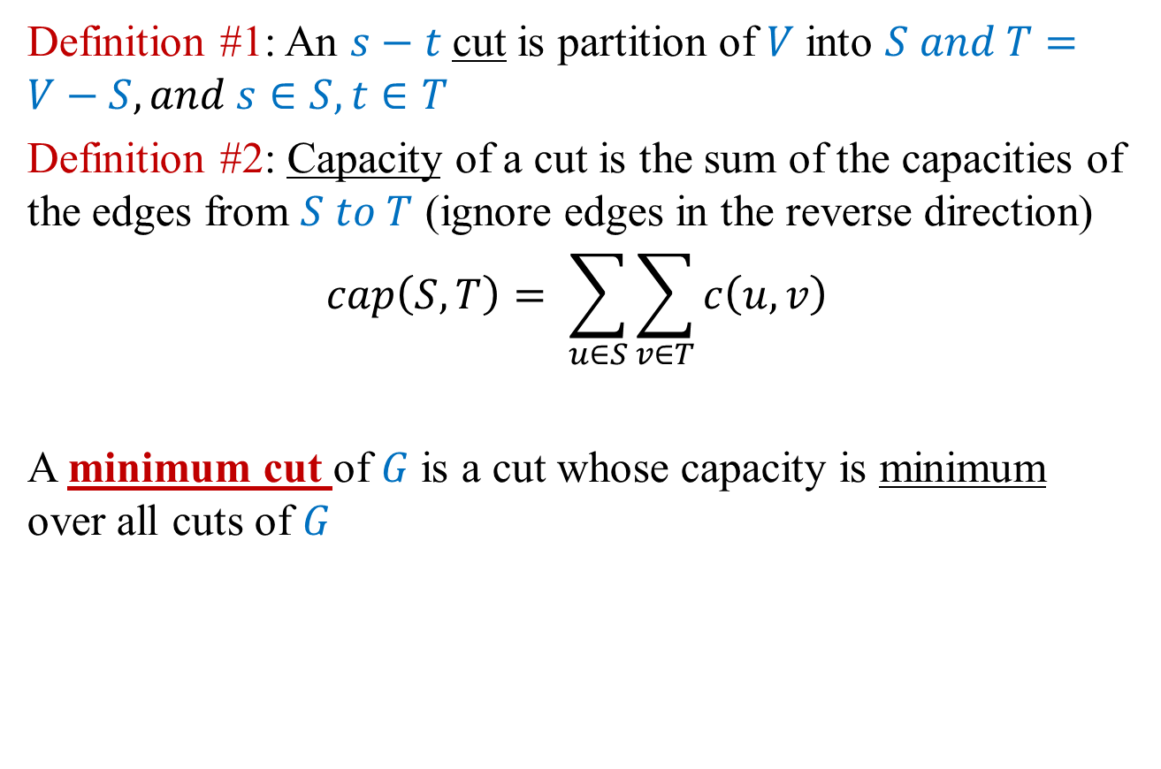
Minimum cut problem
Definition #1: An $s−t$cut is partition of $V$into $S and T=V−S, and s∈S, t∈T$
Definition #2: Capacity of a cut is the sum of the capacities of the edges from $S to T$ (ignore edges in the reverse direction)
$$cap\left(S, T\right)= \sum_{u∈S}{\sum_{v∈T}{c\left(u, v\right)}}$$
A minimum cut of $G$is a cut whose capacity is minimum over all cuts of $G$

Slide 9
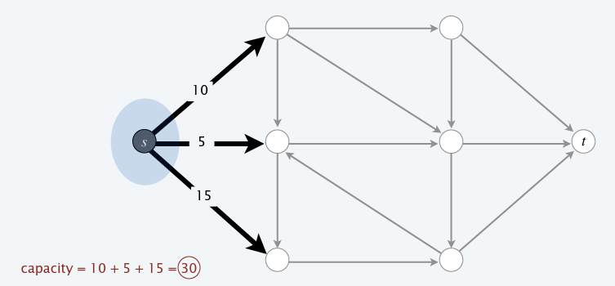
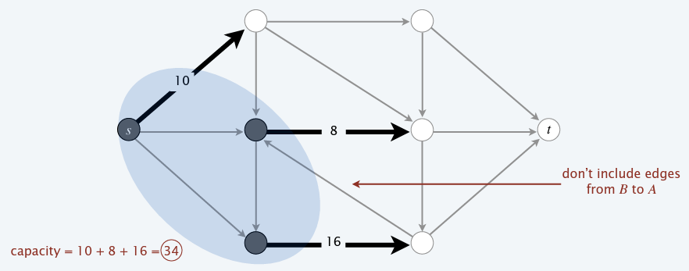
Examples

Slide 10
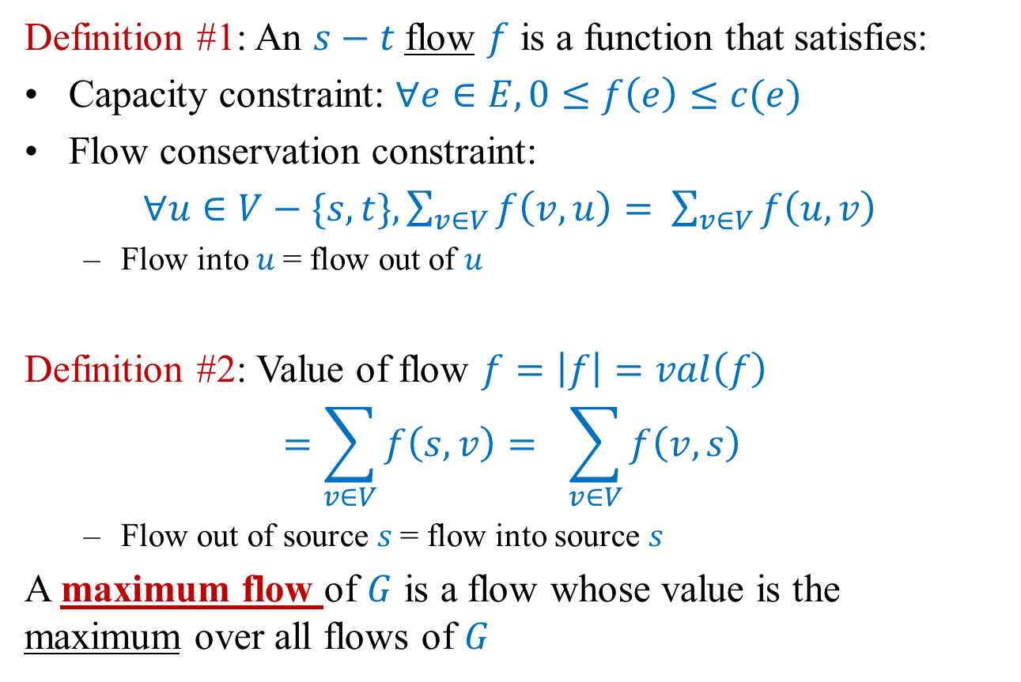
Maximum flow problem
Definition #1: An $s−t$flow $f$ is a function that satisfies:
Capacity constraint: $∀e∈E, 0≤f\left(e\right)≤c(e)$
Flow conservation constraint:
$∀u∈V−\{s,t\}, \sum_{v∈V}{f\left(v,u\right)= }$ $\sum_{v∈V}{f\left(u,v\right) }$
Flow into $u$= flow out of $u$
Definition #2: Value of flow $f=\left|f\right|=val\left(f\right)$
$$=\sum_{v∈V}{f\left(s,v\right)= } \sum_{v∈V}{f\left(v,s\right) }$$
Flow out of source $s$= flow into source $s$
A maximum flow of $G$ is a flow whose value is the maximum over all flows of $G$

Slide 11
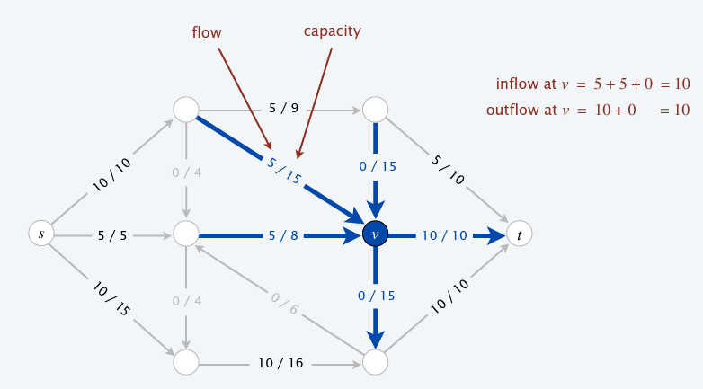

Example

Slide 12

Multiple sources and sinks
Given multiple sources $s_{1}, s_{2},…, s_{n},$ create a single supersource $s$ with edges $\left(s, s_{i}\right)$ and $c\left(s, s_{i}\right)=∞$ for $i=1, …, n$
Given multiple sinks $t_{1}, t_{2},…, t_{n},$ create a single supersink $t$ with edges $\left(t_{i}, t\right)$ and $c\left(t_{i} ,t\right)=∞$ for $i=1, …, n$

Slide 13
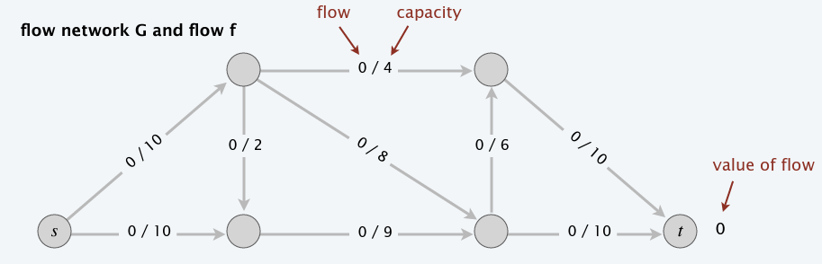
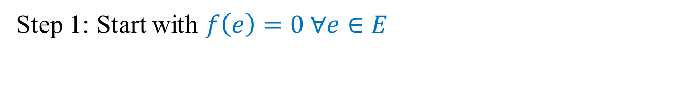
Towards a max-flow algorithm
Step 1: Start with $f\left(e\right)=0 ∀e∈E$

Slide 14
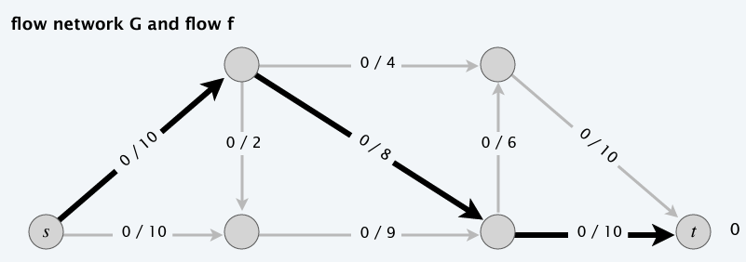
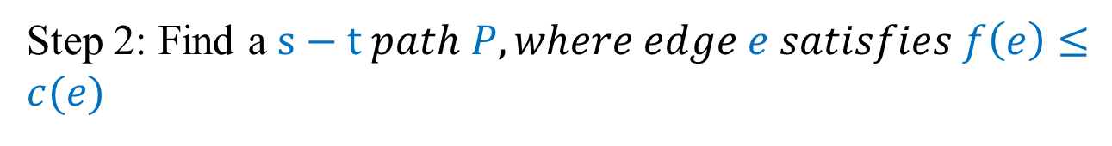
Towards a max-flow algorithm
Step 2: Find a $s−t path P, where edge e satisfies f\left(e\right)≤c(e)$

Slide 15
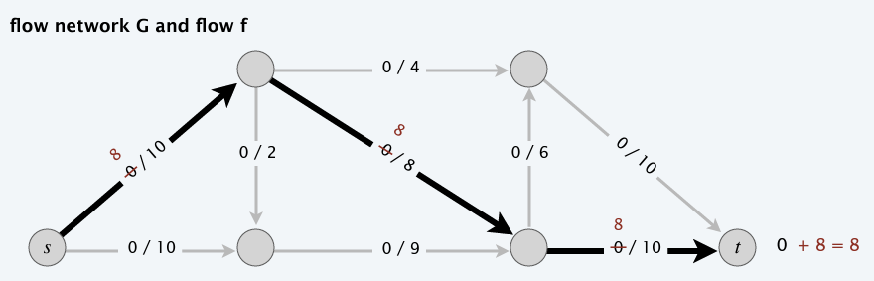
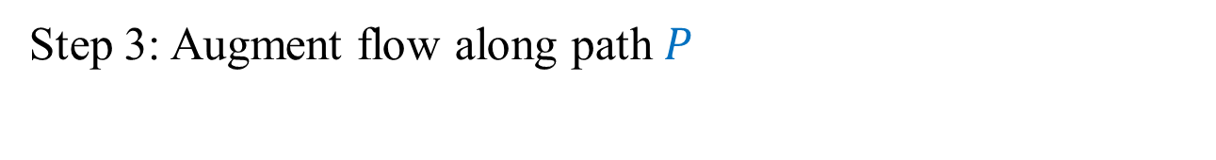
Towards a max-flow algorithm
Step 3: Augment flow along path $P$

Slide 16
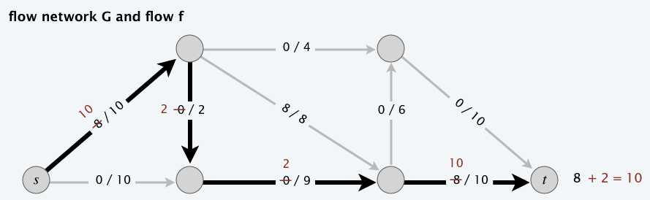
Towards a max-flow algorithm
Step 4: Repeat until you get stuck

Slide 17
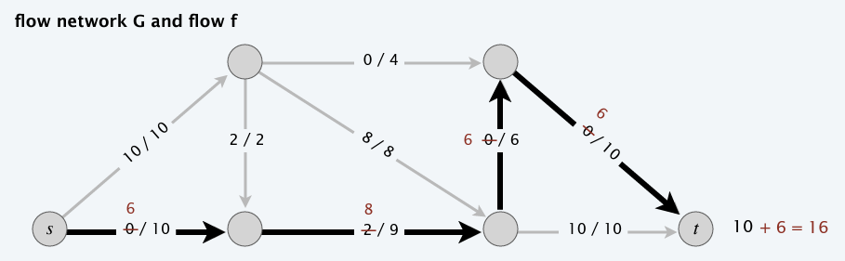
Towards a max-flow algorithm
Step 4: Repeat until you get stuck

Slide 18
Towards a max-flow algorithm
Step 4: Repeat until you get stuck

Slide 19
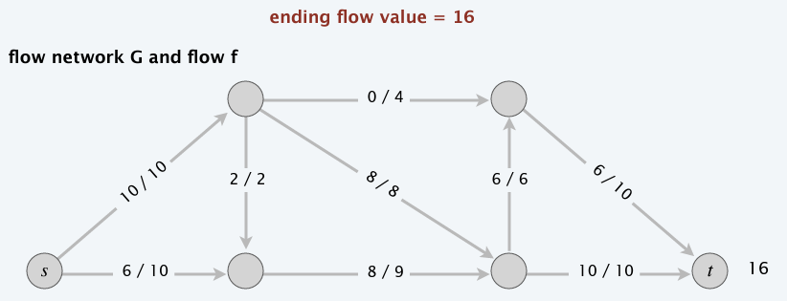
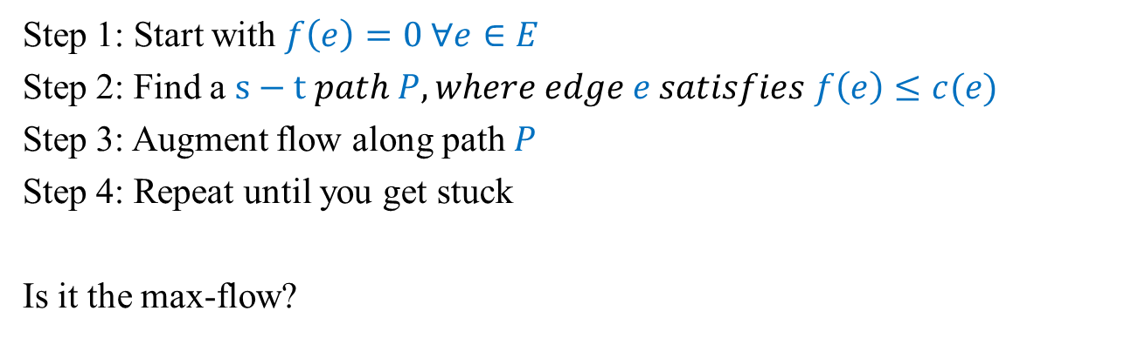
Towards a max-flow algorithm: Greedy
Step 1: Start with $f\left(e\right)=0 ∀e∈E$
Step 2: Find a $s−t path P, where edge e satisfies f\left(e\right)≤c(e)$
Step 3: Augment flow along path $P$
Step 4: Repeat until you get stuck
Is it the max-flow?

Slide 20
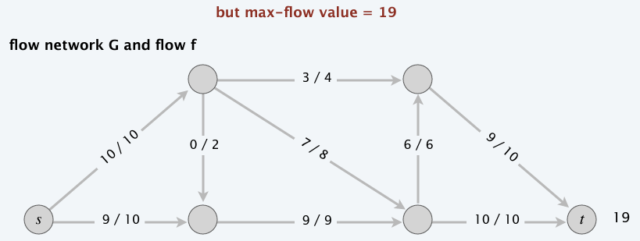
Greedy vs. OPT

Slide 21
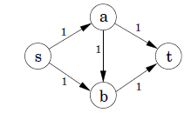
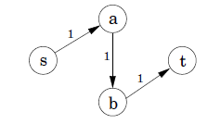
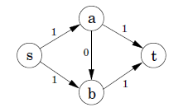
Why Greedy fails?
If first path
Once greedy increases flow on an edge, it never decreases it
Need some mechanism to “undo” a bad decision (cancelling flows)
OPT

Slide 22
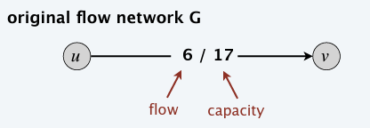
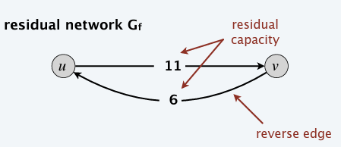
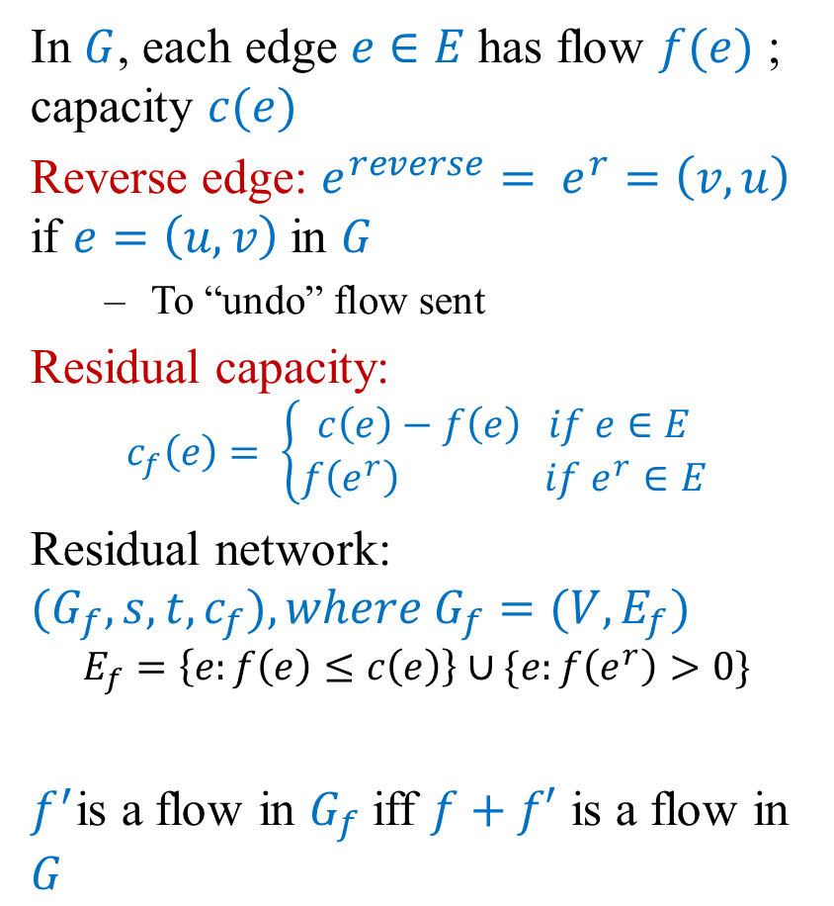
Residual network
In $G$, each edge $e∈E$has flow $f(e)$ ; capacity $c(e)$
Reverse edge: ${e^{reverse}= e}^{r}=\left(v, u\right)$ if $e=\left(u, v\right)$in $G$
To “undo” flow sent
Residual capacity:
$$c_{f}\left(e\right)= \left\{\begin{aligned}c\left(e\right)−f\left(e\right) if e∈E \\ f\left(e^{r}\right) if e^{r}∈E\end{aligned}\right.$$
Residual network: ${(G}_{f}, s,t, c_{f}), where G_{f}=(V, E_{f})$
$$E_{f}=\left\{e:f\left(e\right)≤c\left(e\right)\right\}∪\{e:f\left(e^{r}\right)>0\}$$
$f^{′}$is a flow in $G_{f}$ iff $f+f′$ is a flow in $G$

Slide 23
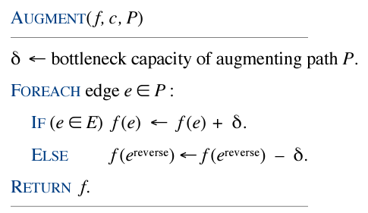
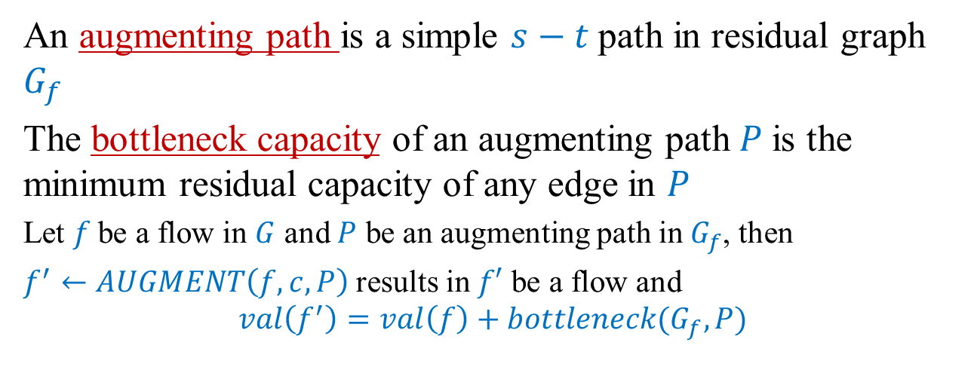
Augmenting path
An augmenting path is a simple $s−t$path in residual graph $G_{f}$
The bottleneck capacity of an augmenting path $P$is the minimum residual capacity of any edge in $P$
Let $f$be a flow in $G$ and $P$ be an augmenting path in $G_{f}$, then
$f^{′}←AUGMENT\left(f,c,P\right)$results in $f′$ be a flow and
$$val\left(f^{′}\right)=val\left(f\right)+bottleneck(G_{f}, P)$$

Slide 24
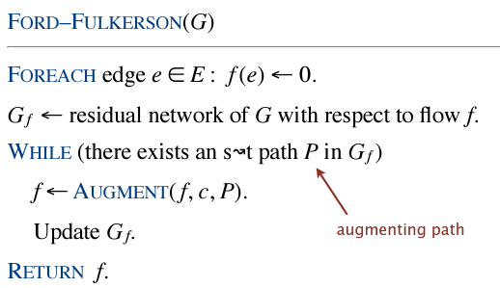
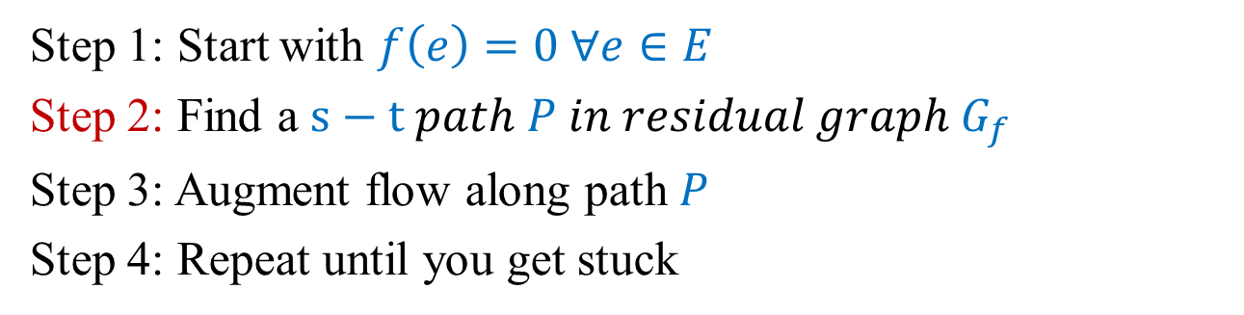
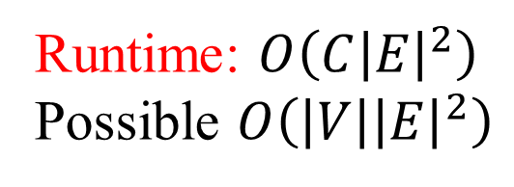
Ford-Fulkerson algorithm
Step 1: Start with $f\left(e\right)=0 ∀e∈E$
Step 2: Find a $s−t path P in residual graph G_{f}$
Step 3: Augment flow along path $P$
Step 4: Repeat until you get stuck
Runtime: $O\left(C{\left|E\right|}^{2}\right)$
Possible $O\left(\left|V\right|{\left|E\right|}^{2}\right)$

Slide 25
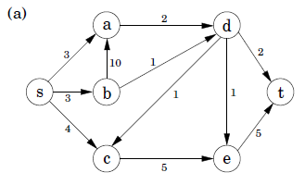
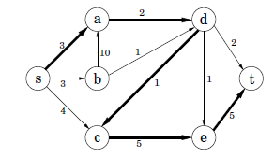
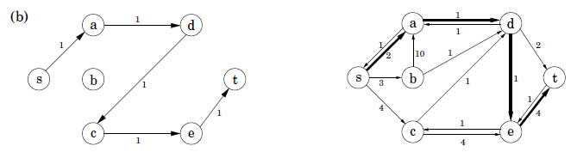


Example
$$G$$
$$G_{f}$$

Slide 26
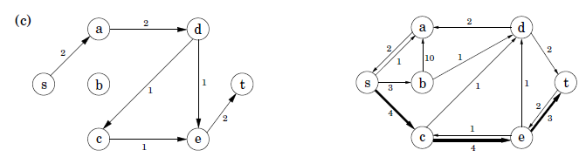
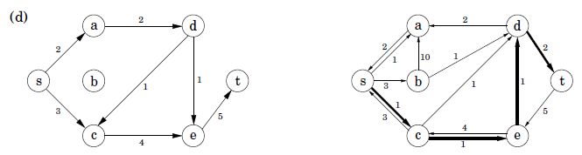
Example
$$G$$
$$G_{f}$$

Slide 27
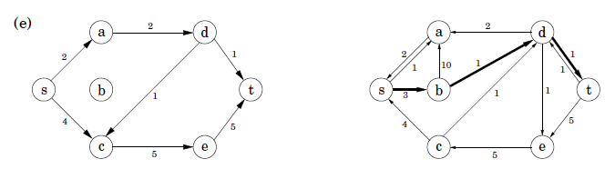
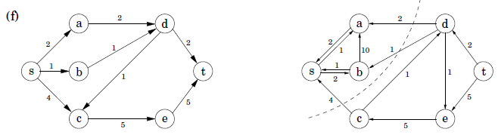
Example
$$G$$
$$G_{f}$$

Slide 28
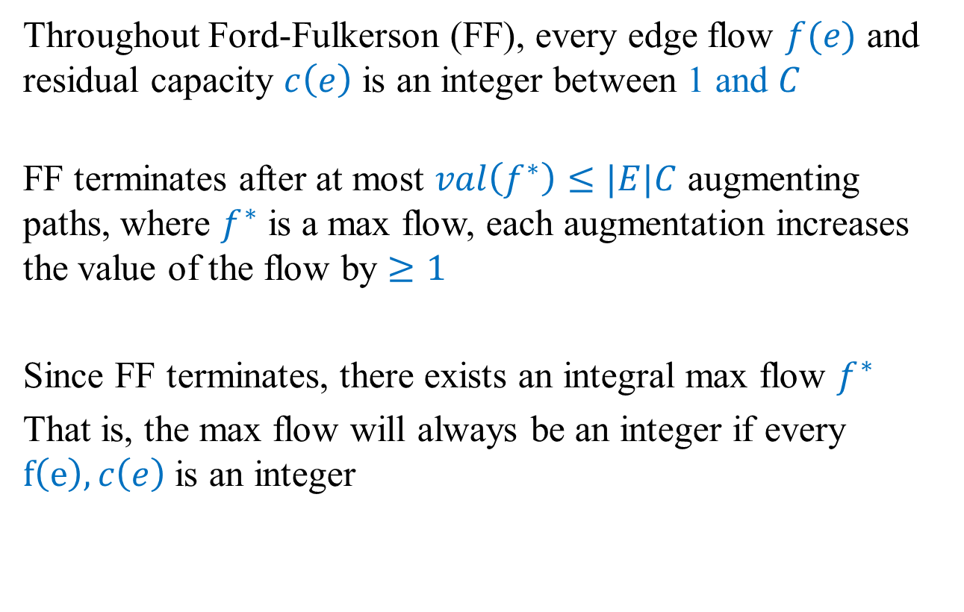
Integrality invariance of Ford-Fulkerson
Throughout Ford-Fulkerson (FF), every edge flow $f(e)$ and residual capacity $c\left(e\right)$ is an integer between 1 and $C$
FF terminates after at most $val\left(f^{∗}\right)≤|E|C$ augmenting paths, where $f^{∗}$ is a max flow, each augmentation increases the value of the flow by $≥1$
Since FF terminates, there exists an integral max flow $f^{∗}$
That is, the max flow will always be an integer if every $f\left(e\right), c\left(e\right)$ is an integer

Slide 29
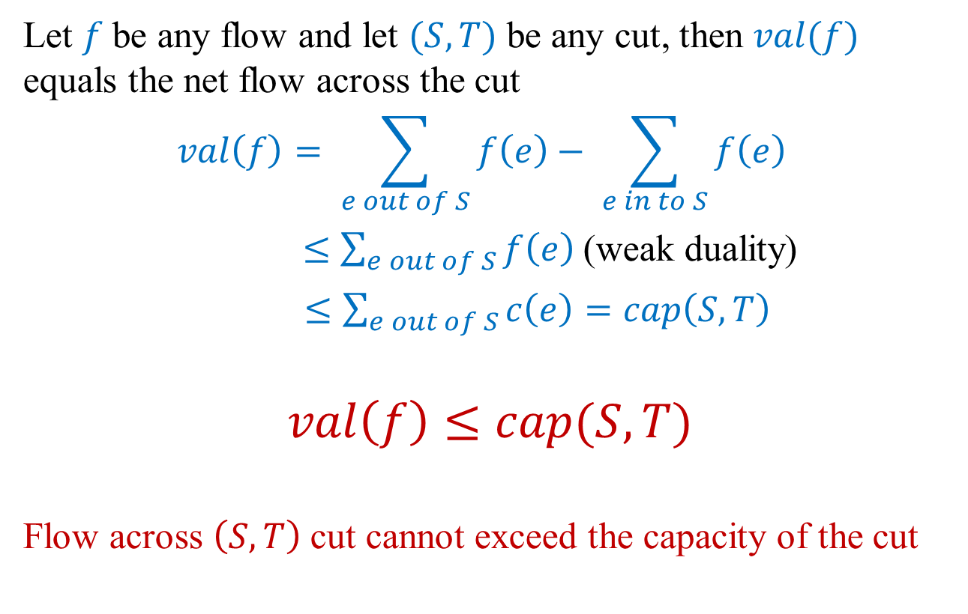
Relationship between flows and cuts
Let $f$be any flow and let $(S, T)$ be any cut, then $val(f)$ equals the net flow across the cut
$$val\left(f\right)= \sum_{e out of S}{f\left(e\right)− \sum_{e in to S}{f\left(e\right) }}$$
$≤\sum_{e out of S}{f\left(e\right)}$(weak duality)
$≤\sum_{e out of S}{c\left(e\right)}=cap\left(S, T\right)$
$$val\left(f\right)≤cap(S,T)$$
Flow across $\left(S, T\right)$ cut cannot exceed the capacity of the cut

Slide 30
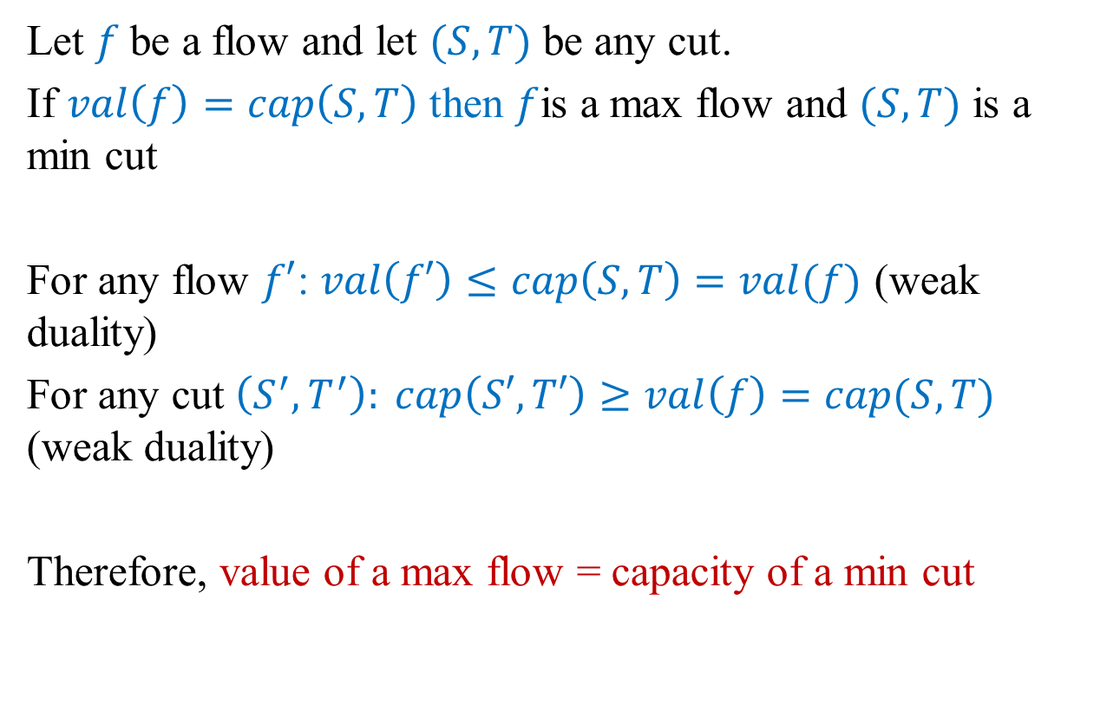
Certificate of optimality
Let $f$be a flow and let $(S, T)$ be any cut.
If $val\left(f\right)=cap\left(S,T\right)$ then $f$is a max flow and $(S, T)$ is a min cut
For any flow $f′$: $val\left(f′\right)≤cap\left(S,T\right)=val(f)$ (weak duality)
For any cut $\left(S^{′}, T^{′}\right): cap\left(S′,T′\right)≥val\left(f\right)=cap(S, T)$ (weak duality)
Therefore, value of a max flow = capacity of a min cut

Slide 31
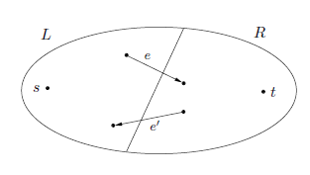
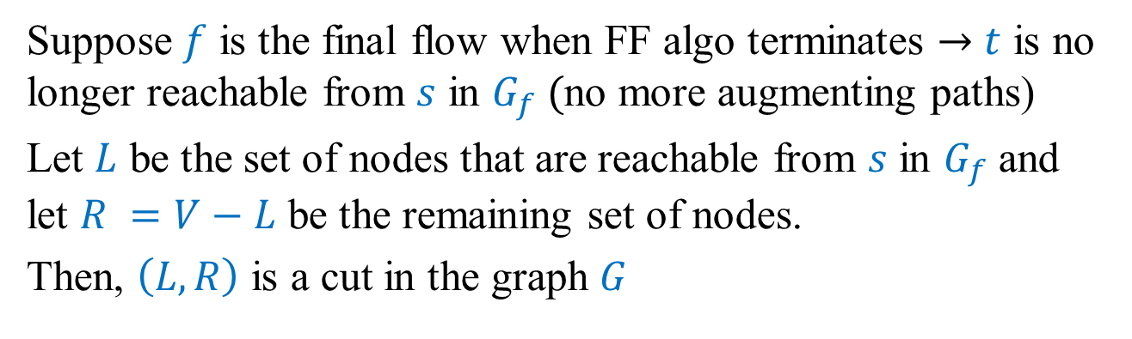
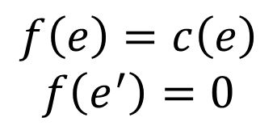
Why Max flow finds a min cut?
Suppose $f$ is the final flow when FF algo terminates $→$ $t$ is no longer reachable from $s$ in $G_{f} ($no more augmenting paths)
Let $L$ be the set of nodes that are reachable from $s$ in $G_{f}$ and let $R =V−L$ be the remaining set of nodes.
Then, $\left(L,R\right)$ is a cut in the graph $G$
$$f\left(e\right)=c\left(e\right)$$
$$f\left(e^{′}\right)=0$$

Slide 32
Lecture 11 Summary
Dynamic programming
Vertex cover
Network flows
Ford Fulkerson
Max flow = min cut

Slide 33
Extra Credit Question #8 [5 points]
Please email your responses to snath@scu.edu by 7:09pm of Nov 2, 2022.
Question: The Ford-Fulkerson algorithm is guaranteed to terminate if the edge capacities are
Rational numbers
Real numbers
Both A and B
Neither A nor B
Please provide explanation /counterexample of your response.

