Slide 1
Design and Analysis of Algorithms
Sid Nath (snath@scu.edu)
Lecture 12
Nov 2, 2022

Slide 2
Agenda
Administrative
Stable matching
Gale-Shapley algorithm

Slide 3
Administrative
PR announced – due Nov 26, 11:59pm.
Thanksgiving week plans… Nov 23 no class
Finals details announced
Part 1 (take-home, 6hrs, 4-5 algo design questions)
Only typed answers. Develop your Word / LaTeX templates NOW!!!
Part 2 (in-class)
Who is registered in AMTH?

Slide 4
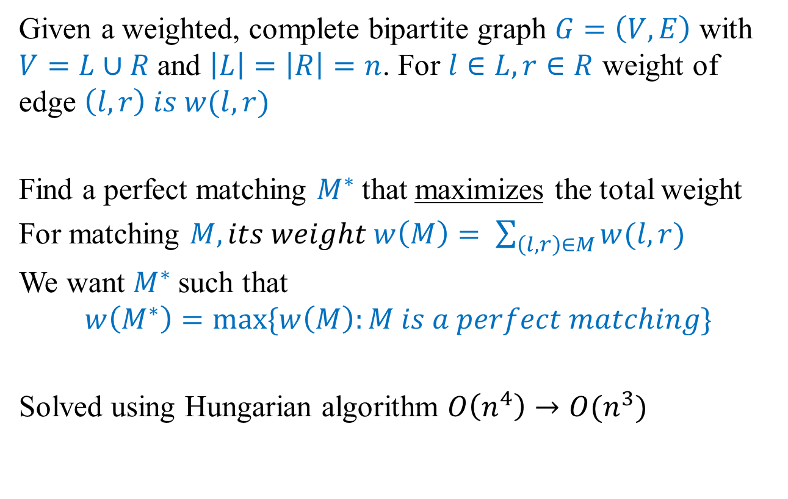
Assignment problem
Given a weighted, complete bipartite graph $G=\left(V, E\right)$ with $V=L∪R$ and $\left|L\right|=\left|R\right|=n$. For $l∈L, r∈R$ weight of edge $\left(l,r\right) is w(l,r)$
Find a perfect matching $M^{∗}$that maximizes the total weight
For matching $M, its weight w\left(M\right)= \sum_{\left(l,r\right)∈M}{w(l,r)}$
We want $M^{∗}$such that
$$w\left(M^{∗}\right)=max⁡\{w\left(M\right):M is a perfect matching\}$$
Solved using Hungarian algorithm $O\left(n^{4}\right)→O(n^{3})$

Slide 5
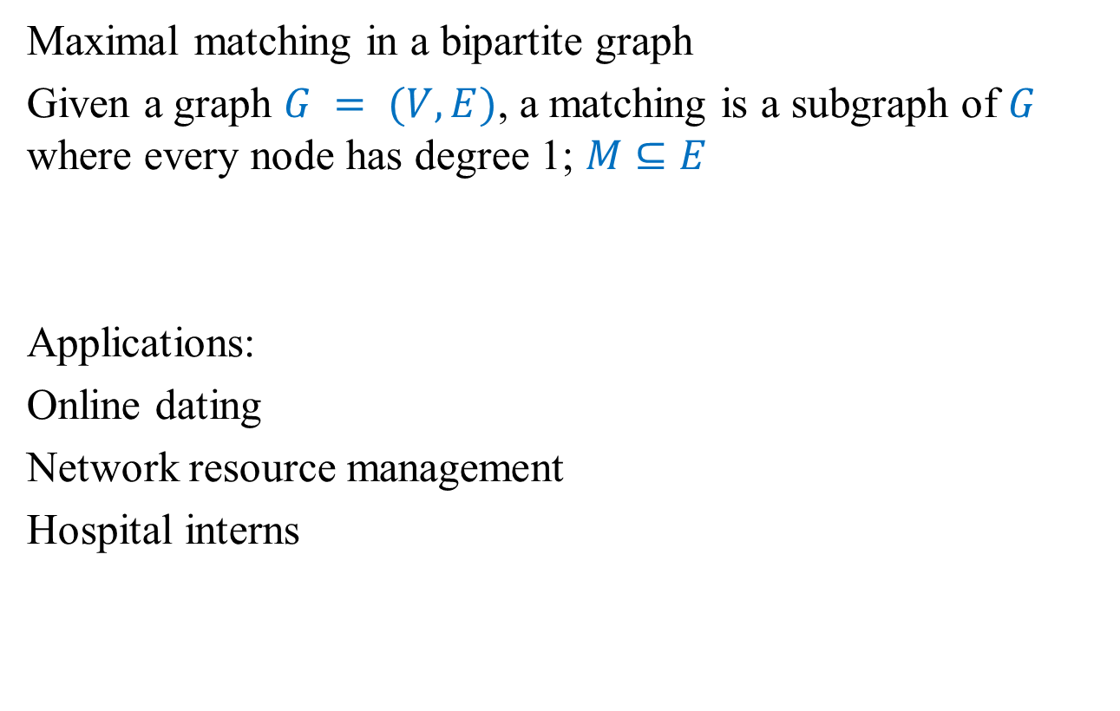
Matching problem
Maximal matching in a bipartite graph
Given a graph $G = (V, E)$, a matching is a subgraph of $G$ where every node has degree 1; $M⊆E$
Applications:
Online dating
Network resource management
Hospital interns

Slide 6
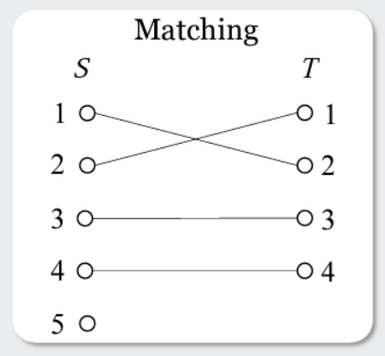
Example
Nodes 1, 2, 3, 4 of S are matched
Node 5 of S is exposed / unmatched / uncovered

Slide 7
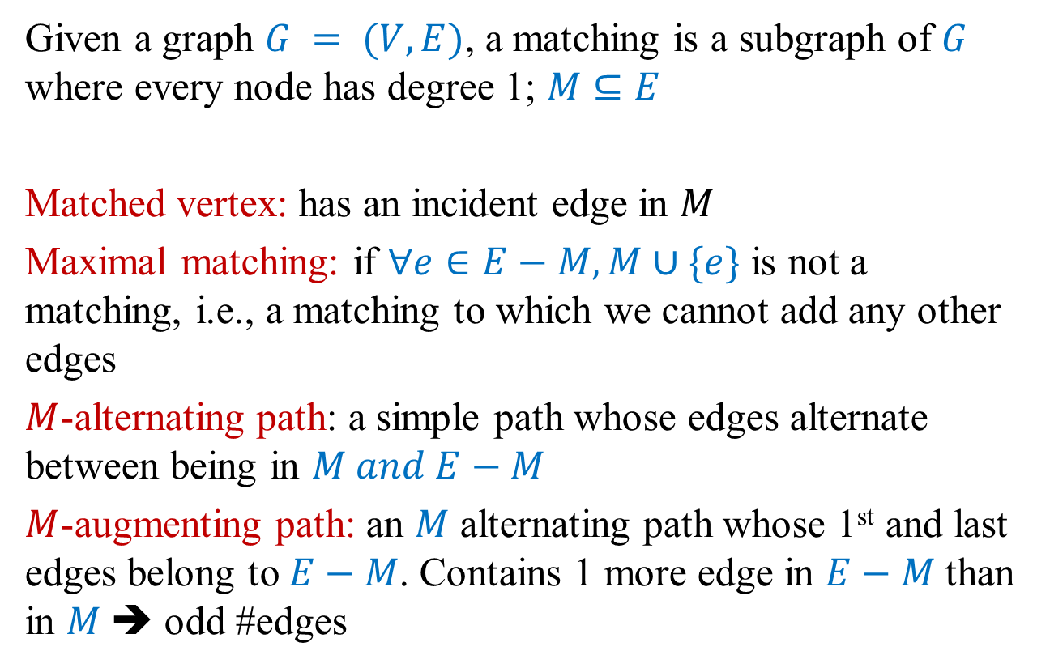
Matching problem
Given a graph $G = (V, E)$, a matching is a subgraph of $G$ where every node has degree 1; $M⊆E$
Matched vertex: has an incident edge in $M$
Maximal matching: if $∀e∈E−M, M∪\{e\}$ is not a matching, i.e., a matching to which we cannot add any other edges
$M$-alternating path: a simple path whose edges alternate between being in $M and E−M$
$M$-augmenting path: an $M$ alternating path whose 1st and last edges belong to $E−M$. Contains 1 more edge in $E−M$ than in $M$➔ odd #edges

Slide 8
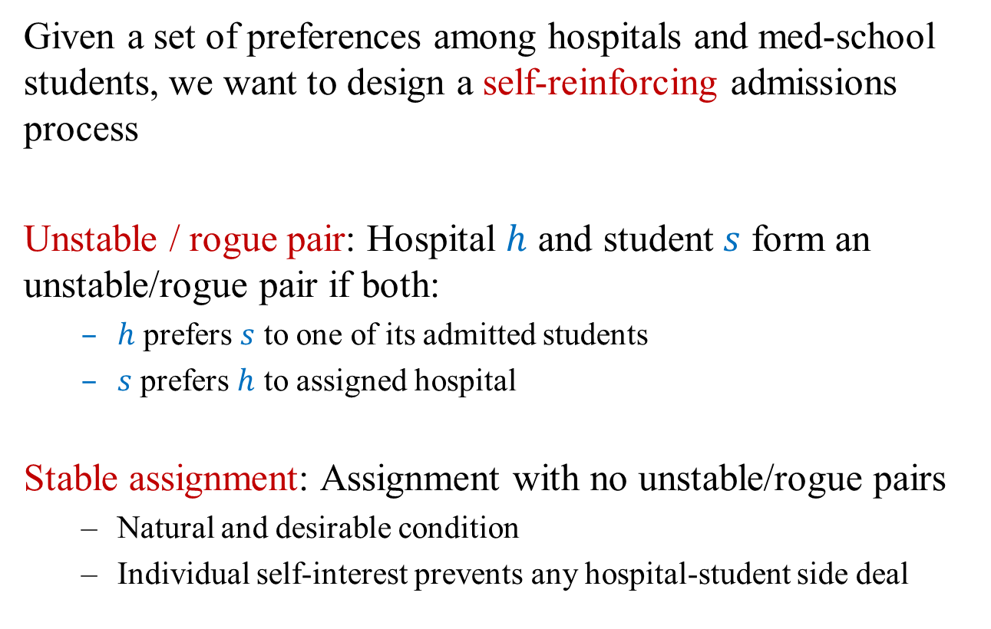
Matching med-school students to hospitals
Given a set of preferences among hospitals and med-school students, we want to design a self-reinforcing admissions process
Unstable / rogue pair: Hospital $h$ and student $s$ form an unstable/rogue pair if both:
$h$ prefers $s$ to one of its admitted students
$s$ prefers $h$ to assigned hospital
Stable assignment: Assignment with no unstable/rogue pairs
Natural and desirable condition
Individual self-interest prevents any hospital-student side deal

Slide 9
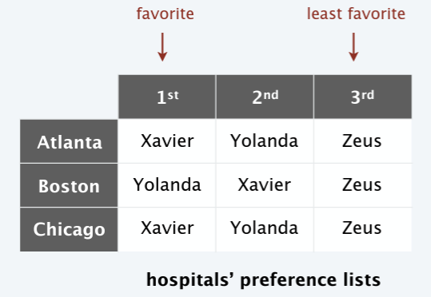
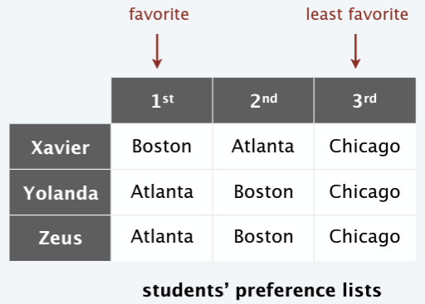
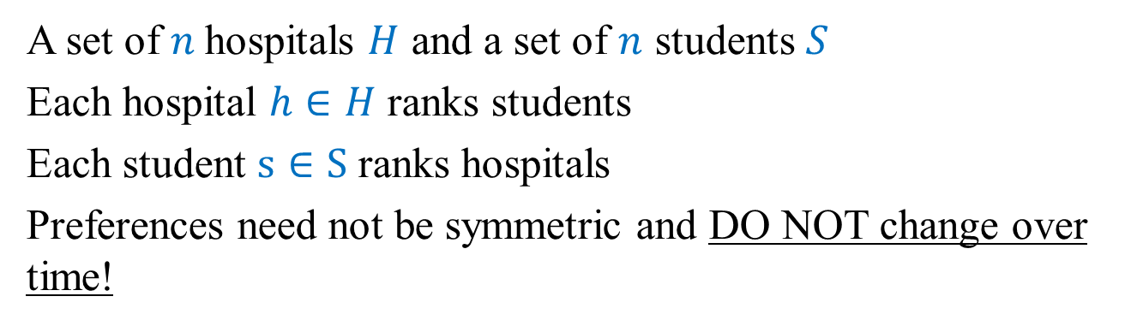
Stable matching problem: Input
A set of $n$hospitals $H$ and a set of $n$ students $S$
Each hospital $h∈H$ ranks students
Each student $s∈S$ ranks hospitals
Preferences need not be symmetric and DO NOT change over time!

Slide 10
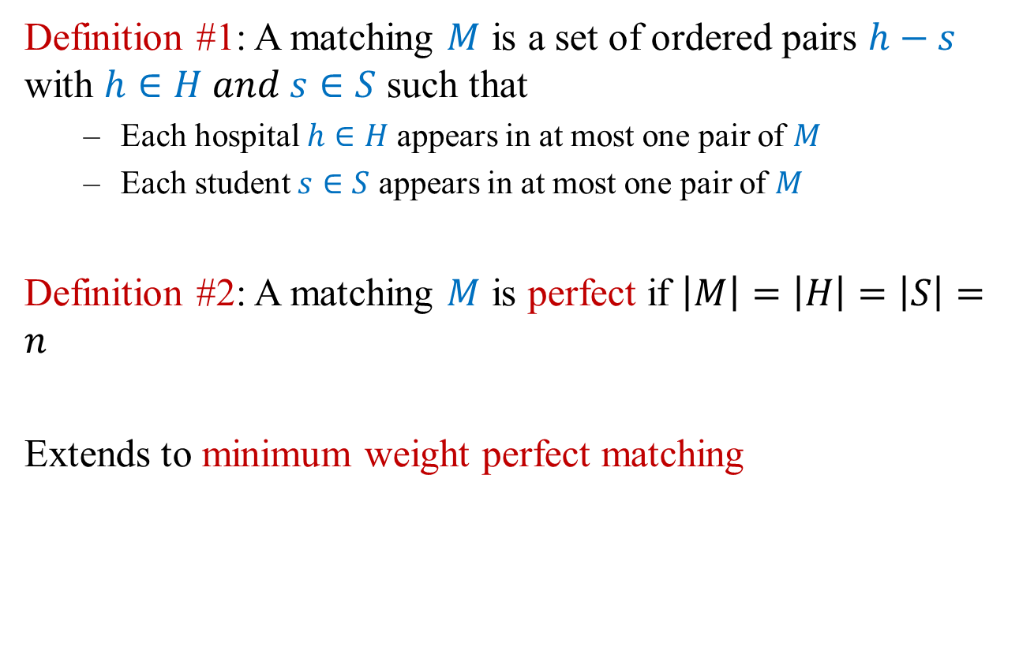
Perfect matching
Definition #1: A matching $M$ is a set of ordered pairs $h−s$ with $h∈H and s∈S$ such that
Each hospital $h∈H$appears in at most one pair of $M$
Each student $s∈S$ appears in at most one pair of $M$
Definition #2: A matching $M$ is perfect if $\left|M\right|=\left|H\right|=\left|S\right|=n$
Extends to minimum weight perfect matching

Slide 11
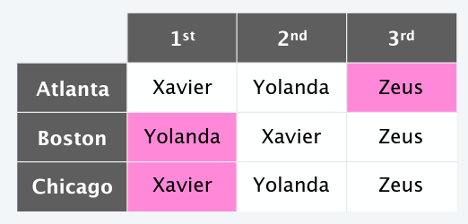
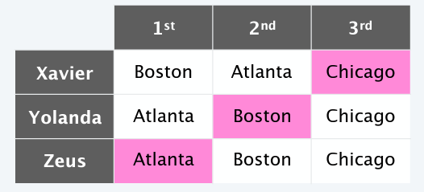

Example

Slide 12
A
10
M
5
16
B
N
10
Min weight perfect matching: $\{A−M, B−N\}$cost: 20

Slide 13

Complexity
Finding the maximum matching (i.e., the maximum number of edges we can put together) or finding a min weight perfect matching are problems that can be solved in polynomial time
Typical $O\left(n^{2}\right) or O\left(n^{3}\right)$
But, with preference lists given, we can get a faster algorithm

Slide 14
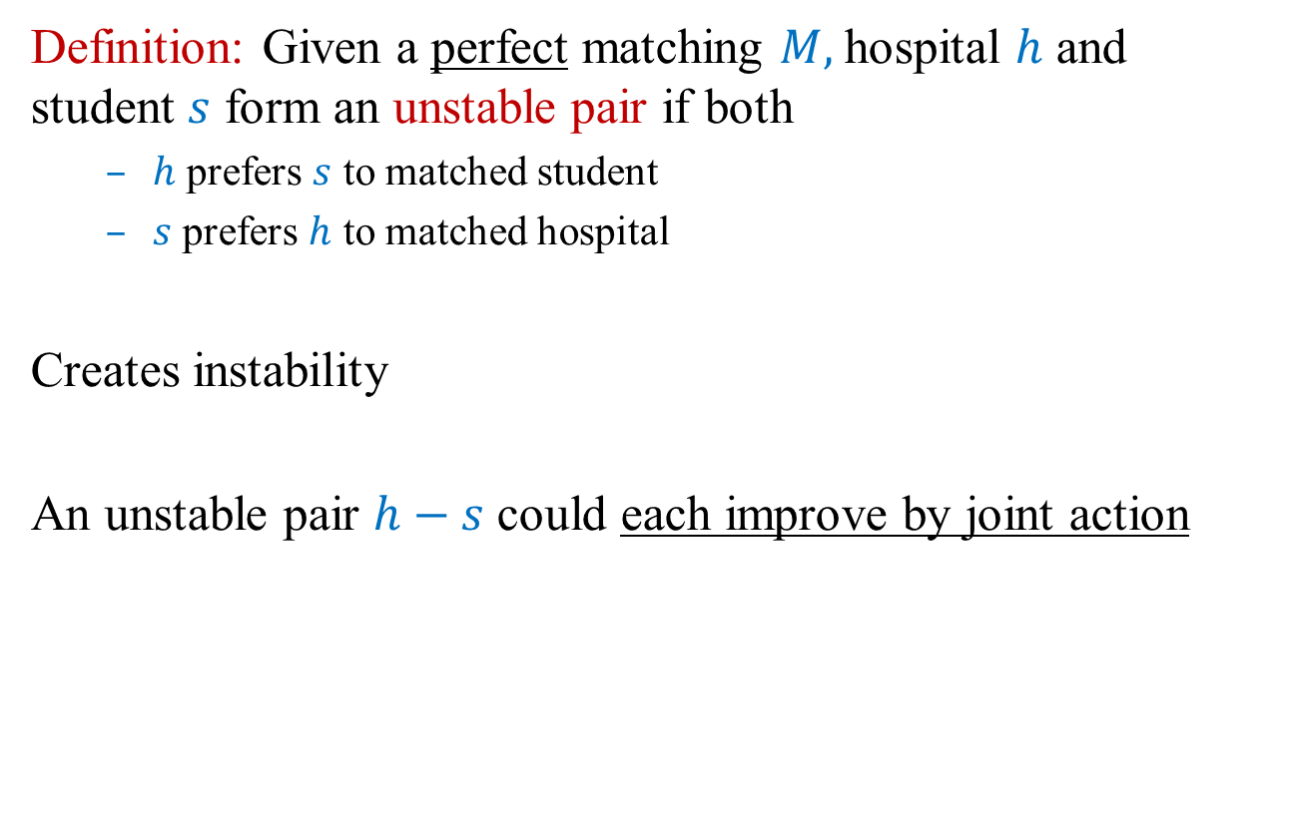
Unstable / rogue pair
Definition: Given a perfect matching $M,$hospital $h$ and student $s$ form an unstable pair if both
$h$ prefers $s$ to matched student
$s$ prefers $h$ to matched hospital
Creates instability
An unstable pair $h−s$ could each improve by joint action

Slide 15
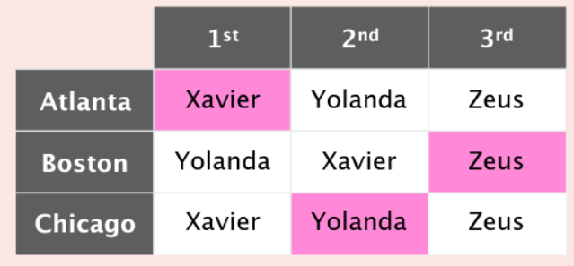
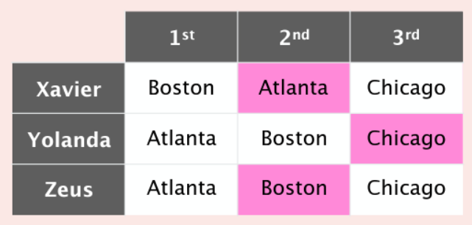
Quiz
Which pair is unstable in matching $\{A−X, B−Z, C−Y\}$?

Slide 16
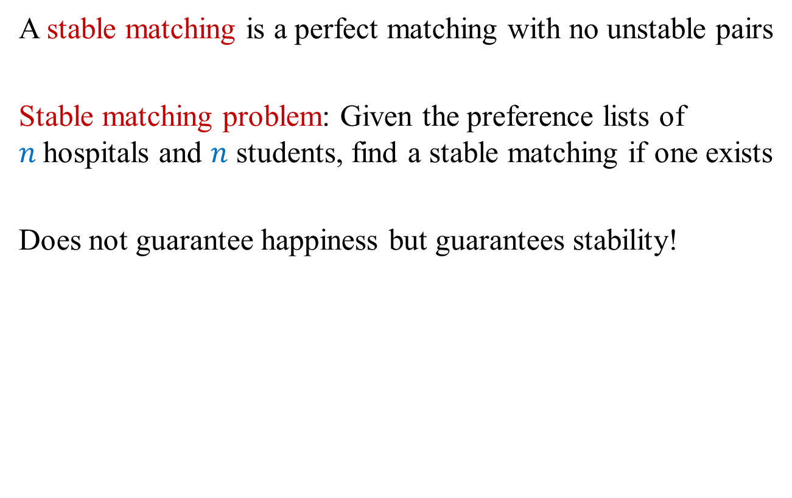
Stable matching / marriage problem
A stable matching is a perfect matching with no unstable pairs
Stable matching problem: Given the preference lists of $n$hospitals and $n$ students, find a stable matching if one exists
Does not guarantee happiness but guarantees stability!

Slide 17
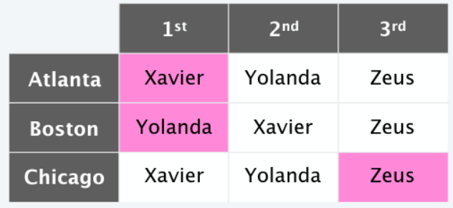
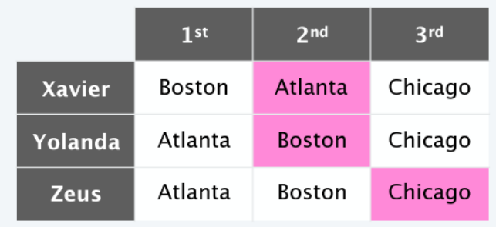
Example

Slide 18
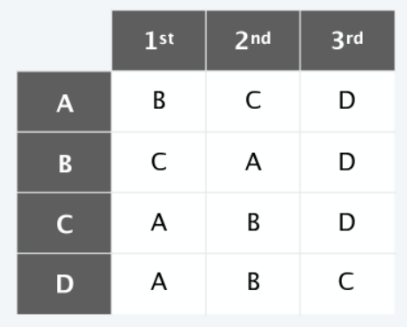
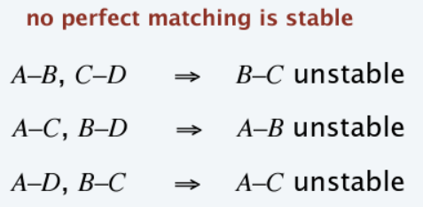
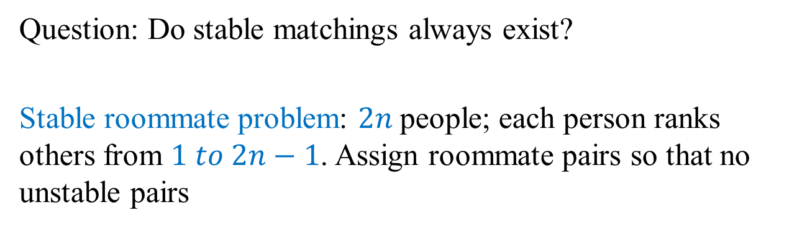
Stable roommate problem
Question: Do stable matchings always exist?
Stable roommate problem: $2n$people; each person ranks others from $1 to 2n−1$. Assign roommate pairs so that no unstable pairs
Stable matchings need not exist!

Slide 19
Greedy?
A-X
B-Y
C-Z
Stable matching!!!

Slide 20
Greedy?
1 | C | B | E | A | D
2 | A | B | E | C | D
3 | D | C | B | A | E
4 | A | C | D | B | E
5 | A | B | D | E | C
A | 3 | 5 | 2 | 1 | 4
B | 5 | 2 | 1 | 4 | 3
C | 4 | 3 | 5 | 1 | 2
D | 1 | 2 | 3 | 4 | 5
E | 2 | 3 | 4 | 1 | 5
1-C
2-A
3-D
4-B
5-E
4-C form a rogue pair!!!

Slide 21
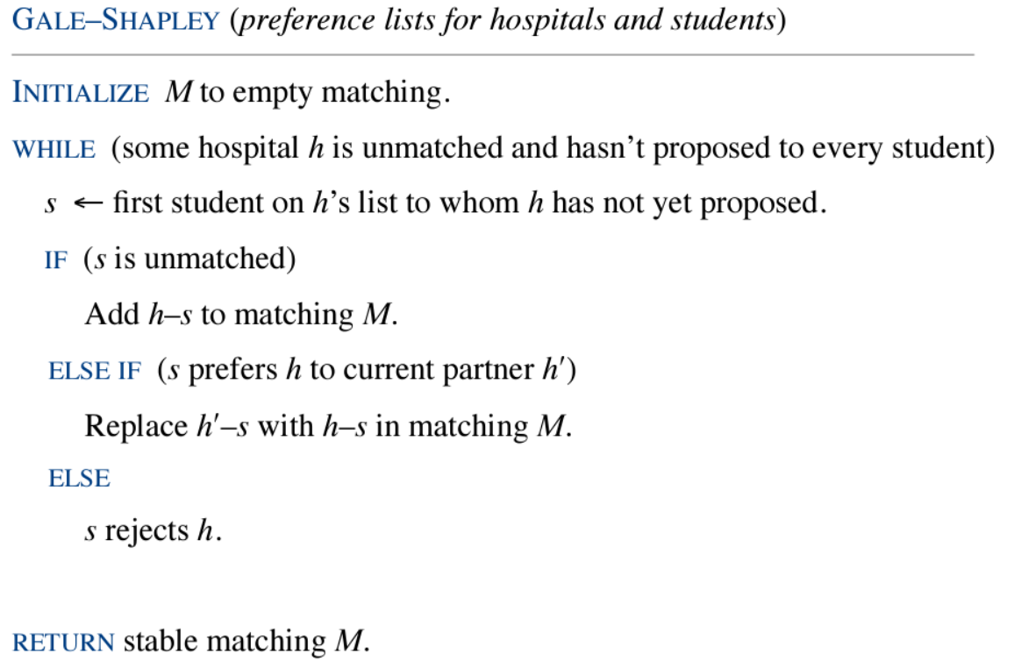
Gale-Shapley deferred acceptance algorithm
Guarantees to find a stable matching, if one exists

Slide 22
Example
1 | C | B | E | A | D
2 | A | B | E | C | D
3 | D | C | B | A | E
4 | A | C | D | B | E
5 | A | B | D | E | C
A | 3 | 5 | 2 | 1 | 4
B | 5 | 2 | 1 | 4 | 3
C | 4 | 3 | 5 | 1 | 2
D | 1 | 2 | 3 | 4 | 5
E | 2 | 3 | 4 | 1 | 5
Student | Iter1 | Iter2 | Iter3 | Iter4
A | {2, 4, 5}
B | {}
C | {1}
D | {3}
E | {}
1
2
3
4
5
Crossouts for
hospitals

Slide 23
Example
1 | C | B | E | A | D
2 | A | B | E | C | D
3 | D | C | B | A | E
4 | A | C | D | B | E
5 | A | B | D | E | C
A | 3 | 5 | 2 | 1 | 4
B | 5 | 2 | 1 | 4 | 3
C | 4 | 3 | 5 | 1 | 2
D | 1 | 2 | 3 | 4 | 5
E | 2 | 3 | 4 | 1 | 5
Student | Iter1 | Iter2 | Iter3 | Iter4
A | {5} | {5}
B | {} | {2}
C | {1} | {1, 4}
D | {3} | {3}
E | {} | {}
1 | Iter1
2 | A
3
4 | A
5
Crossouts for
hospitals

Slide 24
Example
1 | C | B | E | A | D
2 | A | B | E | C | D
3 | D | C | B | A | E
4 | A | C | D | B | E
5 | A | B | D | E | C
A | 3 | 5 | 2 | 1 | 4
B | 5 | 2 | 1 | 4 | 3
C | 4 | 3 | 5 | 1 | 2
D | 1 | 2 | 3 | 4 | 5
E | 2 | 3 | 4 | 1 | 5
Student | Iter1 | Iter2 | Iter3 | Iter4
A | {5} | {5} | {5}
B | {} | {2} | {2, 1}
C | {1} | {4} | {4}
D | {3} | {3} | {3}
E | {} | {} | {}
Hospital | Iter1 | Iter2 | Iter3 | Iter4
1 |  | C
2 | A
3
4 | A
5
Crossouts for
hospitals

Slide 25
Example
1 | C | B | E | A | D
2 | A | B | E | C | D
3 | D | C | B | A | E
4 | A | C | D | B | E
5 | A | B | D | E | C
A | 3 | 5 | 2 | 1 | 4
B | 5 | 2 | 1 | 4 | 3
C | 4 | 3 | 5 | 1 | 2
D | 1 | 2 | 3 | 4 | 5
E | 2 | 3 | 4 | 1 | 5
Student | Iter1 | Iter2 | Iter3 | Iter4
A | {5} | {5} | {5} | {5}
B | {} | {2} | {2} | {2}
C | {1} | {4} | {4} | {4}
D | {3} | {3} | {3} | {3}
E | {} | {} | {} | {1}
Hospital | Iter1 | Iter2 | Iter3 | Iter4
1 |  | C | B
2 | A
3
4 | A
5
Crossouts for
hospitals

Slide 26
Example
1 | C | B | E | A | D
2 | A | B | E | C | D
3 | D | C | B | A | E
4 | A | C | D | B | E
5 | A | B | D | E | C
A | 3 | 5 | 2 | 1 | 4
B | 5 | 2 | 1 | 4 | 3
C | 4 | 3 | 5 | 1 | 2
D | 1 | 2 | 3 | 4 | 5
E | 2 | 3 | 4 | 1 | 5
Student | Iter1 | Iter2 | Iter3 | Iter4
A | {5} | {5} | {5} | {5}
B | {} | {2} | {2} | {2}
C | {1} | {4} | {4} | {4}
D | {3} | {3} | {3} | {3}
E | {} | {} | {} | {1}
Any rogue couples?
1-C, 1-B?
2-A?
4-A?
Stable matching
5-A
2-B
4-C
3-D
1-E

Slide 27
What facts do we need to prove?
Termination (runs quickly)
Produces a perfect matching
No rogue couples
Fairness

Slide 28
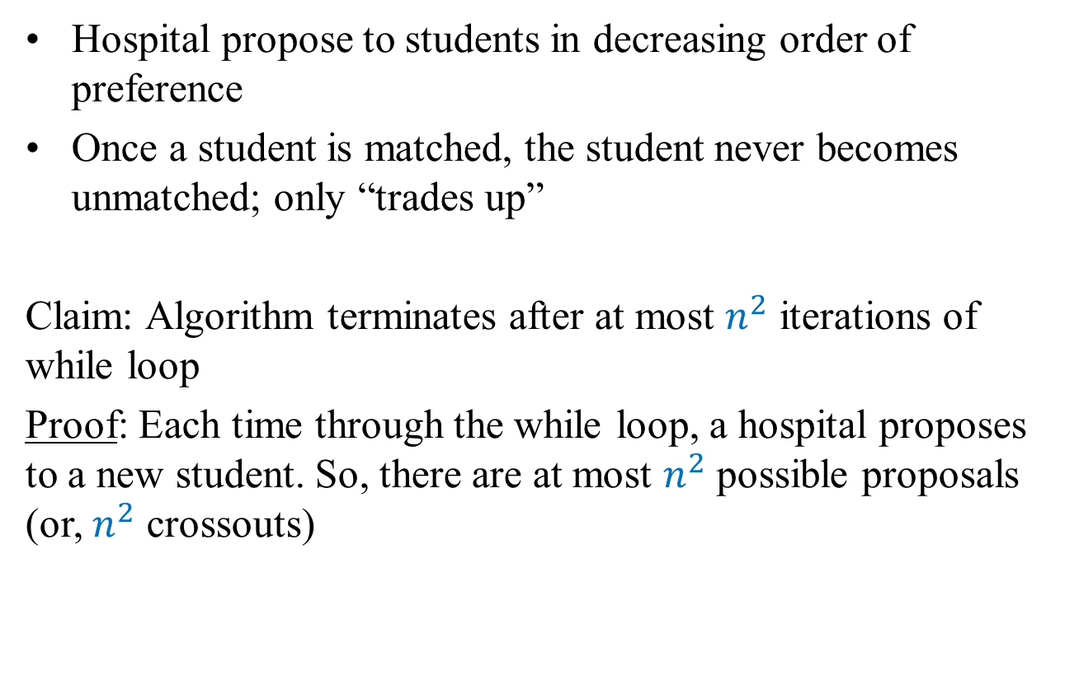
Proof of correctness: Termination
Hospital propose to students in decreasing order of preference
Once a student is matched, the student never becomes unmatched; only “trades up”
Claim: Algorithm terminates after at most $n^{2}$ iterations of while loop
Proof: Each time through the while loop, a hospital proposes to a new student. So, there are at most $n^{2}$ possible proposals (or, $n^{2}$ crossouts)

Slide 29
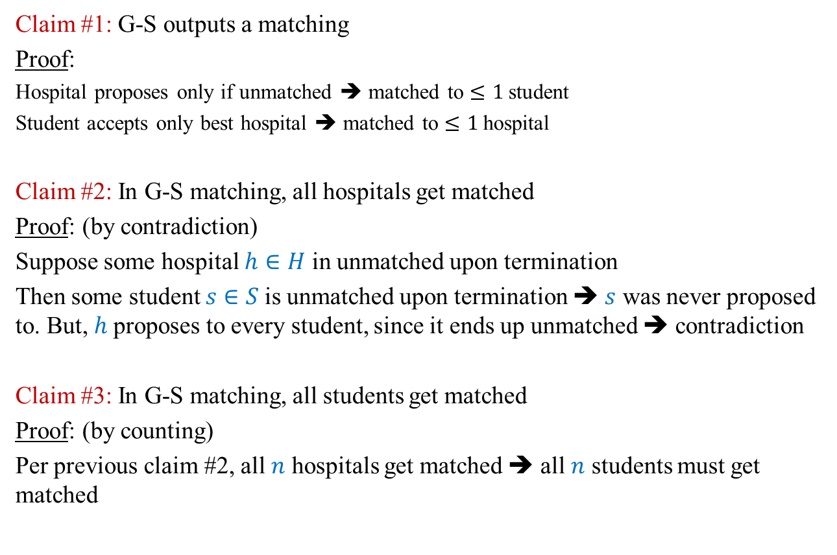
Proof of correctness: perfect matching
Claim #1: G-S outputs a matching
Proof:
Hospital proposes only if unmatched ➔ matched to $≤1$student
Student accepts only best hospital ➔ matched to $≤1$hospital
Claim #2: In G-S matching, all hospitals get matched
Proof: (by contradiction)
Suppose some hospital $h∈H$ in unmatched upon termination
Then some student $s∈S$is unmatched upon termination ➔ $s$ was never proposed to. But, $h$proposes to every student, since it ends up unmatched ➔ contradiction
Claim #3: In G-S matching, all students get matched
Proof: (by counting)
Per previous claim #2, all $n$ hospitals get matched ➔ all $n$ students must get matched

Slide 30
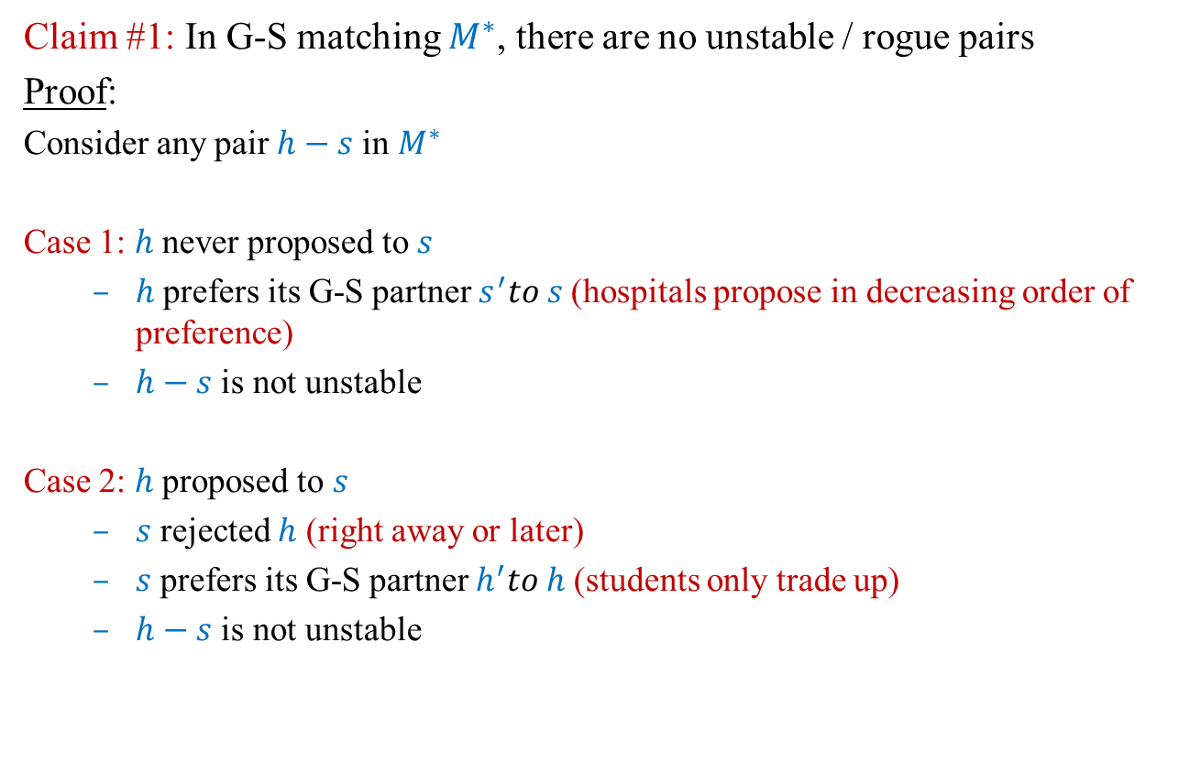
Proof of correctness: stable matching
Claim #1: In G-S matching $M^{∗}$, there are no unstable / rogue pairs
Proof:
Consider any pair $h−s$in $M^{∗}$
Case 1: $h$ never proposed to $s$
$h$ prefers its G-S partner $s^{′}to s$(hospitals propose in decreasing order of preference)
$h−s$ is not unstable
Case 2: $h$ proposed to $s$
$s$ rejected $h$ (right away or later)
$s$ prefers its G-S partner $h^{′}to h$(students only trade up)
$h−s$ is not unstable

Slide 31
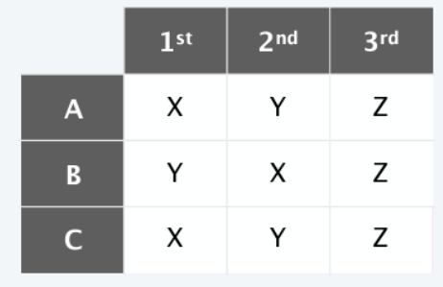
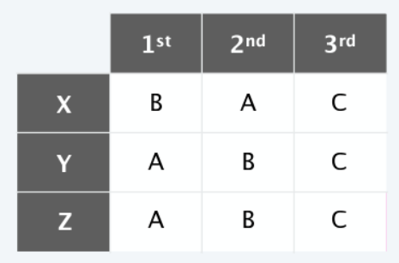
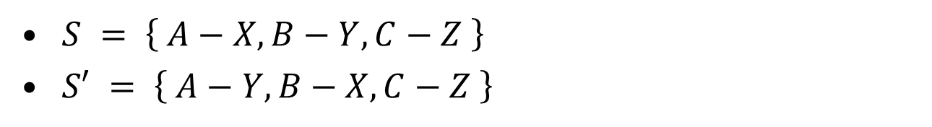
Fairness
For a given problem instance, there may be several stable matchings but G-S gives one unique matching
$S = \left\{ A−X, B−Y, C−Z \right\}$
$S′ = \left\{ A−Y, B−X, C−Z \right\}$

Slide 32
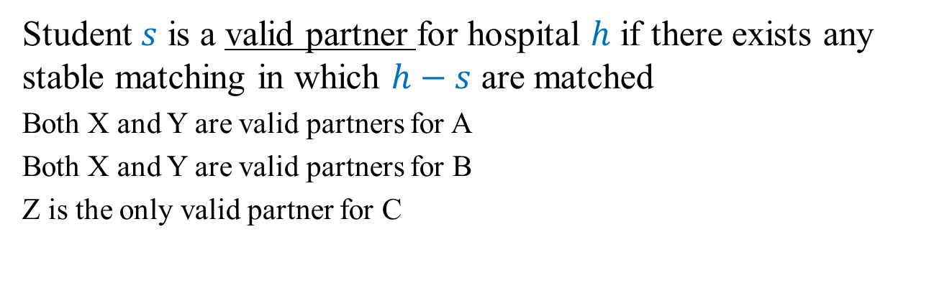
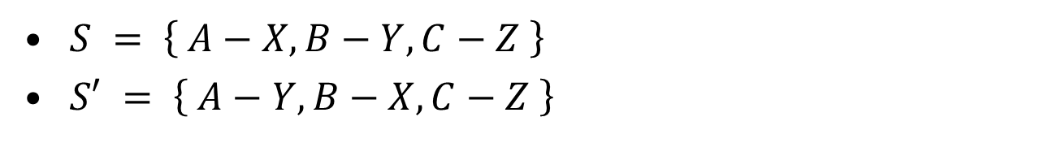
Fairness
Student $s$ is a valid partner for hospital $h$ if there exists any stable matching in which $h−s$ are matched
Both X and Y are valid partners for A
Both X and Y are valid partners for B
Z is the only valid partner for C
$S = \left\{ A−X, B−Y, C−Z \right\}$
$S′ = \left\{ A−Y, B−X, C−Z \right\}$

Slide 33
Fairness
Hospital-optimal assignment.
Each hospital receives best valid partner
Is it a perfect matching?
Is it stable?
Claim: All executions of Gale-Shapley yield hospital-optimal assignment
Corollary. Hospital-optimal assignment is a stable matching

Slide 34
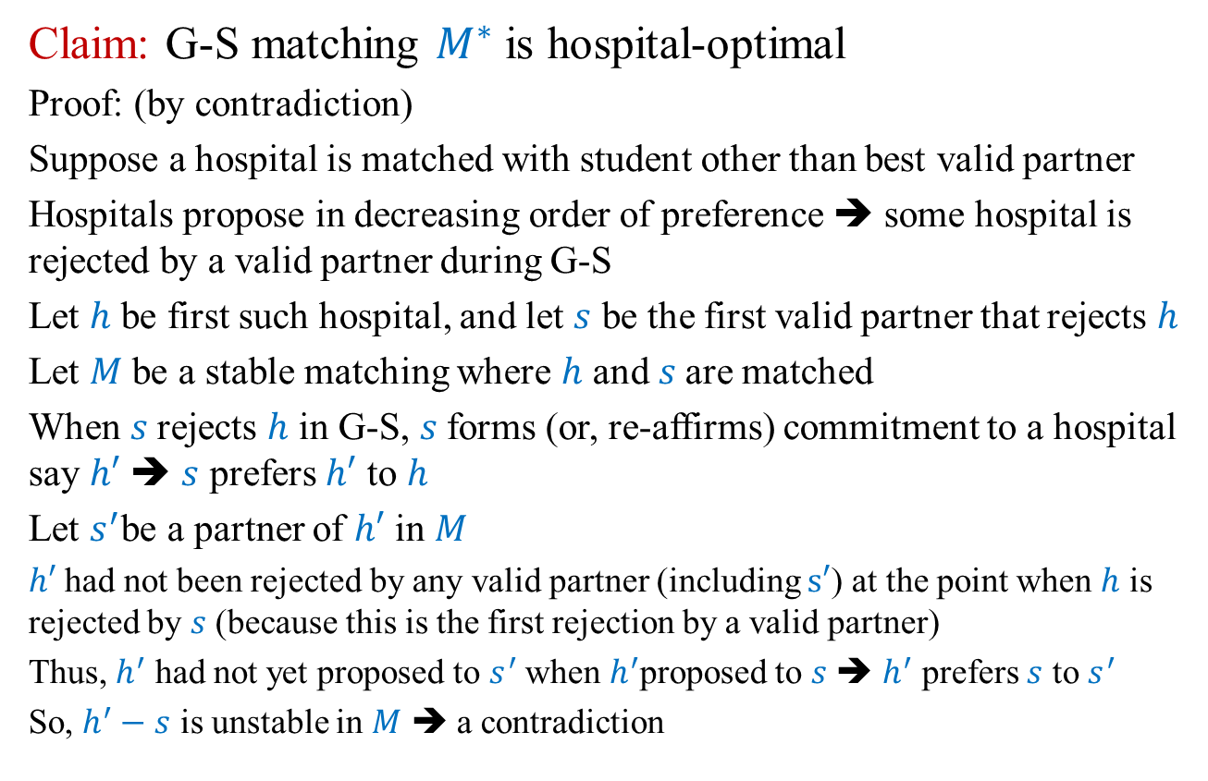
Fairness: Hospital Optimality
Claim: G-S matching $M^{∗}$ is hospital-optimal
Proof: (by contradiction)
Suppose a hospital is matched with student other than best valid partner
Hospitals propose in decreasing order of preference ➔ some hospital is rejected by a valid partner during G-S
Let $h$ be first such hospital, and let $s$ be the first valid partner that rejects $h$
Let $M$ be a stable matching where $h$ and $s$are matched
When $s$rejects $h$ in G-S, $s$forms (or, re-affirms) commitment to a hospital say $h′$ ➔ $s$ prefers $h′$ to $h$
Let $s^{′}$be a partner of $h′$ in $M$
$h′$ had not been rejected by any valid partner (including $s′$) at the point when $h$ is rejected by $s$ (because this is the first rejection by a valid partner)
Thus, $h^{′}$ had not yet proposed to $s^{′}$ when $h^{′}$proposed to $s$ ➔ $h^{′}$ prefers $s$ to $s^{′}$
So, $h^{′}−s$ is unstable in $M$ ➔ a contradiction

Slide 35
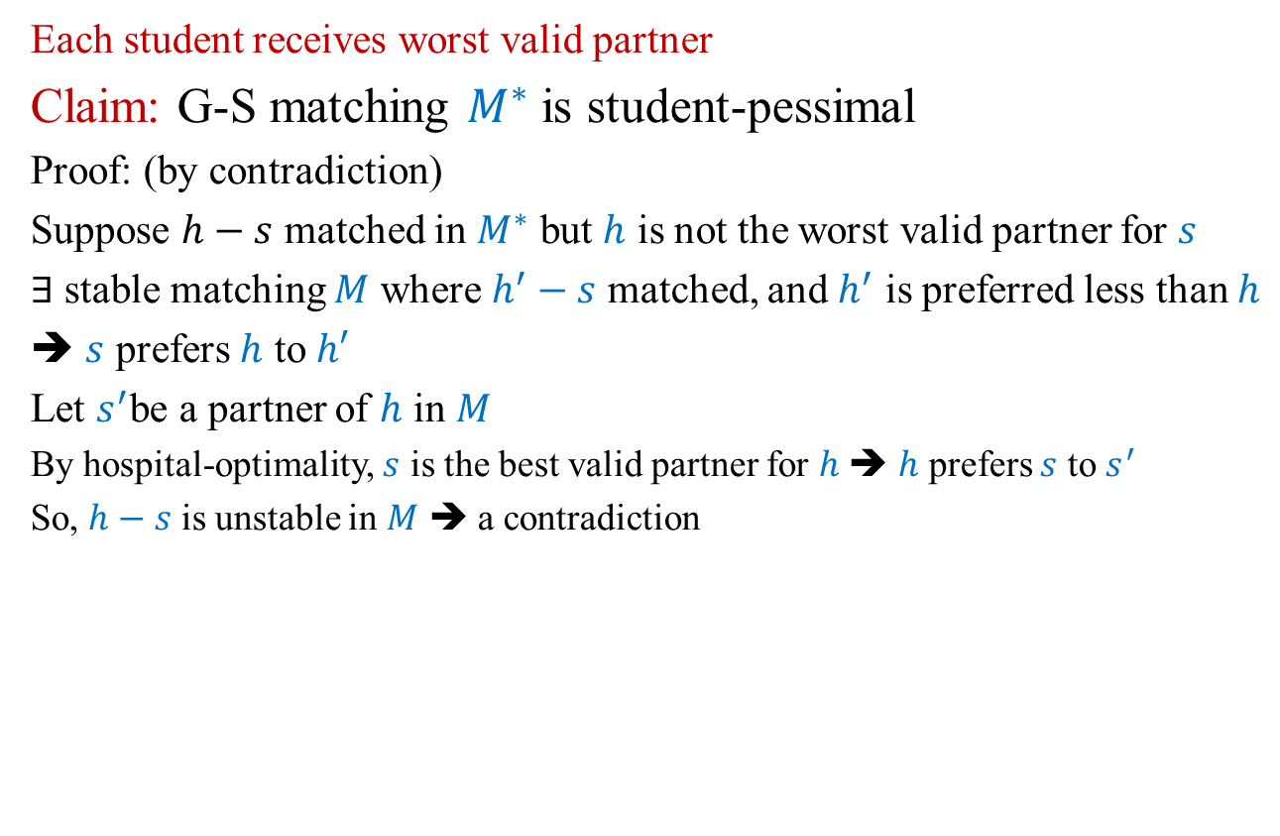
Fairness: Student Pessimality
Each student receives worst valid partner
Claim: G-S matching $M^{∗}$ is student-pessimal
Proof: (by contradiction)
Suppose $h−s$ matched in $M^{∗}$ but $h$ is not the worst valid partner for $s$
$∃$stable matching $M$ where $h^{′}−s$ matched, and $h^{′}$ is preferred less than $h$
➔ $s$ prefers $h$ to $h′$
Let $s^{′}$be a partner of $h$ in $M$
By hospital-optimality, $s$ is the best valid partner for $h$ ➔ $h$ prefers $s$ to $s^{′}$
So, $h−s$ is unstable in $M$ ➔ a contradiction

Slide 36
Lecture 12 Summary
Stable matching

