Slide 1
Design and Analysis of Algorithms
Sid Nath (snath@scu.edu)
Lecture 13
Nov 7, 2022

Slide 2
Agenda
Administrative
Linear programming

Slide 3
Administrative
HW5 announced
Lec 11-16; due end of Week 10
Thanksgiving week plans… Nov 23 no class
Finals details announced
Part 1 (take-home, 6hrs, 4-5 algo design questions)
Only typed answers. Develop your Word / LaTeX templates NOW!!!
Sun Dec 4, 2022 2p-8p?
Part 2 (in-class)

Slide 4
Linear Programming (LP)
Tool for optimal allocation of scarce resources
Optimization is subject to “compatibility constraints”
Powerful and general problem-solving method
Shortest paths, max flows, min-cost flows, MST, matching, zero-sum games, ….
Significance and practice
Among the most important scientific advances of the 20th century
Dominates industrial practice (Delta airlines $100M/year benefit from use of LP)
Commercial solvers (CPLEX, scikit, Matlab, COIN, OSL, Gurobi), modeling languages (AMPL)
General tool to attack intractable (NP-hard) optimization problems

Slide 5
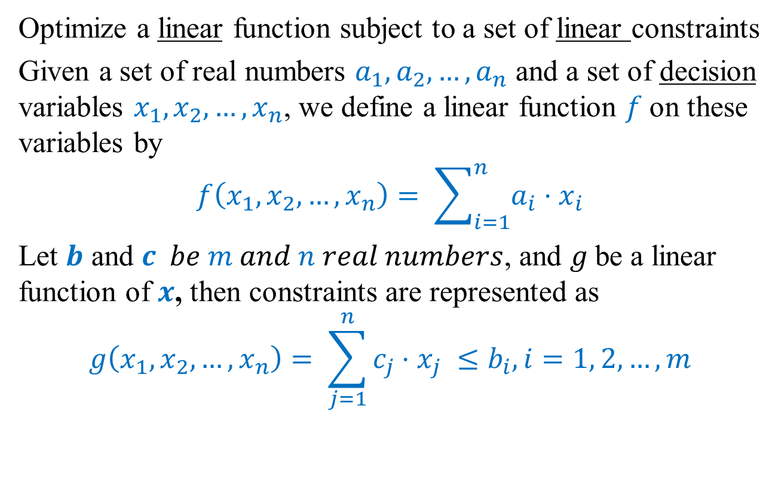
General form of LPs
Optimize a linear function subject to a set of linear constraints
Given a set of real numbers $a_{1}, a_{2},…, a_{n}$ and a set of decision variables $x_{1}, x_{2},…, x_{n}$, we define a linear function $f$on these variables by
$$f\left(x_{1}, x_{2},…, x_{n}\right)= \sum_{i=1}^{n}{a_{i}⋅x_{i}}$$
Let $b$ and $c be m and n real numbers$, and $g$be a linear function of $x$, then constraints are represented as
$$g\left(x_{1},x_{2},…, x_{n}\right)= \sum_{j=1}^{n}{c_{j}⋅x_{j} }≤b_{i}, i=1, 2, …, m$$

Slide 6
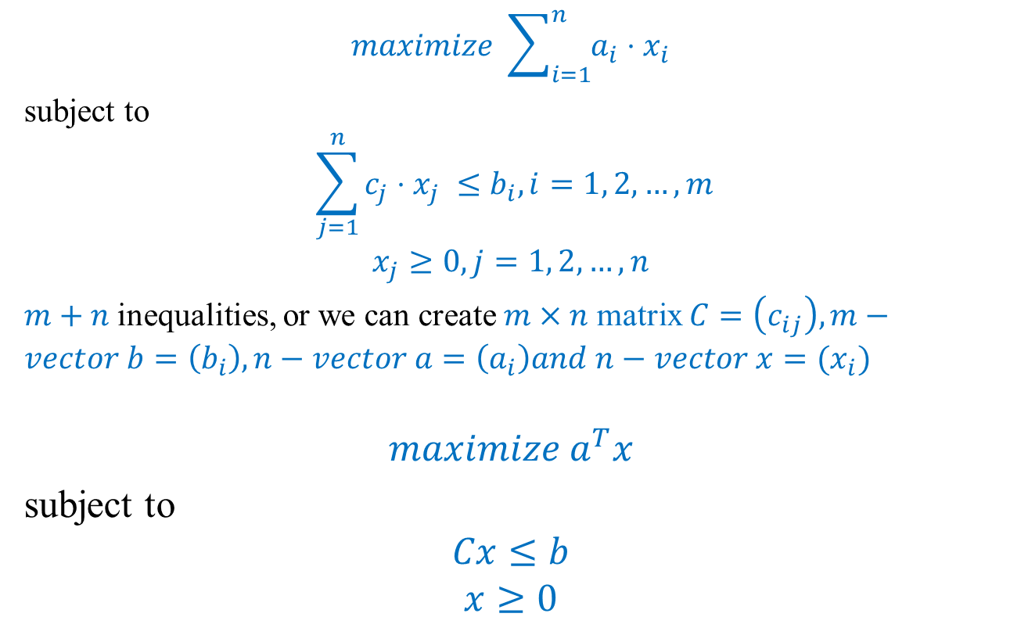
General form of LPs
$$maximize \sum_{i=1}^{n}{a_{i}⋅x_{i}}$$
subject to
$$\sum_{j=1}^{n}{c_{j}⋅x_{j} }≤b_{i}, i=1, 2, …, m$$
$$x_{j}≥0, j=1, 2, …, n$$
$m+n$inequalities, or we can create $m×n$ matrix $C=\left(c_{ij}\right), m−vector b=\left(b_{i}\right), n−vector a=\left(a_{i}\right)and n−vector x=(x_{i})$
$$maximize a^{T}x$$
subject to
$$Cx≤b$$
$$x≥0$$
Objective function
Constraints
Obj func as inner product of two vectors

Slide 7
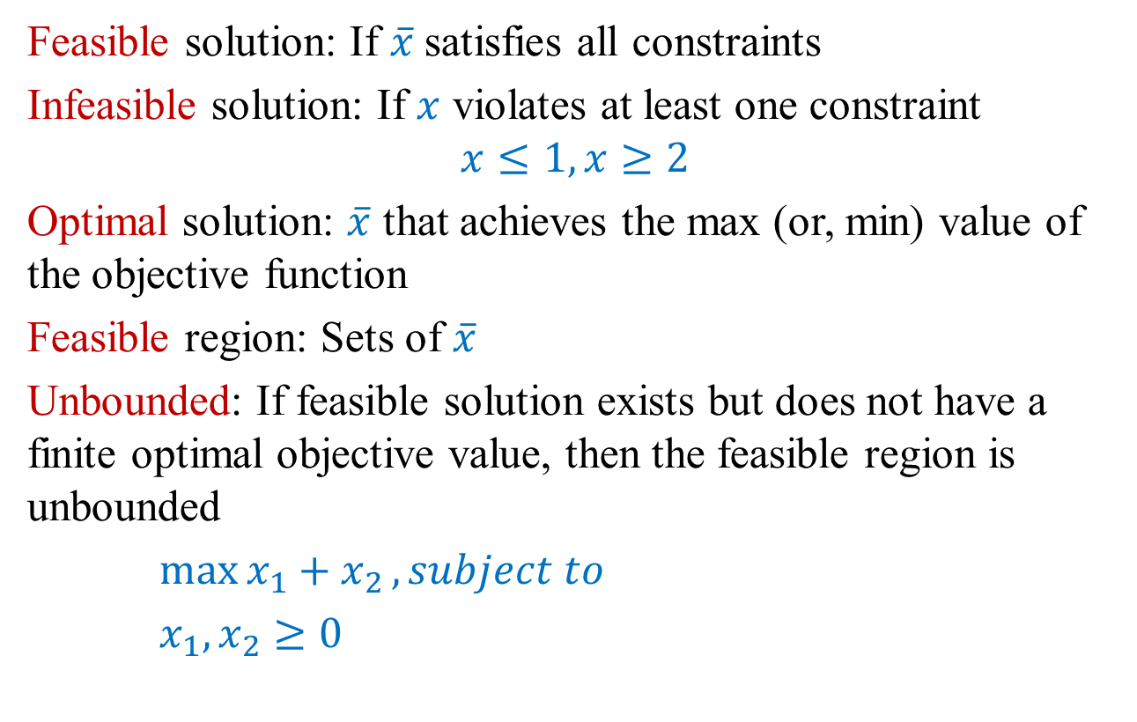
Terminologies
Feasible solution: If $\overline{x}$satisfies all constraints
Infeasible solution: If $x$ violates at least one constraint
$$x≤1, x≥2$$
Optimal solution: $\overline{x}$ that achieves the max (or, min) value of the objective function
Feasible region: Sets of $\overline{x}$
Unbounded: If feasible solution exists but does not have a finite optimal objective value, then the feasible region is unbounded
$\max{x_{1}+x_{2}}, subject to$
$x_{1},x_{2}≥0$

Slide 8
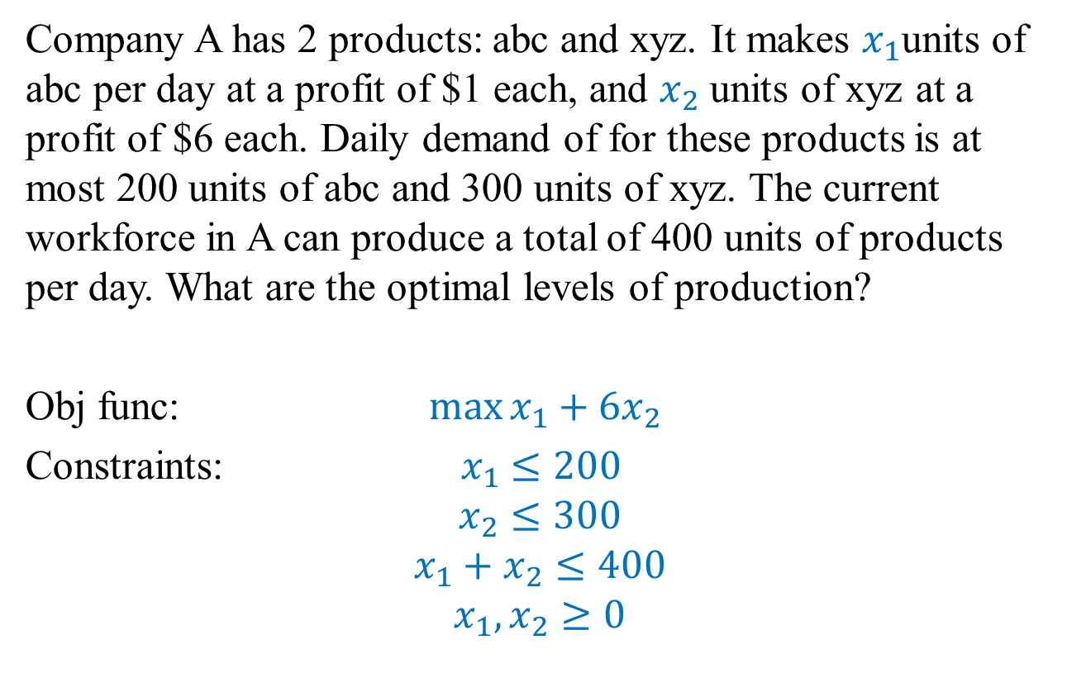
Example
Company A has 2 products: abc and xyz. It makes $x_{1}$units of abc per day at a profit of $1 each, and $x_{2}$ units of xyz at a profit of $6 each. Daily demand of for these products is at most 200 units of abc and 300 units of xyz. The current workforce in A can produce a total of 400 units of products per day. What are the optimal levels of production?
Obj func: $\max{x_{1}+6x_{2}}$
Constraints: ${ x}_{1} ≤200$
$$x_{2}≤300$$
$${x_{1}+x}_{2}≤400$$
$$x_{1},x_{2}≥0$$

Slide 9
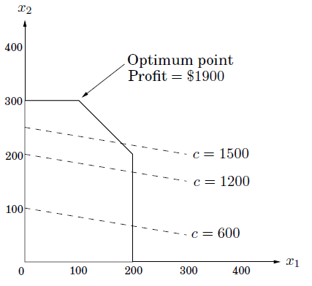
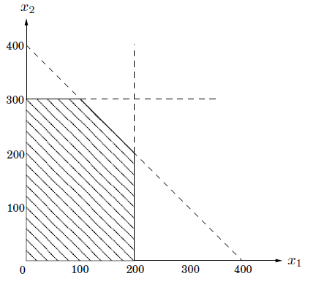
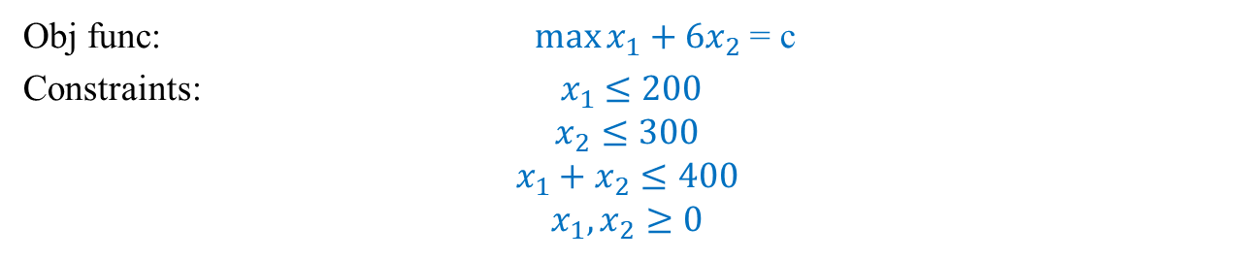
Example
Obj func: $\max{x_{1}+6x_{2}}$ = c
Constraints: ${ x}_{1} ≤200$
$$x_{2}≤300$$
$${x_{1}+x}_{2}≤400$$
$$x_{1},x_{2}≥0$$
Feasible region =
area common to all constraints
Contour lines of c , slope = -1/6

Slide 10
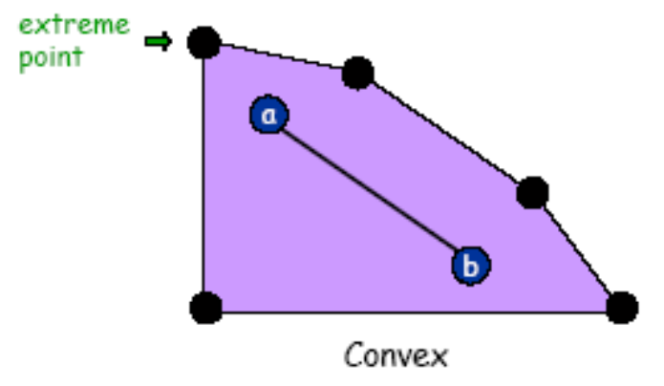
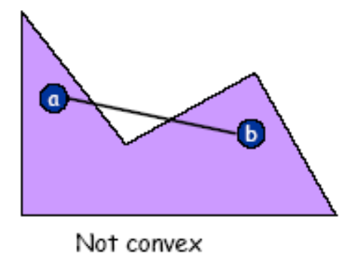
Geometry: Concave, Convex, Linear
Inequalities include halfspaces with respect to hyperplanes
Bounded feasible region: convex polygon (or, polytope)
Feasible region = convex set: if a, b feasible, so is (a+b)/2
Extreme point: feasible solution x that cannot be written as (a+b)/2 for two distinct feasible solutions a and b

Slide 11
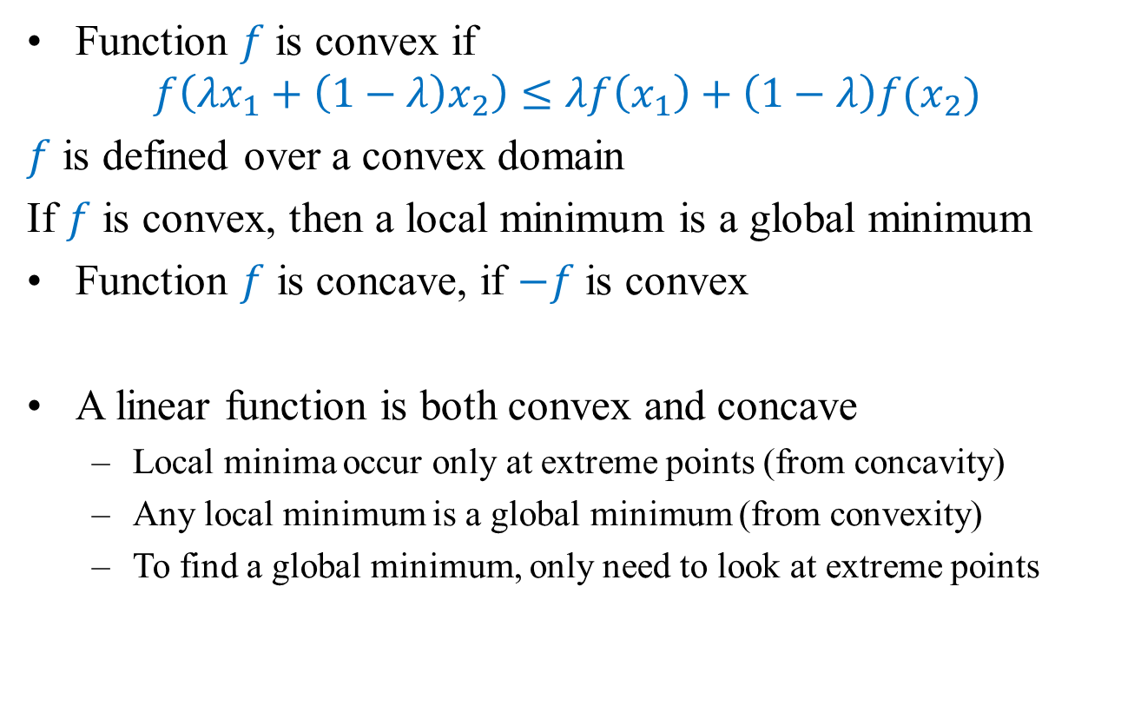
Convex, Concave, Linear
Function $f$is convex if
$$f\left(λx_{1}+\left(1−λ\right)x_{2}\right)≤λf\left(x_{1}\right)+\left(1−λ\right)f(x_{2})$$
$f$ is defined over a convex domain
If $f$ is convex, then a local minimum is a global minimum
Function $f$ is concave, if $−f$ is convex
A linear function is both convex and concave
Local minima occur only at extreme points (from concavity)
Any local minimum is a global minimum (from convexity)
To find a global minimum, only need to look at extreme points

Slide 12
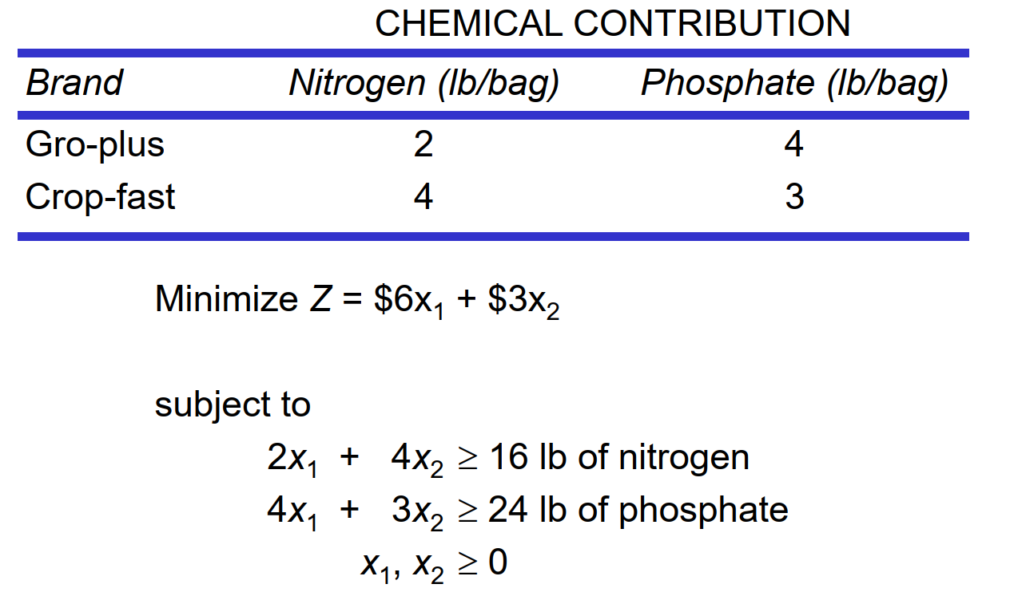
Example

Slide 13
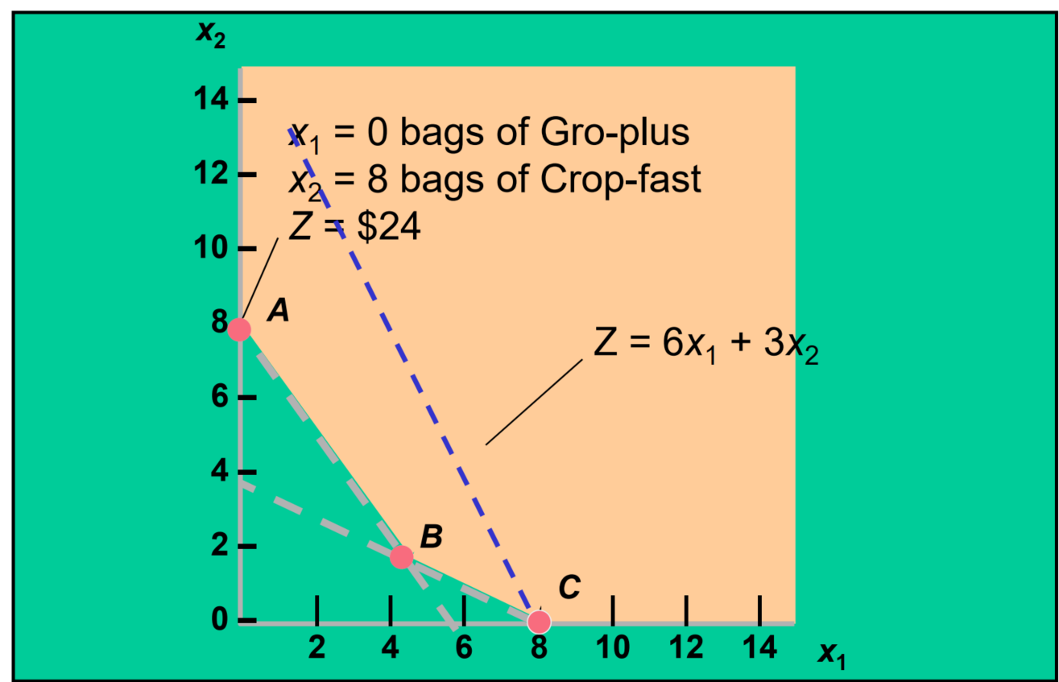
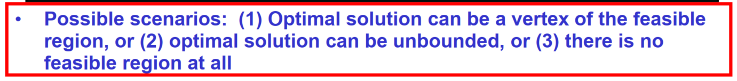
Geometric Interpretation

Slide 14
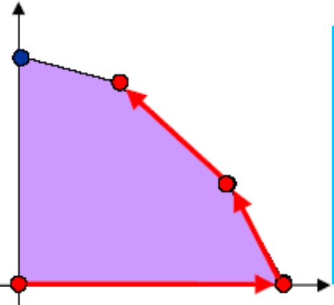
Simplex Method
Invented by George Dantzig in 1947
Developed shortly after WWII in response to logistics challenges
User for 1948 Berlin airlift
Objective function is linear, and feasible region is convex → use a greedy strategy (hill-climbing)
Start at an extreme point
“Pivot” from one extreme point to a neighboring one
Never worsen the objective function in doing so
Stop when the current extreme point is a local optimum

Slide 15
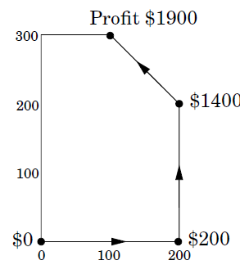
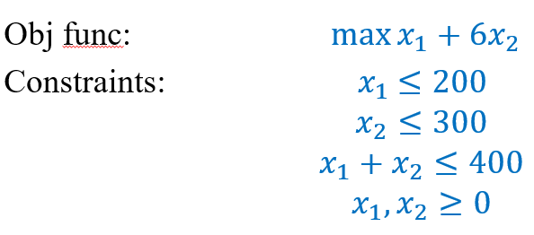
Simplex Method
Objective function is linear, and feasible region is convex → use a greedy strategy (hill-climbing)
Start at an extreme point
“Pivot” from one extreme point to a neighboring one
Never worsen the objective function in doing so
Stop when the current extreme point is a local optimum

Slide 16
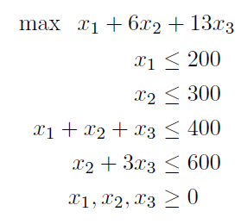
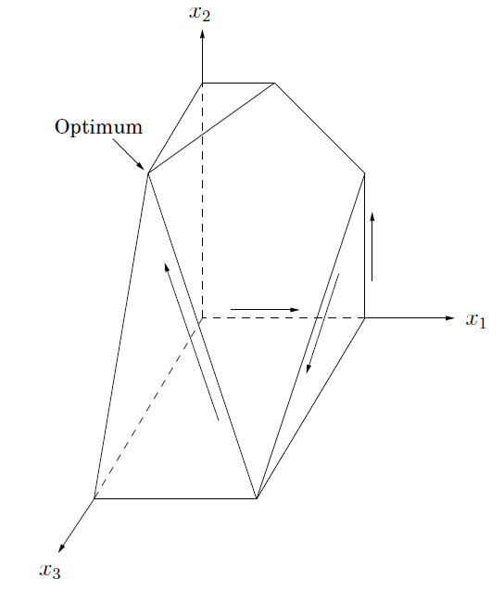
More Products
Company A adds new product pqr that will bring a profit of $13 per unit sold.
Feasible region = polyhedron, 7 half-spaces

Slide 17
Optimal solution?
Optimal vertex (0, 300, 100) with total profit $3100
Simplex: moves along edges of polyhedron
Possible trajectory
(0, 0, 0) → $0
(200, 0, 0) → $200
(200, 200, 0) → $1400
(200, 0, 200) → $2800
(0, 300, 100) → $3100

Slide 18
More products
Add 100 more products? → high-dimensional and hard to visualize
Simplex → quadratic, worst-case exponential
Others (polynomial time):
Ellipsoid
Interior-point

Slide 19
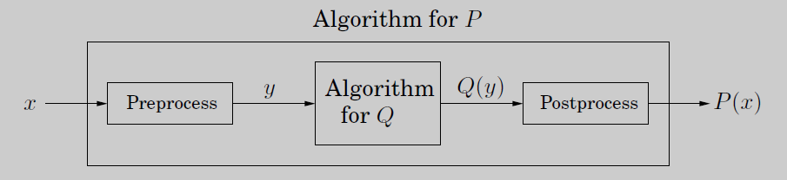
Reduction
Subroutine for a computational task may be general that it can be used to solve a variety of other tasks (may be unrelated)
If any subroutine for task Q can also be used to solve task P, we say P reduces to Q ➔ any instance x of P can be transformed into an instance y of Q such that P(x) can be deduced from Q(y)
We can use transformations of different types of LPs to reduce it to the standard / general form of LP

Slide 20
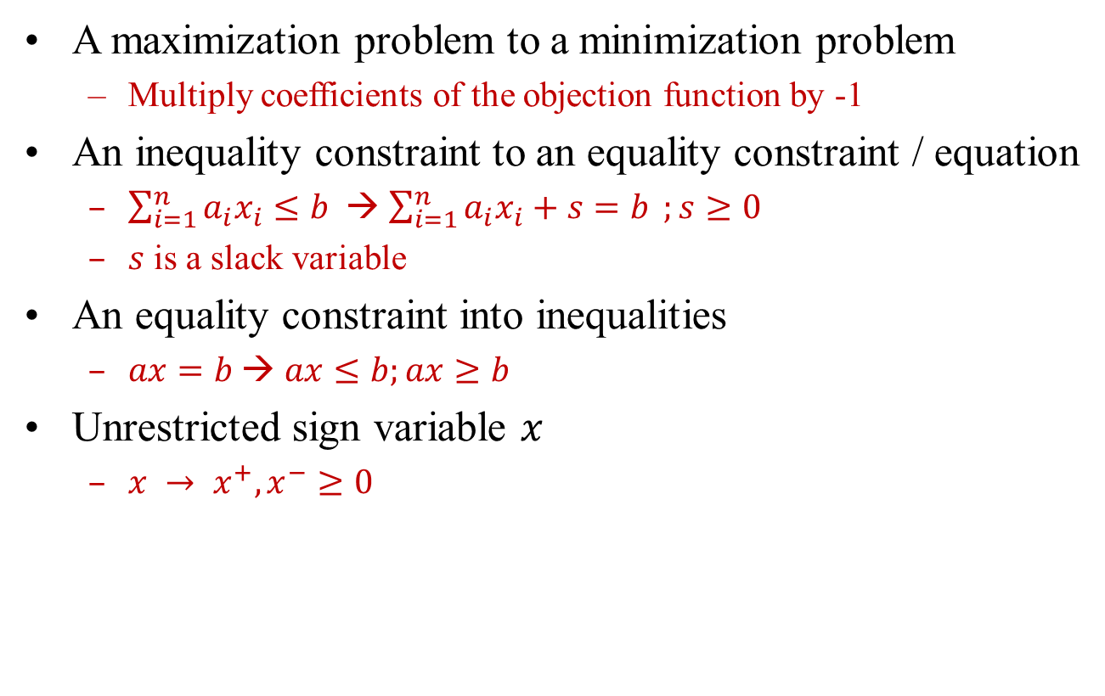
Common Transforms
A maximization problem to a minimization problem
Multiply coefficients of the objection function by -1
An inequality constraint to an equality constraint / equation
$\sum_{i=1}^{n}{a_{i}x_{i}≤b }$→ $\sum_{i=1}^{n}{a_{i}x_{i}+s=b };s≥0$
$s$ is a slack variable
An equality constraint into inequalities
$ax=b$→ $ax≤b;ax≥b$
Unrestricted sign variable $x$
$x → x^{+}, x^{−}≥0$

Slide 21
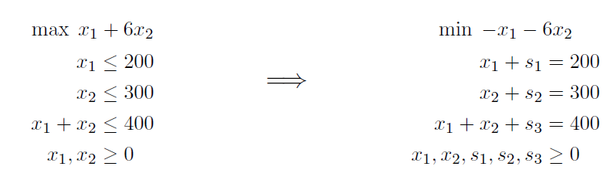
Example

Slide 22
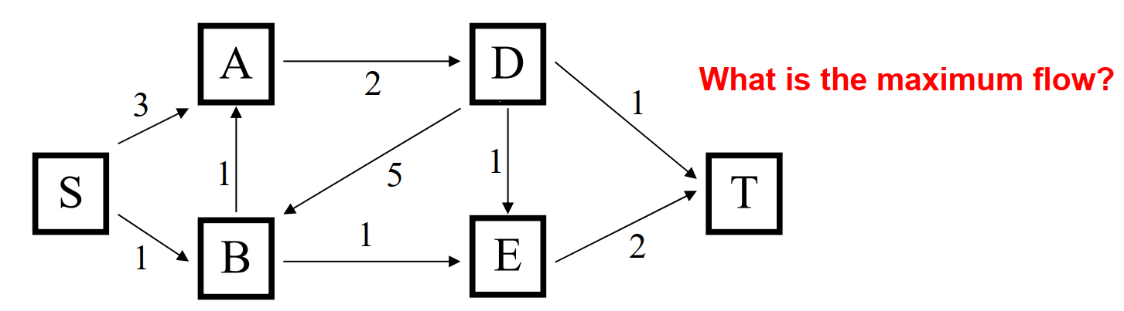
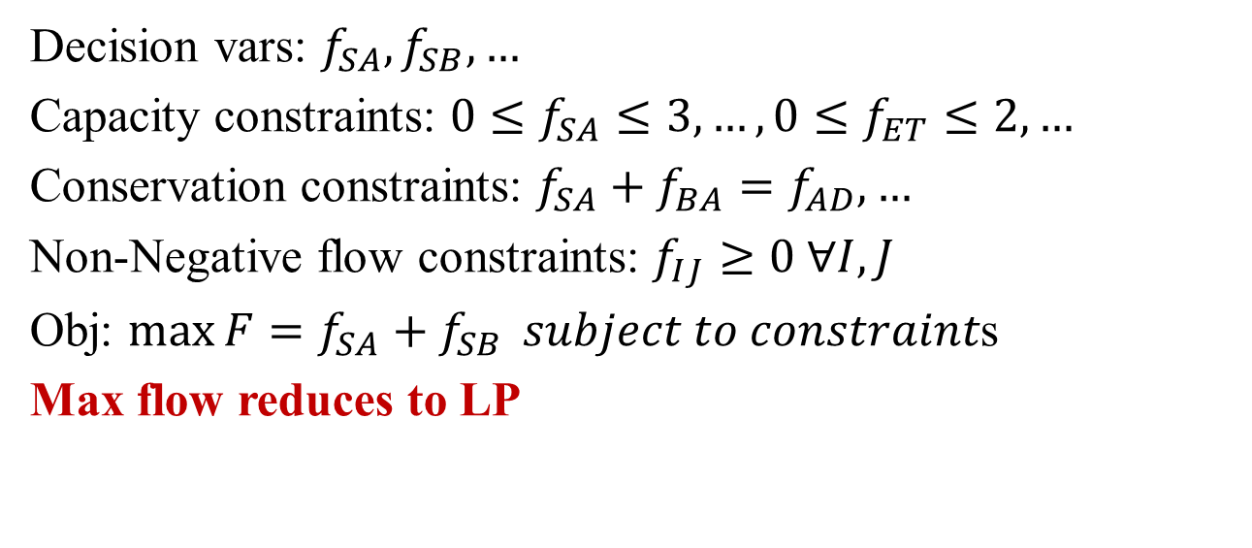
LP: Network Flows
Decision vars: $f_{SA}, f_{SB}, …$
Capacity constraints: $0≤f_{SA}≤3, …, 0≤f_{ET}≤2, …$
Conservation constraints: $f_{SA}+f_{BA}=f_{AD}, …$
Non-Negative flow constraints: $f_{IJ}≥0 ∀I,J$
Obj: $\max{F=f_{SA}+f_{SB}} subject to constraint$s
Max flow reduces to LP

Slide 23
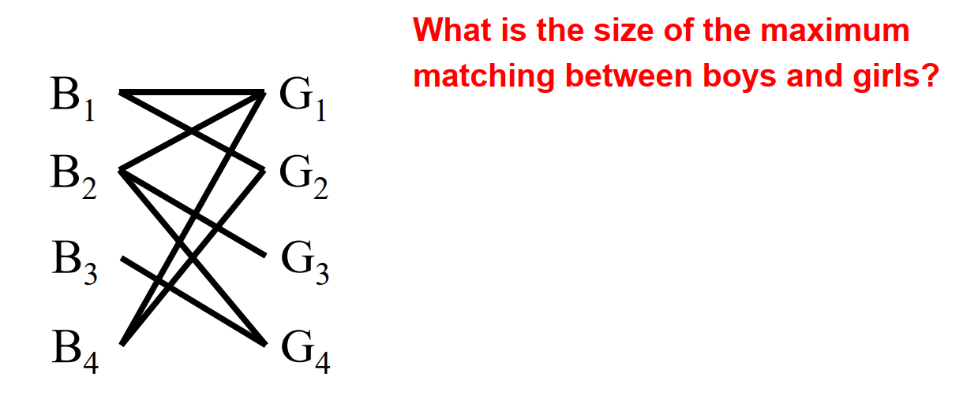
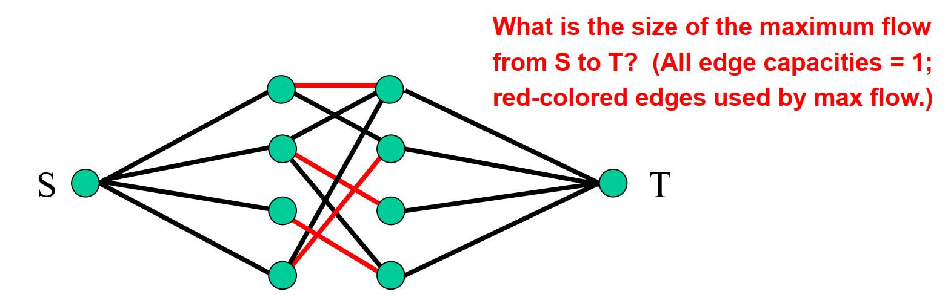
Matching Reduces to Max Flow
Matching reduces to max flow ➔ matching reduces to LP!

Slide 24
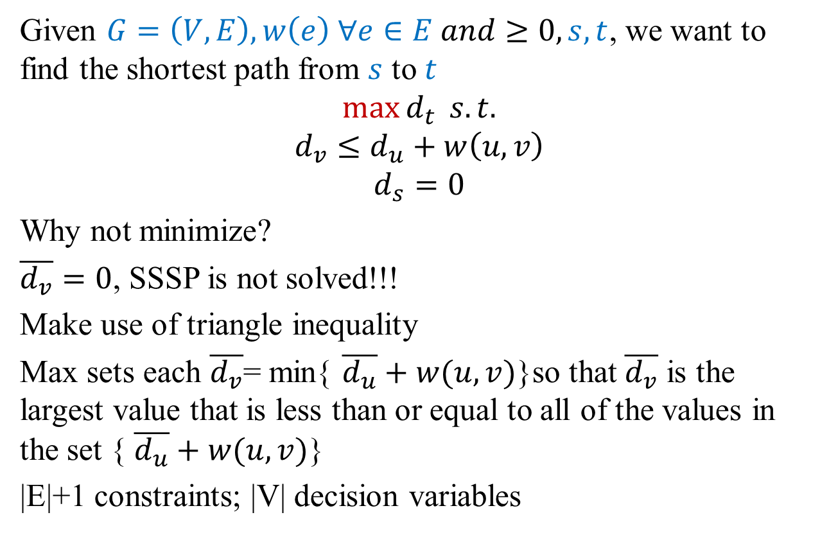
LP Example: Single Source Shortest Path
Given $G=\left(V,E\right), w\left(e\right) ∀e∈E and≥0, s, t$, we want to find the shortest path from $s$ to $t$
$$\max{d_{t}} s.t.$$
$$d_{v}≤d_{u}+w\left(u,v\right)$$
$$d_{s}=0$$
Why not minimize?
$\overline{d_{v}}=0$, SSSP is not solved!!!
Make use of triangle inequality
Max sets each $\overline{d_{v}}$= min{ $\overline{d_{u}}+w(u,v)$}so that $\overline{d_{v}}$ is the largest value that is less than or equal to all of the values in the set { $\overline{d_{u}}+w(u,v)$}
|E|+1 constraints; |V| decision variables

Slide 25
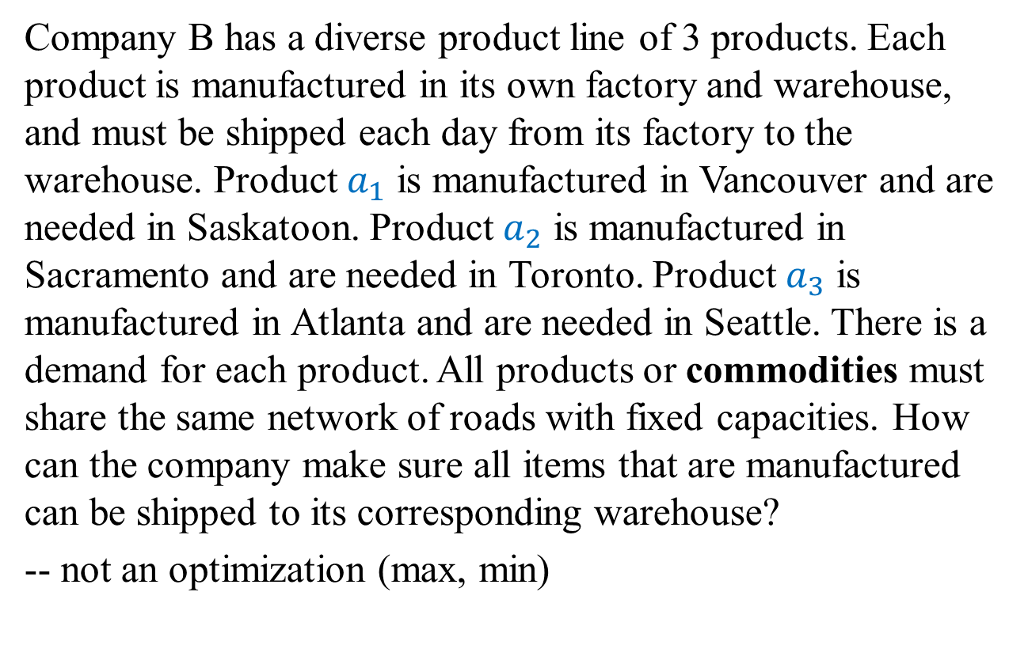
LP Example: Multicommodity flows (MCF)
Company B has a diverse product line of 3 products. Each product is manufactured in its own factory and warehouse, and must be shipped each day from its factory to the warehouse. Product $a_{1}$ is manufactured in Vancouver and are needed in Saskatoon. Product $a_{2}$ is manufactured in Sacramento and are needed in Toronto. Product $a_{3}$ is manufactured in Atlanta and are needed in Seattle. There is a demand for each product. All products or commodities must share the same network of roads with fixed capacities. How can the company make sure all items that are manufactured can be shipped to its corresponding warehouse?
-- not an optimization (max, min)

Slide 26
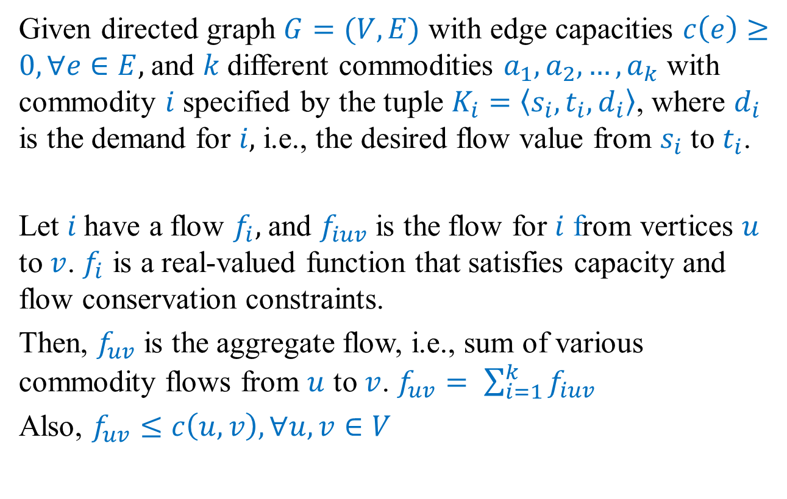
MCF Problem
Given directed graph $G=(V,E)$ with edge capacities $c\left(e\right)≥0, ∀e∈E,$and $k$different commodities $a_{1},a_{2},…, a_{k}$ with commodity $i$ specified by the tuple $K_{i}=\left\langle s_{i}, t_{i}, d_{i}\right\rangle$, where $d_{i}$ is the demand for $i,$ i.e., the desired flow value from $s_{i}$ to $t_{i}$.
Let $i$have a flow $f_{i},$and $f_{iuv}$is the flow for $i$ from vertices $u$ to $v$. $f_{i}$ is a real-valued function that satisfies capacity and flow conservation constraints.
Then, $f_{uv}$ is the aggregate flow, i.e., sum of various commodity flows from $u$ to $v$. $f_{uv}= \sum_{i=1}^{k}{f_{iuv}}$
Also, $f_{uv}≤c\left(u,v\right), ∀u, v∈V$

Slide 27
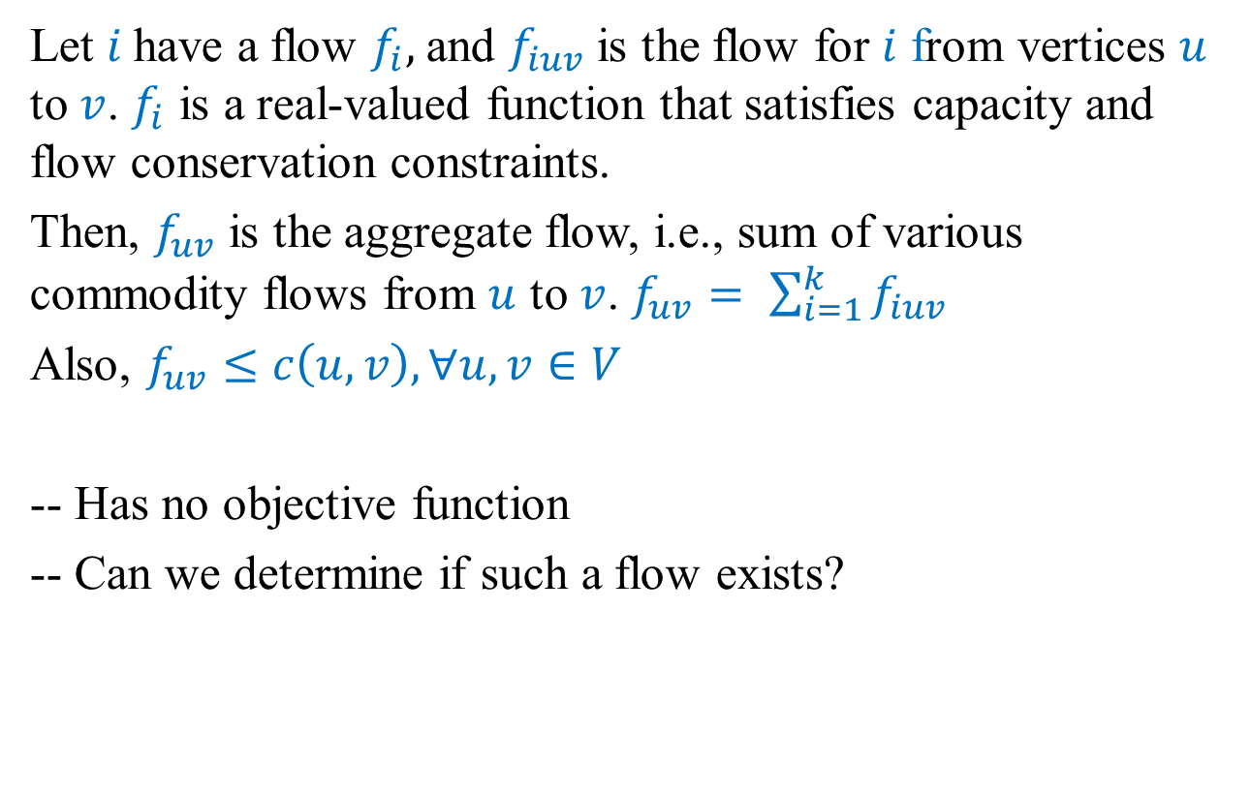
MCF Problem
Let $i$have a flow $f_{i},$and $f_{iuv}$is the flow for $i$ from vertices $u$ to $v$. $f_{i}$ is a real-valued function that satisfies capacity and flow conservation constraints.
Then, $f_{uv}$ is the aggregate flow, i.e., sum of various commodity flows from $u$ to $v$. $f_{uv}= \sum_{i=1}^{k}{f_{iuv}}$
Also, $f_{uv}≤c\left(u,v\right), ∀u, v∈V$
-- Has no objective function
-- Can we determine if such a flow exists?

Slide 28
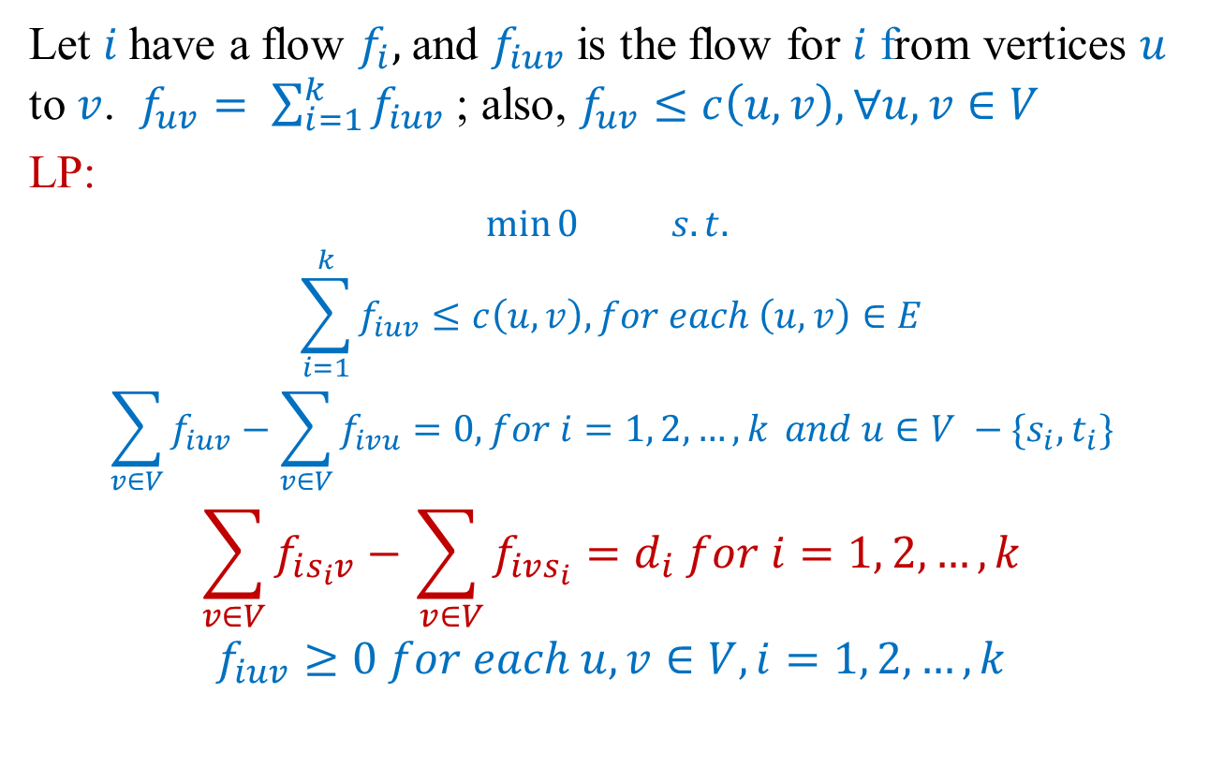
MCF Problem
Let $i$have a flow $f_{i},$and $f_{iuv}$is the flow for $i$ from vertices $u$ to $v$. $f_{uv}= \sum_{i=1}^{k}{f_{iuv}}$ ; also, $f_{uv}≤c\left(u,v\right), ∀u, v∈V$
LP:
$$\min{0} s.t.$$
$$\sum_{i=1}^{k}{f_{iuv}≤c\left(u,v\right), for each \left(u, v\right)∈E}$$
$$\sum_{v∈V}{f_{iuv}−\sum_{v∈V}{f_{ivu}=0, for i=1, 2, …, k} and u∈V −\{s_{i}, t_{i}\}}$$
$$\sum_{v∈V}{f_{is_{i}v}−\sum_{ v∈V}{f_{ivs_{i}}=d_{i} for i=1, 2, …, k}}$$
$$f_{iuv}≥0 for each u, v∈V, i=1, 2, …, k$$

Slide 29
LP Duality
Max flow = min cut each other’s certificate of optimality
Can we guarantee this for any problem that is solvable using LP?

Slide 30
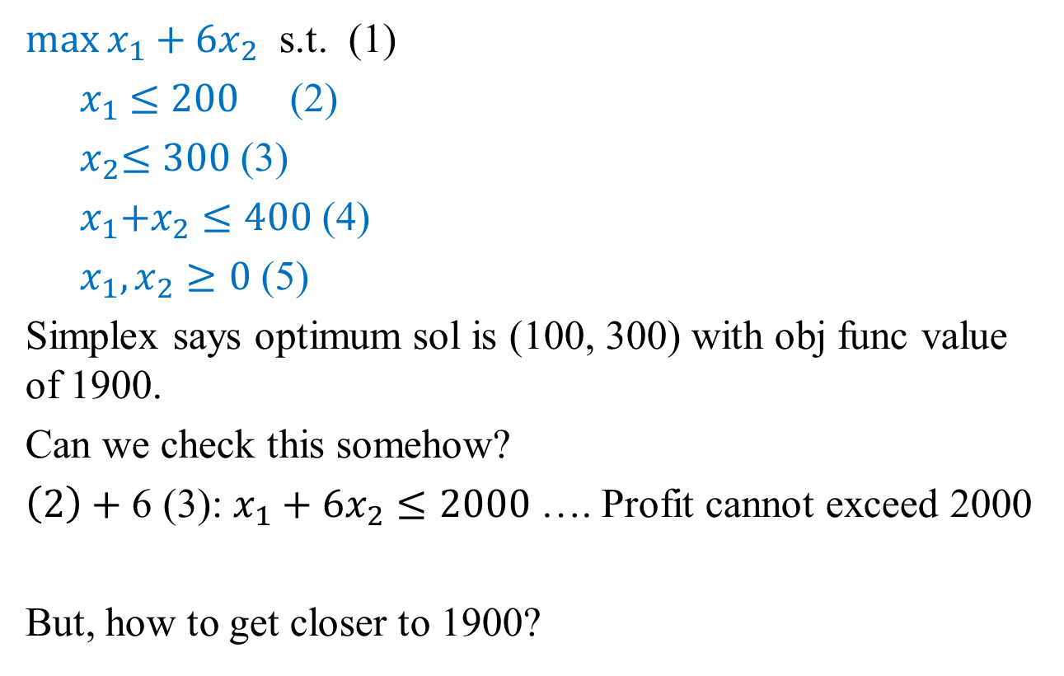
Example
$\max{x_{1}+6x_{2}}$ s.t. (1)
${ x}_{1} ≤200$ (2)
${ x}_{2}≤300$ (3)
${{ x}_{1}+x}_{2}≤400$ (4)
${ x}_{1},x_{2}≥0$ (5)
Simplex says optimum sol is (100, 300) with obj func value of 1900.
Can we check this somehow?
$\left(2\right)+$ 6 (3): $x_{1}+6x_{2}≤2000$ …. Profit cannot exceed 2000
But, how to get closer to 1900?

Slide 31
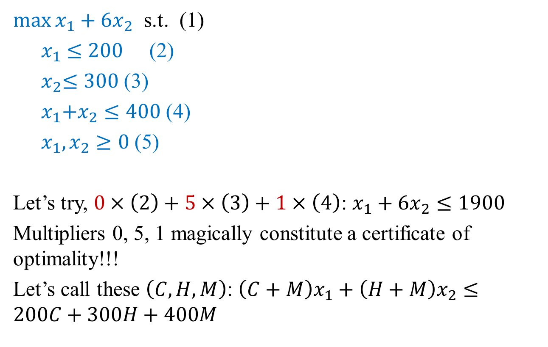
Example
$\max{x_{1}+6x_{2}}$ s.t. (1)
${ x}_{1} ≤200$ (2)
${ x}_{2}≤300$ (3)
${{ x}_{1}+x}_{2}≤400$ (4)
${ x}_{1},x_{2}≥0$ (5)
Let’s try, $0×\left(2\right)+5×\left(3\right)+1×\left(4\right)$: $x_{1}+6x_{2}≤1900$
Multipliers 0, 5, 1 magically constitute a certificate of optimality!!!
Let’s call these $\left(C, H, M\right)$: $\left(C+M\right)x_{1}+\left(H+M\right)x_{2}≤200C+300H+400M$

Slide 32
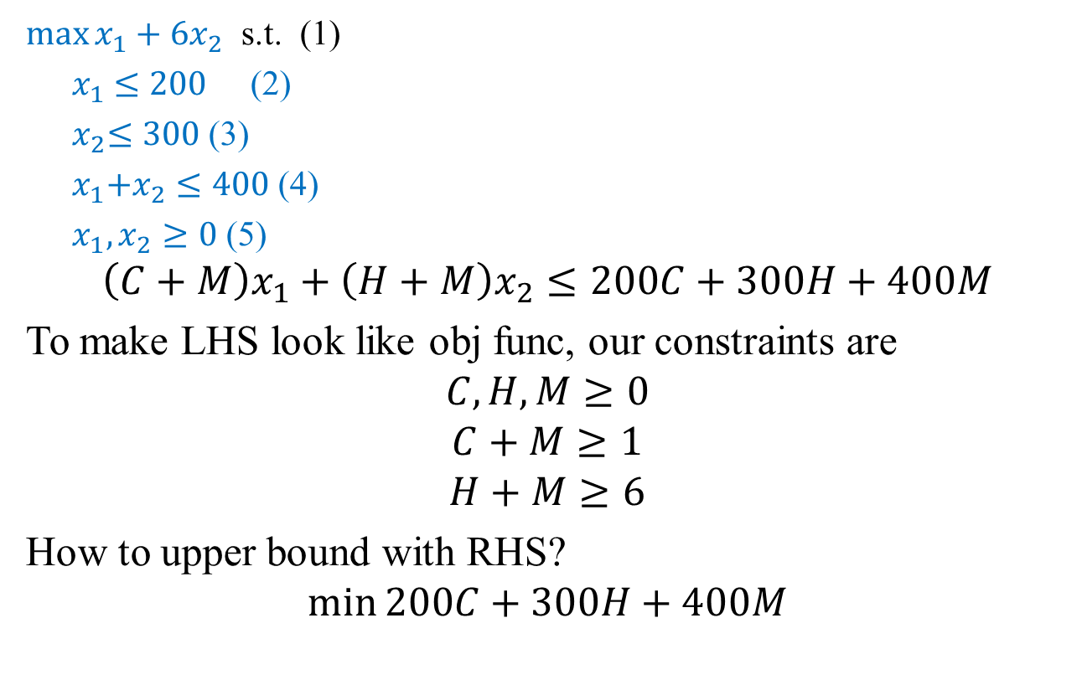
Example
$\max{x_{1}+6x_{2}}$ s.t. (1)
${ x}_{1} ≤200$ (2)
${ x}_{2}≤300$ (3)
${{ x}_{1}+x}_{2}≤400$ (4)
${ x}_{1},x_{2}≥0$ (5)
$$\left(C+M\right)x_{1}+\left(H+M\right)x_{2}≤200C+300H+400M$$
To make LHS look like obj func, our constraints are
$$C, H, M≥0$$
$$C+M≥1$$
$$H+M≥6$$
How to upper bound with RHS?
$$\min{200C+300H+400M}$$

Slide 33
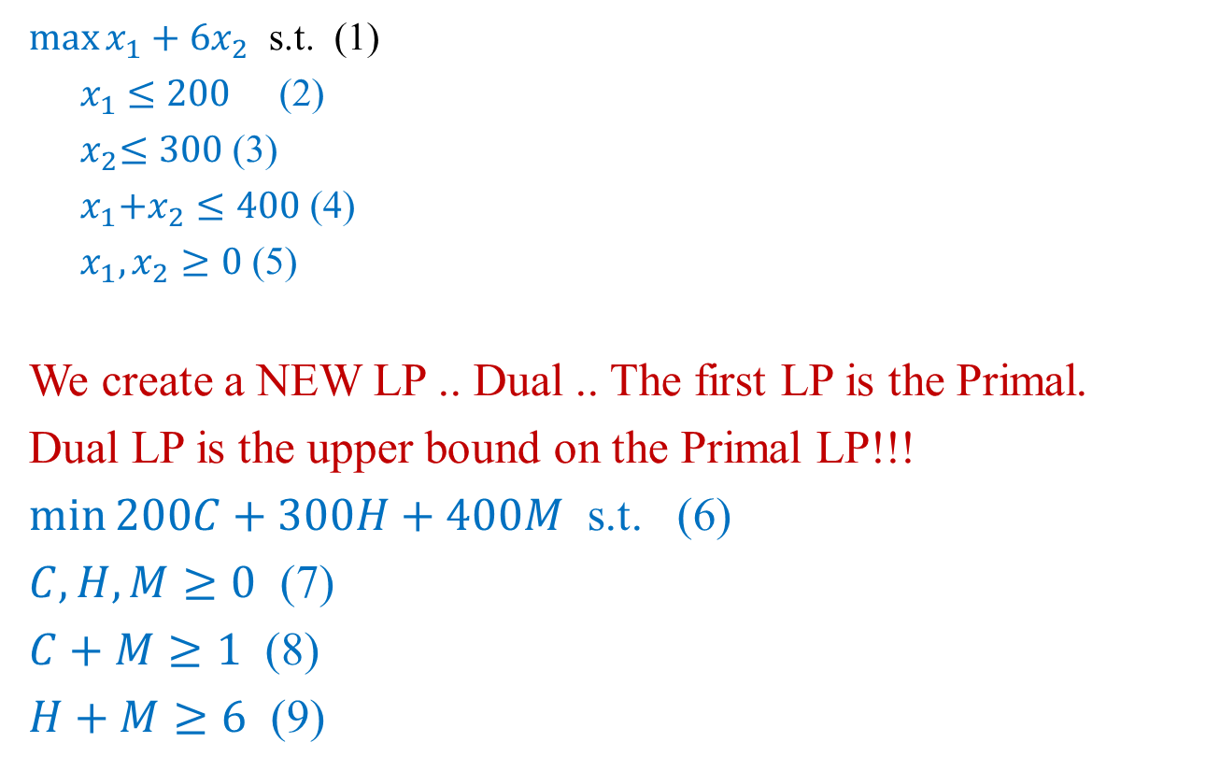
Example
$\max{x_{1}+6x_{2}}$ s.t. (1)
${ x}_{1} ≤200$ (2)
${ x}_{2}≤300$ (3)
${{ x}_{1}+x}_{2}≤400$ (4)
${ x}_{1},x_{2}≥0$ (5)
We create a NEW LP .. Dual .. The first LP is the Primal.
Dual LP is the upper bound on the Primal LP!!!
$\min{200C+300H+400M}$ s.t. (6)
$C, H, M≥0$ (7)
$C+M≥1$ (8)
$H+M≥6$ (9)

Slide 34
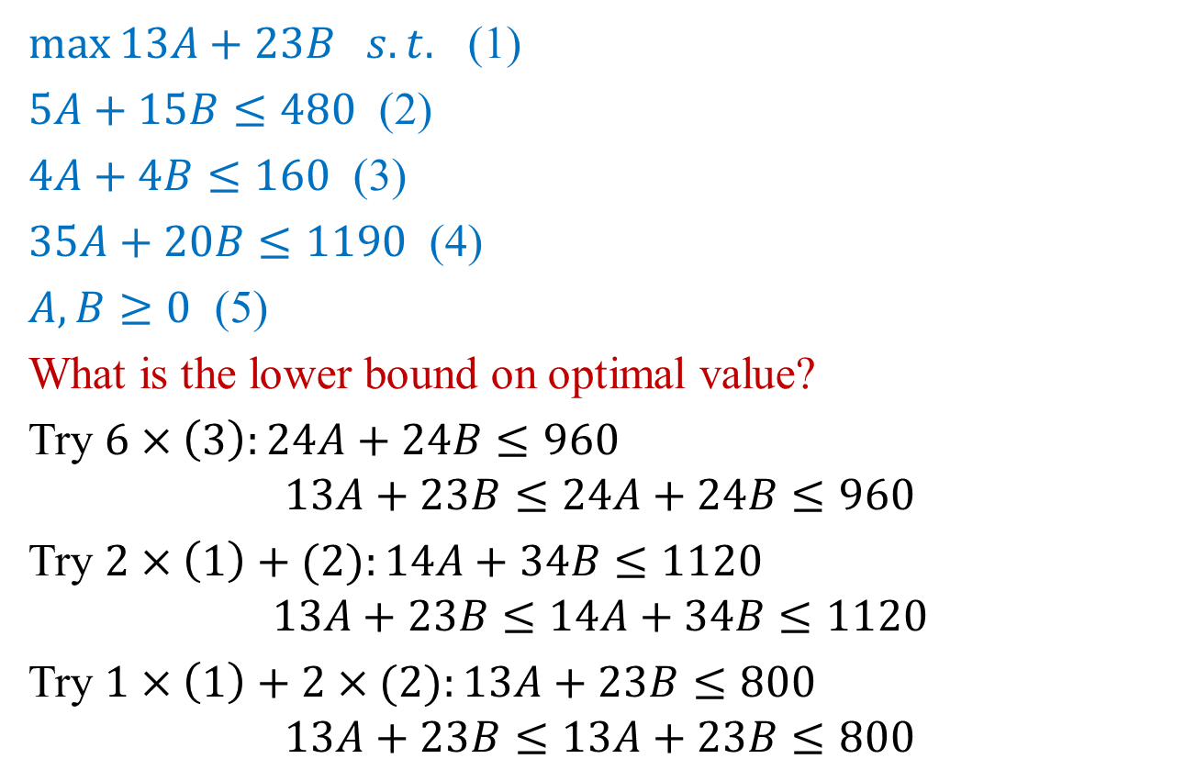
Example
$\max{13A+23B s.t.}$ (1)
$5A+15B≤480$ (2)
$4A+4B≤160$ (3)
$35A+20B≤1190$ (4)
$A, B≥0$ (5)
What is the lower bound on optimal value?
Try $6×\left(3\right):24A+24B≤960$
$$13A+23B≤24A+24B≤960$$
Try $2×\left(1\right)+(2):14A+34B≤1120$
$$13A+23B≤14A+34B≤1120$$
Try $1×\left(1\right)+2×(2):13A+23B≤800$
$$13A+23B≤13A+23B≤800$$

Slide 35
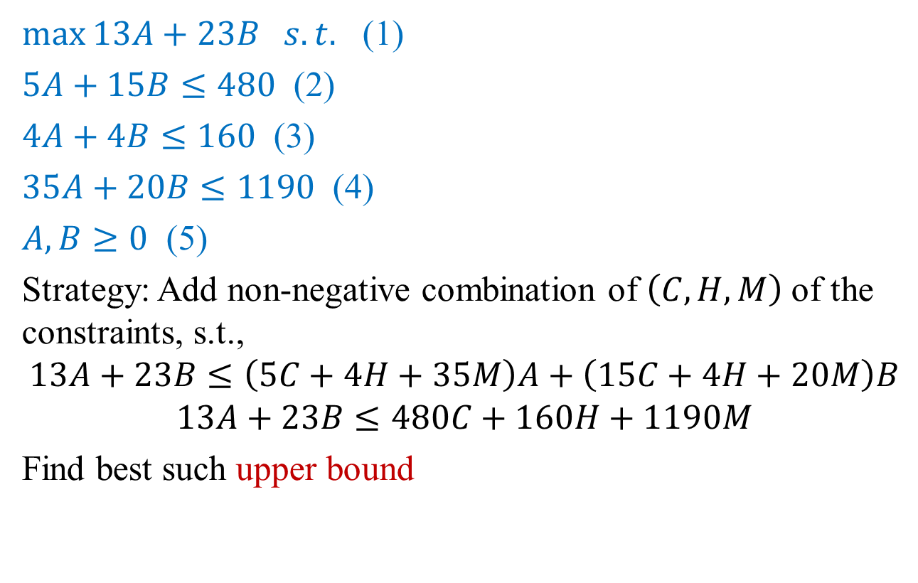
Example
$\max{13A+23B s.t.}$ (1)
$5A+15B≤480$ (2)
$4A+4B≤160$ (3)
$35A+20B≤1190$ (4)
$A, B≥0$ (5)
Strategy: Add non-negative combination of $\left(C, H, M\right)$ of the constraints, s.t.,
$$13A+23B≤\left(5C+4H+35M\right)A+\left(15C+4H+20M\right)B$$
$$13A+23B≤480C+160H+1190M$$
Find best such upper bound

Slide 36
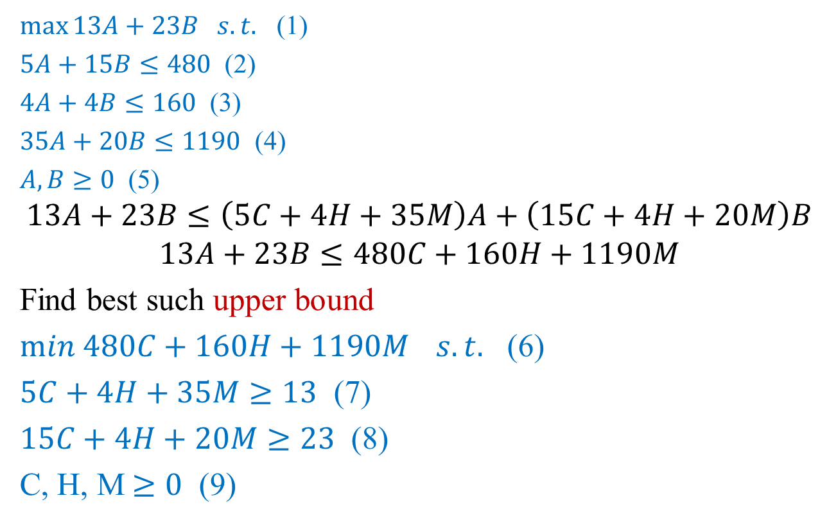
Example
$\max{13A+23B s.t.}$ (1)
$5A+15B≤480$ (2)
$4A+4B≤160$ (3)
$35A+20B≤1190$ (4)
$A, B≥0$ (5)
$$13A+23B≤\left(5C+4H+35M\right)A+\left(15C+4H+20M\right)B$$
$$13A+23B≤480C+160H+1190M$$
Find best such upper bound
$min 480C+160H+1190M{ s.t.}$ (6)
$5C+4H+35M≥13$ (7)
$15C+4H+20M≥23$ (8)
C, H, M$≥0$ (9)

Slide 37
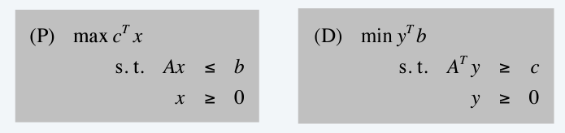
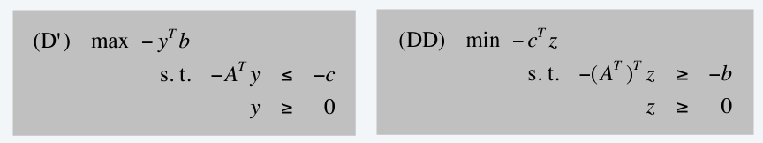
Facts
Dual of the dual is primal
Rewrite (D) has a maximization problem, take dual

Slide 38
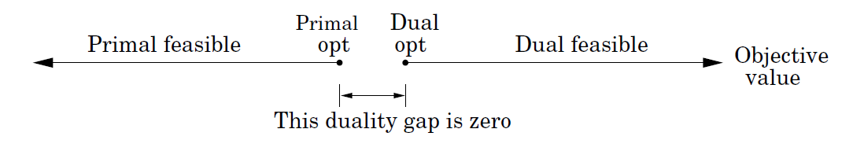
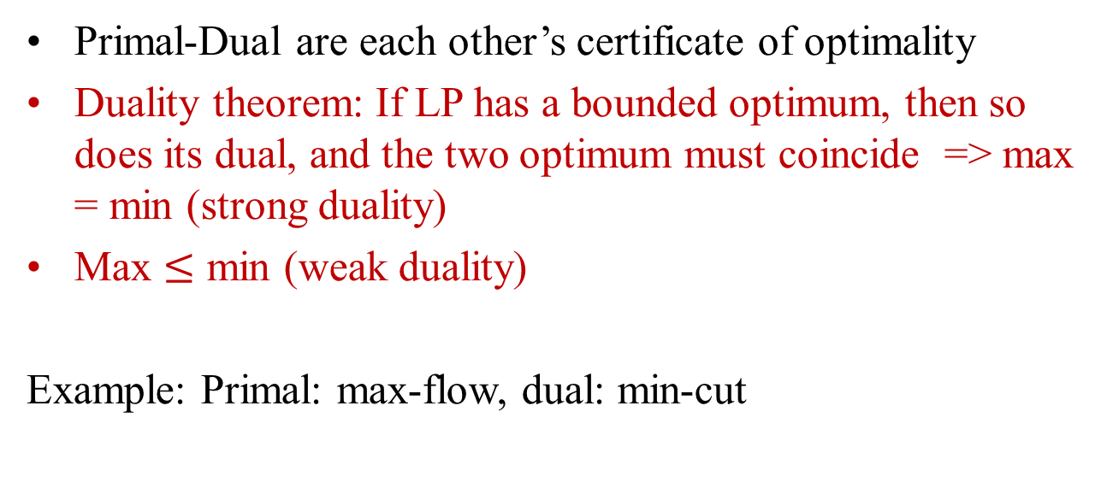
Dual vs. Primal Feasible Values
Primal-Dual are each other’s certificate of optimality
Duality theorem: If LP has a bounded optimum, then so does its dual, and the two optimum must coincide => max = min (strong duality)
Max $≤$ min (weak duality)
Example: Primal: max-flow, dual: min-cut

Slide 39
Lecture 13 Summary
Linear programming
Reductions
Duality

Slide 40
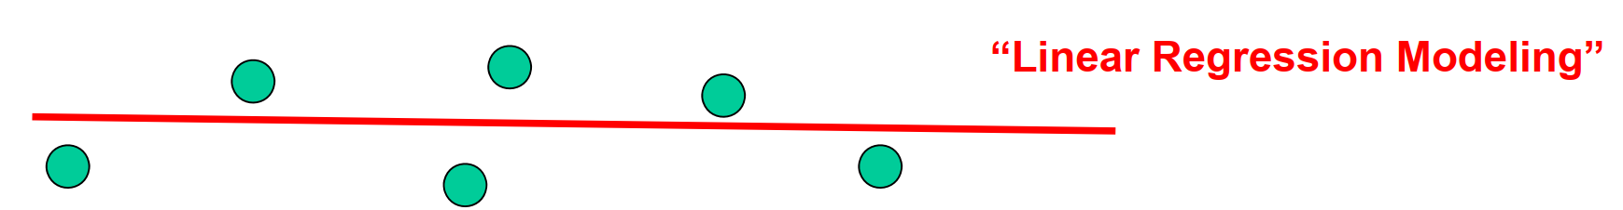
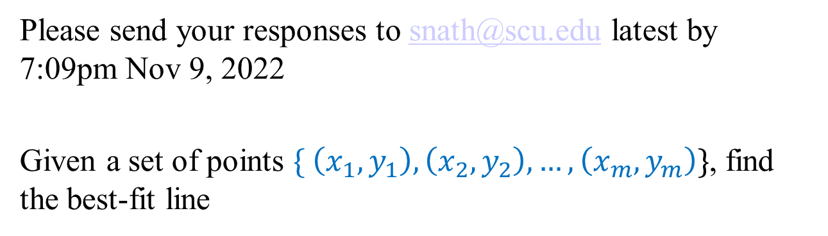
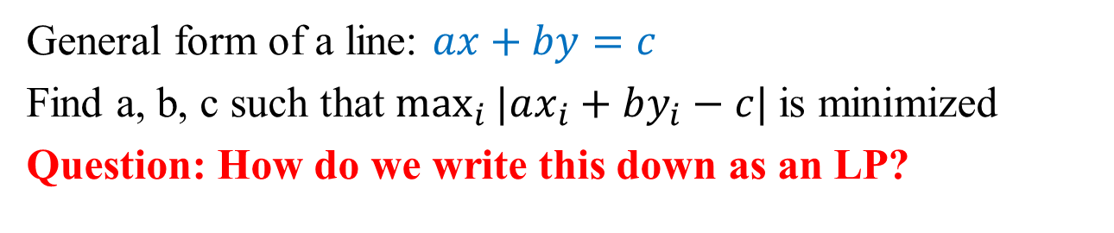
Extra Credit Qs #9 [5 points]
Please send your responses to snath@scu.edu latest by 7:09pm Nov 9, 2022
Given a set of points $\{ \left(x_{1},y_{1}\right), \left(x_{2},y_{2}\right), …, \left(x_{m}, y_{m}\right)\}$, find the best-fit line
General form of a line: $ax+by=c$
Find a, b, c such that $\max_{i}{|ax_{i}+by_{i}−c|}$is minimized
Question: How do we write this down as an LP?

