Slide 1
Design and Analysis of Algorithms
Sid Nath (snath@scu.edu)
Lecture 14
Nov 9, 2022

Slide 2
Agenda
Administrative
Linear programming
Assignment problem

Slide 3
Administrative
HW4 grades posted
PA2 due Week 9, HW5, PR due end of Week 10
PR questions?
No algo design questions on global opto, approx. and randomized algo topics. At most, short-answer qs.
Finals details announced
Part 1 (take-home, 6hrs, 4-5 algo design questions)
Sat Dec 3, 2022 2p-8p (finalized)
Part 2 (in-class)

Slide 4
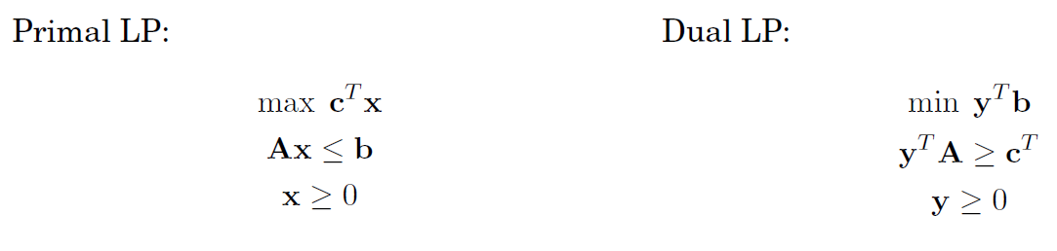
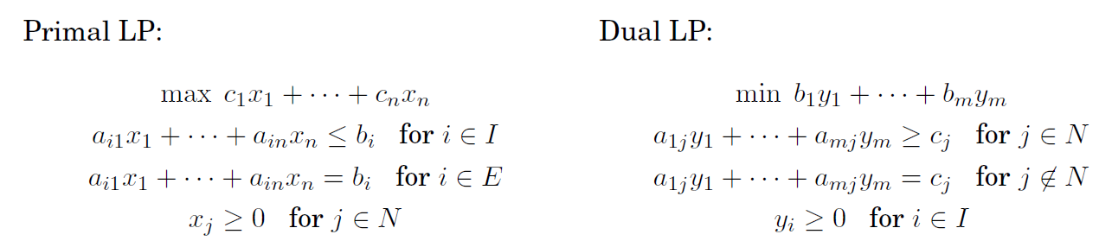
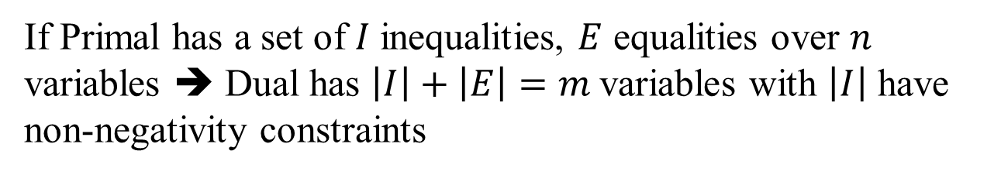
Primal/Dual Standard Forms
If Primal has a set of $I$inequalities, $E$ equalities over $n$ variables ➔ Dual has $\left|I\right|+\left|E\right|=m$variables with $\left|I\right|$ have non-negativity constraints

Slide 5
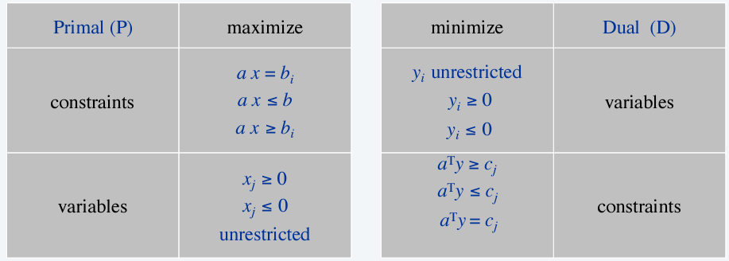
LP Dual Recipe

Slide 6
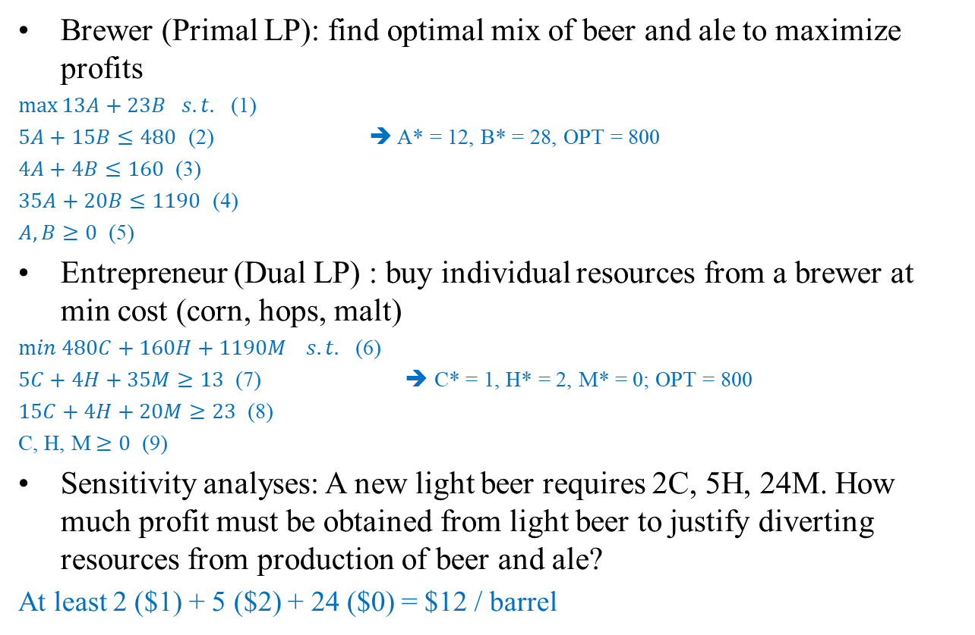
Applications: Economic Interpretation
Brewer (Primal LP): find optimal mix of beer and ale to maximize profits
$\max{13A+23B s.t.}$ (1)
$5A+15B≤480$ (2) ➔ A* = 12, B* = 28, OPT = 800
$4A+4B≤160$ (3)
$35A+20B≤1190$ (4)
$A, B≥0$ (5)
Entrepreneur (Dual LP) : buy individual resources from a brewer at min cost (corn, hops, malt)
$min 480C+160H+1190M{ s.t.}$ (6)
$5C+4H+35M≥13$ (7) ➔ C* = 1, H* = 2, M* = 0; OPT = 800
$15C+4H+20M≥23$ (8)
C, H, M$≥0$ (9)
Sensitivity analyses: A new light beer requires 2C, 5H, 24M. How much profit must be obtained from light beer to justify diverting resources from production of beer and ale?
At least 2 ($1) + 5 ($2) + 24 ($0) = $12 / barrel

Slide 7
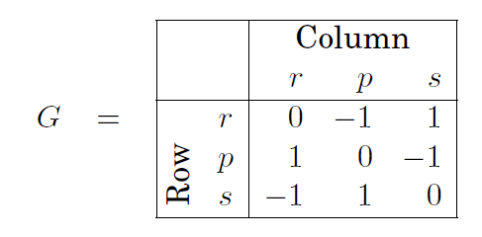
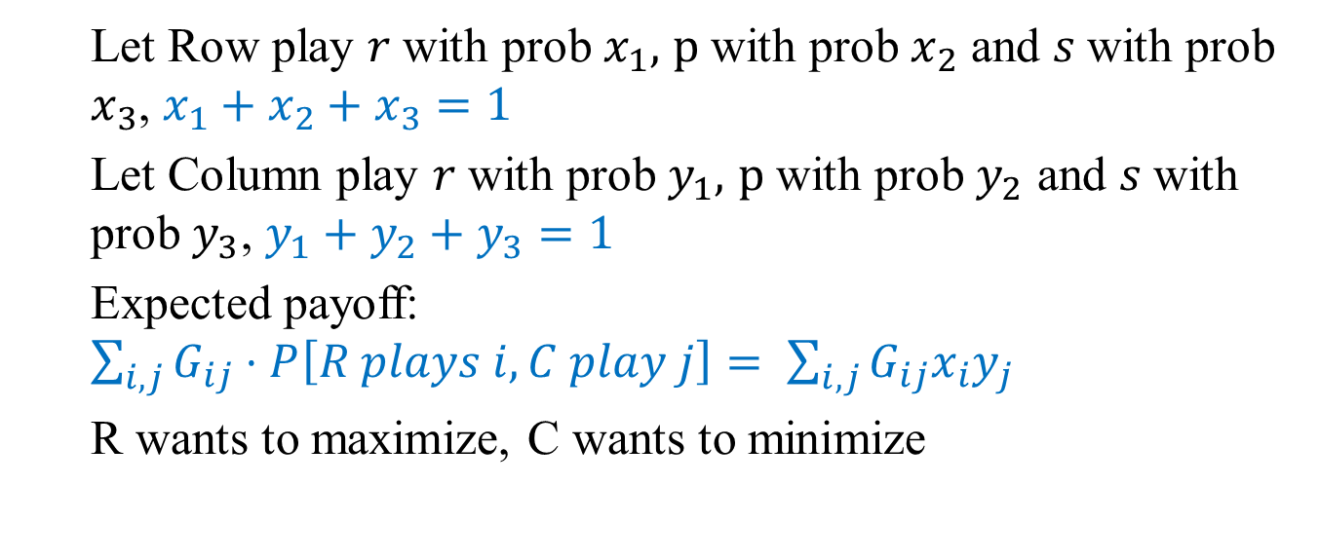
Applications: Zero-Sum Games
Payoff matrix
Let Row play $r$with prob $x_{1},$ $p$with prob $x_{2}$ and $s$with prob $x_{3}$, $x_{1}+x_{2}+x_{3}=1$
Let Column play $r$with prob $y_{1},$ $p$with prob $y_{2}$ and $s$with prob $y_{3}$, $y_{1}+y_{2}+y_{3}=1$
Expected payoff: $\sum_{i,j}{G_{ij}⋅P\left[R plays i, C play j\right]= \sum_{i,j}{G_{ij}x_{i}y_{j}}}$
R wants to maximize, C wants to minimize

Slide 8
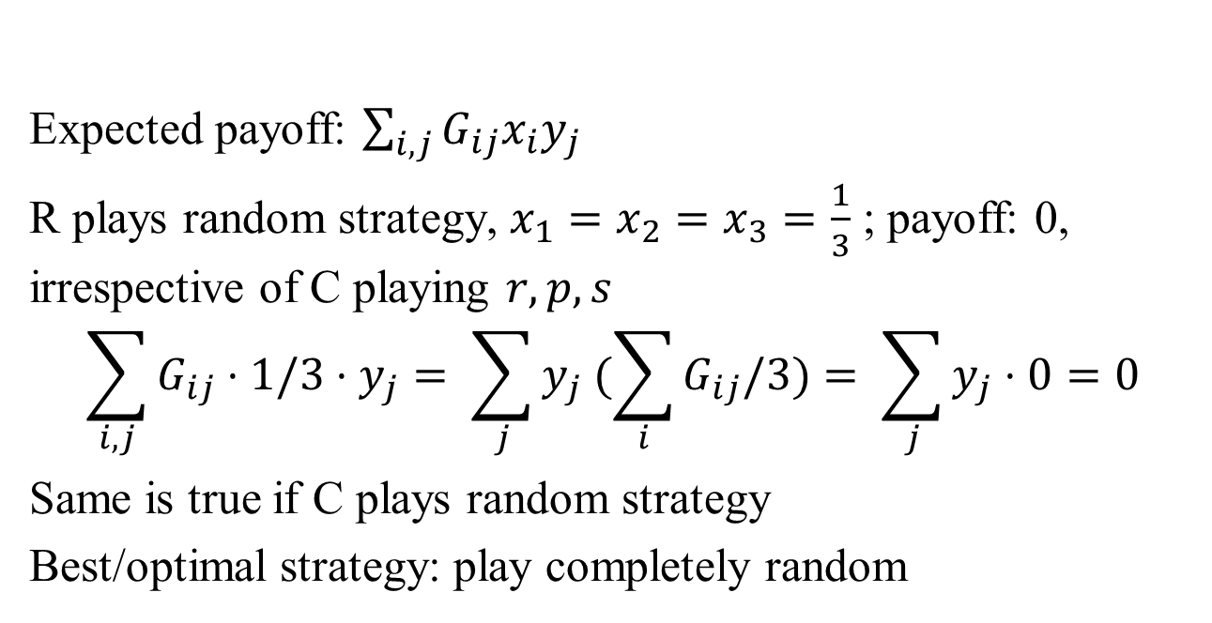
Applications: Zero-Sum Games
Payoff matrix
Expected payoff: $\sum_{i,j}{G_{ij}x_{i}y_{j}}$
R plays random strategy, $x_{1}=x_{2}=x_{3}=\frac{1}{3}$ ; payoff: 0, irrespective of C playing $r, p, s$
$$\sum_{i,j}{G_{ij}⋅1/3{⋅y}_{j}}= \sum_{j}{y_{j} (\sum_{i}{G_{ij}/3)= \sum_{j}{y_{j}⋅0=0}}}$$
Same is true if C plays random strategy
Best/optimal strategy: play completely random

Slide 9
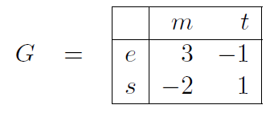
Applications: Election
Two presidential candidates campaigning on economic, society, morality and tax cut
If Cand1 announces strategy first, does it benefit Cand2?
If Cand2 announces strategy first, does it benefit Cand1?

Slide 10
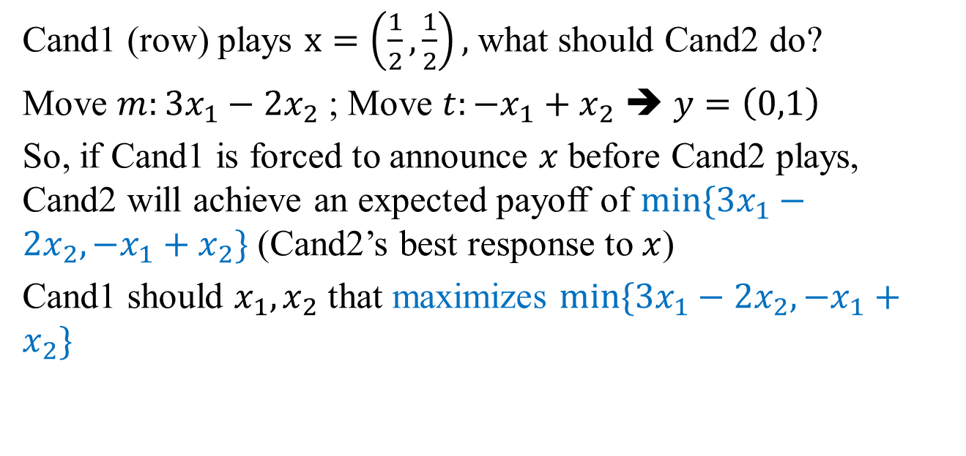
Applications: Election
Two presidential candidates campaigning on economic, society, morality and tax cut
Cand1 (row) plays $x=\left(\frac{1}{2},\frac{1}{2}\right),$what should Cand2 do?
Move $m:3x_{1}−2x_{2}$ ; Move $t:−x_{1}+x_{2}$ ➔ $y=\left(0,1\right)$
So, if Cand1 is forced to announce $x$ before Cand2 plays, Cand2 will achieve an expected payoff of $min⁡\{3x_{1}−2x_{2}, −x_{1}+x_{2}\}$ (Cand2’s best response to $x$)
Cand1 should $x_{1},x_{2}$ that maximizes $min⁡\{3x_{1}−2x_{2}, −x_{1}+x_{2}\}$

Slide 11
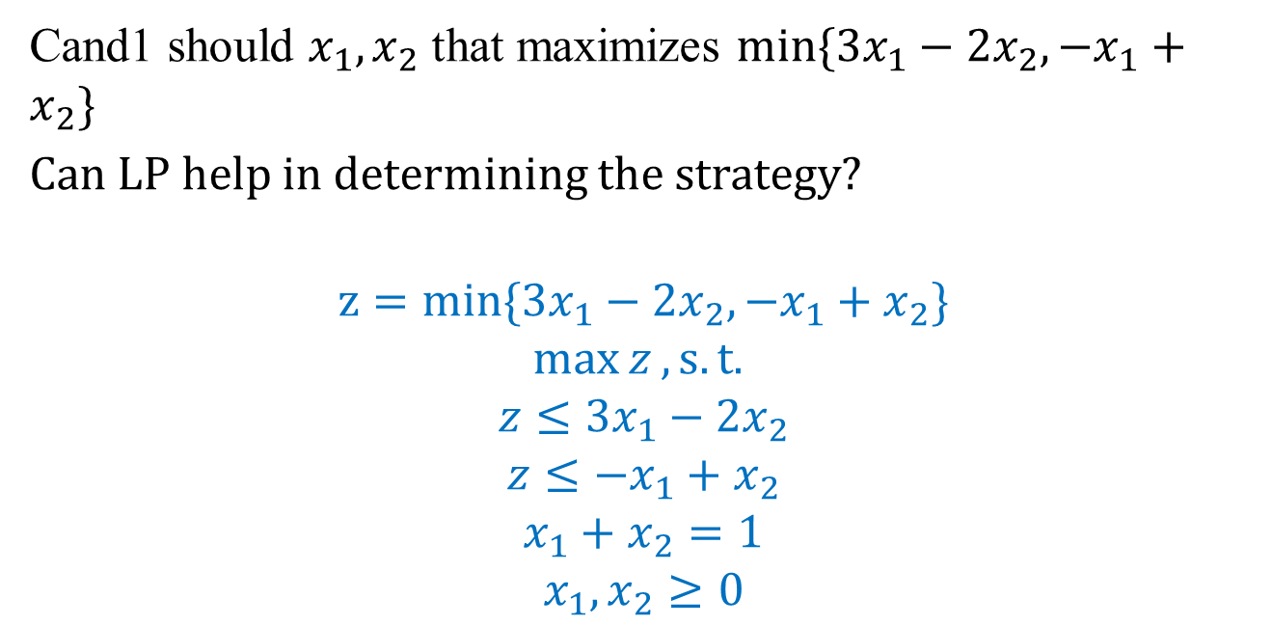
Applications: Election
Two presidential candidates campaigning on economic, society, morality and tax cut
Cand1 should $x_{1},x_{2}$ that maximizes $min⁡\{3x_{1}−2x_{2}, −x_{1}+x_{2}\}$
Can LP help in determining the strategy?
$$z=min⁡\{3x_{1}−2x_{2}, −x_{1}+x_{2}\}$$
$$\max{z}, s.t.$$
$$z≤3x_{1}−2x_{2}$$
$$z≤−x_{1}+x_{2}$$
$$x_{1}+x_{2}=1$$
$$x_{1},x_{2}≥0$$

Slide 12
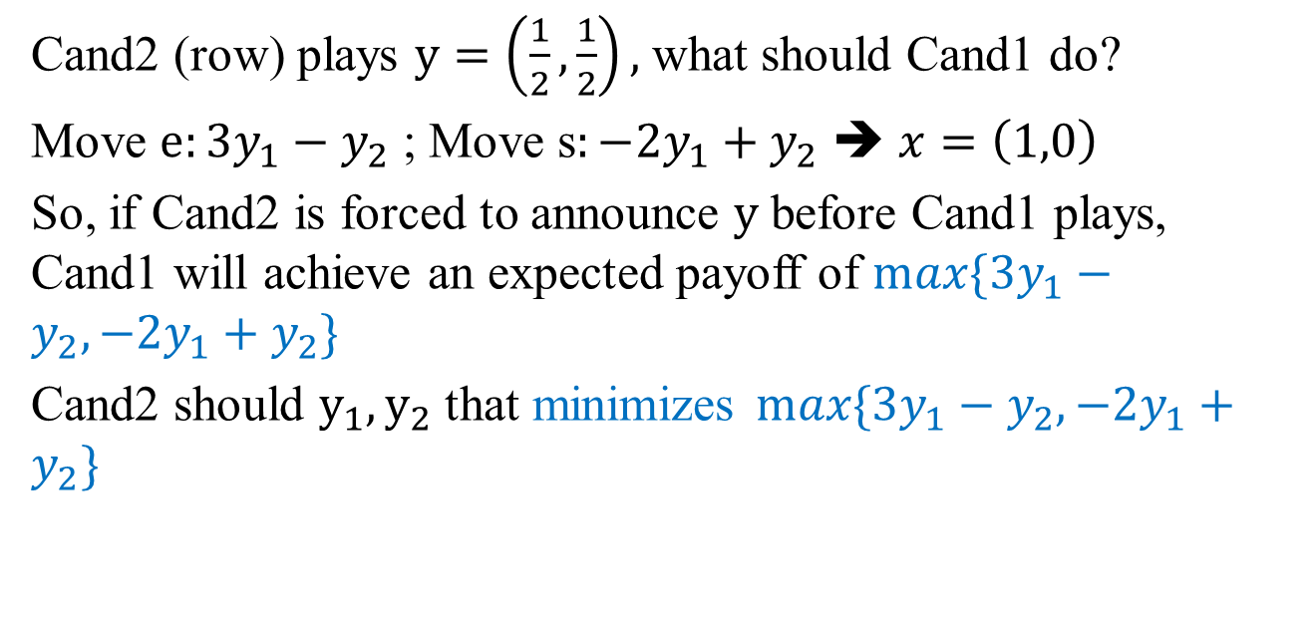
Applications: Election
Two presidential candidates campaigning on economic, society, morality and tax cut
Cand2 (row) plays $y=\left(\frac{1}{2},\frac{1}{2}\right),$what should Cand1 do?
Move $e:3y_{1}−y_{2}$ ; Move s$:−2y_{1}+y_{2}$ ➔ $x=\left(1,0\right)$
So, if Cand2 is forced to announce $y$ before Cand1 plays, Cand1 will achieve an expected payoff of $max⁡\{3y_{1}−y_{2}, −{2y}_{1}+y_{2}\}$
Cand2 should $y_{1}, y_{2}$ that minimizes$max⁡\{3y_{1}−y_{2}, −{2y}_{1}+y_{2}\}$

Slide 13
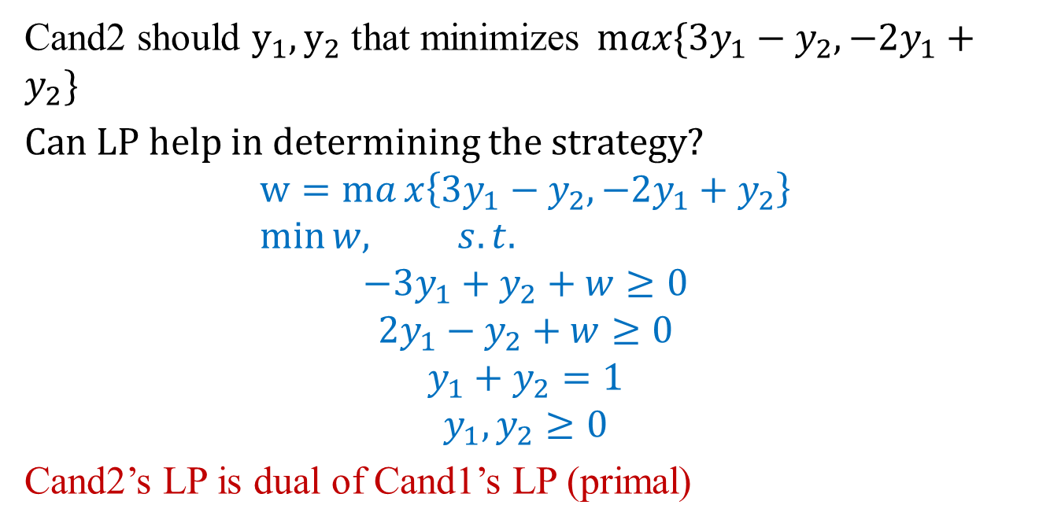
Applications: Election
Two presidential candidates campaigning on economic, society, morality and tax cut
Cand2 should $y_{1}, y_{2}$ that minimizes$max⁡\{3y_{1}−y_{2}, −{2y}_{1}+y_{2}\}$
Can LP help in determining the strategy?
$$w=max\left\{3y_{1}−y_{2}, −{2y}_{1}+y_{2}\right\} \\ \min{w, s.t.}$$
$$−3y_{1}+y_{2}+w≥0$$
$$2y_{1}−y_{2}+w≥0$$
$$y_{1}+y_{2}=1$$
$$y_{1},y_{2}≥0$$
Cand2’s LP is dual of Cand1’s LP (primal)

Slide 14
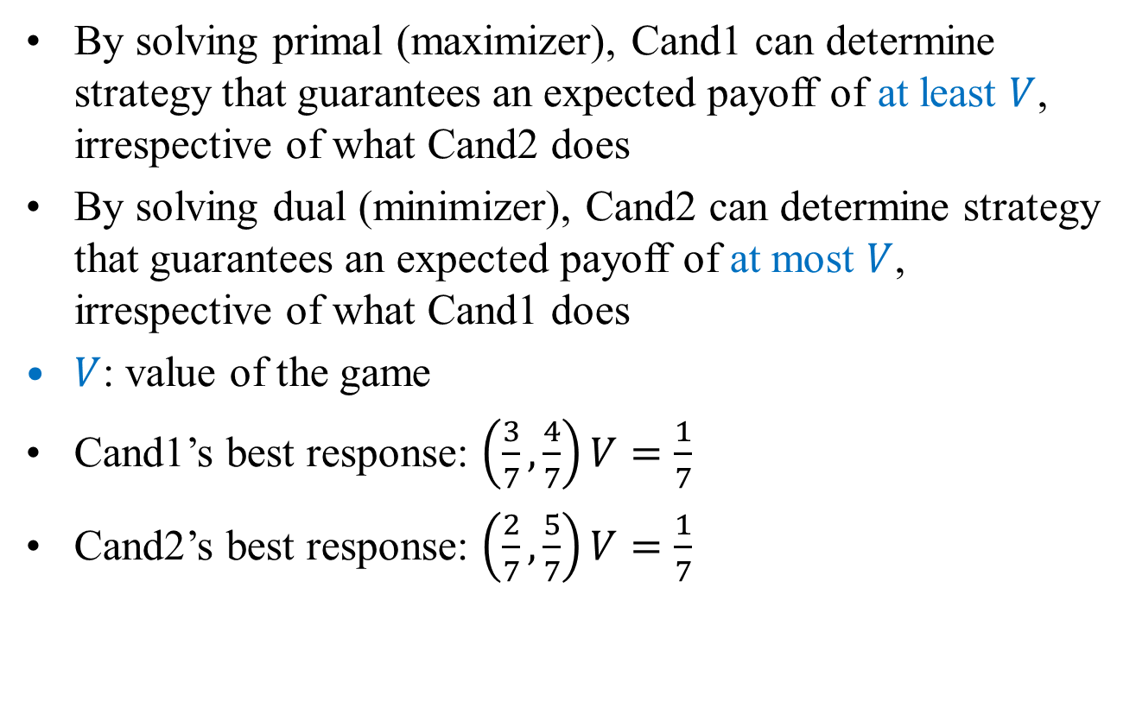
Applications: Election
By solving primal (maximizer), Cand1 can determine strategy that guarantees an expected payoff of at least $V$, irrespective of what Cand2 does
By solving dual (minimizer), Cand2 can determine strategy that guarantees an expected payoff of at most $V$, irrespective of what Cand1 does
$V$: value of the game
Cand1’s best response: $\left(\frac{3}{7},\frac{4}{7}\right)V=\frac{1}{7}$
Cand2’s best response: $\left(\frac{2}{7},\frac{5}{7}\right)V=\frac{1}{7}$

Slide 15
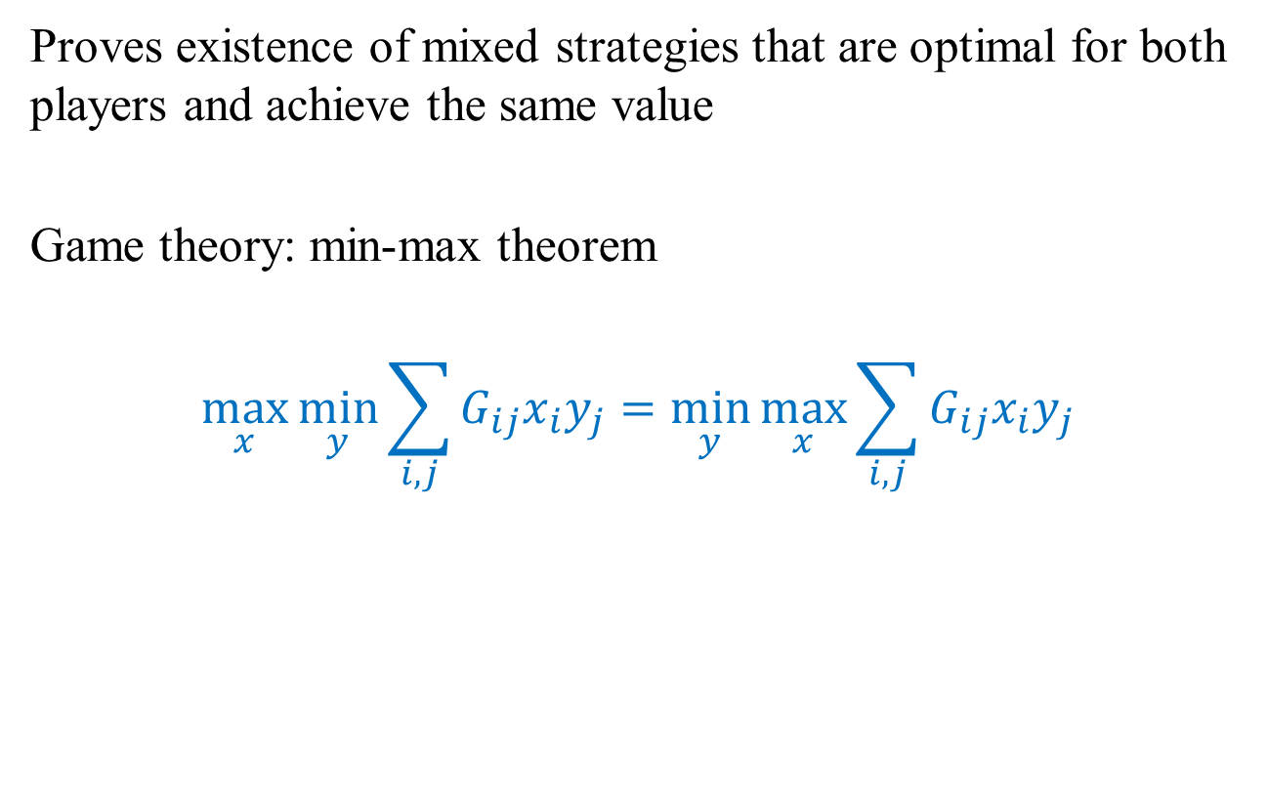
Zero-Sum Games LP Formulation
Proves existence of mixed strategies that are optimal for both players and achieve the same value
Game theory: min-max theorem
$$\max_{x}{\min_{y}{\sum_{i,j}{G_{ij}x_{i}y_{j}=\min_{y}{\max_{x}{\sum_{i,j}{G_{ij}x_{i}y_{j}}}}}}}$$

Slide 16
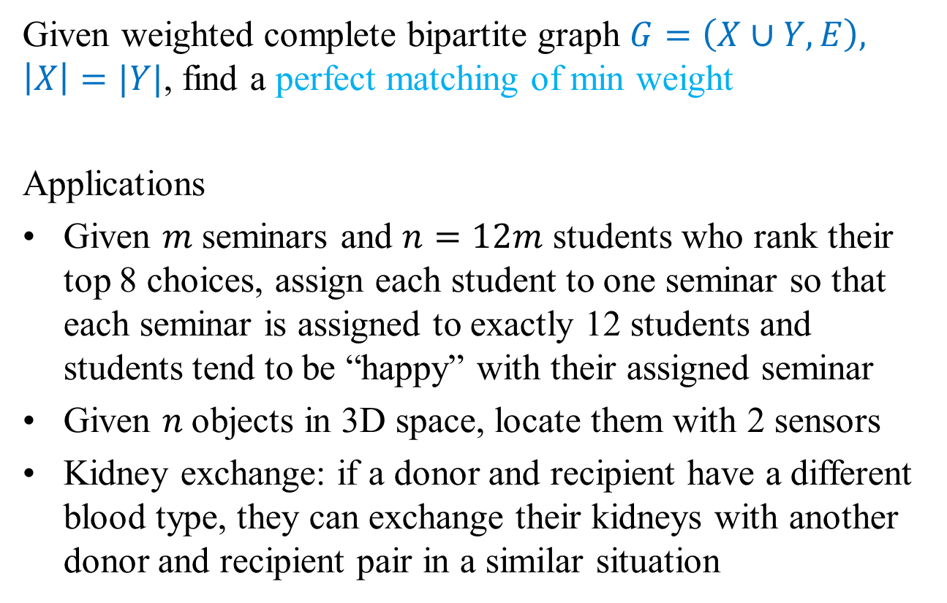
Assignment Problem
Given weighted complete bipartite graph $G=\left(X∪Y, E\right), \left|X\right|=|Y|$, find a perfect matching of min weight
Applications
Given $m$seminars and $n=12m$ students who rank their top 8 choices, assign each student to one seminar so that each seminar is assigned to exactly 12 students and students tend to be “happy” with their assigned seminar
Given $n$objects in 3D space, locate them with 2 sensors
Kidney exchange: if a donor and recipient have a different blood type, they can exchange their kidneys with another donor and recipient pair in a similar situation

Slide 17
Other Applications
Natural applications
Match jobs to machines
Match personnel to tasks
Match PU students to writing seminars
Non-obvious applications
Vehicle routing
Signal processing
Earth-mover’s distance
Multiple object tracking
Virtual output queueing
Handwriting recognition
Approximate string matching
….

Slide 18
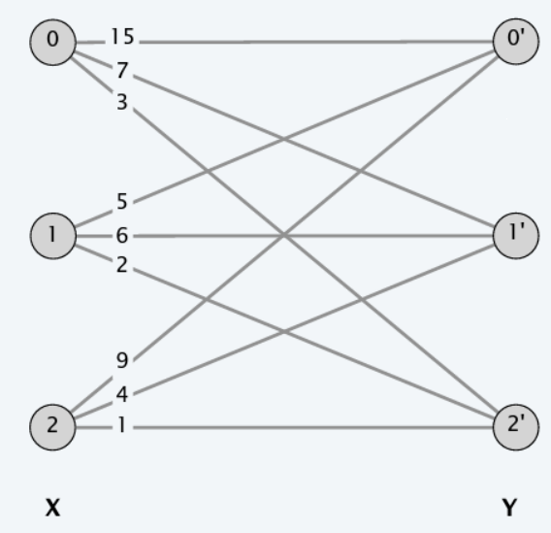
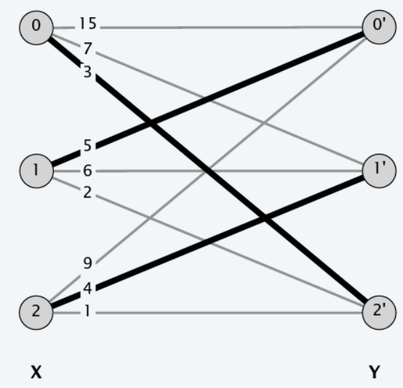
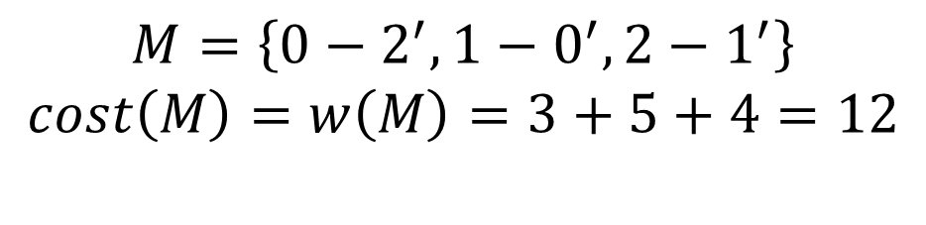
Example
$$M=\left\{0−2^{′}, 1−0^{′}, 2−1^{′}\right\}$$
$$cost\left(M\right)=w\left(M\right)=3+5+4=12$$

Slide 19
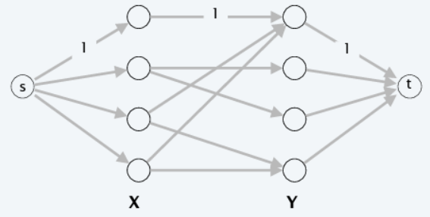
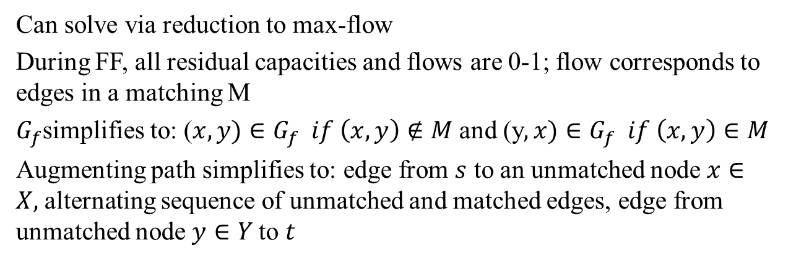
Bipartite Matching
Can solve via reduction to max-flow
During FF, all residual capacities and flows are 0-1; flow corresponds to edges in a matching M
$G_{f}$simplifies to: ($x,y)∈G_{f} if \left(x,y\right)∉M$ and (y$,x)∈G_{f} if \left(x,y\right)∈M$
Augmenting path simplifies to: edge from $s$ to an unmatched node $x∈X,$alternating sequence of unmatched and matched edges, edge from unmatched node $y∈Y$to $t$

Slide 20
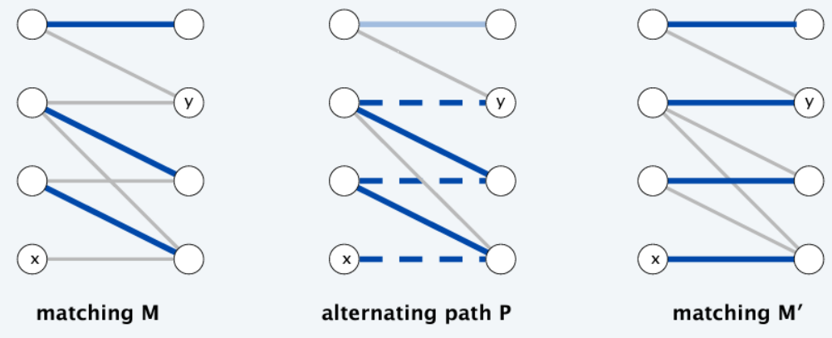
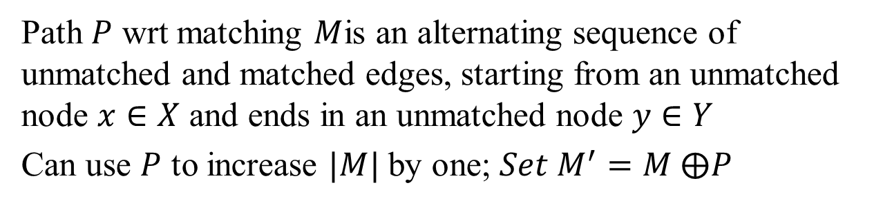
Alternating Path
Path $P$ wrt matching $M$is an alternating sequence of unmatched and matched edges, starting from an unmatched node $x∈X$ and ends in an unmatched node $y∈Y$
Can use $P$ to increase $|M|$ by one; $Set M^{′}=M ⨁P$

Slide 21
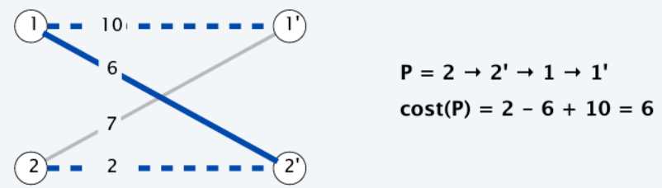
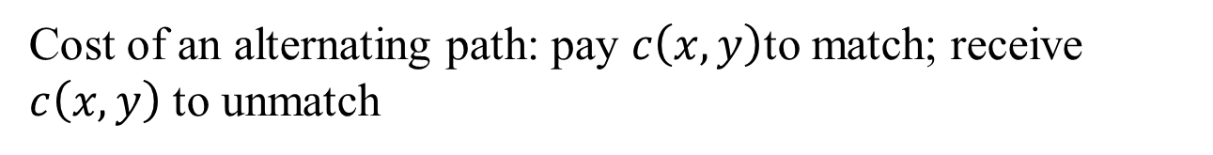
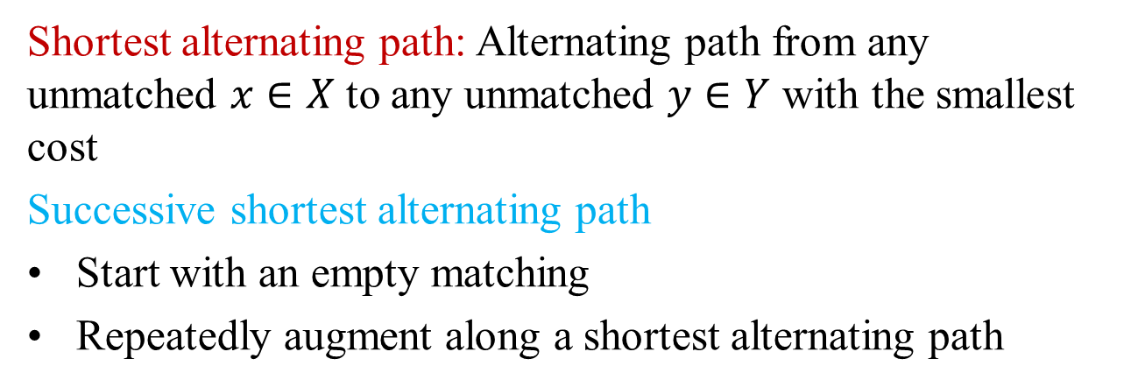
Successive Shortest Path Algorithm
Cost of an alternating path: pay $c\left(x,y\right)$to match; receive $c\left(x,y\right)$ to unmatch
Shortest alternating path: Alternating path from any unmatched $x∈X$to any unmatched $y∈Y$ with the smallest cost
Successive shortest alternating path
Start with an empty matching
Repeatedly augment along a shortest alternating path

Slide 22
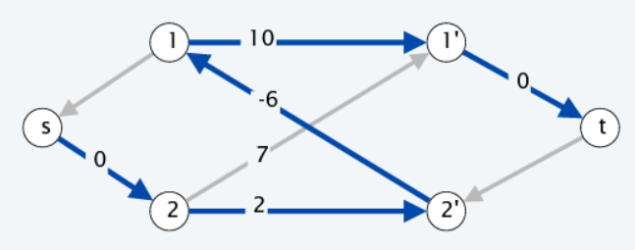
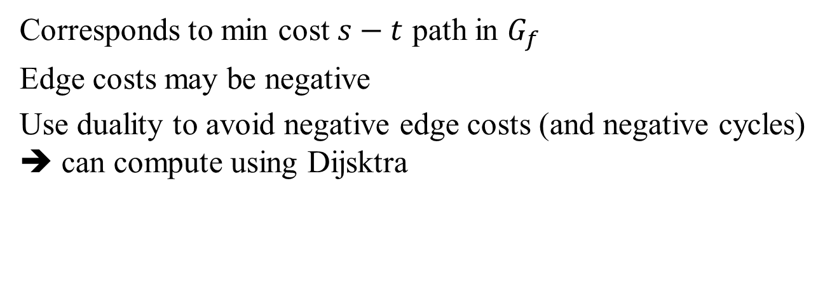
Finding the shortest alternating path
Corresponds to min cost $s−t$ path in $G_{f}$
Edge costs may be negative
Use duality to avoid negative edge costs (and negative cycles) ➔ can compute using Dijsktra

Slide 23
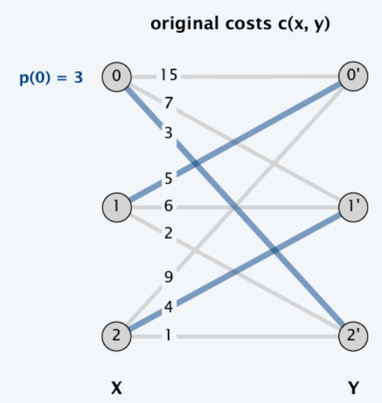
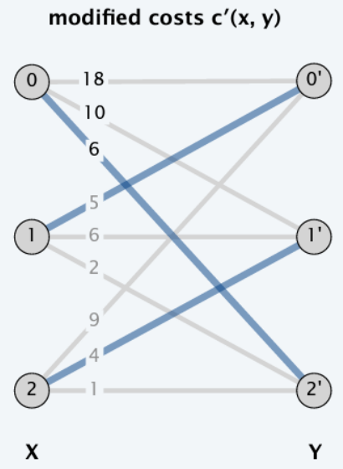
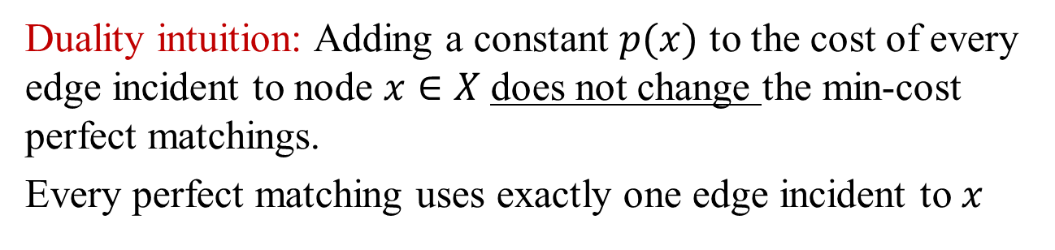
Equivalent Assignment Problem
Duality intuition: Adding a constant $p(x)$ to the cost of every edge incident to node $x∈X$does not change the min-cost perfect matchings.
Every perfect matching uses exactly one edge incident to $x$
+3 to all edges incident to node 0

Slide 24
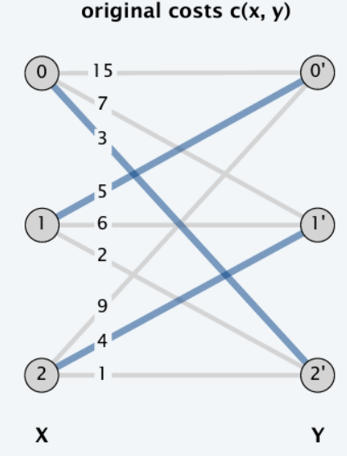
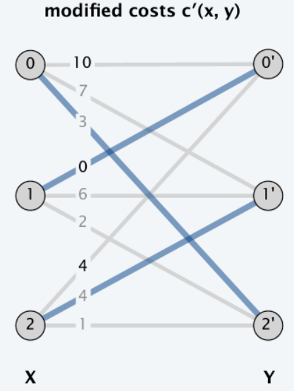
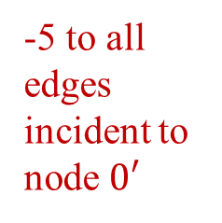
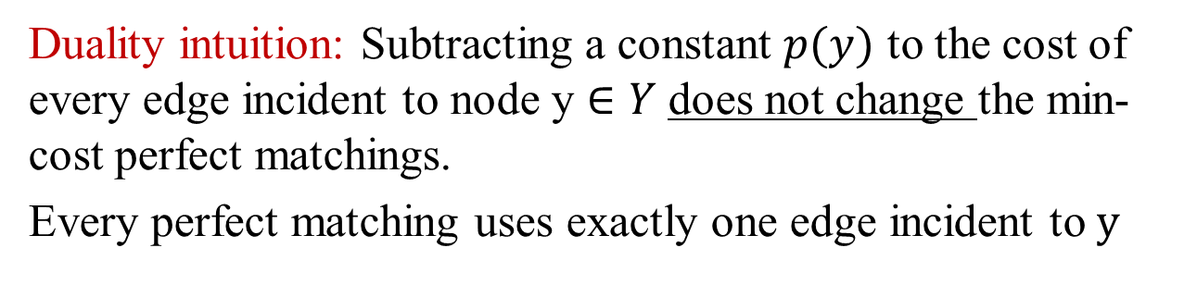
Equivalent Assignment Problem
Duality intuition: Subtracting a constant $p(y)$ to the cost of every edge incident to node y $∈Y$does not change the min-cost perfect matchings.
Every perfect matching uses exactly one edge incident to $y$
-5 to all edges incident to node $0′$

Slide 25
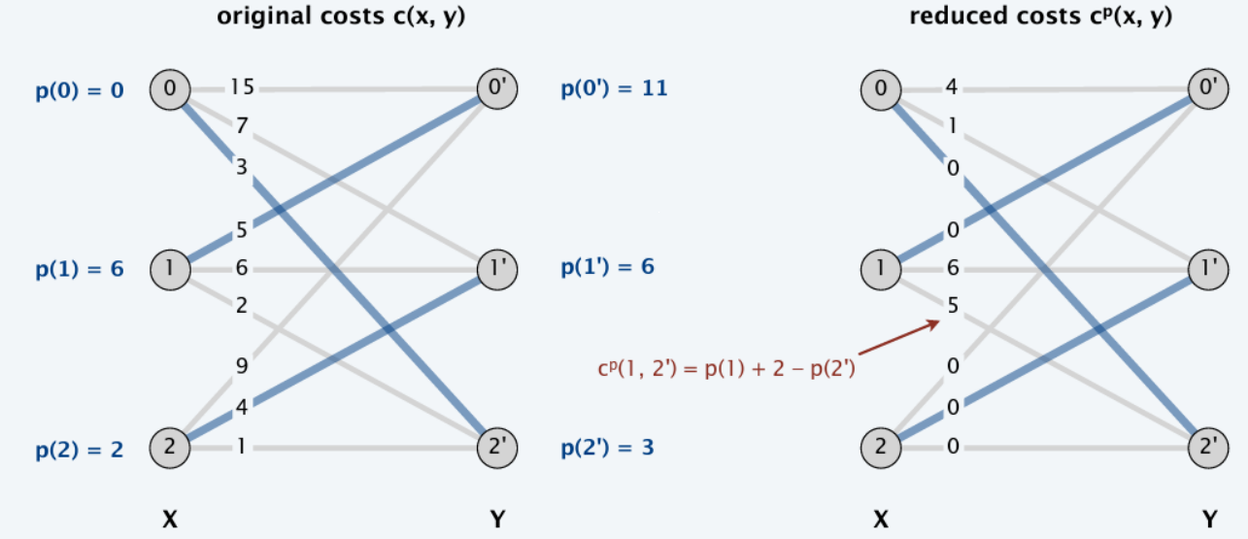

Reduced costs
$$For x∈X, y∈Y, c^{p}\left(x,y\right)=p\left(x\right)+c\left(x,y\right)−p(y)$$
Finding a min-cost perfect matching with reduced costs is equivalent to finding a min-cost perfect matching with original costs

Slide 26
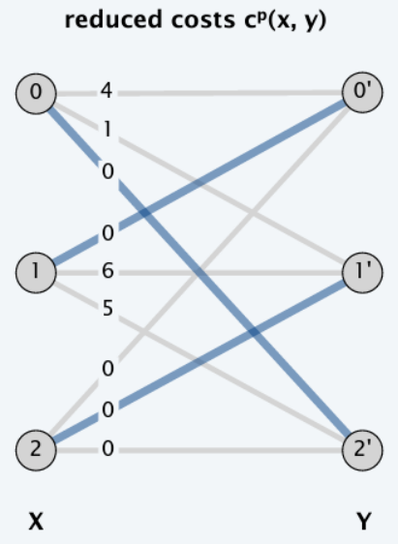

Compatible Prices
For each node $v∈X∪Y,$ maintain prices $p\left(v\right)$ such that
$c^{p}\left(x,y\right)≥0 ∀\left(x, y\right)∉M$
$c^{p}\left(x,y\right)=0 ∀\left(x, y\right)∈M$
If prices $p$are compatible with a perfect matching $M$, then $M$ is a min-cost perfect matching

Slide 27
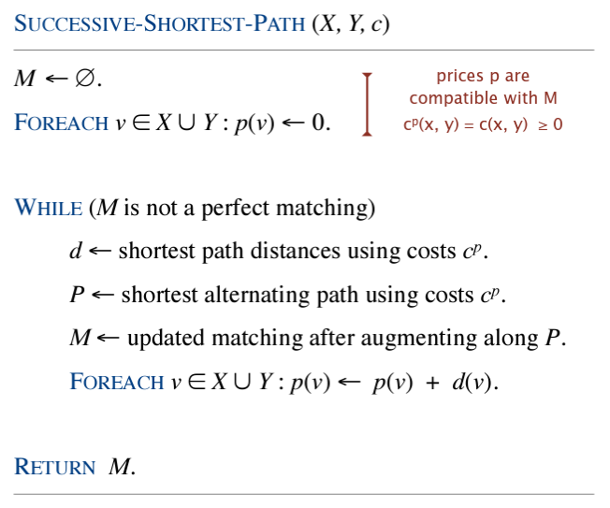
Successive shortest path (SSP) algorithm

Slide 28
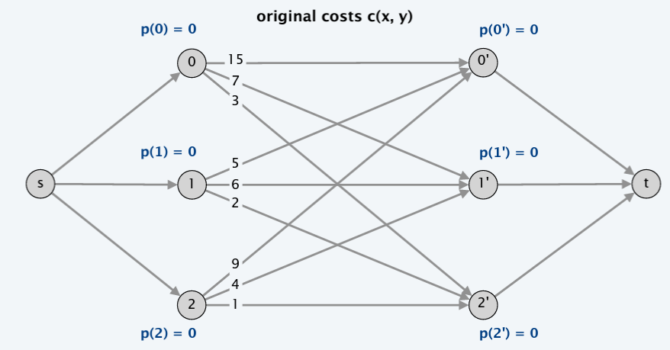
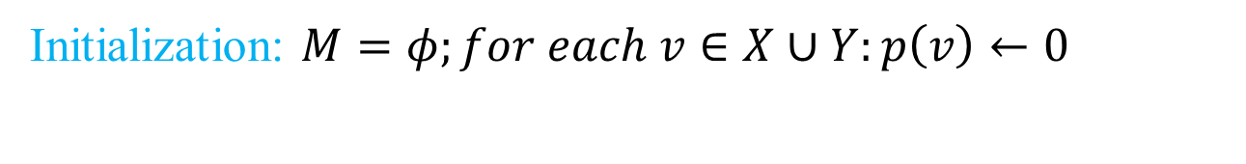
Example: SSP
Initialization: $M=φ;for each v∈X∪Y:p\left(v\right)←0$

Slide 29
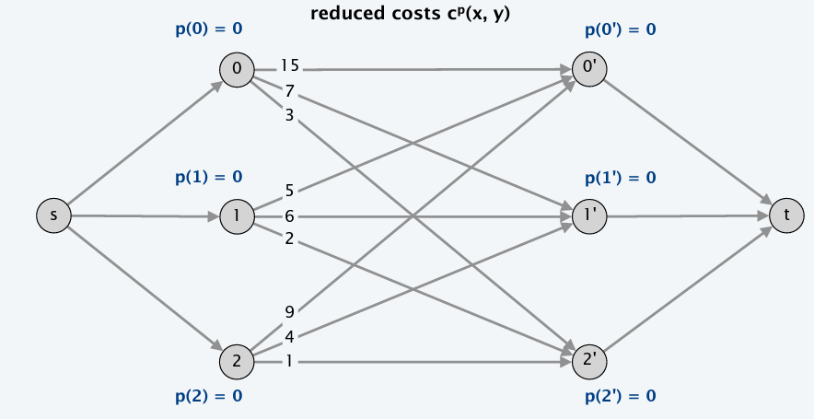
Example: SSP
Initialization: $M=φ;for each v∈X∪Y:p\left(v\right)←0$

Slide 30
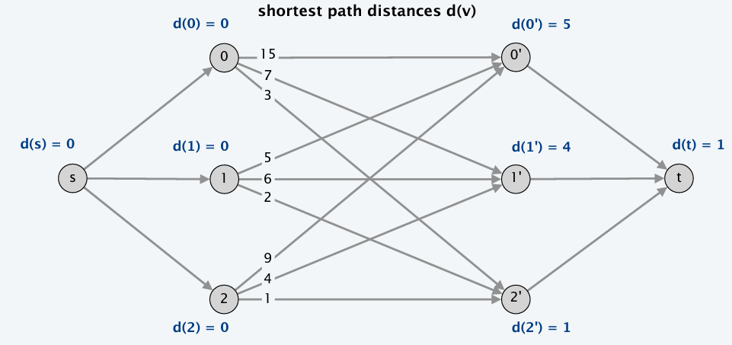
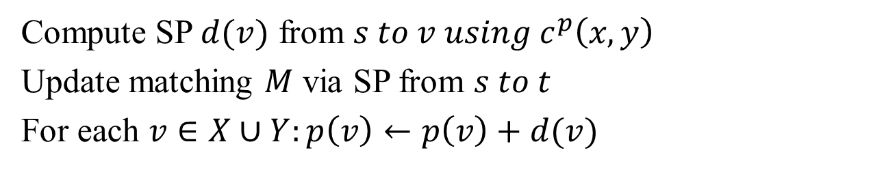
Example: SSP Step 1
Compute SP $d(v)$ from $s to v using c^{p}\left(x,y\right)$
Update matching $M$ via SP from $s to t$
For each $v∈X∪Y:p\left(v\right)←p\left(v\right)+d(v)$

Slide 31
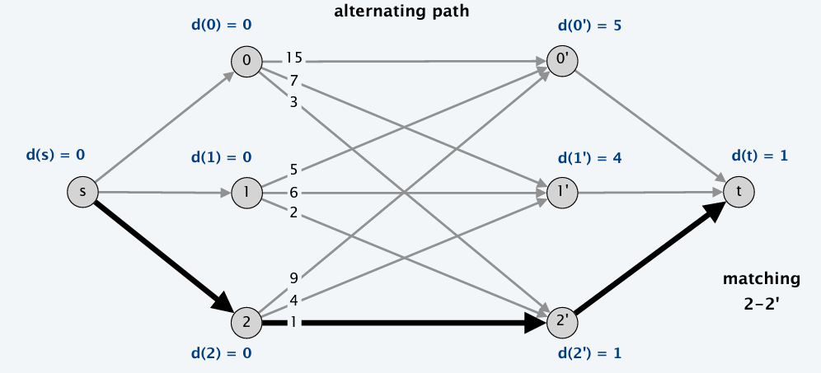
Example: SSP Step 1
Compute SP $d(v)$ from $s to v using c^{p}\left(x,y\right)$
Update matching $M$ via SP from $s to t$
For each $v∈X∪Y:p\left(v\right)←p\left(v\right)+d(v)$

Slide 32
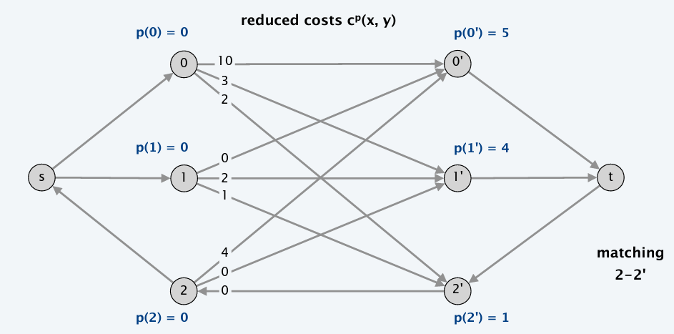
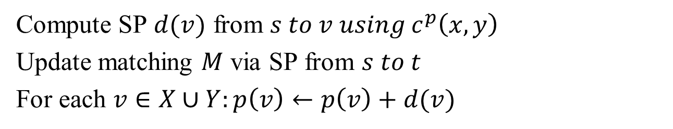
Example: SSP Step 1
Compute SP $d(v)$ from $s to v using c^{p}\left(x,y\right)$
Update matching $M$ via SP from $s to t$
For each $v∈X∪Y:p\left(v\right)←p\left(v\right)+d(v)$

Slide 33
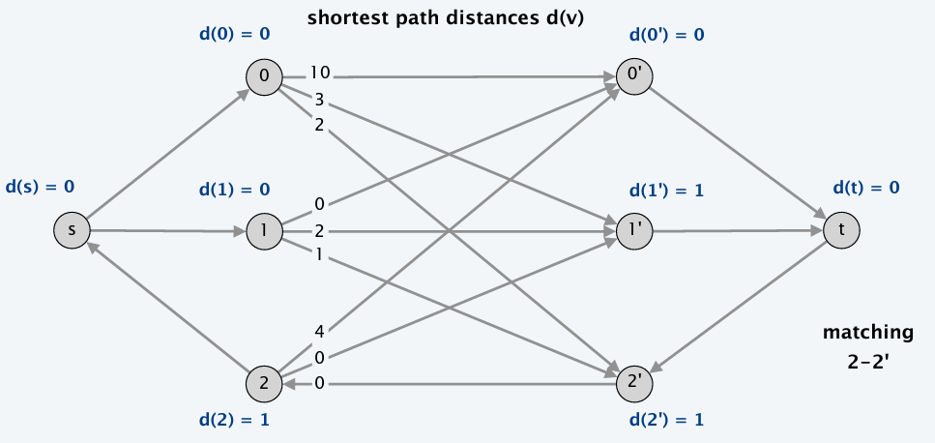
Example: SSP Step 2
Compute SP $d(v)$ from $s to v using c^{p}\left(x,y\right)$
Update matching $M$ via SP from $s to t$
For each $v∈X∪Y:p\left(v\right)←p\left(v\right)+d(v)$

Slide 34
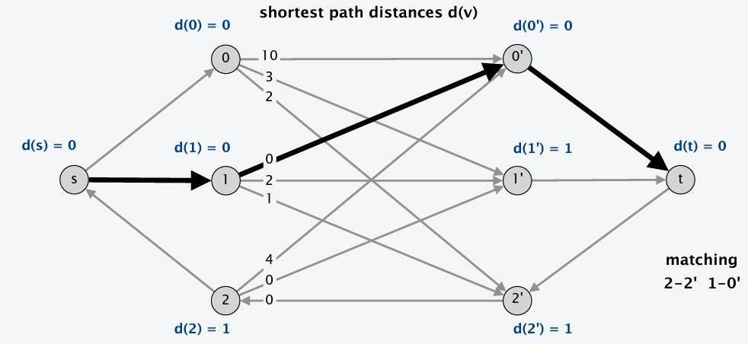
Example: SSP Step 2
Compute SP $d(v)$ from $s to v using c^{p}\left(x,y\right)$
Update matching $M$ via SP from $s to t$
For each $v∈X∪Y:p\left(v\right)←p\left(v\right)+d(v)$

Slide 35

Example: SSP Step 2
Compute SP $d(v)$ from $s to v using c^{p}\left(x,y\right)$
Update matching $M$ via SP from $s to t$
For each $v∈X∪Y:p\left(v\right)←p\left(v\right)+d(v)$

Slide 36

Example: SSP Step 3
Compute SP $d(v)$ from $s to v using c^{p}\left(x,y\right)$
Update matching $M$ via SP from $s to t$
For each $v∈X∪Y:p\left(v\right)←p\left(v\right)+d(v)$

Slide 37

Example: SSP Step 3
Compute SP $d(v)$ from $s to v using c^{p}\left(x,y\right)$
Update matching $M$ via SP from $s to t$
For each $v∈X∪Y:p\left(v\right)←p\left(v\right)+d(v)$

Slide 38

Example: SSP Step 3
Compute SP $d(v)$ from $s to v using c^{p}\left(x,y\right)$
Update matching $M$ via SP from $s to t$
For each $v∈X∪Y:p\left(v\right)←p\left(v\right)+d(v)$

Slide 39


Example: SSP Termination
$M$ is a perfect matching
Prices $p$ are compatible with $M$

Slide 40

Running time: SSP
$O(n^{3})$
Each iteration increases $\left|M\right| by one=⇒n iterations$
Bottleneck operation is computing the SP distances
Each iteration takes $O(n^{2})$ time using Dijkstra

Slide 41

Weighted Bipartite Matching
Given weighted bipartite graph with n nodes and m edges, find a maximum cardinality matching of minimum weight
Two Hungarian mathematicians proposed solution: Hungarian algorithm in 1955
In 1957, Mukres observed $O\left(n^{4}\right)$ implementation
In 1971, Edmonds-Karp improved to $O\left(n^{3}\right)$

Slide 42




Assignment Problem: Another view
A max-weight perfect matching
Vertex labeling is a function $l:V→R$
A feasible labeling satisfies $l\left(x\right)+l\left(y\right)≥w\left(x,y\right)∀x∈X, y∈Y$
Equality graph (wrt $l$) is $G_{l}=\left(V, E_{l}\right), E_{l}=\{\left(x,y\right):l\left(x\right)+l\left(y\right)=w\left(x,y\right)\}$

Slide 43

KM Theorem
Kuhn-Munkres Theorem: if $l$is feasible, and $M$ is a perfect matching in $E_{l}$ then $M$is a max-weight matching
KM Theorem transforms the optimization problem of finding a max-weight matching into a combinatorial one of finding a perfect matching. It combinatorializes the weights. A classic technique in combinatorial optimization.
For any matching $M$ and any feasible labeling $l$we have $w\left(M\right)≤\sum_{v∈V}{l(v)}$
Strong echoes of max-flow min-cut!!!

Slide 44

Max-Weight Perfect Matching Algorithm (Optional)
Start with any feasible labeling l and some matching M in $E_{l}$
While M is not perfect repeat the following:
1. Find an augmenting path for M in $E_{l};$this increases size of M
2. If no augmenting path exists, improve $l to l^{′}such that E_{l}⊂E_{l′}$ ; Goto 1
In each step of the loop, we either increase |M| or | $E_{l}$|
When algo terminates, M will be a perfect matching in $E_{l}$ for some feasible labeling l. By KM theorem, M will be a max-weight matching

Slide 45


Finding an initial feasible labeling
$$∀y∈Y, l\left(y\right)=0 ;$$
$$∀x∈X l\left(x\right)=\max_{y∈Y}{\{w\left(x,y\right)\}}$$
It maintains $l\left(x\right)+l\left(y\right)≥w(x)$

Slide 46


Improve labeling

Slide 47

Hungarian Algorithm

Slide 48

Running time
Initializing all slacks take $O\left(\left|V\right|\right) time$
Step 4: update all slacks when vertex moves from $\overline{S} to S$, it takes $O\left(\left|V\right|\right) time$; only |V| vertices can be moved, so $O\left({\left|V\right|}^{2}\right) time$
Step 3: $α_{l}$ can be calculated in $O\left(\left|V\right|\right) time$, at most |V| times per phase, so $O\left({\left|V\right|}^{2}\right) time$
|V| phases and $O\left({\left|V\right|}^{2}\right)$work per phase, so $O\left({\left|V\right|}^{3}\right) time$

Slide 49
Lecture 14 Summary
Linear programming: Duality
Zero-sum games
Min-weight perfect matching
Max-weight perfect matching (optional)

