Slide 1
Design and Analysis of Algorithms
Sid Nath (snath@scu.edu)
Lecture 16
Nov 16, 2022

Slide 2
Agenda
Administrative
Intractability

Slide 3
Administrative
No algo design questions on global opto, approx. and randomized algo topics. At most, short-answer qs.
Finals details announced
Part 1 (take-home, 6hrs, 4-5 algo design questions)
Sat Dec 3, 2022 2p-8p (finalized)
Part 2 (in-class)

Slide 4
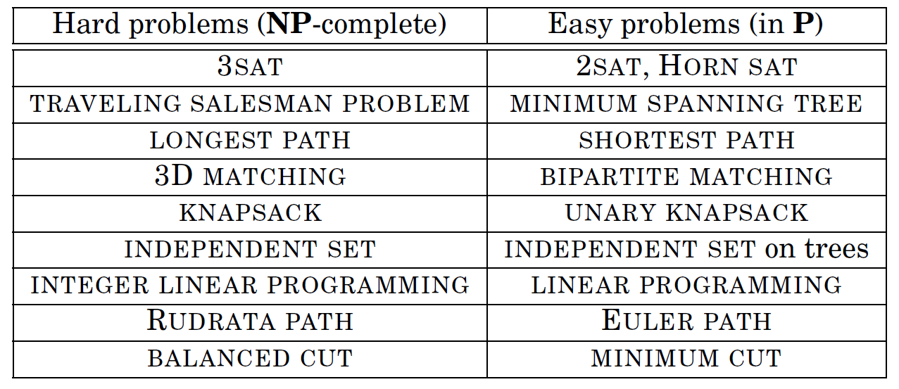
Hard (NP) vs. Easy (P)

Slide 5
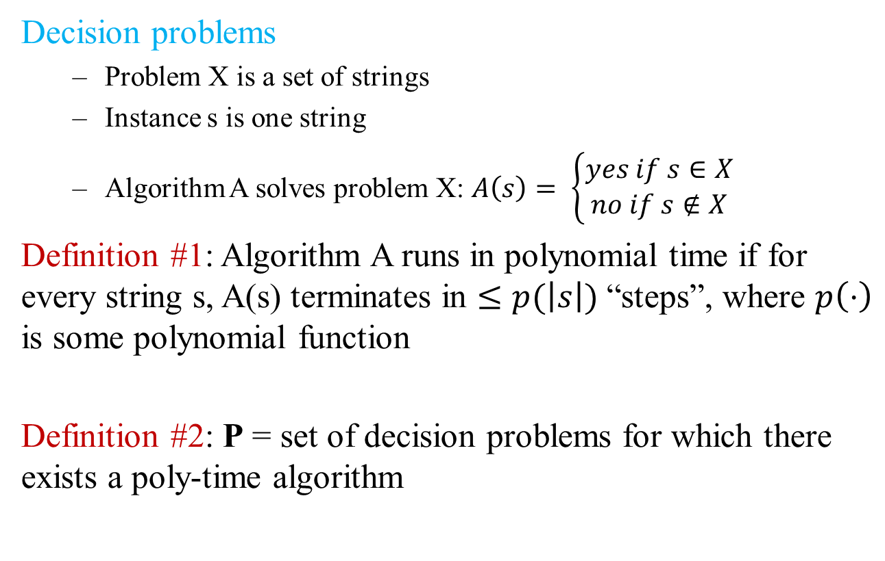
P
Decision problems
Problem X is a set of strings
Instance s is one string
Algorithm A solves problem X: $A\left(s\right)= \left\{\begin{aligned}yes if s∈X \\ no if s∉X\end{aligned}\right.$
Definition #1: Algorithm A runs in polynomial time if for every string s, A(s) terminates in $≤p(\left|s\right|)$ “steps”, where $p\left(⋅\right)$ is some polynomial function
Definition #2: P = set of decision problems for which there exists a poly-time algorithm

Slide 6
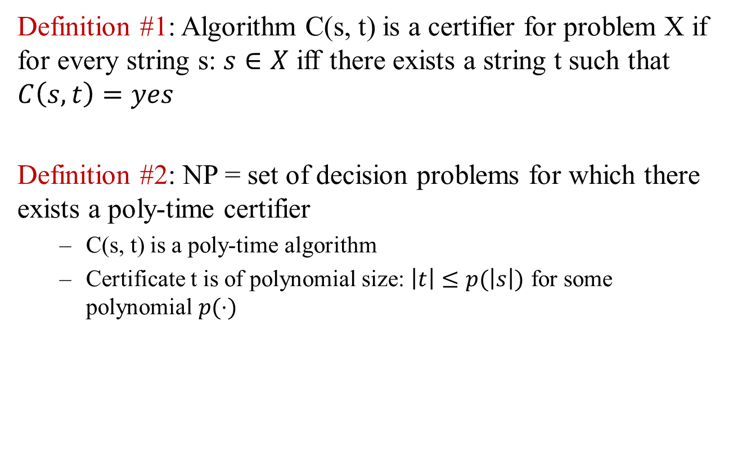
NP
Definition #1: Algorithm C(s, t) is a certifier for problem X if for every string s: $s∈X$ iff there exists a string t such that $C\left(s, t\right)=yes$
Definition #2: NP = set of decision problems for which there exists a poly-time certifier
C(s, t) is a poly-time algorithm
Certificate t is of polynomial size: $\left|t\right|≤p(\left|s\right|)$ for some polynomial $p(⋅)$

Slide 7
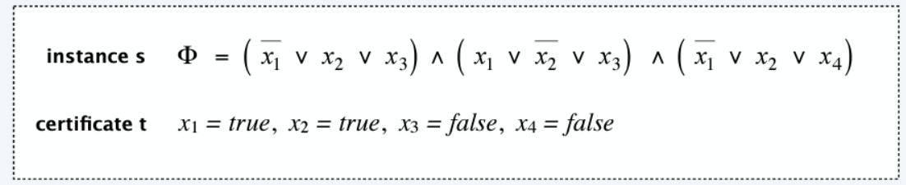
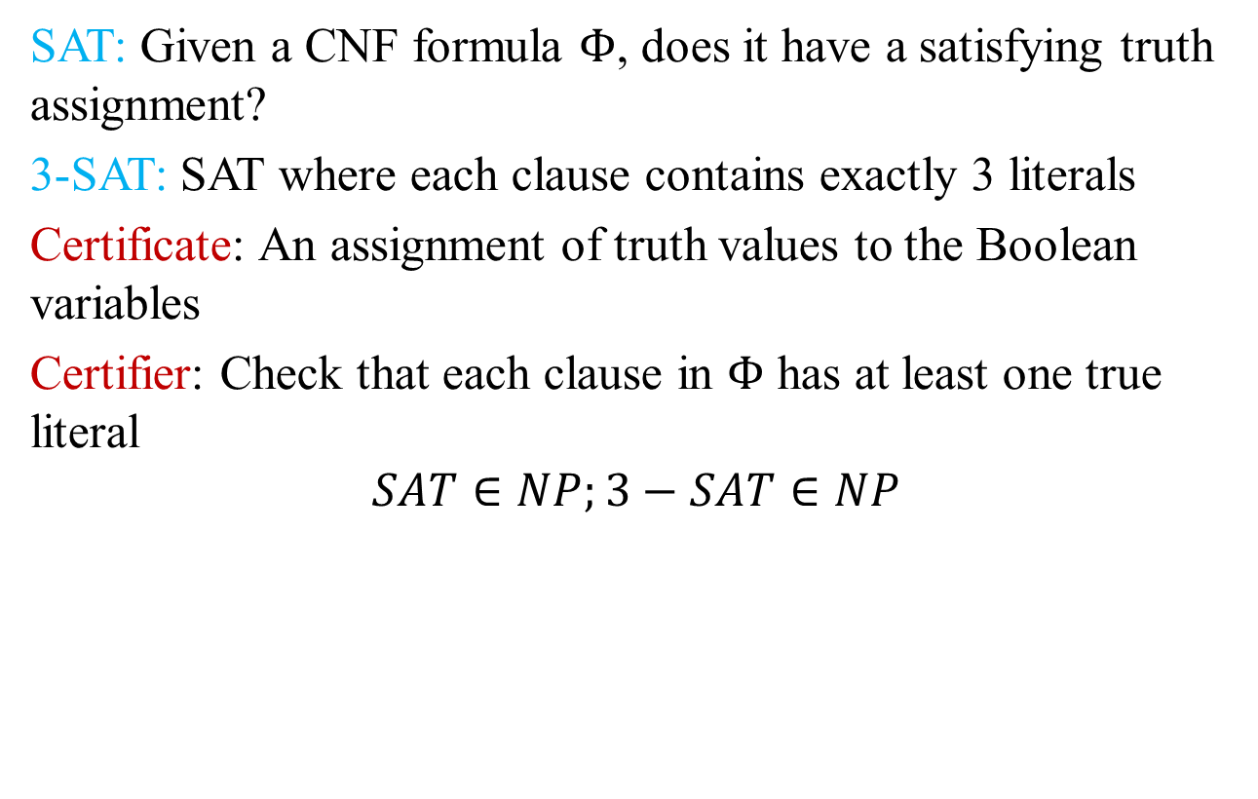
Certifiers and certificates: Satisfiability
SAT: Given a CNF formula $Φ$, does it have a satisfying truth assignment?
3-SAT: SAT where each clause contains exactly 3 literals
Certificate: An assignment of truth values to the Boolean variables
Certifier: Check that each clause in $Φ$ has at least one true literal
$$SAT∈NP;3−SAT∈NP$$

Slide 8
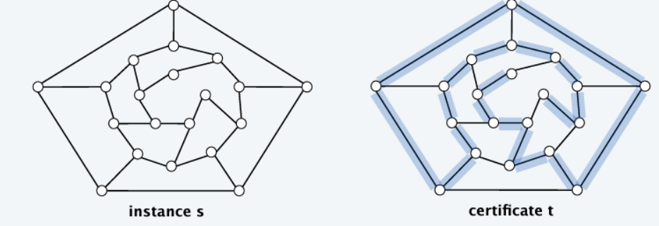
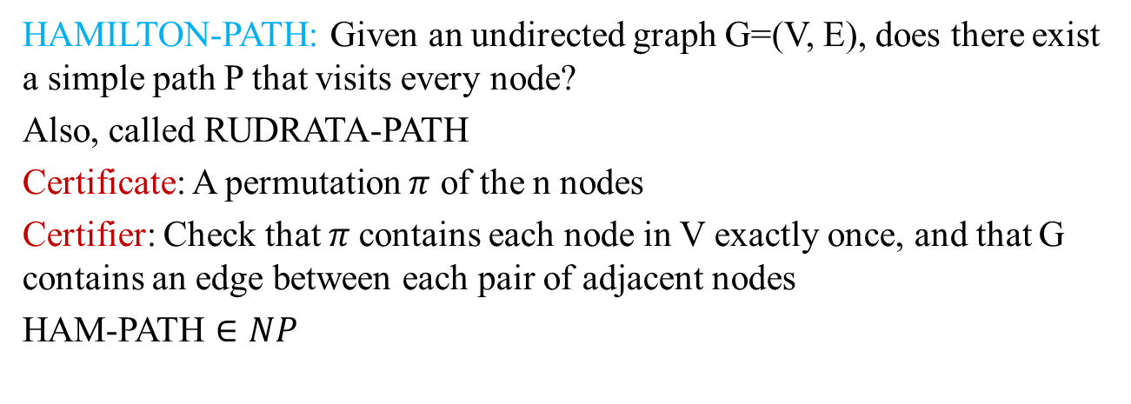
Certifiers and certificates: Hamilton path
HAMILTON-PATH: Given an undirected graph G=(V, E), does there exist a simple path P that visits every node?
Also, called RUDRATA-PATH
Certificate: A permutation $π$ of the n nodes
Certifier: Check that $π$contains each node in V exactly once, and that G contains an edge between each pair of adjacent nodes
HAM-PATH $∈NP$

Slide 9
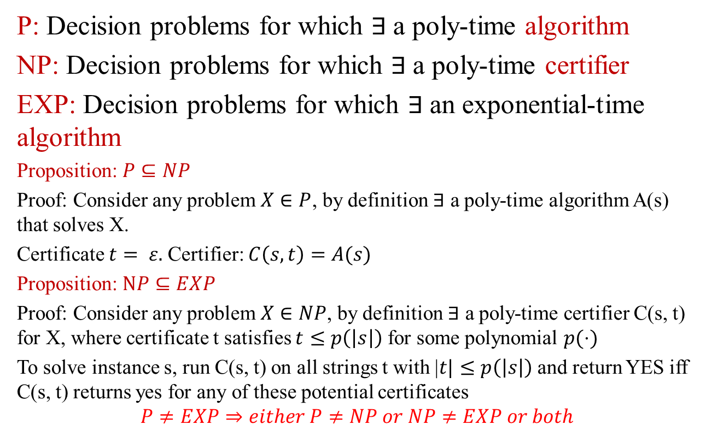
P, NP, EXP
P: Decision problems for which $∃$a poly-time algorithm
NP: Decision problems for which $∃$a poly-time certifier
EXP: Decision problems for which $∃$an exponential-time algorithm
Proposition: $P⊆NP$
Proof: Consider any problem $X∈P$, by definition $∃$ a poly-time algorithm A(s) that solves X.
Certificate $t= ε.$Certifier: $C\left(s, t\right)=A(s)$
Proposition: $NP⊆EXP$
Proof: Consider any problem $X∈NP$, by definition $∃$ a poly-time certifier C(s, t) for X, where certificate t satisfies $t≤p\left(\left|s\right|\right)$ for some polynomial $p(⋅)$
To solve instance s, run C(s, t) on all strings t with |$t|≤p\left(\left|s\right|\right)$ and return YES iff C(s, t) returns yes for any of these potential certificates
$$P≠EXP⇒either P≠NP or NP≠EXP or both$$

Slide 10
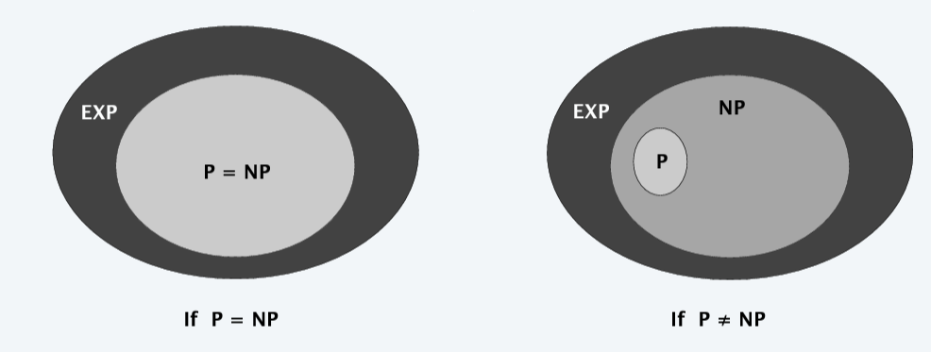
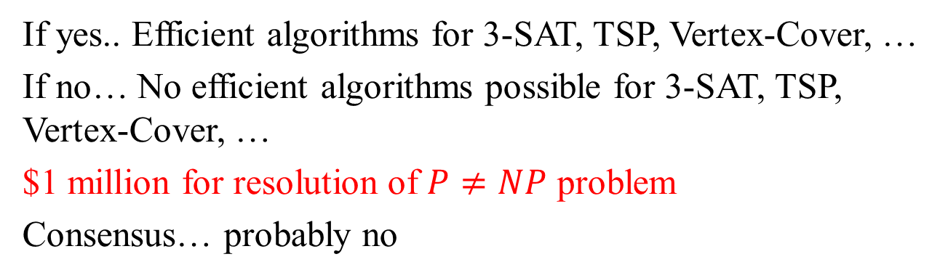
P vs. NP: Main question
If yes.. Efficient algorithms for 3-SAT, TSP, Vertex-Cover, …
If no… No efficient algorithms possible for 3-SAT, TSP, Vertex-Cover, …
$1 million for resolution of $P≠NP$ problem
Consensus… probably no

Slide 11
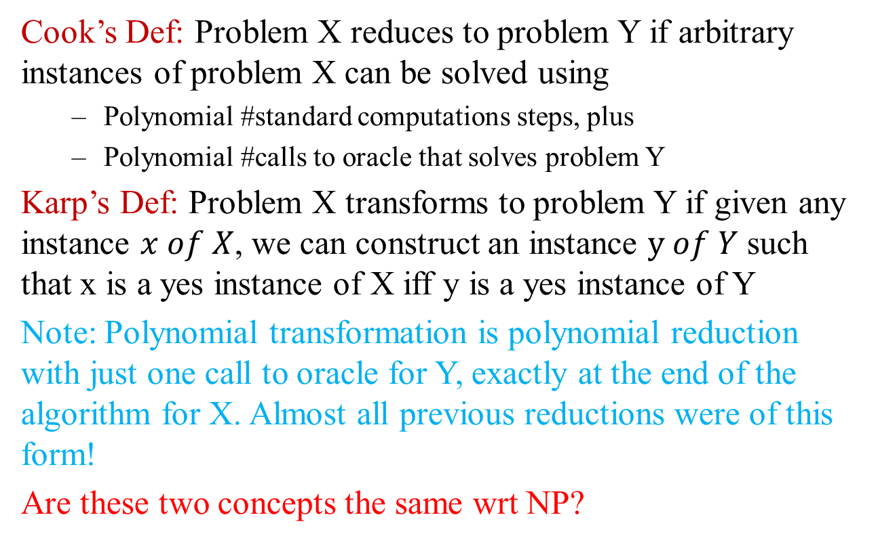
Polynomial Transformations
Cook’s Def: Problem X reduces to problem Y if arbitrary instances of problem X can be solved using
Polynomial #standard computations steps, plus
Polynomial #calls to oracle that solves problem Y
Karp’s Def: Problem X transforms to problem Y if given any instance $x of X$, we can construct an instance $y of Y$ such that x is a yes instance of X iff y is a yes instance of Y
Note: Polynomial transformation is polynomial reduction with just one call to oracle for Y, exactly at the end of the algorithm for X. Almost all previous reductions were of this form!
Are these two concepts the same wrt NP?

Slide 12
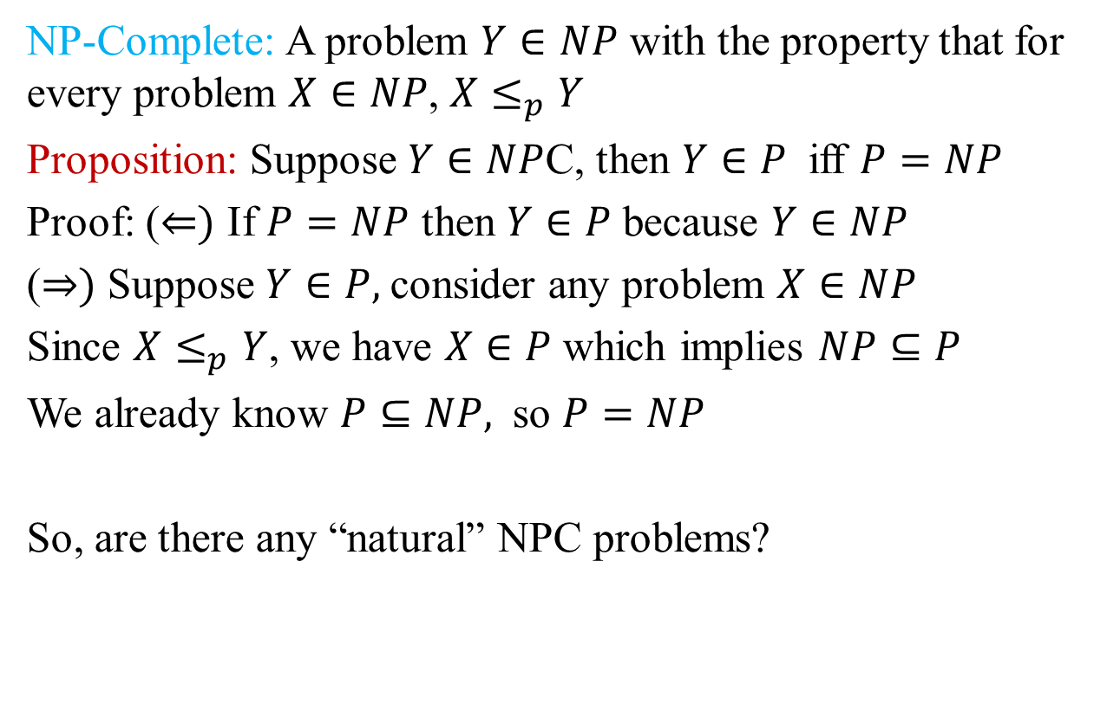
NP-complete
NP-Complete: A problem $Y∈NP$ with the property that for every problem $X∈NP$, $X≤_{p}Y$
Proposition: Suppose $Y∈NP$C, then $Y∈P$ iff $P=NP$
Proof: ($⇐)$ If $P=NP$ then $Y∈P$because $Y∈NP$
($⇒)$ Suppose $Y∈P,$consider any problem $X∈NP$
Since $X≤_{p}Y$, we have $X∈P$which implies $NP⊆P$
We already know $P⊆NP,$ so $P=NP$
So, are there any “natural” NPC problems?

Slide 13
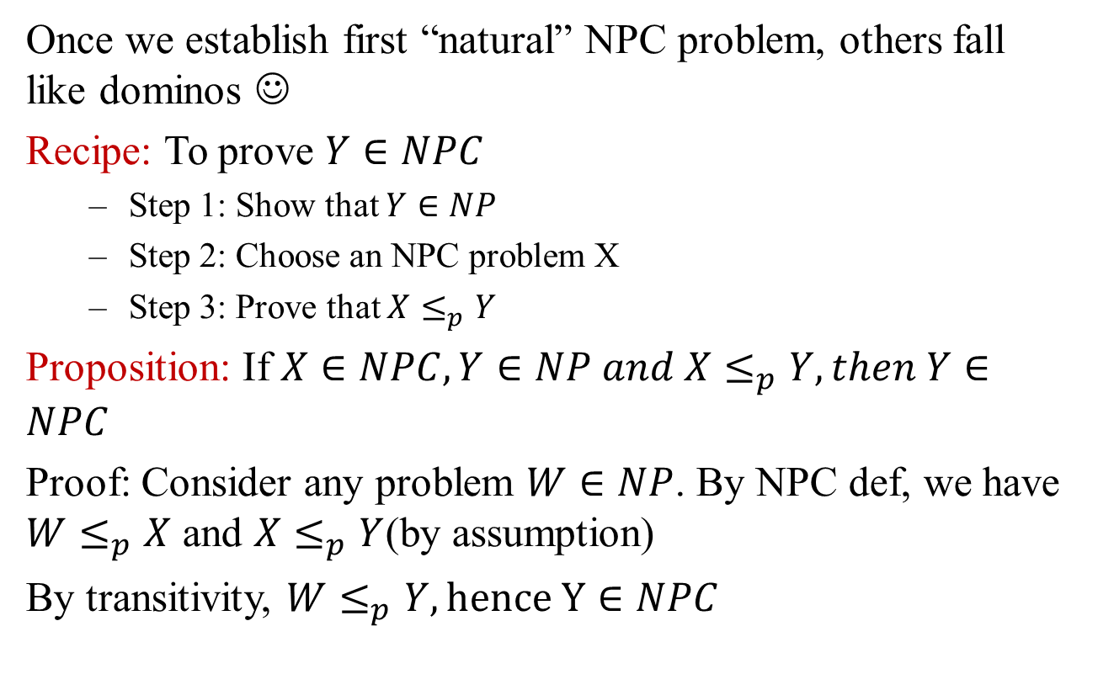
Establishing NP-completeness
Once we establish first “natural” NPC problem, others fall like dominos ☺
Recipe: To prove $Y∈NPC$
Step 1: Show that $Y∈NP$
Step 2: Choose an NPC problem X
Step 3: Prove that $X≤_{p}Y$
Proposition: If $X∈NPC, Y∈NP and X≤_{p}Y, then Y∈NPC$
Proof: Consider any problem $W∈NP$. By NPC def, we have $W≤_{p}X$ and $X≤_{p}Y$(by assumption)
By transitivity, $W≤_{p}Y, hence Y∈NPC$

Slide 14
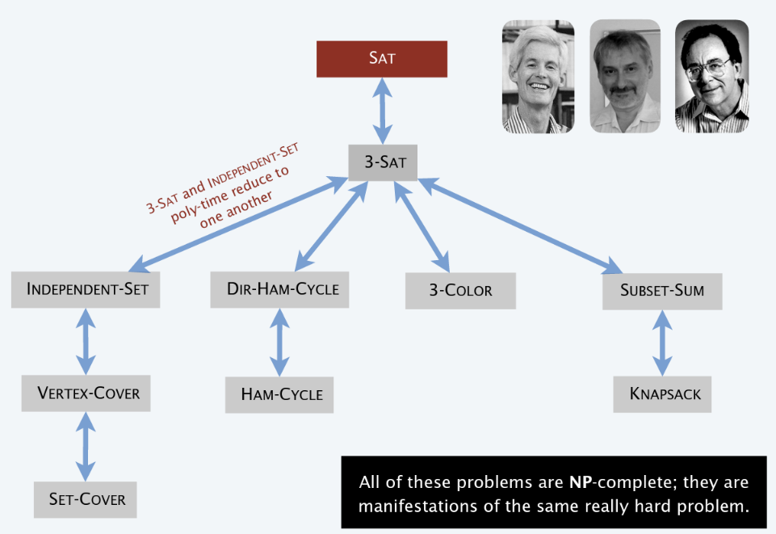
Implications of Cook-Levin + Karp

Slide 15
Some NPC problems
Basic genres of NPC problems and paradigmatic examples
Packing/covering: SET-COVER, VERTEX-COVER, INDEPENDENT-SET
Constraint satisfaction: CIRCUIT-SAT, SAT, 3-SAT
Sequencing: HAM-CYCLE, TSP
Partitioning: 3D-MATCHING, 3-COLOR
Numerical: SUBSET-SUM, KNAPSACK
Most NP problems are known to be either in P or NPC

Slide 16
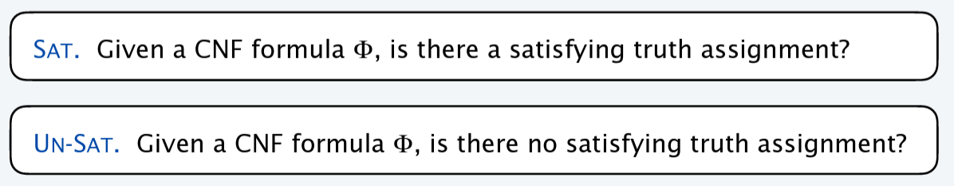
Asymmetry of NP
We need short certificates only for yes instance
Example: SAT vs. UN-SAT
Can prove a CNF formula is satisfiable by specifying an assignment
How could we prove that a formula is not satisfiable?

Slide 17
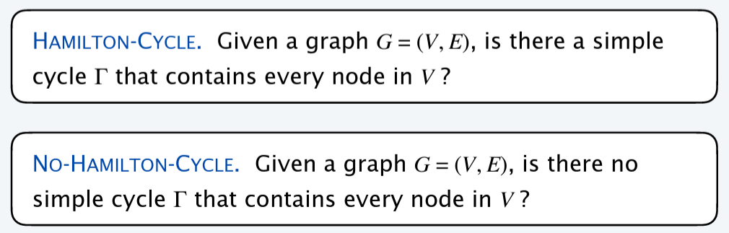
Asymmetry of NP
We need short certificates only for yes instance
Example: HAM-CYCLE vs. NO-HAM-CYCLE
Can prove a graph is Hamiltonian by specifying a permutation
How could we prove that a graph is not Hamiltonian?

Slide 18
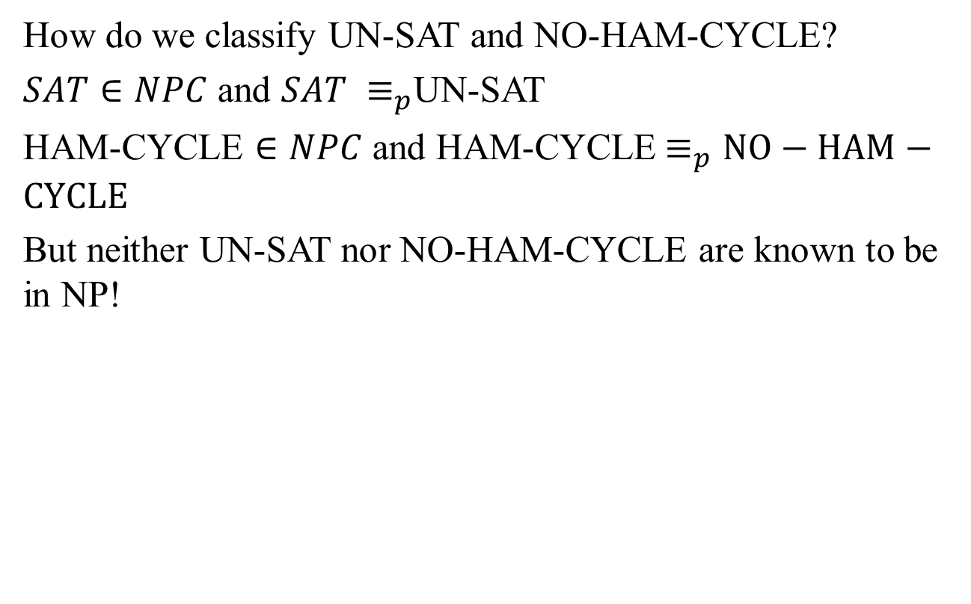
Asymmetry of NP
How do we classify UN-SAT and NO-HAM-CYCLE?
$SAT∈NPC$ and $SAT ≡_{p}$UN-SAT
HAM-CYCLE $∈NPC$ and HAM-CYCLE$≡_{p}NO−HAM−CYCLE$
But neither UN-SAT nor NO-HAM-CYCLE are known to be in NP!

Slide 19
NP and co-NP
NP: Decision problems for which there is a poly-time certifier
Definition: Given a decision problem X, its complete X’ is the same problem with yes and no answers reversed
Example: X = {4, 6, 8, 9, 10, 12, 14, 15, …}
X’ = { 2, 3, 5, 7, 11, 13, 17, 23, 29, …. }
Co-NP: Complements of decision problems in NP
E.g., UN-SAT, NO-HAM-CYCLE, PRIMES

Slide 20
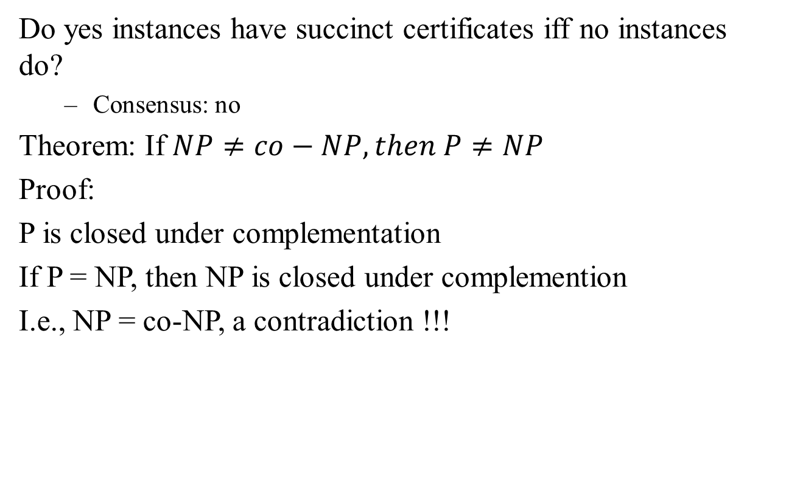
NP = co-NP?
Do yes instances have succinct certificates iff no instances do?
Consensus: no
Theorem: If $NP≠co−NP, then P≠NP$
Proof:
P is closed under complementation
If P = NP, then NP is closed under complemention
I.e., NP = co-NP, a contradiction !!!

Slide 21
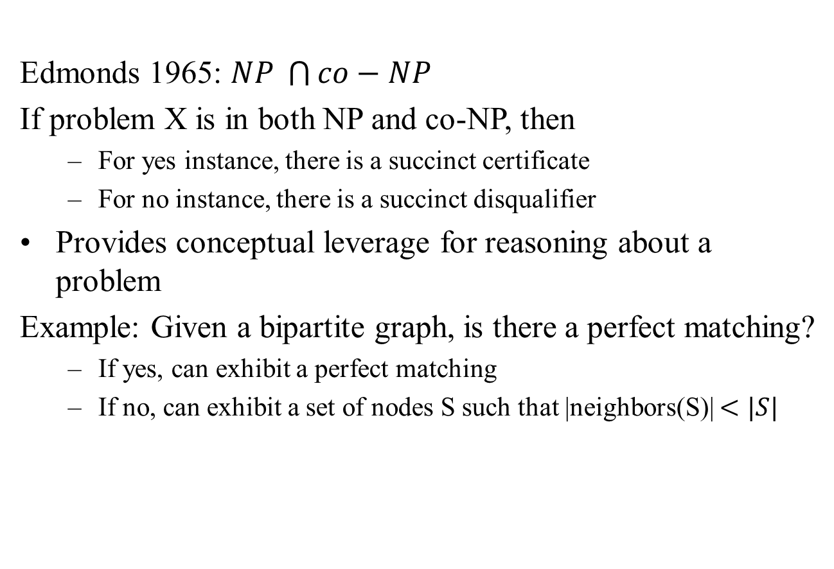
Good characterizations
Edmonds 1965: $NP \bigcap{co−NP}$
If problem X is in both NP and co-NP, then
For yes instance, there is a succinct certificate
For no instance, there is a succinct disqualifier
Provides conceptual leverage for reasoning about a problem
Example: Given a bipartite graph, is there a perfect matching?
If yes, can exhibit a perfect matching
If no, can exhibit a set of nodes S such that |neighbors(S)| $<|S|$

Slide 22
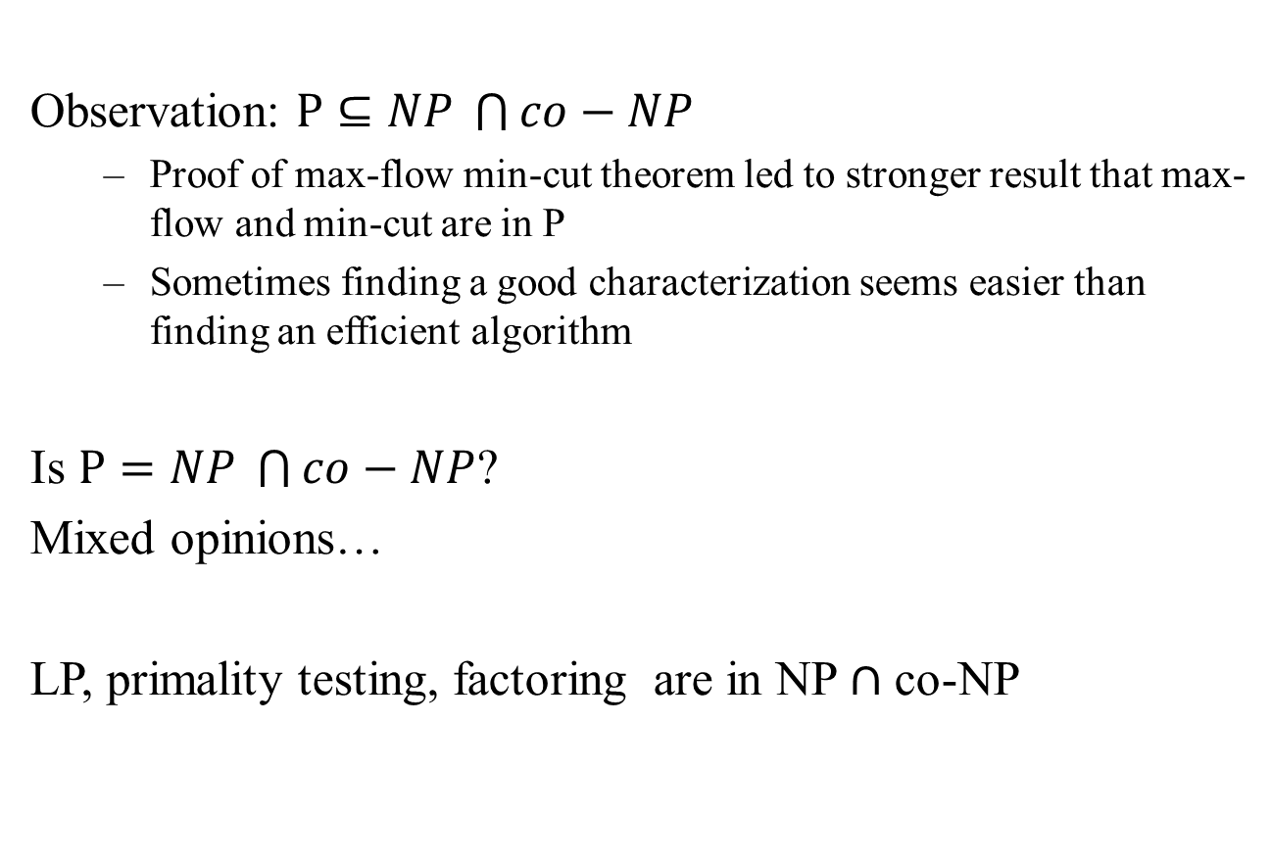
Good characterizations
Observation: $P⊆NP \bigcap{co−NP}$
Proof of max-flow min-cut theorem led to stronger result that max-flow and min-cut are in P
Sometimes finding a good characterization seems easier than finding an efficient algorithm
Is $P=NP \bigcap{co−NP}$?
Mixed opinions…
LP, primality testing, factoring are in NP $∩$ co-NP

Slide 23
NP-Hard
NP-Complete: A problem in NP such that every problem in NP poly-time reduces to it
NP-Hard: A problem such that every problem in NP poly-time reduces to it

Slide 24
Coping with NP-completeness
What should I do to solve an NP-hard problem?
Sacrifice one of these 3 desired features
Solve arbitrary instances of the problem
Solve problem to optimality
Solve problem in poly-time
Coping strategies
Design algorithms for special cases of the problem
Design approximation algorithms
Design algorithms that may take exponential time
(make use of greedy, DP, DQ, network flow algorithms!!!)

Slide 25
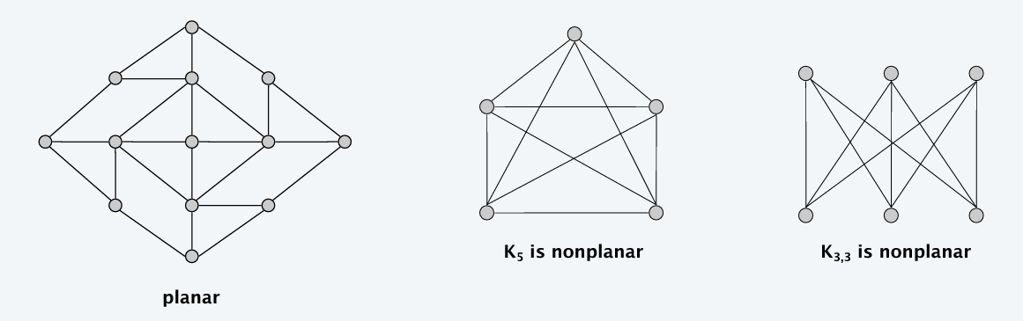
Graph Planarity
A graph is planar if it can be embedded in the plane in such a way that no two edges cross
Used a lot in computer graphs, VLSI
There exists O(n) algorithm to determine whether a graph is planar

Slide 26
Problems on planar graphs
Many graph problems can be solved faster in planar graphs
Shortest path, max-flows, MST, matchings, …
Some NPC problems become tractable in planar graphs
MAX-CUT, ISING, CLIQUE, GRAPH-ISOMORPHISM, 4-COLOR
Other NPC problems become easier in planar graphs
INDEPENDENT-SET, VERTEX-COVER, TSP, STEINER-TREE

Slide 27
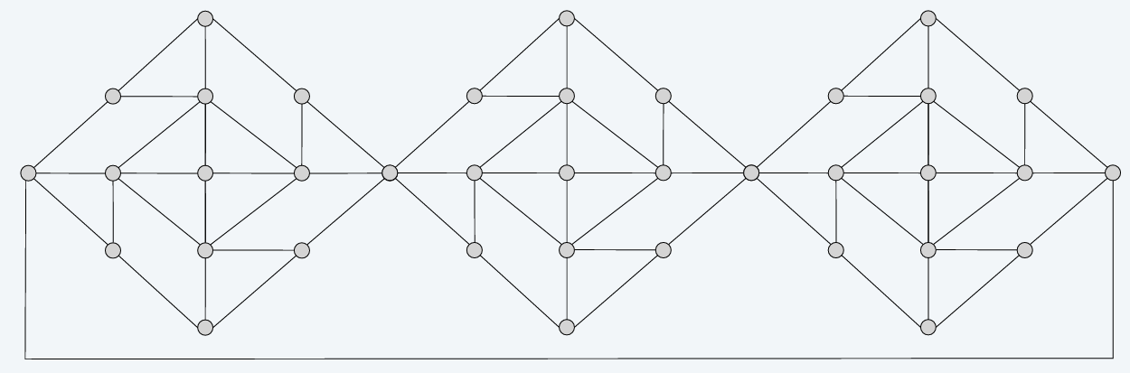
3-COLORABILITY on Planar Graph
PLANAR-3-COLOR: Given a planar graph, can it be colored using 3 colors so that no two adjacent nodes have the same color?

Slide 28
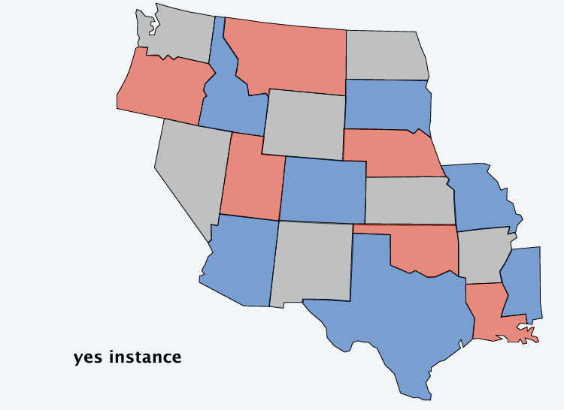
Planar map 3-COLORABILITY
PLANAR-MAP-3-COLOR: Given a planar map, can it be colored using 3 colors so that no two adjacent regions have the same color?

Slide 29
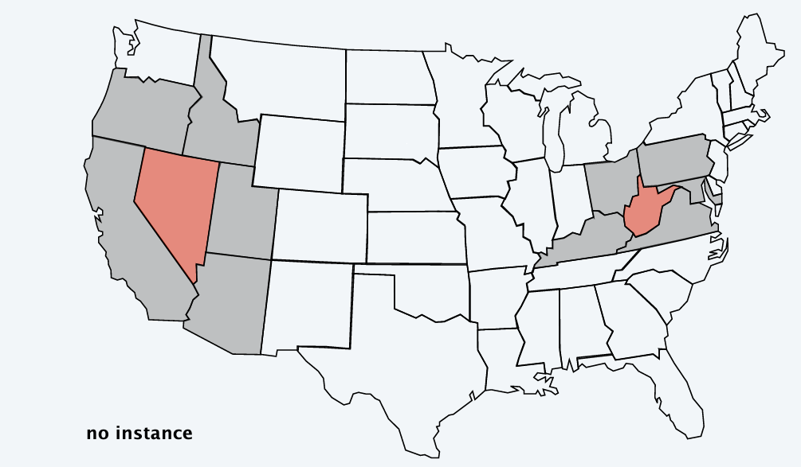
3-COLORABILITY on Planar Graph
PLANAR-MAP-3-COLOR: Given a planar map, can it be colored using 3 colors so that no two adjacent regions have the same color?

Slide 30
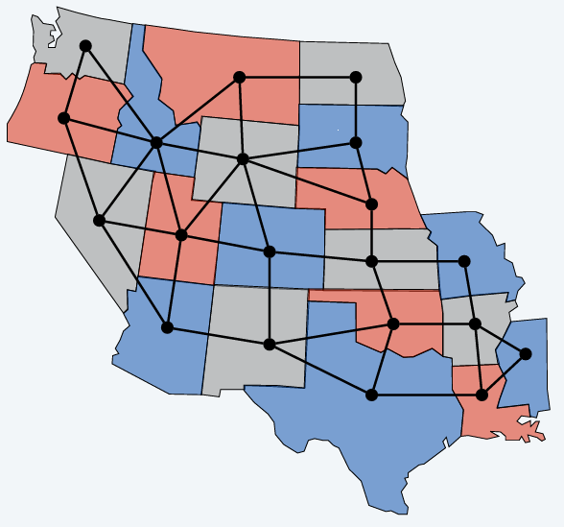
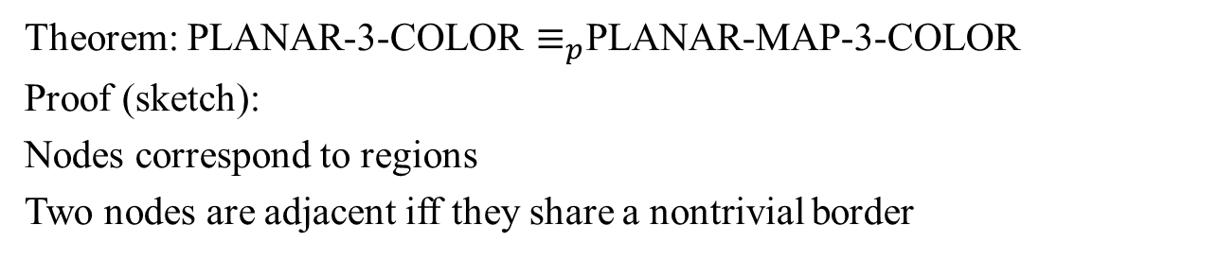
Planar graph and map 3-colorability reduce to one another
Theorem: PLANAR-3-COLOR $≡_{p}$PLANAR-MAP-3-COLOR
Proof (sketch):
Nodes correspond to regions
Two nodes are adjacent iff they share a nontrivial border

Slide 31
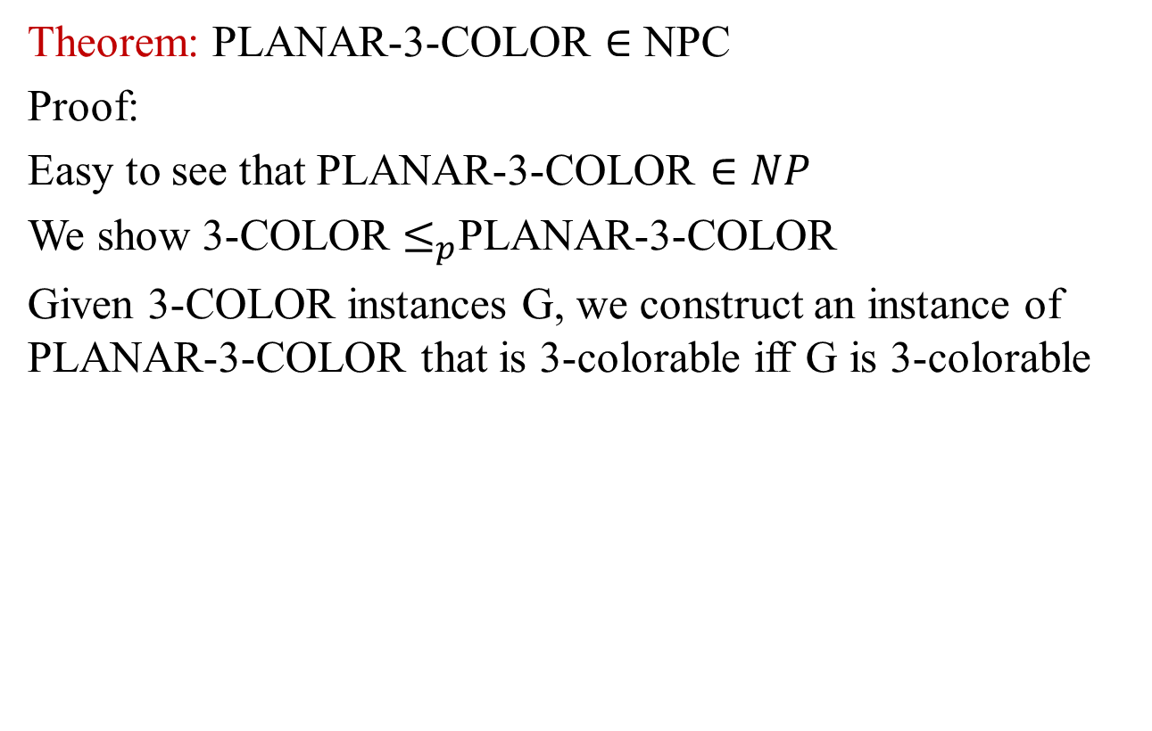
Planar 3-Colorability is NP-Complete
Theorem: PLANAR-3-COLOR $∈$ NPC
Proof:
Easy to see that PLANAR-3-COLOR $∈NP$
We show 3-COLOR $≤_{p}$PLANAR-3-COLOR
Given 3-COLOR instances G, we construct an instance of PLANAR-3-COLOR that is 3-colorable iff G is 3-colorable

Slide 32
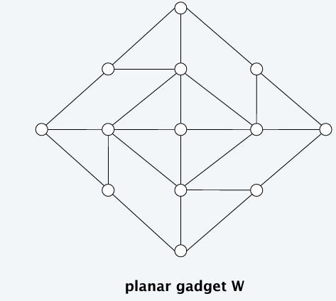
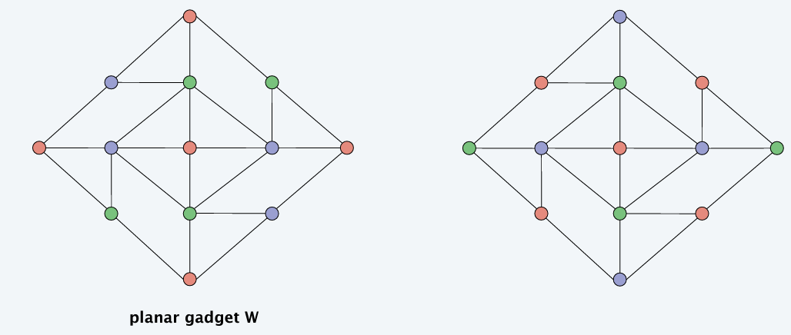
Planar 3-Colorability is NP-Complete
Lemma: W is a planar graph such that
In any 3-coloring of W, opposite corners have the same color
Any assignment of colors to the corners in which opposite corners have the same color extends to a 3-coloring of W

Slide 33
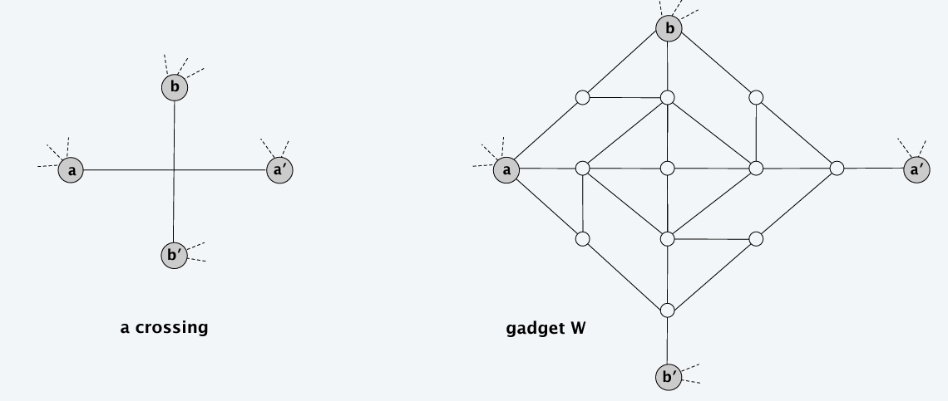
Planar 3-Colorability is NP-Complete
Construction: Given instance G of 3-COLOR, draw G in plane letting edges cross. Form planar G’ by replacing each edge crossing with planar gadget W

Slide 34
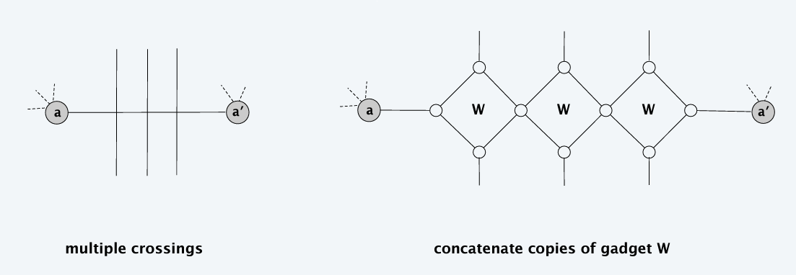
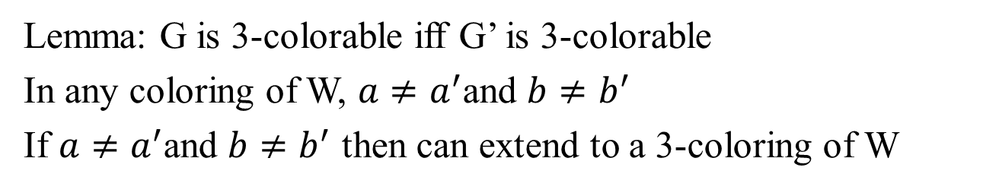
Planar 3-Colorability is NP-Complete
Lemma: G is 3-colorable iff G’ is 3-colorable
In any coloring of W, $a≠a^{′}$and $b≠b^{′}$
If $a≠a^{′}$and $b≠b^{′}$ then can extend to a 3-coloring of W

Slide 35
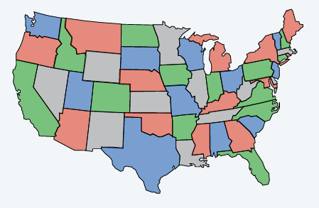
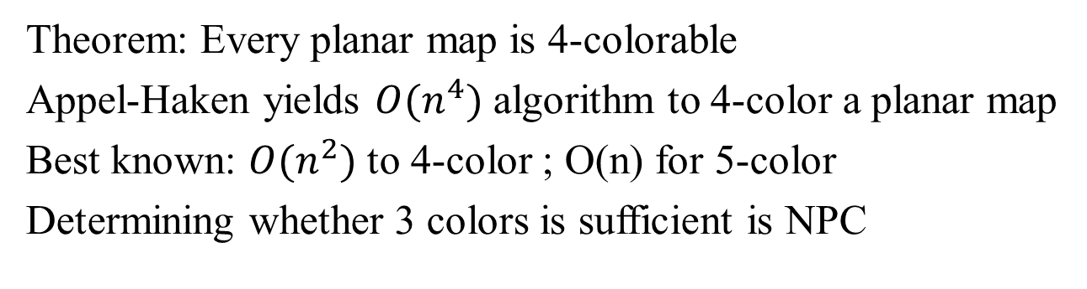
Planar map k-colorability
Theorem: Every planar map is 4-colorable
Appel-Haken yields $O(n^{4})$ algorithm to 4-color a planar map
Best known: $O(n^{2})$ to 4-color ; O(n) for 5-color
Determining whether 3 colors is sufficient is NPC

Slide 36
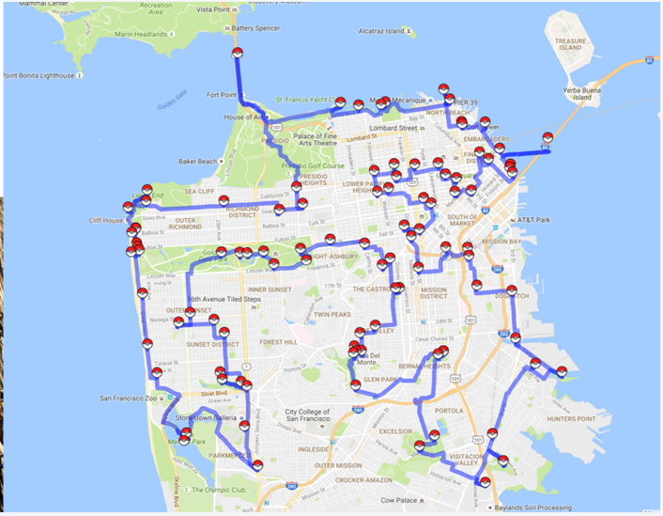
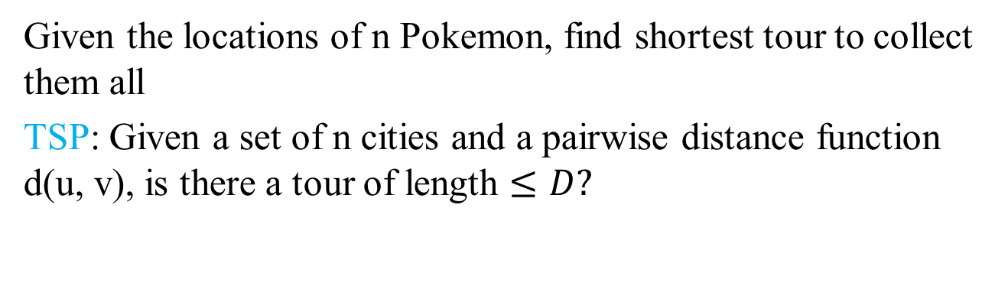
Pokemon Go (TSP)
Given the locations of n Pokemon, find shortest tour to collect them all
TSP: Given a set of n cities and a pairwise distance function d(u, v), is there a tour of length $≤D?$

Slide 37
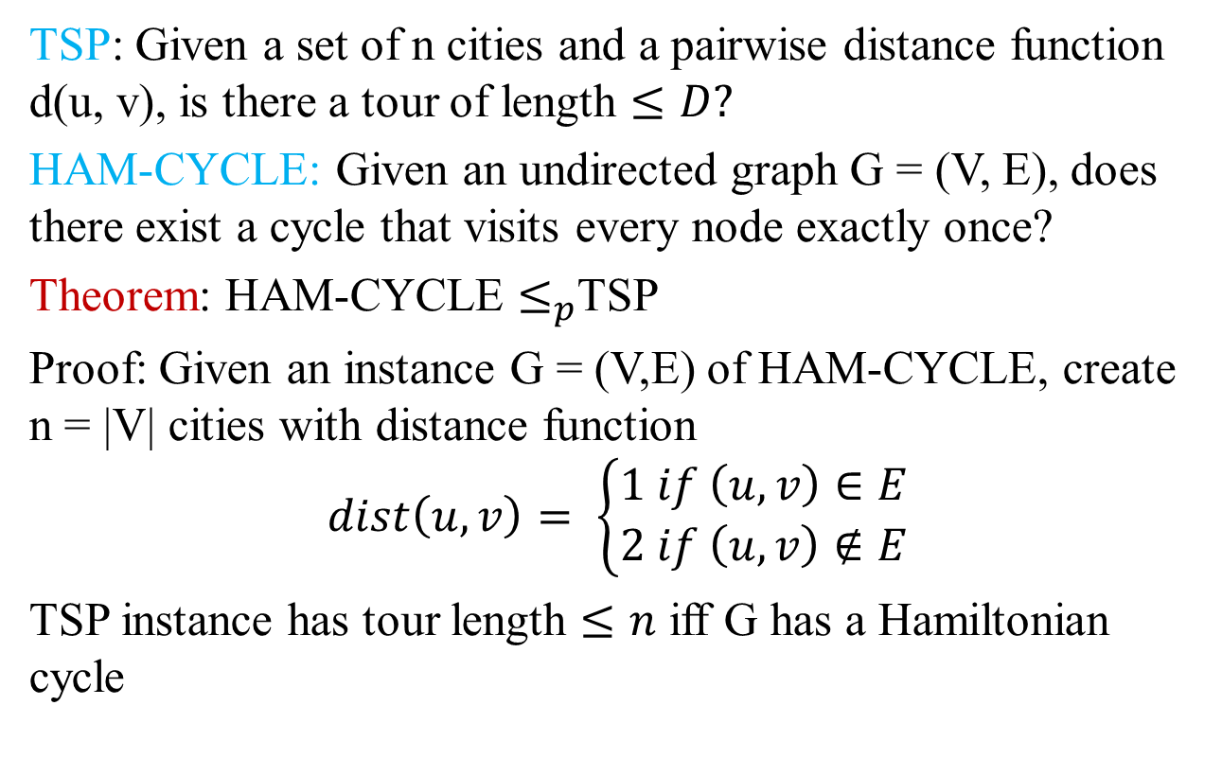
HAM-CYCLE reduces to TSP
TSP: Given a set of n cities and a pairwise distance function d(u, v), is there a tour of length $≤D?$
HAM-CYCLE: Given an undirected graph G = (V, E), does there exist a cycle that visits every node exactly once?
Theorem: HAM-CYCLE $≤_{p}$TSP
Proof: Given an instance G = (V,E) of HAM-CYCLE, create n = |V| cities with distance function
$$dist\left(u, v\right)= \left\{\begin{aligned}1 if \left(u, v\right)∈E \\ 2 if \left(u, v\right)∉E\end{aligned}\right.$$
TSP instance has tour length $≤n$ iff G has a Hamiltonian cycle

Slide 38
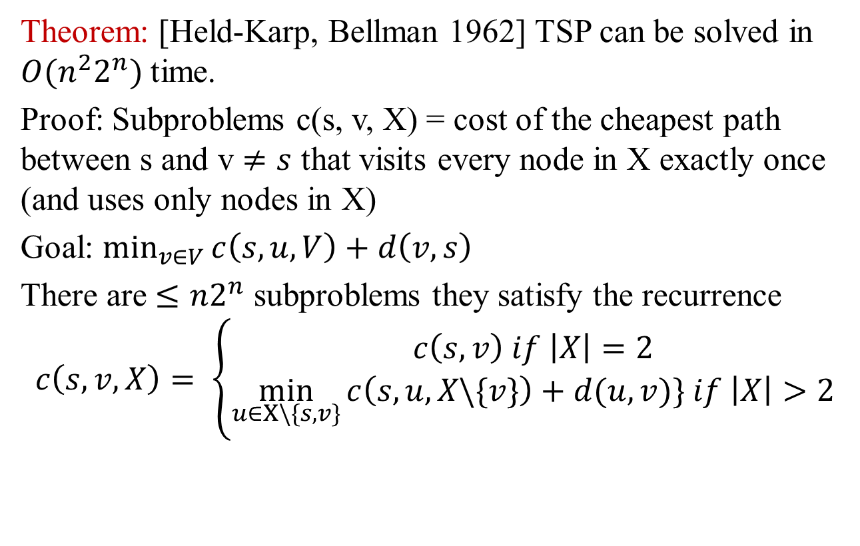
Exponential algorithm for TSP: DP
Theorem: [Held-Karp, Bellman 1962] TSP can be solved in $O(n^{2}2^{n})$ time.
Proof: Subproblems c(s, v, X) = cost of the cheapest path between s and v $≠s$ that visits every node in X exactly once (and uses only nodes in X)
Goal: $\min_{v∈V}{c\left(s, u, V\right)+d\left(v, s\right)}$
There are $≤n2^{n}$ subproblems they satisfy the recurrence
$$c\left(s, v, X\right)= \left\{\begin{aligned}c\left(s, v\right) if \left|X\right|=2 \\ \min_{u∈X\backslash \{s,v\}}{c\left(s, u, X\backslash \{v\}\right)+d(u,v)}\} if \left|X\right|>2\end{aligned}\right.$$

Slide 39
Concorde TSP Solver
LP + branch-and-bound + polyhedral combinatorics
Greedy heuristics, including Lin-Kernighan
MST, Delaunay triangulations, fractional b-matchings
Concorde has solved all 110 TSPLIB instances!!!

Slide 40
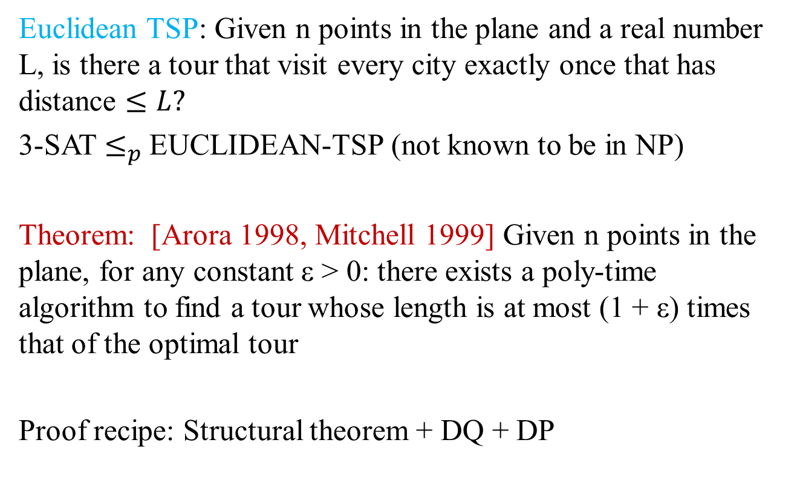
Euclidean TSP
Euclidean TSP: Given n points in the plane and a real number L, is there a tour that visit every city exactly once that has distance $≤L?$
3-SAT $≤_{p}$EUCLIDEAN-TSP (not known to be in NP)
Theorem: [Arora 1998, Mitchell 1999] Given n points in the plane, for any constant ε > 0: there exists a poly-time algorithm to find a tour whose length is at most (1 + ε) times that of the optimal tour
Proof recipe: Structural theorem + DQ + DP

Slide 41
Lecture 16 Summary
Intractability
P vs. NP
NP-complete
Co-NP
Coping with NP-completeness
No more extra credit Qs!!! ☺

