Slide 1
Big Data Architecture and Governance
Analysis of Global Trade Statistics Dataset
Dileep Ravindranath Holla
Shaunak Prabhu

Slide 2
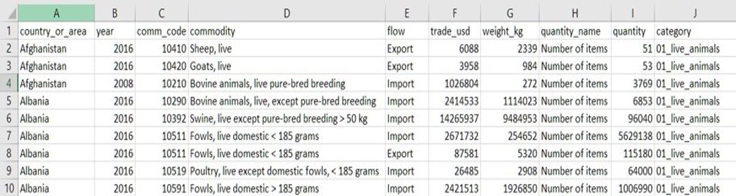
About the Data
The dataset is the Global Commodity Trade Statistics dataset published by the United Nations.
This dataset covers import and export volumes for 5,000 commodities across most countries on Earth over the last 30 years.
The dataset has 10 fields and contains over 8 million records.
This dataset can be used to draw interesting insights on which countries trade on which commodities as well as the trade weights, trade values and how trades increased or decreased in nations over time.

Slide 3
Use Cases of the Dataset
Through analysis of trade data, you can reveal key insights about domestic and global markets to better inform your business decisions. Trade data can illustrate the mechanics of product supply chains and domestic demand for goods and services, as well as recent shifts in the movement of raw materials between nations
Trade analysis can help identify how materials are acquired and value is added by different nations. As such, there may be a correlation between the flow of raw materials into one country and the exports from that country of finished goods, or intermediate parts.
Export data from different regions may further provide insight into which nations are the highest exporters of certain goods, and can inform future strategies for acquiring intermediate or raw materials.

Slide 4
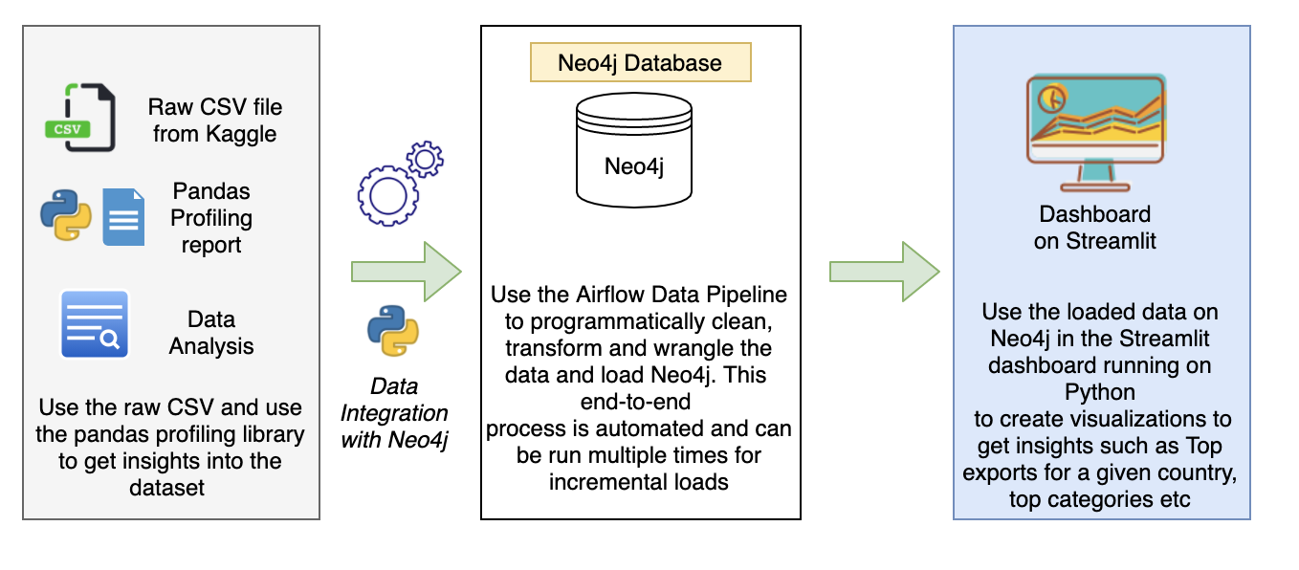
Vision Diagram

Slide 5
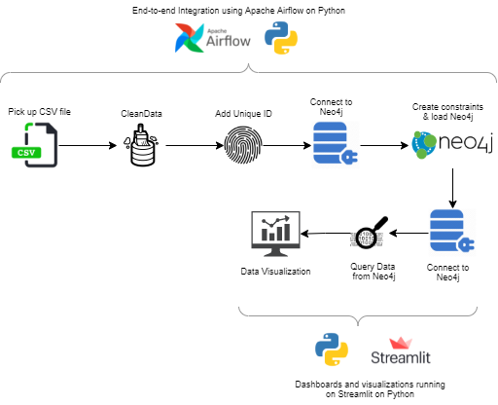

Slide 6
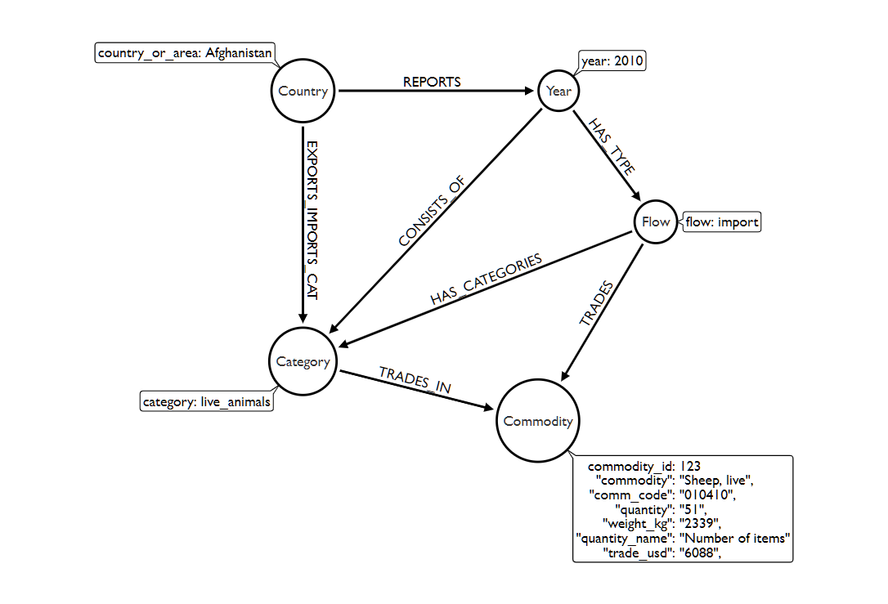
Graph Data Model
Here we have 5 nodes which traverse from country to commodity
Commodity node has individual row records and has the id field on which others are merged

Slide 7
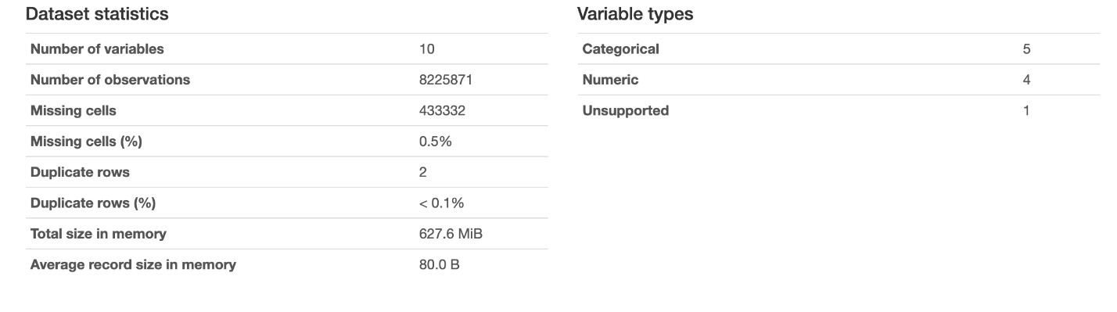
Data profiling
From the summary above we get a rough overview of the tables and the data consistency. The dataset has 0.5% of fields with missing values which can't be dropped as these are over 430,000 records.

Slide 8
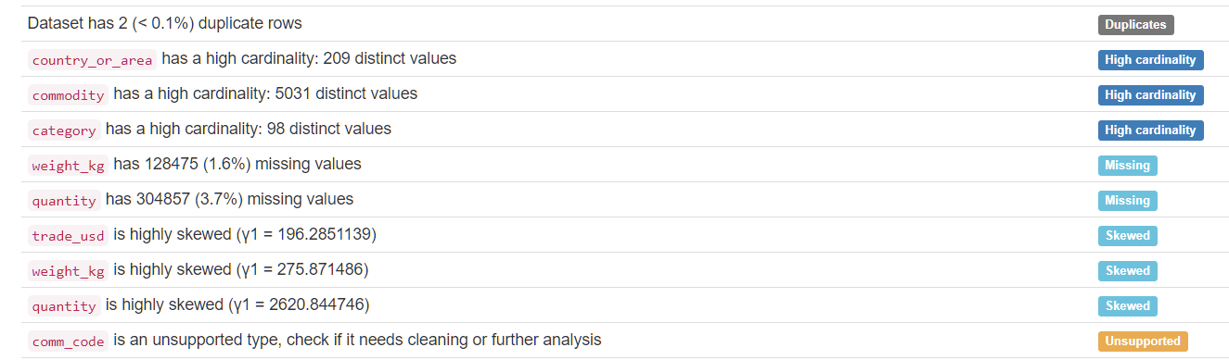
As the dataset is exceptionally large it has a high degree of cardinality but none of the columns are unique for all rows. There are missing values primarily in the ‘weight_kg’ column as well as the ‘quantity’ column.

Slide 9
Data Mapping
Raw CSV Field | Node | Property
comm_code | Commodity | CommodityCode
quantity | Commodity | Quantity
quantity_name | Commodity | QuantityName
trade_usd | Commodity | TradeValue
commodity | Commodity | CommodityName
weight_kg | Commodity | Weight
category | Category | category
country_or_area | Country | country
flow | Flow | flow
year | Year | year

Slide 10
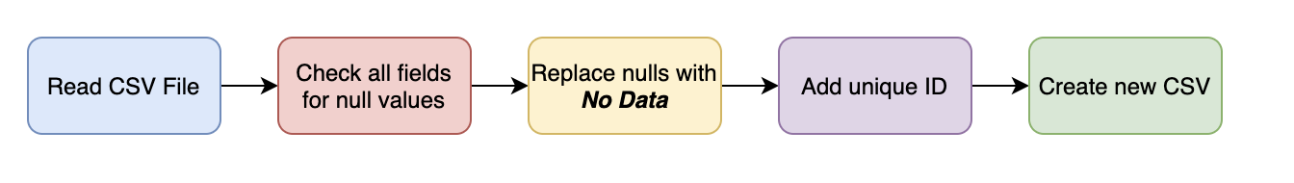
Data Cleaning
The dataset has 10 fields and contains over 8 million records.
On profiling the data – it was noticed that the fields quantity and weight_kg has null or empty values.
As an added check – all columns were checked for null/empty values. All empty values were replaced with No Data.
As part of the data wrangling and cleansing process – a unique identifier was added to each record in the file.
The other fields in the dataset were clean and did not require any added data wrangling or cleansing.

Slide 11
Technical Metadata
counts | label | property | dbName | relationships
8225871 | Commodity | CommodityCode | CommodityDB | TRADES,BELONGS_TO
8225871 | Commodity | Quantity | CommodityDB | TRADES,BELONGS_TO
8225871 | Commodity | QuantityName | CommodityDB | TRADES,BELONGS_TO
8225871 | Commodity | TradeValue | CommodityDB | TRADES,BELONGS_TO
8225871 | Commodity | CommodityName | CommodityDB | TRADES,BELONGS_TO
8225871 | Commodity | Weight | CommodityDB | TRADES,BELONGS_TO
98 | Category | category | CommodityDB | BELONGS_TO,EXPORTS_IMPORTS_CAT,HAS_CATEGORIES
209 | Country | country | CommodityDB | EXPORTS_IMPORTS_CAT,REPORTS
4 | Flow | flow | CommodityDB | HAS_TYPE,TRADES,HAS_CATEGORIES
29 | Year | year | CommodityDB | REPORTS,HAS_TYPE

Slide 12
Business Metadata
Domain Name | Business Term Name | Term Description
GlobalTradeStats | Country | Area or country taking part in exports/imports
GlobalTradeStats | Year | Year in which country exported/imported a given commodity
GlobalTradeStats | Commodity Code | Unique identifier for a commodity
GlobalTradeStats | Commodity | Commodity/Item being exported/imported by a country
GlobalTradeStats | Flow | Flow of trade i.e. Export, Import
GlobalTradeStats | Trade Value | Value of the trade in US Dollars
GlobalTradeStats | Weight | Weight of the commodity in Kilograms
GlobalTradeStats | Quantity Name | A description of the quantity measurement type given the type of item (i.e. Number of Items, Weight in KG)
GlobalTradeStats | Quantity | Count of the quantity of a given item based on the Quantity Name
GlobalTradeStats | Category | Category to identify commodity.

Slide 13
Cypher for Neo4j
// Loading the csv file into neo4j :auto using periodic commit LOAD CSV WITH HEADERS FROM "file:///cleaned2.csv" AS row
//Performing a merge on the nodes MERGE(com:Commodity{id:row.id}) ON CREATE SET com.CommodityName=row.commodity, com.CommodityCode=row.comm_code, com.Quantity= row.quantity, com.Weight= row.weight_kg, com.TradeValue= row.trade_usd, com.QuantityName=row.quantity_name MERGE (cat: Category {category: row.category}) MERGE (cou: Country {country: row.country_or_area}) MERGE (flo: Flow {flow: row.flow})
//Creating relationships between each of the nodes MERGE (yea: Year {year: row.year})MERGE (cou)-[:REPORTS]->(yea) MERGE (cou)-[:EXPORTS_IMPORTS_CAT]->(cat) MERGE (yea)-[:CONSISTS_OF]->(cat) MERGE (yea)-[:HAS_TYPE]->(flo) MERGE (flo)-[:HAS_CATEGORIES]-> (cat) MERGE (flo)-[:TRADES]-> (com) MERGE (cat)-[:TRADES_IN]->(com);
//Creating constraints for the data
CREATE CONSTRAINT com IF NOT EXISTS ON (com:Commodity) ASSERT com.id IS UNIQUE; CREATE CONSTRAINT flow IF NOT EXISTS ON (flo:Flow) ASSERT flo.flow IS UNIQUE; CREATE CONSTRAINT cat IF NOT EXISTS ON (cat:Category) ASSERT cat.category IS UNIQUE; CREATE CONSTRAINT country IF NOT EXISTS ON (cou:Country) ASSERT cou.country_or_area IS UNIQUE; CREATE CONSTRAINT year IF NOT EXISTS ON(yea:Year) ASSERT yea.year IS UNIQUE;
CREATE CONSTRAINT com IF NOT EXISTS ON (com:Commodity) ASSERT com.id IS UNIQUE; CREATE CONSTRAINT flow IF NOT EXISTS ON (flo:Flow) ASSERT flo.flow IS UNIQUE; CREATE CONSTRAINT cat IF NOT EXISTS ON (cat:Category) ASSERT cat.category IS UNIQUE; CREATE CONSTRAINT country IF NOT EXISTS ON (cou:Country) ASSERT cou.country_or_area IS UNIQUE; CREATE CONSTRAINT year IF NOT EXISTS ON(yea:Year) ASSERT yea.year IS UNIQUE;

Slide 14
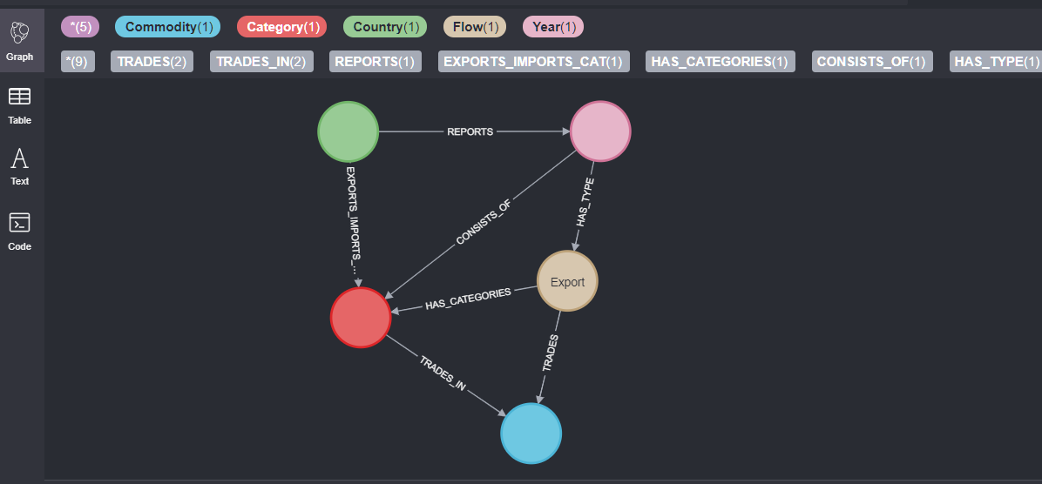
Neo4j Data Model

Slide 15
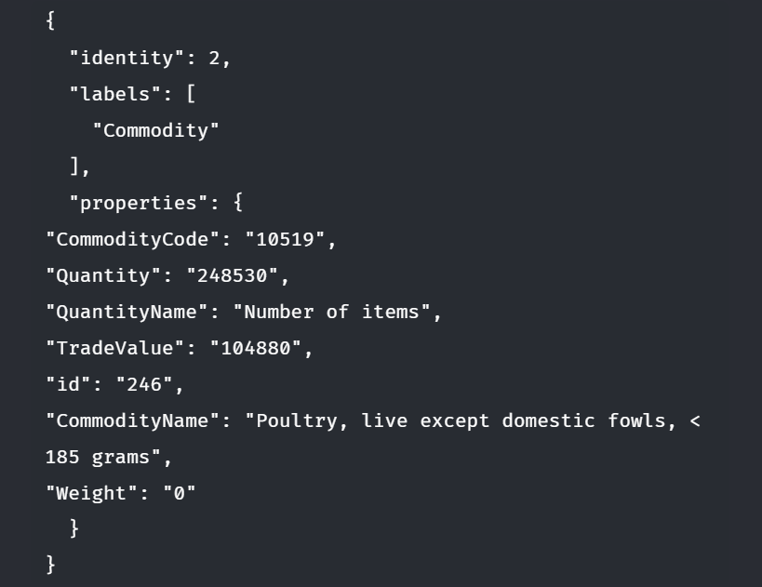
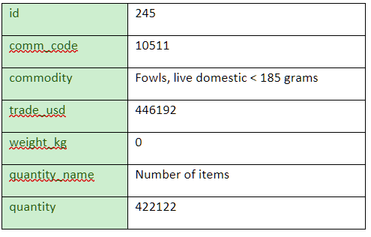
Data Validation
The database was queried on an id number and cross validated with the same id number in the csv

Slide 16
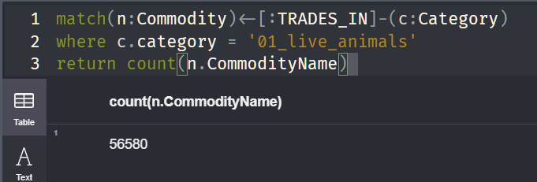
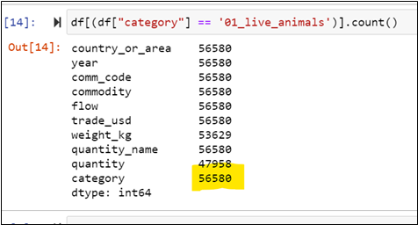
Here we compared the output through querying the database by creating a join and comparing it to the same output when analyzing the csv

Slide 17
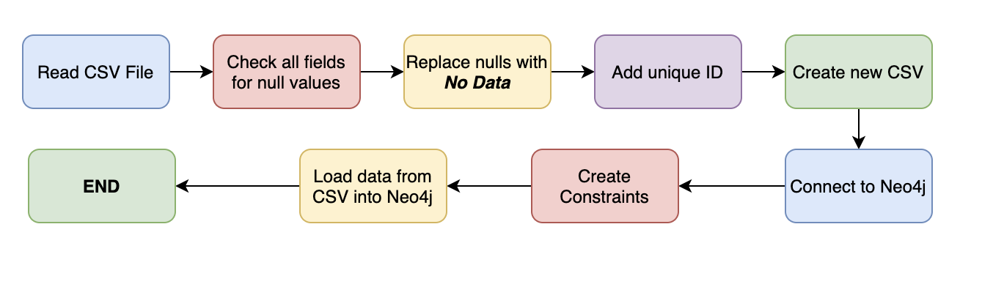
Data Integration
Complete end-to-end integration is made possible with the help of a data pipeline.
Apache Airflow was chosen as the preferred data pipelining tool since it is open-source and free to use.
Apache Airflow also offers a very convenient user-interface from where the data ingestion pipeline can be monitored and triggered on demand.
To integrate both the cleansing and loading process, the pipeline takes the source file as the input, cleans, and transforms the data and loads the Neo4j database.

Slide 18

Data Integration
Advantages of using Apache Airflow:
Data pipeline is highly modular and can be re-used to load Neo4j with other datasets.
UI can track multiple incremental/delta loads over time.
Ability to track and report any failures during the data ingestion or cleansing process.
Single trigger to read, transform, clean and load the data into Neo4j
Ability to schedule loads on a pre-defined cadence: daily, hourly or weekly

Slide 19
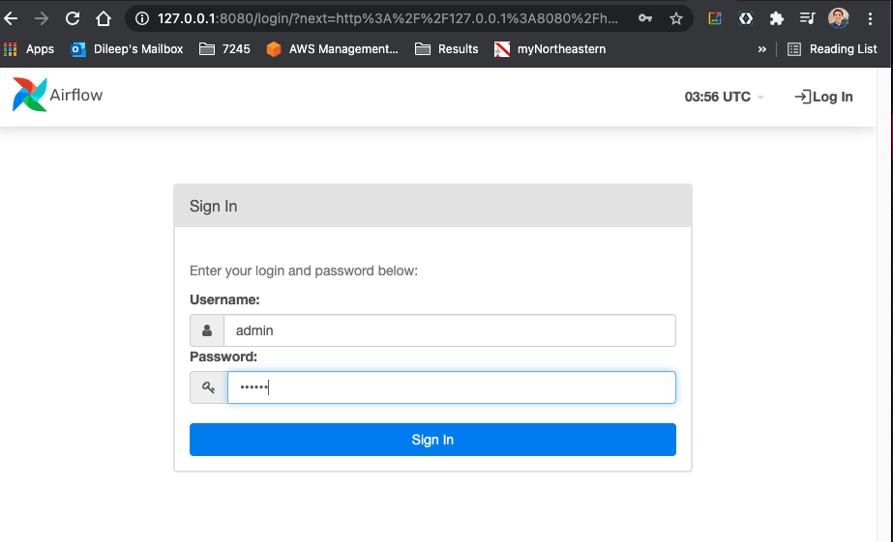
Airflow Login Screen

Slide 20
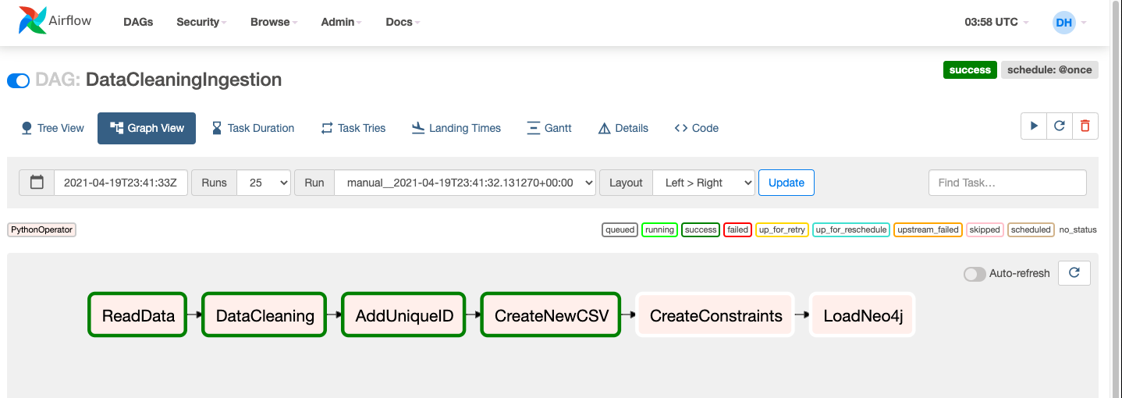
Airflow DAG to orchestrate the Data Integration from CSV to Neo4J

Slide 21
Data Visualization
The dashboard supplies value to potential business-users who would want to track and visualize global trade statistics in a single web application.
The end-users would be business/finance analysts who would want to track how a country, or a product category is being traded around the world.
The visualizations are written in Python by using Plotly, matplotlib and other visualization libraries. The visualizations are rendered by Streamlit on a web-browser.
Business users need not write Python code or run Python scripts to get insights from the data – deploying the entire visualization and reporting framework as a web-application ensures that any business users can just visit the application on their browsers and view metrics.
The dashboard/visualization offers multiple ways to slice and filter the data.
In most of the visualizations – there is functionality to filter data by country, flow (exports, imports etc.), product categories etc.
Why Streamlit?
Streamlit makes it extremely easy to deploy a stand-alone visualization as a web application.
Easy to code and uses Python as the programming language.
Extremely easy to integrate with Pandas dataframes.

Slide 22
Key Insights from the Data
China has emerged as a key player in the global trade market with its exports constantly on the rise.
China is the dominating exporter in global trade today, and that it experienced a spectacular growth in exports after the WTO accession in 2001.
EU’s biggest imports continue to be petroleum products and minerals.
Among the tariff goods, Aircraft related products has the highest trading value, more than 97.5%. It carries almost the whole import market for USA.
We can see Chinese import goods is more diversified, Auto, Aluminum and aircraft has high ratios.
Petroleum products and fuel account for the highest imports across all categories.

Slide 23
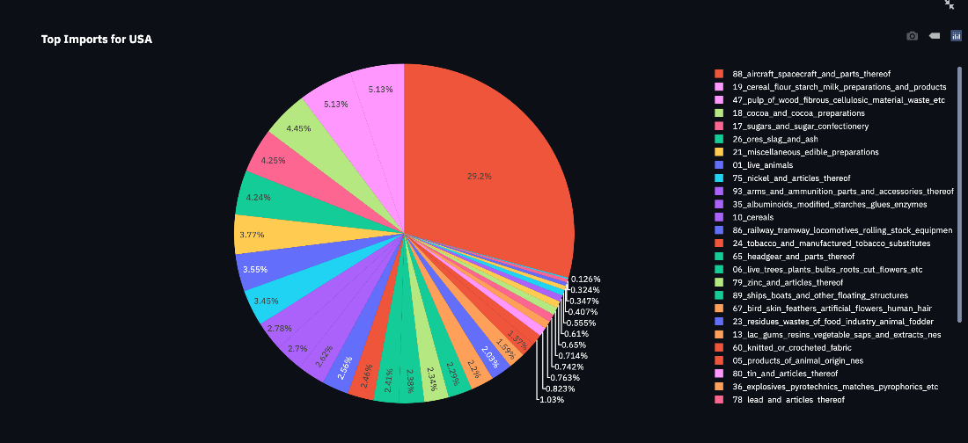
Data Visualization
Breakdown of exports/imports by top categories for a selected country.

Slide 24
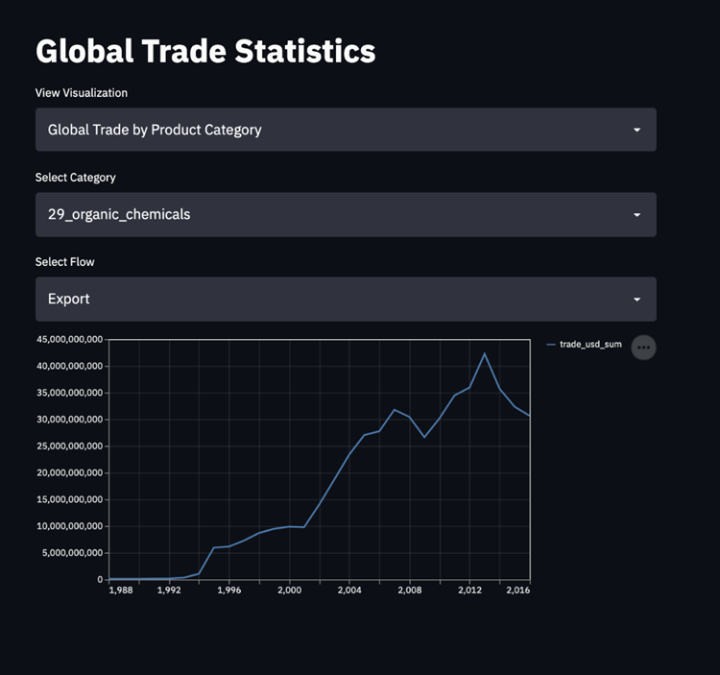
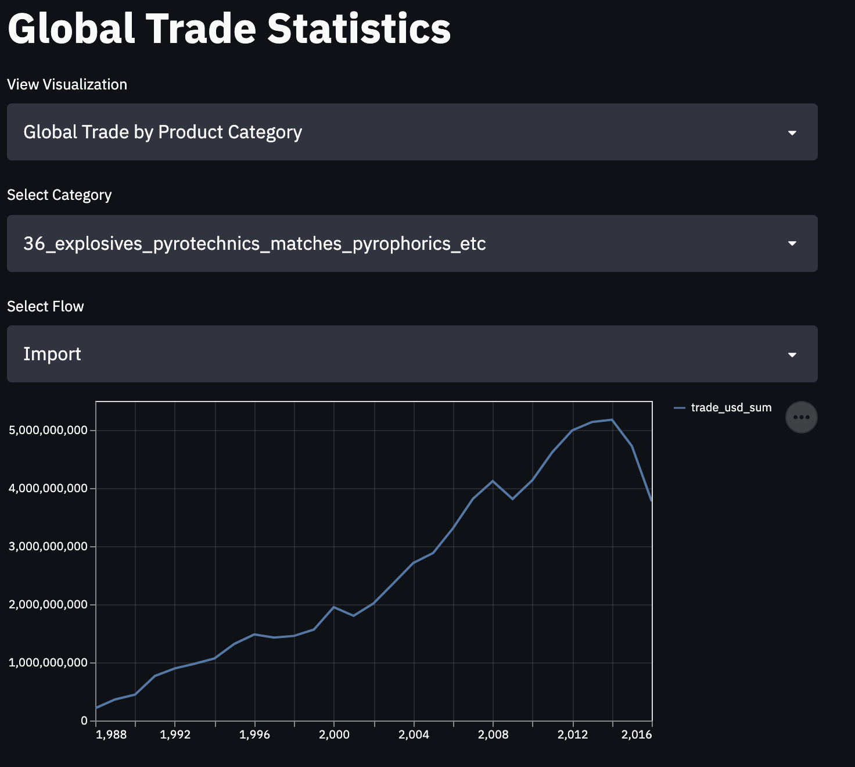
Data Visualization
Total value of exports/imports by category over time

Slide 25
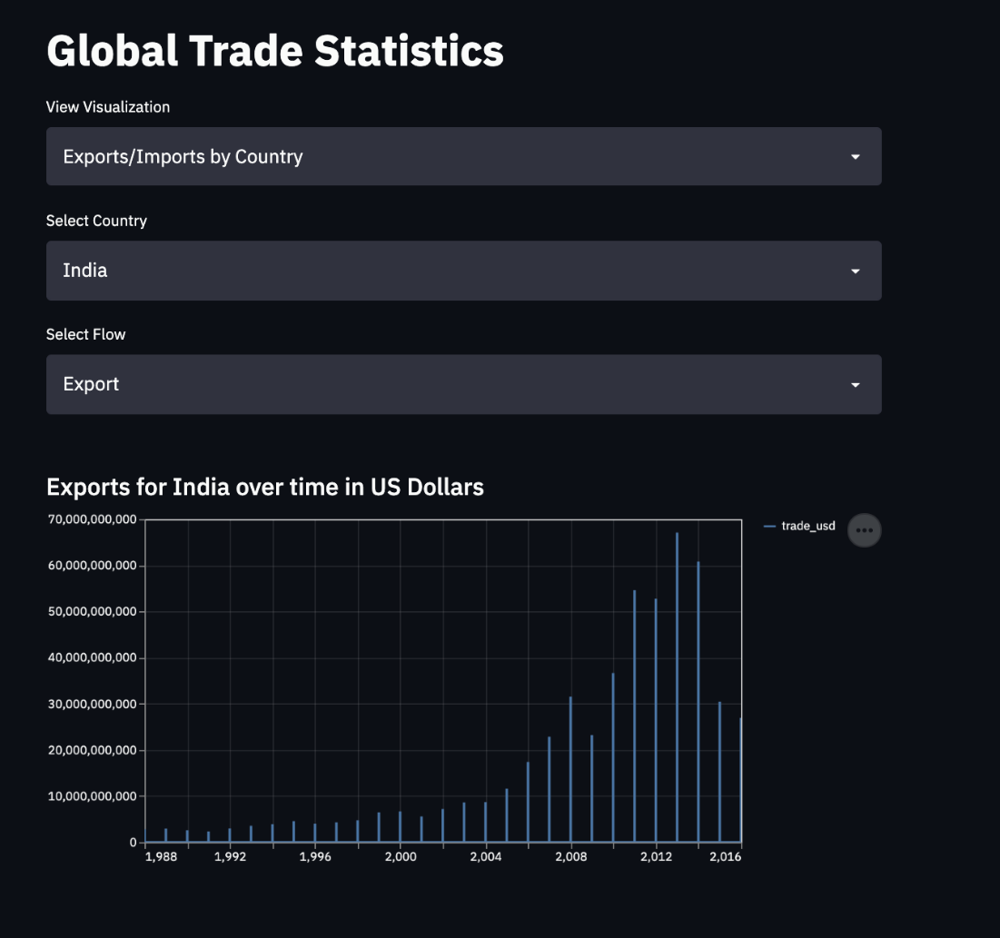
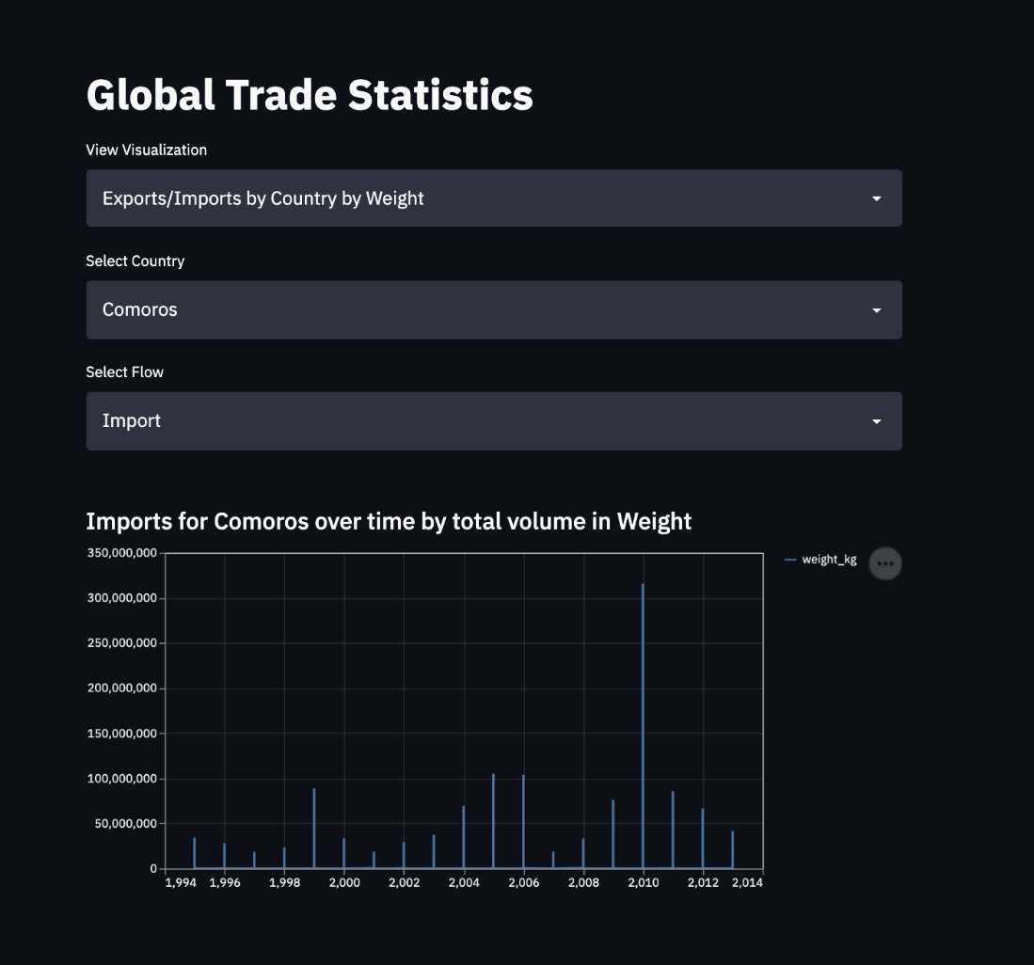
Data Visualization
Total value and weight of exports/imports by country over time

Slide 26
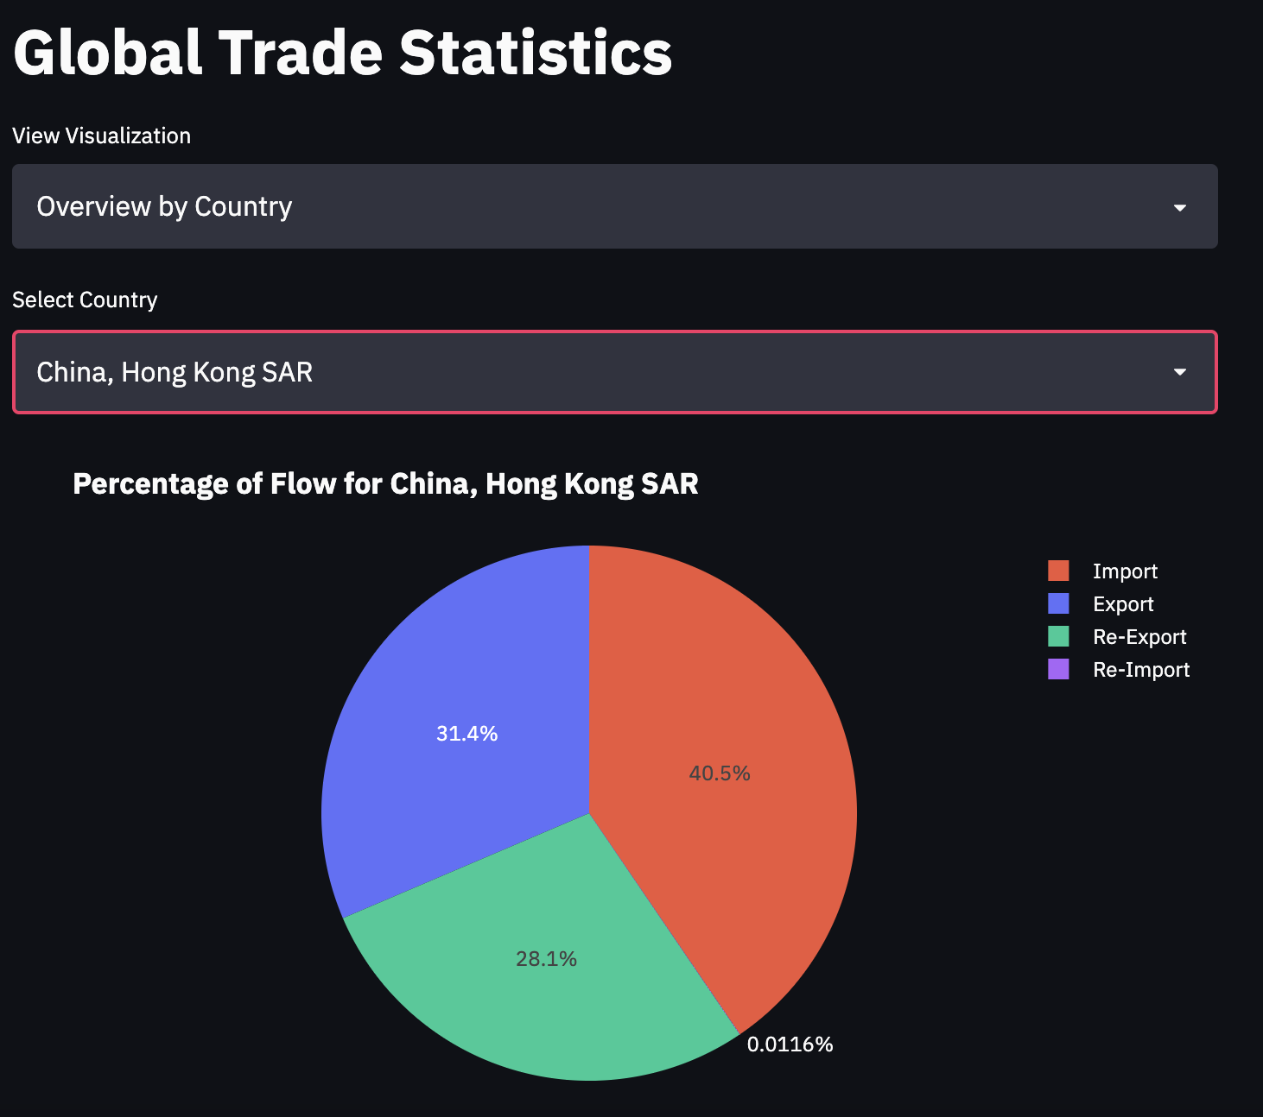
Data Visualization
Total value of exports/imports by category over time & overview by country

Slide 27
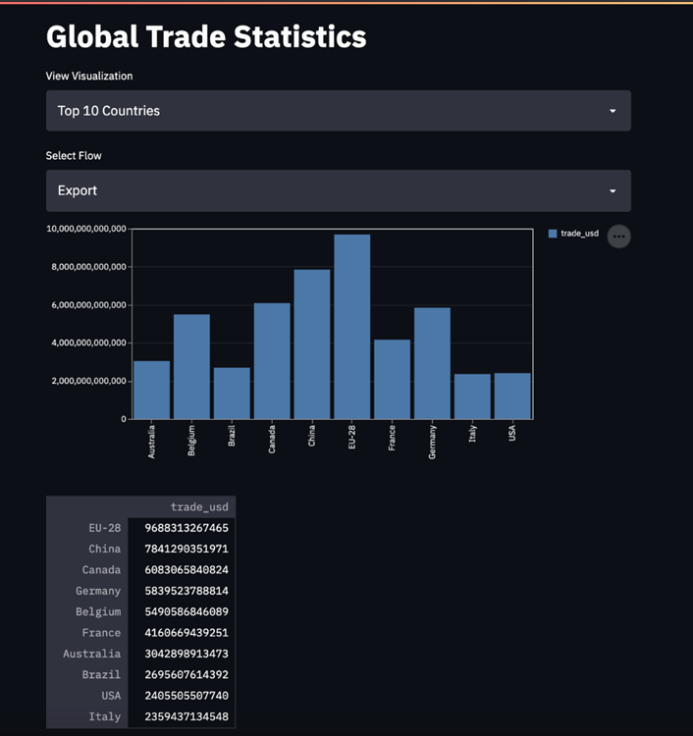
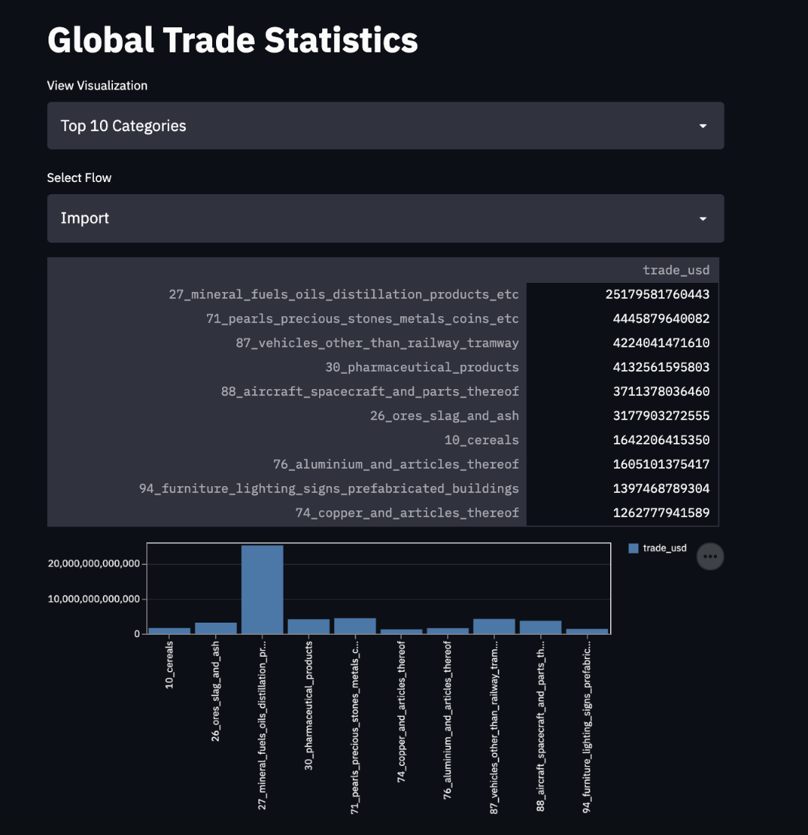
Data Visualization
Top 10 countries and categories of all time

Slide 28
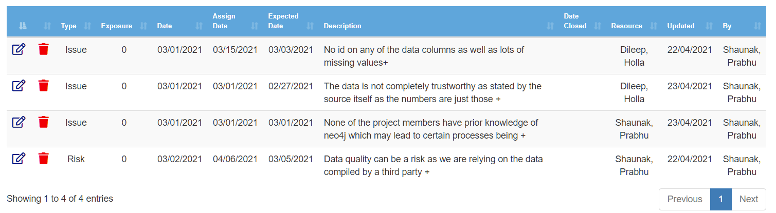
Risks and Issues
Issue: No id on any of the data columns as well as lots of missing values in the dataset which had to be handled in a manner that does not reduce the data and keeps data integrity. This was mitigated by changing null values and ‘NaN’ to ‘No Data’ to ensure data consistency and by creating a new column for ‘id’.
Issue: The data is not completely trustworthy as stated by the source itself as the numbers are just those which the country has shared with the UN. Cannot be mitigated but analysis must be done only on commodities that are more likely to have trustworthy data.
Issue: None of the project members have prior knowledge of neo4j which may lead to certain processes being done inefficiently. It may also lead to poorer usage of the database tool and neo4j's cypher for querying. This can be mitigated by better studying the intricacies of neo4j and its cypher language as well as studying better practices when loading and accessing data.
Risk: Data quality can be a risk as we are relying on the data compiled by a third party. Can be mitigated by profiling the UN data individually although the probability of this is low as the data has simply been scraped but there is chances of error.

Slide 29
Challenges Encountered
No prior experience with Neo4j: Graph databases were a relatively new concept and there was a major learning curve to understand the differences between relational and graph databases.
Method of querying is also different from the usual ANSI SQL syntax and was a challenge.
The dataset provided had over 8 million records – reducing load times to Neo4j was one of the major challenges.
End-to-end integration using Python to clean, wrangle and load the database was a huge learning curve as well – since Apache Airflow was used to integrate the entire process.
Manpower: Only team with 2 members. Hence, there was more work distributed between team members.

Slide 30
End User Instructions – Data Ingestion & Integration
Python version: Python 3.7+ Libraries: py2neo, pandas, apache-airflow, pandas-profiling
Run instructions:
The contents of the data ingestion pipeline are present in the data-ingestion directory.
Download and install Python from here: https://www.python.org/downloads/release/python-370/
Install the dependencies by using the requirements.txt file by running the following command: pip install –r requirements.txt
Once all dependencies are installed, set up the Airflow instance. Initialize the instance by running the following commands: # Use your present working directory as# the airflow home export AIRFLOW_HOME=~(pwd) # export Python Path to allow use# of custom modules by Airflowexport PYTHONPATH="${PYTHONPATH}:${AIRFLOW_HOME}" # initialize the database airflow db init
Copy the contents of dags directory into the dags directory on your machine.
Start the Airflow webserver by running airflow webserver –D
Start the Airflow scheduler by running airflow scheduler
Visit http://127.0.0.1:8080/ to view the Airflow UI and trigger the pipleine: DataCleaningIngestion

Slide 31
End User Instructions – Data Visualization
Python version: Python 3.7+ Libraries: streamlit, pandas
Run instructions:
Install the required libraries by running pip install streamlit and pip install pandas
The Python file is present in viz/app.py directory.
Start the application by running streamlit run app.py
This should start the streamlit application.
View the dashboard by visiting http://127.0.0.1:8501/ on your browser.

Slide 32
Velero Screenshots

Slide 33
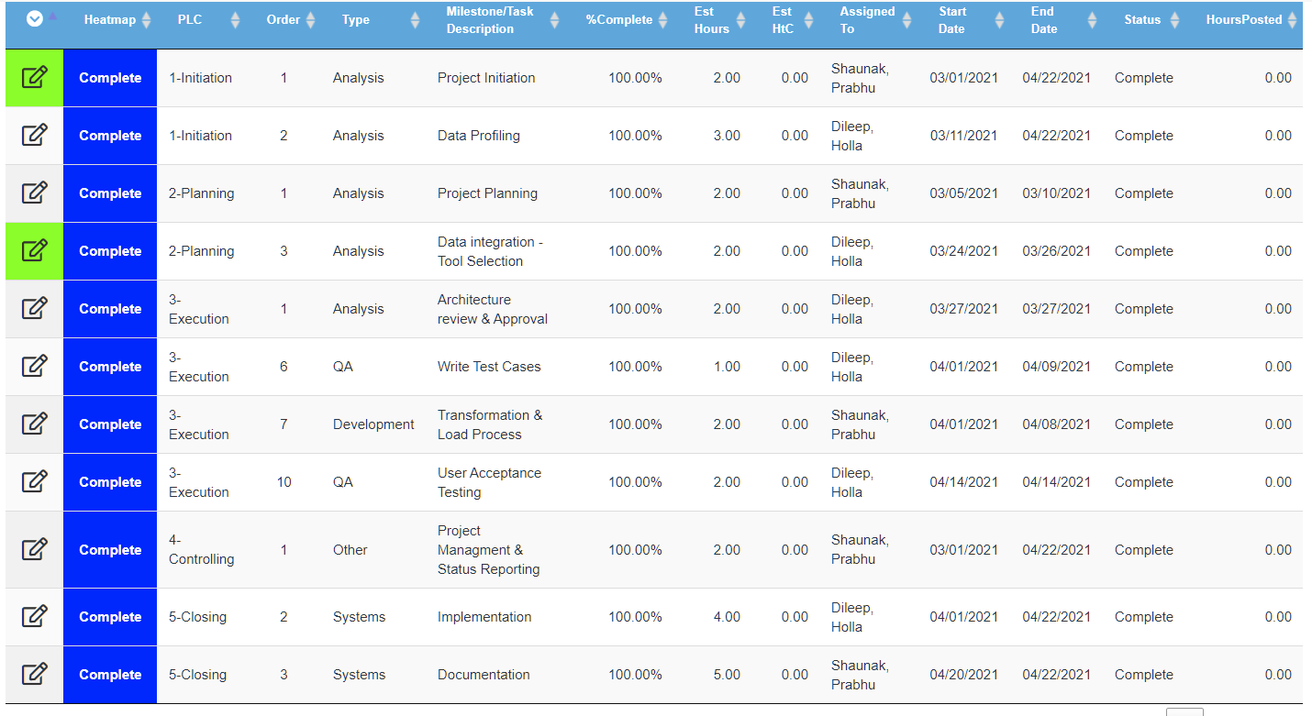
Project Milestones/Tasks

Slide 34
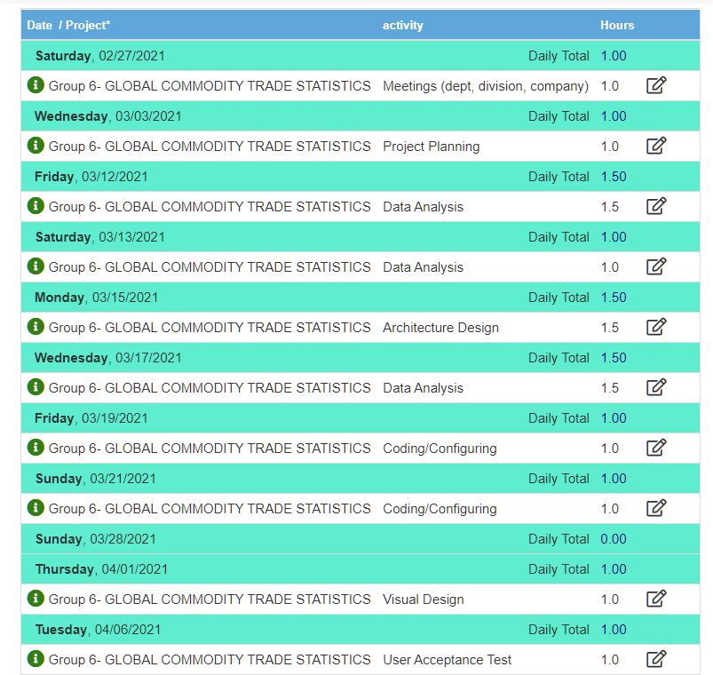
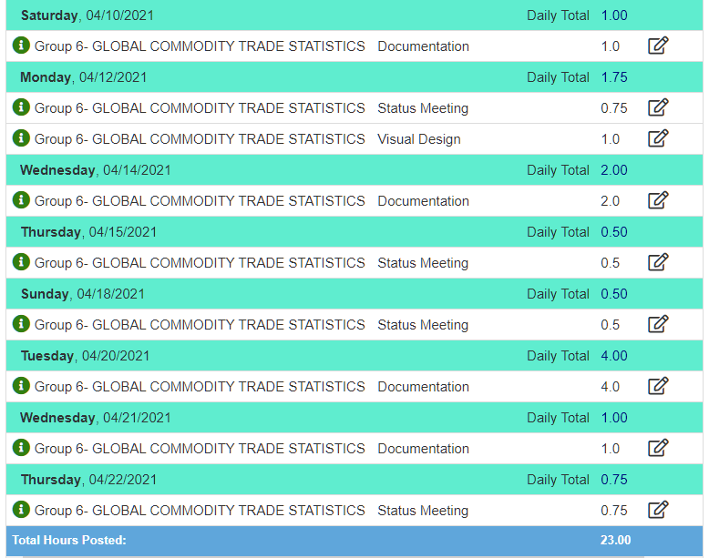
Project Timesheet

