Slide 1
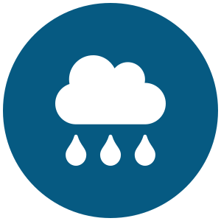
Urban Flood & Waterlogging
Early Warning System
Reference & Pilot City: Pune
Shaunak Samant | B.Tech CSE, Final Year — MIT-WPU, Pune

Slide 2
THE PROBLEM
Urban Flooding - One of India's Most Costly,
Least-Addressed Civic Hazards
~$4B/yr
up to $30B/yr
70%+
lost to urban flooding across India today
projected annual losses by 2070 without intervention
of Indian urban areas lack scientifically designed stormwater drains
Waterlogging is almost always discovered only after a road is already impassable — because no zone-level system predicts where it will happen before it does, in most Indian cities.
Urban Flood & Waterlogging Early Warning System — Pune Pilot
1
Notes:
SOURCE CONTEXT: World Bank 2025 urban flood assessment for India. Current annual losses ~$4B, projected to climb to $14-30B/year by 2070 without intervention. Over 70% of Indian urban areas lack scientifically designed stormwater drainage.
TALKING POINTS: This isn't a one-city problem. Recognized urban flood events have struck Mumbai, Chennai, Bengaluru, Delhi, Hyderabad, Kolkata, Surat, Ahmedabad, Jamshedpur, Guwahati, and Pune — a recurring, nationwide pattern driven by rapid unplanned urban growth, encroachment on natural drains, and inadequate stormwater infrastructure.
KEY FRAMING: The core problem is REACTIVE vs PREDICTIVE. Cities find out about flooding when a road is already underwater. The entire pitch rests on shifting that timeline earlier — from 'reactive cleanup' to 'predictive, zone-level early warning.'
If asked for a citation: World Bank / WRI 2025 assessment, widely reported in Indian financial press (Business Standard, Mint) covering urban flood economic risk projections through 2070.

Slide 3
REFERENCE CITY
Pune's Flood History
2005
2019
2026
~200mm rain in 24 hrs — directly compared at the time to Mumbai's catastrophic July 26, 2005 deluge
Khadakwasla dam discharge compounded heavy rain; dozens killed and hundreds of thousands displaced across the wider Pune division
First major monsoon downpour (100mm+) still caused widespread waterlogging in Uttamnagar, Shivne & more — PMC's own ₹15-crore Disaster Management Centre came under scrutiny
PMC's own 2026 target: “waterlogging should not persist for more than one hour anywhere in the city” — an operational goal with no predictive system today to actually deliver it.
Urban Flood & Waterlogging Early Warning System — Pune Pilot
2
Notes:
PUNE FLOOD FACTS TO KNOW COLD:
• 2005: Pune received 200mm+ average rainfall in 24 hours; Tamhini Ghat recorded 556mm in 24 hours (a record). Commentators explicitly compared it to Mumbai's July 26, 2005 deluge (the benchmark disaster in Indian urban flood history).
• 2019: Pune received close to 200mm rain in 24 hours (25-26 Sept), the highest in a decade at the time. Khadakwasla dam released ~13,891 cusecs into the Mutha River after an additional 8.7cm of rain filled it. Across Pune division (Pune, Solapur, Satara, Sangli, Kolhapur) ~62 people died, 7-8 lakh people were displaced/evacuated using NDRF, Army, 200 boats, 2 helicopters. PMC later sanctioned ₹36 crore to replace a century-old bridge after commuters were swept away crossing it.
• 2026 (June, this year): PMC reported pre-monsoon drain desilting at ~85% completion (up from 72%). Despite this, the first major downpour (100mm+) caused waterlogging in areas like Uttamnagar, Shivne, Chandani Chowk. Root cause per officials: plastic waste clogging drainage chambers, not just absolute capacity — removing chamber covers manually often fixed it, showing this is a MONITORING gap as much as an infrastructure gap. PMC's own ₹15-crore Disaster Management Centre was reported as 'under the scanner' amid this flooding.
• PMC's 2026 initiative: topographic mapping + predictive modelling for waterlogging hotspots, robotic systems for auditing stormwater drain cleaning (piloted for drainage chamber inspections) — PMC is CLEARLY already moving toward the kind of data-driven approach this project proposes, which is a strong argument the mentor/PMC would be receptive.
WHY THIS SLIDE MATTERS: shows the problem is current (a story from this year), recurring (3 separate decades), and that PMC itself is already trying to go 'data-driven' — this project is a natural extension of PMC's own stated direction, not an outside idea being imposed.

Slide 4
PRIOR TECH
India Already Has Flood-Warning Tech —
Just Not Nearly Enough of It
CFLOWS-Chennai
iFLOWS-Mumbai
2015 — India's first city flood-warning system, built after the devastating 2015 Chennai floods. Integrates weather, hydrologic, hydraulic & hydrodynamic models across six modules.
2020 — second city in India to get one. Joint effort: Ministry of Earth Sciences + BMC + IIT Bombay + IISc + IIT Madras + IMD + NCCR. Warns 6–72 hrs ahead across all 24 wards.
But the gap is real:
Took years and 5–6 national research institutions to build — not something a typical city can replicate alone
IMD's own Vision 2047 roadmap: expansion to other cities only “in phases” — most cities, Pune included, have nothing today
Even where deployed: iFLOWS was initially civic-body-only access, and an IIT Bombay climate scientist has noted it's “practically the same as the forecast, not a true early warning”
Urban Flood & Waterlogging Early Warning System — Pune Pilot
3
Notes:
CFLOWS-CHENNAI DETAIL: Built after the catastrophic December 2015 Chennai floods. India's first dedicated urban flood forecasting system. Integrates weather, hydrologic, hydraulic and hydrodynamic models across six modules.
IFLOWS-MUMBAI DETAIL: Launched June 12, 2020 by then-CM Uddhav Thackeray. A joint initiative of the Ministry of Earth Sciences (MoES) and BMC, developed through the National Centre for Coastal Research (NCCR) using expertise from IMD, NCMRWF, and field data from a 165-station rain gauge network (IITM + BMC). 7 modules: Data Assimilation, Flood, Inundation, Vulnerability, Risk, Dissemination, Decision Support System. Can estimate inundation up to 3 days ahead, with ~12-hour advance ward-level warnings. Factors in tidal waves/storm tides since Mumbai is coastal. Similar systems were reportedly planned for Bengaluru and Kolkata but are not confirmed live as of this deck.
CRITICAL NUANCE FOR MENTOR CONVERSATION: iFLOWS was initially accessible ONLY to the civic body (BMC), not citizens directly. A separate 'Disaster Management BMC' citizen app was launched in 2016 but 'failed to reach the masses' per Citizen Matters reporting; it was relaunched around 2022. Researchers (Subimal Ghosh, IIT Bombay Climate Studies) have candidly noted the app's forecast data 'had poor validation since its start' and that the system is 'practically the same as the forecast, so it is not really an early warning' in his words (paraphrased). He also proposed a crowdsourced Twitter-based validation approach (#MumbaiFloodData) to get ground-truth flood-level data from citizens — this is a real precedent we reference again on the citizen-services slide.
WHY THIS MATTERS: don't hide these limitations — volunteering them proactively shows the mentor you've done real research, not just found two acronyms and moved on.

Slide 5




PRIOR TECH
Others Building In The Space
AIResQ
IIT Gandhinagar + Northeastern University spinout (Udit Bhatia & Auroop Ganguly). AI-based rainfall + flood prediction with real-time response — rerouting, evacuation, strategic pump deployment. Live in Gurugram and Changodar (Ahmedabad). Presented at the 2026 India AI Impact Summit.
Google Flood Hub
LSTM-based flood forecasting, covers all of India plus parts of Bangladesh, 30M+ notifications sent historically. Riverine / river-basin scale forecasting — not hyperlocal urban ward-level waterlogging.
Andhra Pradesh – RTGS Platform
A new state-government AI platform combining predictive analytics, satellite terrain mapping, and hydrological modelling to forecast urban floods before they strike.
IIT Bombay Research
Dual machine-learning framework using satellite radar + elevation data; 93%+ accuracy flood-depth mapping across 55,000 sq km of the Western Ghats. Strong published research — not a deployed civic product.
This validates real demand — but none of them are Pune-specific, low-cost to replicate, or built as an open, multi-tenant platform for cash-strapped municipalities.
Urban Flood & Waterlogging Early Warning System — Pune Pilot
4
Notes:
THIS SLIDE IS THE MOST IMPORTANT ONE TO INTERNALIZE. A sharp mentor will ask 'hasn't this been done already?' — you want to be the one who brings this up first.
AIResQ (closest comparable, know this well): co-founded by Udit Bhatia (IIT Gandhinagar civil engineering professor, Northeastern-trained) and Auroop Ganguly (Northeastern Distinguished Professor, advisor/co-founder). Featured at the 2026 India AI Impact Summit in New Delhi (the 4th global AI summit, first in the Global South). Does rainfall prediction PLUS prescriptive real-time response — rerouting traffic, evacuating residents, deploying pumps at strategic points including railway lines. Currently working with Gurugram (Delhi NCR) and Changodar (an industrial part of Ahmedabad). This is a well-resourced, IIT-backed, internationally co-founded startup — acknowledge this directly rather than pretending it doesn't exist.
GOOGLE FLOOD HUB: Started as a 2018 pilot in Patna, Bihar (India's most flood-prone region, 100+ deaths/year historically). Uses LSTM (Long Short-Term Memory) neural networks trained on historical flood data across river basins globally. Partnered with India's Central Water Commission, Israel Institute of Technology, Bar-Ilan University. Now covers all of India + parts of Bangladesh. Over 30 million notifications sent to date. KEY DISTINCTION: this is RIVER-BASIN flood forecasting (will a river overflow its banks), which is a different problem from URBAN WATERLOGGING (will this specific street/ward flood from rainfall + drainage failure, independent of any river). This distinction is your strongest technical differentiation point.
ANDHRA PRADESH RTGS: a state-government-built platform (Real-Time Governance Society), very recently announced. Shows government appetite for exactly this category of solution — a positive signal, not a threat, since it's state-specific to AP and doesn't cover Maharashtra/Pune.
IIT BOMBAY RESEARCH: purely a research paper/system (not a deployed product), focused on the coastal Western Ghats region using satellite radar (SAR) + elevation data for flood depth mapping at 30m resolution. High accuracy (93%+) but academic, not operational.
HOW TO FRAME THIS IF ASKED 'so what's left for you to build': The forecasting SCIENCE (rainfall-to-flood models) is a well-trodden, validated research area — you are not claiming to invent new ML. Your contribution is the SYSTEMS/PRODUCT layer: an open, low-cost, containerized, multi-tenant architecture specifically designed for Tier-2/3 Indian municipalities that cannot afford an AIResQ-style vendor contract or a Google/IIT-scale research partnership — with Pune as the proof-of-concept city.

Slide 6
POSITIONING
Where This Project Actually Adds Value
Existing Players
(AIResQ / Google / Govt.)
This Project
Cost to stand up
Vendor-priced or state-government funded
Near-₹0 pilot on free-tier cloud infrastructure
Target cities
Resourced metros & industrial zones (Gurugram, Ahmedabad)
Tier-2/3 cities & cash-strapped municipalities — Pune first
Architecture
Proprietary / closed
Open, containerized, replicable by any team
Granularity
River-basin scale (Google) or vendor-specific zones
Ward-level urban streets, calibrated per city
Citizen access
Often internal-only initially (iFLOWS)
Citizen-first: risk map, routes, safe zones from day one
Urban Flood & Waterlogging Early Warning System — Pune Pilot
5
Notes:
This slide is your direct answer to 'why should this exist if AIResQ/Google already do this.'
Say out loud, in your own words: 'The underlying prediction science isn't new — what's missing is a version of this that a city like Pune, or any Tier-2/3 Indian city without an AIResQ contract or a Google-scale research partnership, could realistically stand up itself, cheaply, and see running in a few months rather than years.'
Be ready for the follow-up: 'Would Pune actually use a student-built system over a vendor contract?' Honest answer: this isn't pitched as a REPLACEMENT for AIResQ or iFLOWS — it's pitched as a low-risk PILOT that a municipality can try for near-zero cost before committing to a vendor contract, and the architecture is designed so it could later interoperate with those systems rather than compete head-on.

Slide 7
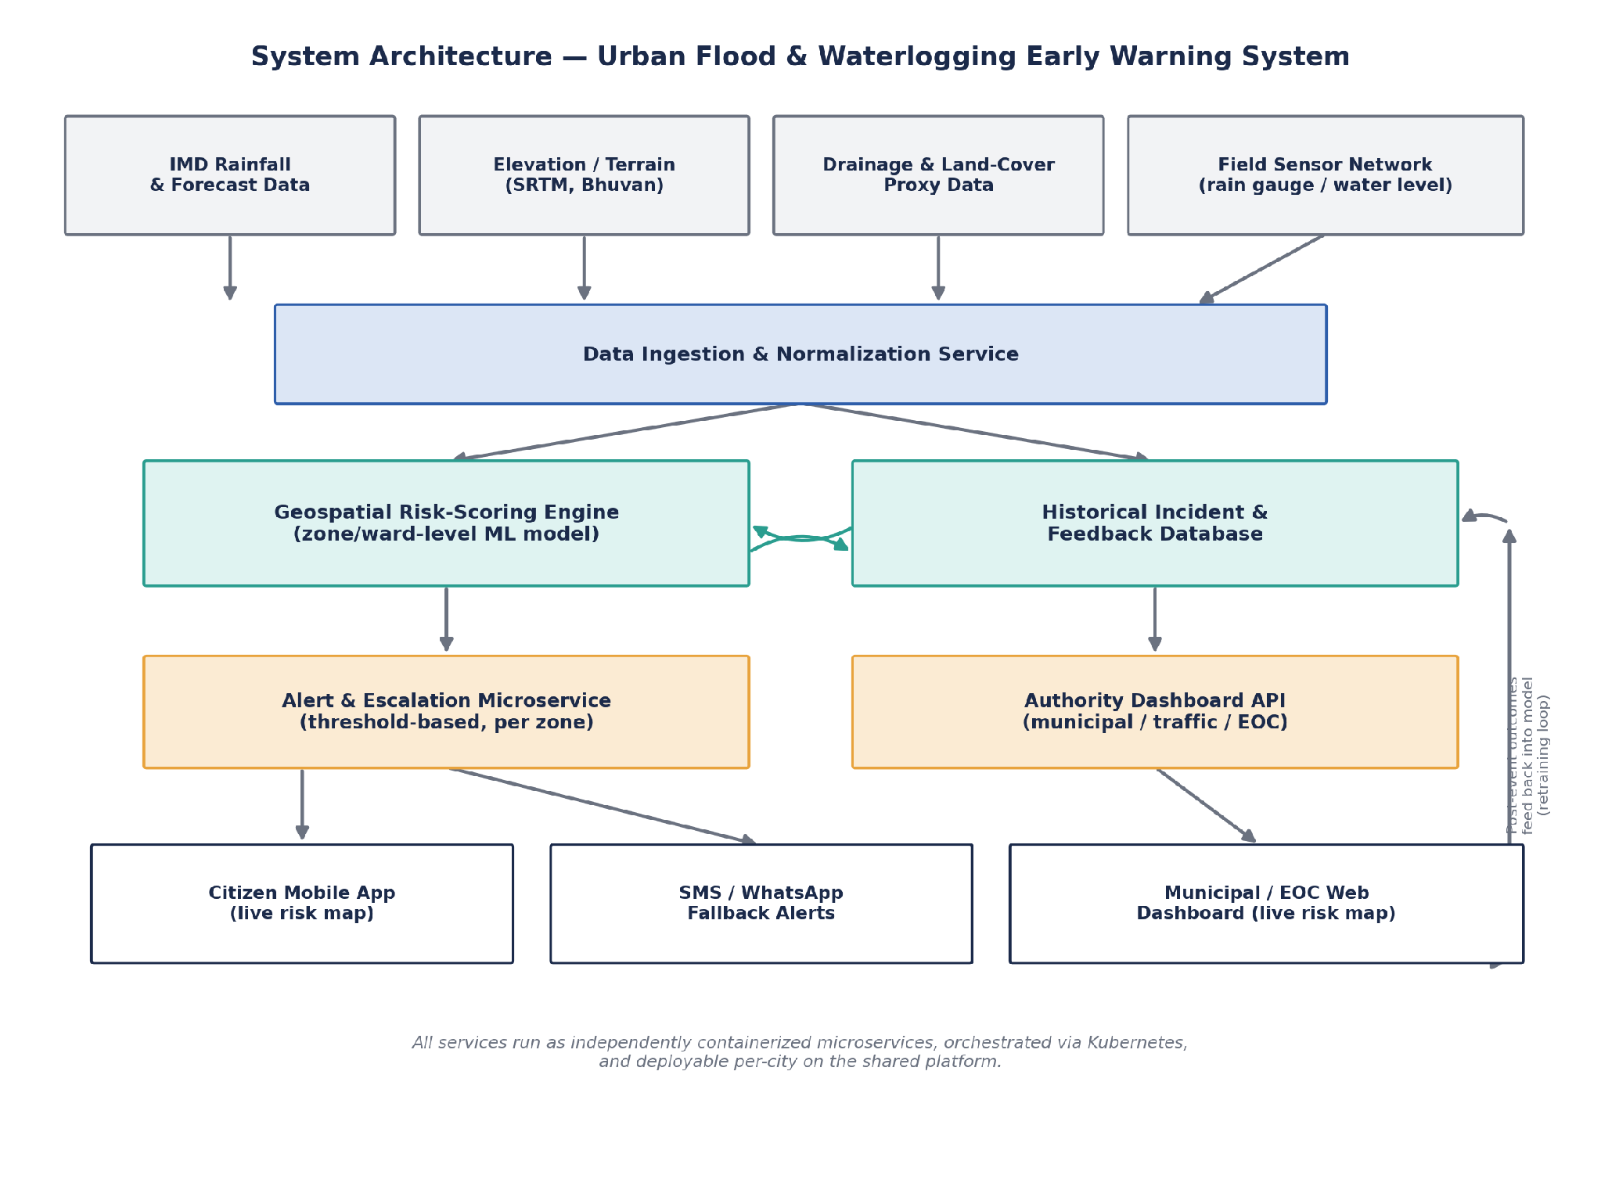
THE SOLUTION
The Proposed System
Urban Flood & Waterlogging Early Warning System — Pune Pilot
6
Notes:
Walk through the diagram top to bottom, out loud:
1. DATA SOURCES: IMD rainfall/forecast, elevation/terrain (SRTM/Bhuvan), drainage & land-cover proxy data, and an optional field sensor network.
2. DATA INGESTION & NORMALIZATION SERVICE: pulls all of the above into one common schema.
3. GEOSPATIAL RISK-SCORING ENGINE: a per-ward/zone model combining rainfall intensity, terrain, and historical incident patterns — lightweight enough to run on CPU, no GPU dependency, alongside the HISTORICAL INCIDENT & FEEDBACK DATABASE which both trains it and captures outcomes afterward for continuous improvement.
4. ALERT & ESCALATION MICROSERVICE + AUTHORITY DASHBOARD API: risk scores get evaluated against per-zone thresholds; authorities see a live dashboard.
5. DELIVERY LAYER: citizen mobile app, SMS/WhatsApp fallback (for citizens without smartphones), and the municipal/EOC web dashboard.
6. FEEDBACK LOOP: post-event outcomes flow back into the model for retraining — shown as the loop on the right of the diagram.
KEY LINE TO SAY: 'Every one of these boxes is an independently containerized microservice — the same code runs identically on my laptop during development and on a Kubernetes cluster in production, which is what makes the multi-city scaling story work later.'

Slide 8




ARCHITECTURE DETAIL
Five Core Microservices
Data Ingestion & Normalization
Pulls IMD rainfall, terrain, land-cover proxies, and optional sensor data into one schema.
Geospatial Risk-Scoring Engine
Per-ward risk model combining rainfall, terrain & history — CPU-only, no GPU dependency.
Alert & Escalation Service
Evaluates risk vs. per-zone thresholds; escalates if risk climbs without acknowledgement.
Authority Dashboard API
Live ward-level risk map for Municipal EOCs, traffic police, disaster management cells.
Citizen Layer (App + SMS/WhatsApp)
Dual-channel delivery so alerts reach citizens without reliable smartphone access too.
Urban Flood & Waterlogging Early Warning System — Pune Pilot
7
Notes:
Use this slide if the mentor wants more engineering detail than the architecture diagram gives at a glance. Emphasize: this is explicitly NOT 'one AI model behind an API' — it's workflow orchestration across five distinct, independently deployable services, which was direct mentor feedback from the original project ideation phase (avoid generic 'AI demo' projects, emphasize real systems engineering).
If asked 'why microservices and not a monolith for a student project': containerized independence is what allows (a) local dev on a laptop, (b) clean per-city multi-tenant scaling later, and (c) swapping simulated data sources for real ones (e.g. real sensors) without touching the rest of the system.

Slide 9

HANDLING REAL-WORLD DATA
Handling Incomplete Data & Real vs.
Simulated Rainfall
Data Confidence Scoring
Rainfall: Real Sources vs. Simulated
Every ward's risk score is tagged Verified / Stale / Proxy-only — never presented as uniformly accurate
REAL: IMD's public API gateway — district & station nowcasts, live AWS/ARG readings, subdivision forecasts
PMC's own desilting records feed in where recent (e.g. the 85% completion figure PMC already reports)
REAL: Pune's own historical extremes (2019, 2026 events) used to calibrate and validate the model
Missing/stale records fall back to satellite land-cover data as a lower-confidence proxy signal
SIMULATED (only): minute-by-minute sensor telemetry, since hardware isn't installed yet — generated by perturbing real historical Pune rainfall profiles, not random values
Real Pune failure mode: drains blocked by plastic waste during storms — no static dataset predicts this, so live symptom data (sensor/citizen reports) can override a stale 'low-risk' rating
Swap-in design: simulated input is replaced by live sensor input per ward with zero change to the risk engine itself
Urban Flood & Waterlogging Early Warning System — Pune Pilot
8
Notes:
THIS IS LIKELY THE SINGLE MOST-ASKED TECHNICAL QUESTION — know this slide cold.
The one-line summary if asked 'is this data real': 'Everything that can be real, is real — rainfall comes directly from IMD's public API, and Pune's own 2019 and 2026 flood events give me real extreme-case ground truth to calibrate against. The only thing simulated is the second-by-second sensor stream, because no one hands a student live hardware feeds before it's installed — and even that simulation is anchored to real historical Pune storm intensities, not random numbers.'
IMD API DETAIL: api.imd.gov.in / mausam.imd.gov.in offers City Weather Forecast (7-day), Subdivision Rainfall Forecast, District/State-wise Rainfall, District-wise & Station-wise Nowcast, AWS/ARG (Automatic Weather Station / Automatic Rain Gauge) data, River Basin QPF, and Highway Nowcast Warnings — all public, documented endpoints.
ANALOGY IF PRESSED: this is standard practice in safety-critical system testing generally — nobody tests a fire alarm by waiting for a real fire; they simulate smoke conditions against real, calibrated detection thresholds. Same logic here.

Slide 10


WHY IT'S WORTH BUILDING
Business Value & Societal Impact
Economic
Societal
Institutional
Targets the avoidable share of India's ~$4B/yr urban flood losses — business disruption, vehicle damage, delayed logistics
Earlier, more localized warning reduces loss of life and property
Supports the Smart Cities Mission's push toward data-driven governance without a new research collaboration per city
Complements ongoing drainage investment (e.g. AMRUT 2.0) rather than duplicating it — makes the drainage gap visible and actionable
SMS-accessible alerts specifically reach low-lying informal settlements — research shows they carry the highest flood exposure with the least institutional support
Gives a decision-support layer that today exists only in Mumbai & Chennai — extending NDMA's stated multi-hazard tech strategy
Urban Flood & Waterlogging Early Warning System — Pune Pilot
9
Notes:
ECONOMIC: current losses ~$4B/yr rising to $14-30B/yr by 2070 without intervention (World Bank 2025). Over 70% of Indian urban areas lack scientifically designed stormwater drainage — this platform doesn't replace drainage infrastructure spend, it makes the existing gap visible and actionable in real time, and complements government drainage funding pushes like AMRUT 2.0.
SOCIETAL: earlier warning reduces both loss of life and property. Urban flood resilience research consistently shows low-lying informal settlements face the highest exposure with the least institutional support — the SMS/WhatsApp fallback channel is specifically designed for residents without smartphone/app access, not an afterthought.
INSTITUTIONAL: aligns with the Smart Cities Mission's data-driven governance push. Positions the platform as a natural extension of NDMA's technology-driven, multi-hazard national strategy — giving municipal corporations (PMC included) a decision-support layer that today exists only in Mumbai and Chennai.

Slide 11
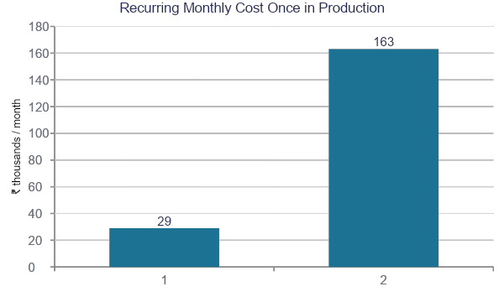
ECONOMICS
What It Actually Costs to Run
Pilot stage stays ~₹0/month
Free-tier cloud infrastructure (Oracle Always Free, Atlas/Supabase free tiers) covers the entire evaluation phase.
Figures above apply once in production:
Compute + database + monitoring
SMS/WhatsApp alerts (₹0.11–₹0.35/msg)
One-time DLT SMS registration: ₹5,900 + GST
State-level cost doesn't scale linearly — compute/DB is shared across tenants, and SMS providers discount above ~50k msgs/month.
Urban Flood & Waterlogging Early Warning System — Pune Pilot
10
Notes:
FULL BREAKDOWN (single city, midpoint of range shown in doc): Compute ₹8k-15k/mo, DB+storage ₹3k-6k/mo, load balancer/backups/monitoring ₹2k-4k/mo, SMS/WhatsApp ₹5k-15k/mo (~30k-50k alerts in an active monsoon month) — recurring total roughly ₹18k-40k/month. State-level (8-10 cities): compute ₹40k-70k/mo, DB ₹15k-25k/mo, LB/monitoring ₹8k-12k/mo, SMS ₹40k-1.2L/mo — recurring total roughly ₹1L-2.25L/month.
PRICING BASIS: current (2026) AWS Mumbai (ap-south-1) region pricing; Indian bulk-SMS market rates (transactional/OTP routes run ₹0.11-0.35/SMS in 2026, with one-time DLT registration ~₹5,900+GST, mandatory under TRAI regulations).
IF ASKED 'why does state-level cost less than 10x single-city': because compute and database infrastructure is SHARED across tenants on the same core platform rather than duplicated per city (this is the multi-tenant architecture paying off), and SMS providers give real volume discounts once you cross ~50,000 messages/month combined across cities.

Slide 12
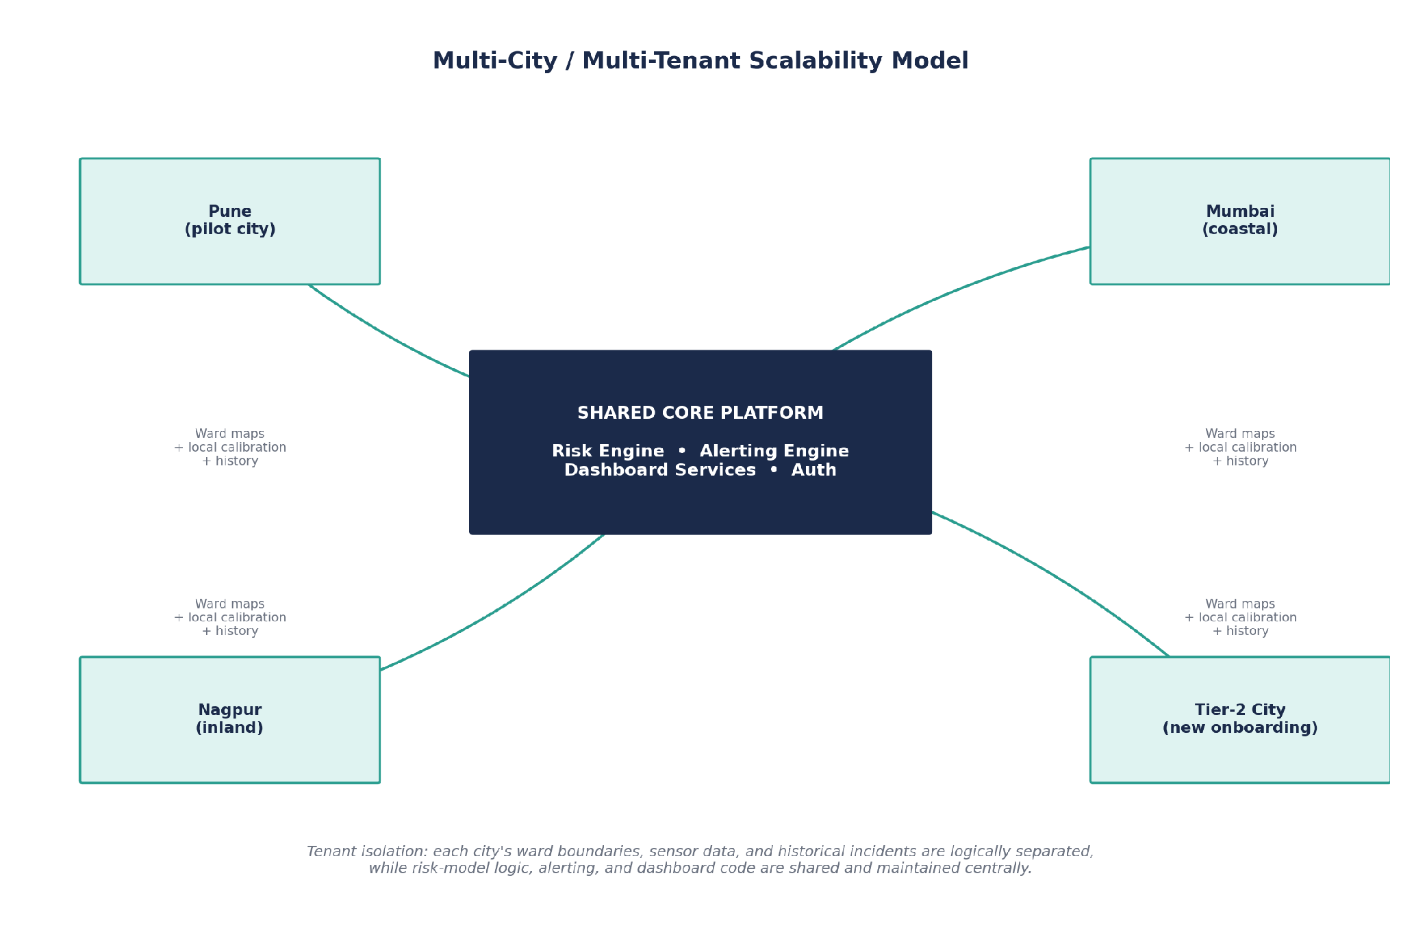
GROWTH STRATEGY
From One City to Many, Without Rebuilding
Every service is stateless & containerized — more cities add load, not new code
Each city is a tenant: ward boundaries, history & calibration stay logically isolated
Core logic (risk engine, alerting, dashboard) is shared — one fix benefits every city at once
Per-city calibration matters: Pune's dam-release-driven floods (Khadakwasla) differ fundamentally from Mumbai/Chennai's coastal storm-surge pattern
Urban Flood & Waterlogging Early Warning System — Pune Pilot
11
Notes:
CITY ONBOARDING STEPS (if asked 'how do you actually add a new city'): 1) ingest the new city's ward/administrative GIS boundaries (public for most municipal corporations); 2) ingest historical incident records geocoded from municipal reports/news; 3) calibrate the risk model with available local data, flagging data-sparse wards for lower-confidence scoring; 4) pilot in known chronic-flooding wards first; 5) full citywide rollout, then optional sensor investment.
KUBERNETES DETAIL: namespace-per-city or a shared cluster with tenant-partitioned data both work with this design; the Pune pilot starts with the simpler shared-cluster model and graduates to namespace isolation as city count grows.
CALIBRATION NUANCE: don't oversimplify to just 'coastal vs inland.' There are really three distinct flood-driver patterns to know: (1) coastal storm-surge cities like Mumbai/Chennai where tide timing interacts with rainfall, (2) dam-release-driven cities like Pune where upstream reservoir discharge compounds local rainfall, and (3) pure rainfall-runoff cities (most Tier-2/3 towns) with no major coastal or dam factor. The shared architecture handles this with one core engine plus city-specific calibrated parameters, not three separate codebases.

Slide 13






BEYOND BASIC ALERTS
More Than Just an Alert
Live risk map
Affected & safe routes
Nearby safe zones
Same data authorities see, in a simplified public view
Specific roads flagged, plus an alternate route suggestion
Designated gathering points per ward, same as PMC/NDRF use
Drainage status per ward
Historical flood insights
Citizen-reported waterlogging
Surfaces PMC's own published desilting-completion data
“Has this location flooded before, and when” lookup
Geo-tagged “report flooding here”, crowdsourced signal
Urban Flood & Waterlogging Early Warning System — Pune Pilot
12
Notes:
WHY THIS SLIDE EXISTS: iFLOWS-Mumbai itself was initially built for internal civic-body use only, and BMC's own citizen-facing 'Disaster Management BMC' app struggled to reach the public after its 2016 launch (per Citizen Matters reporting). A bare alert-only citizen layer risks repeating that outcome, so this platform treats the citizen layer as a real product surface, not just a notification pipe.
CROWDSOURCING PRECEDENT: BMC researchers (Subimal Ghosh, IIT Bombay) proposed an experimental #MumbaiFloodData Twitter-based approach to get citizen-reported ground truth for validating flood data — this project's 'citizen-reported waterlogging' feature is directly modeled on that idea, but built as a first-class in-app feature instead of a manual social-media workaround.
IMPORTANT CAVEAT TO STATE PROACTIVELY: citizen reports are a SUPPLEMENTARY signal, not a trusted source on their own — they feed into the same Data Confidence Scoring layer from Slide 9, helping validate or challenge the model's output in near real time, rather than being taken at face value (guards against spam/false reports).

Slide 14
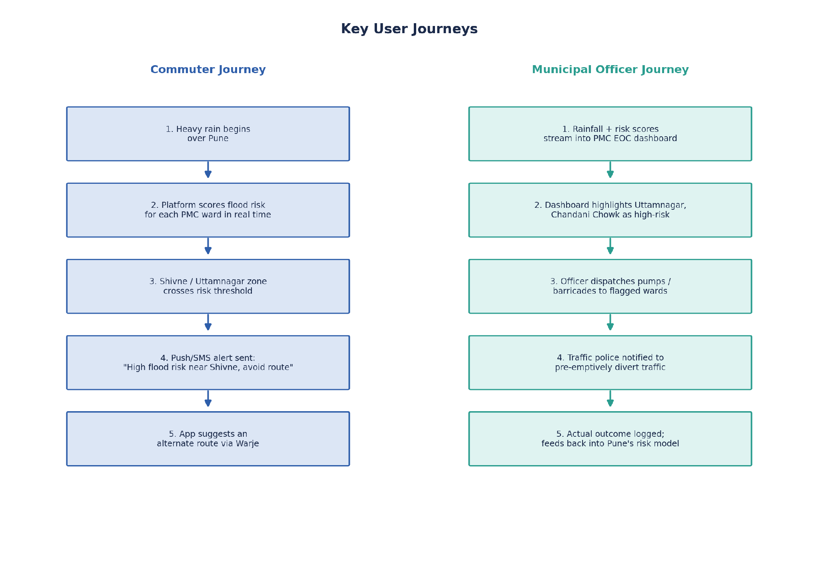
IN PRACTICE
How It Plays Out: Two User Journeys
Urban Flood & Waterlogging Early Warning System — Pune Pilot
13
Notes:
Walk through both journeys briefly, then mention the other two use cases not shown in the diagram:
COMMUTER JOURNEY: heavy rain begins over Pune → platform scores flood risk per PMC ward in real time → Shivne/Uttamnagar zone crosses risk threshold → push/SMS alert sent (“High flood risk near Shivne, avoid route”) → app suggests an alternate route via Warje.
MUNICIPAL OFFICER JOURNEY: rainfall + risk scores stream into PMC EOC dashboard → dashboard highlights Uttamnagar/Chandani Chowk as high-risk → officer dispatches pumps/barricades to flagged wards → traffic police notified to pre-emptively divert traffic → actual outcome logged, feeding back into Pune's risk model.
TWO MORE USE CASES TO MENTION IF ASKED: (1) Traffic pre-diversion — traffic police proactively redirect flow the moment the risk map flags a route segment, before congestion/flooding compounds. (2) Post-event model improvement — every event's actual outcome (flooded or not) is logged and fed back into that city's risk model, so accuracy compounds over each monsoon season rather than resetting every year.

Slide 15
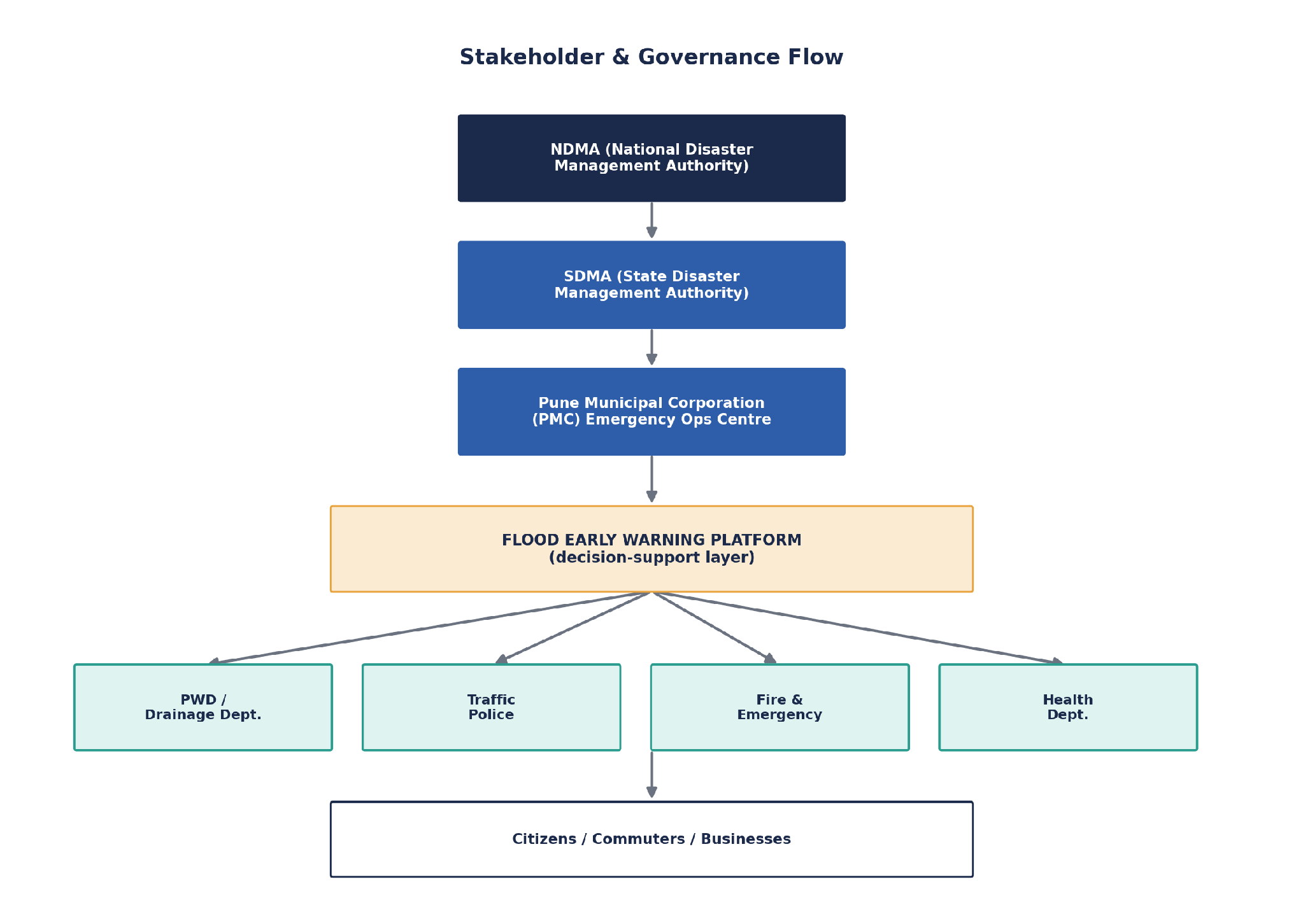
WHO'S INVOLVED
Where This Fits in India's Disaster-
Management Chain
Urban Flood & Waterlogging Early Warning System — Pune Pilot
14
Notes:
GOVERNANCE STRUCTURE: the Disaster Management Act, 2005 establishes NDMA at the national level, SDMA at the state level, and municipal Emergency Operations Centres (EOCs) at the city level — with named line-agency responsibilities during urban flooding. This platform is deliberately positioned as a DECISION-SUPPORT layer feeding into this existing, legally defined chain — not a replacement for any of it.
STAKEHOLDER ROLES:
• NDMA / SDMA — policy-level oversight; potential long-term interoperability partner for national-scale rollout
• PMC / Municipal EOC — primary operational user, receives ward-level risk data and dispatches response
• PWD / Drainage Department — responsible for physical drain maintenance, a direct consumer of the risk map
• Traffic Police — pre-emptive traffic diversion around high-risk zones
• Fire & Emergency Services, Health Department — named response agencies under the NDMA urban flooding SOP for rescue, evacuation, medical response
• Citizens, commuters, businesses — end beneficiaries who receive direct alerts and rerouting guidance
IF ASKED 'does PMC even have an EOC': yes — PMC's Disaster Management Centre (the same one mentioned on the Pune case-study slide, ₹15 crore, came under scrutiny in the 2026 flooding) is exactly this kind of operations center; this project is proposed as feeding into it, not replacing it.

Slide 16

HONEST RISK ASSESSMENT
What Could Go Wrong, and the Plan for Each
Ward-level drainage data doesn't exist digitally in most cities
Satellite land-cover data as a proxy signal instead of waiting for a full survey
Pune's dam-release flood pattern differs from coastal cities
Per-city model calibration within one shared core engine
Last-mile alert dissemination gaps (a documented weakness even in iFLOWS)
Multi-channel delivery — app + SMS + WhatsApp
Forecast accuracy limits — models can struggle even 24 hrs ahead
Show confidence levels, not binary alerts; retrain on local feedback
Municipal/institutional adoption and trust
Start with one willing pilot partner on a small ward set first
Urban Flood & Waterlogging Early Warning System — Pune Pilot
15
Notes:
Presenting risks proactively, with a mitigation for each, is one of the strongest credibility signals you can give a mentor — it shows you're not just pitching the upside.
ADDITIONAL CHALLENGE NOT ON SLIDE (mention if there's time): perceived overlap with CFLOWS/iFLOWS or AIResQ. Mitigation: position explicitly as complementary and aimed at cities with no dedicated system today, with future interoperability rather than head-on competition in cities those systems already cover.

Slide 17
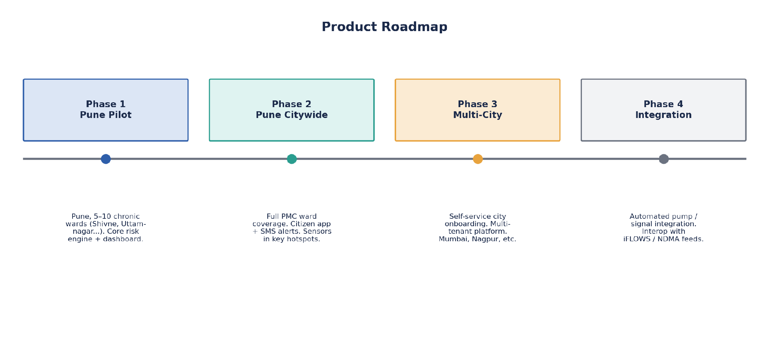
WHAT'S NEXT
Phased Rollout: Pune First, Then Beyond
Urban Flood & Waterlogging Early Warning System — Pune Pilot
16
Notes:
PHASE 1 — Pune Pilot: 5-10 known chronic-flooding PMC wards (Shivne, Uttamnagar, Chandani Chowk), core risk engine + authority dashboard, running on free-tier infrastructure. This is the realistic scope for the 4-5 month mentorship window.
PHASE 2 — Pune Citywide: full PMC ward coverage, citizen app + SMS/WhatsApp alerts, first IoT sensor deployments in top hotspot wards.
PHASE 3 — Multi-City: self-service city onboarding workflow, full multi-tenant platform, expansion to 2-3 additional cities (Mumbai, Nagpur, etc.) including at least one non-Pune flood-driver pattern to validate the calibration approach.
PHASE 4 — Integration: automated drainage-pump and traffic-signal integration in high-risk zones; explore interoperability with iFLOWS/NDMA data feeds rather than operating as a fully separate system.
IF ASKED 'is 4-5 months realistic for all of this': be direct — only Phase 1 is committed to this mentorship window. Phases 2-4 are the roadmap, not the deliverable, and saying so clearly is better than overpromising.

Slide 18
FAQ’s
Isn't this already being done (AIResQ, Google, iFLOWS)?
Yes — and that validates the problem. None are Pune-specific, low-cost, or open/replicable the way this is.
How accurate can a student project really be?
Not claiming to beat IIT-grade forecasting science — the contribution is deployable architecture, calibrated against real Pune historical events.
What if PMC won't share data?
Runs entirely on public data (IMD, satellite, news-sourced incidents) even with zero PMC cooperation — PMC data is a bonus, not a dependency.
Is this just a weather app?
No — it scores ward-level flood RISK from rain + terrain + drainage + history, and drives an alert/response workflow, which weather apps don't do.
Is 4–5 months realistic for all of this?
Only Phase 1 (Pune pilot, core engine + dashboard) is the committed deliverable.
Urban Flood & Waterlogging Early Warning System — Pune Pilot
17
Notes:
FULL EXTRA Q&A BANK (beyond what fits on the slide — study these too):
Q: What happens when your simulated sensor data doesn't match reality once real hardware goes in?
A: The architecture treats live sensors as a direct swap-in for the simulated feed, with zero change to the risk engine downstream — simulation is only ever used for testing/demo, never presented as production-grade telemetry.
Q: Why would PMC trust a student-built system over just hiring more staff or buying an existing tool?
A: This isn't pitched as replacing the EOC's authority — it's a decision-support layer, and the pilot approach (a handful of wards) is a low-risk way for PMC to evaluate it before any bigger commitment.
Q: What's the actual novel technical contribution, if the ML techniques aren't new?
A: Be upfront — the contribution is the systems/product engineering (multi-tenant SaaS architecture, the data-confidence layer, low-cost replicability), not a new ML algorithm. Own this framing rather than overselling the AI novelty.
Q: How is this different from just checking a weather app before leaving home?
A: Weather apps give city-wide rain forecasts. This scores ward-level flood risk by combining rain with terrain, drainage state, and history, then drives an institutional alert/escalation workflow — a weather app does neither of those.
Q: How do you validate the model without a real deployment yet?
A: Backtesting against real historical Pune extreme events (2019, 2026) as ground truth, since those are real, documented, high-intensity cases the model must handle correctly.

