Slide 1

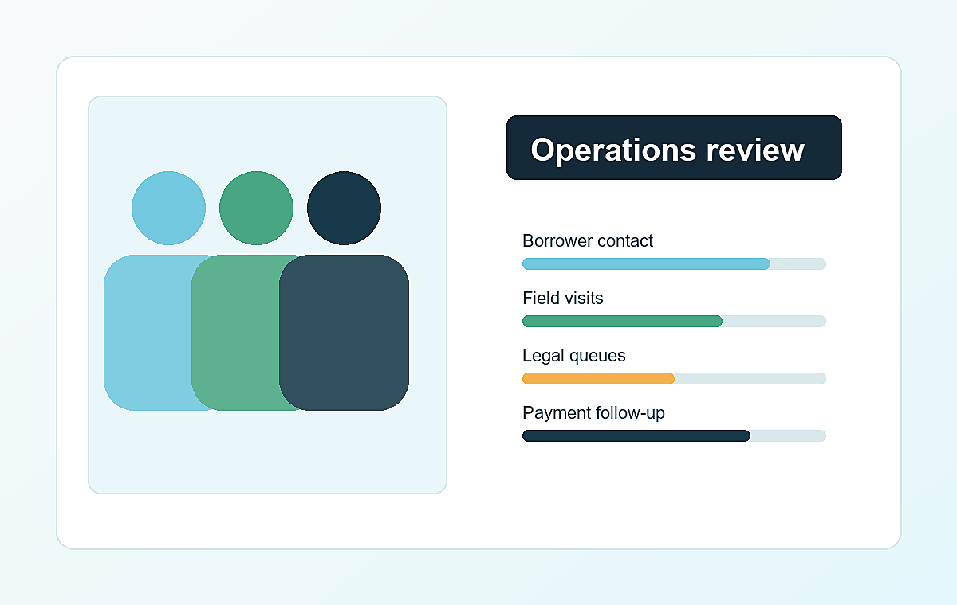
Lyv Eventia & Co.
Lively Operations & Engagement Deck
A responsible operating system for borrower contact, field recovery, legal coordination, payment reminders and portfolio visibility.
Manage. Recover. Grow.
80%
47%
24h
Resolution focus
Connect lift
Action updates
Lyv Eventia & Co.

Slide 2
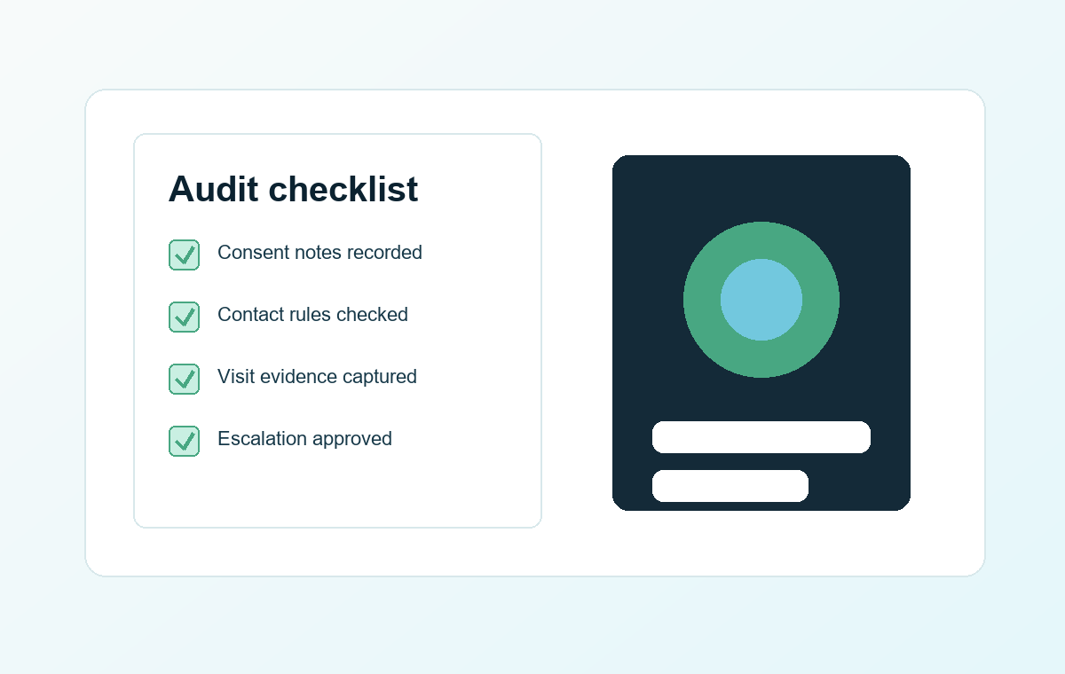
Lyv Eventia & Co.
OPERATING PROMISE
A sharper way to run recovery work
The website story turns into three operating advantages: measured communication, controlled field activity and visible portfolio movement.
01
02
03
Calm engagement
Field control
Portfolio clarity
Borrower-sensitive messaging and controlled contact cadence.
Assignment, route visibility and accountable execution loops.
Branch, bucket and agent-level reporting for faster decisions.
Responsible execution layer
Communication logs
Field status
Legal coordination
Lyv Eventia | 02

Slide 3
Lyv Eventia & Co.
PLATFORM MAP
From portfolio input to action-ready visibility
Control view
The operating flow keeps handoffs explicit, so every borrower interaction and field movement has context.
Branch, bucket and agent performance in one review loop.
Data layer
Portfolio
intake
Smart
segmentation
Contact
cadence
Field
execution
Resolution
analytics
Action layer
S1
S2
S3
S4
S5
Governance layer
Lyv Eventia | 03

Slide 4
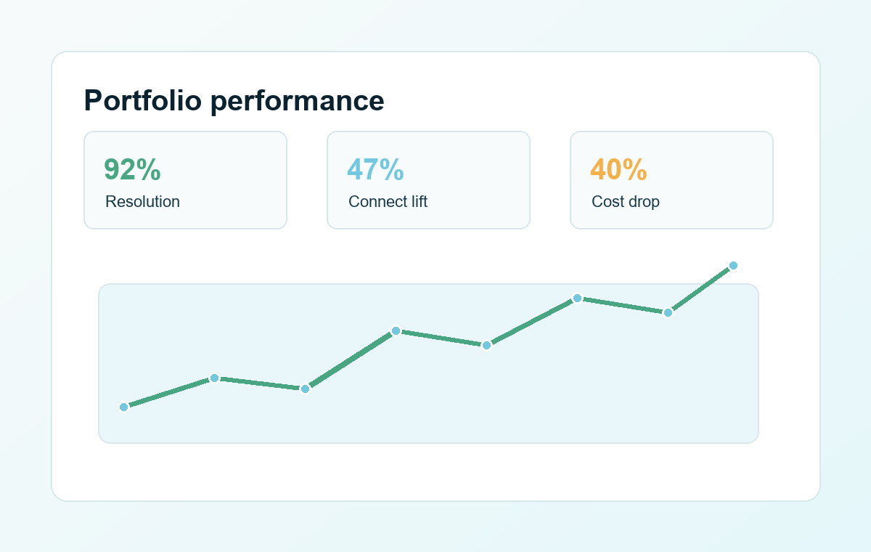
Lyv Eventia & Co.
EXECUTION RHYTHM
A daily cadence that stays human and measurable
1
2
3
4
5
Portfolio intake
Segmentation
Communication plan
Field action
Resolution tracking
Designed to reduce noise: one cadence, clear owners, visible action status and compliant borrower communication.
Lyv Eventia | 04

Slide 5






Lyv Eventia & Co.
IMPACT PROOF
What leaders can inspect every week
The same visual language used on the website carries into a clean review deck: status, movement and accountability.
Enterprise-ready association set
Resolution movement
80%
Connect improvement
47%
Case visibility
92%
Use the final PDF as a client-ready overview or a first meeting leave-behind.
Lyv Eventia | 05

Slide 6
Lyv Eventia & Co.
Ready for a sharper recovery review?
This deck and the downloadable PDF mirror the website identity while staying easy to read for client conversations.
Digital follow-ups
Tele-calling coordination
Field collections
Legal workflow support
Lyv Eventia & Co.

