Slide 1
Angular2
-By Swapnil Gaikwad

Slide 2

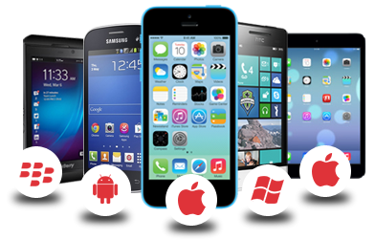


Problems Faced in Angular 1.5
Notes:
Performance
When angular was created it was not for developers but for a designers who needed to build persistent HTML forms.
Developers had picked up angular to create more and more complex applications.Angular 2 tried worked very hard to make incremental changes to the design allowing it continue to be relevant as the need of modern applications.
But there are hard limits on the improvements that can be made which leads to performance problems . In order to fix those problems , new strategies are needed.
Mobile
Phones and tablets are everywhere While angular can be used to build mobile apps . it was not designed with them in mind which leads to fundamental performance issues also issues like inability to cache precompile view and even touch support. Some can be fixed but other needs fundamental changes to fix.
Changing Web
Web has changed significantly , in coming next years the ES6 will be finalized . so we need support for modules ,classes, lambdas generators etc. this will transform the JS programming experience
Ease of Use
Angular js is not easiest things to learn as you start building complex applications its very difficult to understand whats happening.

Slide 3
Features and Benefits
Cross Platform
- Progressive Web Apps
- Desktop
Speed and Performance
- Code Generation
- Universal
- Code Splitting
Notes:
Cross Platform
1. Progressive Web Apps
Use modern web platform capabilities to deliver app like experience .
2.Desktop
Create desktop installed apps across mac, windows and linux .
Speed and Performance
1.Code generation
Angular turns your templates into a code that’s highly optimized for today JS virtual machines.
2. Universal
Serve the first view of your application on nodeJS,.NET and PHP and other servers for near instant rendering in just HTML and CSS
3. Code Splitting
Apps load quickly with new component router , it provides automatic code splitting so users only load code required to render the view they request.
Productivity
Templates
Quickly create UI views with simple and powerful template syntax
Angular CLI
Command line tools start building fast , add components and test and then instantly deploy
IDEs
Get intelligent code completion, instant errors and other feedback in popular editors and IDEs
Full Development Story
Testing
With Karma for unit tests you can know if you have broken things every time you save.
Protractor makes your scenario tests run faster and in a stable manner
Animation
Create high performance , animation timelines with very little code

Slide 4
Features and Benefits
Productivity
- Templates
- Angular CLI
- IDEs
Full Development
- Testing
- Animation
Notes:
Cross Platform
1. Progressive Web Apps
Use modern web platform capabilities to deliver app like experience .
2.Desktop
Create desktop installed apps across mac, windows and linux .
Speed and Performance
1.Code generation
Angular turns your templates into a code that’s highly optimized for today JS virtual machines.
2. Universal
Serve the first view of your application on nodeJS,.NET and PHP and other servers for near instant rendering in just HTML and CSS
3. Code Splitting
Apps load quickly with new component router , it provides automatic code splitting so users only load code required to render the view they request.
Productivity
Templates
Quickly create UI views with simple and powerful template syntax
Angular CLI
Command line tools start building fast , add components and test and then instantly deploy
IDEs
Get intelligent code completion, instant errors and other feedback in popular editors and IDEs
Full Development Story
Testing
With Karma for unit tests you can know if you have broken things every time you save.
Protractor makes your scenario tests run faster and in a stable manner
Animation
Create high performance , animation timelines with very little code

Slide 5
Modules

Slide 6
Introduction to Modules
Angular APP
Angular Module
Angular Module
@NgModule Decorator
export class AppModule { }
Notes:
Angular Apps are modular . It manage its modularity using Angular Module or NgModules
- Modules are great way to organize the application and extend it with capabilities from external libraries.
Every Angular app has atleast one angular module class the root module named as AppModule
But it can have multiple feature module which is block of code dedicated to an application domain.
Angular Module Consists of
NgModule :
Export class AppModule

Slide 7
Root Module : NgModule | AppModule Structure
Angular Library
import { NgModule } from '@angular/core';
import { BrowserModule } from '@angular/platform-browser';
@NgModule({
imports: [ BrowserModule ],
providers: [ Logger ],
declarations: [ AppComponent ],
exports: [ AppComponent ],
bootstrap: [ AppComponent ]
})
export class AppModule { }
Registers critical application service provider and also includes common directives like ngIf and ngFor
The declarations list identifies the application's only component, the root component
identifies this AppComponent as the bootstrap component. When Angular launches the app, it places the HTML rendering of AppComponent in the DOM, inside the <my-app> element tags
Notes:
Need of @NgModule Decorator
- Metadata declares the component , directives and pipes belong to the module
- Make some of those classes public so that other components templates can use them.
Import other modules with the components, directives and pipes needed by the components in this module.
- Provide services at the application level that any application component can use.
@ NgModule consists of 5 object properties
1. Declarations : View classes that belong to this module. It has 3 types
Components
Directives
Pipes
2. Exports : Subset of declaration that should be visible and usable in the component templates of other modules
3. Imports : Other modules whose exported classes are needed by component templates declared in this module.
4. Providers : Creators of services that this module contributes to the global collection of services. They become accessible to all parts of app
5. Bootstrap : the main application view called the root component that hosts all other app views. Only root module should set this bootstrap property

Slide 8
BootStraping in main.ts
// The browser platform with a compiler
import { platformBrowserDynamic } from '@angular/platform-browser-dynamic';
// The app module
import { AppModule } from './app.module';
// Compile and launch the module
platformBrowserDynamic().bootstrapModule(AppModule);
Notes:
We launch the application by bootstrapping the AppModule in the main.ts file.
The Angular Compiler converts the application code we write into highly performant JavaScript code. The @NgModule metadata play an important role in guiding the compilation process.
The code we write is not immediately executable. Consider components. Components have templates that contain custom elements, attribute directives, Angular binding declarations, and some peculiar syntax that clearly isn't native HTML.

Slide 9
View

Slide 10
View
Template
Metadata
Component
Notes:
Template, Metadata and Component together describe a view.

Slide 11
Component
export class HeroListComponent implements OnInit {
heroes: Hero[];
selectedHero: Hero;
constructor(private service: HeroService) { }
ngOnInit() {
this.heroes = this.service.getHeroes();
}
selectHero(hero: Hero) { this.selectedHero = hero; }
}
Notes:
Component controls a patch of screen called view
Components application logic needs to be define inside class. The class interacts with the view through an API of properties and methods.

Slide 12
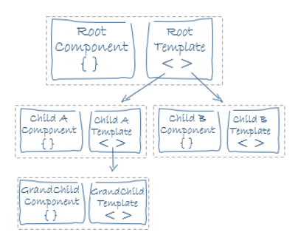
Template
HTML rendering of AppComponent in the DOM, inside the <my-app> element tags ,<h2>Hero List</h2>
<p><i>Pick a hero from the list</i></p>
<ul>
<li *ngFor="let hero of heroes" (click)="selectHero(hero)">
{{hero.name}}
</li>
</ul>
<hero-detail *ngIf="selectedHero" [hero]="selectedHero"></hero-detail>
Notes:
You define a components view with its companion template.
Template tells angular how to render the component.
It contains HTML elements with some angular related code like (click), *ngFor,{{titile}}

Slide 13
Metadata
Tag to use in root component
@Component({
selector: 'hero-list',
templateUrl: 'hero-list.component.html',
providers: [ HeroService ]
})
View to be visible for this component
Other Services needed by this Component
Notes:
Tells Angular how to process a class
To do this you need to attach metadata using decorator
We have to use @Component decorator which identifies the class immediately below it as a component class

Slide 14
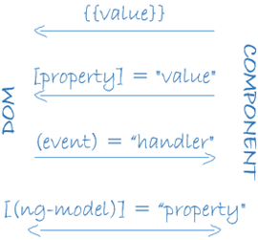
Data Binding
<li>{{hero.name}}</li>
<hero-detail [hero]="selectedHero"></hero-detail>
<li (click)="selectHero(hero)"></li>
<input [(ngModel)]="hero.name">
Notes:
Interpolation : displays the components property value.{{}}
Property binding : passes the value from property of parent to another property of child component []
Event Binding : Its use to bind the events (click)
Two Way : it combines the property and event binding

Slide 15
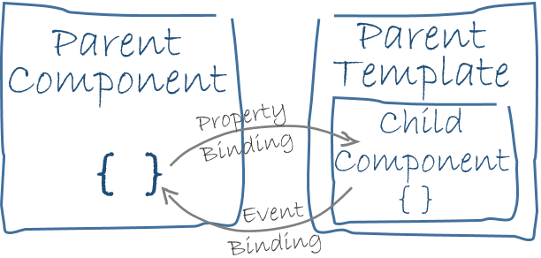
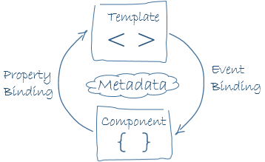
Need of Data Binding
Notes:
It plays an imp role in communication between template and component or parent and child component.

Slide 16

Directives
It’s a class with directive decorator
Component is a directive with a template
Two types of Directive
I .Structural
ii. Attribute
Notes:
Directives
Angular templates are dynamic , when angular renders them , it transforms the DOM according to the instructions given by directives.
A directive is class with a @Directive decorator
A component is a directive with a template
There are 2 types of directive
Structural
It alters the layout by adding , removing and replacing elements in the DOM
For example .. ngIf, ngSwitch and ngFor
Attribute
It alters the appearance of an existing element

Slide 17

Services
It gives any value , function or feature that your application needs
It’s a class with narrow well defined purpose
Notes:
Services
It gives any value , function or feature that your application needs
It’s a class with narrow well defined purpose
Example
Logging Service
Data service
Tax calculator

Slide 18

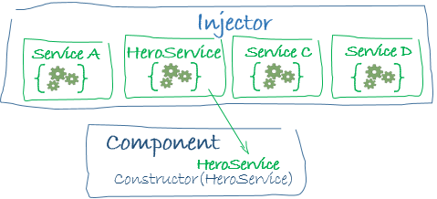
Dependency Injection
Notes:
Its a way to supply a new instance of a class with fully formed dependencies it requires.
DI provide new components with services the application needs or component needs.
An injector maintains container of service instances that it has previously created .
if requested services is not in the container then it makes one. When all requested services has been resolved and returned , angular can call the components constructor with those services as arguments . this is dependency injection.

Slide 19
Root Module
Defines how application fits together
Application should have at least one module
Use to bootstrap your application
Conventionally named ass AppModule

Slide 20
RootModule
import { NgModule } from '@angular/core';
import { BrowserModule } from '@angular/platform-browser';
import { AppComponent } from './app.component';
@NgModule({
imports: [ BrowserModule ],
declarations: [ AppComponent ],
bootstrap: [ AppComponent ]
})
export class AppModule { }
Imports
Declarations
bootstrap
Notes:
Imports :
Angular modules are way to consolidate features that belong together into discrete units
Whenever application requires some module and its features , add a module to the imports array.
Angular JS application needs to execute on the browser so we need browsermodule . So every such application includes Browser Module in its root.
Declarations :
You must declare event component in NgModule class
You tell angular which components belong to AppModule by using modules declarations array.
Bootstrap
You launch the application by boot straping the root.
Bootstrapping is a process create the component listed and inserts each one into the browser DOM.
It sets up execution environment , digs root AppComponent . creates an instance of the component and inserts it withing the element tag identified by components selector

Slide 21
Angular Application
NGMODULE
COMPONENT
COMPONENT
@Component Decorator
{ METADATA}
@Component Decorator
{ METADATA}
Export class className{}
Export class className{}
Notes:
Angular applications are made up of components.
Component must belong to an Ngmodule in order to be usable by another component or application.
Component is the combination of and HTML component present inside decorator and component class that controls the portion of the screen.
Every Component begins with an @Component
@Component is decorator function that takes metadata object . metadata describes how the HTML template and Component class work together

Slide 22
Component Decorator
COMPONENT
@Component Decorator({
Selector:’my-app’,
Template :’<h1> </h1>’
}
Metadata Object
Notes:
Every Component begins with an @Component
@Component is decorator function that takes metadata object .
metadata describes how the HTML template and Component class work together
@Component is decorator function that takes metadata object . metadata describes how the HTML template and Component class work together
Component Decorator
It allows you to mark a class as an angular component and provide additional metadata that determines how the component should be processed , instantiated and used at runtime.

Slide 23
Create Component
Myfirst.component.ts
import { Component } from '@angular/core';
@Component({
selector:'my-first',
template:'<h2> Hello This is my first component</h2>'
})
export class MyFirstComponent{}
Notes:
1. Add new File with the myFirst.component.ts. Follow the naming cpnvention
2. Import the Component class from core module
3. Create a decorator with a selector and template
4. Add a class

Slide 24
Angular Application
ROOT COMPONENT
` <my-app>
<child1> </child1>
<child2> </child2>
<child3> </child3>
</my-app>
`
CHILD COMPONENT
CHILD COMPONENT
CHILD COMPONENT
Notes:
Angular applications are made up of components.

Slide 25
Show Simple HelloWorld DEMO

Slide 26
Using Product Component in Root Component
import { ProductComponent} from './Product.component';
@NgModule({
declarations: [ AppComponent,ProductComponent],
})
export class AppModule { }
Register and declare
Available To Root Component
@Component({
selector :’my-papp’,
Template :`<h1>Hello </h1>
<my-product><my-product>`
})
Export class ProductComponent{}
@Component({
selector :’my-product’,
Template :<h1></h1>
})
Export class ProductComponent{}
App.component.ts
Product.component.ts

Slide 27
Add Custom Component into Root Component
import { Component } from '@angular/core';
import {MyFirstComponent} from './myfirst.component'
@Component({
selector: 'my-app',
template: `<h1> This is Swapnil Gaikwad Root Component</h1>
<my-first></my-first>`,
directives:[MyFirstComponent]
})
export class AppComponent { }
Notes:
Import the MyFirstComponent in to Root Component
Add a tags in template section after adding sepcil ` symbol
Add directives with the class name

Slide 28
Demo : Registering and using Product Component in ROOT Component

Slide 29
Using Template URL
@Component({
selector :’my-app’
,
templateUrl:’partial.html’,
<my-product><my-product>`
})
Export class ProductComponent{}
<div>
<my-app>
<my-product> </my-product>
<my-app>
</div>
Partial.html
App.component.ts

Slide 30
Demo : How to keep HTML template in separate file and load it by passing ref using templateURL

Slide 31
Component Style
Every Angular Component can be stule using CSS Styles
This style will be only available for specific component
It can be applied in 2 ways
Style
StyleUrl
Notes:
For every Angular Component we can write HTML template as well as CSS styles that go with that template .
We can set this style for component by using styles property of component metadata.
There are 2 ways of Setting style for component
Style
It takes array of string that contain CSS code.
StyleUrl
It takes the ref where style is stored.
Style and StyleUrl
Its use to ref external stylesheet.

Slide 32
Component Style using style metadata
@Component({
selector:'my-product',
template:`<h3> Product Information </h3>`,
styles:[`h3{ background-color: black;}`]
})

Slide 33
Component Style using styleUrls
@Component({
selector:'my-product',
template:`<h3> Product Information </h3>`,
styleUrls:['app/css/mystyle.css']
})
Mystyle.css

Slide 34
Component using Interpolation
@Component({
selector:'my-product',
template:`<h3> Product Information </h3>
<h4> Welcome : {{name}}</h4>
<h6> You Logged : {{datetime}}</h6>`,
})
export class ProductComponent{
name :string;
datetime:string;
constructor(){
this.name='Swapnil Gaikwad';
this.datetime='04-04-2017';
}
}
Notes:
You can associate property name with the template

Slide 35
Show productcomponent interpolation

Slide 36
Event Binding
<button class="btn1" (click)="onClick()"> Click Me </button>
{{clickMessage }}
export class ProductEventComponent{
clickMessage :string;
onClick(){
this.clickMessage='You Click Button Click Me';
}
}
Notes:
To bind DOM event and surround the DOM event name in parenthesis and assign eventhandler to it.
(click) identifies button click event and event handler which responds to the click event by calling onClickMe method.

Slide 37
Show Demo : How to bind click event of buttoen to event handler present in component

Slide 38
$Event Object
Contains payload of information about the events
For example : If key is pressed then
i. Which key pressed
ii. The values of the object which initiated event.
Notes:
DOM events carry payload of information that may be useful for component.
$ event object can be use to get the information about the event inside component.

Slide 39
$Event object
<input type="text" (keyup)="onKey($event)" />
{{values}}
export class ProductEventComponent{
values='';
onKey(event:any){
this.values +=event.key +' '+ event.target.value + ' | ';
}
}
Notes:
To bind DOM event and surround the DOM event name in parenthesis and assign eventhandler to it.
(click) identifies button click event and event handler which responds to the click event by calling onClickMe method.

Slide 40
Show Demo : How to pass event information like keypressed and values using $Event object

Slide 41
Passing data using Ref variable
Ref Variable
<input type="text" #productname (keyup)="0" />
Data Using KeyUp :{{productname.value}}
Notes:
Passing an event object is like passing entire DOM event into method and the component has too much awareness about template details.
So we can use template reference variable .

Slide 42
Show Demo : How to pass values using ref variable instead of $Event object

Slide 43
Key Event Filtering
<input type="text" #brandname (keyup.enter)="onEnter(brandname.value)"
(blur)="update(brandname.value)"/>
{{brandnamevalue}}
export class ProductEventComponent{
addNewProduct(pname:string){
if(pname){
this.products.push(pname);
}
}
update(bname:string){
this.brandnamevalue=bname;
}
}
Notes:
The (keyup) event handler hears every keystroke.
Some time only the enter key matters because it signals that the use has finished typing.
You can accomplished it using Angulars keyup.enter pseudo event.
The angular will call the event handler only when the user presses enter.

Slide 44
Show Demo : Demo on onEnter and blur event

Slide 45
Property Binding
@Component({
selector:'my-product',
template:`<div>
<img [src]="imgLink"/>
<br/>
<button class="btn1" [disabled]="available" > Click Me</button>
<input type="text" [disabled]="available" value="Enter Data"/>
</div> `
})
export class ProductComponent{
imgLink : string;
available:boolean;
constructor(){
this.imgLink='app/images/first.jpg';
this.available=true;
}
}

Slide 46
Show Demo : PropertyBinding using image , button textbox binding.

Slide 47
Class Binding
Note [ ] Syntax
template:'<div
[class.myClass]=
"applyclass“ // It will check value of apply Class
>Apply Class from CSS styles section</div>',
// Create a class in Component with myClass name
styles:['.myClass{ color:green;font-size:40px;}']

Slide 48
Show Demo : Apply classes on Template using class.

Slide 49
Style Binding
@Component({
selector:'my-product',
template:` <div [style.background-color]="applyColor?'red':'green'">
Style Binding: Use to Set Inline Style</div>
</div> `,`
})
export class ProductComponent{
applyColor:boolean;
constructor(){
this.applyColor=true;
}
}
Notes:
Its use to set the inline styles

Slide 50
Show Demo : Apply Style on template use this to apply inline styles

Slide 51
Two Way Data Binding
When we want to display and update the property at the same time we go for Two way data binding.
You need FormsModule to use ngModel
import { FormsModule } from '@angular/forms';
@NgModule({
imports: [ BrowserModule,FormsModule ],
declarations: [ AppComponent,ProductComponent],
bootstrap: [ AppComponent ]
})
export class AppModule { }
NgModule File

Slide 52
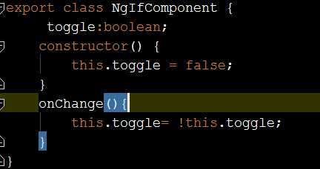
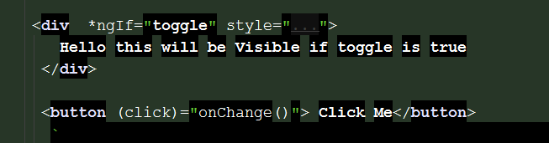
NgIf
It used to Show or hide the element

Slide 53
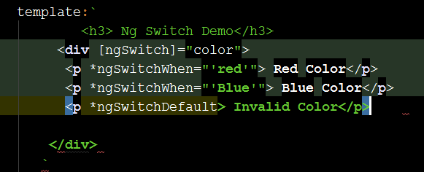
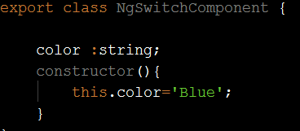
Ng-Switch
Render Different elements depending on the condition. So we have to use *ngIf several time . This is where ng-switch is useful.

Slide 54
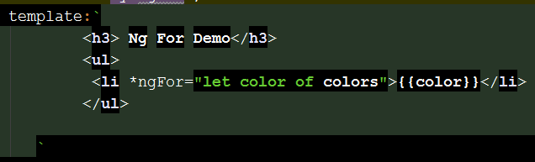
NgFor
Use to iterate over Collection.

Slide 55
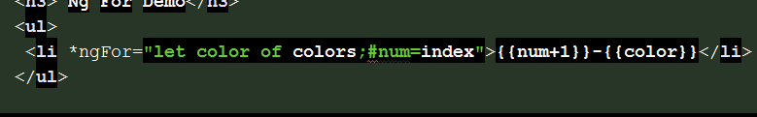
Getting an index

Slide 56
NgClass
Adds and removes CSS classes on an HTML element.
It takes collection of classes to be applied

Slide 57
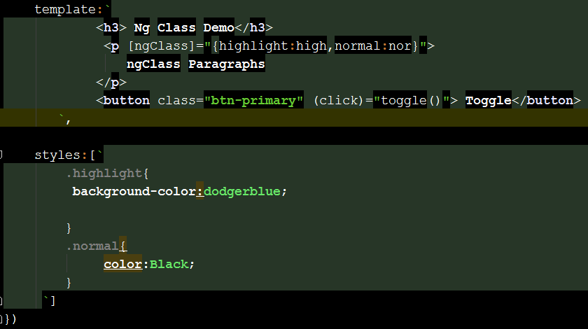

Slide 58
NgStyle
Its use to apply inline style

Slide 59
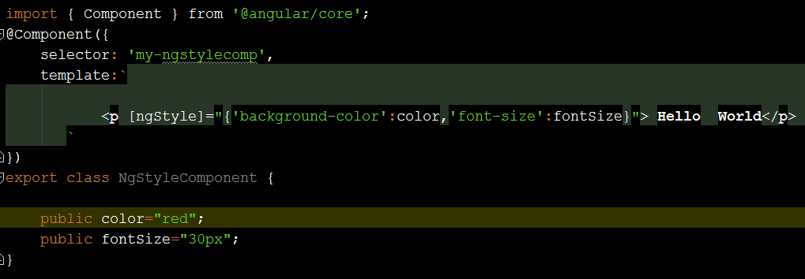

Slide 60
NgNonBindable
Its used when we don’t angular to compile or bind a particular section of our page.
For example we want to render the literal text {{content}}. Normally this will be bound to the value of content variable because of template syntax.

Slide 61
Forms
You can create forms using 2 ways
Model Driven approach
Template Driven approach

Slide 62
Model Driven Approach
It is achieved using FormGroup and and FormControl
FormGroup
- FormGroup encapsulates the state of all of its inner controls
So Formgroup is valid only if all of tis inner controls are valid.
2 . FormControl
FormControl is created for each template form control
Each form control in the template is represented by an instance of FormControl
This encapsulates the state of the control whether its valid or invalid and event its current value

Slide 63
Model Driven Approach
<form novalidate [formGroup]="userForm">
<fieldset formGroupName="name">
<div class="form-group">
<label>First Name</label>
<input type="text"
class="form-control" formControlName="firstName">
</div>
<div class="form-group">
<label>Last Name</label>
<input type="text"
class="form-control" formControlName="lastName">
</div>
</fieldset>
<form>
export class CustomerComponent implements OnInit {
countries :string[]=['India','Australia','UK','US'];
userForm:FormGroup;
ngOnInit(){
this.userForm= new FormGroup({
name:new FormGroup({
firstName:new FormControl(),
lastName:new FormControl()
}),
email:new FormControl(),
password:new FormControl(),
countr:new FormControl()
})
}
}

Slide 64
Pipes
Input
Pipe
Desired output

Slide 65
Built in Pipes
Lowercase
Uppercase
Date
<h4>{{name}}</h4>
<h4> {{name | uppercase}}</h4>
<h4> {{name | lowercase}}</h4>

Slide 66
Chaining Pipe
{{ mfgDate | date | uppercase}}
{{ mfgDate | date:'fullDate' | uppercase}}<br/>

Slide 67
Custom Pipe
import { Pipe,PipeTransform } from '@angular/core';
@Pipe({
name:'double'
})
export class DoublePipe implements PipeTransform{
transform(value:any,args?:any):any{
return value*value;
}
}
<input type="text" #input (keyup)="0"/>
<p>{{input.value}}</p>
<p>{{input.value|double}}</p>

Slide 68
Async Pipe
Async pipe accepts promise or observavle input and subscribes to the input automatically and eventually returns the emitted value.
This pipe maintains a subscription to the input observable and keeps delivering values from that

Slide 69
Need of Services
Component1
Code
Same Code appeared in both
Component.
Component2
Difficult to maintain
2. Code Duplication
Code
Notes:
Suppose we have 3 components which some code which is duplicated
Hence
Code duplication
Hard to maintain and Update

Slide 70
Services
Component1
Injected
inst1
Constructor(type)
Service
Code
Component2
inst2
Constructor(type)
Notes:
Suppose we have 3 components which some code which is duplicated
Hence
Code duplication
Hard to maintain and Update

Slide 71
Dependency Injection
Allows us to inject dependencies in different components across application without needing to know how dependencies are create or what dependencie they need.

Slide 72
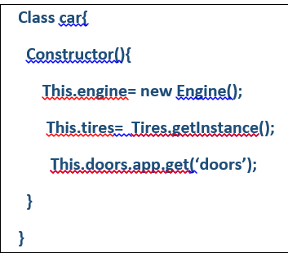
Problem
We have Created all the required instances inside Constructor.
Such code is hard to maintain and TEST

Slide 73
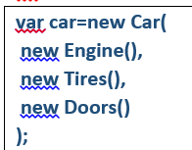
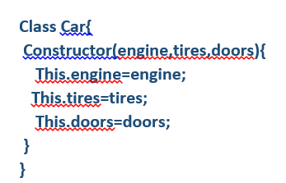
Moved all the dependency outside the constructor
Pass needed dependency to Car through Constructor Called Constructor Injection
Advtantage
- Dependency are now decoupled from a class. Hence would be easier to test and maintain.

Slide 74
Who will Assemble this in Angular 2? = DI Framework
Provider consists of Car token and Configurable object
Providers:[{provide:Car,useClass:Car]
Class Car{
constructor(engine:Engine,tire:Tire){
}
}
Injector
Car Instance
Notes:
1.Inject : It’s a decorator that attaches the metadata to our class that is then consumed by the DI system afterwards. Basically we are telling DI that the first constructor parameter should be instance of type Engine,Tires and Doors.
Injector – it exposes API to create instances of dependencies.
It maps token to configuration object.
Token can be type or string
We are specifying here we provide an instance of a class via the class Car.
Providers tells the injector which dependencies are used across the application.
Providers is an instruction which tells how the object of certain token is created.
In the above syntax we can map the token engine to the class OtherEngine which means we now asks for an object of type engine and we get an instance of class OtherEngine which can avoid name collision which was a problem in

Slide 75
Providers
Class Provider
Value Provider
Factory Provider

Slide 76
Show ComponentDIInjection

Slide 77
Injecting Services into Module
Component1
Constructor(type)
Injected
inst1
Service
AppMdule
Code
Component2
Constructor(type)
Notes:
Suppose we have 3 components which some code which is duplicated
Hence
Code duplication
Hard to maintain and Update

Slide 78
Show ModuleDIInjection

Slide 79
What is Routing
Changing the state of the application
Loading appropriate URL depending on Users Action

Slide 80
How Routing Works
http://Swapnil.app/products/12/Iphone
Url Segment
Parse Url
Identify Components
/user
/user/:id
Identify Routes
UserComponent
UserDataComponent
Notes:
First Step is URL Parsing URL its done using identifying different segment in the URL. In this products , 12 and Iphone is the Url Segment
Then it identifies the component to load depending on the user URL . All this is registered in some routing file.

Slide 81
Setting Routes
Create separate app.routing file
Use Routes
Create Collection of Routes
Export the Routes using RouterModule forRoot method
Add Ref of the routing in AppModule
Render the Routes

Slide 82
import {Routes, RouterModule} from "@angular/router";
import { HomeComponent } from './home.component';
import { UserComponent } from './user.component';
const APP_ROUTES:Routes=[
{ path :'user',component:UserComponent},
{path:'',component:HomeComponent}
];
export const routing=RouterModule.forRoot(APP_ROUTES);
App.routing File
Notes:
Create app.routing file
Use routes
Import necessary files
Define routes in the form of JS objects in array .
Export this routes to the application using RouterModule

Slide 83
import { NgModule } from '@angular/core';
import { BrowserModule } from '@angular/platform-browser';
import { AppComponent } from './app.component';
import { HomeComponent } from './home.component';
import { UserComponent } from './user.component';
import { routing } from './app.routing';
@NgModule({
imports: [ BrowserModule,routing ],
declarations: [ AppComponent,HomeComponent,UserComponent],
bootstrap: [ AppComponent ]
})
export class AppModule { }
App.routing.ts
Register your Route to Application
Notes:
We need to make aware about the routes to the entire application
So Add its ref to the AppModule

Slide 84
Render the Routes : ROUTER-OUTLET
<h1> Routing Demo </h1>
App.routing
‘ User’
User.Component
<router-outlet>
Router-outlet specifies the location where component to be loaded
</router-outlet>
Routes
Home.component
‘ Home’
App.component.ts
Notes:
For Rendering the Routes you need to use Router-Outlet.
Its defines the section where component should load

Slide 85
Using Navigation Links:routerLink
<h1>Routing Demo</h1>
<a [routerLink]="['']">Home</a> ||
<a [routerLink]="['user']">User</a>
<br/>
<router-outlet> </router-outlet>
routerLink Directives is use to create link to component. It allows us to pass the path of route which will be compared with routing file .
It uses property binding syntax

Slide 86
Imperative Routing
<button (click)="onNavigateTo()">Home</button>
export class UserComponent {
constructor(private router:Router){
}
onNavigateTo(){
this.router.navigate(['/']);
}
}
Notes:
Suppose you want to do routing on some button click. Then we have to create some method and we have to use Router class
We pass this router to constructor and use its navigate method to do this.

Slide 87
Route Parameter
1. {path:'user/:id',component:UserComponent}
2.
<input type="text" #id (input)="0"/>
<a [routerLink]="['user',id.value]">User</a>
Notes:
How to Pass Route Parameter
Change the route from Routing so that it can accept the routing parameter
Pass the value from routerLink value.

Slide 88
Reading Route Parameters
export class UserComponent {
id:string;
constructor(private router:Router,private activatedRoute:ActivatedRoute){
this.id=activatedRoute.snapshot.params['id'];
}
}
Notes:
To extract Route parameter you need to use ActivateRoute type object
We use activatedRoute.snapshot.params[‘id’]
This is first method of accepting values and it is not observable

Slide 89
Reading using Observable
Import Subscription and onDestroy
export class UserComponent implements OnDestroy{
id:string;
private subscription: Subscription;
constructor(private router:Router,private activatedRoute:ActivatedRoute){
this.subscription= activatedRoute.params.subscribe((param:any)=>this.id=param['id'])
}
ngOnDestroy(){
this.subscription.unsubscribe();
}
}
Notes:
You need to use params method in this which is observable
But it can lead to memory leak so we need to use lifecycle and use ngDestroy to recreate the things again and unsubscribe.

Slide 90
Defining Child Routes
Create Separate Child Route file
Change the Main app routing file
Add a router outlet in the component where you want to add child

Slide 91
Create Separate Child Route file
import {Routes} from "@angular/router";
import { UserDetailComponent } from './userdetails.component';
import { UserEditComponent } from './useredit.component';
export const USER_ROUTES: Routes=[
{path:'detail',component:UserDetailComponent},
{path:'edit',component:UserEditComponent}
];

Slide 92
Change app.routing file
import {Routes, RouterModule} from "@angular/router";
import { HomeComponent } from './home.component';
import { UserComponent } from './user.component';
import { USER_ROUTES } from './app.childroute';
const APP_ROUTES:Routes=[
//{ path :'user',component:UserComponent},
{path:'user/:id',component:UserComponent},
{path:'user/:id',component:UserComponent,children:USER_ROUTES},
{path:'',component:HomeComponent}
];
export const routing=RouterModule.forRoot(APP_ROUTES);

Slide 93
Add Router-Outlet
template:`<h3>User Component</h3>
<a [routerLink]="['/user']">User</a>
<button (click)="onNavigateTo()">Go to Home</button>
{{id}}
<hr/> <hr/>
<router-outlet></router-outlet>

Slide 94
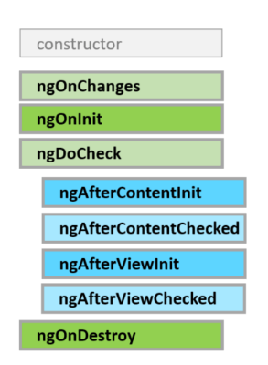
Angular JS LifeCycle
Notes:
Angular Offers Lifecycle hooks that provide visibility into these key life moments. Developers can use them by implementing the interfaces and each interface has a single hook.
LifeCycle Hooks and its Sequence
ngOnChanges : When data bound property value changes. Its called before ngOnInit.
ngOnInit :Initialize the directive/Component after angular first display data bound properties and sets the directive/component input properties. When component initialization, after first ngOnChanges. It execute only once.
ngDoCheck : Detect and act upon changes . it is called after every ngOnChnages and ngOnInit.During every Angular2 Change detection cycle.
ngAfterContentInit :Respond after Angular projects external content into components view. After inserting content using <ng-content>.
ngAfterContentChecked : Responds after Angular checks the content projected into component.After every check of inserted Content.
ngAfterViewInit : Responds after Angular initialize the Components view and child views. Called after ngAfterContentChecked.After Initializing the components views/child views.
ngAfterViewChecked : Respond after Anuglar Checks for Component Views.After every Check of the components views/child views.
ngOnDestroy : Clean up just before Angular destroys the directive/component. Unsubsscribe observables and detach event handlers to avoid memory leaks.just before Angular 2 destroys the directive/component.
Can we use this in real world applications??
OnInit
To perform complex initialization shortly after construction.
To set up the component after Angular sets the input properties.
Rule :
Don’t fetch data in component constructor . it should only be used to initialize the things.
ngOnInit : it’s a good place for a component to fetch its initial data.
OnDestroy
Put Clean up logic in ngOnDestroy .
This logic must be run before Angular destroys the directive.
It can be use to notify the another part of the application that component is going away.
OnChanges
Angular calls its ngOnChanges method whenever it detects changes to input properties of the component. This hooks iterates over the changed properties and logs them.
DoCheck
Use the doCheck hook to detect and act upon changes.
It can be used to capture and compare the current state against previous values.

Slide 95
View Encapsulation
Style to specific component
Component
Style
Notes:
Angular allows us to specify Component Specific Styles
Angular gives3 attribute for that Style and StyleUrls to use External CSS files.
The Styles applied to that specific component.

Slide 96
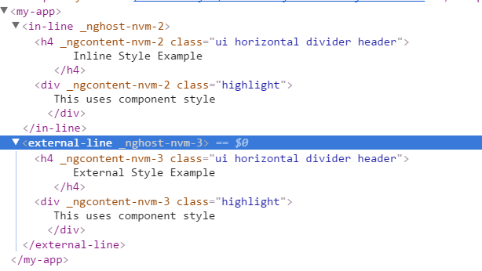
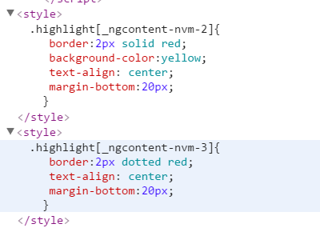
Entire Style is rewritten with the different name to achieve scope style/
Emulated

Slide 97
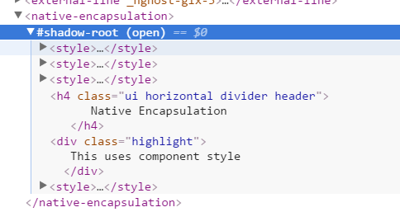
Check this Shadow Root . Which create a unique tree. Its done to create scope Styles.
Encapsulation:ViewEncapsulation.Native
Notes:
Shadow DOM Encapsulation
Shadow DOM the component we uses a Unique DOM tree that is hidden from the other elements on the Page.
This allows styles defined within that element to be invisible to the rest of the Page.
Everything inside the shadow element has been encapsulated and isolated from the rest of the page.
Shadow DOM allows us to hide DOM logic behind other elements.
IT also enables us to apply scoped styles to elements without them bleeding out to the outer world.
In order to get proper output without weird attributes.
When it comes to Shadow DOM, the tables are turned, as Shadow DOM creates DOM inside DOM, combining multiple DOM trees into a single hierarchy. These chunks of isolated DOM act as a “shield” around all these global entities such as CSS and JavaScript logic and are locally scoped to one another.
Problem with Emulation is it can inherit from global styles.
Shadow DOM helps us to Solve this problem. So no inheritance here.

Slide 98
View Encapsulation
Emulated
Native :Shadow DOM
None : Style will be leaked to other pages.

