Slide 1
RS485 Fundamental

Slide 2
Contents
  Introduction
  RS-232 Line Driver
  RS-485 Line Driver
  Advantage of Differential Signaling
  RS-485 Network
  RS-485 Half-duplex
  RS-485 Full-duplex
  RS-232 vs RS-485
  Advantages of RS485

Slide 3
Introduction
What is RS-485?
  RS-485 is an EIA (Electronic Industries Alliance) standard interface which is very common in the data acquisition world.
  RS-485 provides balanced transmission line which also can be shared in Multidrop mode.
  It allows high data rates communications over long distances in real world environments.
How fast can RS-485 be?
  RS-485 offers data transmission speeds of 10 Mbit/s up to 10 m and 100 kbit/s at 1200 m. Since it uses a differential balanced line over twisted pair (like RS-422), it can span relatively large distances (up to 4,000 feet (1,200 m)). A rule of thumb is that the speed in bit/s multiplied by the length in meters should not exceed 10⁸. Thus a 50 meter cable should not signal faster than 2 Mbit/s.

Slide 4
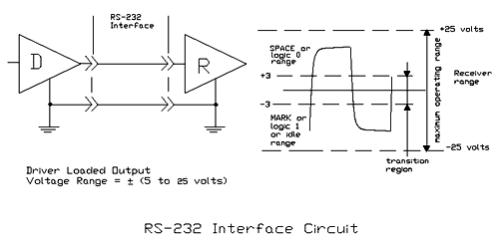
RS-232 Line Driver
Unbalanced Line Drivers
  Each signal appears on the interface connector as a voltage with reference to a signal ground.
  The “idle” state (MARK) has the signal level negative with respect to common whereas the active state (SPACE) has the signal level positive respest to the same reference.

Slide 5
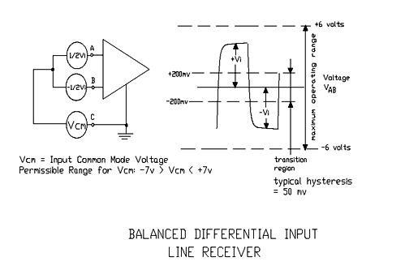
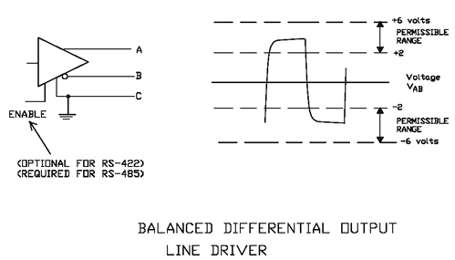
RS-485 Line Driver
Balanced Line Drivers
  Voltage produced by the driver appears across a pair of signal wires that transmit only one signal. Both wires are driven opposite.
  RS-485 driver has always the “Enable” direction control signal.
  Differential system provides noise immunity, because much of the common mode signal can be rejected by the receiver. So ground shifts and induced noise signals can be nullified.

Slide 6
Advantage of Differential Signaling
  Consider a single-ended digital system with supply voltage Vs. The high logic level is Vs and the low logic level is 0 V. The difference between the two levels is therefore Vs – 0 = Vs. Now consider a differential system with the same supply voltage. The voltage difference in the high state, where one wire is at and the other at 0 V, is Vs – 0 = Vs. The voltage difference in the low state, where the voltages on the wires are exchanged, is 0 – Vs = -Vs. The difference between high and low logic levels is therefore Vs – (-Vs) = 2Vs. This is twice the difference of the single-ended system. Supposing that the voltage noise on one wire is uncorrelated to the noise on the other one, the result is that it takes twice as much noise to cause an error with the differential system as with the single-ended system. In other words, the noise immunity is doubled.

Slide 7
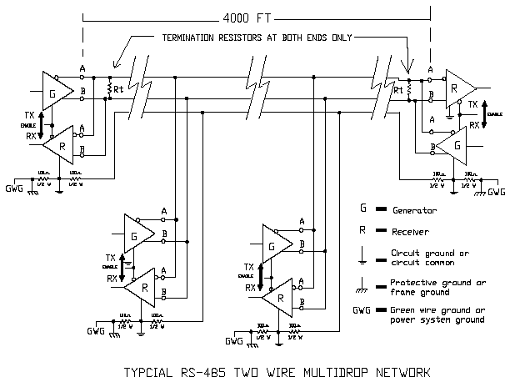
RS-485 Network
RS-485 provides Half-Duplex, Multidrop communications over a single twisted pair cable.
  The standard specifies up to 32 drivers and 32 receivers can share a multidrop network
  Terminator resistors avoid reflected signal
MASTER
SLAVE-1
SLAVE-2
SLAVE-3

Slide 8
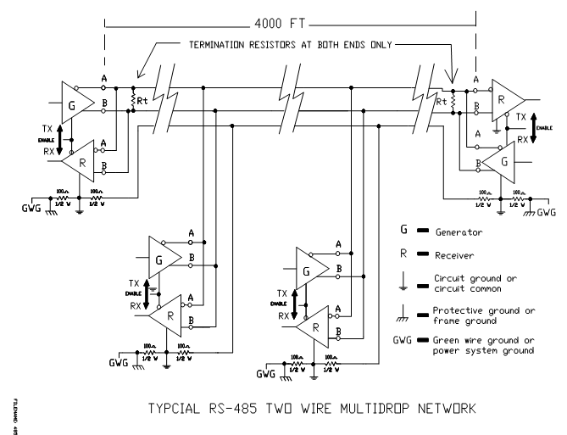
RS-485 Half Duplex

Slide 9
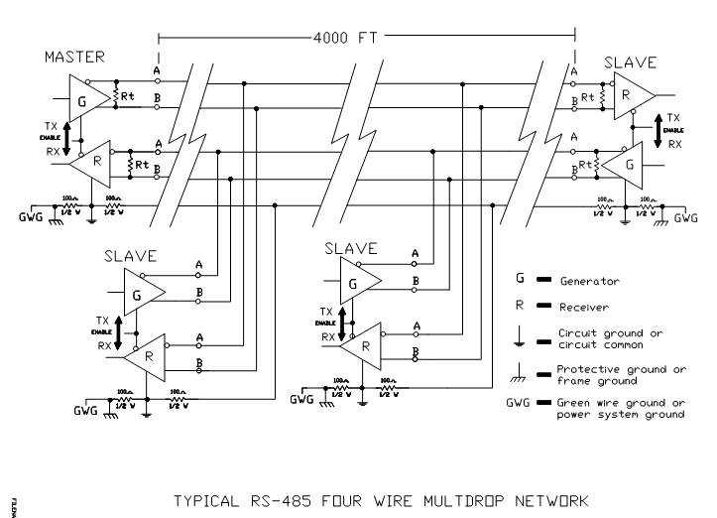
RS-485 Full-duplex

Slide 10
RS-232 vs RS-485
The architectural difference between RS-232 and RS-485 is that 232 is a bi-directional point to point link, whereas 485 is a single channel bus.
Electrically, each 232 signal uses a single wire with symmetric voltages about a common ground wire. 485 uses two wires to carry the single signal differentially.
The big difference to the software is that only one device on a 485 bus can transmit at a time, whilst there is not similar limitation on RS232 because is a peer-to-peer link .

Slide 11
RS-232 vs RS-485(Contd.)
RS-232 RS-485
Mode of Operation SINGLE-ENDED DIFFERENTIAL
Total Number of Drivers 1 DRIVER 32 DRIVER
and Receivers on One Line 1 RECEIVER 32 RECEIVER
Maximum Cable Length 50 FEET 4000 FEET
Maximum Data Rate @Max length 20kb/s 100kb/s
Driver Output Signal Level
(Loaded Min.) Loaded +/-5V to +/-15V +/-1.5V
Driver Output Signal Level
(Unloaded Max) Unloaded +/-25V +/-6V
Driver Load Impedance 3kΩ to 7kΩ 54Ω
Max. Driver Current in
High Z State Power On N/A N/A
Max. Driver Current in
High Z State Power Off +/-6mA @ +/-2v +/-100uA
Slew Rate (Max.) 30V/μS N/A
Receiver Input Voltage Range +/-15V -7V to +12V
Receiver Input Sensitivity +/-3V +/-200mV
Receiver Input Resistance 3kΩ to 7kΩ ≥ 12kΩ

Slide 12
Advantages of RS485
The RS485 interface adopts the role of balancing driver and differential receiver so that the common mode disturbance immunity is improved, i.e. it has good noise immunity.
Maximum 32 transceivers are allowed to connect to the bus. With this multi-station capability, a device network can be conveniently established via a single RS485 interface.
Normally only two wires, a shielded twisted pair (STP), are needed in the half duplex network formed by the RS485 interface.

