Slide 1
Custom trading algorithms
Shaun Cox
Byte Academy

Slide 2
Demonstration!

Slide 3
Custom Trading algorithms
What does it do?
Allow individuals to back-test various trading and stock screening strategies
Takes user input, screens stocks, then buys & sells each trading day
User can track performance of custom algorithm vs S&P 500
Why create a trading algorithm?
Learn how to develop my own personal trading algorithms
Test trading theories

Slide 4
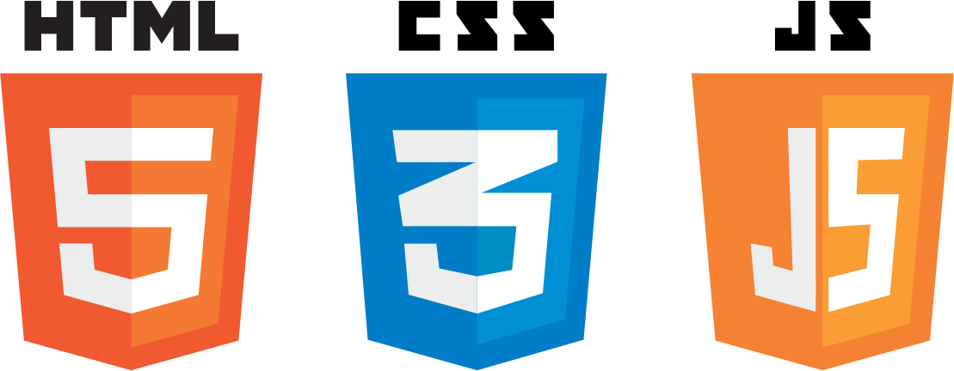


FRONT-END TECHNOLOGIES

Slide 5






BACK-END TECHNOLOGIES

Slide 6
success & obstacles
Successes
Created a massive database with 108 million rows of data
Automatically buys and sells stocks
Able to run back-tests for 10 years (2007 – 2017)
Can prove or disprove trading theories
Obstacles
Developing a massive database – 4 weeks and many attempts
Speed of algorithm – 1 yr back-test takes about 15 minutes
Chart creation

Slide 7
Demonstration!

Slide 8
Future aspirations
Optimize algorithms to be much faster
Scale application for mobile use
Link application to trading accounts (i.e., Robinhood)
Implement live-trading
Add stats: winners, losers, buys, sells, turnover time, etc.

Slide 9
Many Thanks to:
Billy, Tom, Kenso, Kai, Jenna, Emily, Wes, Sasha and the Byte Staff

