Slide 1
Custom trading algorithms
Shaun Cox
Byte Academy

Slide 2
Custom Trading algorithms
What does it do?
Allow individuals to test various trading and stock screening strategies
Takes user input, screens stocks, then buys & sells each trading day
User can track performance of custom algorithm vs S&P 500
Why?
Learn how to develop my own personal trading algorithms
Test trading theories

Slide 3
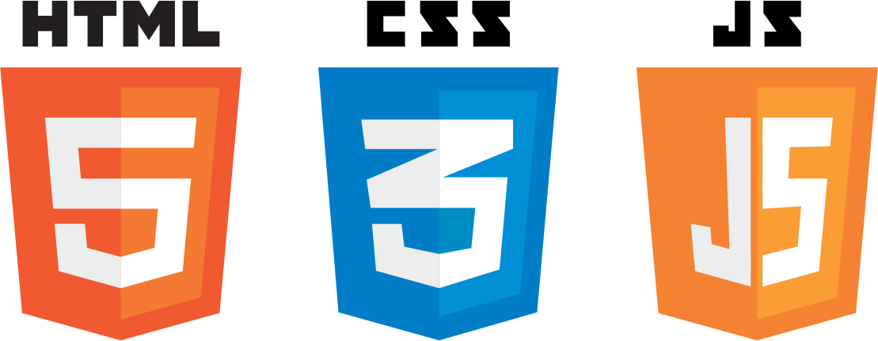


FRONT-END TECHNOLOGIES

Slide 4




BACK-END TECHNOLOGIES

Slide 5
DEMOnstration!

Slide 6
success & obstacles
Successes
Created a massive database with 108 million rows of data
Able to run back-tests for 10 years (2007 – 2017)
Can prove or disprove trading theories
Obstacles
Developing a massive database – 4 weeks and many attempts
Speed of algorithm – 1 yr back-test takes about 15 minutes

Slide 7
Future aspirations
Optimize algorithms to be much faster
Scale application for mobile use
Link application to trading accounts (i.e., Robinhood)
Implement live-trading

Slide 8
Many Thanks to:
Billy, Tom, Kenso, Kai, Jenna, Emily, Wes, Sasha and the Byte Staff

