Slide 1

Marketing Pitch

Slide 2
Why Is Marketing Important?
Marketing is the strategy employed for increasing the awareness, understanding and demand of a business and/or product.
Bringing brand awareness to HaloGen
Maintaining product demand
Retain customers

Slide 3
7 Principles of Marketing Mix
1
2
3
4
5
6
7
Product
Price
Promotion
Place
People
Packaging
Process

Slide 4
7 Principles of Marketing Mix
What are we bringing to the market?
Halogen Smart Meter
Reduces energy consumption
Removes the hassle of manually submitting meter readings
Brings awareness to any faulty appliances
Eco-friendly and helps to save the planet
1
Product
The item that is being brought to the market place.

Slide 5
7 Principles of Marketing Mix
How will the product be priced?
We should consider if Halogen will charge a premium or a discount to current competition
Competition offer “free” smart meters and installation and then charge via the energy billing.
Space for upselling: charge for warranty, charge for the mobile application or charge for removal of previous meter.
2
Price
How much does the product cost and how it effect the brand

Slide 6
7 Principles of Marketing Mix
How can we get people to buy the Halogen Smart Meter?
Offer current (indirect) customers a discount to switch over
Offer a discount for first-time home buyers
Offer the product alongside other energy related essentials such as lightbulbs, sockets, switches
Demo app account before customer buys
3
Promotion
Method employed to inform people about the new product and to increase engagement.

Slide 7
7 Principles of Marketing Mix
4
Where will people find the Halogen Smart Meter?
Home blogs
Pinterest pages specialising in home decor
- Financial advice websites
Energy comparison websites
Place
The locations in where potential customers are going to be exposed to the product

Slide 8
7 Principles of Marketing Mix
Who is going to buy the Halogen Smart Meter?
Homeowners
First-time, over 50 % ages between 25-35 years old
Urban locations
32k-40k per year, average home buyer salary
Those who have a variable energy tariff
5
People
The target market, who specifically is going to want to buy the product

Slide 9
7 Principles of Marketing Mix
How is the Halogen Smart Meter going to come?
Clear instructions on the back
QR code with link to YouTube video tutorial/app/website
How the device is saving the planet
Image showing the device in use
Modern, new, lighter colours, futuristic, utopian
6
Packaging
The look and feel of the product and how fits with the brand

Slide 10
7 Principles of Marketing Mix
Halogen Smart Meter
Insurance of the systems in place for smooth delivery and usage
Manufacturer builds and packages product – Warehouse for distribution – Customer receives product
Booking for installation is also done online
Scannable code linking to installation booking
Provide an emergency helpline via online chat and phone
Accessibility to online orders with quick and easy checkouts
Energy supplier checker to make sure the customer can have the product installed.
7
Process
The way in which the product is going to get from the manufacturer to the customer

Slide 11
Traditional Marketing vs Digital Marketing
Time consuming
Performance is harder to measure
More risk on investment due to lack of measurability
Harder to make adjustments
Easier targeting – Being able to focus primarily on target market will optimise sales
Tracking/measurable – Ability to track campaign reach and performance
Quicker and easier to make adjustments
Instantaneous feedback
Guaranteed reach
Cost effective

Slide 12
Importance of ROI
To insure that the money invested in marketing will be returned with profit
Considering Halogens change from B2B to B2C it is vital that ROI is correct formulated as the return from customers needs to out-way the previous model whilst exceeding the cost of marketing
Making sure that manufacturing, installation and delivery costs is less than how much customers will be paying for the product.
Measure long term profit targets so that the Halogen can continue to plan ahead.

Slide 13
Customer Journey
Customer Experience and Product Support
Helpline and online chat
Customer Forum
Customer Experience check-ins
Awareness
SEO
Social Media
Email Marketing
Influencer endorsement
Marketing & Knowledge
Copywriting
Video content
News Letters
Blog Posts
Meet the experts
Sales Conversion
Demo App to use
Offer alongside other products
Discount when you switch
Retention
Updated News letter
Email Blogs
Snail mail Flyers
Company updates
Advocacy
Easy sharing options
Affiliation link

Slide 14
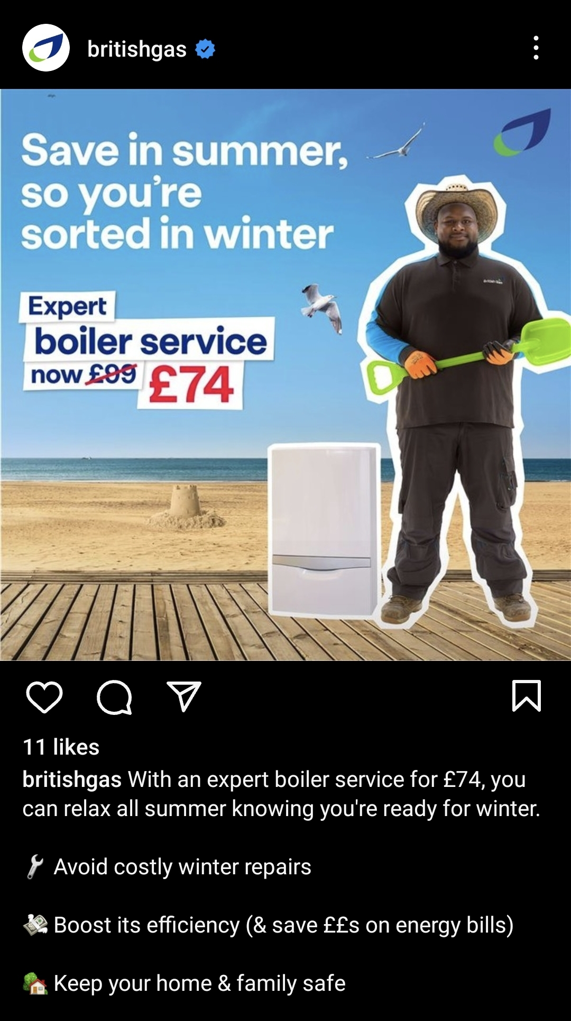
Portfolio example 1
British Gas Summer Discount campaign
Bring awareness to British Gas’ discounted boiler service.
This is effective because it suggests the risks of higher prices occurring in winter within the caption, enticing people to take advantage of the offer now.

Slide 15
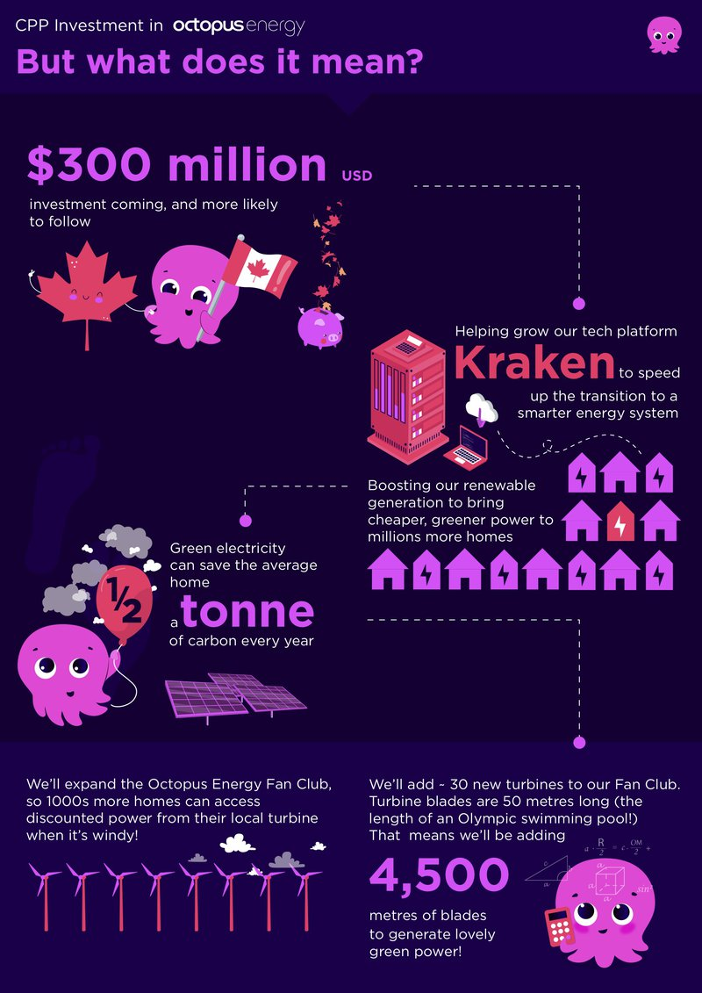
Portfolio example 2
Octopus energy infographics
To teach customers about the movement to green energy and how much they can save
The infographics are easy to read and understand and are very brand heavy staying on theme

Slide 16
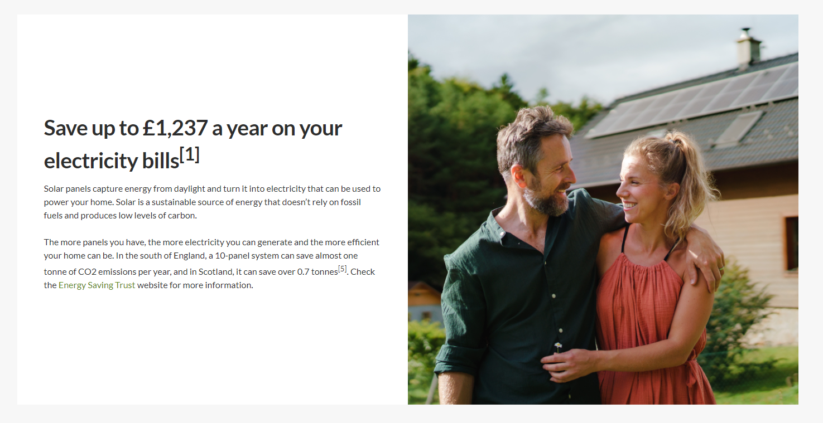
Portfolio example 3
Scottish Power Solar Panel Campaign
To make people aware of how much money they save with solar panels and the advantages of them for the environment.
Effective because it shows a precise amount that customers are saving and provides information of how much emissions are saved.

