Slide 1

Holistic well-being and patient-reported outcomes (PROs) in translational IBD research Rebecca Hall^{1,2}, Shaun Chuah^{1,2}, Emily Brownson³, Broc Drury¹, Beena Poulose², Athena Oddy², Craig Mowat⁴, Jonathan MacDonald³, John Paul Seenan³, Gwo-Tzer Ho^{1,2}
¹ Centre for Inflammation Research, University of Edinburgh
² Western General Hospital, NHS Lothian
³ Queen Elizabeth University Hospital, NHS Greater Glasgow & Clyde
⁴ Ninewells Hospital, NHS Tayside
Scottish Society of Gastroenterology
Winter Meeting 2022

Slide 2
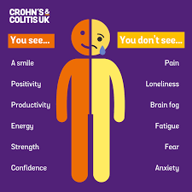
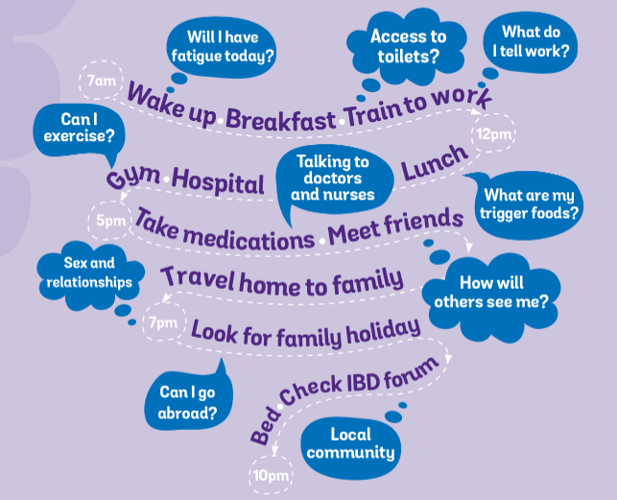
Well-being in IBD
Increasing awareness of ‘hidden burden’ of IBD
Wider impact of IBD on general well-being and quality of life
Development of new treatments to include patient focused endpoints

Slide 3
What are Patient Reported Outcomes (PROs)?
PROs provide insight into patient perspective of health and efficacy of treatments
Concern that commonly used clinical endpoints do not accurately represent patient experience
FDA and EMA recommend PROs used as measures of treatment efficacy in clinical trials. Consequently, there is an increasing interest in PROs
Notes:
Causing disconnect between clinical trials and real world practice

Slide 4
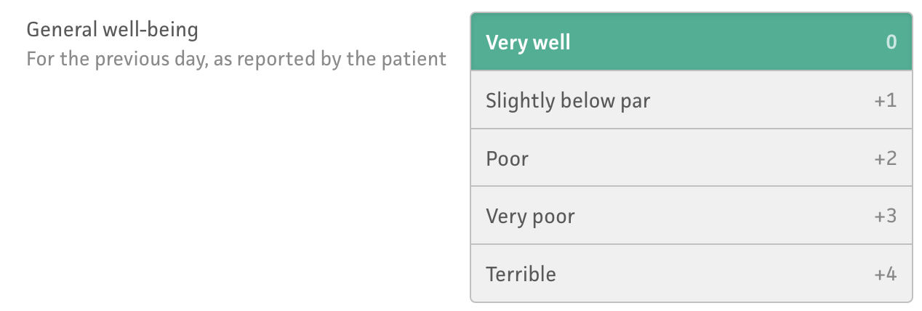
Conventional clinical end-points and general well-being
Variety of clinical disease activity scores are used as clinical endpoints in trials
Focus on specific IBD symptoms with one exception:

Slide 5
Is there a role for PROs in translational research studies?
2 IBD biomarkers studies (MUSIC and GIDAMPs)
CUCQ-32
Assess relationship between CUCQ-32 and conventional activity scores, biomarkers and mucosal healing

Slide 6
CUCQ-32
Bowel
General
Loose stool
Psychological
Social
Blood
Frustration
Happiness
ADLs
Social Events
Tired
Energy Levels
32 questions
Covers preceding 2 weeks
Range: 0-272
No ‘normal’ score
Notes:
The CUCQ32 is a 32 item QOL questionnaire that was developed by a team in Swansea in order to develop a shorter and easier to use QOL questionnaire for IBD.
QOL questionnaires used to gain insight into impact of disease on patient perception of health
Previously generic, non IBD specific tools being used.
Acute questions: nocturnal diarrhoea and rectal bleeding

Slide 7

Patient
Clinical
Outcomes
All known biomarkers
PROSPECTIVE
Time-points over 12 months
Paired gut biopsies/blood/
stools
MUCOSAL HEALING
Genetics
Transcriptomics
Microbiome
(Gut and Stools)
Patient Reported
Outcomes

Slide 8

Cohort 2:
GI-DAMPs study
Cross-sectional study
N=1000 IBD
N=200 Healthy Controls
Patient Reported
Outcomes
No of patients
Clinical
Outcomes
All known biomarkers
Remission
Active
Highly
Active
IBD Activity

Slide 9
What is a ‘normal’ CUCQ-32 score?

Slide 10
n = 33
n = 97
n = 108
n = 71

Slide 11
n = 33
n = 97
n = 108
n = 71

Slide 12
n = 33
n = 97
n = 108
n = 71

Slide 13
n = 33
n = 97
n = 108
n = 71

Slide 14
CUCQ-32 decrease during treatment of IBD: MUSIC

Slide 15
Notes:
TP1 = 97
TP2 = 79
TP3 = 61
TP4 = 44
TP5 = 35

Slide 16
MUSIC: CUCQ-32 correlates to HBI (CD) and SCCAI (UC)
r = 0.71
p = <0.0001
r = 0.69
p = <0.0001

Slide 17
GIDAMPs: CUCQ-32 correlates to HBI (CD) & SCCAI (UC)
r = 0.47
p = 0.0015
r = 0.72
p = <0.0001
Notes:
All GIDAMPs (inc remission and unknown)

Slide 18
Statistical difference in high vs low calprotectin
Notes:
305 pairs

Slide 19
Statistical difference in high vs low CRP
Notes:
383 pairs

Slide 20
MUSIC: No statistical difference in mucosal healing
Notes:
Mucosal healing n =21 Not mucosal healing n = 32
EXPLAIN WHAT MUCOSAL HEALING MEANS

Slide 21
Conclusions
We have prospectively captured PROs in association with clinical metadata in the translational setting
CUCQ32 correlates well with clinical disease activity scores, as in original validation study
CUCQ32 scores are higher in active disease (CRP/calprotectin) but not associated with mucosal healing
Notes:
Summary We have prospectively captured PROs with clinical data
Correlate with HBI etc
Not with FCP/CRP. Maybe mucosal healing
What do the numbers mean? What is the point
Future work: more numbers, link to science: group looking at damps, proteominc, immunometabolic signatures, microbiome
Long covid work – trying to identify biological signature for long covid

Slide 22
Future Work
Molecular/biological signals vs PROMs:
Continuing recruitment
Mitochondrial DAMPS
Immunometabolic signatures
Proteomic/microbiome
Suspected biological groups:
Active disease & high PROs
Active disease & low PROs
Remission & high PROs
Remission & low PROs
Use of PROs increasing, in future may be able to focus research on specific sub-groups

Slide 23





Acknowledgements
Beena Poulose
Athena Oddy
Gwo-Tzer Ho
Broc Drury
Lena Fischer
Robert Whelan
Duncan Rutherford
Alex Cavanagh
Phoebe Lau
Craig Mowat
Abigail Grieve
Leanne Cosgrove
Samera Mohammed
John Paul Seenan
Jonathan MacDonald
Emily Brownson
Shona Perry
Faye McMeeken
Thank you to all our patients, volunteers and fellow clinicians

