Slide 1
GitHub Training
Shaun

Slide 2
Welcome to GitHub Training
Shaun
Notes:
Image source: Microsoft 365 content library Welcome to our GitHub training session! In this course, you’ll gain hands-on experience with version control using GitHub. We will cover creating repositories, collaborating with teams, and mastering essential workflows. Let’s get started on your journey to becoming a proficient GitHub user.

Slide 3
Welcome to GitHub Training
Shaun
Notes:
Image source: Microsoft 365 content library Welcome to our GitHub training session! In this course, you’ll gain hands-on experience with version control using GitHub. We will cover creating repositories, collaborating with teams, and mastering essential workflows. Let’s get started on your journey to becoming a proficient GitHub user.

Slide 4
GitHub Training
Version Control Introduction
GitHub enables efficient version control, allowing teams to track changes and manage code history for every project.
Collaboration Tools
Features like repositories, branches, and pull requests support seamless teamwork and code review processes.
Best Practices and Security
Adopting best practices in code management, security, and communication ensures project integrity and efficient workflow.
Notes:
Image source: Microsoft 365 content library Introduce corporate employees to GitHub, focusing on version control and collaboration. Highlight key features such as repositories, branches, and pull requests for effective teamwork. Emphasize best practices in code management, security, and communication using GitHub’s platform to streamline development workflows.

Slide 5
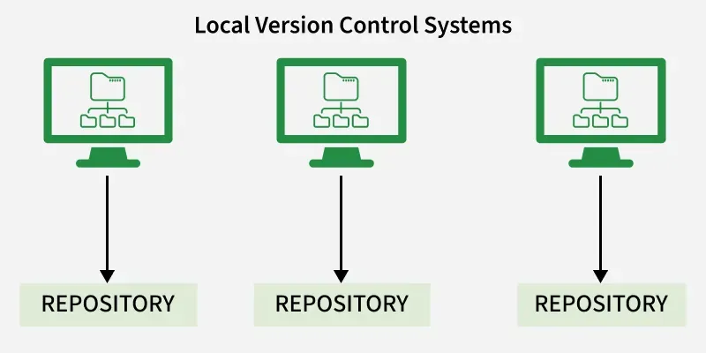
Local VCS
Notes:
Image source: Microsoft 365 content library Introduce corporate employees to GitHub, focusing on version control and collaboration. Highlight key features such as repositories, branches, and pull requests for effective teamwork. Emphasize best practices in code management, security, and communication using GitHub’s platform to streamline development workflows.

Slide 6
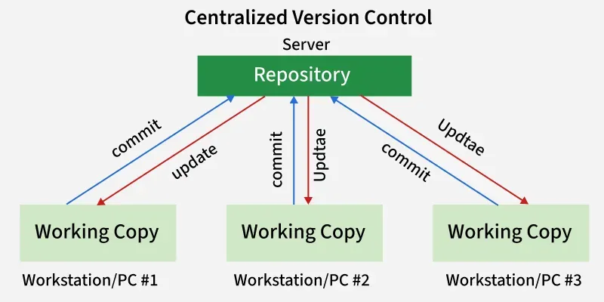
Centralized VCS
Notes:
Image source: Microsoft 365 content library Introduce corporate employees to GitHub, focusing on version control and collaboration. Highlight key features such as repositories, branches, and pull requests for effective teamwork. Emphasize best practices in code management, security, and communication using GitHub’s platform to streamline development workflows.

Slide 7
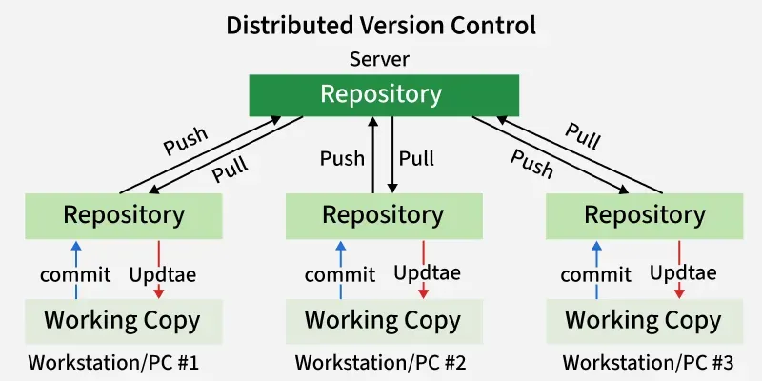
Distributed VCS
Notes:
Image source: Microsoft 365 content library Introduce corporate employees to GitHub, focusing on version control and collaboration. Highlight key features such as repositories, branches, and pull requests for effective teamwork. Emphasize best practices in code management, security, and communication using GitHub’s platform to streamline development workflows.

Slide 8
Git Terminology:
git init
git clone
git push
git pull
git status
git add
git commit
git branch
git checkout
git merge
git log
git diff
git restore
git reset
git revert
git stash
git config
Notes:
Image source: Microsoft 365 content library Introduce corporate employees to GitHub, focusing on version control and collaboration. Highlight key features such as repositories, branches, and pull requests for effective teamwork. Emphasize best practices in code management, security, and communication using GitHub’s platform to streamline development workflows.

Slide 9

Welcome and Overview
Introduction to Objectives
The opening introduces the main objectives and topics, giving the audience a clear understanding of what to expect.
Central Navigation Hub
A homepage acts as a central hub, providing quick navigation to the key presentation sections for easy access.
Engaging Presentation Flow
A clear, organized flow ensures the audience remains engaged and can easily follow along from the very start.
Notes:
Image source: Microsoft 365 content library This presentation begins with an introduction to outline the main objectives and topics to be covered. The homepage serves as a central hub, offering quick navigation to key sections. Together, they set the stage for a clear and organized presentation flow, ensuring audience engagement from the start.

Slide 10
Welcome to GitHub Training
Introduction to Version Control
Learn the basics of version control and how it helps manage code changes effectively and securely.
Creating and Managing Repositories
Understand how to create, organize, and maintain repositories for your projects on GitHub.
Collaborating with Teams
Discover how to work together with others, review code, and manage contributions using collaborative GitHub features.
Notes:
Image source: Microsoft 365 content library Welcome to our GitHub training session! In this course, you’ll gain hands-on experience with version control using GitHub. We will cover creating repositories, collaborating with teams, and mastering essential workflows. Let’s get started on your journey to becoming a proficient GitHub user.

