Slide 1
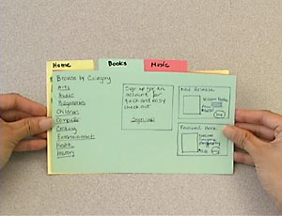
Paper Prototyping CSCI 5839– Fall 2014
Notes:
http://what-the-fail.com/computer-user-fail/

Slide 2
Assignments etc.
Due today: peer feedback on P1
Next week: personas, scenarios, sketches
Notes:
Open ended is part of the class, graduate class. So if you want feedback don’t hesitate to ask me or TAs

Slide 3
Paper prototyping

Slide 4
What is a prototype?
Something to get ideas out into the world
Demonstrates functionality
First version
Minimum viable product

Slide 5
What is a prototype?
Prototype = “working” model
Common in almost every field of engineering design
Airplanes, chemical structures, architecture…
In HCI, prototypes are
Full-size or to scale
Fully or partially functioning
Limited representation of an idea
Virtual or physical

Slide 6
Examples of HCI prototypes
A series of screen sketches (paper)
A storyboard, cartoon-like series of scenes illustrating key points of a scenario
A PowerPoint Slide show
A video simulating the use of a system
A piece of software with limited functionality written in the target language or in another language
An electronic mock-up (hardware)
A cardboard mock-up

Slide 7
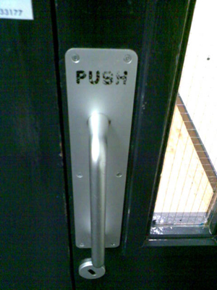
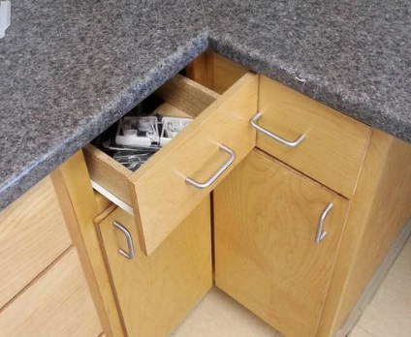
Why Prototype?
To identify user interface and functional requirements
Almost impossible to specify in advance
Can’t always get things right the first time…

Slide 9
Prototype compromises
Low-fidelity
But low-fi can help encourage feedback
Partial functionality
Missing some features
Missing detail
Horizontal and vertical prototypes

Slide 10
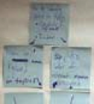
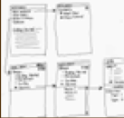
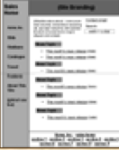

Fidelity
Designers create prototypes at multiple levels of detail, or Fidelity
Example: Web sites are iteratively refined at all levels of detail
Site Maps
Storyboards
Schematics
Mock-ups
Low
High
Fidelity
Notes:
Difference between storyboard - site map: site map on stickynotes which can be rearranged to explore the link structure of this webpage.

Slide 11
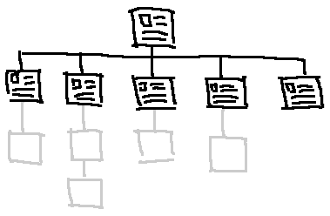
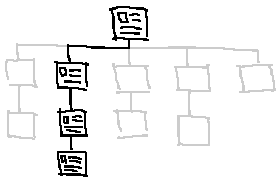
Horizontal vs. Vertical
Horizontal
“thin” prototype
Vertical
“thick” prototype

Slide 12
Horizontal vs. Vertical
Horizontal Designs
First level of user interface is fully present
No, or limited, functionality (but looks complete)
Fast implementation
Full extent of interface can be tested, but not in a real-use context
Often does not capture the interaction “feel”
Vertical Designs
Restricted to a subset of the system
This subset offers the interface and functionality
Can undertake realistic testing

Slide 13
What to prototype?
Not just the main screen
Try to prototype to solve the hard parts, work out the details of interaction

Slide 14
Prototyping tools
Paper
Pre-made paper templates
Diagramming software (PowerPoint, OmniGraffle)
Dedicated prototyping software (Balsamiq, Mockingbird)
HTML/CSS
High-level programming language
Implementation programming language

Slide 15
Why paper?
Easy to make; easy to change
Low-fidelity – encourages user feedback
Does not distract user by implementation details (color etc.)

Slide 16
How to make paper prototypes

Slide 17
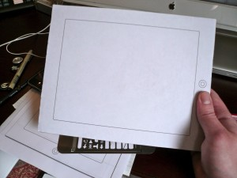
What is this device?

Slide 18
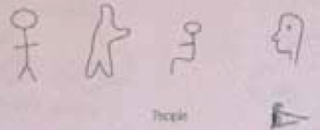
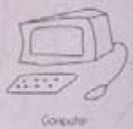

Low Fidelity Prototypes
Sketching is important
Don’t be inhibited about drawing ability, practice simple symbols
Develop your own symbols and icons
People
Computer
Interactions

Slide 19
Paper Prototyping Rules
Set deadline (don’t spend too long)
Draw window on large paper
Draw different screen regions on index cards (or paper) them put on the window paper
Make sketch of each screen
Photocopy to make test version
Test, markup, and iterate

Slide 20
Tools of the trade

Slide 21
Index Cards
Index cards (3”x5”)… a great size!
Each card represents one screen or one element of a task
Great for software prototypes with multiple screens
Website design
Mobile devices
Windows of software

Slide 22
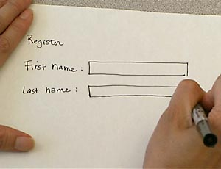
Index Cards (Example)
Include enough detail for users to interact with the prototype
Notes:
I don’t love this example b/c they used some tools to make the prototype look more fancy.

Slide 23
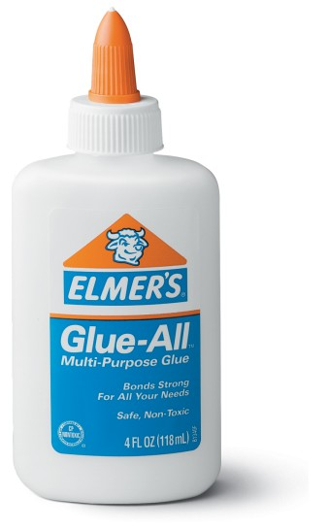
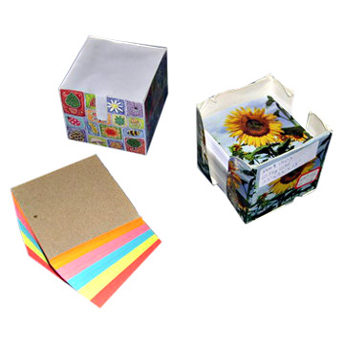

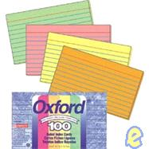
Useful Low Fidelity Tools
Large, heavy, white paper
Index cards
Tape, stick glue, correction tape
Pens & markers (many colors and sizes)
Large sheet of foam core, poster board, butcher paper
Scissors, X-acto knives
Band-aids
Explore your local art store for supplies!

Slide 24
Testing with low fidelity prototypes
Like conducting a user test / think aloud
Concrete tasks
Quiet environment
Let the user guide the process
One experimenter acts as the “computer”

Slide 25
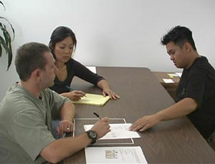
http://www.nngroup.com/reportsprototyping/video_stills.html

Slide 26
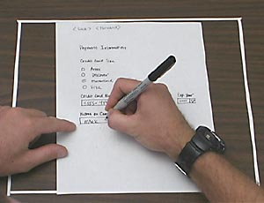

Slide 27
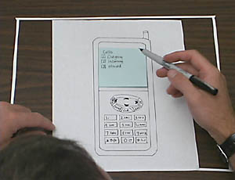

Slide 28
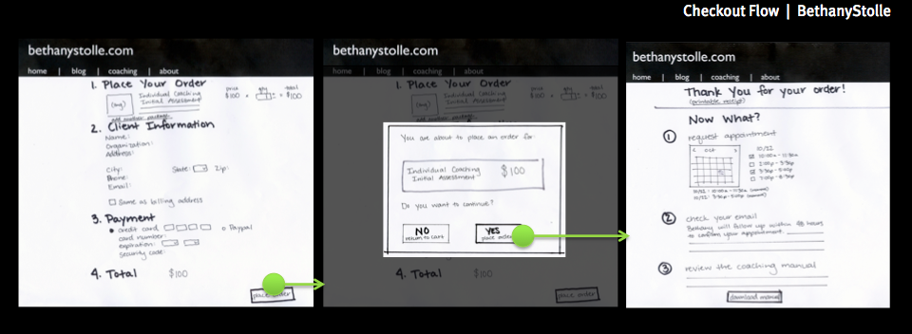
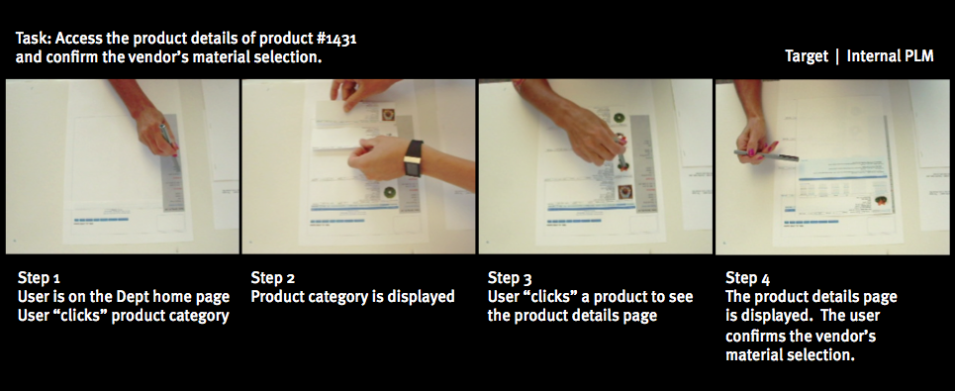

Slide 29
Paper prototyping examples
Pieces of paper
http://www.youtube.com/watch?v=ykJ60H4Qkvg&feature=related
Simulated screen with paper
http://www.youtube.com/watch?v=oITeUEjrY3Q&feature=related
Cell phone testing
http://www.youtube.com/watch?v=Bq1rkVTZLtU&feature=related
Prototype usability testing http://www.youtube.com/watch?v=L7oPR2aTGlM&feature=related
Complete prototyping process
http://www.youtube.com/watch?v=5Ch3VsautWQ
Kid’s game design http://www.youtube.com/watch?v=L3yl9vaJuFE&feature=related

Slide 30
Testing paper prototypes
Will practice next time
Today we’ll make prototypes; next time we will test them

Slide 31
Activity
For P2 you will make user interface sketches of your main screens
Two divergent prototypes (A and B)
Today: make one prototype for your app
Everyone draws

